Slide 1
In the Name of Allah
Food and taste preferences of ants
Investigator: Ali Ghafourian Nasiri
Leader: Dr. Khajeh
Thanks to: H. Niroomand and M. Rahnama
International young Naturalists’ Tournament

Slide 2
Ant
1
Article
Having a lot of smell
Having a little smell
Group of food
Cotton balls
Carbohydrate
Proteins
Fruit

Slide 3
2
Fruit
Carbohydrate
Apple
Orange
corn
Potato
Corn
Potato
Snack
Pop corn
Salty raw potato
Salty chips

Slide 4
3
Protein
Chicken meat
Fish
Sheep
meat
Stew s’ meat
Hot stew meat
Cold stew meat

Slide 5
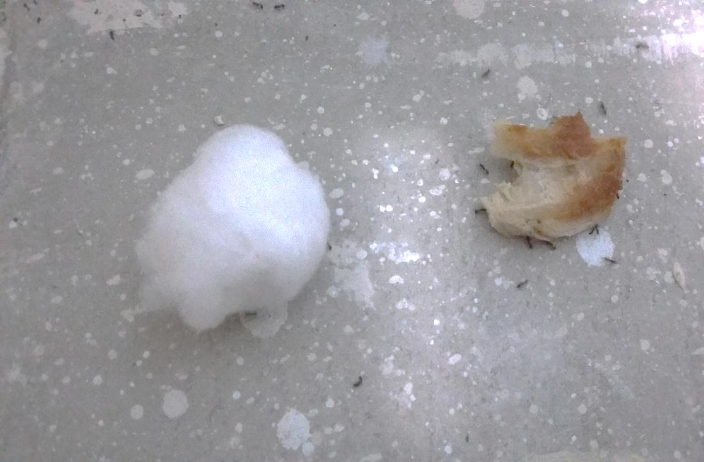
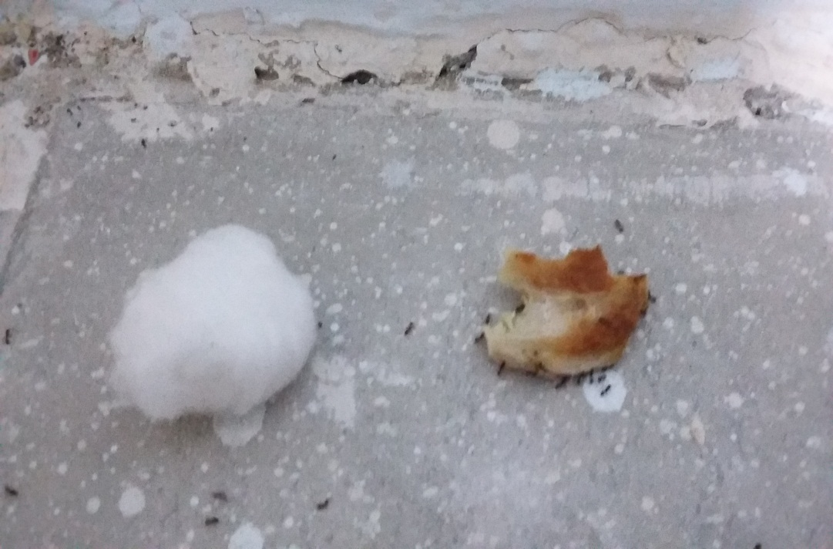
Figure1: Preference of ant between a Cotton ball and a Chicken meat
4
Nest of ant
A
B
C
C

Slide 6
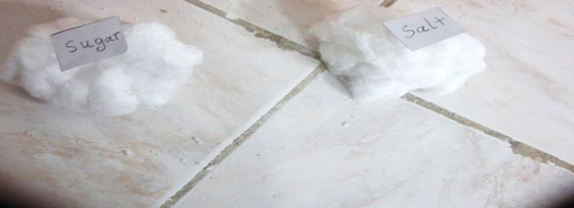
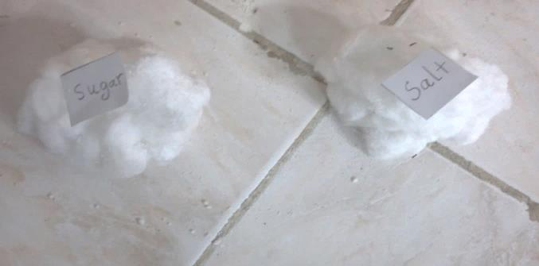
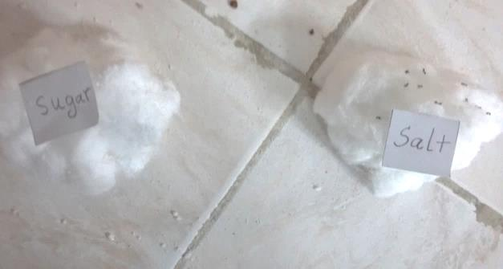
Figure2: This test between salty and sweet cotton balls
5
A
sweet
Salt
B
C
sweet
Salt
sweet
Salt

Slide 7
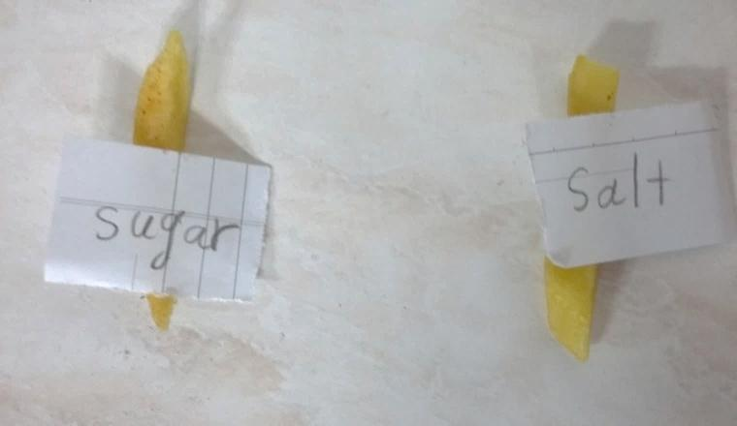
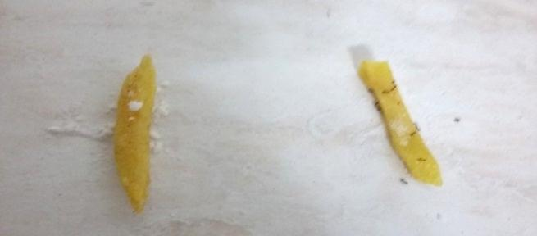
Figure3: This test between salty and sugar French fries
6
Figure 2: This test between salt and sugar potato
A
sweet
Salt
B
C
sweet
Salt
sweet
Salt

Slide 8
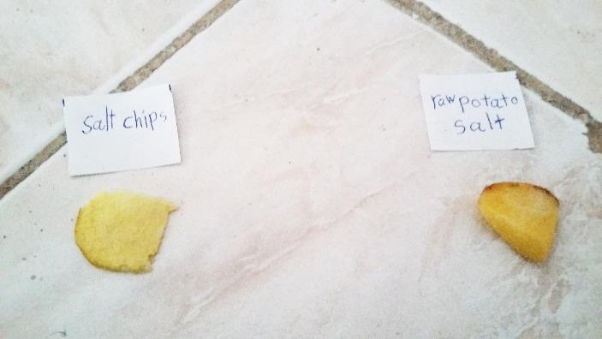
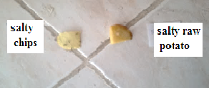
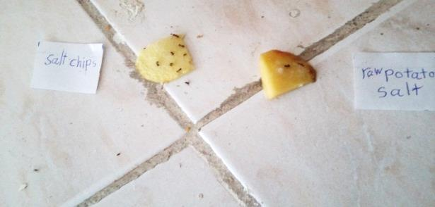
Carbohydrate
Figure 4: Preference of an between salt chips and salty raw potato
A
7
Salty raw potato
Salt chips
B
C
Salty chips
Salty chips
Salty raw potato
Salty raw potato

Slide 9
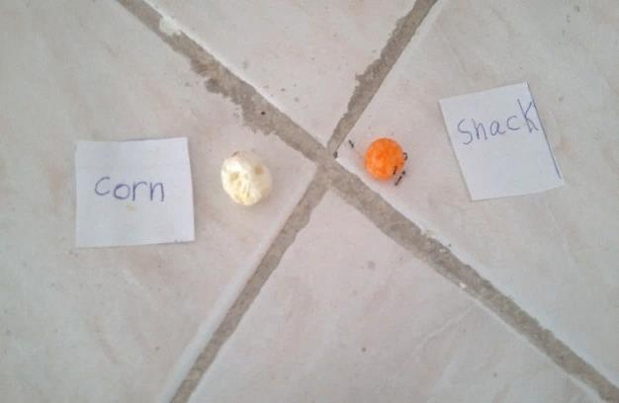
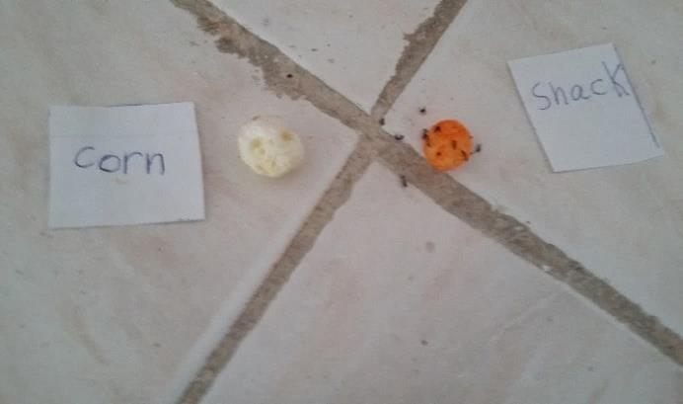
Figure 5: This test between Popcorn and Snack
8
A
popcorn
Snack
B
Snack
popcorn
C
Snack
popcorn

Slide 10
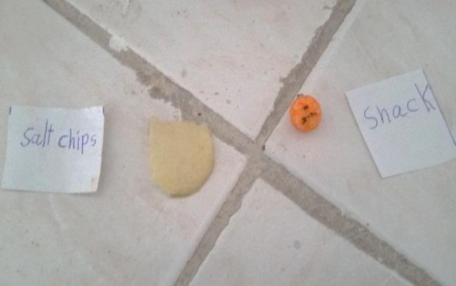
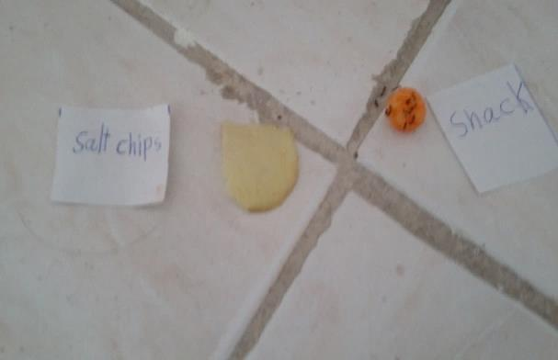
Figure 6: this test between Salty chips and Snack
9
A
Snack
Salty Chips
B
Snack
Salty Chips
C
Snack
Salty Chips

Slide 11
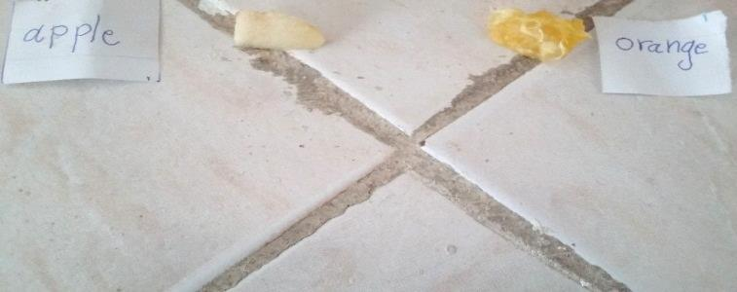
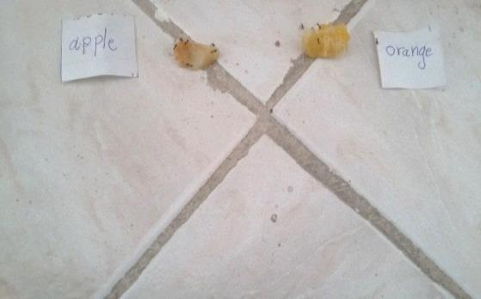
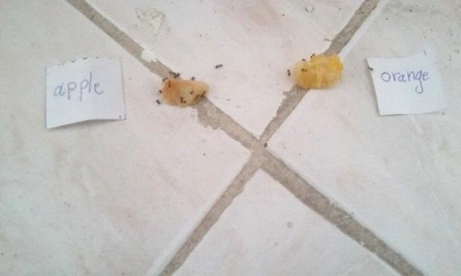
Figure 7: This test between an Apple and Orange
10
Fruits
A
Apple
Orange
B
C
Apple
Orange
Apple
Orange

Slide 12
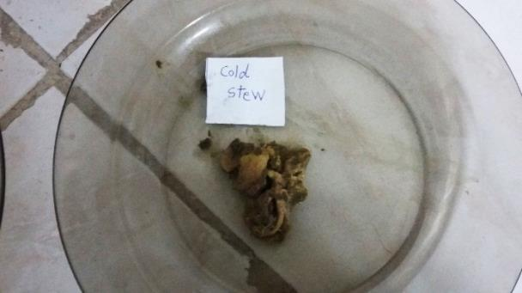
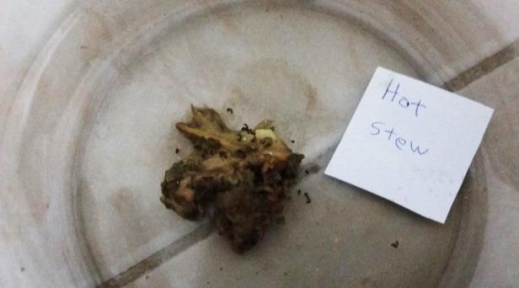
Proteins:
Figure 8: This test between Cold and Hot stew s ’meat
11
A
Hot stew’s meat
Cold stew’s meat
B
Cold stew’s meat
C
Hot stew’s meat

Slide 13
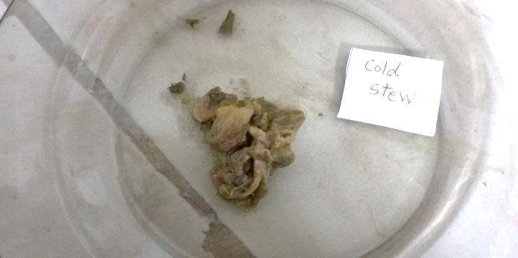
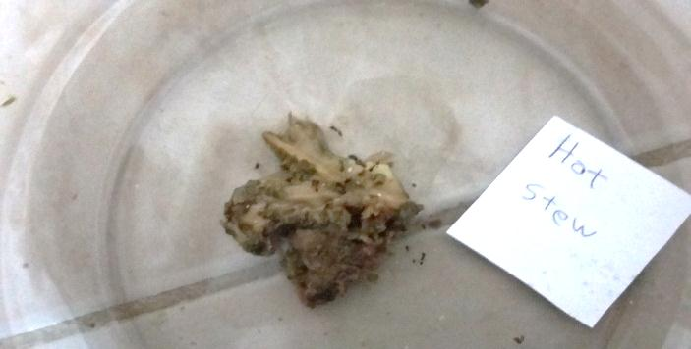
12
D
Cold stew’s meat
E
Hot stew’s meat

Slide 14
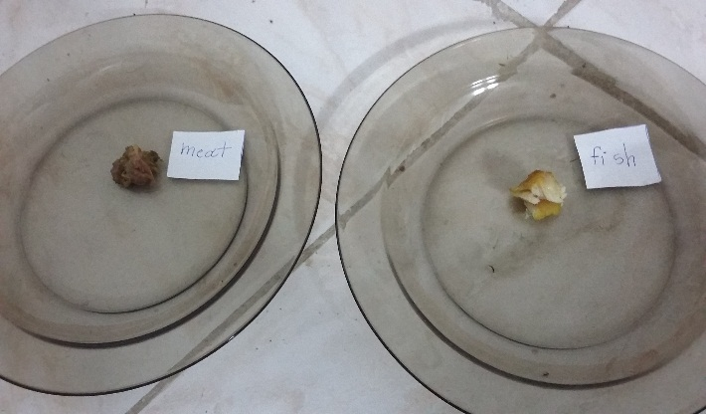
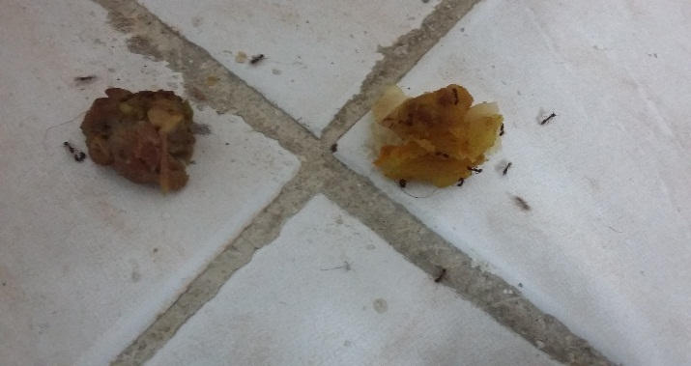
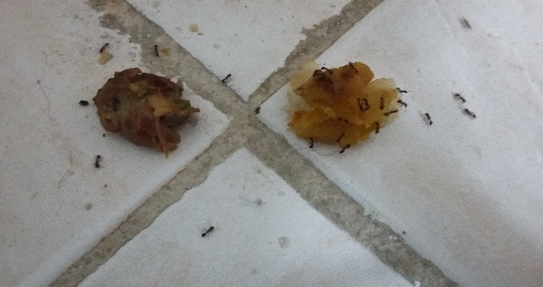
Figure 9: This test between Stew ‘s meat and Fish
13
A
Sheep meat
Fish meat
B
Sheep meat
Fish meat
C
Sheep meat
Fish meat

Slide 15
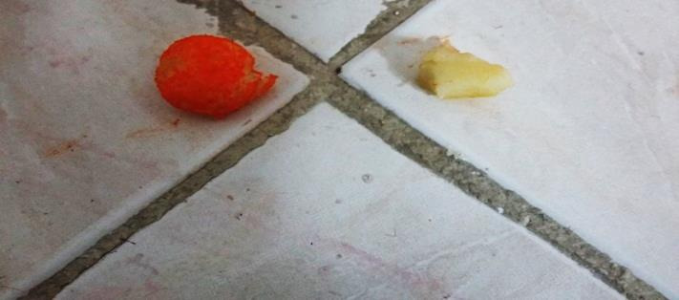
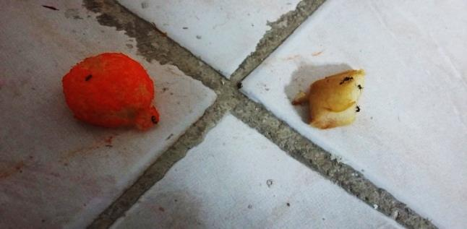
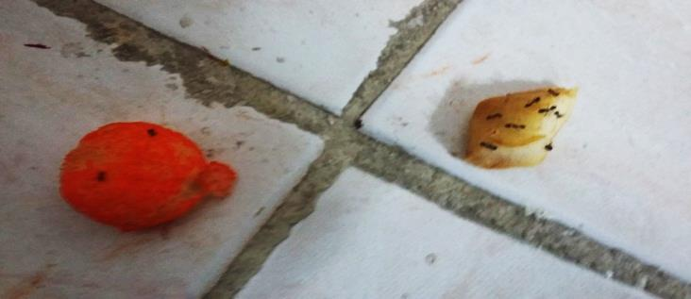
Figure 10: Preference of ant between a Snack and an Apple
14
A
Snack
Apple
B
Snack
Apple
C
Snack
Apple

Slide 16
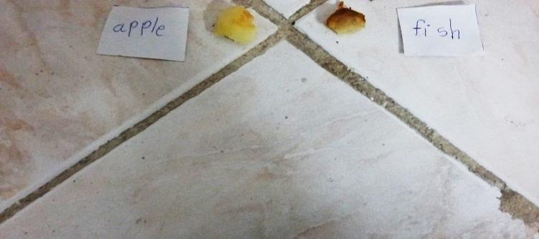
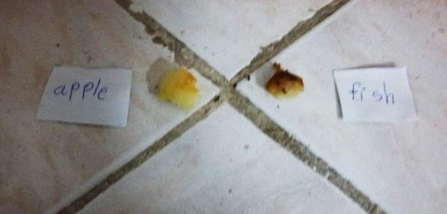
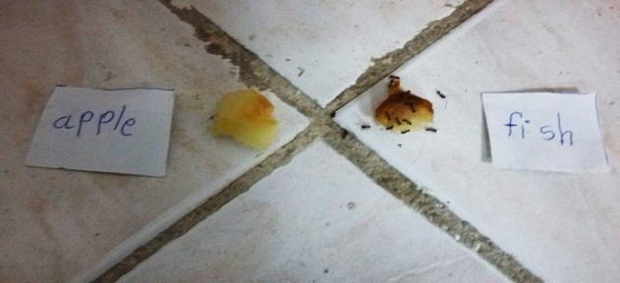
Figure 11: This test between an Apple and a Fish
15
A
Apple
Fish meat
B
Apple
Fish meat
C
Apple
Fish meat

Slide 17
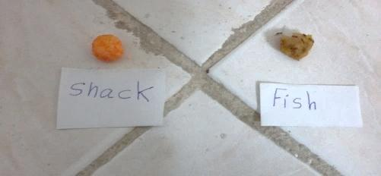
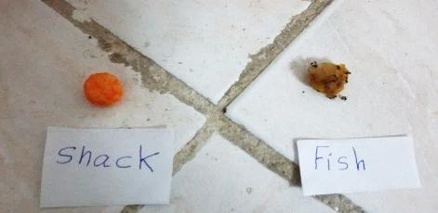
Figure12: preference of ant between a Snack and a Fish
16
A
Snack
Fish meat
B
Snack
Fish meat
C
Snack
Fish meat

Slide 18
Conclusion
17
Chicken meat
Cotton balls
Salty cotton balls
Sugar cotton balls
Sugar French fries
Salty French fries
Salty raw potato
Salty Chips
Snack
Popcorn
Salty Chips
Snack
Apple
Orange
Hot stew’s meat
Cold stew’s meat
Sheep meat
Fish meat
Snack
Apple
Apple
Fish meat
Snack
Fish meat

Slide 19
Materials that it prefer
18
Has a lot of smell
Has more spicy
Salty ‘s materials
Carbohydrate
(Snack)
Fruits
(Apple)
Proteins
(Fish)

Slide 20
THE END
19
Victory in Iran
Reference
www.hd wall papersnews.com
www.wall.alphacoders.com
www.image2puzzle.com
www.wallpaperhdwide.com

