Slide 1
Friction
MohammadReza Jalali Shahri
Besat IYNT Team
M.Ranhama
H.Niroumand
Acknowledgment:

Slide 2
Question Number 13
Investigate various methods to start a fire by friction

Slide 3
First question
Why we can make fire with friction?
for making fire we need three things:
1-oxygen
2-flammable material
3-fist heat
(with out each of them we can not make fire)

Slide 4
1-oxygen
The other name of burn is oxidation
so ,the burn is combination between oxygen and
Flammable material.

Slide 5
2-flammable material
As,I you seen the burning is combination between oxygen and
Flammable material.

Slide 6
3-fist heat
Force is what are we investigate in this question…
For combination between oxygen and
Flammable material we want first heat to start burning.
We can made this heat with friction.

Slide 7
Making Heat With Friction
So,we can make fire with friction but how?

Slide 8
Making fire
first humans made fire with friction and with out technology
So,we want try to make fire with out matches…

Slide 9
We want…
1-a drill
2-different woods
3-wood chips

Slide 10
That is a wood that we made it for test.

Slide 11
video

Slide 12
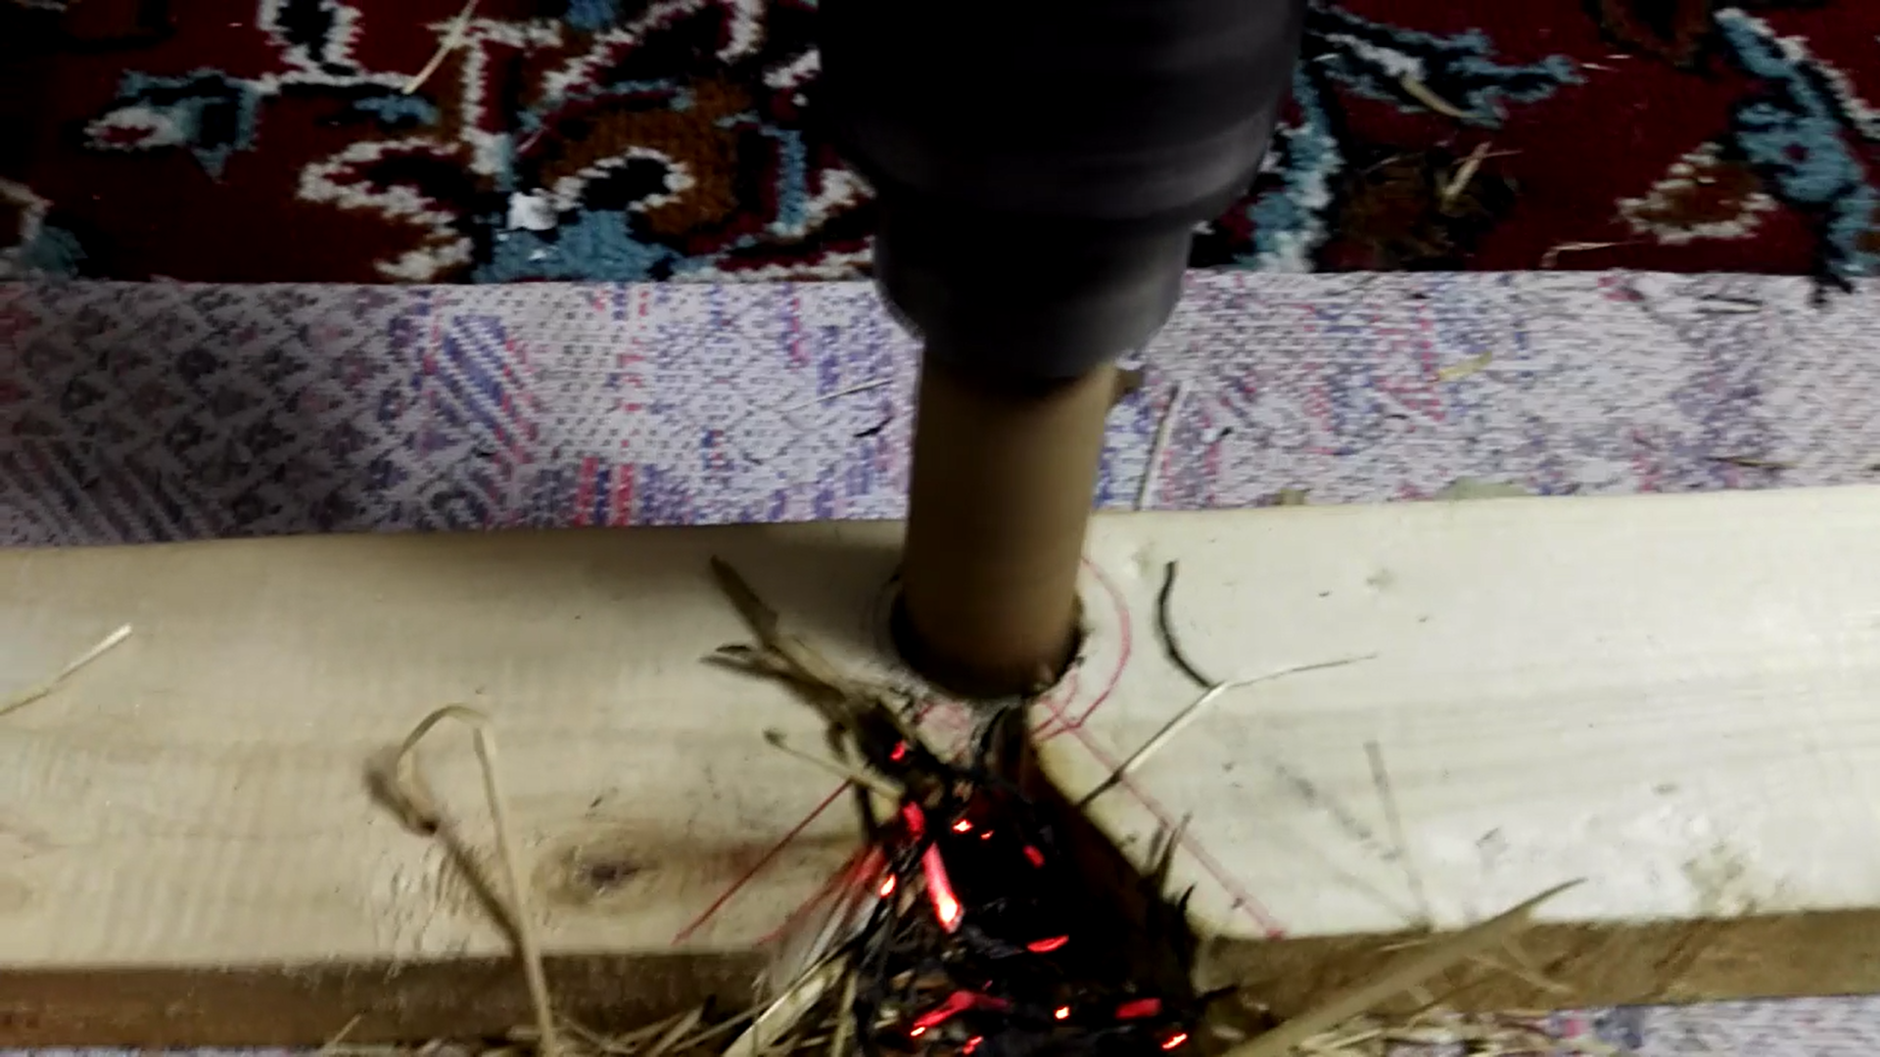
mechanism
friction
Flammable
material

Slide 13
References
All of that was our experiment…

Slide 14
Thanks for your attention

