Slide 4
FIRST WAY: MEASURING THE HEIGHT WITH AN APPLICATION

Slide 5
THE RESULTS

Slide 6
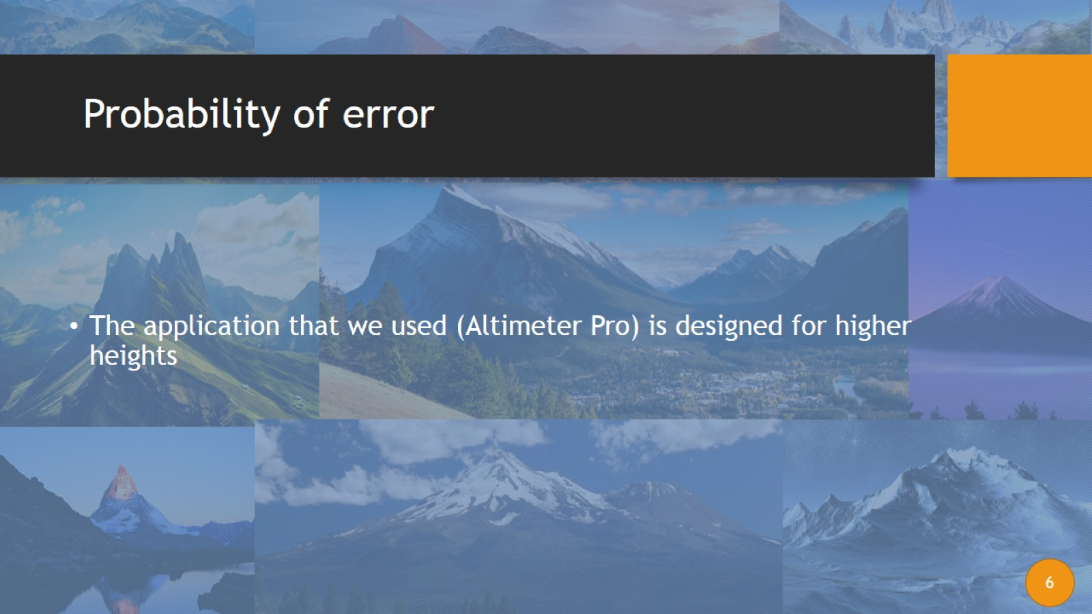
Probability of error

Slide 7
Second way: using scale relationships

Slide 8
Second way: Scale

Slide 9
Second way: scale

Slide 10
Probability of error

Slide 11
Third way: using Tales theorem

Slide 13
THIRD WAY:TALES THEOREM

Slide 14
THIRD WAY:TALES THEOREM

Slide 15
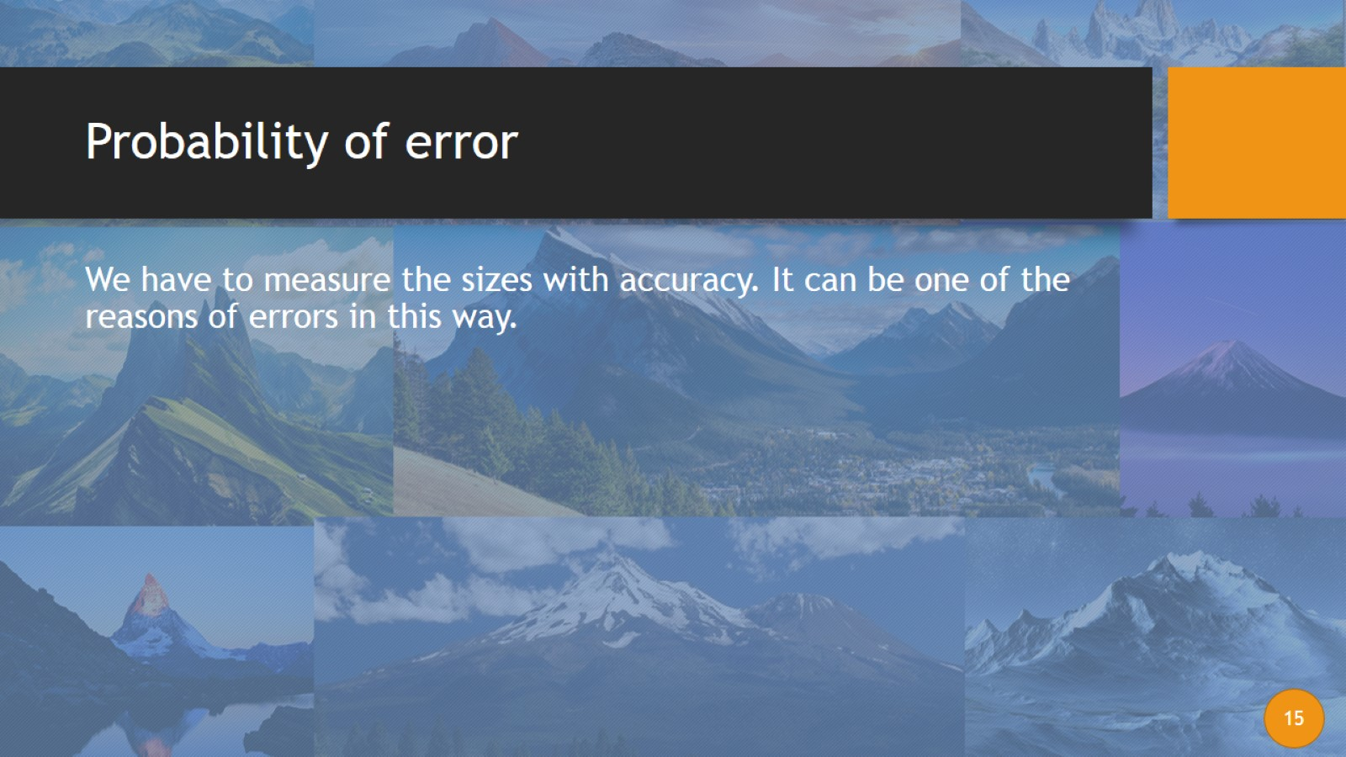
Probability of error

Slide 16
Fourth way: using Trigonometry

Slide 17
Fourth way measuring the height with trigonometry

Slide 18
Fourth WAY: using trigonometry

Slide 19
Probability of error

Slide 20
Four another ways that we can measure the height with

Slide 21
First way: using shadows

Slide 22
second way: throwing a stone

Slide 23
third way: using sun angle

Slide 24
fourth way: using sound speed

