Slide 1
Plant in motion
By: A.M.Jafari
From: Iran
Leader: Dr.Arash Khajeh
Notes:
In the name of god
Hi. Im amirmahdi jafari and im from iran. The subject which I choosed to provide u, is question number 7 plant in motion.

Slide 2
Question
Plants in Motion
Various plants can turn in response to the position of the sun or other light sources. Investigate this motion experimentally and theoretically.
2
Notes:
سلام وقتتون بخیر.
سوالی که برای ارایه انتخاب کردم سوال شماره 7 ، که اسمش گیاهان در حرکت هستش. خبو توی این پاور پینت همونطوری که سوالاز ما خواسته، حرکت گیاهان رو به صورت تیوری و عملی برسی کنیم.
در قسمت تیوری من دلیل و مکانیزم حرکتو براتون میگم و در قسمت عملی 2 تا ازمایشه کلی داریم که یکیش

Slide 3
I will present you:
Plants in Motion
Theoretically
Excrementally
Reality
Reason
Mechanism
Test on root
turn
Test on stem
grow
3
Notes:
And this is my strategic.
Generally I will investigate the motion experimentally and theorietically.
In theoretically I tell u the reason and mechanism too.
And in experimentally I have investigated 2 thinks . First one is light effect of light on root of plant. And other is on stem of plants.
In last of my PowerPoint u will see the conclusion

Slide 4
Theoretically

Slide 5
What is the reality?
Plants in Motion
the reality of this response named :
Phototropism
Phototropism works in all of plants
And in some fungus but in
Different levels.
5
Notes:
Yes, whats the reality of this response?
This is very simple, the reality of this response named phtotropism

Slide 6
What is the reason?
Plants in Motion
The main factor of this motion , are Auxins.
they are hormones which cause lots of reaction in plant.
They are sensitive to light.
Acid Andol acetic is most important of them.
6
Notes:
now , we have to know the reason of motion.
The main factor of this motion are auxins . Auxin are hormones which they cause lots of reaction in plants. For example gather of elongated the cells.
One of the most important feature of auxin , they are sensitive to light.

Slide 7
how does it move? mechanism
Plants in Motion
Auxin tend to aggregation in dark part of plant.
This action causes:
1.Elongated cell wall in darker part of plant
2.Weaken cell wall in light part
7
Notes:
Its time to know the mechanism. Now we going to know how does it move?
As u know , Auxin are sensitive to light. so, when they are sensetive to light if we put them in front of light they will aggregation to the darker part of plant.
And when the auxin aggregation there , the cells in there will elongate. As I told u in previous .
Meanwhile , the cells in the light part will be weaken. Because auxin have left from there.

Slide 8
Plants in Motion
These actions causes a bending in plant
Toward the light source
8
Notes:
When those actions occurred, u can see a bend in stem of plant toward the light source.

Slide 9
Experimentally

Slide 10
Plants in Motion
For Investigate this motion , we have 2 tests.
1.Investigate light effect on root of plant
2.Investigate light effect on stem of plant
10
Notes:
Now its time to investigate this motion experimentally. Generally we have 2 test. First one is investigate the light effect on set…

Slide 11
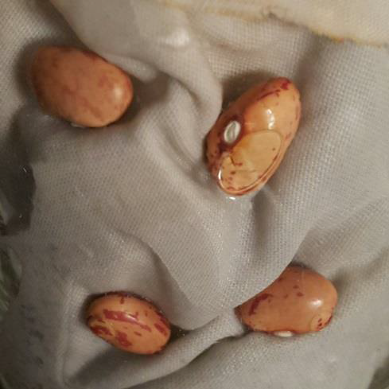
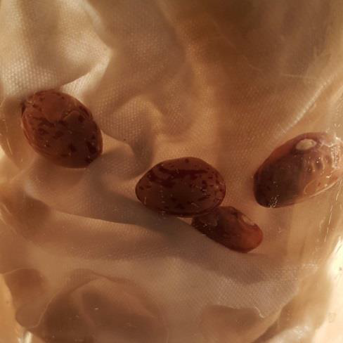
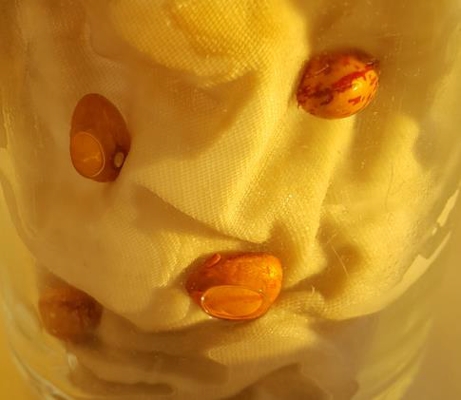
1.Effect of light on root
Plants in Motion
At first, we had 3 glasses to put the bean into that.
Each glass was under each light type.
0 lux
2000 lux
Sunlight
11
Notes:
Effect of light on root of plant. To see this effect, I put 3 glasses with 4 bean in different kinds of light. My light are…

Slide 12
Plants in Motion
light | Lamp |  |  |  | darkness |  |  |  | Sunlight
Bean number | 1 | 2 | 3 | 4 | 1 | 2 | 3 | 4 | 1 | 2 | 3 | 4
After 8 hours | - | - | - | - | - | - | - | - | - | - | - | -
After 16 hours | - | - | - | - | - | - | - | - | - | - | - | -
After 24 hours | - | - | - | - | - | - | - | - | - | - | - | -
After 32 hours | - | - | - | - | - | - | - | - | - | - | - | -
After 40 hours | - | - | - | - | - | - | - | - | - | - | - | -
After 48 hours | - | - | - | - | - | - | 3 | - | - | - | - | -
After 56 hours | - | - | - | - | - | - | 21 | - | - | - | - | -
After 64 hours | - | - | - | - | - | - | 27 | 5 | - | - | - | -
After 72 hours | - | - | 5 | - | - | - | 35 | 13 | - | - | - | -
After 80 hours | - | - | 7 | - | 5 | - | 40 | 23 | - | - | - | -
After 88 hours | - | - | 10 | - | 10 | 12 | 51 | 38 | - | - | - | -
After 96 hours | - | - | 13 | - | 10 | 19 | 65 | 40 | - | - | 15 | 2
12
Notes:
Sunlight isnt in 24 hours?
-> I measured lux of Sunlight and bought lamp in same lux.
Age gofta chera sade has: n=because the aim of Iynt is making the big problem to the easier

Slide 13
Growing Speed
Plants in Motion
2. Sunlight
bean (1): 0
bean (2): 0
bean (3): 0.156 mm/h
bean (4): 0.020 mm/h
Average: 0.088
1. Darkness
bean (1): 0.104 mm/h
bean (2): 0.197 mm/h
bean (3): 0.667 mm/h
bean (4): 0.416 mm/h
Average: 0.346
3. In the light of 2000 lux
bean (1): 0
bean (2): 0
bean (3): 0.135 mm/h
bean (4): 0
Average: 0.033
13
Notes:
This is g s in 96 hours and I just read the average for u.

Slide 14
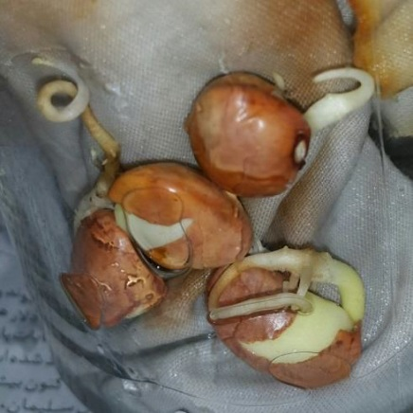
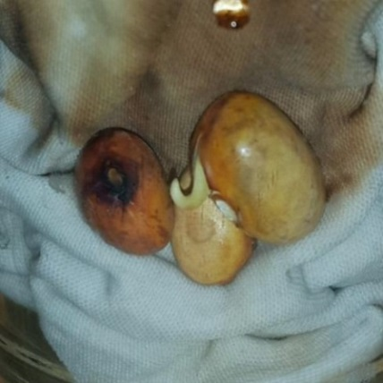
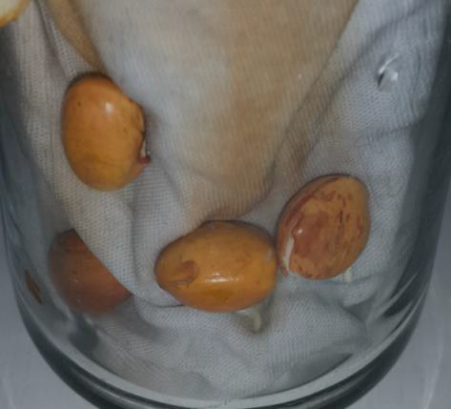
Plants in Motion
As you have seen , the growth of the beans which,
it were in under the 0 lux, is the most.
darkness:0.346
2000Lux:0.033
Sunlight: 0.088
14
Notes:
In finish, the growth of the bean in darkness is best. After that Sunlight and after that 2000 lux .

Slide 15
2.Effect of light on stem
Plants in Motion
Grow
Turn
15
Notes:
Test 1 finished. This is effect of light on stem.

Slide 16
Plant’s Turn
Plants in Motion
I have measured Angular rate in test.
Lights:
1500 lux(lamp) + Sunlight
Our Plants were:
Krobcus flower
Shemshad plant

Slide 17
Green Shemshad .Lamp
Plants in Motion
Left) angular rate:
- 3 degrees in 30 minute
16

Slide 18
Green Shemshad . Sunlight
Plants in Motion
Left) 1. angular rate :
- 6 degrees in 30 minute
17

Slide 19
Krobcus. Lamp
Plants in Motion
Left) 1. angular rate :
6 degrees in 30 minute
18

Slide 20
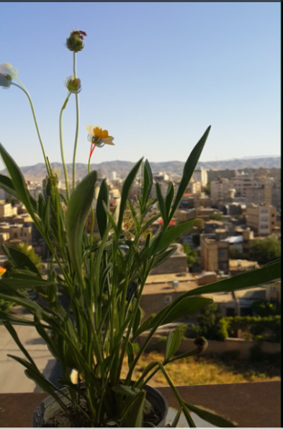
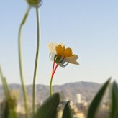
Krobcus. Sunlight
Plants in Motion
Left) 1. angular rate :
- 12 degrees in 30 minute
19

Slide 21
Plant’s grow
Plants in Motion
In the test I have measured Length of Grow.
Lights:
2000 lux
Plants: a flower(unknown)

Slide 22
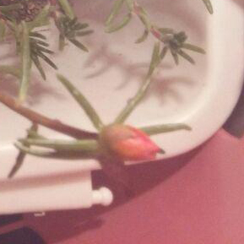
Flower under lamp
after
before

Slide 23
Plants in Motion
Review the test 1
As you saw, the angular rate of the plant which it was under the sun was more than lamp.
Lights \ Plants | flower | shemshad
Lamp | 6.1$°$ | 3.2$°$
Sun | 12.3$°$ | 6.5$°$
20

Slide 24
Conclusion
Plants in Motion
Light, have negative effect on root of plant.(all of the light, like sun). Like soil. Root have to grow in darkness.
Light, have a positive effect on stem of plant. meanwhile, Sun’s effect is the most than others.
21

Slide 25
References
www.wikipedia.com
www.roshd.ir
www.plantcell.org
www.scienceclarified.com

