Slide 1
Soap boat

Slide 2
Total description
Aerodynamic
Triangle
Amount of soap
Bigger bottom part
Small bottom part
Decrease the mass
Increase the mass

Slide 3
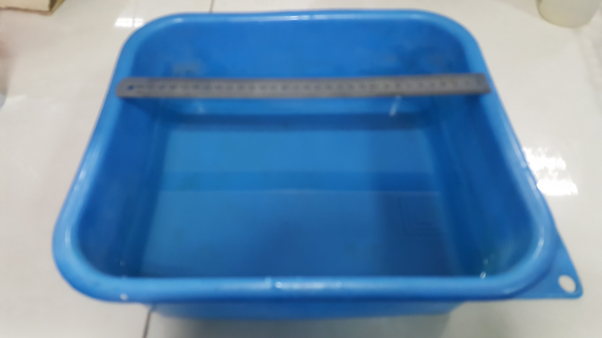
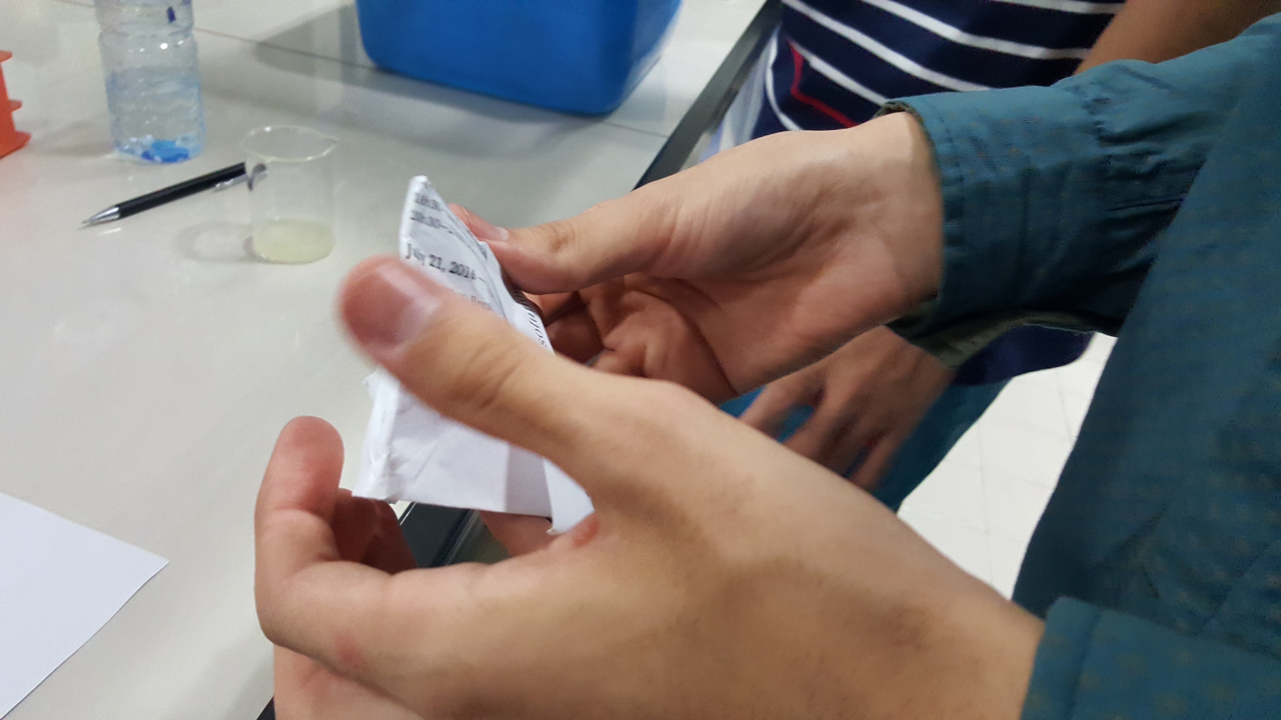
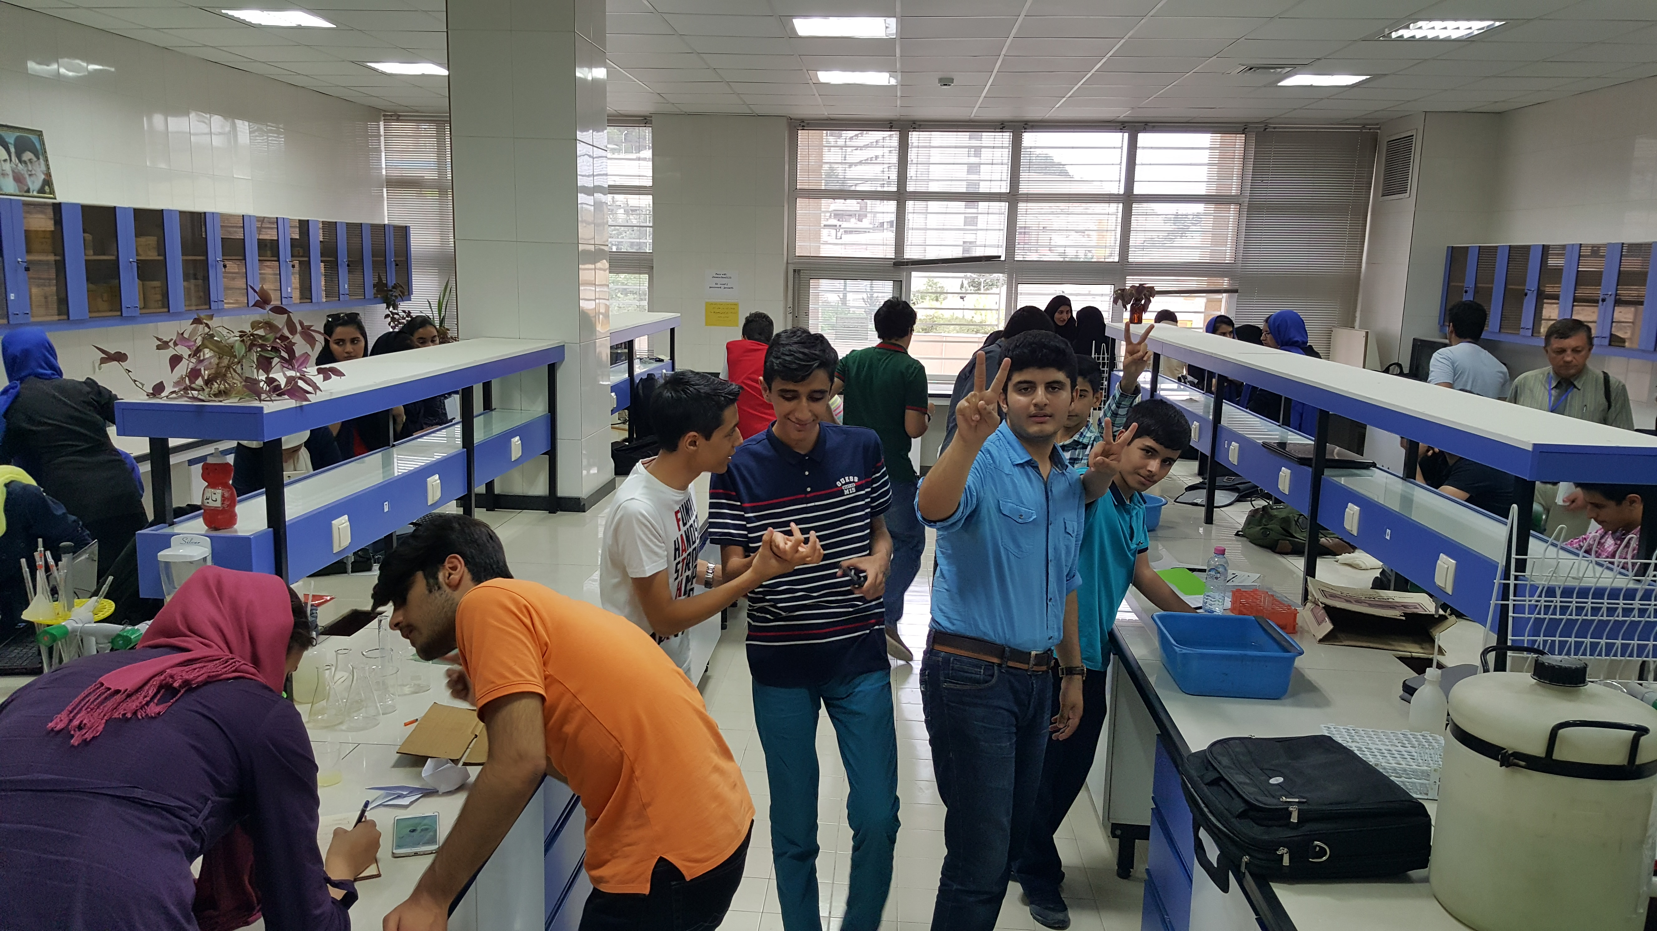
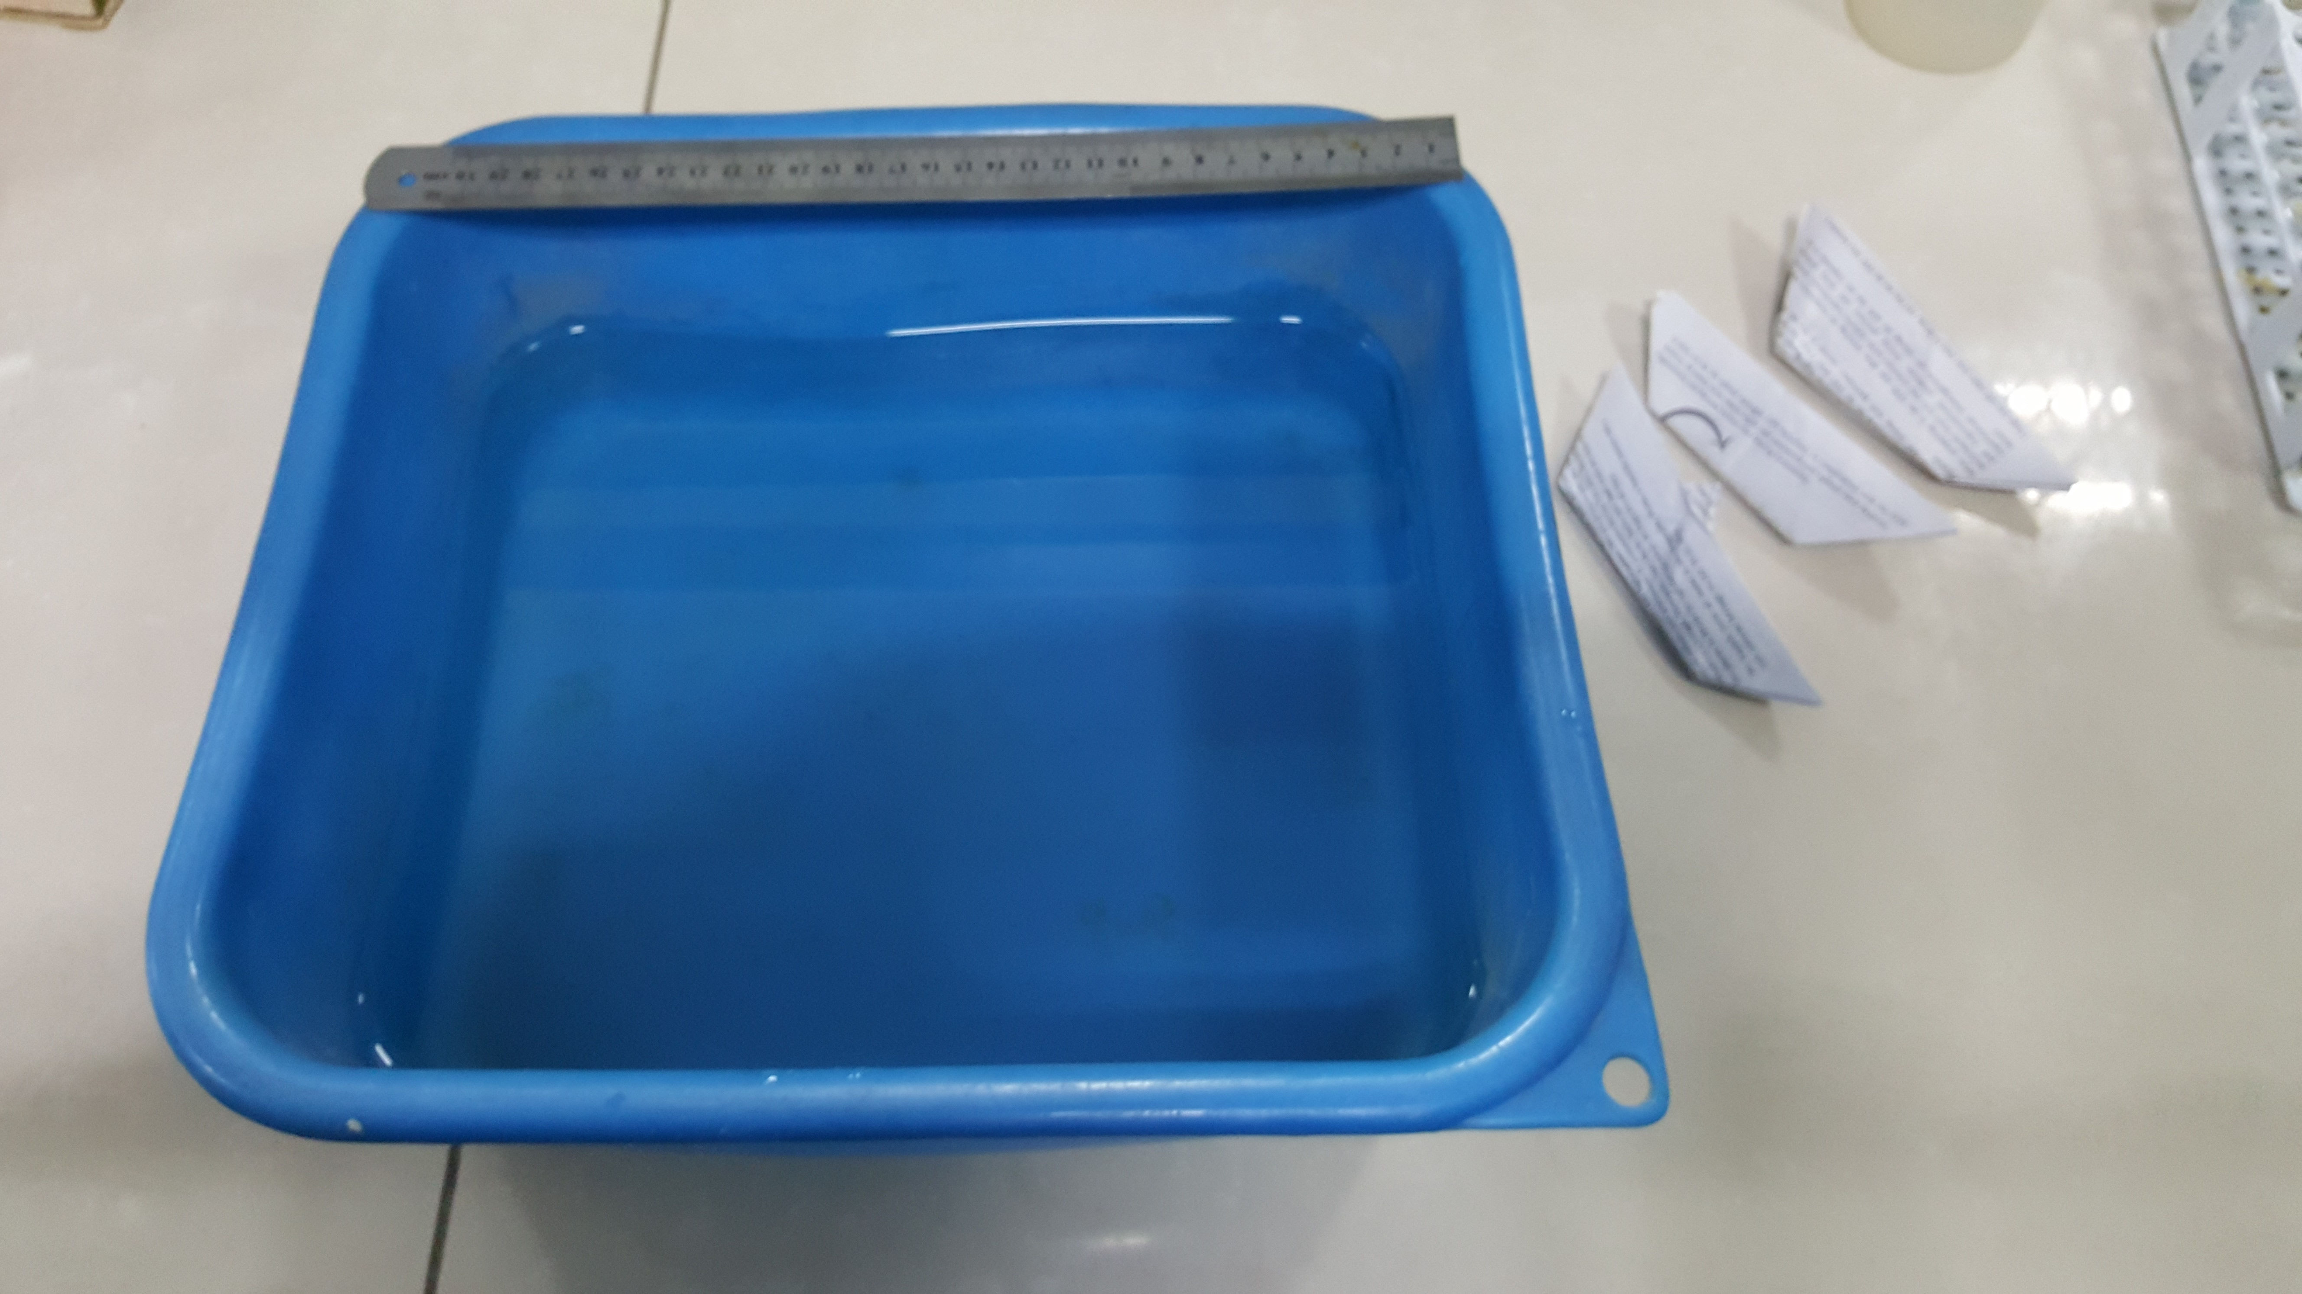
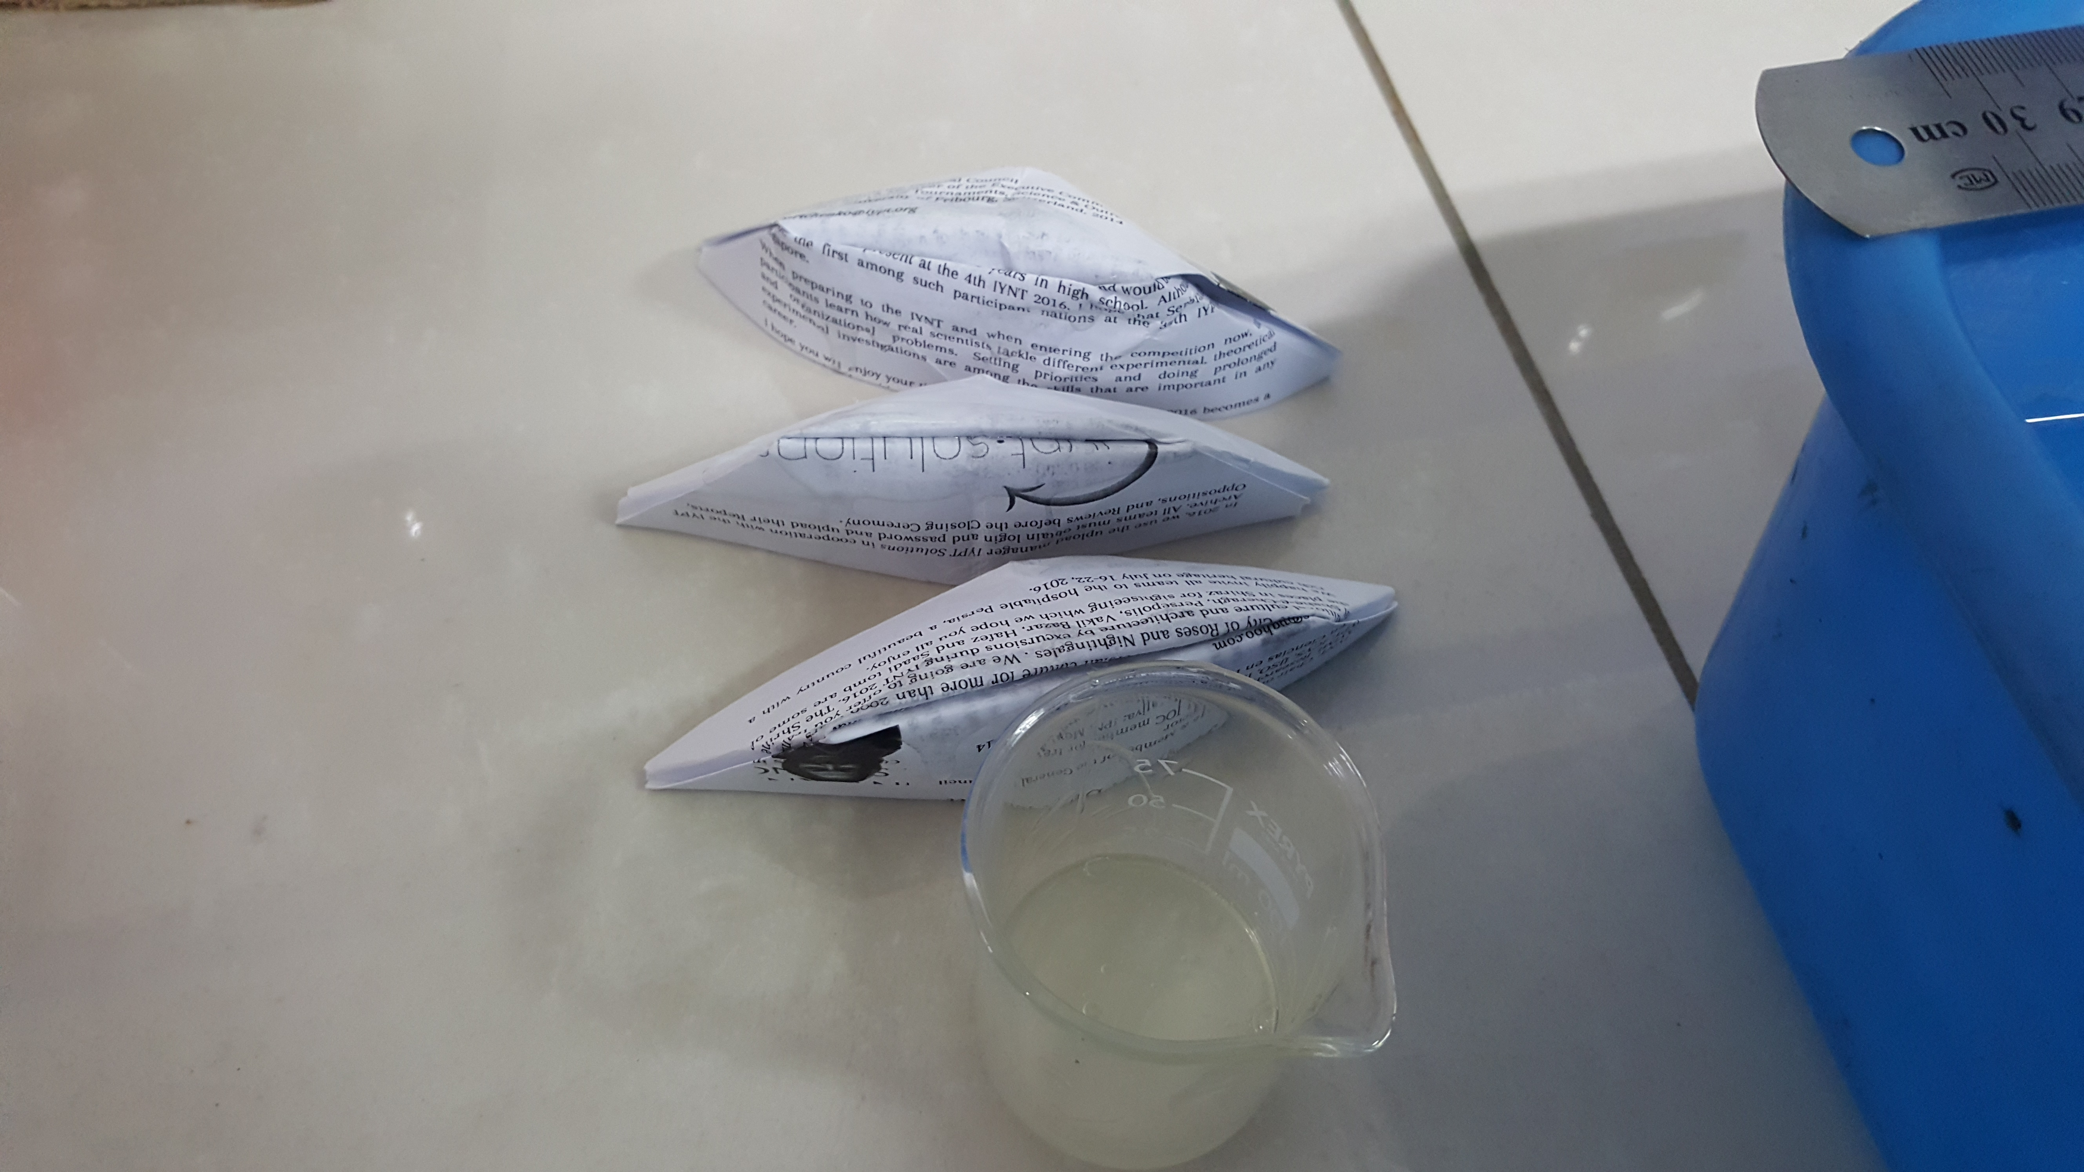

Slide 4
The amount of soap

Slide 5
The aero dynamic shape with soapy cold water

Slide 6
Triangle moving on soapy water
Comparing the triangle and the boat

Slide 7
Boat with more mass in cold water

Slide 8
Boat with more mass and cold water

Slide 9
conclusion
The soap on the bottom of boat
In aerodynamic boat we had less moving in soapy water but in triangle we had lot of moving on soapy water
We found that if we increase the mass we will have more moving on soapy water in warm water but not in cold water
The opposite power is related to three things :
The depth of soapy surface 2) the surface in the bottom od boat 3)speed
If we decrease the bottom surface of the boat the opposite power will increase
with increasing the temperature we will have less viscosity and the boat will go faster
With

