Slide 4
Water spreading

Slide 6
Second part of Water spreading

Slide 8
Conclusion

Slide 13
Water turbulence

Slide 14
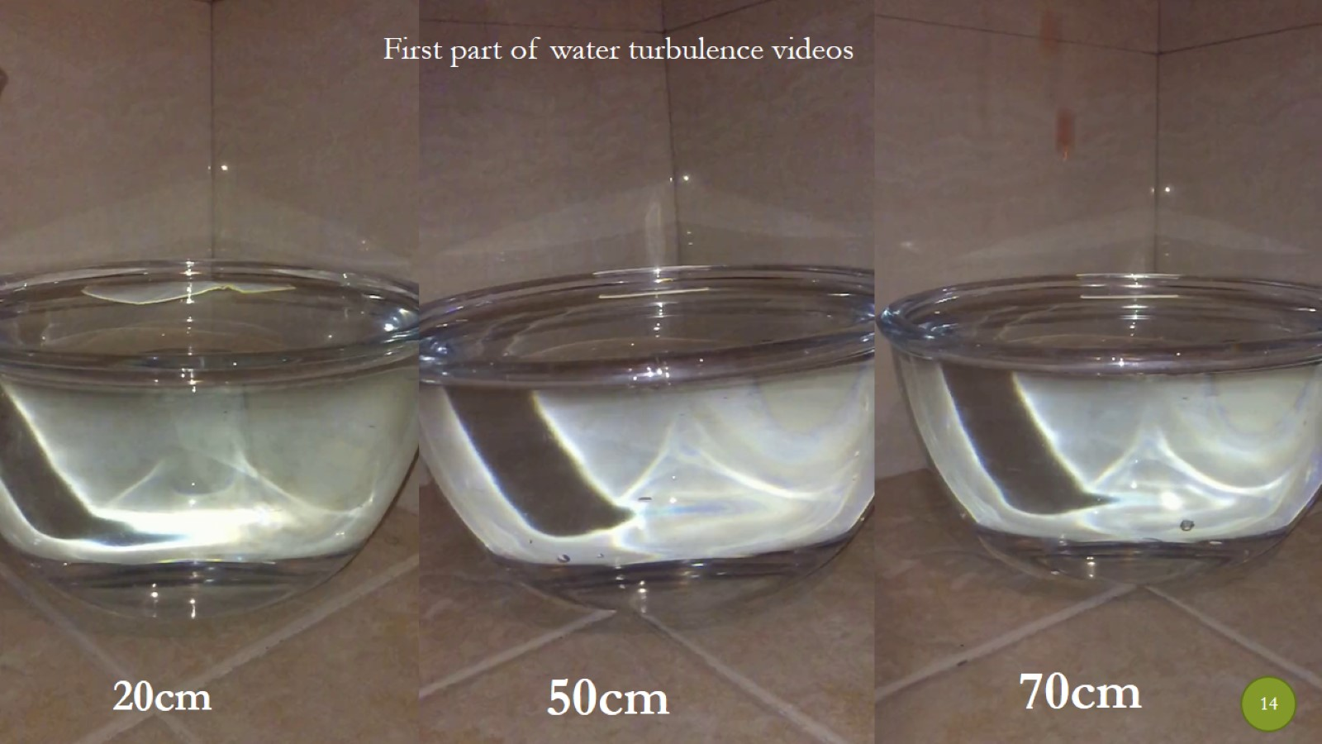

Slide 15
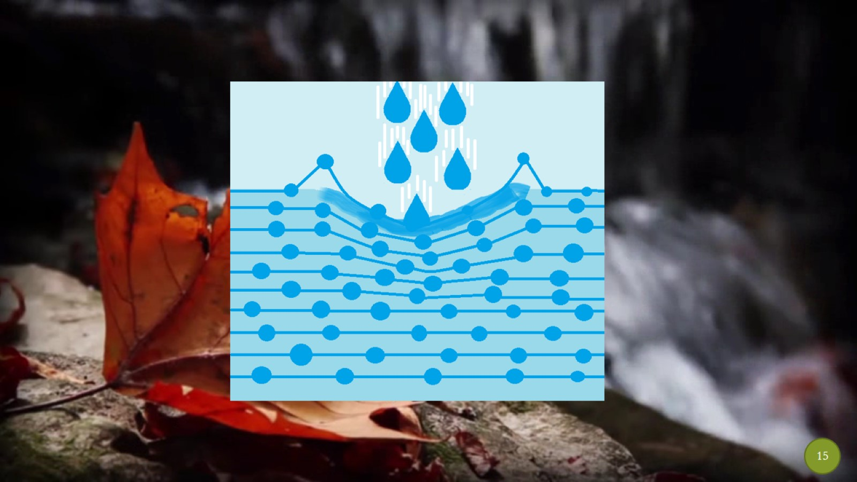

Slide 17
Second part of Water turbulence

Slide 20
Water turbulence

