Slide 1

IN THE NAME OF GOD
Zipf’s law
Seyed
Reza
Poormusavi

Slide 2
8. Zipf’s law :
many times the most frequently appearing word (rank one) appears; the second most frequent word (rank two) appears, etc.
Investigate and explain the dependence of the word count on its
rank in the frequency table. Would it be the same for another book in the same or different language?
1- Does this law have valid relations?
2- Was his law valid and true in every other field?
3- Does the most repetitious word just refer to the text of one story?

Slide 3
A
Christmas
carol
Review
Of
Essay
Researches
Physics
Holiday
Conclusion
Political
Economy Of
communication

Slide 4

According to this topic it has lots of graphs so please be all ear and mention the presentation to understand the relation between laws and word’s quantity.
before that I’ll explain two connected laws again.

Slide 5
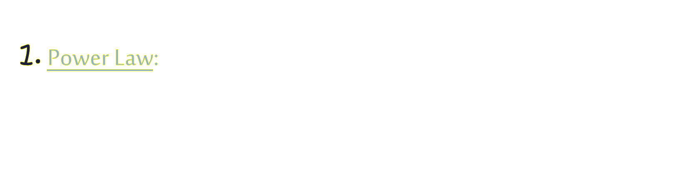
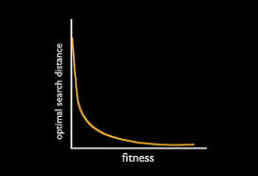
Optimal search distance
fitness

Slide 6
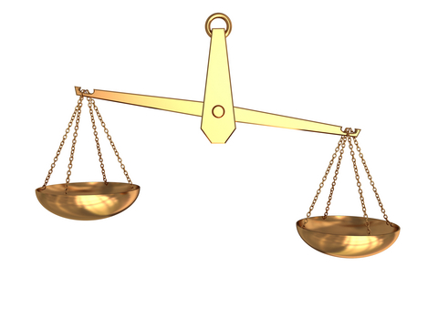
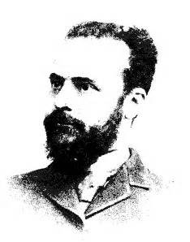
2. 80 and 20 law: Wilfred pareto was an Italian sociologist economist, engineer and philosopher. Pareto had theories in different fields of humanities. The theory of governing the elite in politics, 80 and 20 law in management are examples of his theories.
80
20

Slide 7
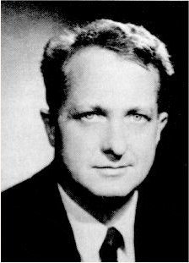
George Kingsley Zipf (1902–1950), was an American linguist and philologist who studied statistical occurrences in different languages.

Slide 8
Now What Is The Correlation With Zipf’s Diagrams? Zipf Used That Law And Concluded That:
1. The function is exponential.
2. 20 percent of the diagram including 80 percent of all frequencies are understood through the particles diagram.
Now How to catch a number.
Frequency * grade= fixed number r * f=C

Slide 9

Time to discuss about book & topics!

Slide 10


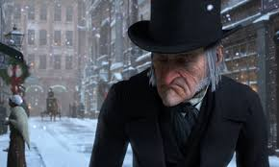
A story about a mean old man
who sees his old friend’s ghost
and the ghosts of last Christmas
and changes his now and future and ignores material world.

Slide 11

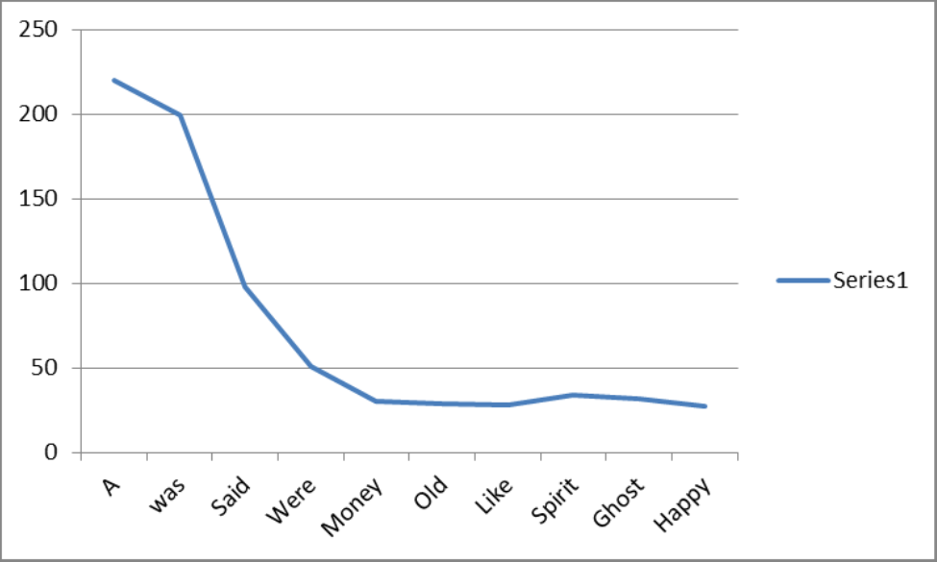
It obeys 20/80 and power law.

Slide 12

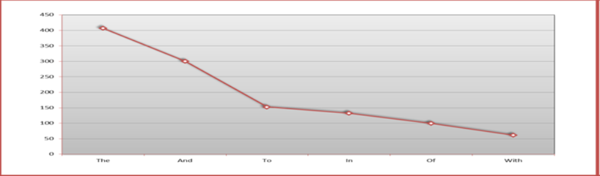
It obeys 20/80 and power law.

Slide 13

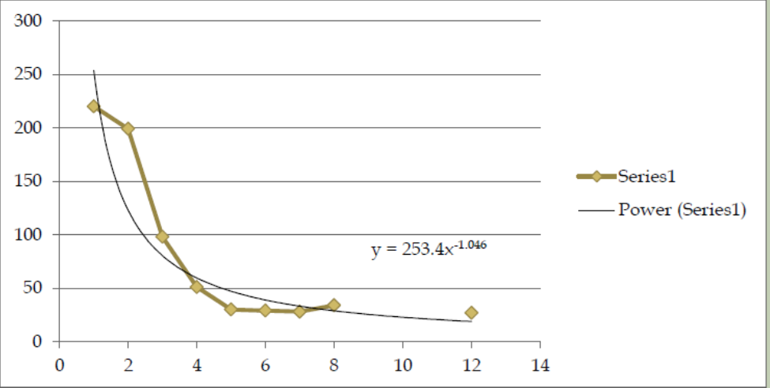
It obeys 20/80 and power law.

Slide 14

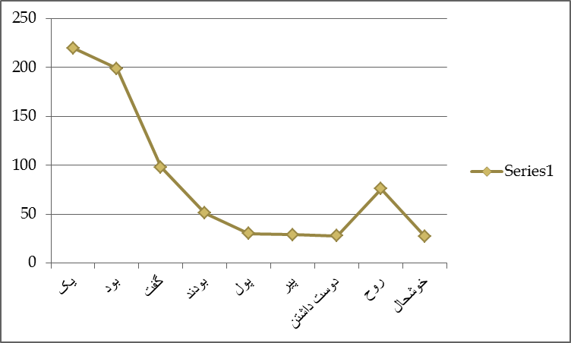

It obeys 20/80 & power law but a little problem.

Slide 15

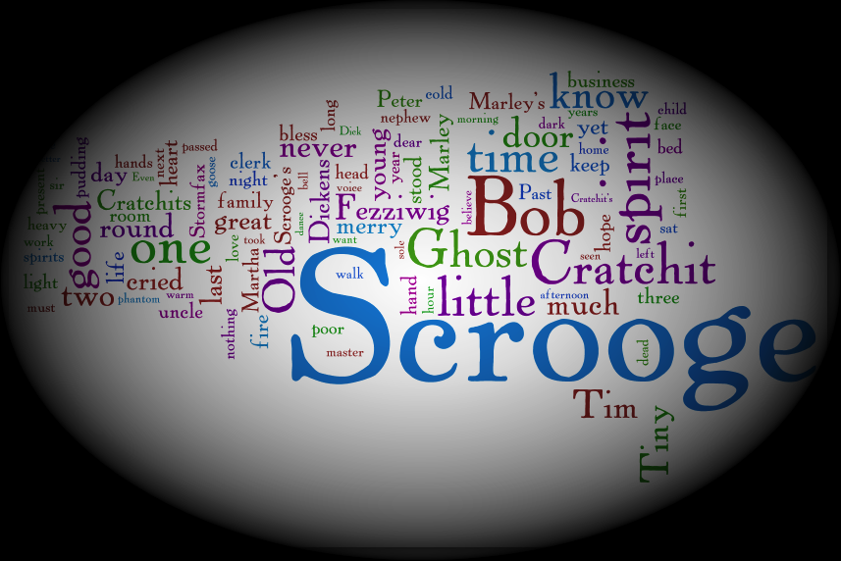

Let’s take a look at Arabic transcript; because it has strong relation to Persian.

Slide 16


Slide 17


Slide 18


Slide 19
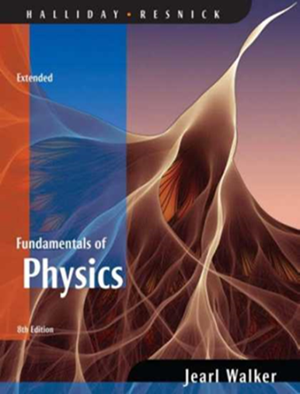
This part includes movements, diagrams, primary speed and acceleration.

Slide 20

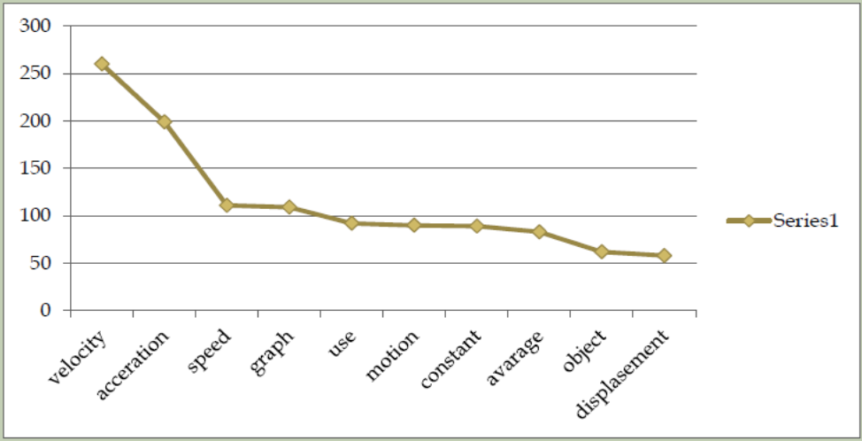

Slide 21

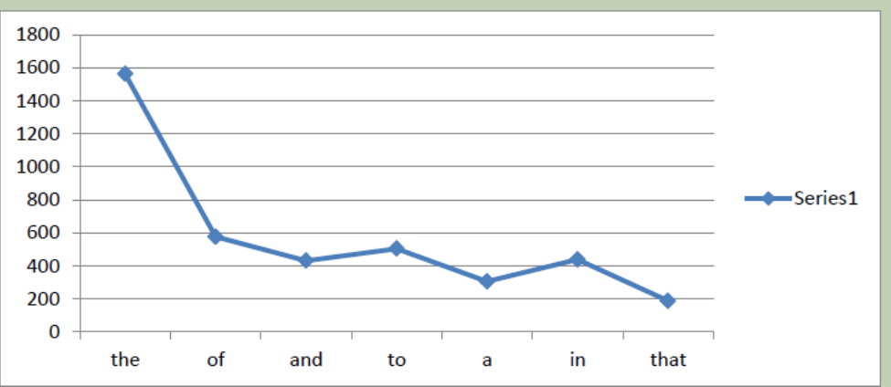

Slide 22

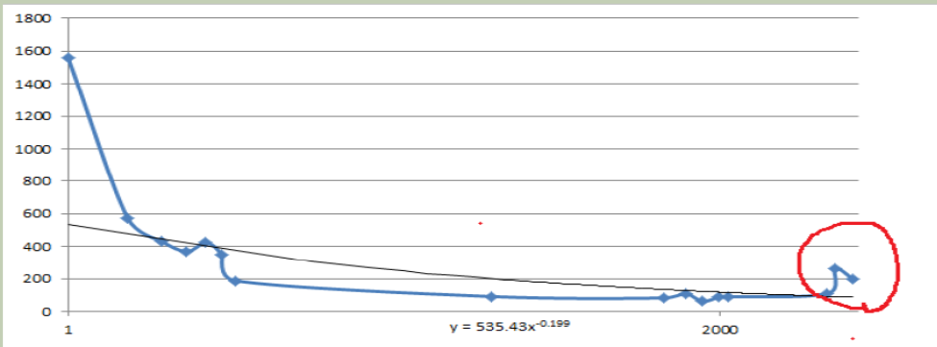
Why is the red circle imbalance?
These are 3 words that they have relation to the book.

Slide 23


In this book some parts including people’s activities, jobs, politics role and politicians in improving economics are written. This book is written in 1960 and some parties like democrat were not created, therefore they are not visible.

Slide 24
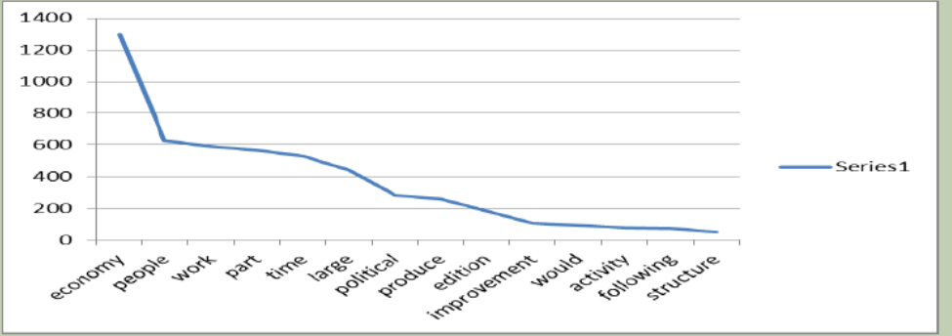

Slide 27


Slide 28

Here the word (In) is for giving information rather the information provided on the different elements and places in the text. Sometimes the author can use other words (in Indochina). But because the topic is much serious and he is going to suppress other parties, he writes:
In Capitalism consists in this that the national wealth grows alongside the Growth in the poverty of the people.

Slide 29

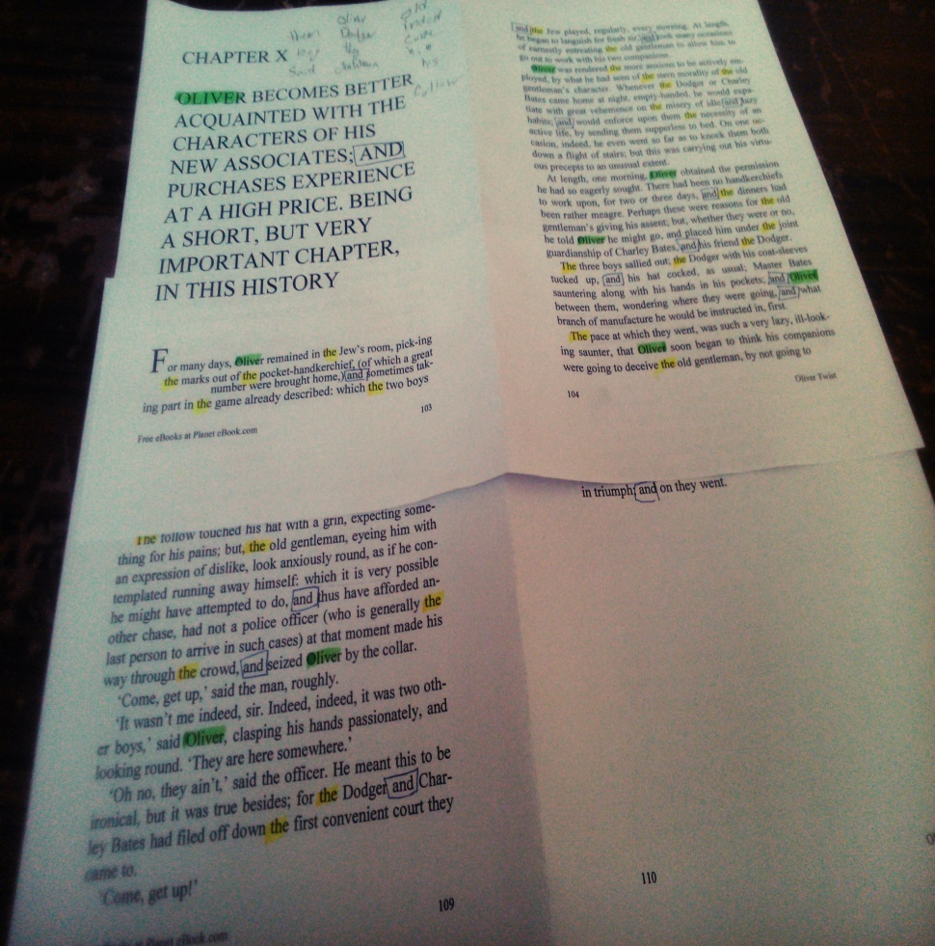
But there is easier & new way to be sure: we can read a book and underline the words that they are more frequent
Oliver twist

Slide 30
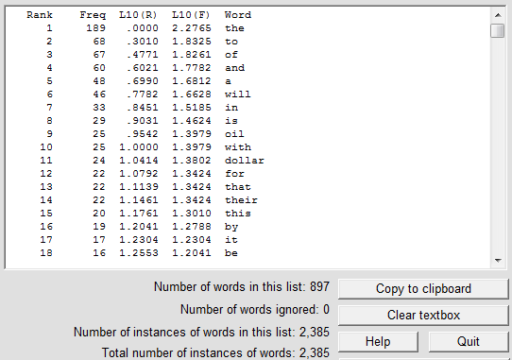
Although we can underline and count words but we can do the easiest work; we made a counter program.

Slide 31


Slide 32
You can see zip’s law even in random typing; let’s take a look:
For decreasing the probability of faults, I tried it on 5 people
F & E

Slide 33

conclusion
We must remove the words that are related to our topic and text and then we can have a total diagram without any unbalance part.

Slide 34

But in some diagrams (scientific, politics, economics and social) we saw, we can conclude that in a scientific text due to lack of description, some particles are not homogenous with others.

Slide 36


