Slide 1
pH Indicator
Creator = MohammadReza Jalali Shahri
Question
Parts
Besat HighSchool Team

Slide 2
Question 10 :
Fruit and vegetables juices contain natural indicators which change the color of the solution due to their acidity or basicity. Investigate these indicators and then identify their different compounds. Next recommend the most effective and accurate one and then, compare its solubility with common paper indicators.
Finish

Slide 3
Parameters
Let’s see the first part
First Part
All about Indicators
Let’s see the second part
Second Part
Conclusion
Let’s see the third part
Third Part

Slide 4
We Tested 3 Parameters Such as:
Red Cabbage Juice
Ox-tongue
Hibiscus Tea

Slide 5
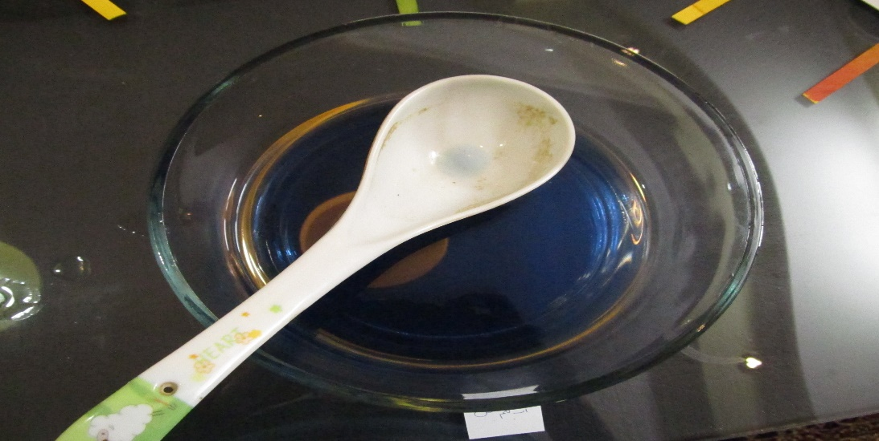
Red Cabbage Juice
0-6 = red or pink
7 = blue
8-9 = green
10-11 = brown
12 = yellow
13 = purple
14 = black
Next

Slide 6
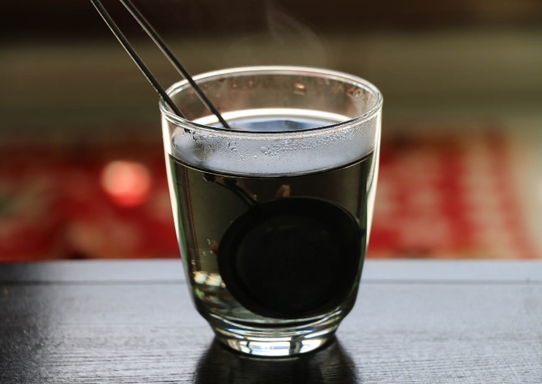
Ox-tongue
0-6 = red or pink
7 = black
8-9 = green
10-11 = brown
12 = yellow
13 = purple
14 = dark brown
Next

Slide 7
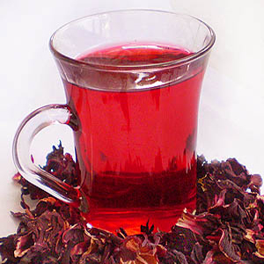
Hibiscus-Tea
0-6 = red or pink
7 = light red
8-9 = green
10-11 = brown
purple
orange 10-11-12-13-14
black
Next

Slide 8
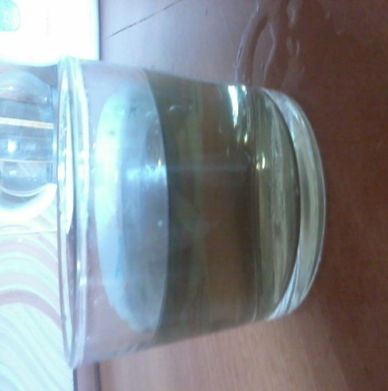
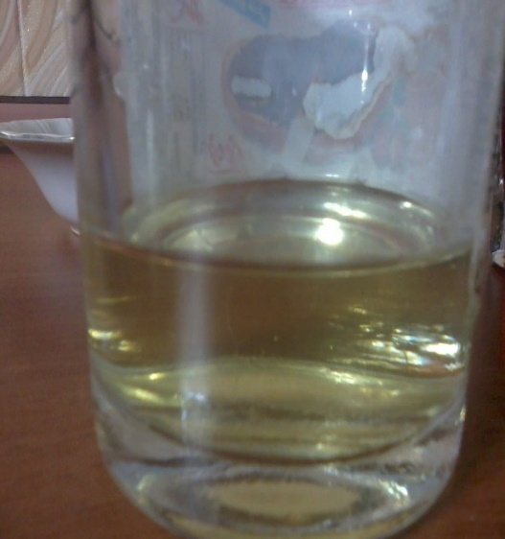
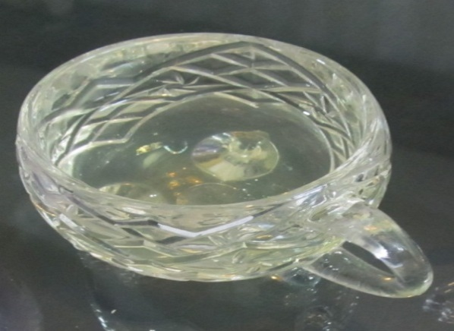
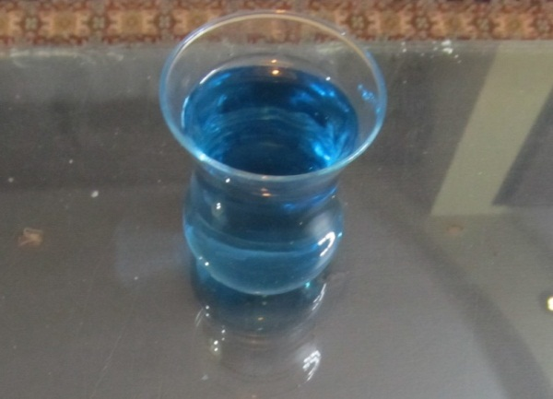
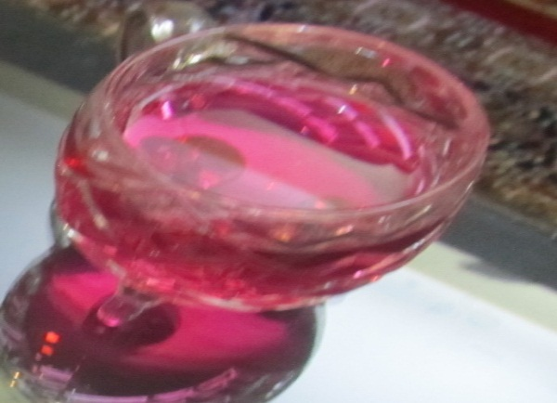
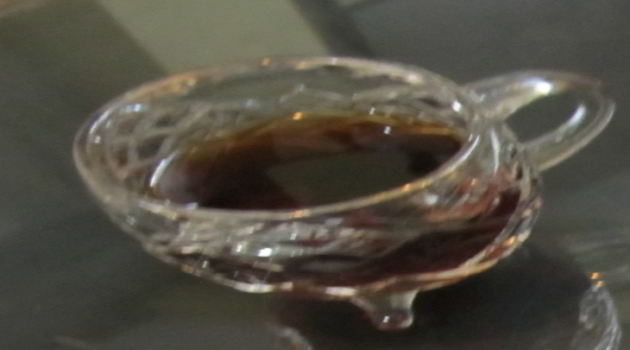
Reaction of a pH13 substance with ox-tongue
Reaction of a pH13 substance with hibiscus tea
Reaction of a pH13 substance with red cabbage extract
Reaction of water with red cabbage juice
Reaction of water with hibiscus tea
Reaction of water with ox-tongue
Finish

Slide 9
Indicators
Chemical reactions of dissociation and integration of indicators associate with the inner structural rearrangement which cause the color of the solution to change.
What is an Indicator?
Next

Slide 10
What We Did !
By Using Fruits and Vegetable juices = We Created Some Indicators.Then, we add them to different substances and specify them based on their colors.
Make Your Ph Indicator

Slide 11
1-A small red cabbage
2-Boiling pot of water
3-Large bowls or pots (2)
4-A series of household items
Steps

Slide 12
Way To Create Your Ph Indicator
Next

Slide 13
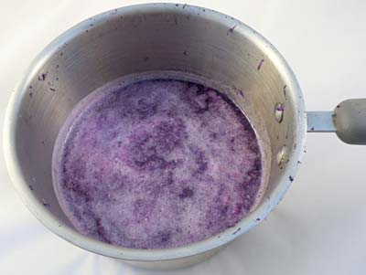
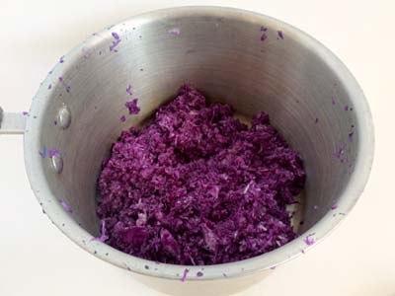
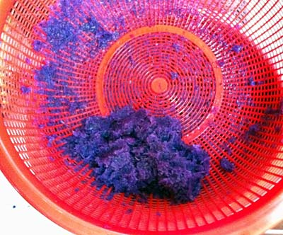
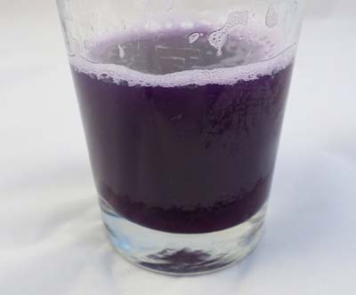
1.Grate a small red cabbage and place the pieces into a large bowl or pot.
2. Pour boiling water into the bowl to just cover the cabbage. Use caution when handling the boiling water.
3.Leave the cabbage mixture steeping, stirring occasionally, until the liquid is room temperature. This may take at least half an hour.
In the bowl, we have a clear liquid that will either be purple or blue in color,
Next

Slide 14
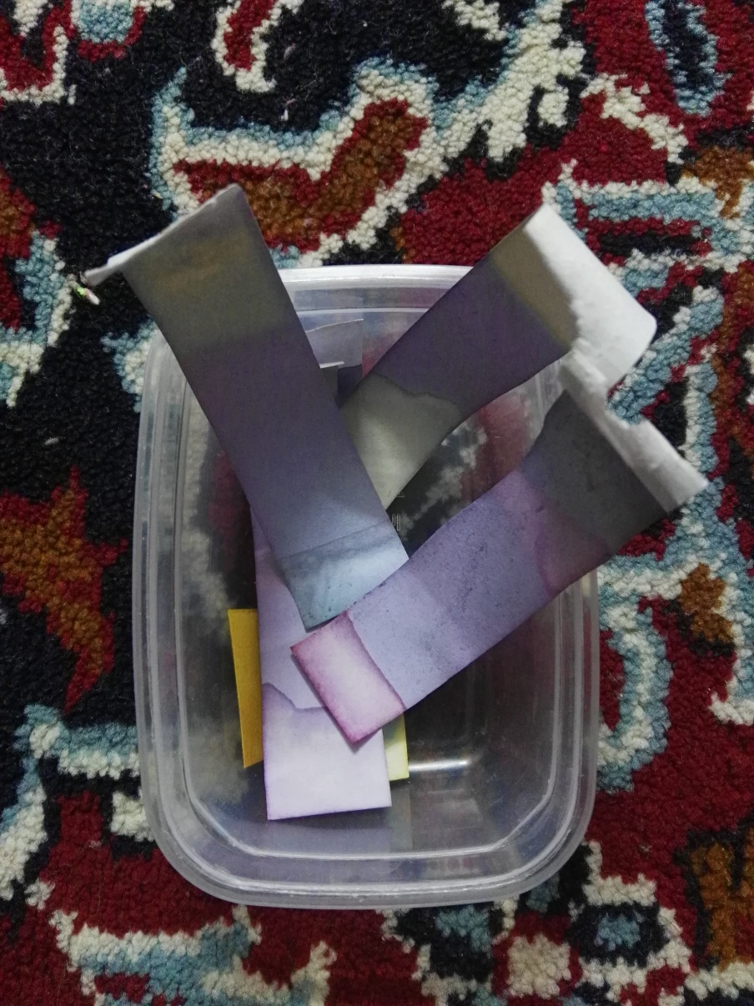
A handmade indicator
[Created By Us]
Finish

Slide 15
Conclusion
Next

Slide 16
The Temperature Effect
Temperature=More Effect=Final Color
Warm ox-tongue=pink color
Cold ox-tongue=brown
While the temperature of ox-tongue affects the color changes, there are some substances that have no effects or they may have more.
Next

Slide 17
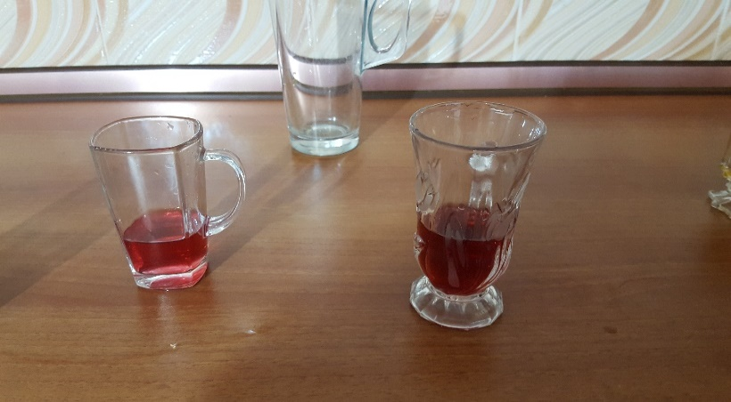
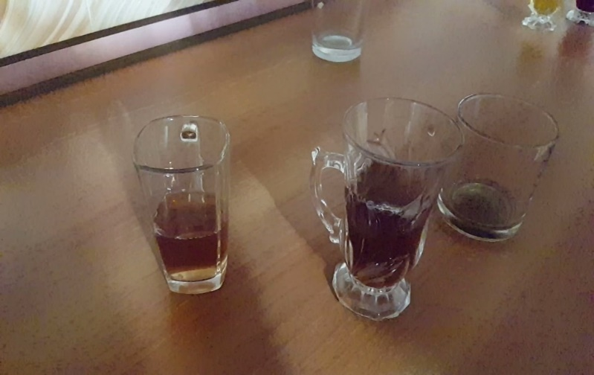
The color of acid after reaction with the warm ox-tongue
The color of acid after reaction with the cold ox-tongue
Next

Slide 18
Final Conclusion :
1-If we have a cold ox-tongue it won’t have reaction with indicators but if we have a warm ox-tongue it will react with indicators and will have a red color.
2-Indicators won’t have an effect on each other.for example if we mixed red carbage juice with ox-tongue,the final color is the mixing color.
3-if we mix two different materials with same ph but different color, they won’t have a reaction and the final color is the mixing color as same as the above result.
Some Questions

Slide 19
1) Why does the color of an indicator change?
Physical reaction indictor will be neutral by adding an alkaline = water and salt
Next

Slide 20
2) As we heat the indicator, its color changes but when we make it cold, its color doesn’t change.why?
Heat the indicator=Number Of ions will increase=ionized
Next

Slide 21
3) Why does the water take the color of the indicator?
Because there is no water in the indicator=there is no ion=the reaction doesn’t occur.
Base of reaction is the existence of the ion.
Next

Slide 22
4) What is the reason of the color change of substance when it adds to the different indicators.
In the procedure of ionization=increase=decrease=become constant=no reaction occurs.
Refrences

Slide 23
1. Chemistry weblog of 6th grade
2. University of Chemistry of Lamard Website
3. Prepared Power points by students
4.Tabriz Oil Refining Company WebsiteS

