Slide 1
In the name of Allah
Problem No.12
Ants and foods
By: Alireza Hamidian
Notes:
In the name of Allah
Hello everyone, I am Alireza Hamidian from national team of Iran, and I’m here to present Problem number 12; Ants and Foods

Slide 2
Problem:
Investigate what food attracts ants. Try different foods and introduce parameters to describe the reaction of ants.
Notes:
Now let’s see what problem says:
(reading text of problem)

Slide 3
Ant
1
Article
Having a lot of smell
Having a little smell
Group of food
Cotton balls
Carbohydrate
Proteins
Vitamin
Notes:
Well, this is my strategy, first we have two kind of foods: having a little smell, and having a lot of smell.
Then for foods that have a little smell we selected cotton balls; and for having a lot of smell we selected group of foods: carbohydrate, vitamins, & proteins.

Slide 4
2
Vitamin
Carbohydrate
Apple
Orange
corn
Potato
Snack
Pop corn
Salty raw potato
Salty chips
Notes:
For vitamin we choosed apple and orange, and for carbohydrate we choosed corn and potato; for corn snack & pop corn , and for potato salty chips and salty raw potato.

Slide 5
3
Protein
Chicken meat
Fish
Sheep
meat
Stew s’ meat
Hot stew meat
Cold stew meat
Notes:
And as for proteins we selected chicken meat, fish and sheep meat; and for sheep meat we selected stew’s meat; hot and cold.

Slide 6
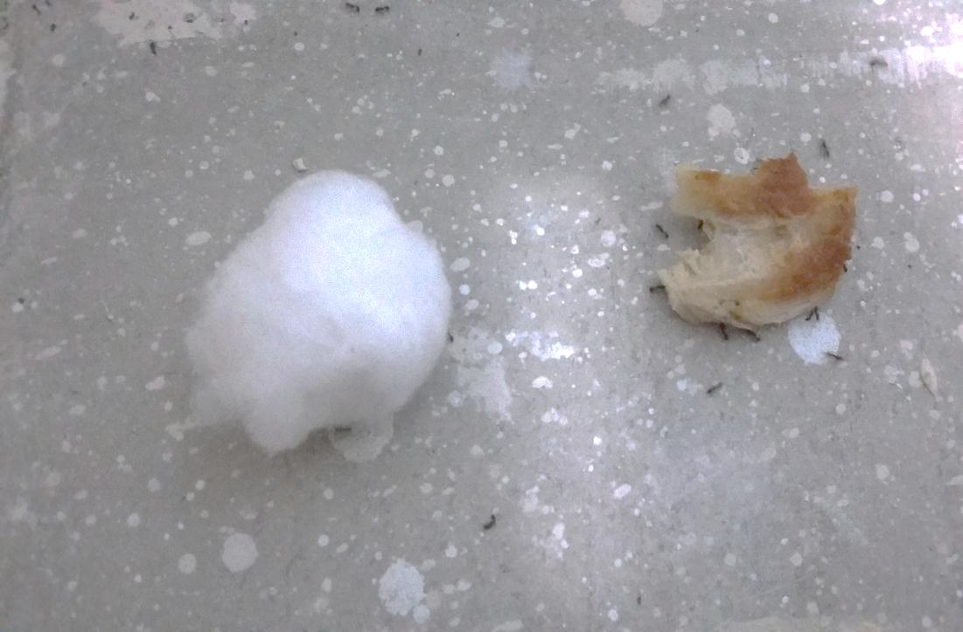
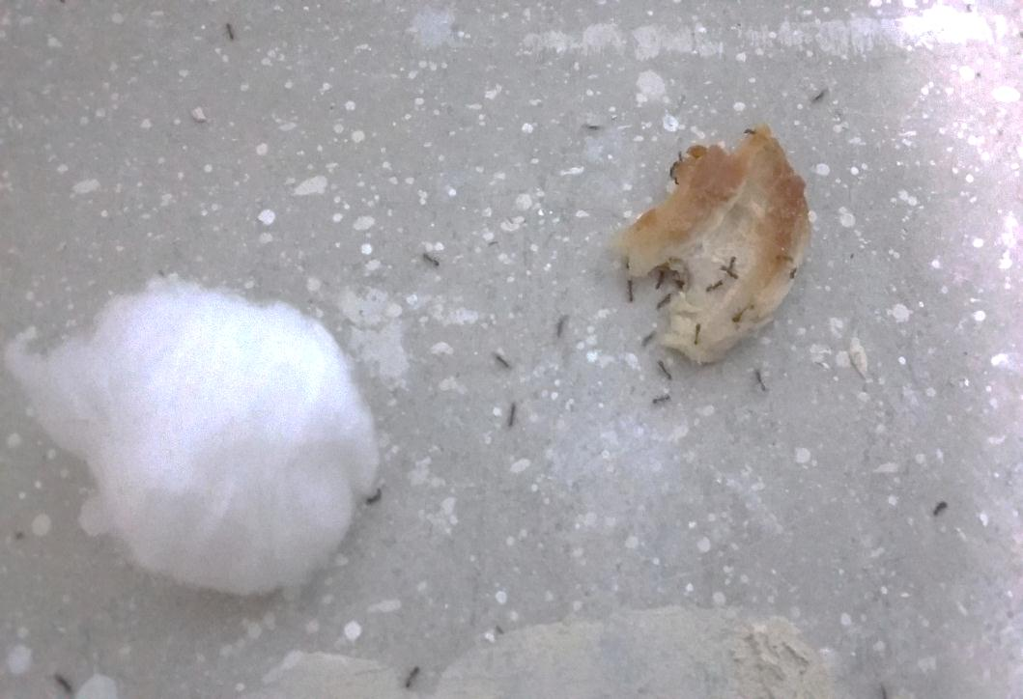
Figure1: Preference of ant between a Cotton ball and a Chicken meat
4
Nest of ant
A
B
C
Notes:
Ok, this test is between a cotton ball and a chicken meat, we did this test to conclude that the ants like something that has a lot of smell or a little smell.
So, we put them near the nest of ants, and we took each picture after 30 minutes.
As you can see in the last picture, the ants are going to the chicken, so we can conclude that the ants like something that has a lot of smell.

Slide 7
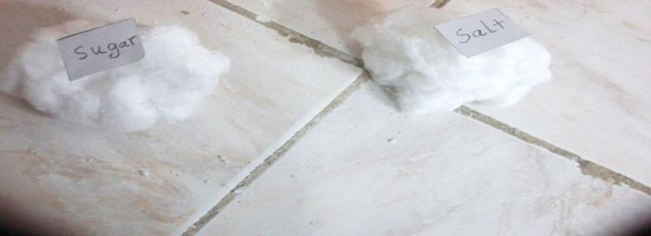
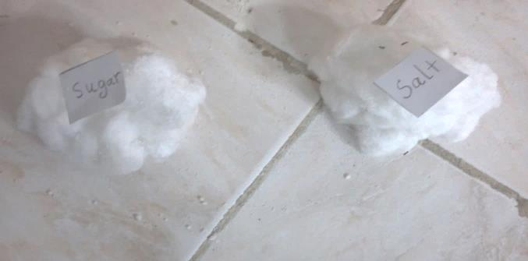
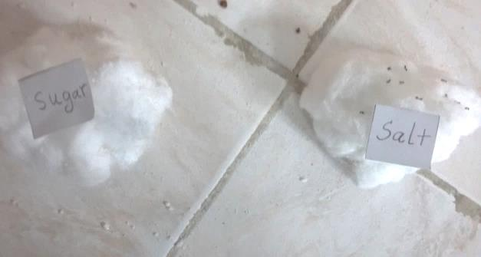
Figure2: This test between salty and sugar cotton balls
6
A
Sugar
Salt
B
C
Sugar
Salt
Sugar
Salt
Notes:
This test is between salty and sweet cotton balls, and as you can see at here the ants prefer the salty cotton ball, so we conclude the ants like something that is salty and isn’t sweet.

Slide 8
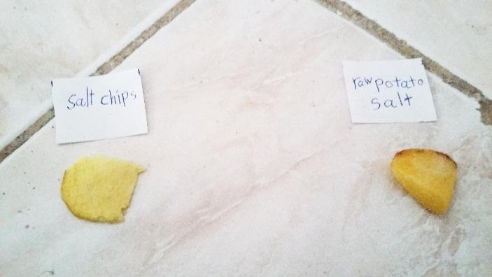
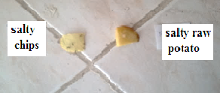
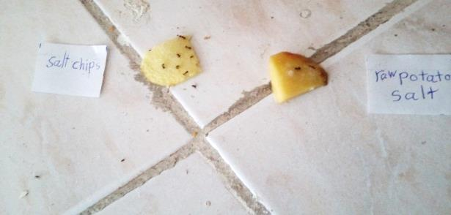
Carbohydrate:
Figure 3: Preference of an between salt chips and salty raw potato
A
8
Salty raw potato
Salty chips
B
C
Salty chips
Salty chips
Salty raw potato
Salty raw potato
Notes:
Now, for carbohydrate group: at here we have salty chips & salty raw potato; and as you can see in here they would rather salty chips, because it has more smell and maybe for its oil after cooking.

Slide 9
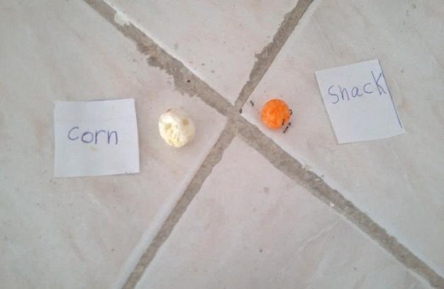
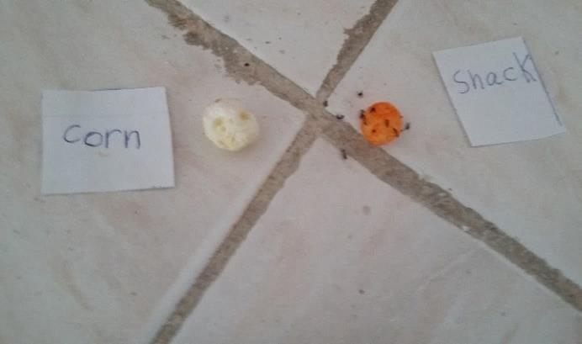
Figure4: This test between Popcorn and Snack
9
A
popcorn
Snack
B
Snack
popcorn
C
Snack
popcorn
Notes:
Now between two kind of corn: snack & pop corn. And as you can see in the last picture, they prefered snack because it has more spice than the pop corn.

Slide 10
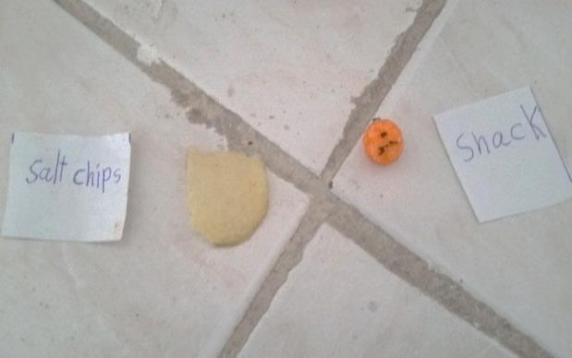
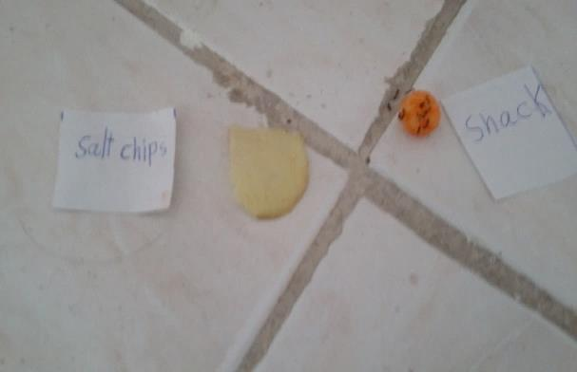
Figure 5: this test between Salty chips and Snack
10
A
Snack
Salty Chips
B
Snack
Salty Chips
C
Snack
Salty Chips

Slide 11
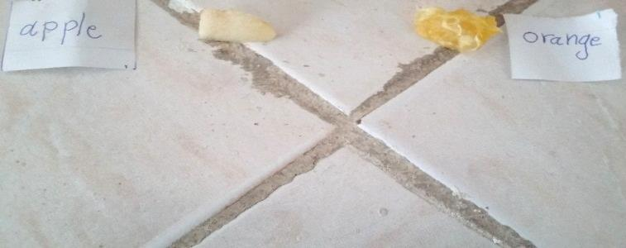
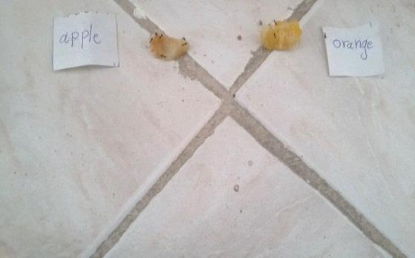
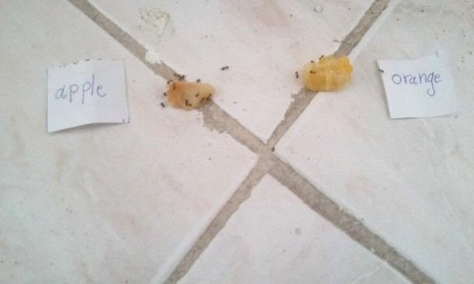
Figure 6: This test between an Apple and Orange
11
Fruits
A
Apple
Orange
B
C
Apple
Orange
Apple
Orange

Slide 12
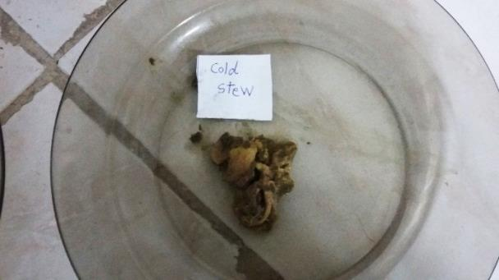
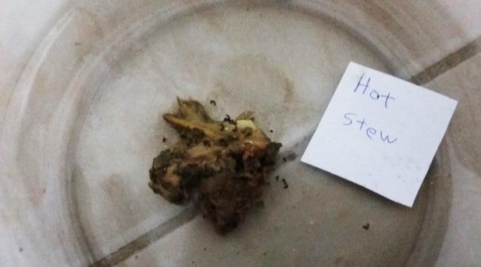
Proteins:
12
A
Hot stew’s meat
Cold stew’s meat
B
Cold stew’s meat
B
Hot stew’s meat

Slide 13
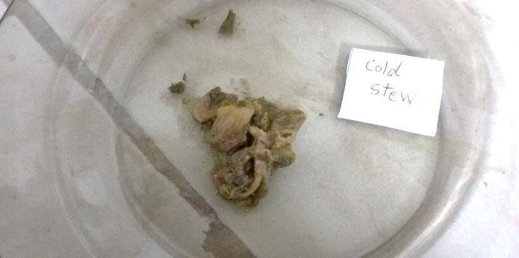
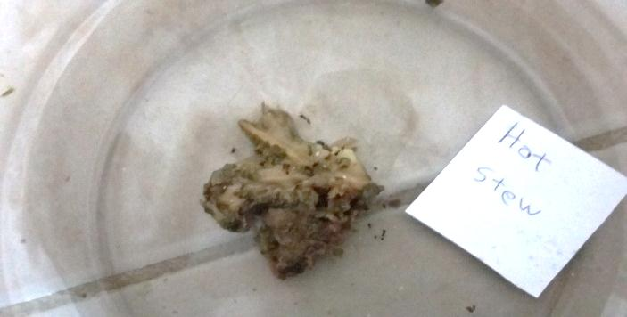
Figure 8: This test between Cold and Hot stew s ’meat
13
C
Cold stew’s meat
C
Hot stew’s meat

Slide 14
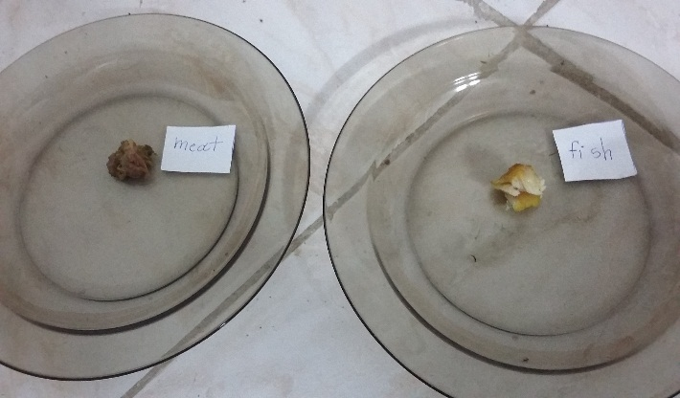
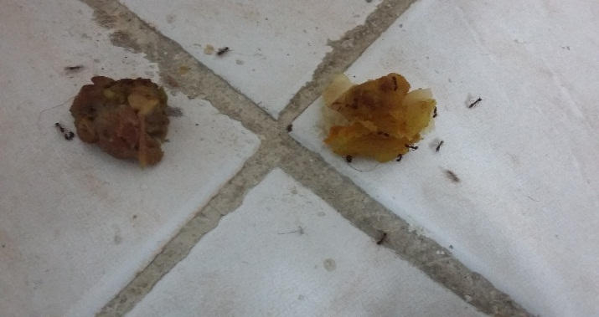
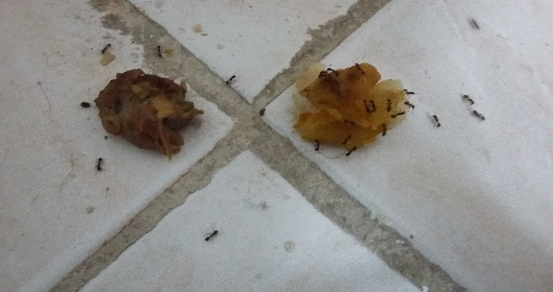
Figure 9: This test between Stew ‘s meat and Fish
14
A
Sheep meat
Fish
B
Sheep meat
Fish
C
Sheep meat
Fish

Slide 15
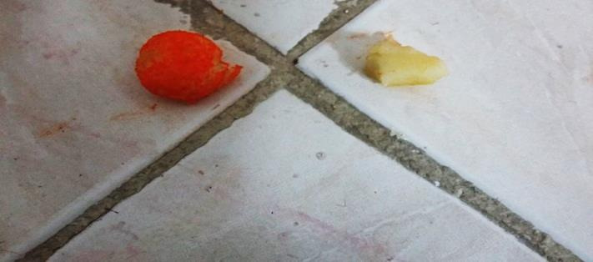
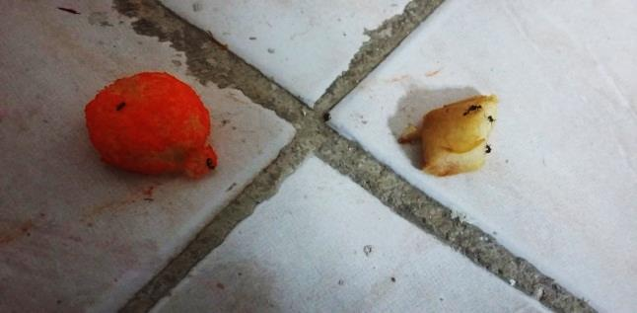
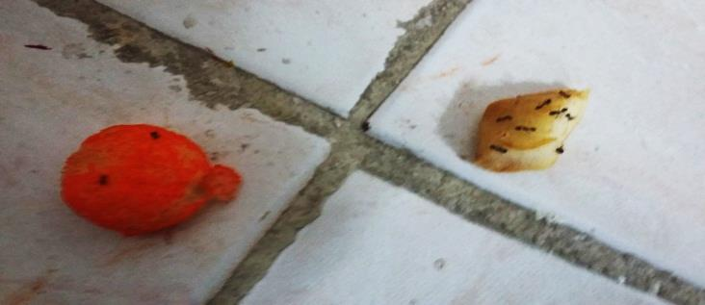
Figure 10: This test between a Snack and an Apple
15
A
Snack
Apple
B
Snack
Apple
C
Snack
Apple

Slide 16
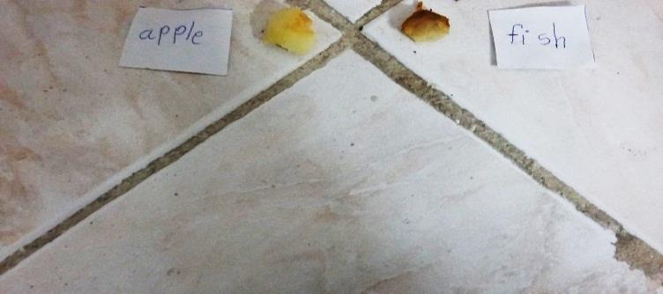
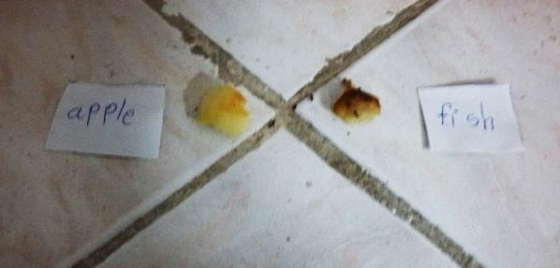
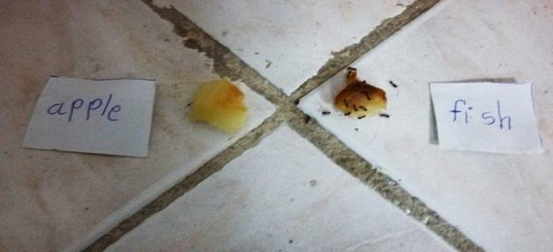
Figure 11: This test between an Apple and a Fish
16
A
Apple
Fish
B
Apple
Fish
C
Apple
Fish

Slide 17
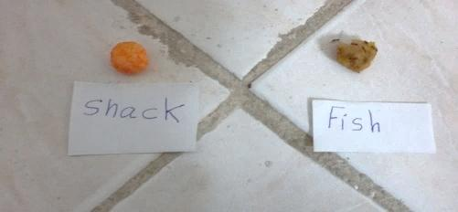
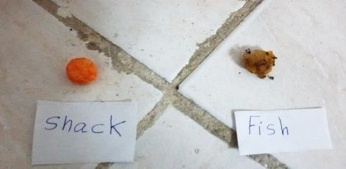
Figure12: This test between a Snack and a Fish
17
A
Snack
Fish
B
Snack
Fish
C
Snack
Fish

Slide 18
Conclusion
18
Chicken meat
Cotton balls
Salty raw potato
Salty Chips
Snack
Popcorn
Salty Chips
Snack
Apple
Orange
Hot stew’s meat
Cold stew’s meat
Sheep meat
Fish
Snack
Apple
Apple
Fish
Snack
Fish

Slide 19
19
Little smell
A lot of smell
Carbohydrates
Fruits
Proteins

Slide 20
THE END

