Slide 14
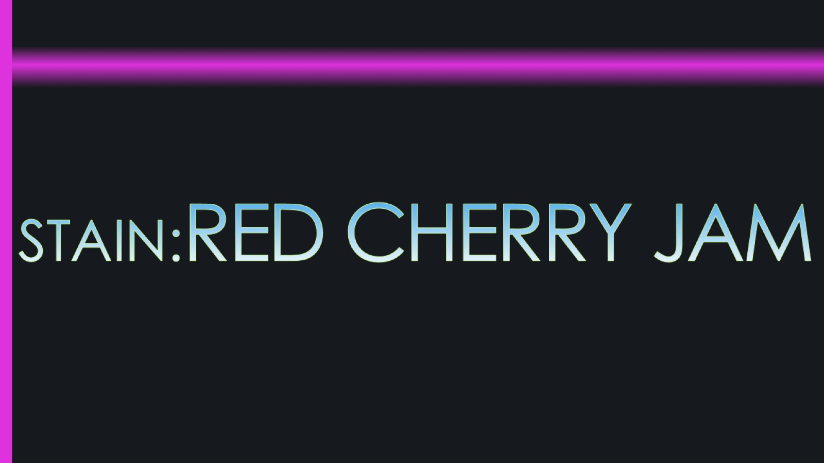

Slide 22
cashmere (coarsely-woven) in the first stage ash didn’t remove honey, but in second stage when we washed, it cleared.

Slide 27
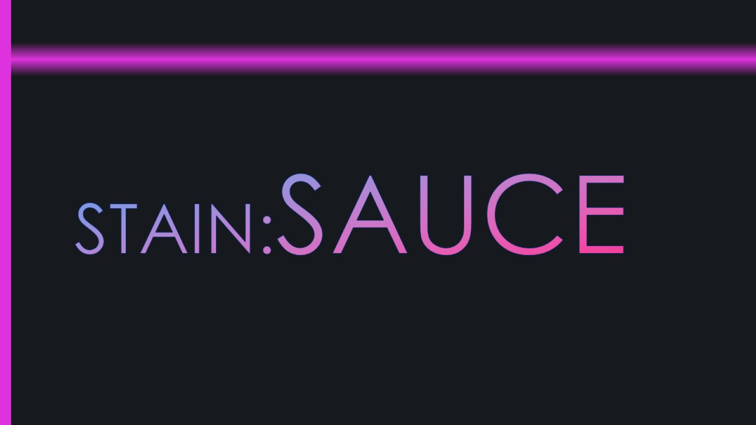

Slide 30
Jersey (fine-woven) like the last one: as easy as pie in the first stage

Slide 35
Jersey (coarsely-woven) Taint went deeply in cloth, and removed after two stages.

Slide 36
Cashmere(coarsely-woven) quietly hard, but removed in the 1st stage

Slide 37
Cashmere(fine-woven) when 1st stage was in progress there wasn't no sign of taint.

Slide 38
crepe(coarsely-woven) we cleared it so hard, but in 1st stage, because I heard that ash told me ‘bank on me.’and it did it’s duty well.

Slide 40
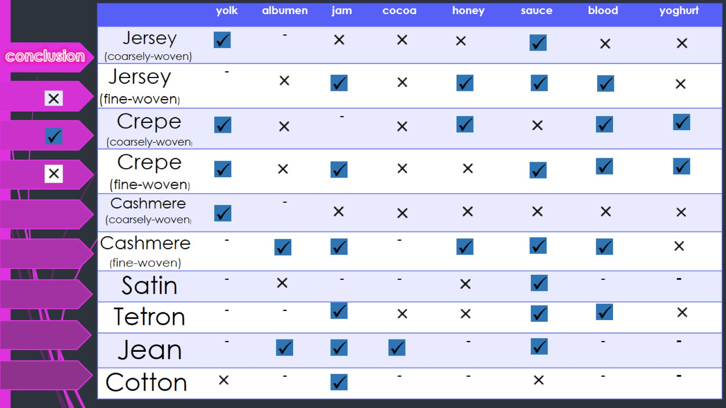
conclusion

Slide 41
THE END

