Slide 1
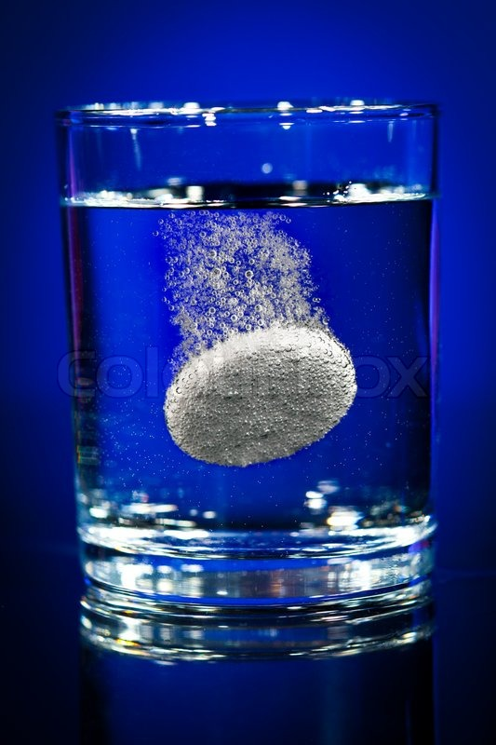
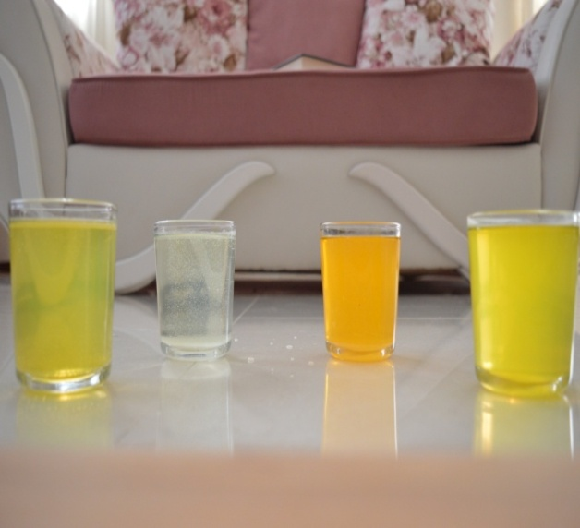
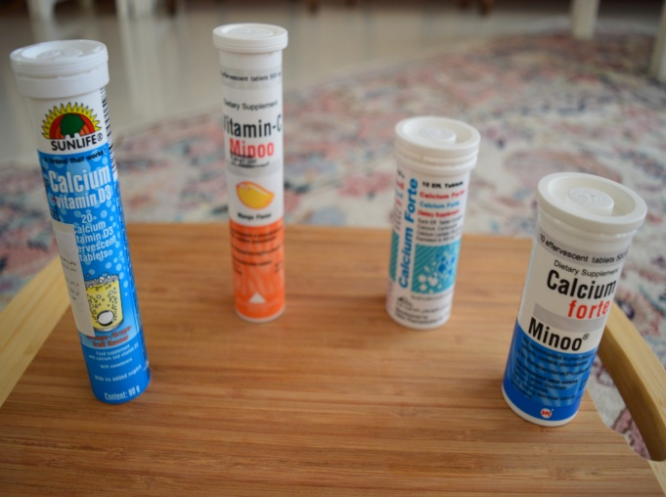
in the name of god researched by ARYAN yousEFLI supervised by: DR.ARASH KHAJEH
EFFERVESCENT TABLETS

Slide 2
Lets know more about the tablets.
Effervescent tablet is a tablet designed to be dissolved or dispersed in water before administration.
The Cause of Effervescence
Effervescent tablets are not coated tablets that mostly contain acid substances and carbonates or bicarbonates and which react rapidly in the presence of water by releasing carbon dioxide. The process is seen by the following chemical reaction
C₆H₈O_{7 (aq)} + 3NaHCO_{3 (aq)} → 3H₂O _{(l)} + 3CO_{2 (g)} + Na₃C₆H₅O_{7 (aq)}
Citric acid + sodium bicarbonate → water + carbon dioxide + sodium citrate
1

Slide 3
And what are their Benefits?
1. Early starting point of medicine effects and higher Efficiency
2. Swallowing the tablet is no more needed.
3. Reduction in digestive disorders and pains related to medicine consumption
4. More portability
5. Favorable taste
6. Longer shelf life
7. More consistent response
8. Larger amounts of active ingredients
9. Enhanced therapeutic effects
2

Slide 4
And what I had done in one look…
Effervescent tablets
Experiments on tablets in three different condition
1.Vitamin c
2.Sunlife small))calcium
3.Hakim calcium (big)
The last experiment on 4 different tablets
Conclusion
3

Slide 5
Problem: 14.Effervescent Tablet The rate of some chemical reactions may depend on surface area. Break effervescent tablets into smaller parts, or stir them into powder, to study how the dissolution rate depends on the surface area.
4

Slide 6
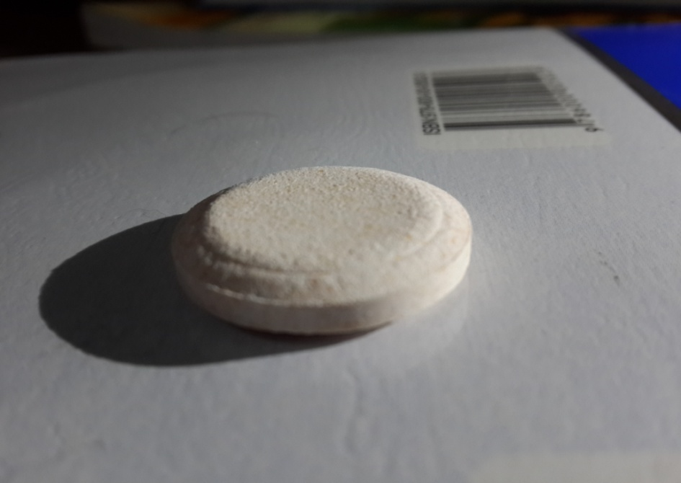
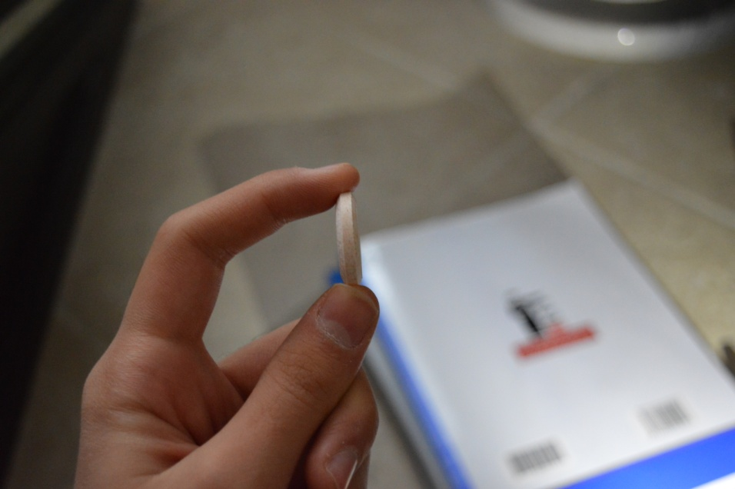
Experiments on vitamin c:
5

Slide 7
Experiment on vitamin c in normal condition:
2:04 s
6

Slide 8
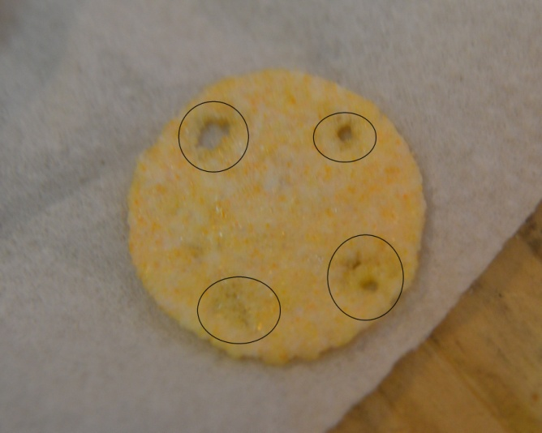
Experiment on vitamin c with holes :
1:55 s
by making these 4 holes about 8% of weight was decreased.
7

Slide 9
Experiment on vitamin c in powder form:
0:49 s
8

Slide 10
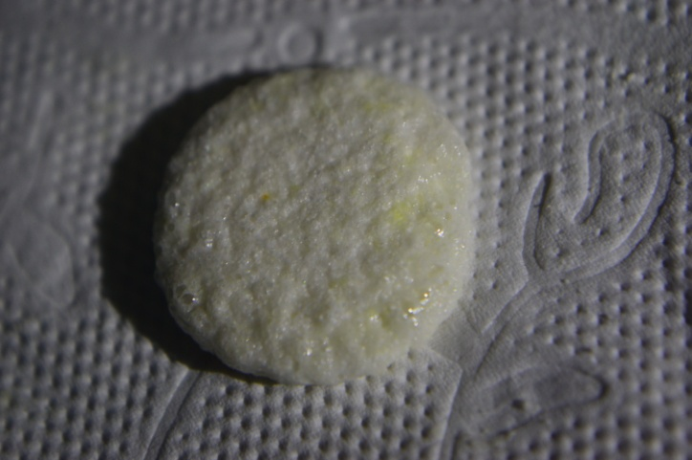
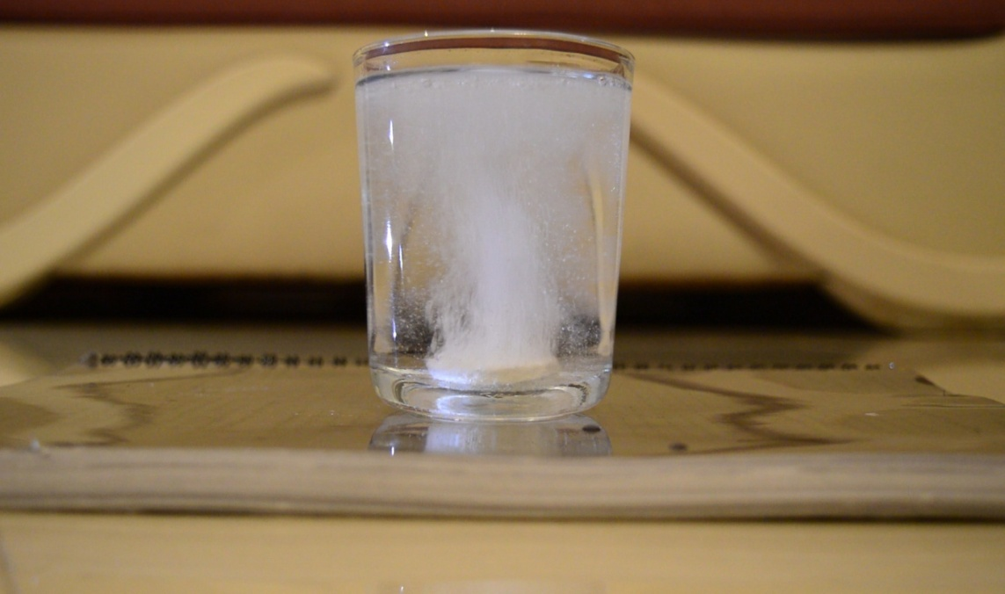
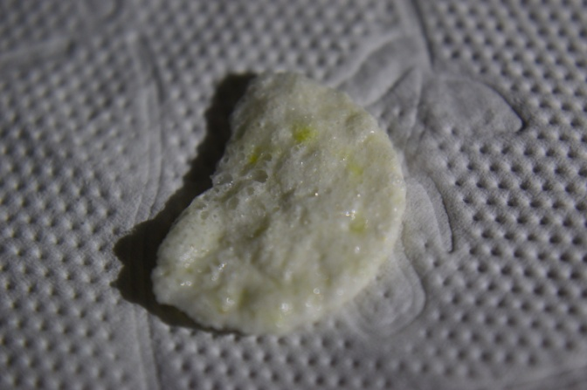
Experiments on sun life calcium tablet:
9

Slide 11
Experiment on sun life calcium in normal condition:
1:40S
10

Slide 12
Experiment on sun life calcium with holes:
1:09s
by making these 4 holes about 7% of weight was decreased.
11

Slide 13
Experiment on sun life calcium in powder condition:
0:30s
12

Slide 14
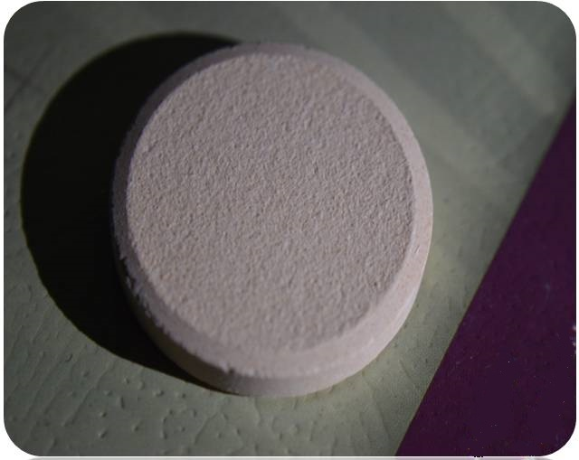
Experiments on hakim calcium tablets:
13

Slide 15
Experiment on hakim calcium in normal condition:
3:02s
14

Slide 16
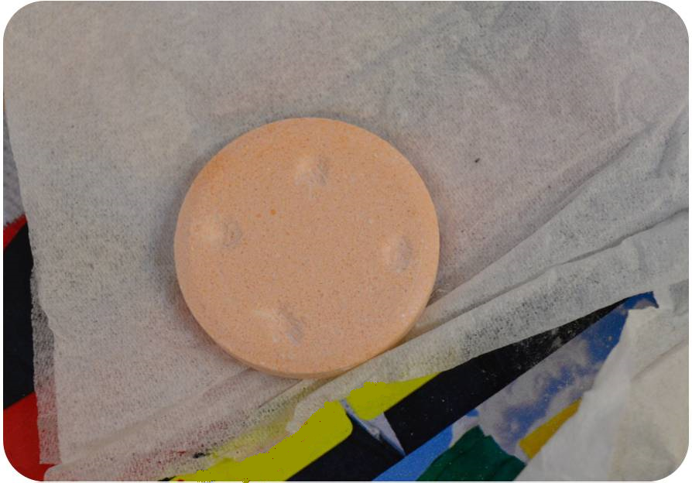
Experiment on hakim calcium with holes condition:
2:40s
by making these 4 holes about 5% of weight was decreased.
15

Slide 17
Experiment on hakim calcium in powder condition:
1:17s
16

Slide 18
EXPIRIMENT ON ALL OF THE TABLETS :
17

Slide 19
18

Slide 20
Time of all reactions
Sun life calcium
Hakim calcium
Vitamin c
Normal condition
1:40s
3:02s
2:04s
With holes
1:09s
2:40s
1:55s
Powder
0:30s
1:17s
0:49s
19

Slide 21
Normalizing time:
(time of reaction / weight of tablets)
1.The sun life calcium tablet: 100/4.5=22.2
2.The hakim calcium tablet: 182/7.5=24.2
3.The vitamin C tablet: 124/3.5=35.5
20

Slide 22
Conclusion:
Less adhesion between ingredients can cause easier disintegration of effervescent tablet and
the effervescent ingredients (including acids and carbonates or bicarbonates) can react faster.
21

