Slide 1
In the name of god
(Besat2 team)
Made by : Mohammad Reza E’zazi

Slide 2
8. Zipf’s law :
many times the most frequently appearing word (rank one) appears; the second most frequent word (rank two) appears, etc.
Investigate and explain the dependence of the word count on its
rank in the frequency table. Would it be the same for another book in the same or different language?
1-Does this law have valid relations?
2- Was his law valid and true in every other field?
3- Does the most repetitious word just refers to the text of one story?

Slide 3
easier way & Conclusion
2. Physics holiday
Review of essay
researches
3. Political economy
1.Christmas carol

Slide 4

According to this topic it has lots of graphs so for god’s sick pay attention to me that I present perfect.
According to my essay l just go to my studies & researches to understand it better & better!
Before it I explain 2 connected laws again.

Slide 5
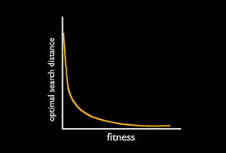
1. Power Law: the correlation of quantity function and quality function, the space of a square in its length, if doubled, it is manipulated with a factor of four & it’s a exponential function.

Slide 6
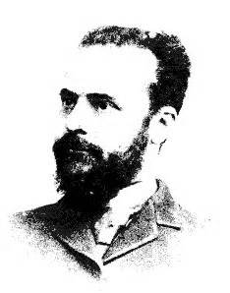

2. 80 and 20 law: Wilfred Pareto was an Italian sociologist economist, engineer and philosopher. Pareto has theories in different fields of humanities. The theory of governing the elite in politics, 80 and 20 law in management are examples of his theories.

Slide 7
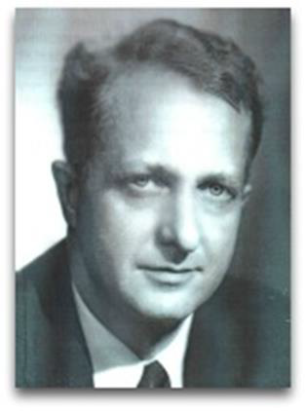
He was the first one to study “the frequency of the words” not for literary methodology, but to reveal the nature of communications.

Slide 8
Now what is the correlation with Zipf’s diagrams? Zipf used that law and concluded that:
1. The function is exponential.
2. 20 percent of the diagram including 80 percent of all frequencies are understood through the particles diagram.
Now How to catch a number.
Frequency * grade= fixed number r * f=C

Slide 9

Now it’s time to discussion about a couple of books & topics.

Slide 10
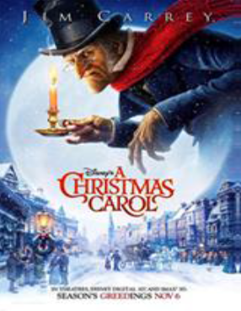
1. Christmas carol (by Charls Dickens ) :
A story about a mean old man who sees his old friend’s ghost and the ghosts of last Christmas and changes his now and future and ignores material world.

Slide 11
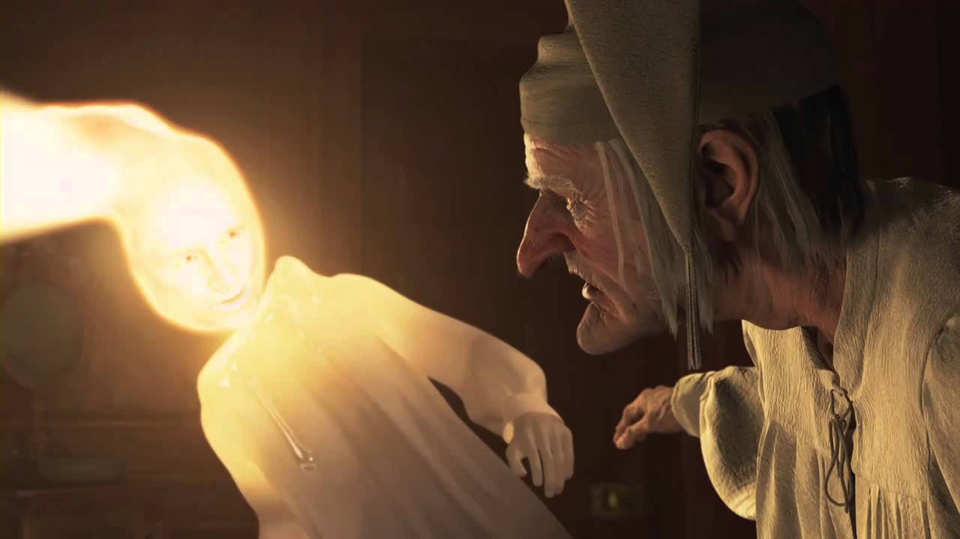
Main words (Persian)
Obey 20/80 & power law but there’s a problem.

Slide 12
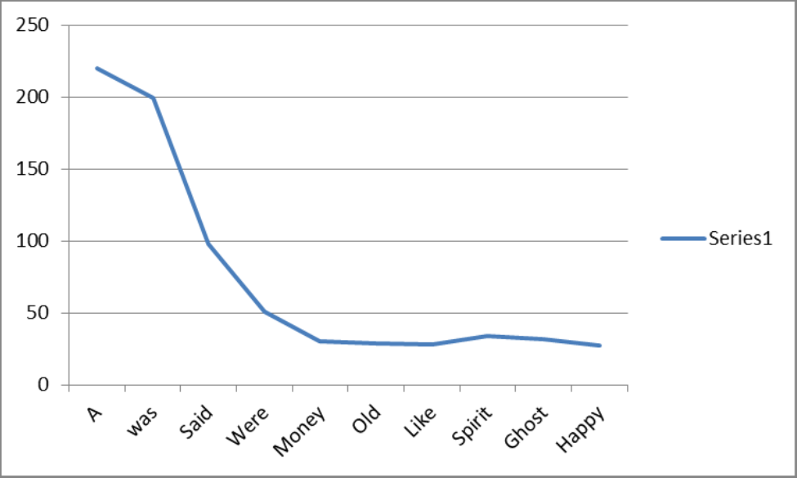
main word( English)
Obey 20/80 & power law.

Slide 13
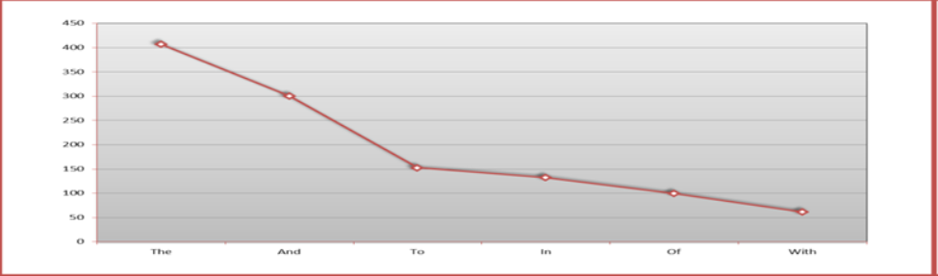
F
Prepositions
Obey 20/80 & power law.

Slide 14
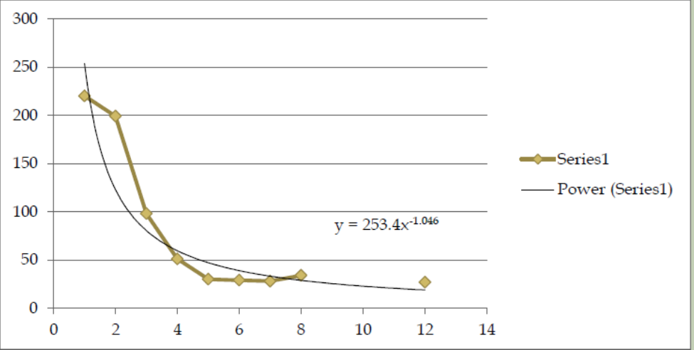
frequency
Total diagram
Obey 20/80 & power law.
rank

Slide 15
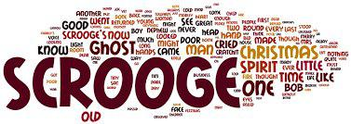
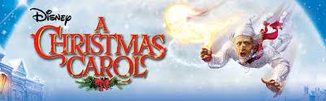
Christmas carol (transcript): this is the Arabic reference; Arabic is the most related language to persian.

Slide 16
F
main words (Arabic)

Slide 17
F
Prepositions ( Arabic)

Slide 18
F
Total diagram
Obey 20/80 & power law.
And/sir/no/that/scrooge/for/to/Christmas/a/spirit/ghost/old

Slide 19
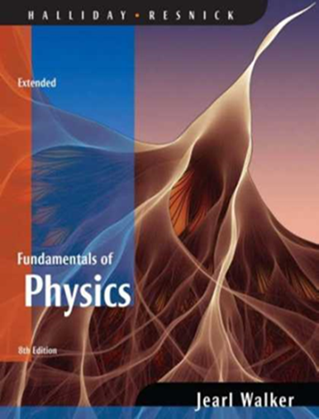
2- The second part of Holiday Physics volume1:
This part includes movements, diagrams, primary speed and acceleration.

Slide 20
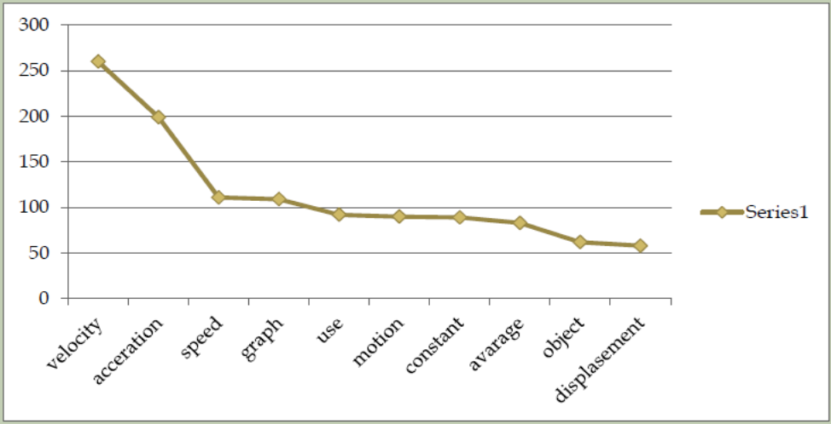
F
main word
Obey 20/80 & power law.
acceleration

Slide 21
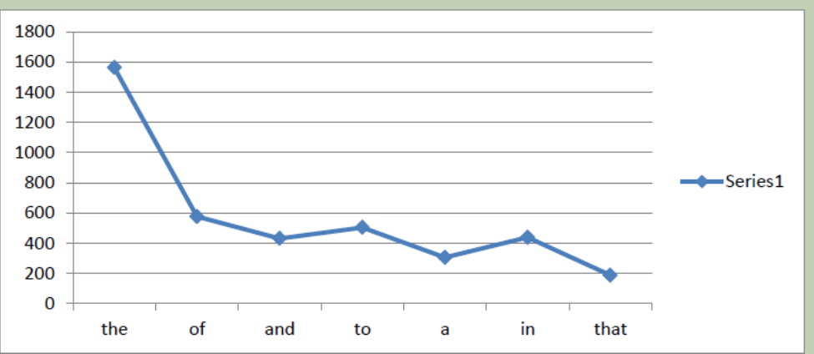
F
Prepositions
Obey 20/80 & power law.

Slide 22
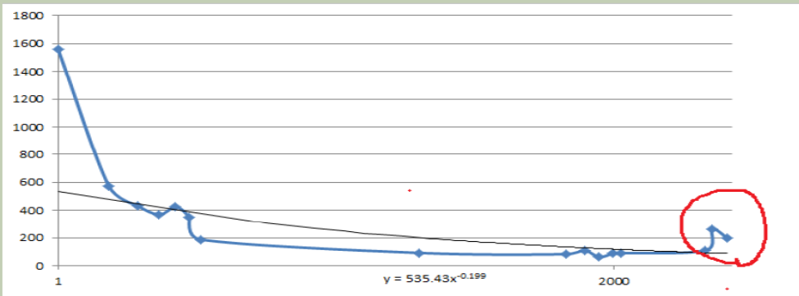
(Total diagram)
Why is the red circle imbalance?
These are 2 words that they have relation to the book.

Slide 23

3-The book political economy:
In this book some parts including people’s activities, jobs, politics role and politicians in improving economics are written. This book is written in 1960 and some parties like democrat were not created, therefore they are not visible.

Slide 24
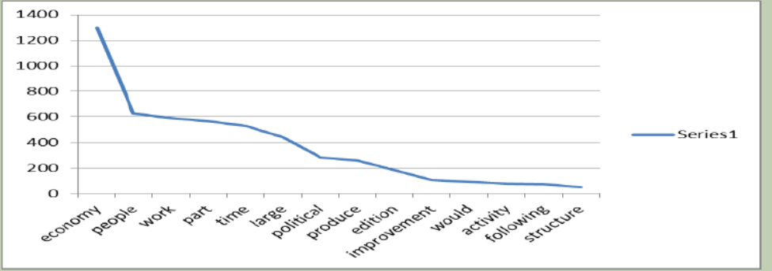
F
main word
Obey 20/80 & power law.

Slide 25
F
Prepositions
Obey 20/80 & power law.

Slide 26
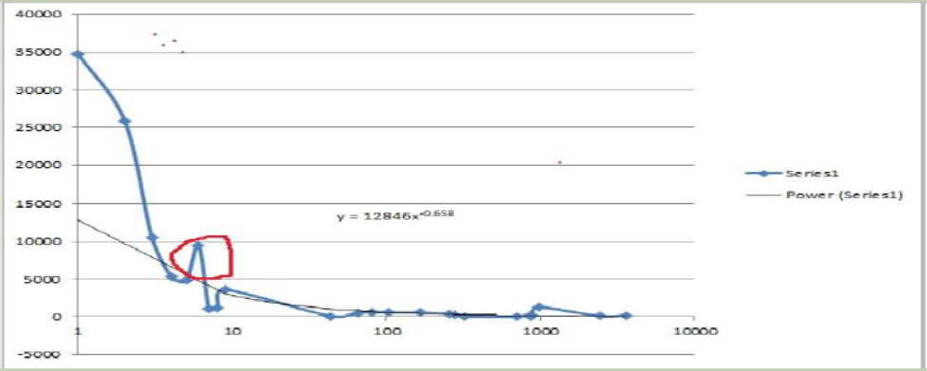
Total diagram
Follow 20/80 but…
Why imbalance? ? ? ? ? ?

Slide 27

Here the word (In) is for giving information rather the information provided on the different elements and places in the text. But because the topic is much serious and he is going to suppress other parties, he writes:
In Capitalism consists in this that the national wealth grows alongside the Growth in the poverty of the people.

Slide 28

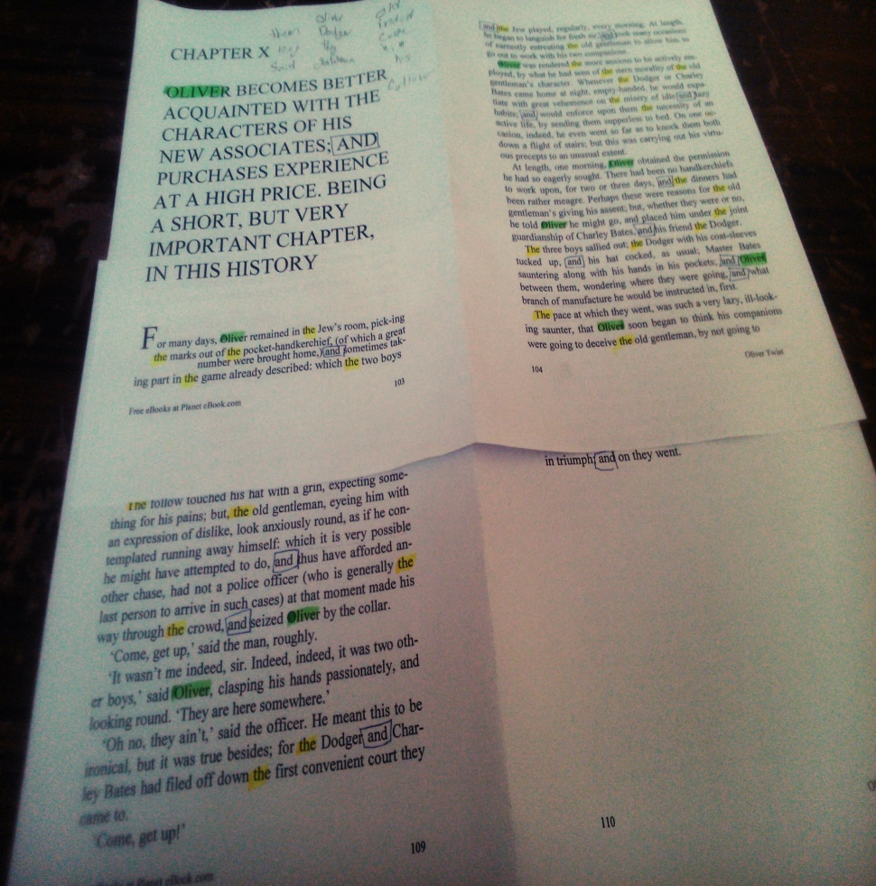
new way to make sure: we can read a book and underline the words that they are more frequent
I read Oliver Twist book

Slide 29
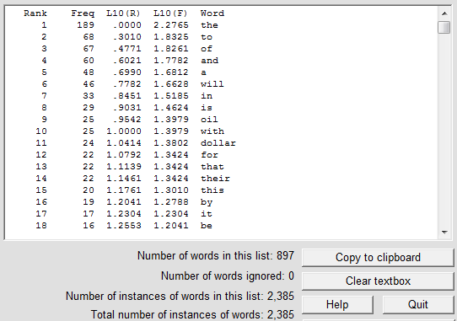
But we can do the easiest; I made a counter program

Slide 30
Total diagram

Slide 31
Zipf’s law i s followed every where ; even in random typing:
I tried typing for 5 different persons to decrease the faults
F & E are the most frequent letter

Slide 32
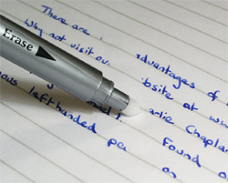
Conclusion:
So before we want to make total diagram we should remove the words that they have relation to our subject.
If we didn’t do like that our diagram have imbalance.

Slide 33

But in some diagrams (scientific, politics, economics and social) we saw, we can conclude that in a scientific text due to lack of description, some particles are not homogenous with others.

Slide 34
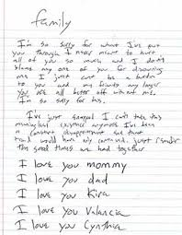
So we can understand that Zipf’s law with the 80/20 rule& power law is complete. It helps us to find the frequency of the words and find out them with one simple formula.
Now start reading a text and find most repeated text. You reach zipf law.
This is the natural relation of the language.

Slide 35
References:
1- wordcount.org
2- www.ncbi.nlm.nih.gov
3-www. nlp.stanford.edu

Slide 36

Thank you for attention

