Slide 1
PH Indicator
In the name of Allah
Problem 10:
PH indicator
Besat IYNT Team
By: Alireza Hamidian
Leader: Dr. Khajeh
Notes:
In the name of Allah
Hello everyone, I’m Alireza Hamidian from national team of Iran, and I’m here to present problem number 10; PH indicator.

Slide 2
Question:
Fruit and vegetables juices contain natural indicators which change the color of the solution due to their acidity or basicity. Investigate these indicators and then identify their different compounds. Next recommend the most effective and accurate one and then, compare its solubility with common paper indicators.
1
Notes:
Now let’s see what problem asks.
It says use fruit and vegetables to make indicators then investigate them and then compare the better one with common paper indicators.

Slide 3
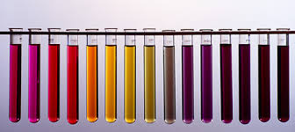
Indicators?
Chemical reactions of dissociation and integration of indicators associate with the inner structural rearrangement which cause the color of the solution to change.
What is an indicator?
2
Notes:
(text)
Now what is an indicator?
Indicators are organic compounds that own a complex structure and perform as a weak acid or base

Slide 4
Acid = donate proton or hydrogen ion
Alkali = accept proton or hydrogen ion

Slide 5
What We Did !
By Using Fruits and Vegetable juices; We Created Some Indicators. Then, we add them to different substances and specify them based on their colors.
3
Notes:
Now what we did!!
We created some indicators by using fruits and vegetables; and then we checked their colors in different PHs.

Slide 6
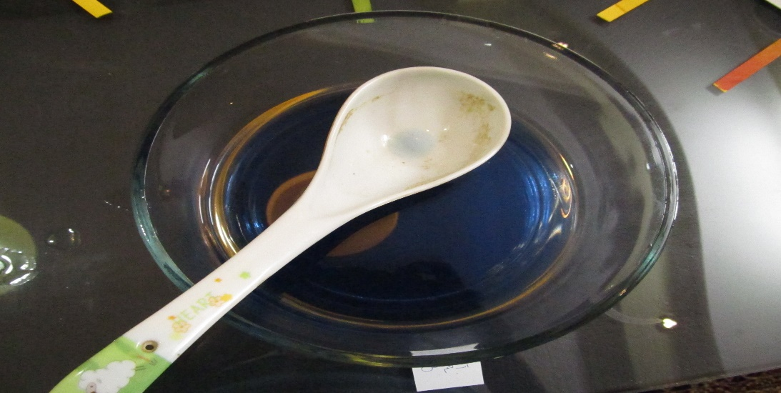
Red cabbage juice
Red Or Pink = 0-6
Blue = 7
Green = 8-9
Brown = 10-11,
Yellow = 12
Purple = 13
Black = 14
4
Notes:
(text)

Slide 7
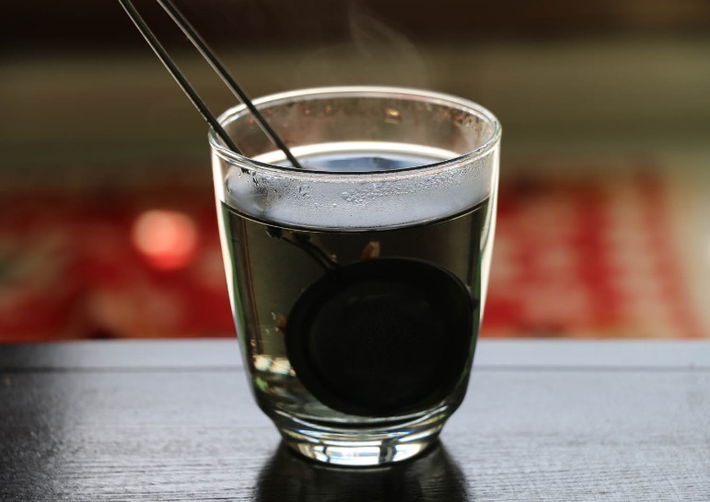
ox-tongue
Red Or Pink = 0-6
Black = 7
Green = 8-9
Brown = 10-11,
Yellow = 12
Purple = 13
Dark brown = 14
5
Notes:
(text)

Slide 8
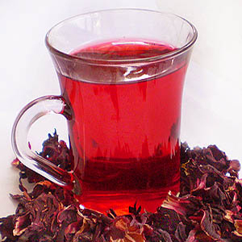
Hibiscus tea.
Red Or Pink = 0-6
Light Red = 7
Green = 8-9
Purple
Orange 10,11,12,13,14
Black
6
Notes:
(text)

Slide 9
Making Own Ph Indicator:
Materials that we need:
1-A small red cabbage
2-Boiling pot of water
3-Large bowls or pots (2)
4-A series of household items to test the PH of:
Fruit juice: lemon, lime, orange, apple
Soda pop (dark sodas might be tricky to see)
Vinegar
Baking soda solution
7
Notes:
Now At here, we need:
(text)

Slide 10
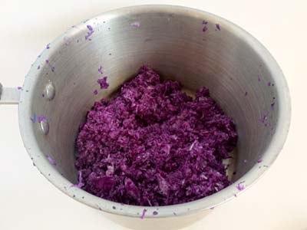
How To Create It:
1.Grate a small cabbage and place the pieces into a large bowl or pot.
8

Slide 11
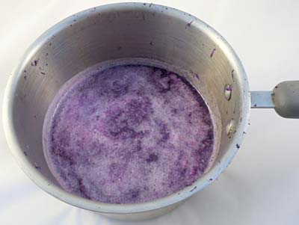
2. Pour boiling water into the bowl to just cover the cabbage. Use caution when handling the boiling water.
3.Leave the cabbage mixture steeping, stirring occasionally, until the liquid is room temperature. This may take at least half an hour. The liquid should be reddish purple in color.
9

Slide 12
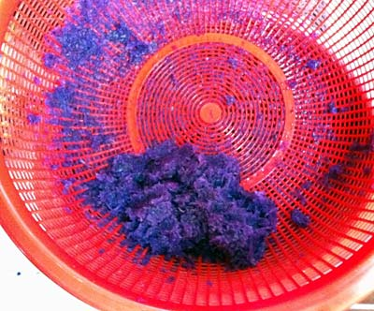
4.Place a strainer over a second large bowl or pot and pour the mixture through the strainer to remove the cabbage pulp, as shown in Figure 4, below. Press down on the pulp in the strainer, such as by using a large spoon, to squeeze more liquid out of the pulp.
10

Slide 13
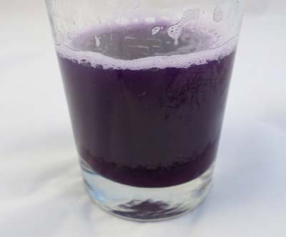
In the bowl, we have a clear liquid that will either be purple or blue in color, as shown in Figure 5, below. (It should look darker after the pulp is removed.) This will be your indicator solution.
11

Slide 14
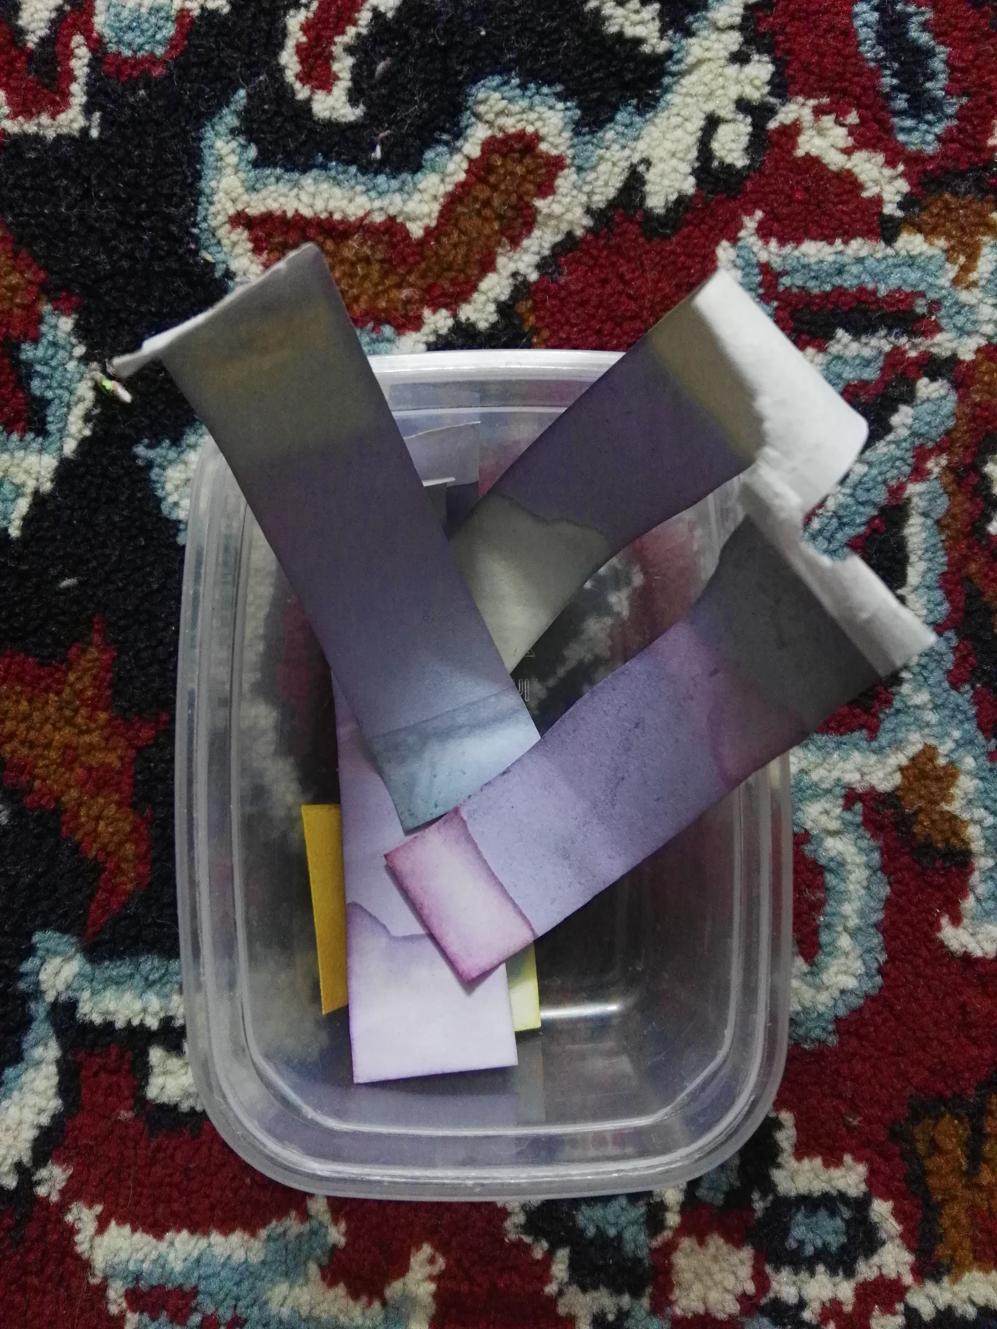
A handmade indicator
[Created By Us]
Red Cabbage Extract Juice Indicator that we wrote the process of creation this above on previous pages
12
Notes:
So, we made our handmade indicator by using red cabbage juice; as I explained.

Slide 15
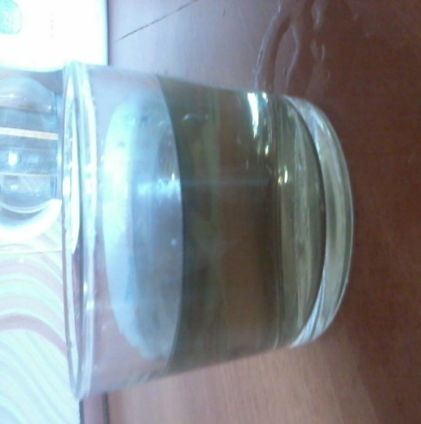
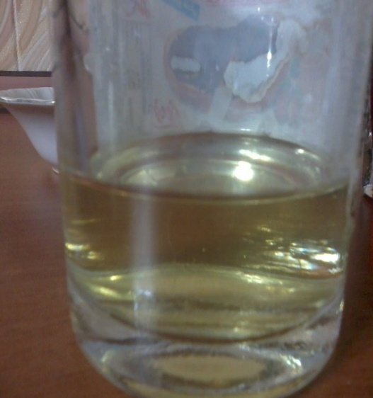
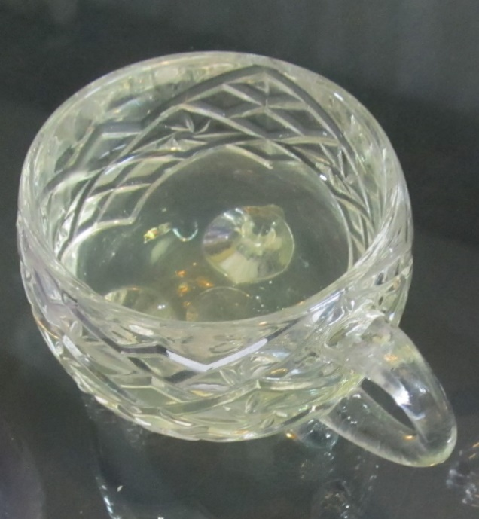
Reaction of a pH13 substance with ox-tongue
Reaction of a pH13 substance with hibiscus tea
Reaction of a pH13 substance with red cabbage extract

Slide 16
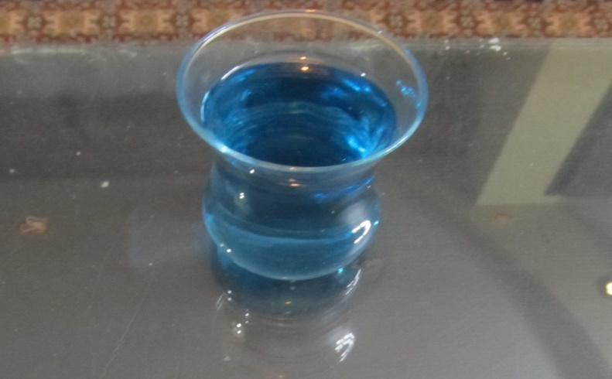
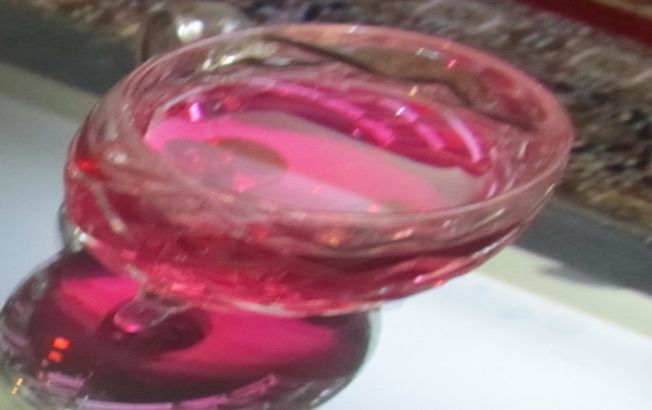
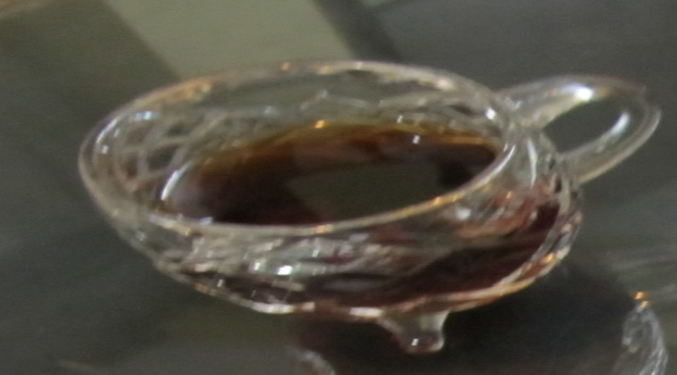
Dissolved red cabbage juice in water
Dissolved hibiscus tea in water
Dissolved ox-tongue in water
13
Notes:
(text)

Slide 17
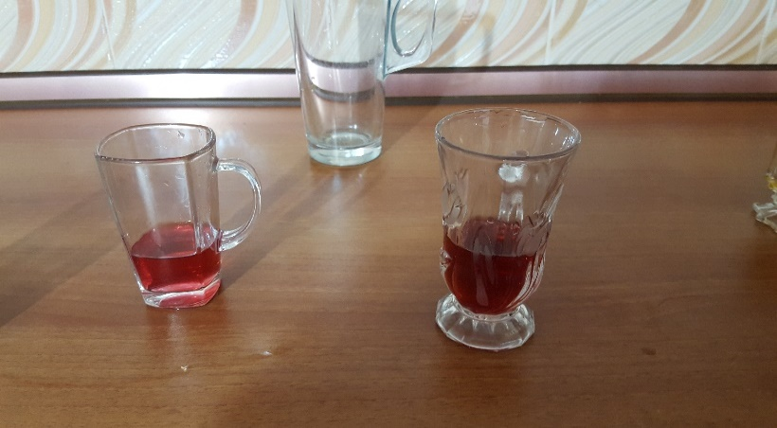
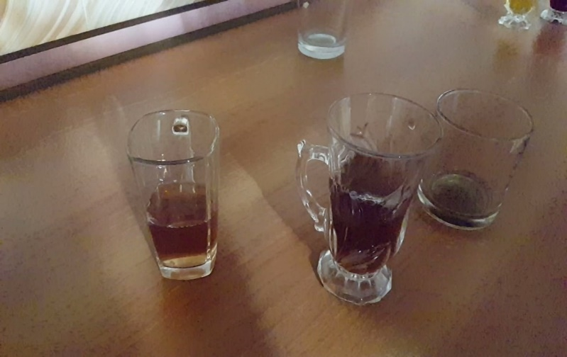
The Effect of Temperature on Color
the color of acid after reaction with the warm ox-tongue
the color of acid after reaction with the cold ox-tongue
14
Notes:
(text)

Slide 18
The Effect Of Temperature On Color
Temperature has more effects on the final color of solution. For instance, if we heat the indicator, the indicator will affect soon.
If the ox-tongue is warm, it exhibits a pink color in acidic environments and the same color for the alkaline.
But, if it is cold it just exhibits a brown color in basic environments. While the temperature of ox-tongue affects the color changes, there are some substances that have no effects or they may have more.
15

Slide 19
Conclusion:
1-If we have a cold ox-tongue it won’t have reaction with indicators but if we have a warm ox-tongue it will react with indicators and it will be red.
2-Indicators won’t have an effect on each other. for example if we mixed red cabbage juice with ox-tongue, the final color is the mixing color.
3-if we mix two different materials with same PH but different color, they won’t have a reaction and the final color is the mixing color as same as the above result.
16

Slide 20
Reasons for the following questions:
1) Why does the color of an indicator change?
Because it is a chemical reaction and the indicator will be neutral by adding an alkaline to an acid or vice versa; and it will turn to water and salt.
17

Slide 21
2) As we heat the indicator, its color changes but when we make it cold, its color doesn’t change, why?
2) By heating the indicators number of ions will increase and then it will be ionized, so the indicator color will change.
18

Slide 22
3) Why does the water take the color of the indicator?
3) Because there is no water in the indicator and when there is no water, it means that there is no ion and so the reaction doesn't occur. The base of a reaction is the existence of the ions.
19

Slide 23
4) What is the reason of the color change of substance when it adds to the different indicators?
4) In the procedure of ionization, it begins with increasing and then a decreasing and after that it becomes constant and no reaction occurs.
20

Slide 24
References:
1. Chemistry weblog of 6th grade
2. University of Chemistry of Lamard Website
3. Prepared Power points by students
4.Tabriz Oil Refining Company Websites
21

Slide 25
Thanks For Your Attention!

