Slide 2
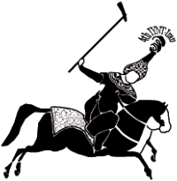
IYNT 2016
Iran-Shiraz
International Young Naturalist’s Tournament

Slide 3
#problem number 9
Cinder
Reporter :
Pariya Nazari Nezhad Giashi
Maple group

Slide 4
9. Cinder
In the Middle Ages, people used to wash the cloth in cinder. Study the effectiveness of cinder in washing clothes.

Slide 5
Theories
Experiments and results
Problems and errors
Conclusions

Slide 6
cinder

Slide 7
KOH
NaOH

Slide 8
KOH
NaOH
water
(K+) (OH_)
(Na+) (OH_)

Slide 9
Water
(OH_)
(H+)

Slide 10
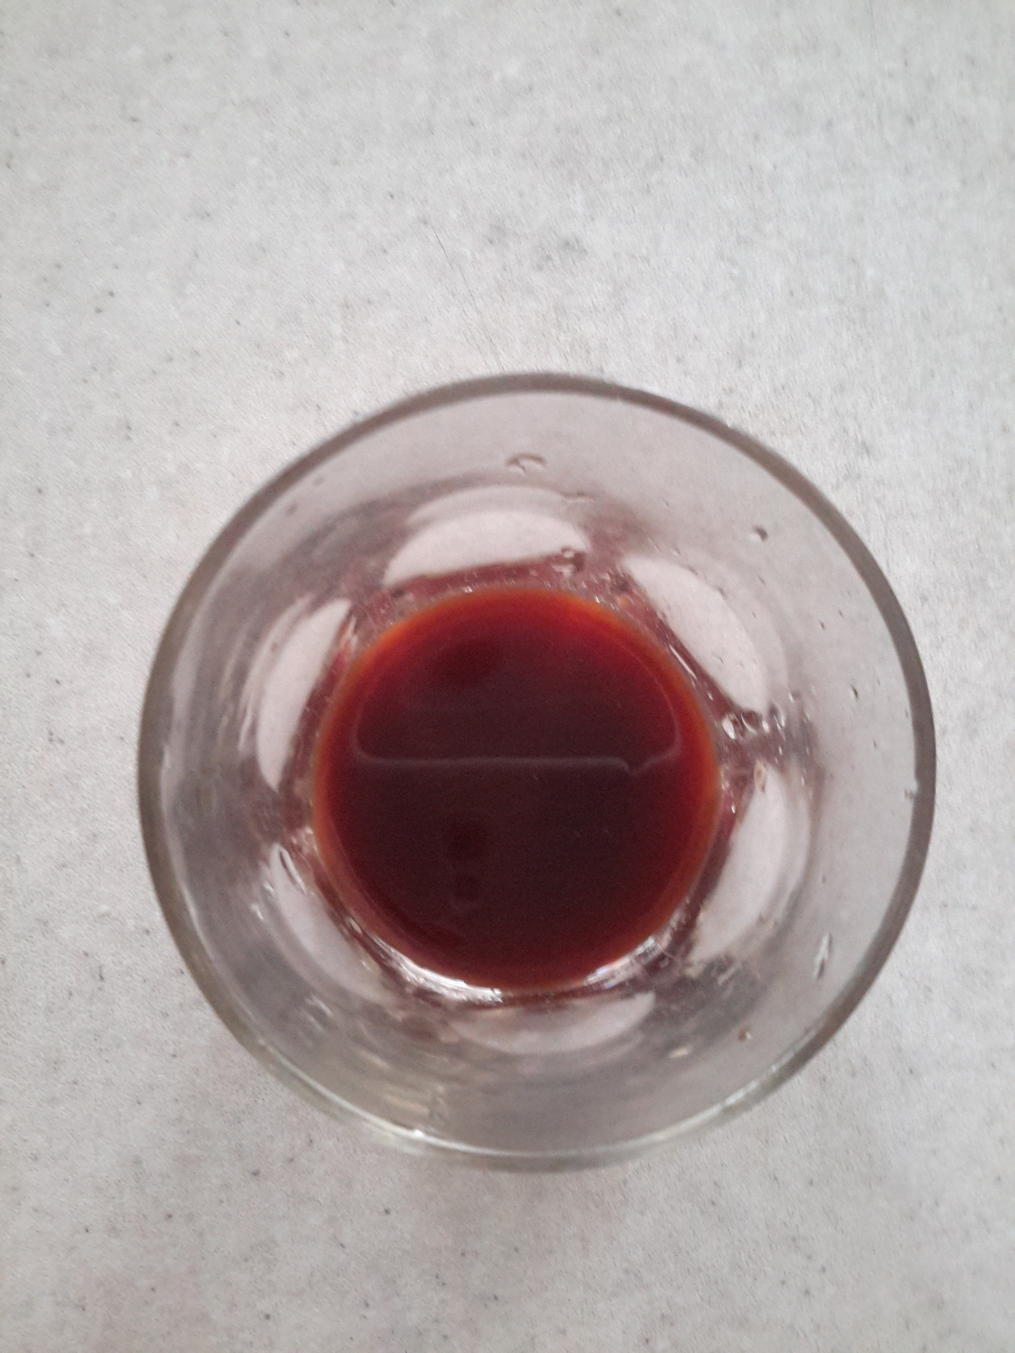
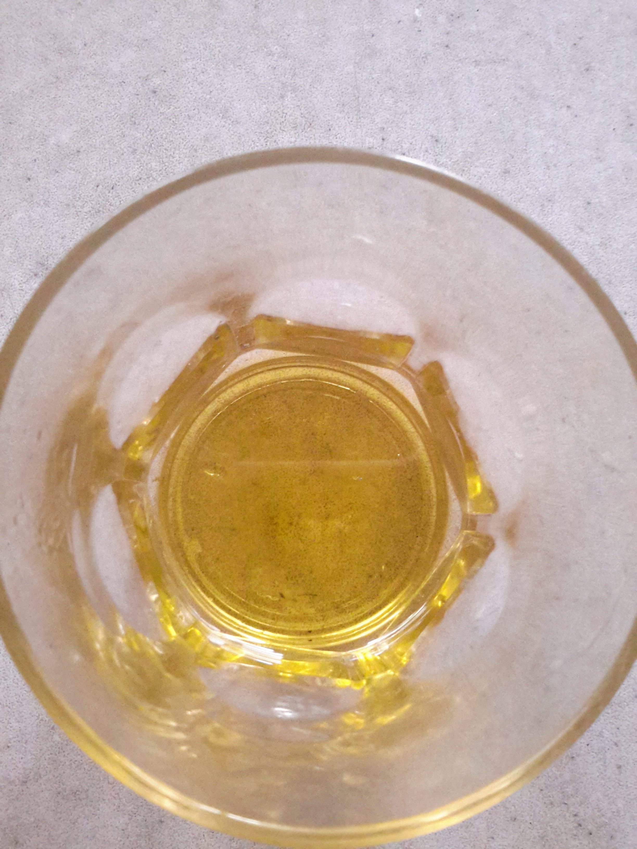
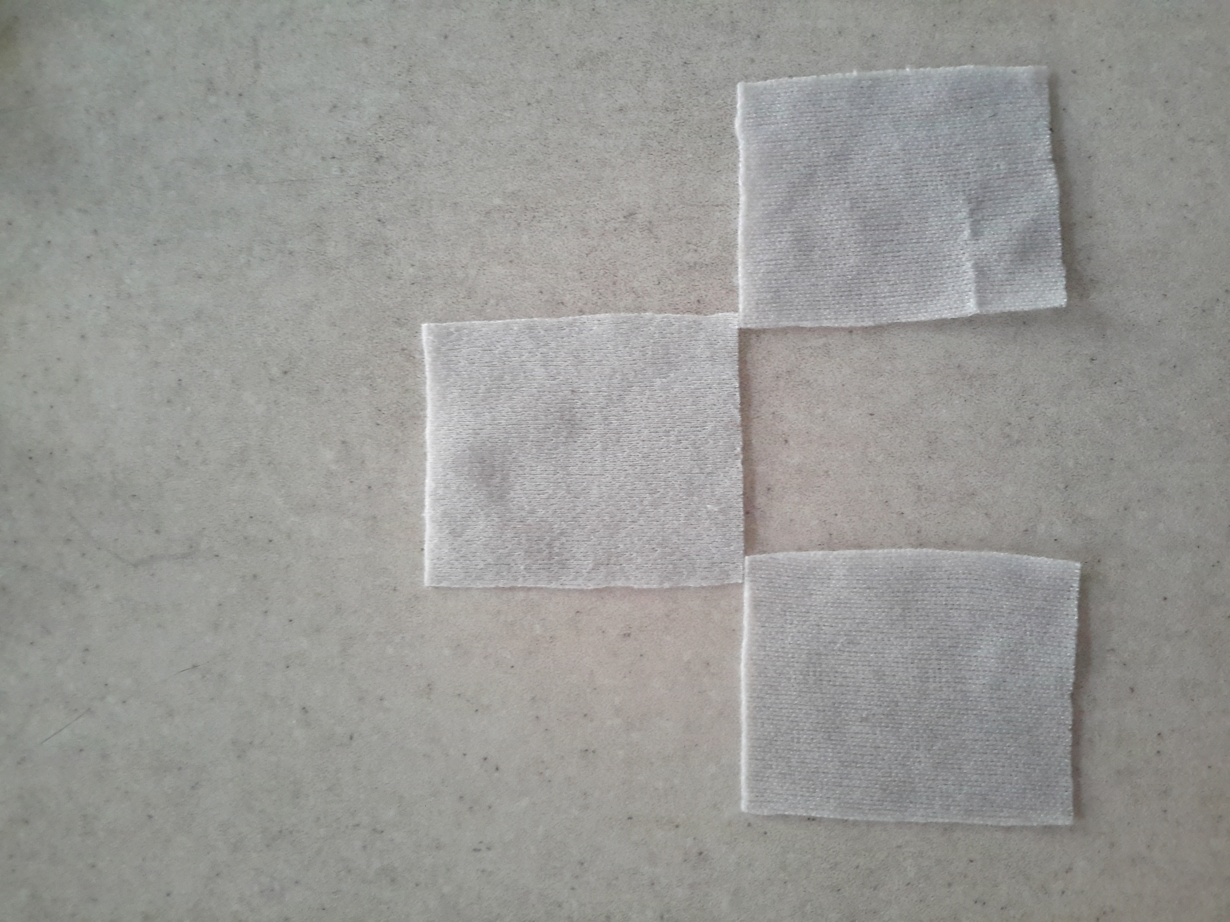
clothes
cherry juice
olive oil

Slide 11
NaOH
ANGIOSPERM cinder
GYMNOSPERM cinder

Slide 12
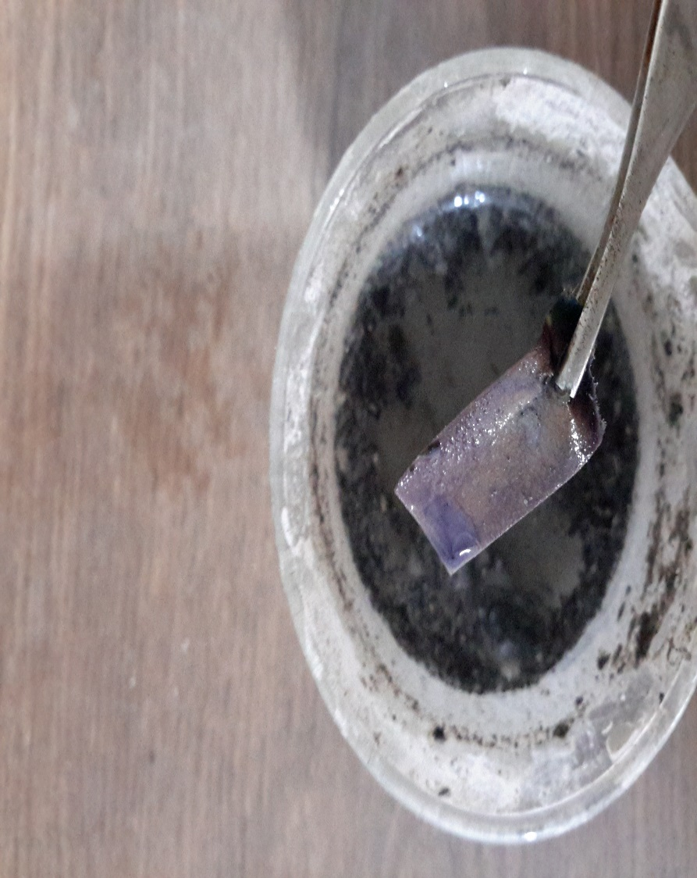
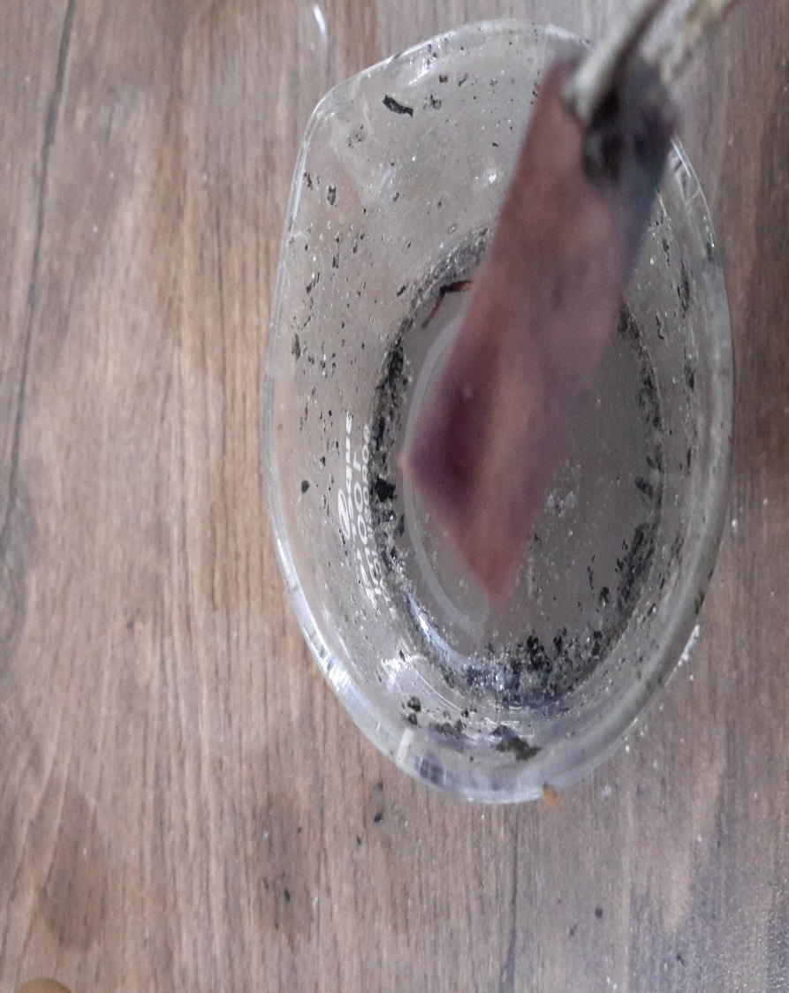
NaOH
ANGIOSPERM lye
GYMNOSPERM lye

Slide 14
Olive oil

Slide 15
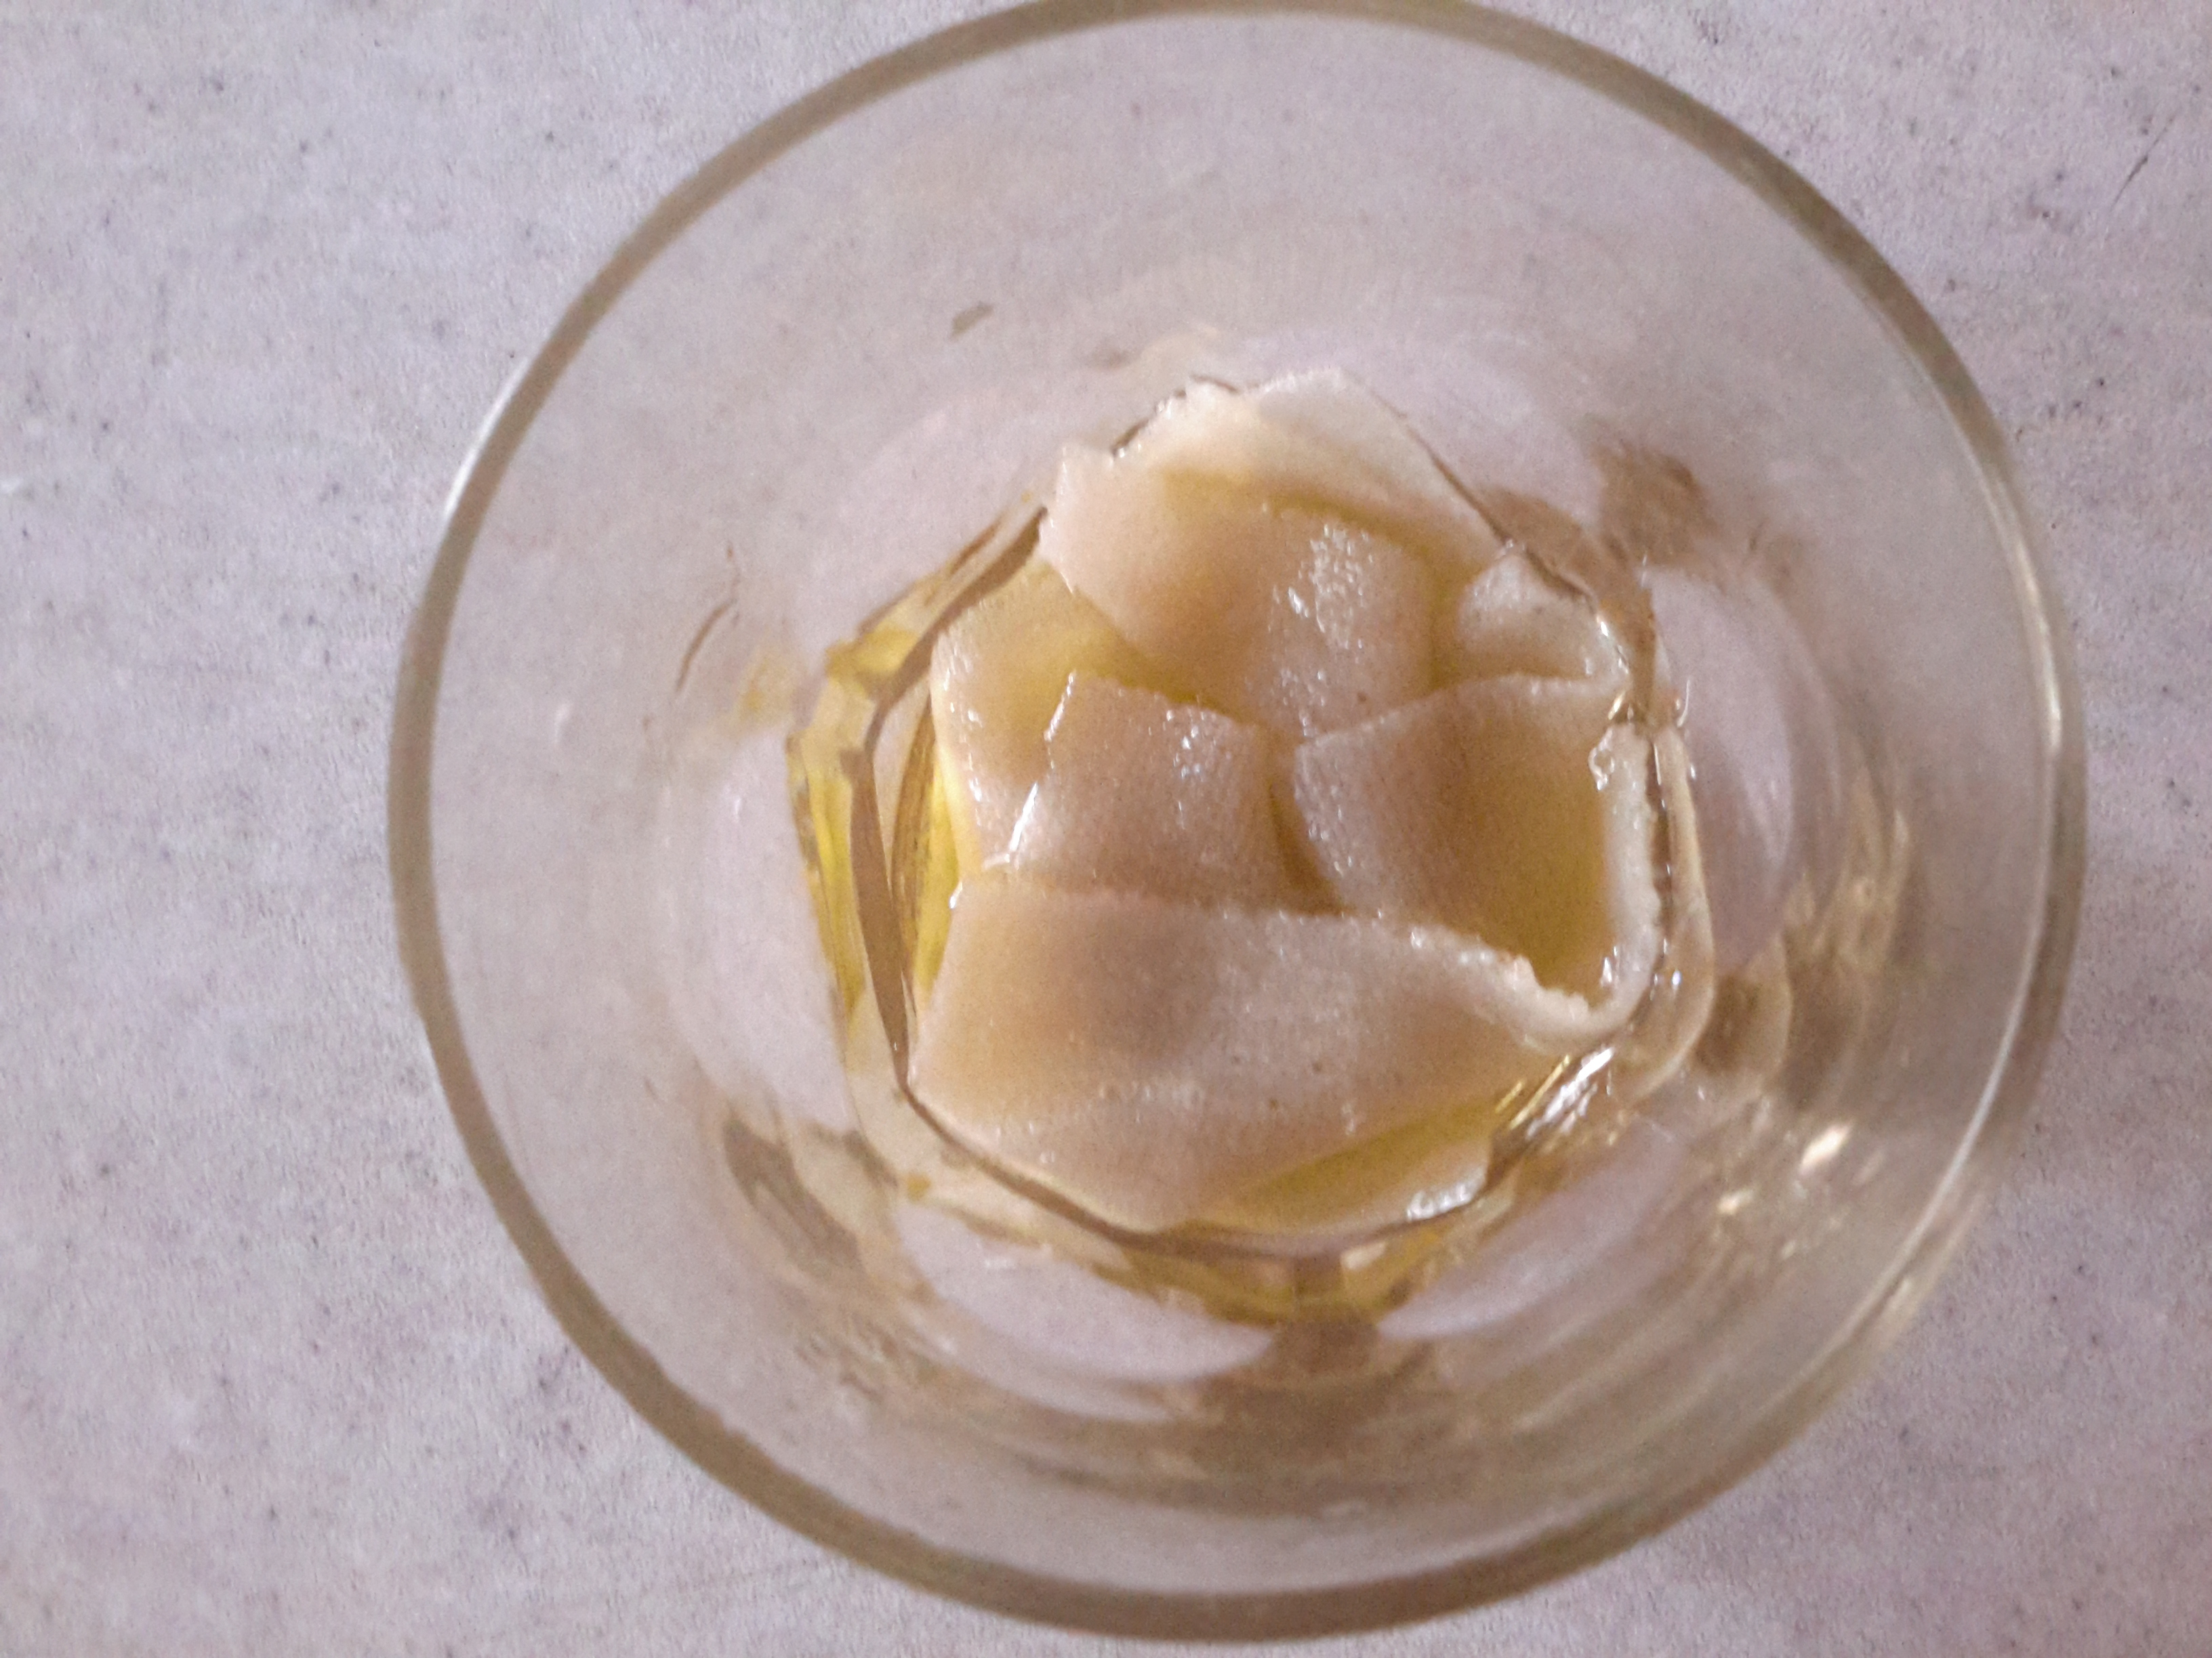
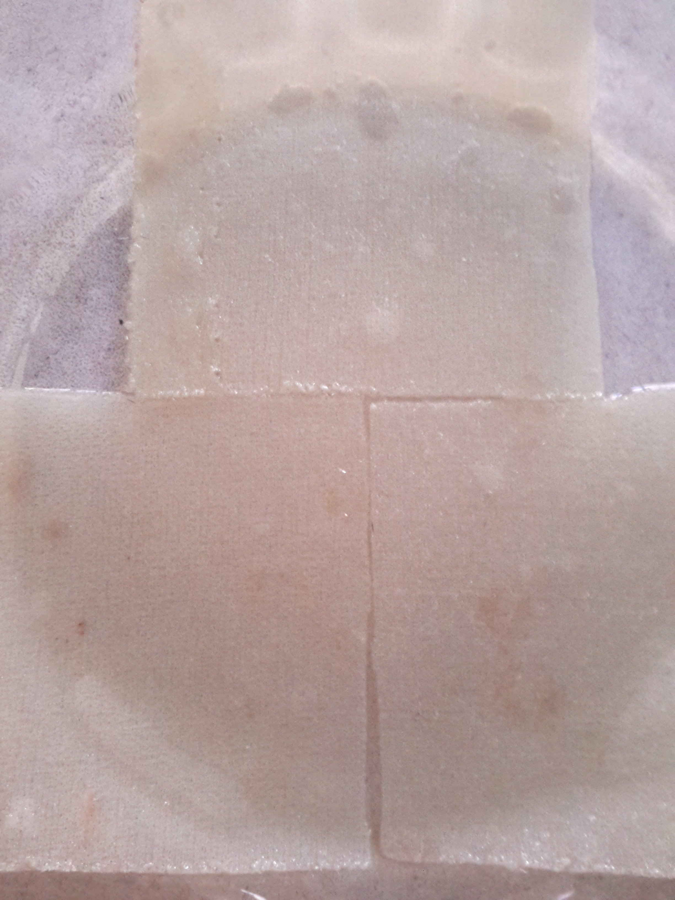

Slide 16
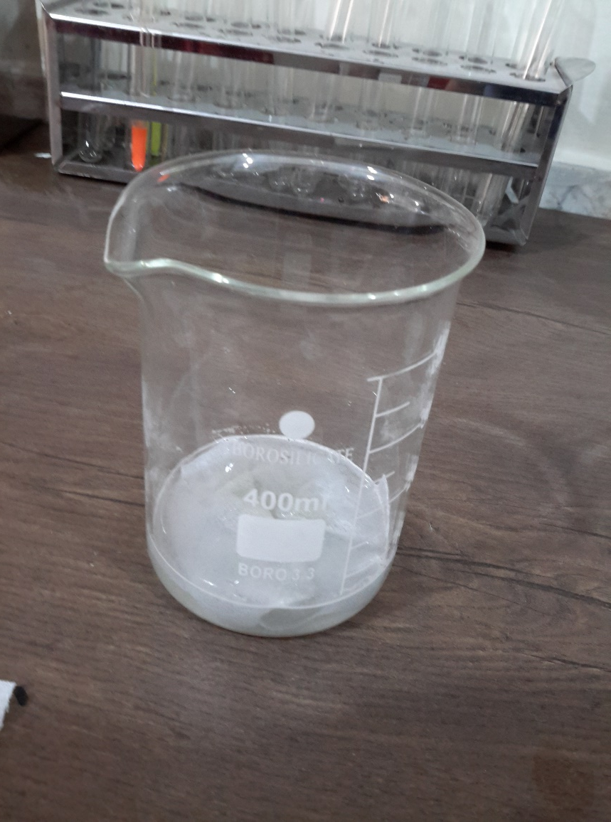
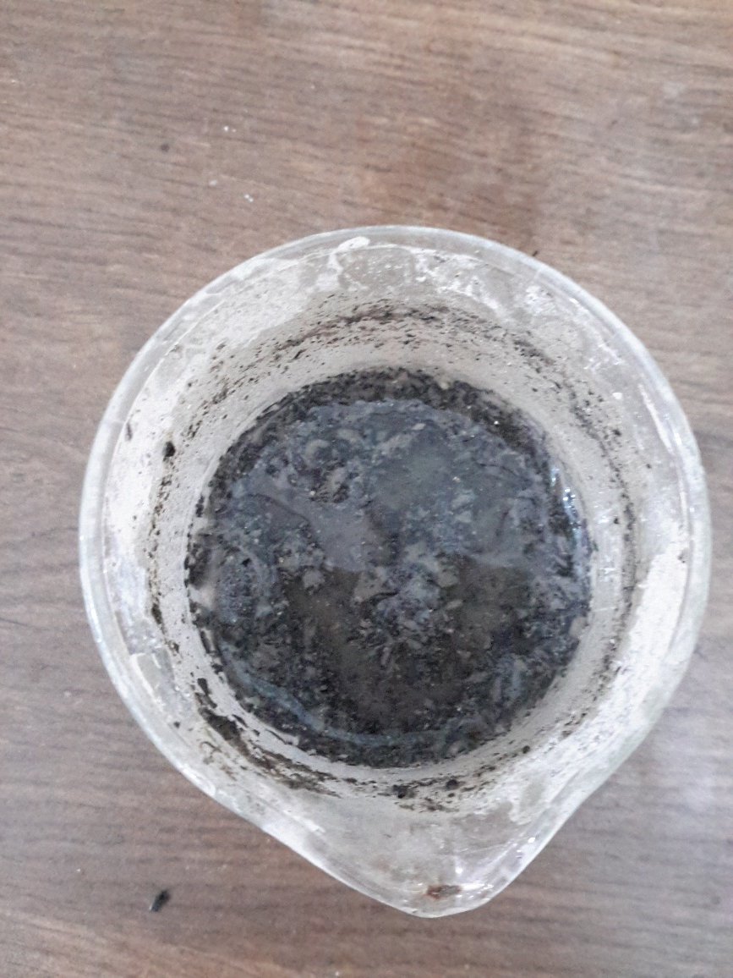
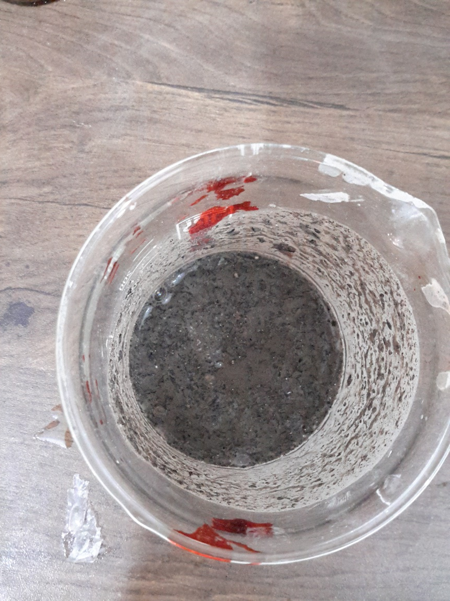
NaOH
ANGIOSPERM lye
GYMNOSPERM lye

Slide 17
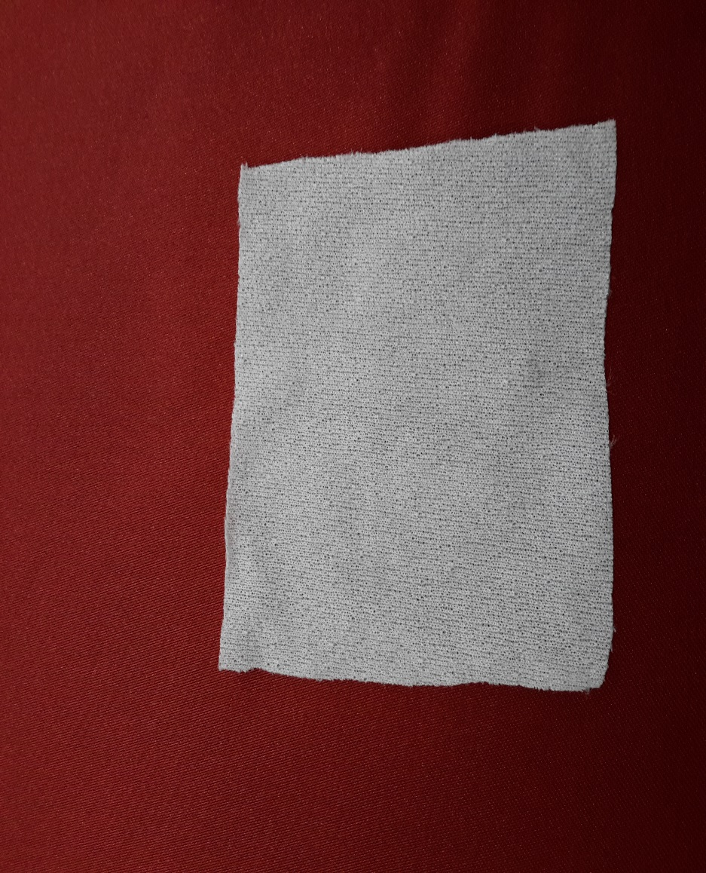
NaOH
ANGIOSPERM cinder
GYMNOSPERM cinder

Slide 18
Cherry juice

Slide 19
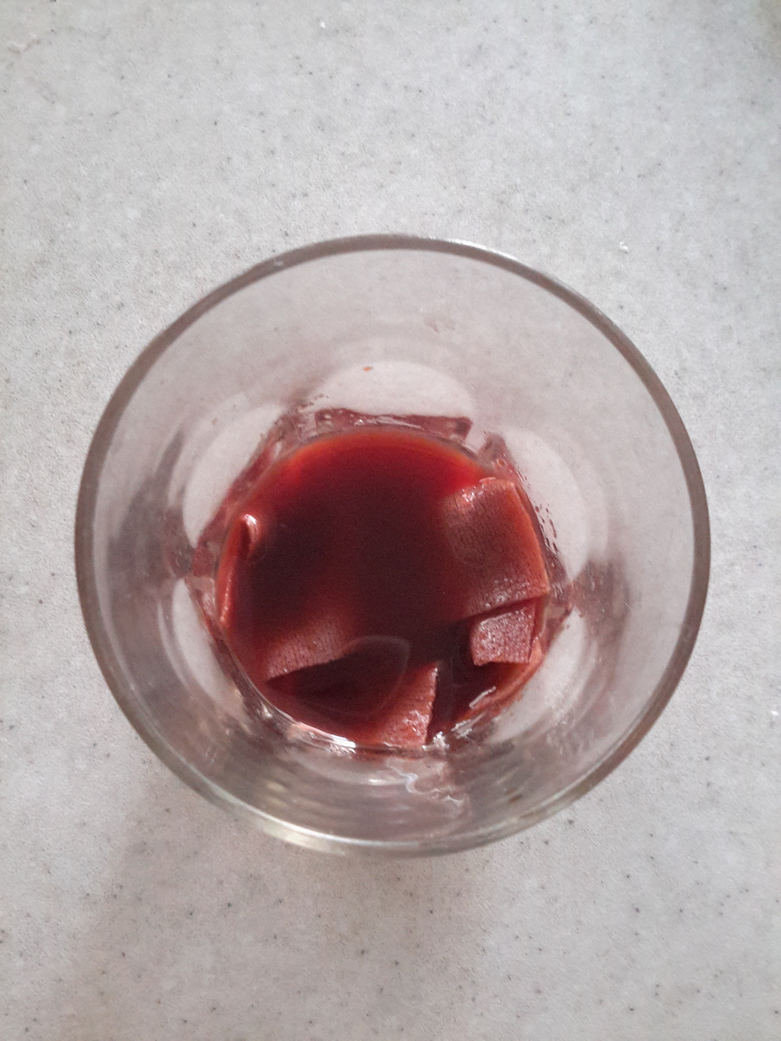
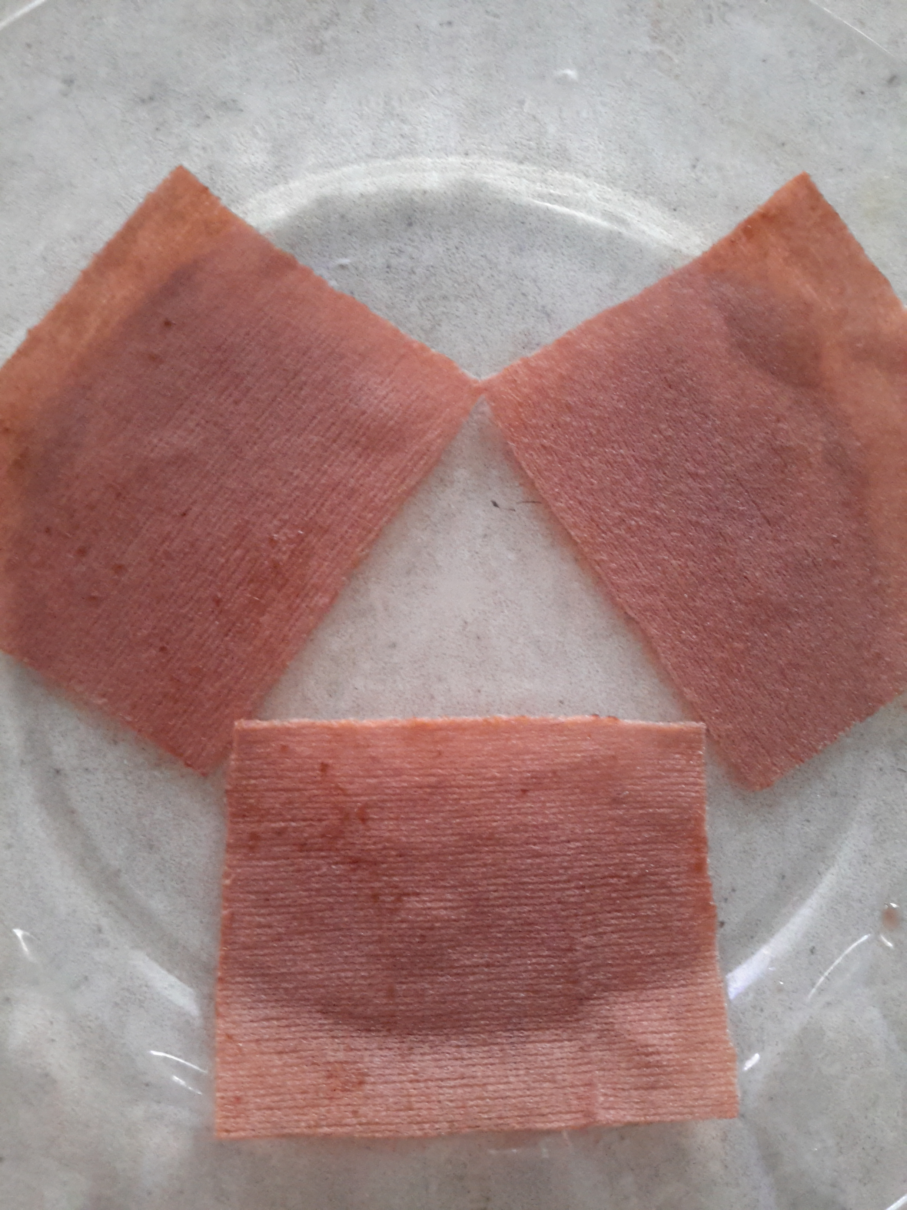

Slide 20
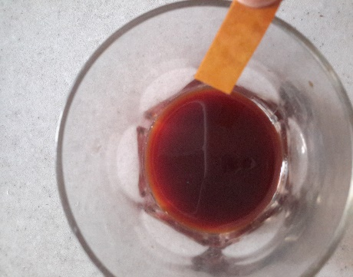
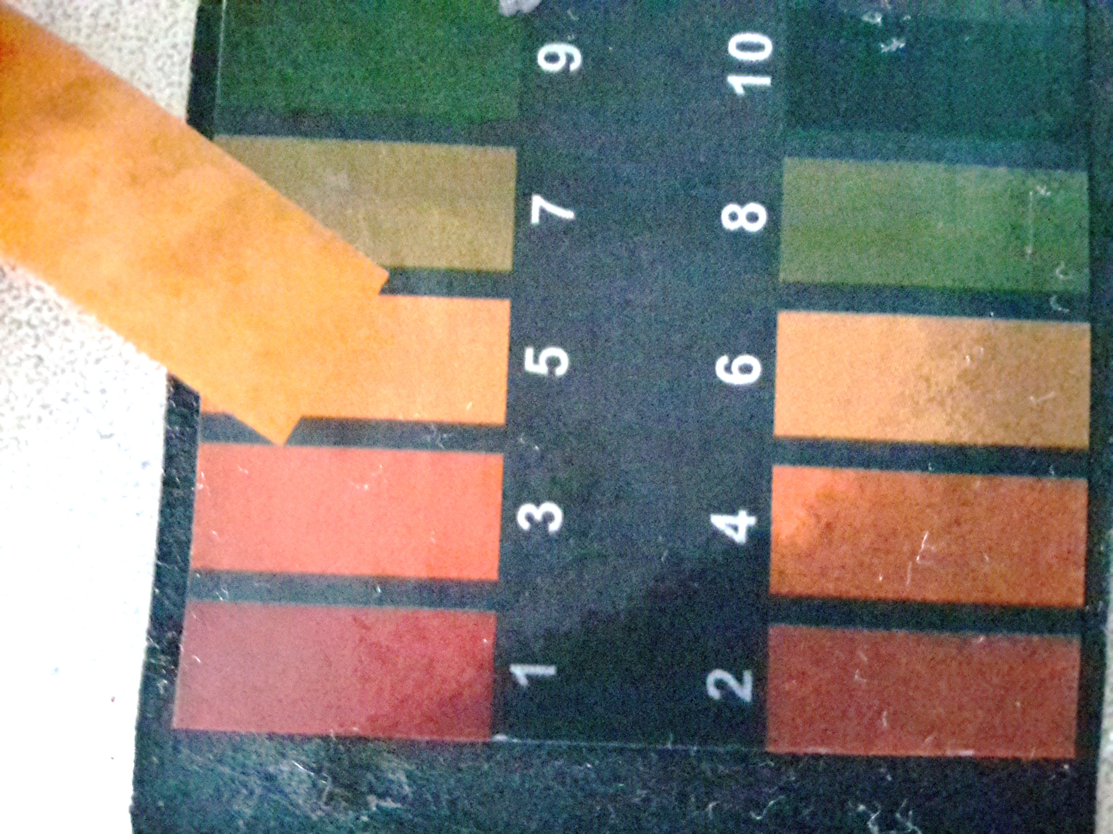
NaOH
ANGIOSPERM lye
GYMNOSPERM lye

Slide 21
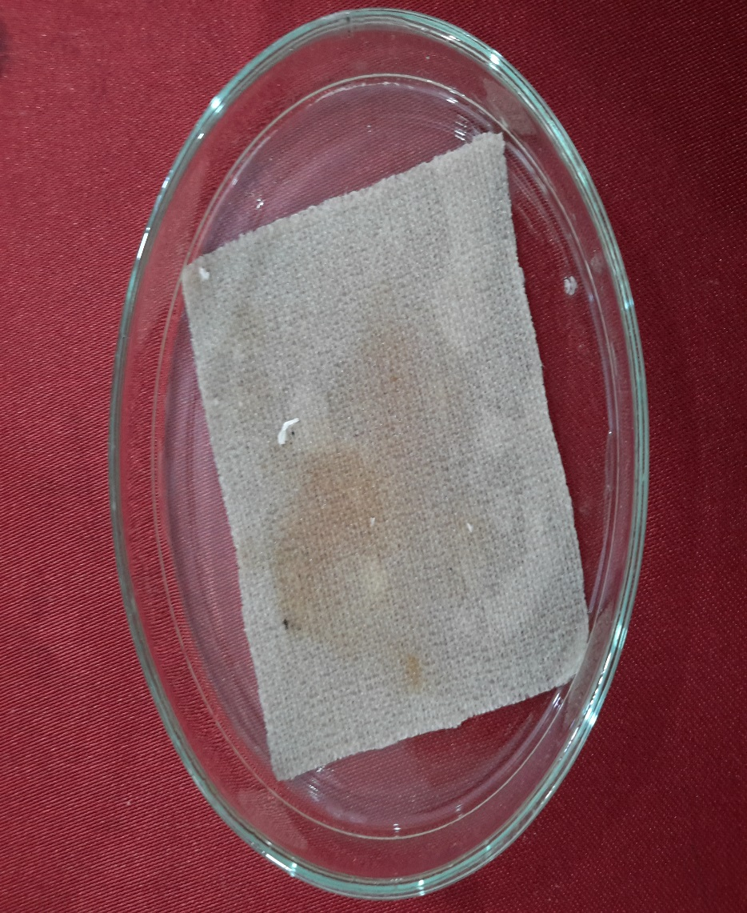
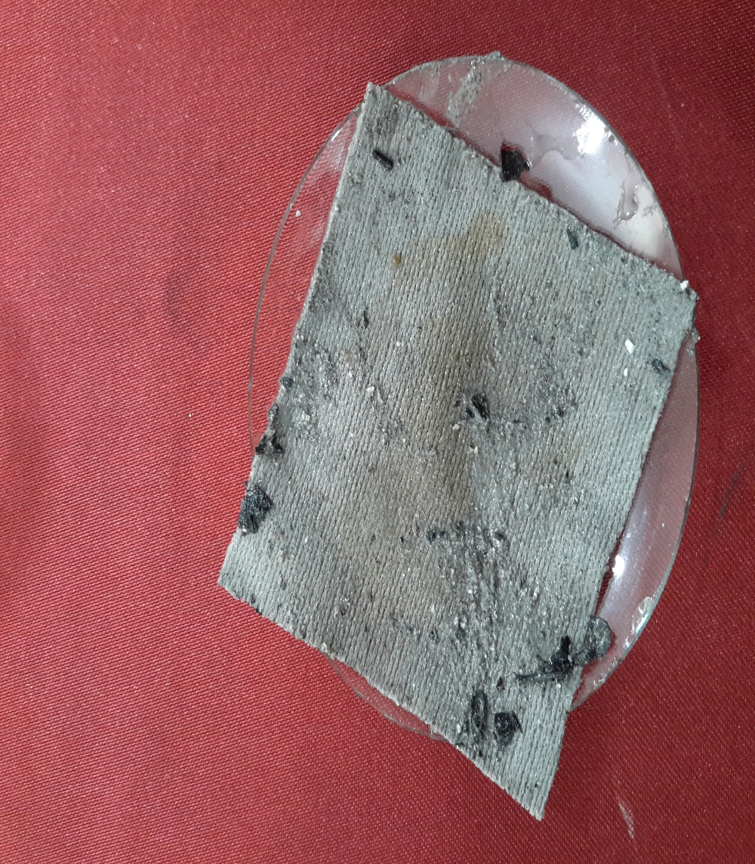
NaOH
ANGIOSPERM cinder
GYMNOSPERM cinder

Slide 22
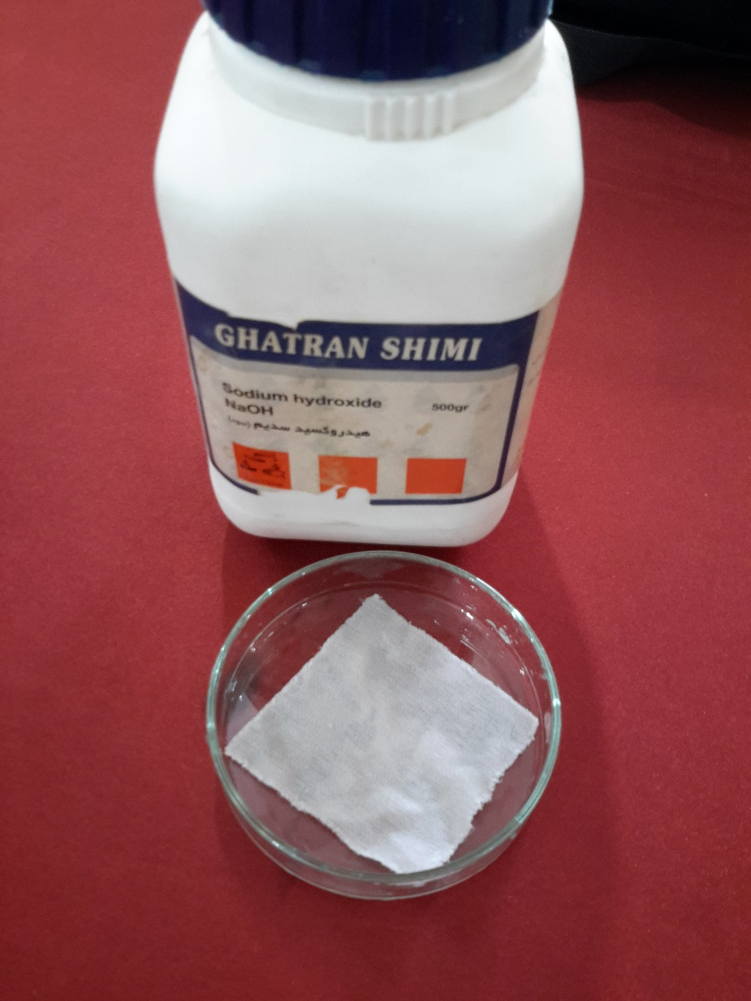
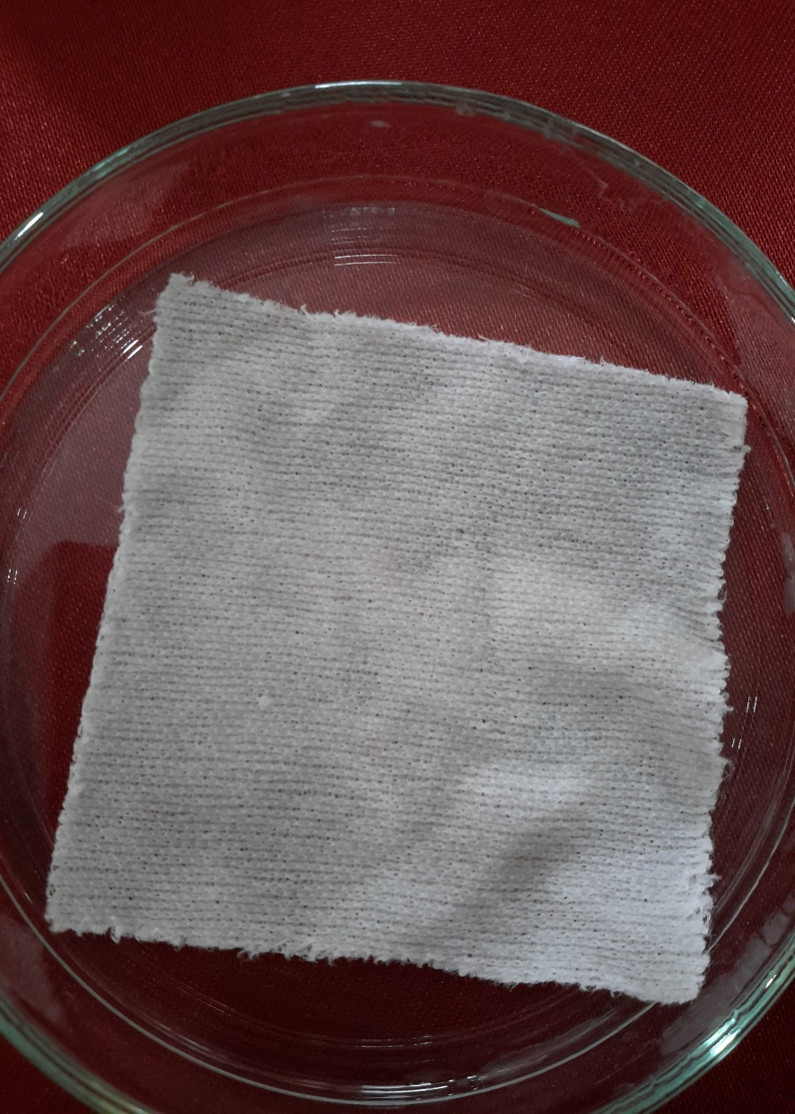
NaOH
ANGIOSPERM cinder
GYMNOSPERM cinder

Slide 23
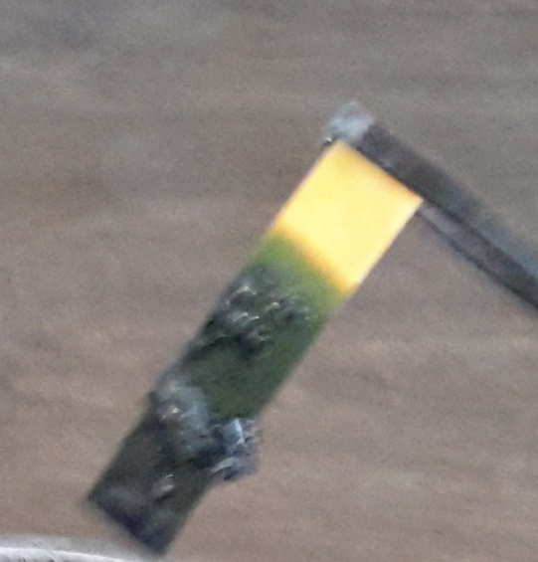

Slide 24
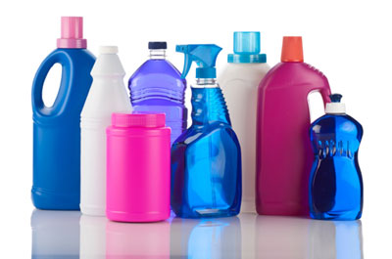
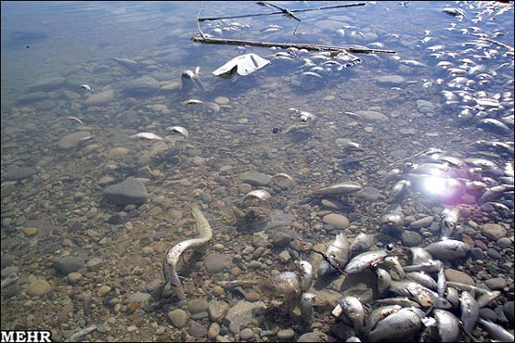
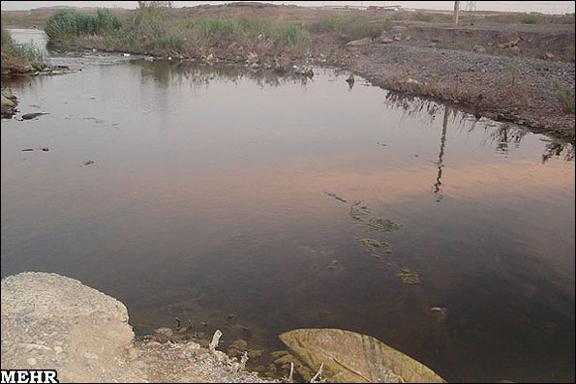
International Young Naturalist’s Tournament | 08/2016 | page 20
`

Slide 25
References:
www.tebyan.net
www.daneshname.rosh.ir
My own experiments

Slide 26
THANKS FOR YOUR ATENTION

