Slide 2
IYNT 2016
Iran-Shiraz
International Young Naturalist’s Tournament

Slide 3
Problem No.11.
Reporter: Zeinab Ammari Allahyari
Maple group

Slide 4
Corrosiveness of cola: It is often argued that cola is so corrosive that can be used to clean metal objects. Investigate this property of cola.

Slide 5
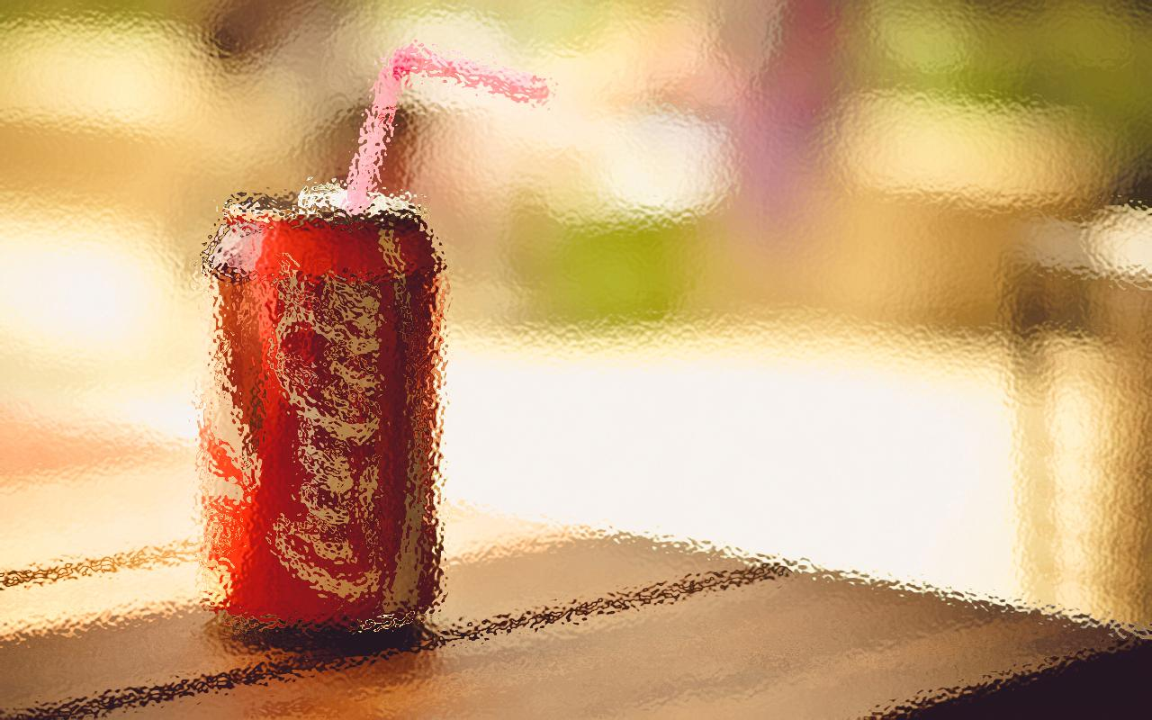
Cola
Corrosiveness of Cola
Experiment
(clean the metal with cola)

Slide 6
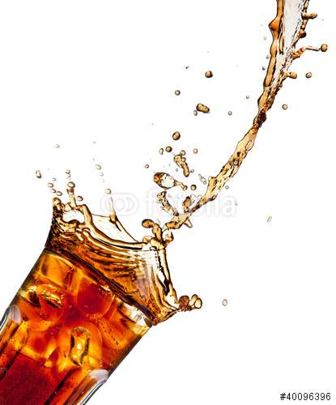
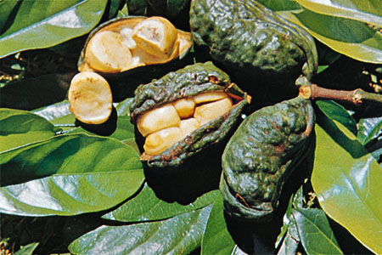
1. a brown carbonated drink that is flavored with an extract of cola nuts, or with a similar flavoring. 2. a small evergreen African tree which is cultivated in the tropics for its seeds (cola nuts).
Cola

Slide 7
One of the active ingredients in Coca Cola is phosphoric acid. It has a pH of 2.8.

Slide 8
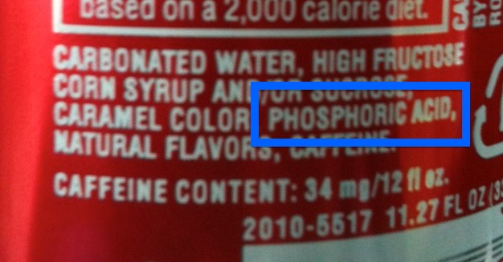

Slide 9
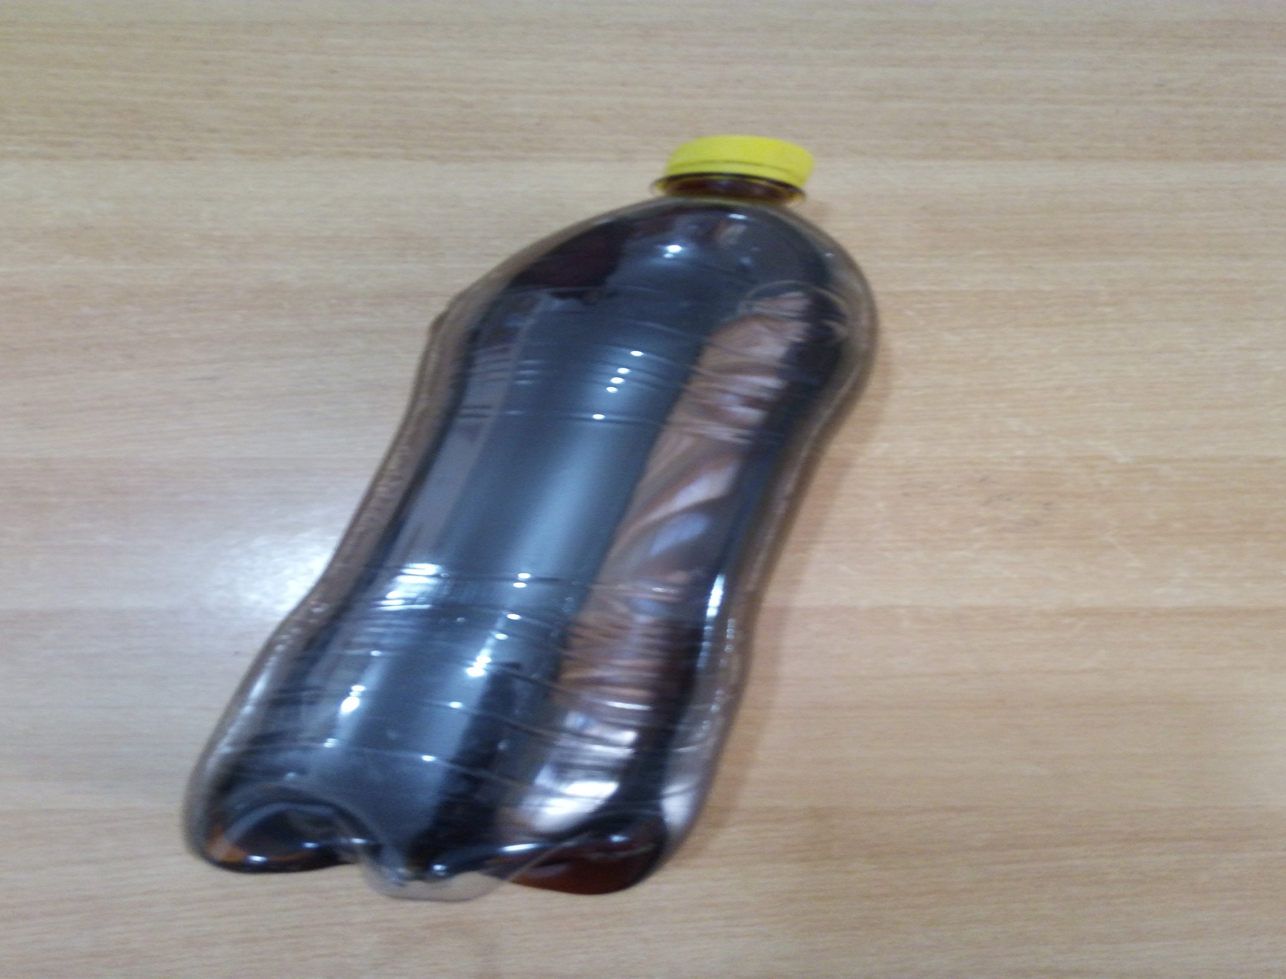
Experiment No.1: cola cleans the metal objects!

Slide 10
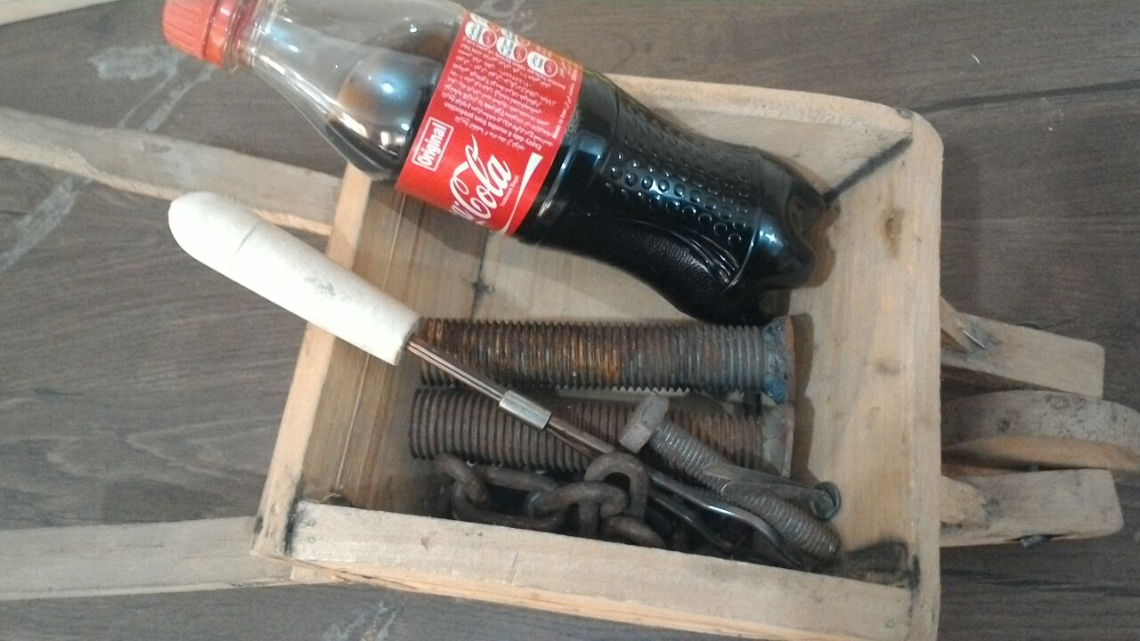
What do we need?

Slide 11
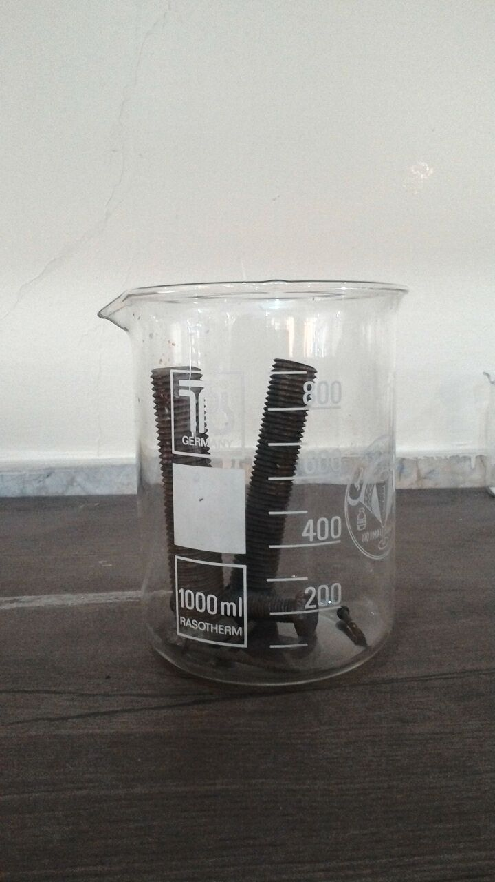
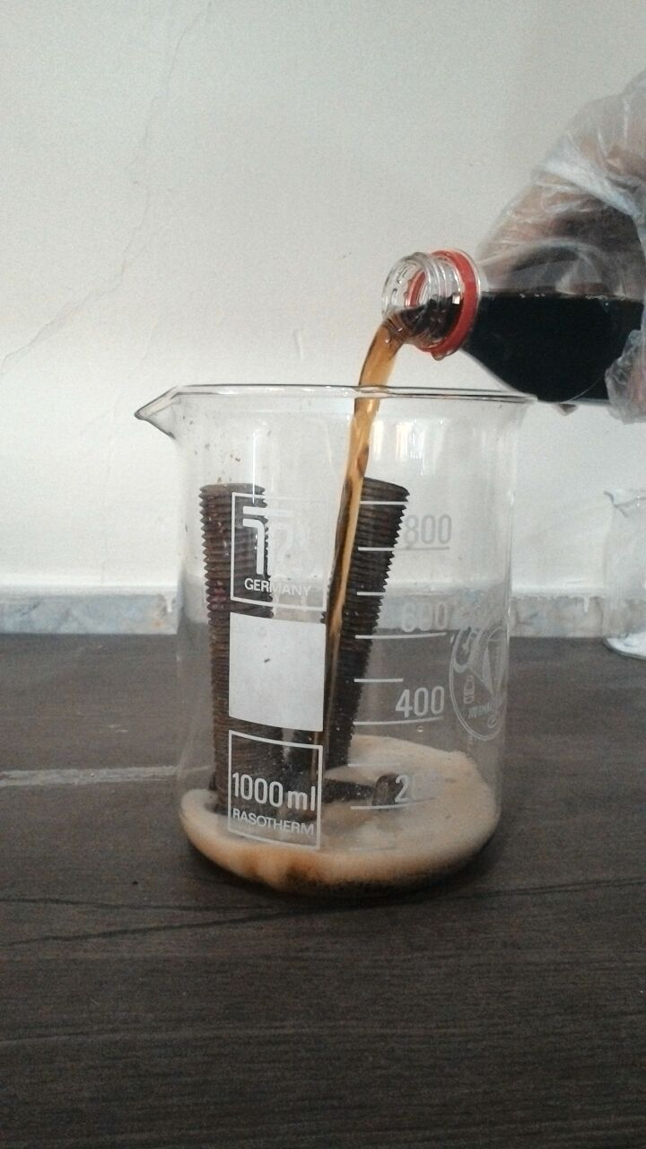
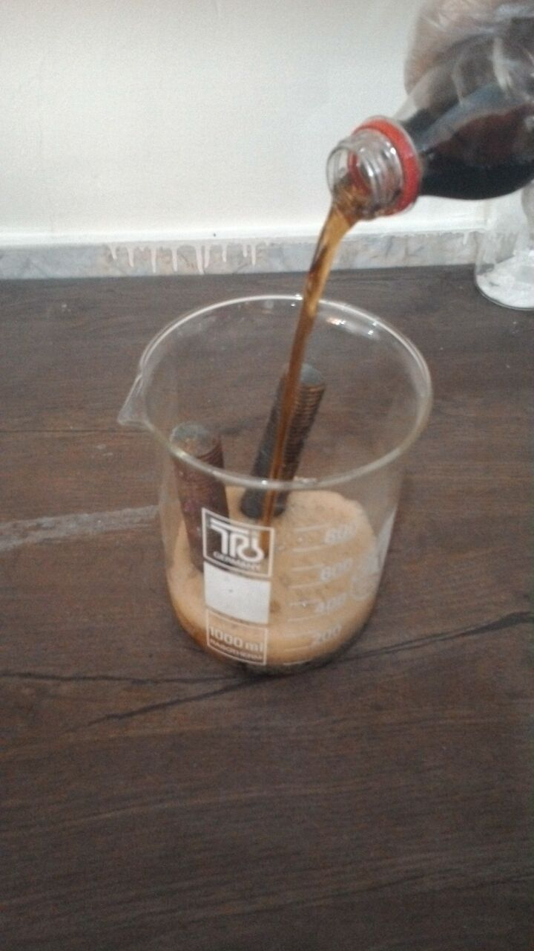
1
2
3
After 2 hours, I washed the metals & saw they get cleaned!!!

Slide 12
Experiment No.2: cola metal cleaners!

Slide 13
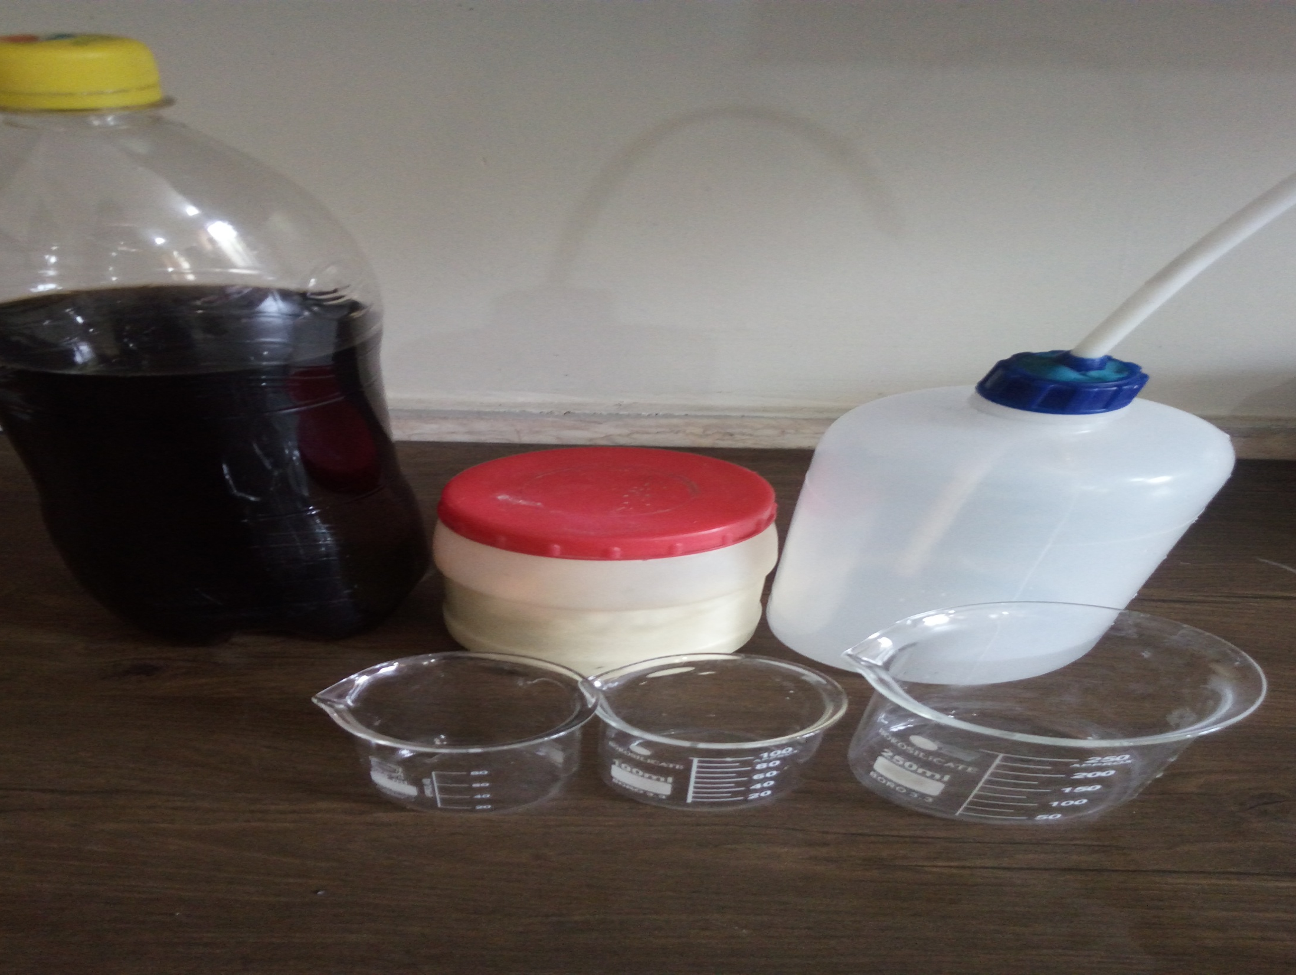
What we need?

Slide 14
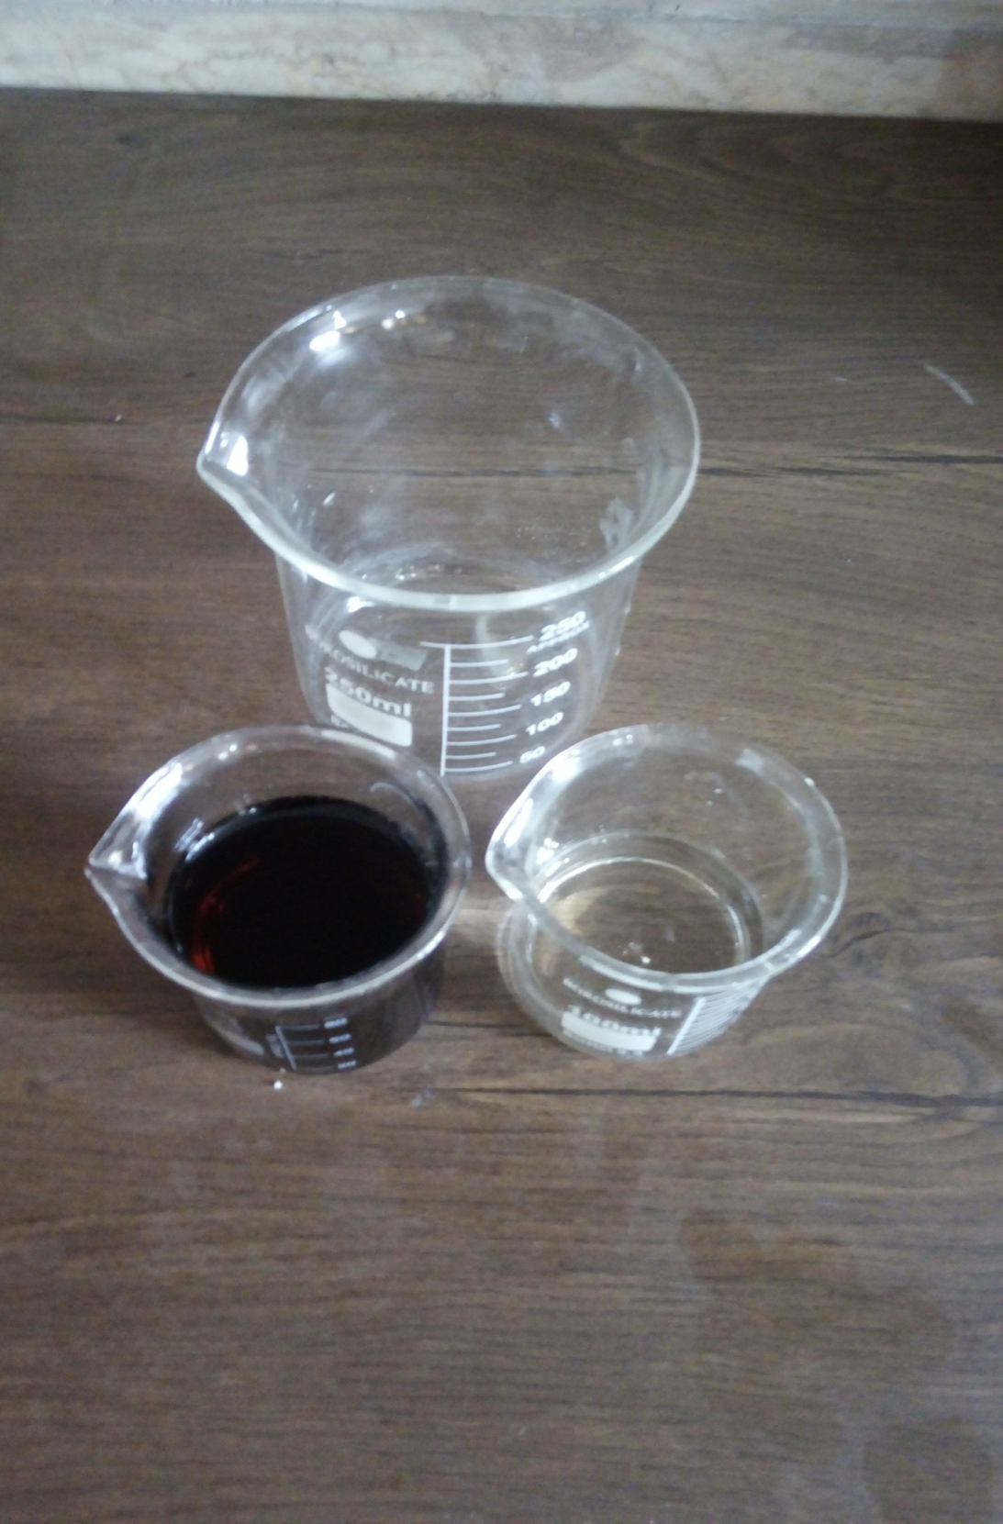
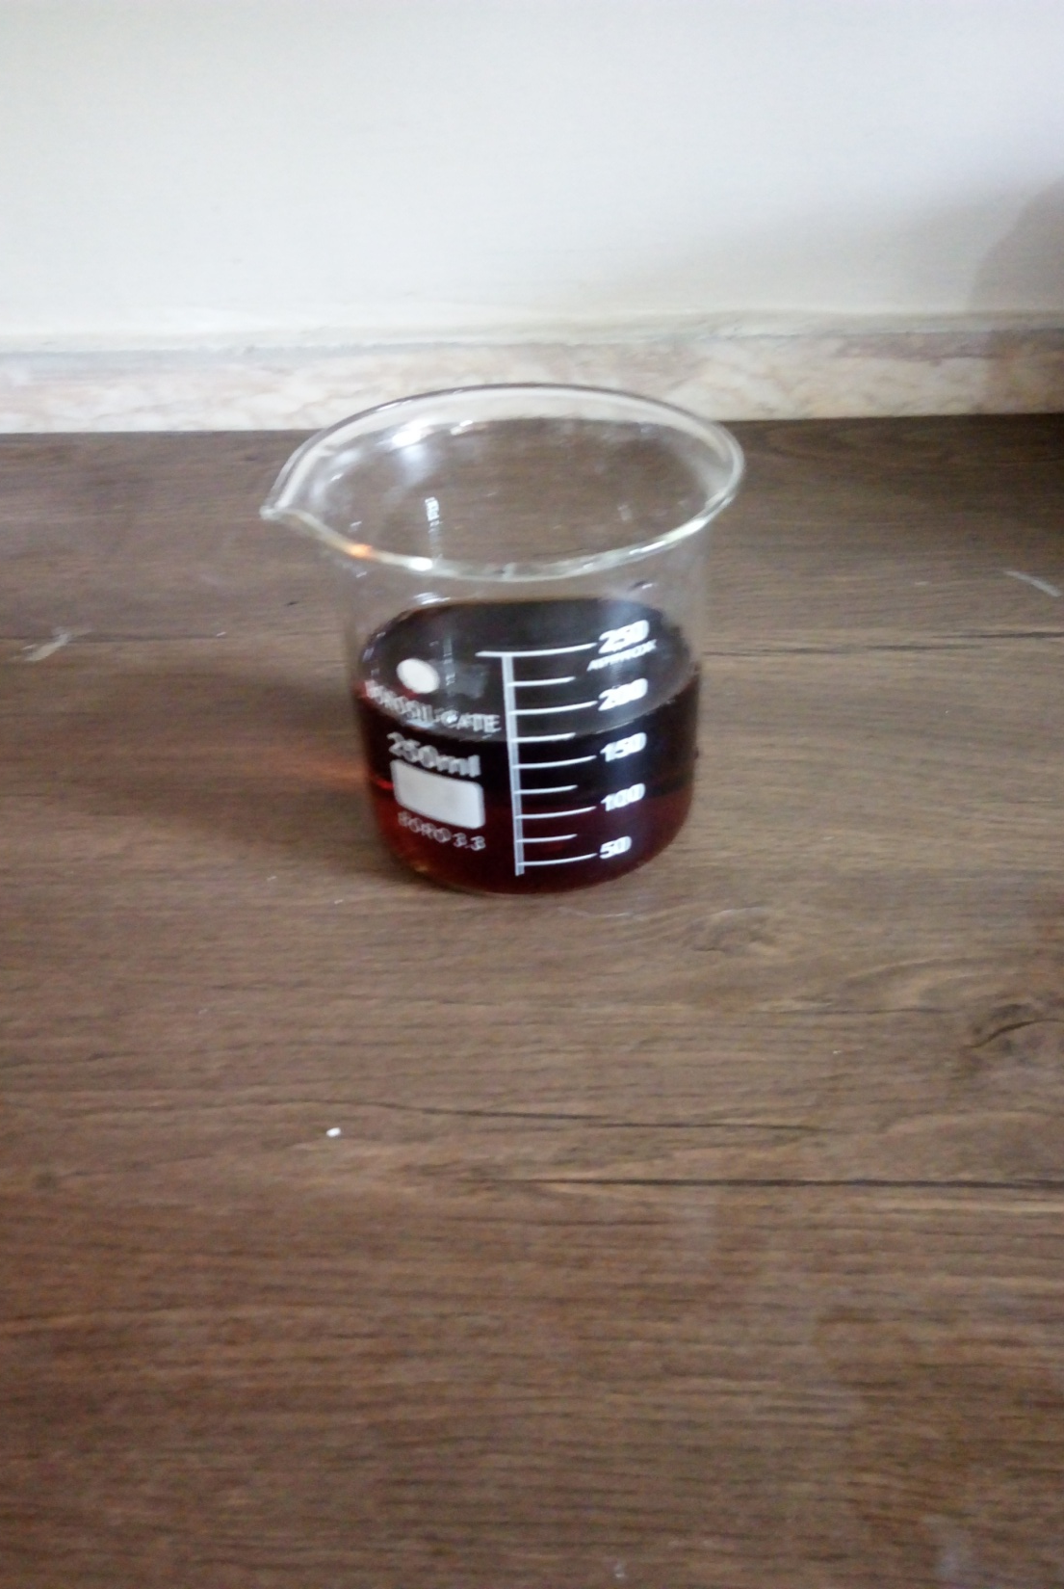
80cc of cola
40cc of citric acid

Slide 15
cola
Pour water
Citric acid
Cola cleaner solution

Slide 16
Experiment No.3: cola metal cleaners!

Slide 17
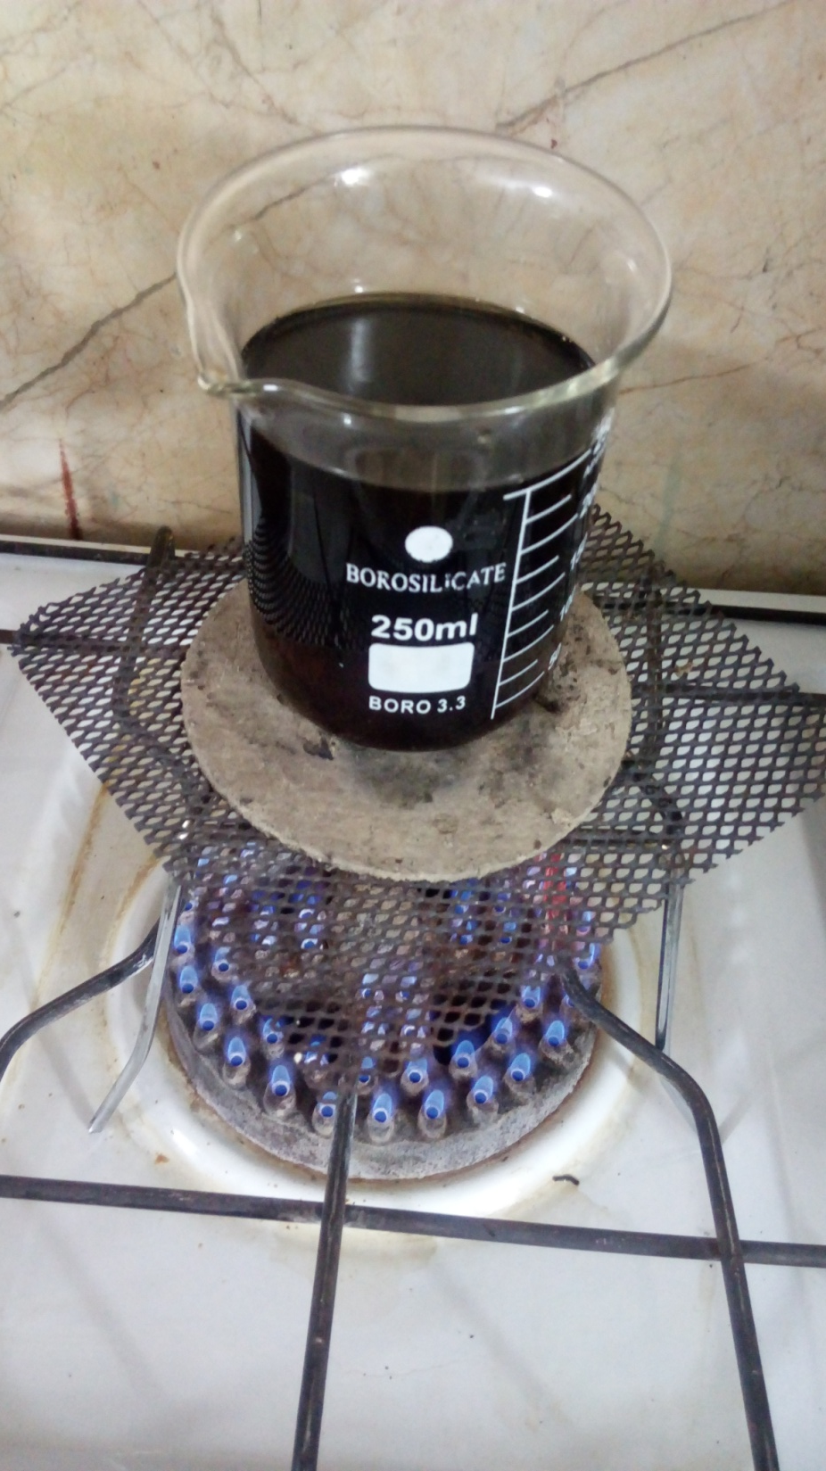
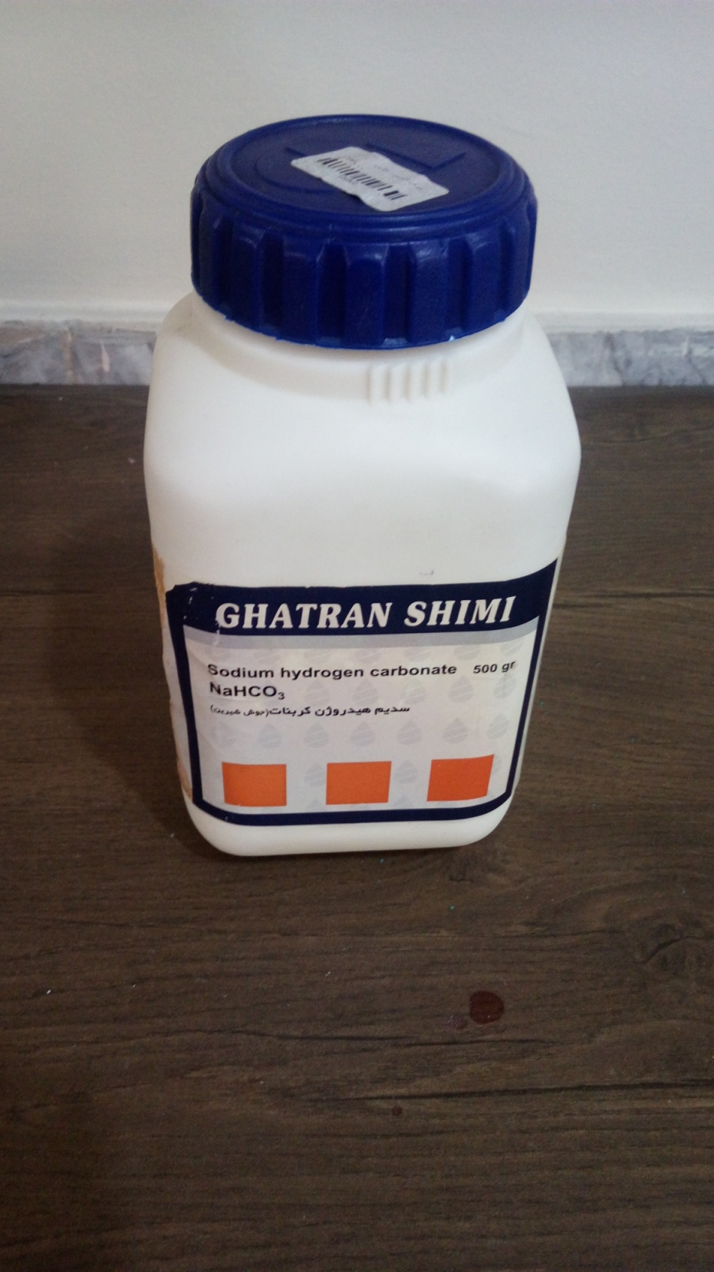

Slide 18
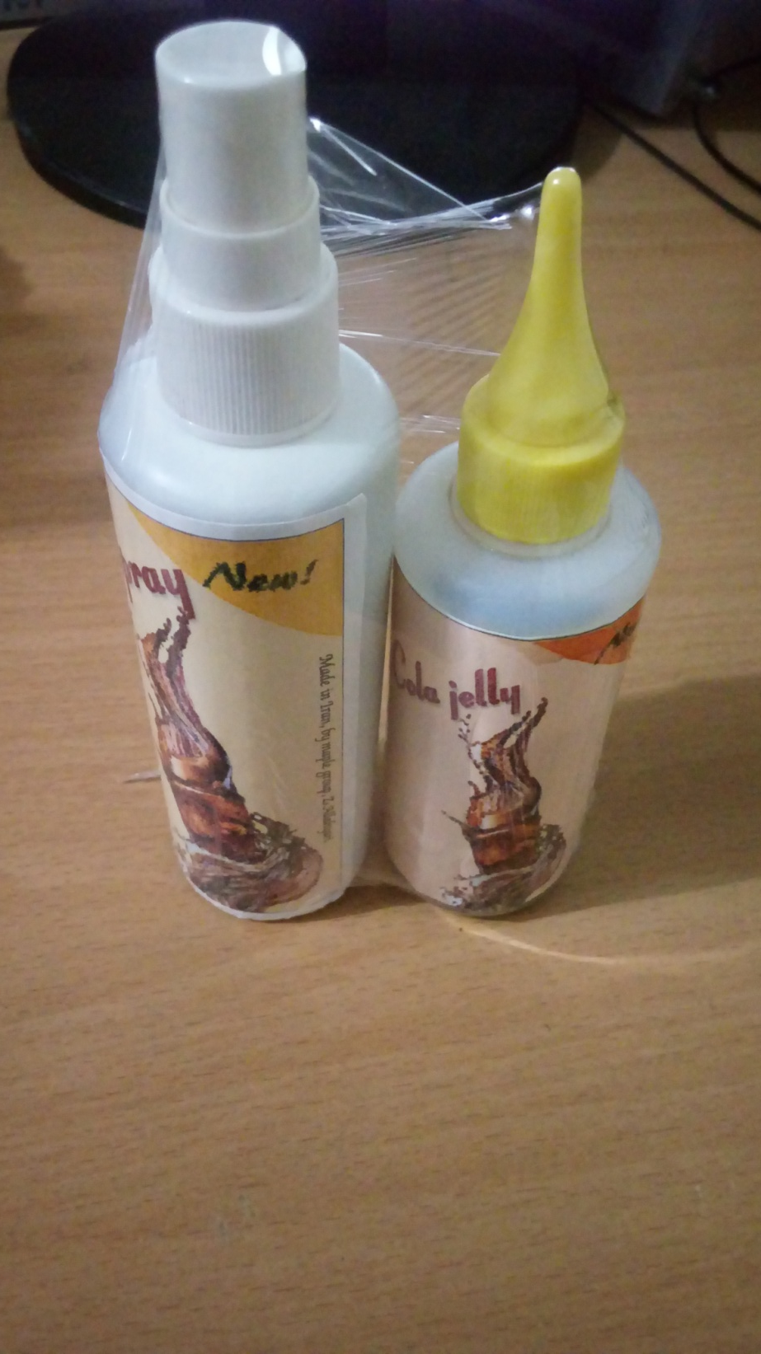
Wow!!!

Slide 19
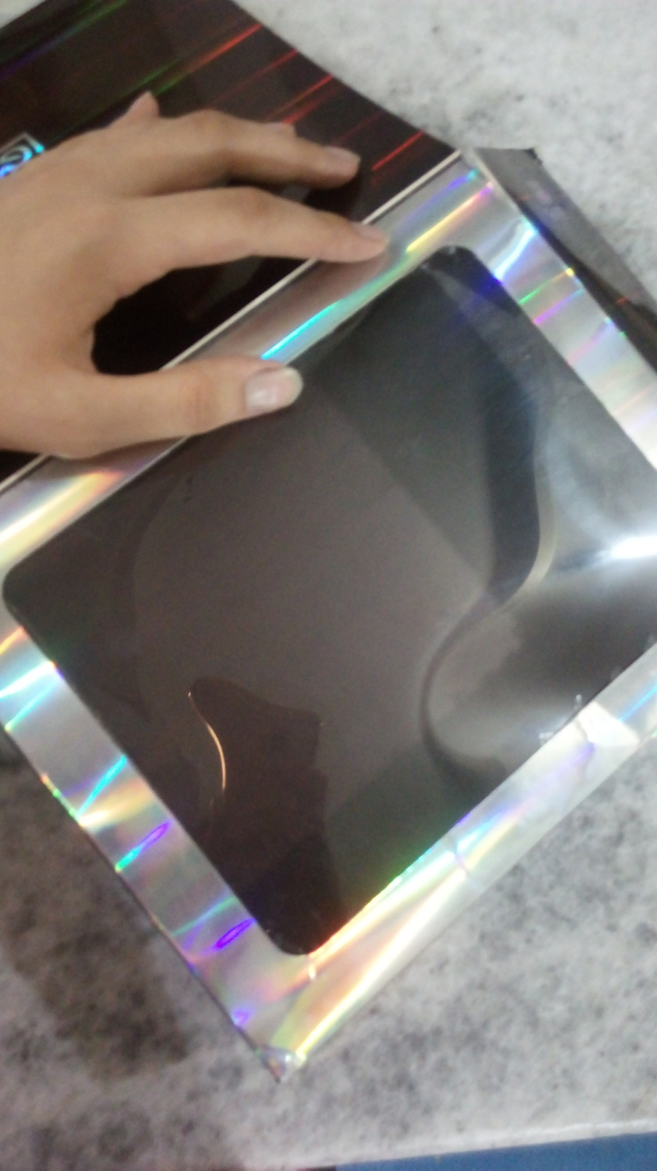
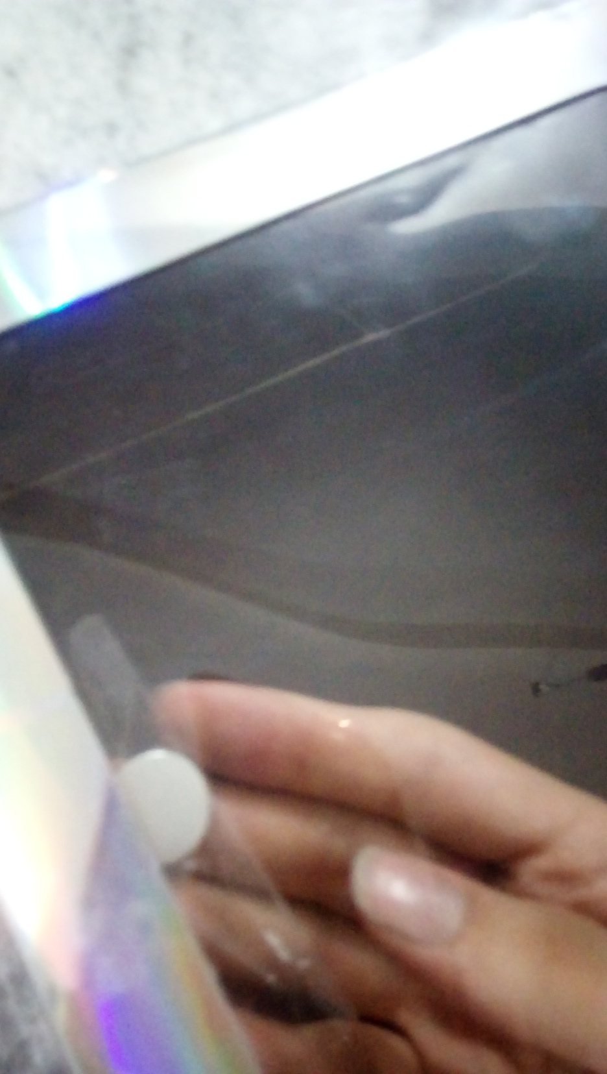

Slide 20
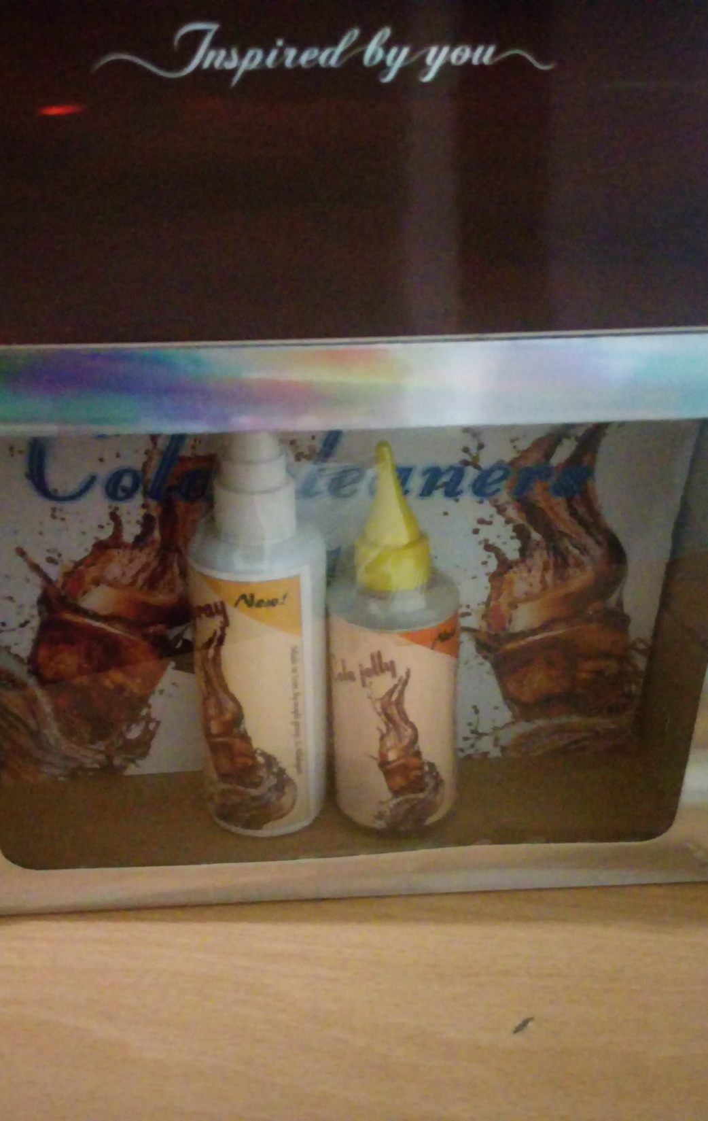
What do you thing about them?

Slide 21
Sources:
http://greencleaningproductsllc.com
http://www.wikihow.com
http://www.vam.ac.uk

