Slide 2
IYNT 2016
Iran-Shiraz
International Young Naturalist’s Tournament

Slide 3
#problem number 15 mountain speak
Reporter : Mahdiyeh Shahrabi
Maple group

Slide 4
15. Mountain Peaks
What methods are used to determine the elevation of the World’s highest mountains? Suggest your own experimental method and determine the height of a mountain or a hill of your choice.

Slide 5
Method
professional
Altimetry
SAR Altimetry
experimental
Temperature of air
Theodolite
Al-Biruni&amp;apos;sClassic Experiment.
Using a Clinometer
Shadow of the mountain

Slide 6
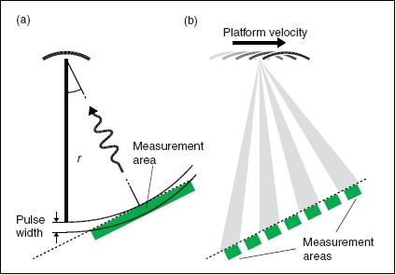
Satellite altimetry
Function

Slide 7
SAR Altimetry (synthetic aperture radar)

Slide 8
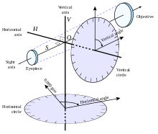
Theodolite

Slide 9
Temperature of air
For example if the air temperature at top of mountain is -10 degrees and 20 degrees in the hillside , altitude mountain will be 5000 meters

Slide 10
Angle of elevation
Al-Biruni&amp;apos;sClassic Experiment
Using a Clinometer

Slide 11
An astrolabe
Knowledge of trigonometry
Angle of elevation

Slide 12
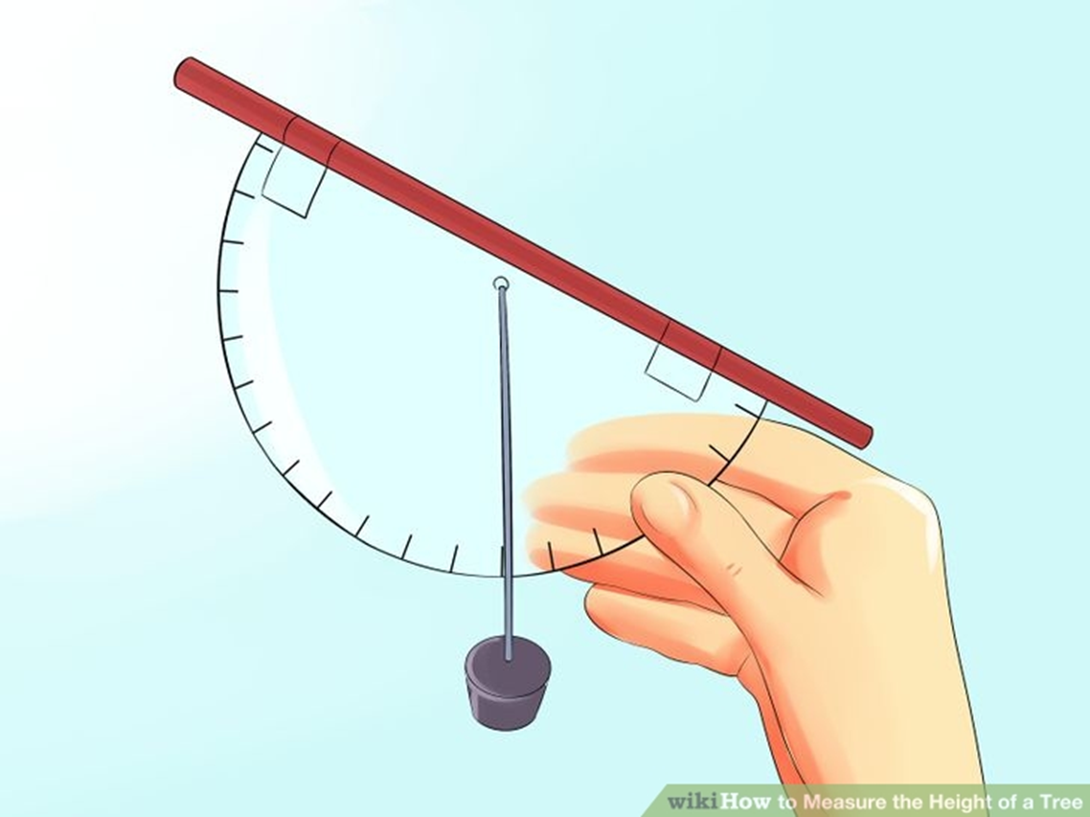
An astrolabe
Clinometer

Slide 13
•Angle of elevation of the mountain top at two different points lying on a straight line were measured using an astrolabe.
The third being the distance between these two points.
Al-Biruni's Classic Experiment

Slide 14
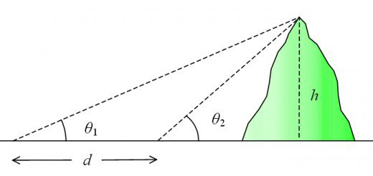

Slide 15
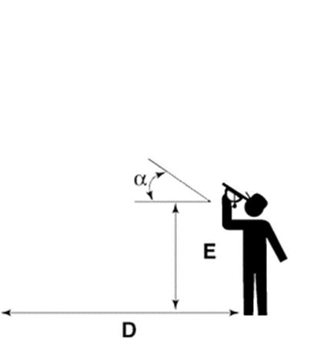
Elevation of mountain=
height of Clinometer + distance to mountain tan of angle
H=
E+D Tan(a)

Slide 18
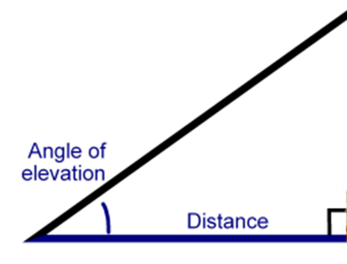
Use knowledge of trigonometry
sine

Slide 19
sine
the trigonometric function that is equal to the ratio of the side opposite a given angle (in a right triangle) to the hypotenuse

