Slide 2
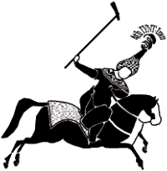
IYNT 2016
Iran-Shiraz
International Young Naturalist’s Tournament

Slide 3
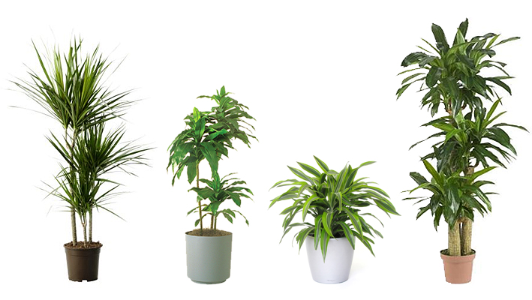
Problem No.7.
Reporter: Zeinab Ammari Allahyari
Maple group

Slide 4
7. Plants in Motion
Various plants can turn in response to the position of the sun or other light sources. Investigate this motion experimentally and theoretically.

Slide 5
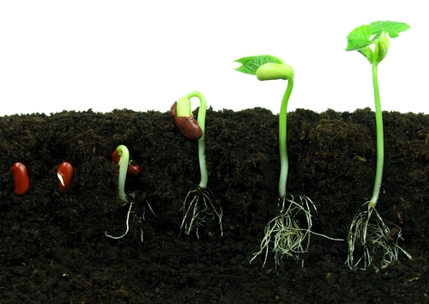
Grows out
Grows up
Grow down

Slide 6
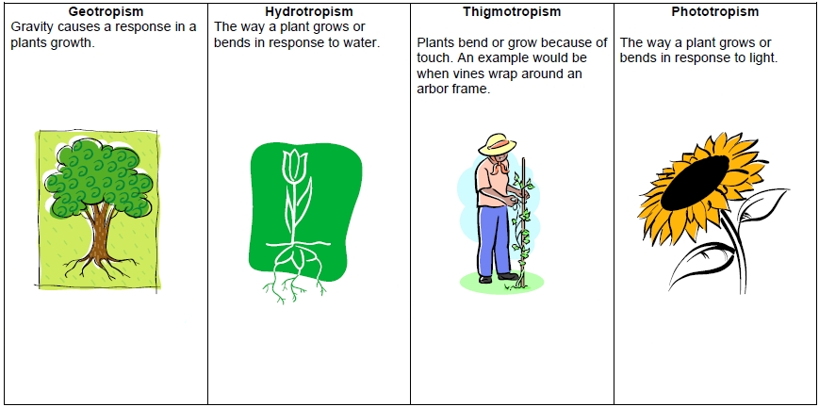
What’s tropisms?

Slide 7
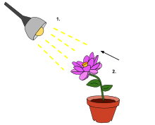
What’s phototropism?
Phototropism is a curvature in relation to directional light.

Slide 8
positive phototropism
negative phototropism

Slide 9
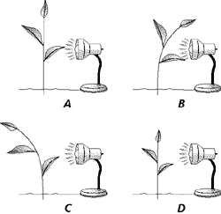
positive phototropism
negative
phototropism

Slide 10
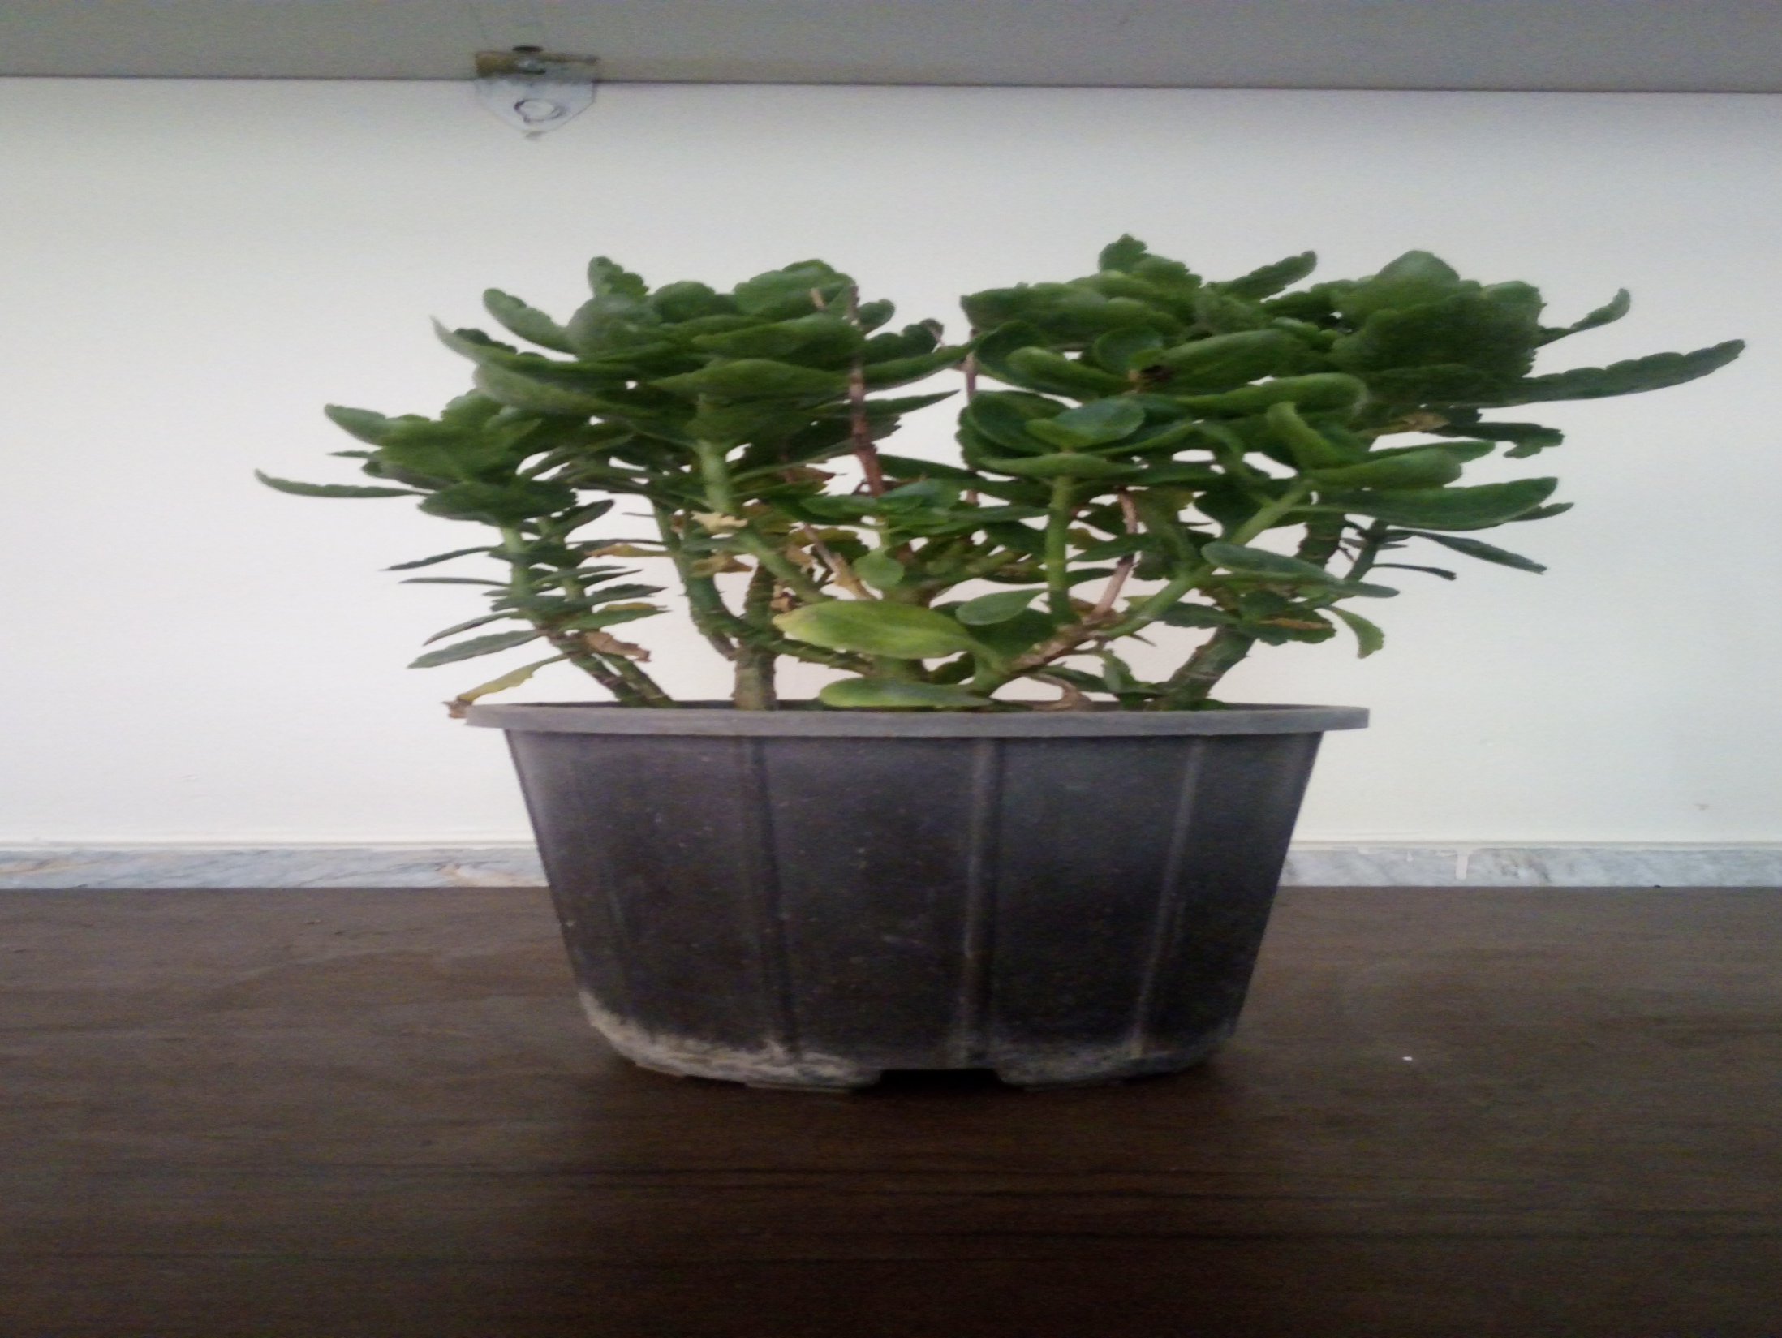
Experiment No.1: positive phototropism

Slide 11
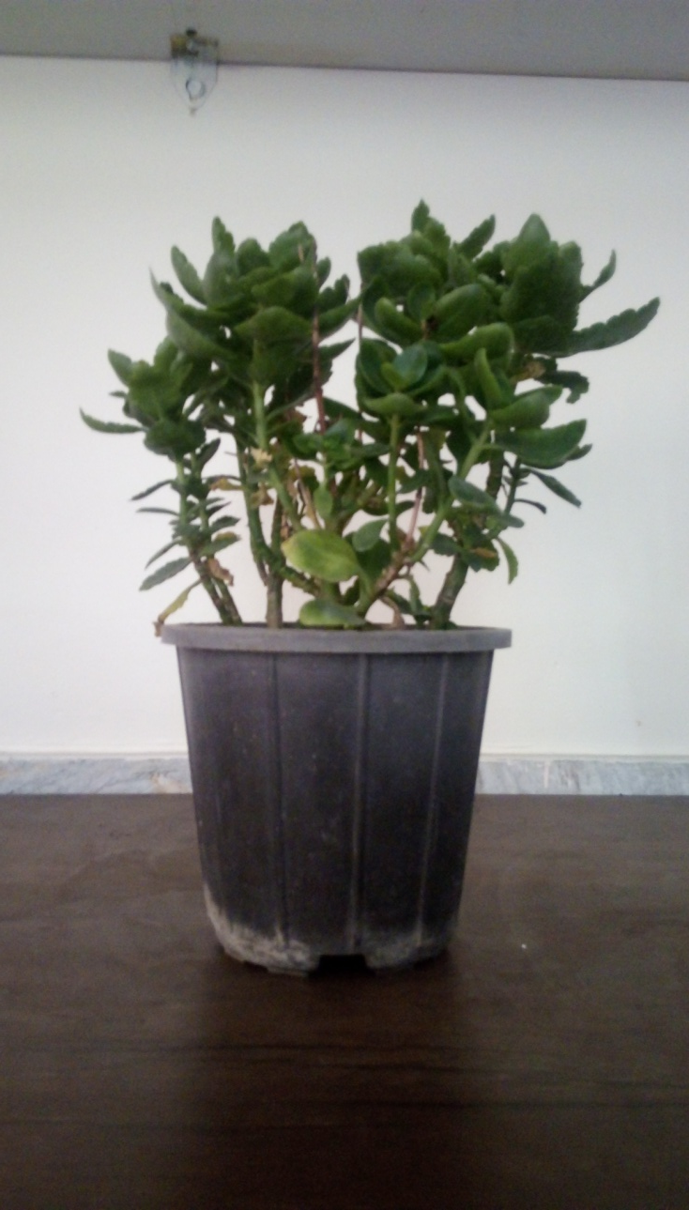
Step1:
1
2
3

Slide 12
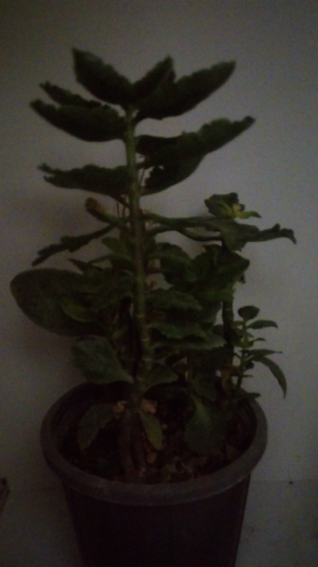
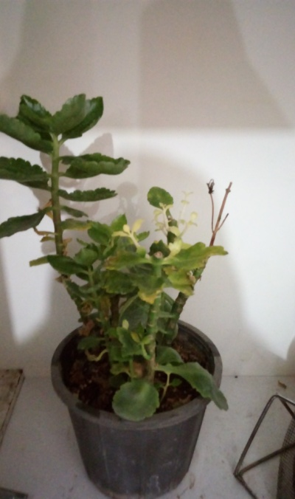
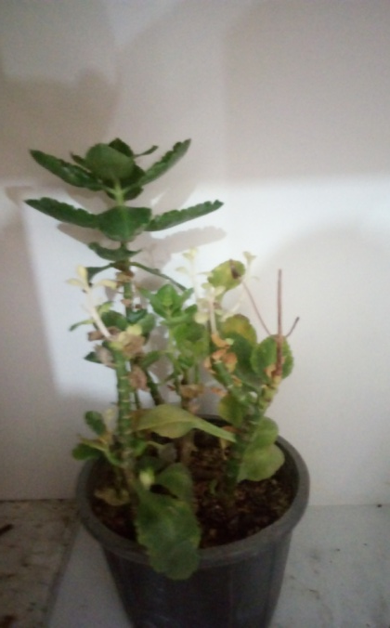
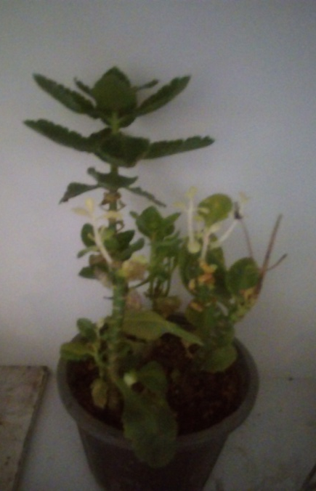
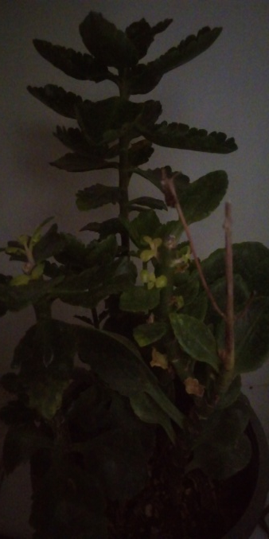
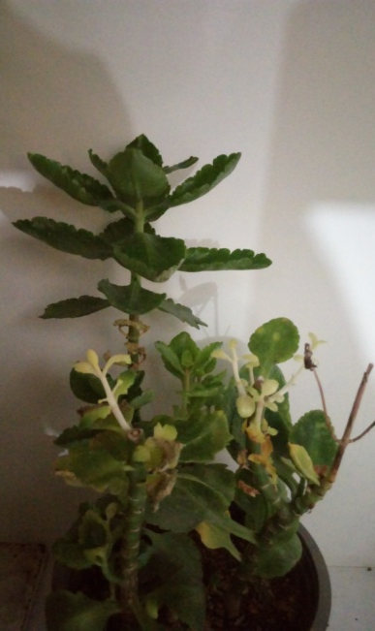
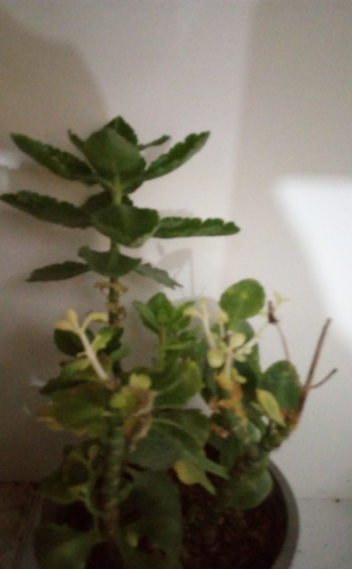
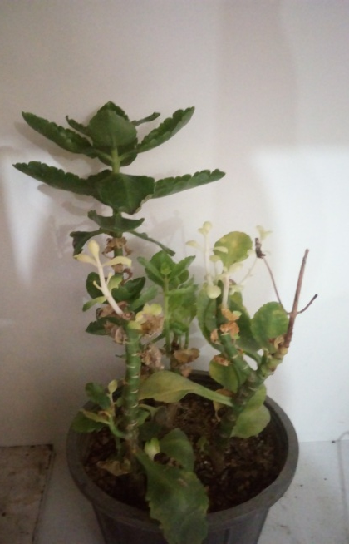
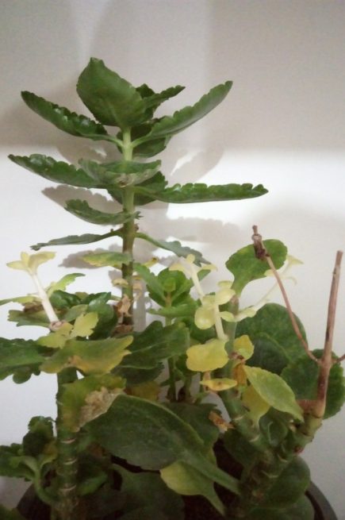
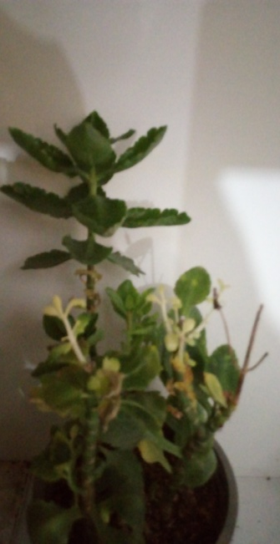
Step2:
Days No.1-5
Days No.5-10

Slide 13
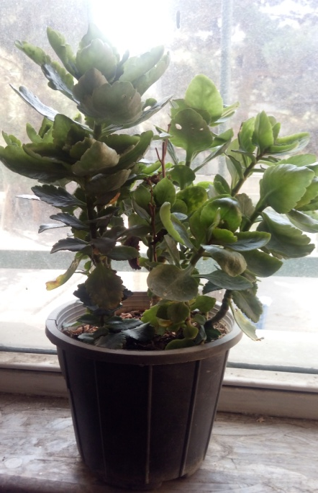
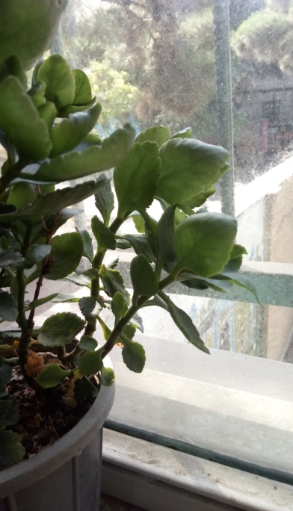
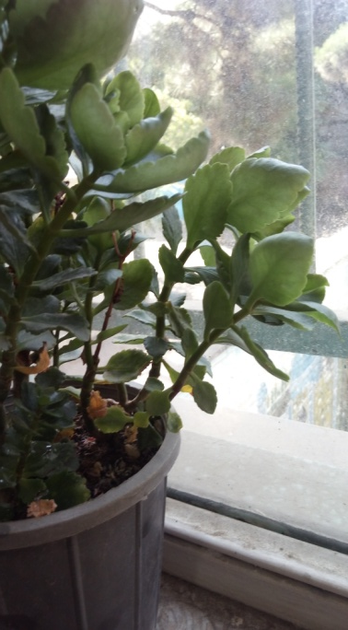
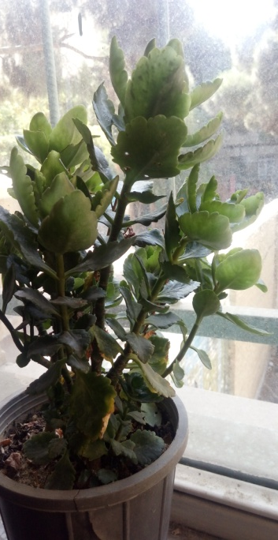
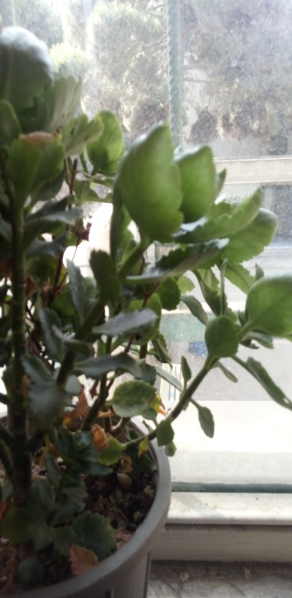
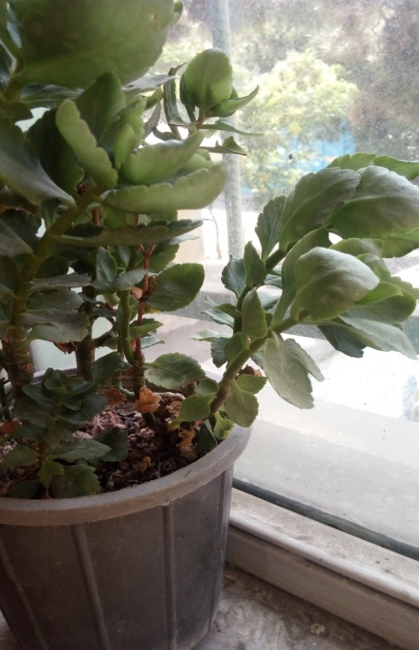
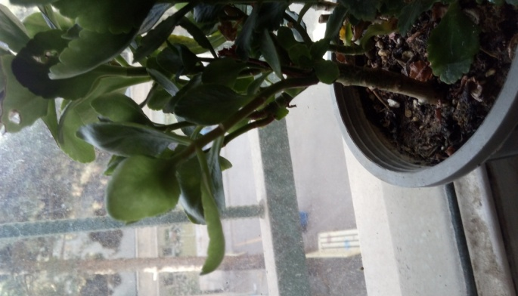
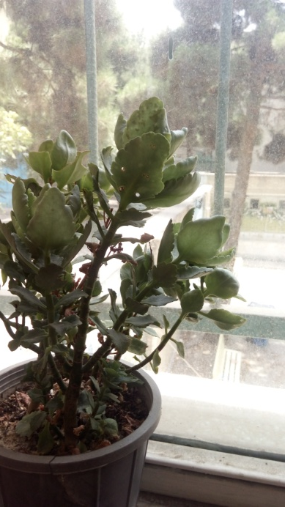
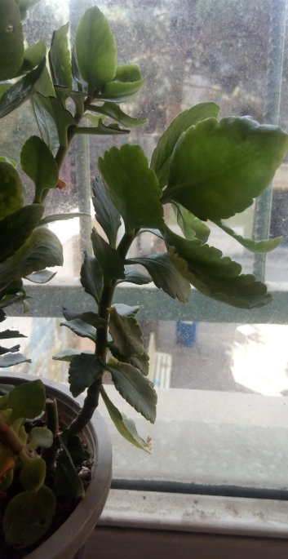
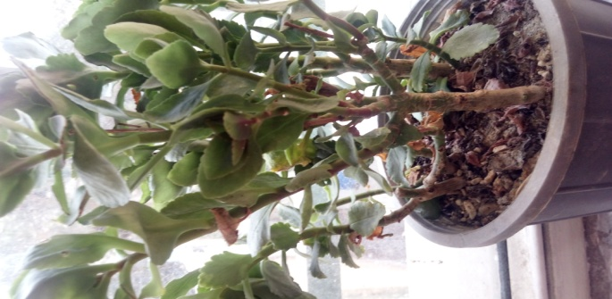
Step3:
Days No.1-5
Days No.5-10

Slide 14
How can they turn like this?

Slide 15
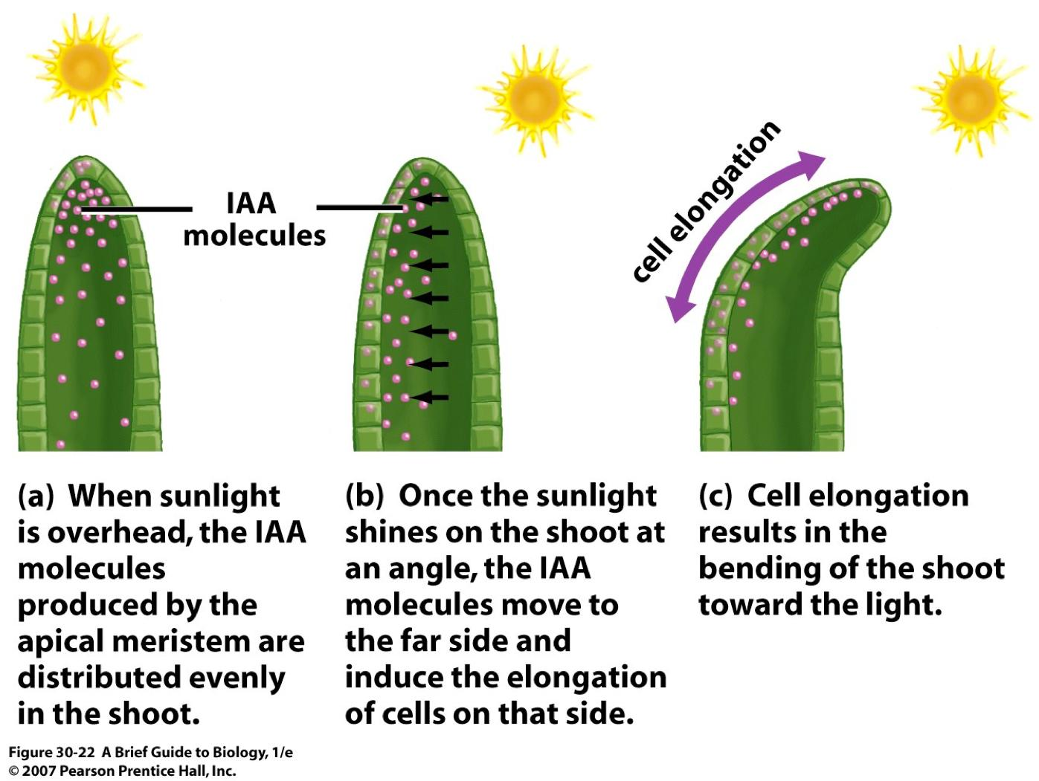

Slide 16
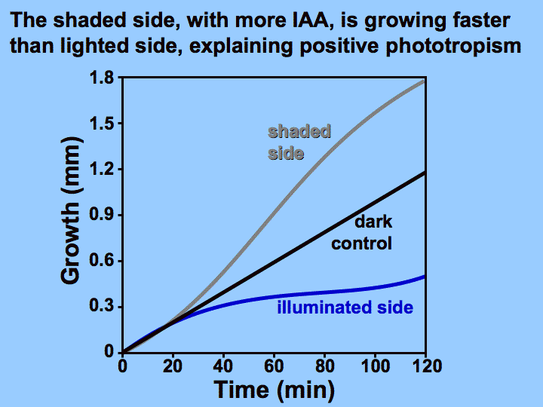

Slide 17
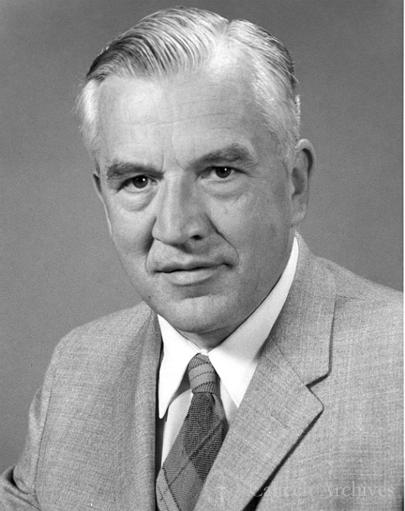
Frits Went’s experiment:
A Dutch graduate student named Frits Went first described auxins in 1926 and chose the name auxin from the Greek word auxien, which means 'to grow.

Slide 18
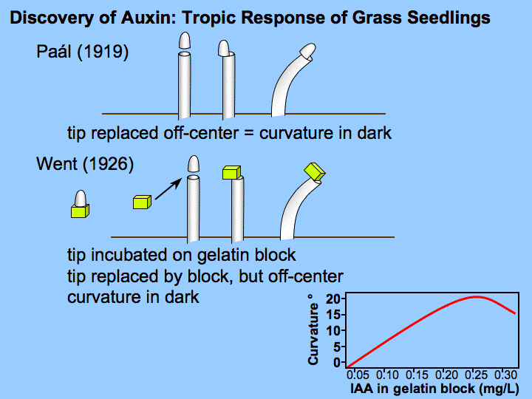

Slide 19
Sources:
www.emaze.com
www.uky.edu
www.sciencepresse.qc.ca
www.sinauer.com
www.whfreeman.com
www.pitara.com
www.plantphys.info
www.slideplayer.com

Slide 20
The end, Thanks for your attention!

Slide 22
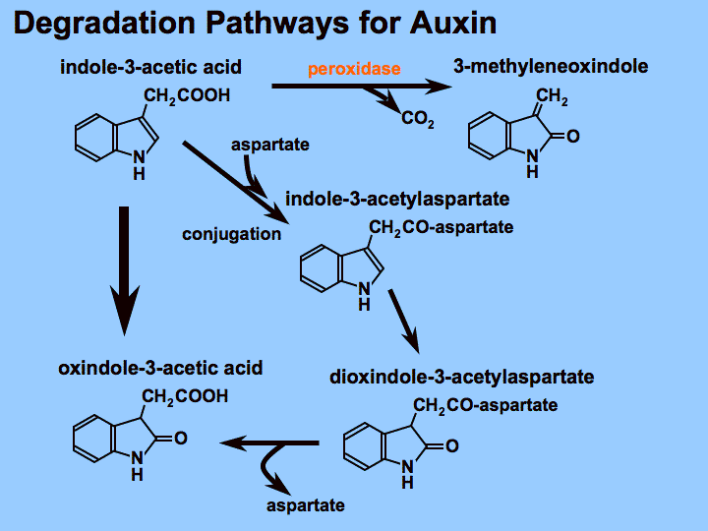

Slide 23
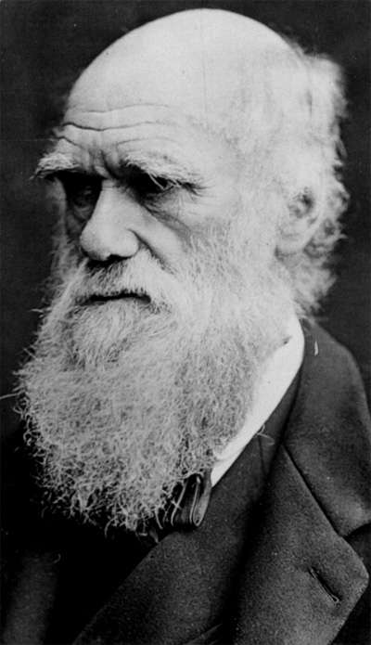
Charles Darwin’s experiment:
Charles Darwin and his son Francis studied the familiar reaction of plants growing toward light.

