Slide 1
Problems for the 4th IYNT Physics competition
Group : Mehr
From : Shiraz
By : Sara Ashraf

Slide 2
problem
6: dice
In many games, dice are thrown to obtain random results. How does the result of a dice roll depend on its height above a table, if the dice is released at zero initial speed.

Slide 3
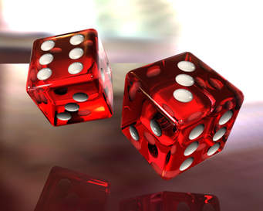
hypothesis
if the dice is released at zero initial speed from different height, the probability of getting result differs.

Slide 4
Theoretical background
In studying mechanics, we learnt about free fall motion.
Any object influencing gravity while falling is at free fall motion.
The formula is : y = - ½ g t^2 + v0t

Slide 5
procedure
I used two dices. The material differ.(wooden and plastic dice)
I used a ruler above a table.
All the number 6 were up and then according to the height , I would release it. In this case the probability for getting 6 is 1/6.

Slide 6
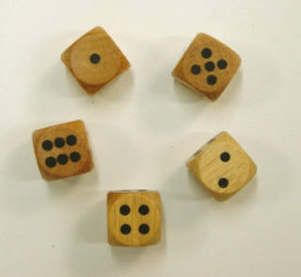
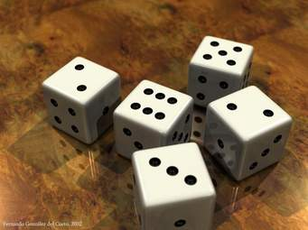
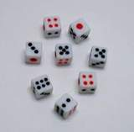

Slide 7
Mass or material also doesn’t change the result of the dice
Surface will have effect on the result because of the friction.
More friction it sticks
Less friction rolls more

Slide 8
Plastic dice
Height (cm) | Probability of getting 6
5 | 12/30 ≈ 40%
10 | 5/30 ≈ 16.66%
15 | 3/30 ≈ 10%
20 | 2/30 ≈ 6.6%
Wooden dice
Height (cm) | Probability of getting 6
5 | 13/30 ≈ 43.3%
10 | 6/30 ≈ 20%
15 | 3/30 ≈ 10%
20 | 2/30 ≈ 6.6%

Slide 9
conclusion
Based on physics law and free fall motion, the object shouldn’t have any rotational motion till it reaches the surface and after that it will have, rolling motion which its velocity before collision divided into horizontal velocity and angular velocity. Due to my experiment if the height increases, as the angular velocity increases, the probability of having 6 decreases. But the role of chance is still inevitable.

Slide 10
Thanks for your attention

Slide 11
1280 x 1025 px www-nonlinear.physik.uni-bremen.de Copyright & Disclaimer 600 x 450 px www.juegosflash.cl Copyright & Disclaimer

Slide 12
Mass or material also doesn’t change the result of the dice
Surface will have effect on the result because of the friction.
More friction it sticks
Less friction rolls more

Slide 13
A free falling object is an object that is falling under the sole influence of gravity.
Any object that is being acted upon only by the force of gravity is said to be in a state of free fall.
Free falling objects do not encounter air resistance.
All free falling objects(on Earth) accelerate downwards at a rate of 9.8m/s/s.

Slide 14
Torque is a measure of how much a force acting on an object causes that object to rotate.
Objects rotate on an axis, called pivot point and it is label “O”. The force is denoted by “F”. The distance from the pivot point to the point where the force acts is called the moment arm and it is denoted by “r”.

Slide 15
C 1996-2016 the physics classroom.
University of Guelph

