Slide 1
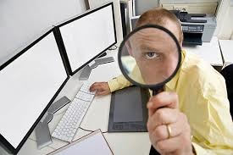
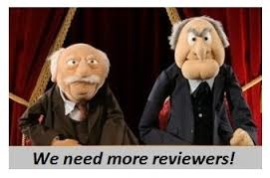
Mehr group (reviewers)
Colors of the rainbow SF4

Slide 2
Opponent positive
Good criticism
Good debatable questions

Slide 3
Opponent negative
Doesn’t state question clearly
Doesn’t speak loudly
Doesn’t comprehend the answer given

Slide 4
Reporter positive
Relevant pictures which makes understanding of the experiment easier (of her own experiment)
They provided us with Step by step explanation
Experiment is reasoned correctly
Used white board to explain
Tries to respond thoroughly to opponent’s question

Slide 5
Reporter negative
Speaking too fast therefore sometimes not clear
Rushed and doesn’t speak clearly
Small font
Doesn’t answer questions properly
Didn’t have a conclusion
Had not conducted enough experiments to complete the question

