Slide 1
Oxygen
Mehr group
Task: Using any chemicals of your choice, produce a flask of oxygen. Prove that the oxygen concentration in the flask is higher than in the ambient air and determine the concentration.

Slide 2
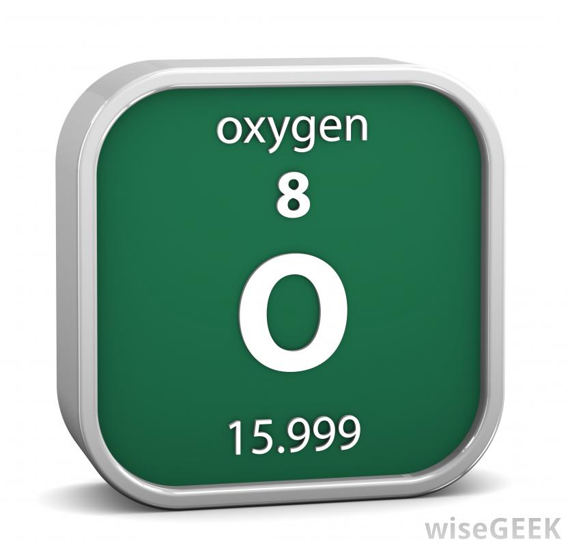
What is oxygen?
colorless
odorless
reactive gas
atomic number 8
Gas that
Oxygen forms about 20 percent of the earth's atmosphere, and is the most abundant element in the earth's crust, mainly in the form of oxides, silicates, and carbonates.

Slide 3
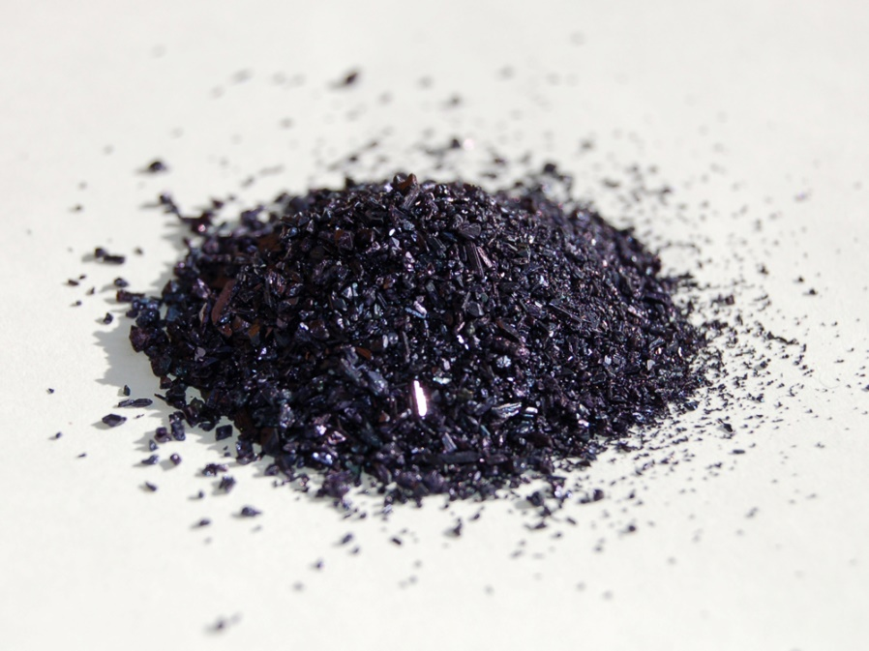
Hypothesis
We can decompose potassium permanganate to produce manganese dioxide and oxygen. We can then collect oxygen in a test tube and check if oxygen is present using a splint.

Slide 4
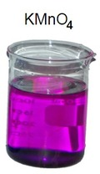
The Equipment
Potassium Permanganate: 0.14 g of the solid. Solution in Water.
2 test tubes
Plastic funnel
Splint
Bunsen Burner

Slide 5
Errors
Limitations of element in the laboratory e.g. hydrogen peroxide.
Broken test tube
Splint wasn’t lighting so we changed our experiment by using water in the test tube and proving the production of oxygen when bubbles were produced.

Slide 6
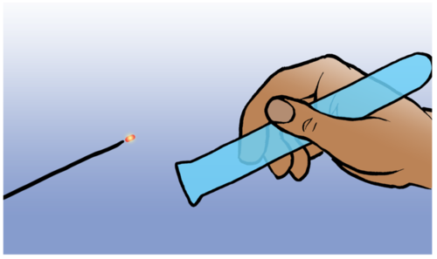
Why didn’t the splint light?

Slide 7
How did we overcome this?
Bubbles mean
oxygen is produced!

Slide 8
Our Experiment
We heated the potassium permanganate to 240 degrees Celsius and it decomposed to produce oxygen.
Potassium manganate and manganese dioxide was also produced.
Oxygen gathered in the test tube.
2 KMnO4 ==> K2MnO4 + MnO2 + O2

Slide 9
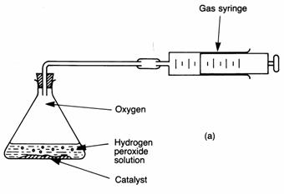
Other Methods
The decomposition of hydrogen peroxide using the catalyst manganese (IV) dioxide.

Slide 10
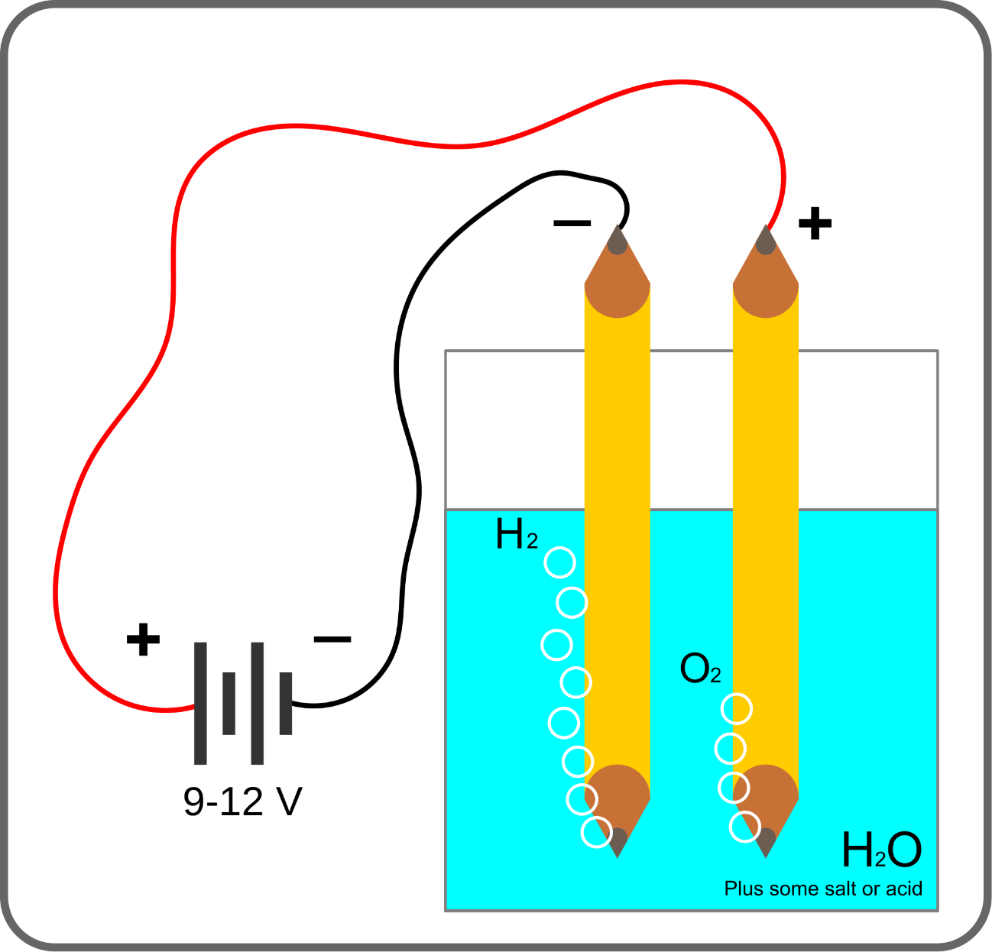
Electrolysis of Water

Slide 11
references
http://www.dictionary.com/browse/oxygen
http://www.ucc.ie/academic/chem/dolchem/html/elem008.html
http://techbrowsing.com/?from=land#&land=1

