Slide 1
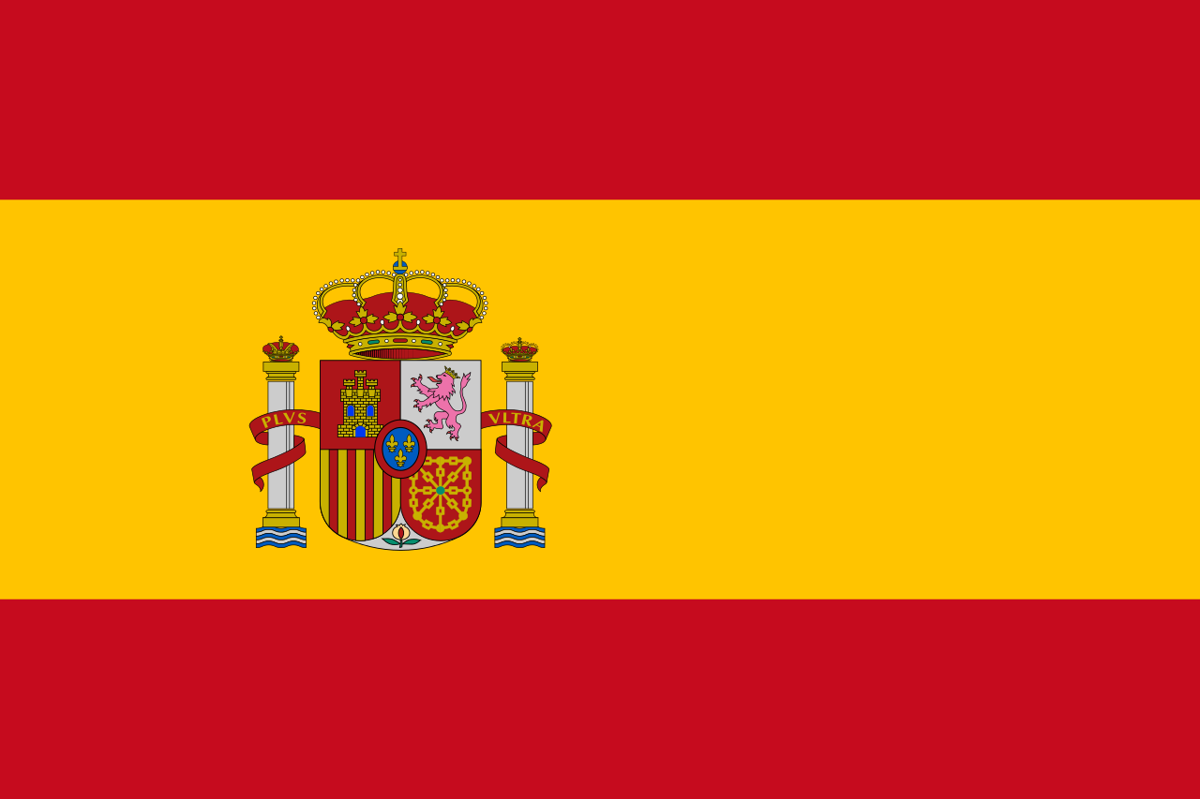
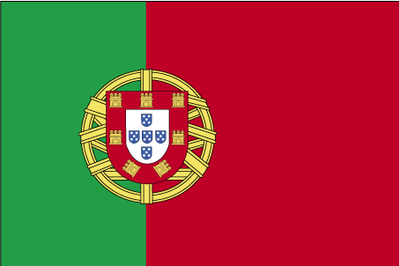
The link between Portuguese, spanish and latin
Dorsa Khalessi

Slide 2
Romance languages
The Romance languages also occasionally labelled Latin languages, and sometimes Romanic or Neo-Latin languages are the ‘modern’ languages that somehow evolved from Vulgar Latin between the sixth and ninth centuries.
Currently, nearly 800 million people are native speakers worldwide, majorly in Europe and the Americas, but also in other international locations. In addition, the chief Romance languages also have many non-native speakers and are in global use as lingua francas. This is mainly the case for French, which is in widespread use throughout Central and West Africa, Madagascar, and the Maghreb.
The five most common spoken Romance languages by number of native speakers are Spanish recited by 410 million people, Portuguese by 216 million, French 80 million, Italian 60 million, and Romanian 25 million.

Slide 3
Background
As previously mentioned, Romance languages are the continuation of Vulgar Latin, the popular and conversational sociolect of Latin spoken by soldiers, settlers, and merchants of the previous Roman Empire, as differentiated from the classical form of the language spoken by the Roman upper classes, the form in which the language was generally written. Somewhere Between 350 BC and 150 AD, through the process of expanding the Empire, due to the Empires administrative and educational policies, made Latin the most dominant native language in continental Western Europe.
During the Empire's dismiss, and after its fragmentation and collapse in the fifth century, many varieties of Latin began to diverge within each local area at an accelerated rate and eventually evolved into a continuum of detectable different typologies. The colonial empires accustomed by Portugal, Spain, and French from the fifteenth century onward stretched out their languages to other continents to such a point that about two-thirds of all Romance language speakers today live outside Europe.

Slide 4
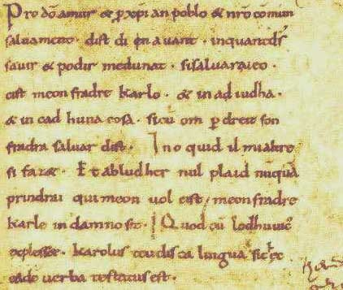
Extract of the Oaths of Strasbourg, the earliest French text. Vulgar Latin ...

Slide 5
Comparison of Portuguese and Spanish
Portuguese and Spanish, even though they are classifies as ‘relatively close sister languages’, also differ in many aspects of their phonology, grammar, and lexicon. They both are part of a broader group known as West Iberian Romance, in which also includes several other languages or dialects with fewer speakers, all of which are mutually intelligible to some degree. The most obvious differences are in pronunciation.
Both Brazilian and European Portuguese differ not only from each other, but from Spanish as well;
Both Peninsular (i.e. European) and Latin American Spanish differ not only from each other, but also from Portuguese.

Slide 6
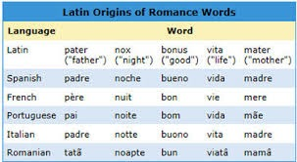
Portuguese and Spanish share a great number of words that are spelled either identically or almost identically although the pronunciation almost always differs, or they differ sometimes in predictable ways.

Slide 7
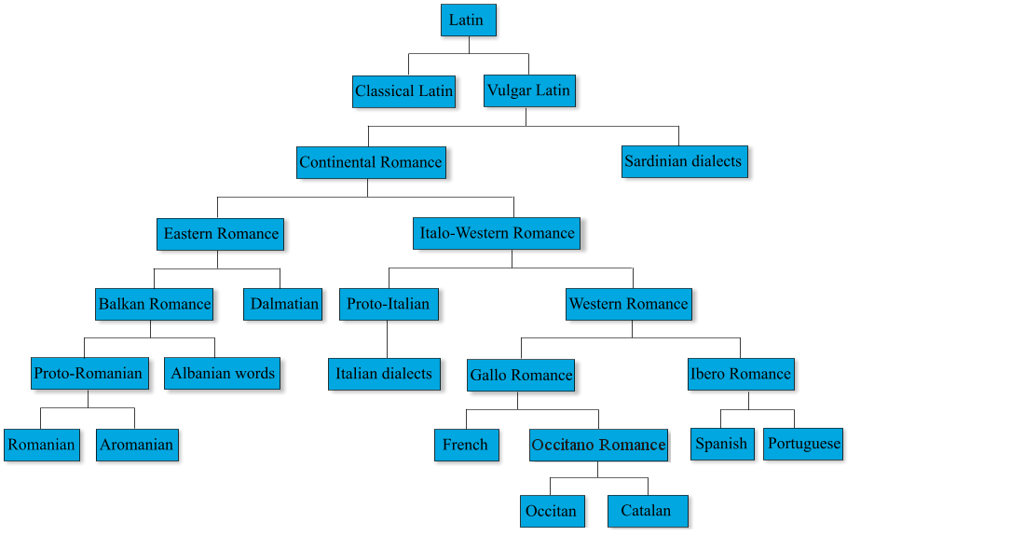

Slide 8
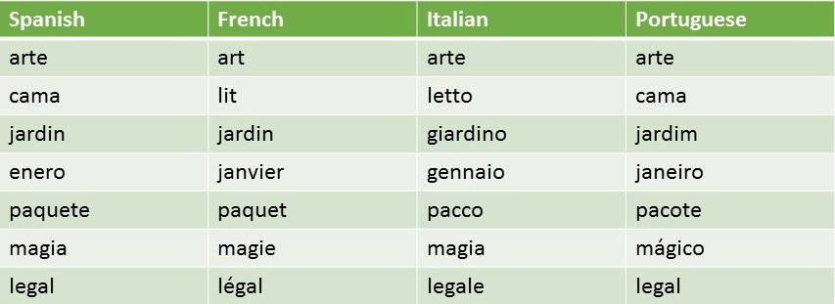

Slide 9
Pero, a pesar de esta variedad de posibilidades que la voz posee, sería un muy pobre instrumento de comunicación si no contara más que con ella. La capacidad de expresión del hombre no dispondría de más medios que la de los animales. La voz, sola, es para el hombre escasamente una materia informe, que para convertirse en un instrumento perfecto de comunicación debe ser sometida a un cierto tratamiento. Esa manipulación que recibe la voz son las "articulaciones".
Mas, apesar da variedade de possibilidades que a voz possui, seria um instrumento de comunicação muito pobre se não se contasse com mais do que ela. A capacidade de expressão do homem não disporia de mais meios que a dos animais. A voz, sozinha, é para o homem apenas uma matéria informe, que para se converter num instrumento perfeito de comunicação deve ser submetida a um certo tratamento. Essa manipulação que a voz recebe são as "articulações".
Spanish
Portugese

Slide 10
Link to French
The influence of French: Both Portuguese and Spanish have somehow borrowed ‘loanwords’ either directly from French or through a negotiation. Even though no constant study based on stable specification has been carried out, it has been suggested that words of French origin in Portuguese are significantly more numerous than those in Spanish.

Slide 11
sources:
hyperland.tk
www.spanishmarks.com
en.wikipedia.org
https://en.wikipedia.org/wiki/Comparison_of_Portuguese_and_Spanish
https://en.wikipedia.org/wiki/Romance_languages
http://ielanguages.com/romlang.html
https://en.wikipedia.org/wiki/Lingua_franca

Slide 12
Glossary
Phonology: The branch of linguistic that deals with systems of sound.
Neo-Latin: New Latin
Vulgar Latin: Informal Latin of classical times
Lingua Franca: A language that is adopted as a common language between speakers whose native languages are different
Sociolect: A dialect of a particular social class.
Typologies: a classification according to general type
Lexicon: The vocabulary of a person or language
Dialects: A particular form of language that is for a certain region or social group
Peninsular: A piece of land almost surrounded by water

