Slide 1
Natural Indicators
What is the most effective indicator, with properties most similar to common indicator paper?

Slide 2
What are indicators?
“A compound that changes color at a specific pH value or in the presence of a particular substance and can be used to monitor acidity, alkalinity, or the progress of a reaction.”
(Googlecom, 2016)
How does it work?
They change structure and their reaction to light depending on the acidity of its environment. (Sue klemmer, 2016)

Slide 3
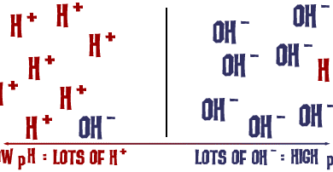
What defines a solution as acidic or basic?
What do the particles consist of?
Reference: http://www.chem4kids.com/files/art/reaction_acidbase4.png

Slide 4
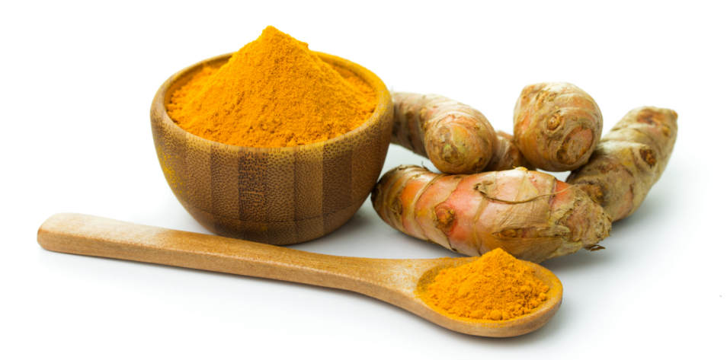
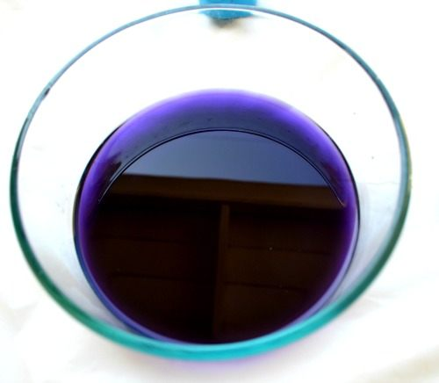
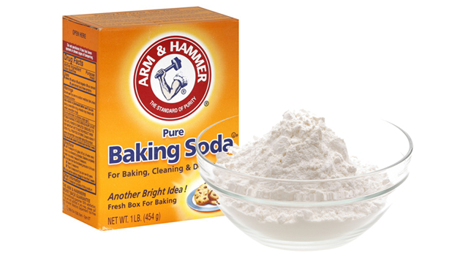
What natural indicators did I use?
Reference: http://a3145z1.americdn.com/wp-content/uploads/2014/11/how-to-fight-colds-and-the-flu-with-baking-soda1.jpg
http://www.glutenfreegigi.com/wp-content/uploads/2015/02/Enhancing-the-Bioavailability-of-Turmeric.jpg
http://cdn5.kidsplaybox.com/wp-content/uploads/2013/07/red-cabbage-experiment.jpg

Slide 5
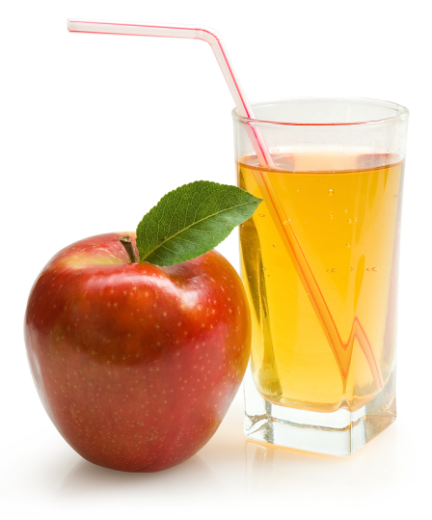
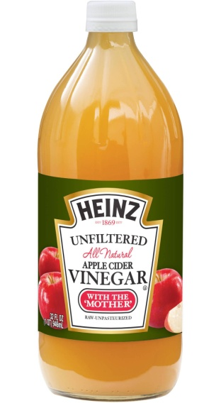
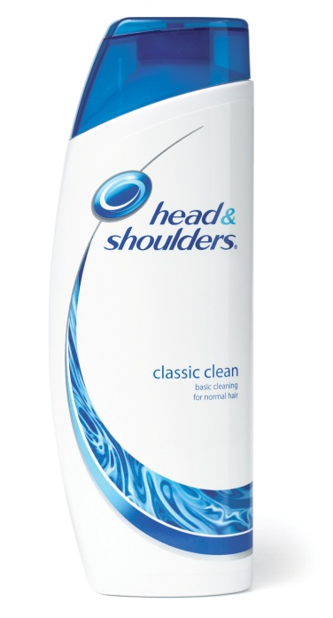
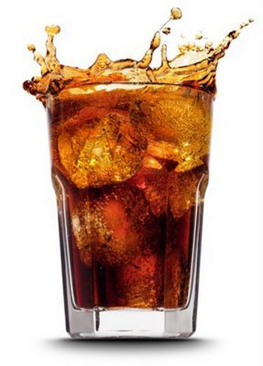
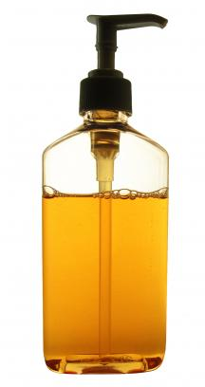
What liquids did I use?
Reference: http://bevarisalliance.com/wp-content/uploads/2013/03/apple_juice.jpeg
http://www.bestfitnessfoods.com/wp-content/uploads/2016/02/k2-_3185f3c4-7261-4a4f-b1b4-80ad392d4d1c.v1.jpg
http://cf.ltkcdn.net/crafts/images/std/149334-319x425-glycerin-soap.jpg
http://news.pg.com/sites/pg.newshq.businesswire.com/files/image/image/Head__AND__Shoulders_Anti-Dandruff_Shampoo.jpg
http://tavernservice.com/wp-content/uploads/2013/04/big_soda.jpg

Slide 6
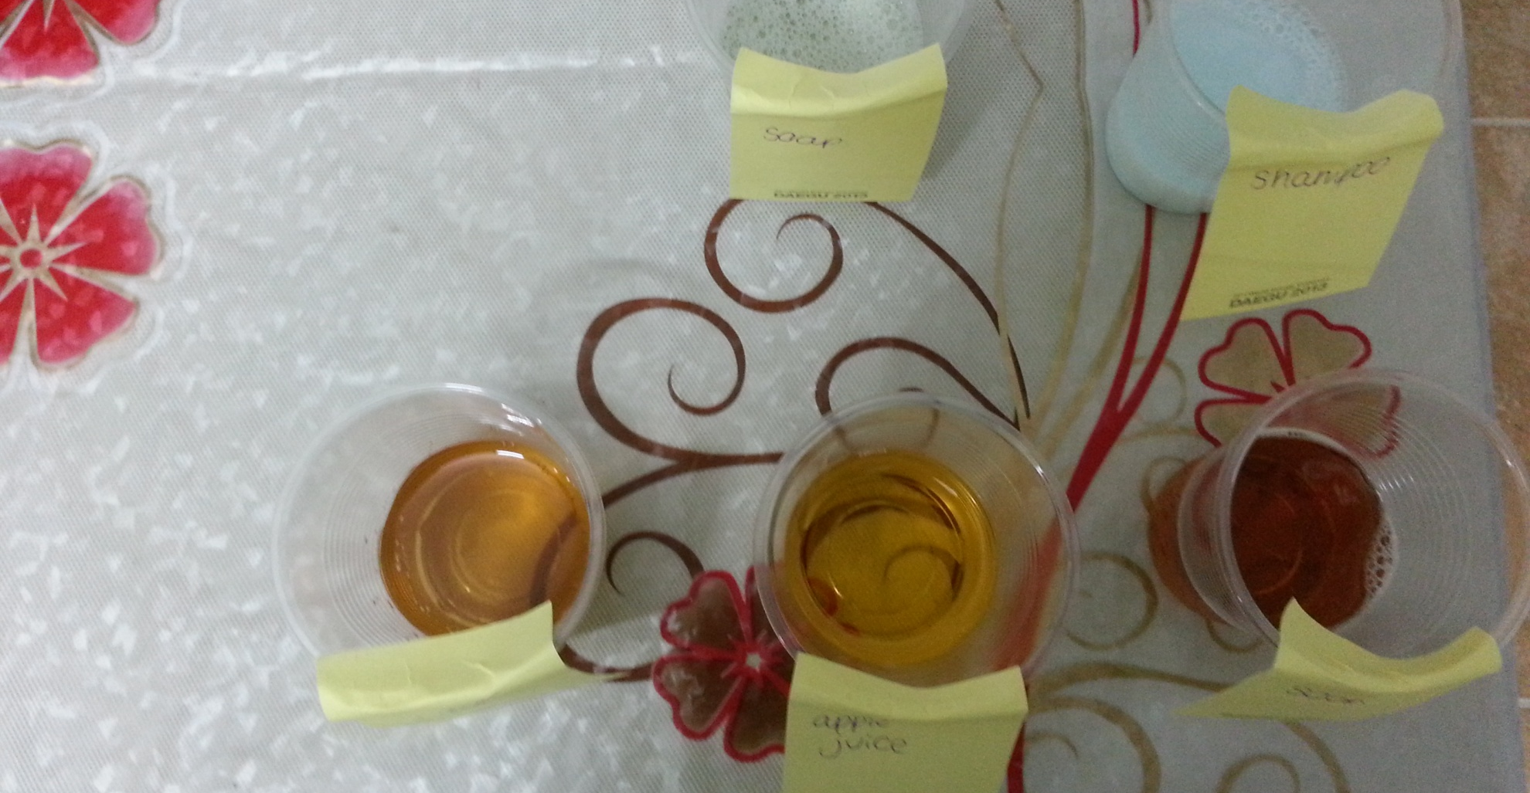
What liquids did I use?
Which will be acidic or basic? Which indicator will help find the most accurate pH value?
Notes:
When explaining the process say that I used a new cup

Slide 7
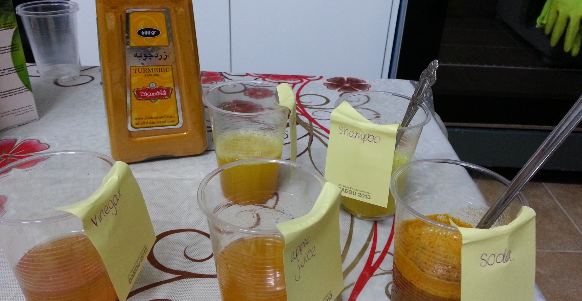
Turmeric
How well can turmeric detect the pH of these substances?

Slide 8
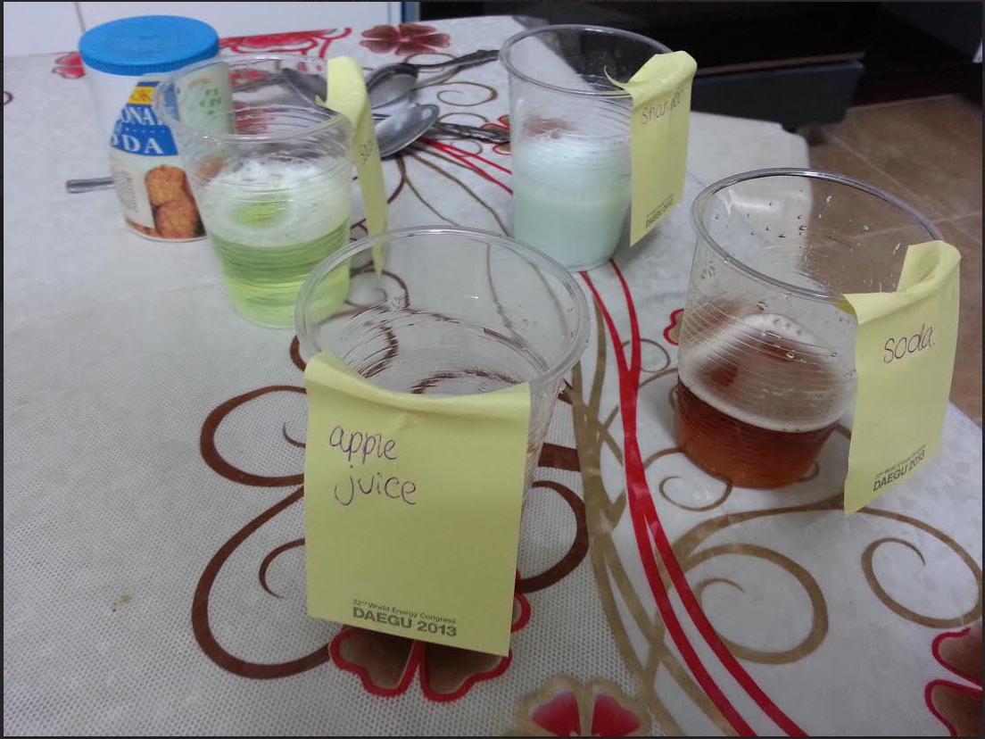
Baking Soda
Can baking soda give us an accurate value of the pH?

Slide 9
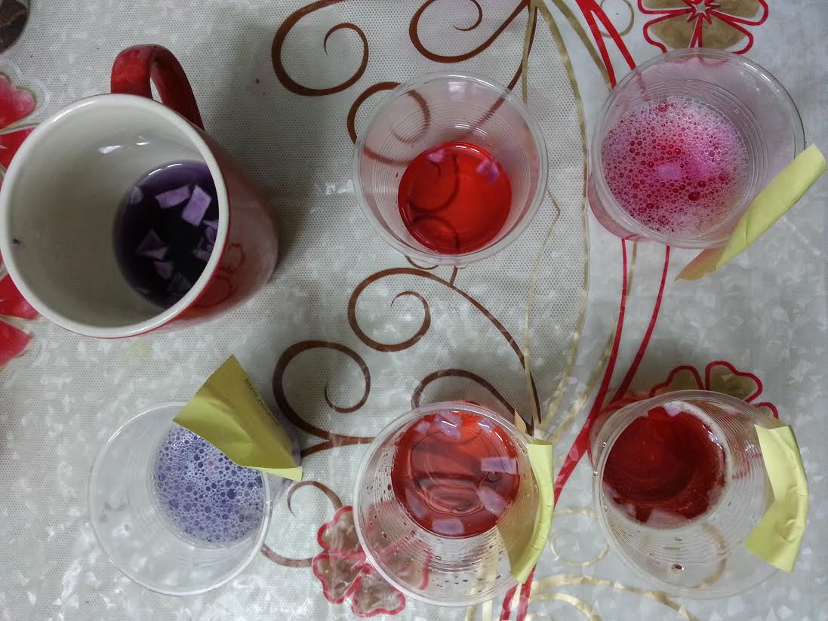
Red Cabbage Juice
Does red cabbage juice find the pH value of the solutions accurately?

Slide 10
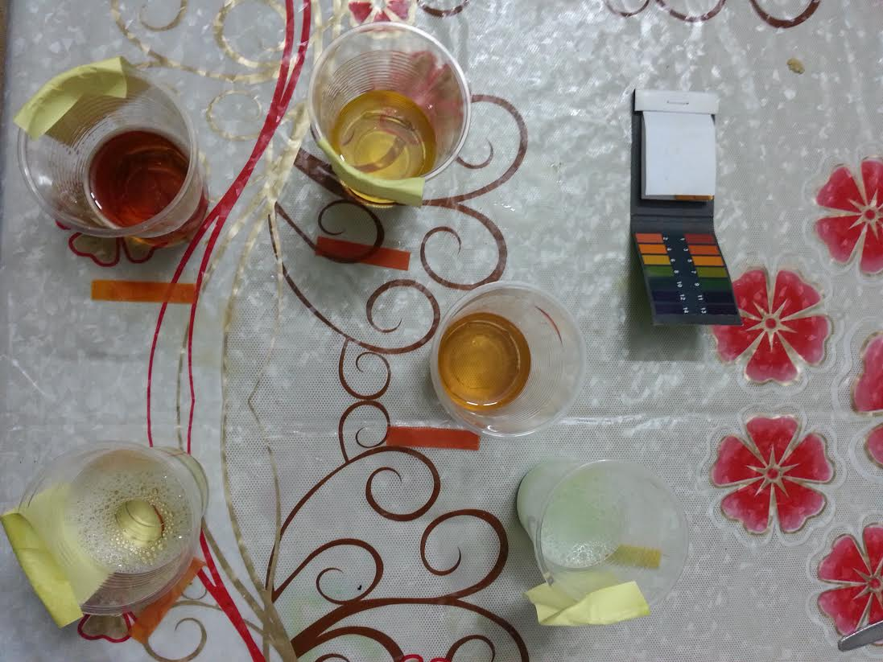
Common pH Paper
Which natural indicator gave results that were closest to the common pH paper?

Slide 11
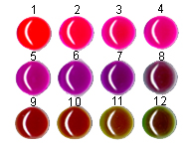
How do the natural indicators work?
Contains curcamin
Yellow in acids & neutral solutions
Red in bases
Fizzes in acids
Does not fizz in bases or neutral substances.
HCO3-(aq) + H+(aq) = H2O(l) + CO2(g).
(Anne marie helmenstine, 2016)
Contains anthocyanin (Frostburgedu, 2016)
Notes:
If you react baking soda with water it will not fizz but will just form a paste. If there are impurities in the baking soda it will fizz to form co2.

Slide 12
Results
 | Tumeric |  | Baking Soda |  | Red Cabbage |  | pH Paper
 | Observation | pH | Observation | pH | Observation | pH | Observation | pH
Apple Juice | yellow | acidic or neutral | little fizz | low acidity | orange | 2 | dark orange | 3
Shampoo | red | basic | no fizz | basic or neutral | very purple | 8 | light green | 7
Soda | yellow | acidic or neutral | a lot of fizz | acidic | pink | 4 | orange | 4
Vinegar | yellow | acidic or neutral | a lot of fizz | acidic | red | 1 | dark orange | 3
Soap | red | basic | very little fizz | very lowly acidic | pink | 4 | dark yellow | 5
 | Tumeric |  | Baking Soda |  | Red Cabbage |  | pH Paper
 | Observation | pH | Observation | pH | Observation | pH | Observation | pH
Apple Juice | yellow | acidic or neutral | fizz | acidic | pink | 3 | dark orange | 3
Shampoo | red | basic | no fizz | basic or neutral | dark purple | 7 | light green | 7
Soda | yellow | acidic or neutral | little fizz | low acidity | dark pink | 4 | light orange | 4
Vinegar | yellow | acidic or neutral | a lot of fizz | highly acidic | bright red | 2 | dark orange | 3
Soap | red | basic | no fizz | basic or neutral | light purple | 5 | light yellow | 6
 | Tumeric |  | Baking Soda |  | Red Cabbage |  | pH Paper
 | Observation | pH | Observation | pH | Observation | pH | Observation | pH
Apple Juice | yellow | acidic or neutral | fizz | acidic | dark pink | 4 | dark orange | 3
Shampoo | red | basic | no fizz | basic or neutral | dark purple | 7 | light yellow | 6
Soda | yellow | acidic or neutral | fizz | low acidity | pink | 3 | dark orange | 3
Vinegar | yellow | acidic or neutral | a lot of fizz | highly acidic | red | 1 | dark orange | 3
Soap | red | basic | no fizz | basic or neutral | purple | 6 | light yellow | 6

Slide 13
Results
Qualitative
Quantitative
Notes:
Qualitative – based off observations. Quantitative – can produce a numeric result.
Repeat experiment 3 times and find average.

Slide 14
What conclusion can we make?
Turmeric
Qualitative
Cannot differentiate between acidic and neutral substances.
Baking Soda
Qualitative
Cannot differentiate between basic and neutral substances.
Not reversible. Used for spot tests. (Frostburgedu, 2016)
Red Cabbage
Quantitative
Changes color to indicate a wide pH range.
(Anne marie helmenstine, 2016)
Closest results to common indicator paper.
Notes:
Baking soda – the reaction it has with acids isn’t reversible so it’s mostly used for a ‘spot test’ rather than an indicator.
Spot tests are simple chemical procedures which uniquely identify a substance. They can be done on small samples, even microscopic samples of matter with no preliminary separation. In a typical spot test, a drop of chemical reagent is added to a drop of an UNKNOWN mixture.
Red cabbage juice works as an indicator because it contains the pigment anthocyanin, which changes its structure and its reaction to light depending on the acidity of its environment.

Slide 15
References
Frostburgedu. (2016). Frostburgedu. Retrieved 11 July, 2016, from http://antoine.frostburg.edu/chem/senese/101/acidbase/faq/natural-indicators.shtml
Anne marie helmenstine. (2016). Aboutcom Education. Retrieved 11 July 2016, from http://chemistry.about.com/cs/acidsandbases/a/aa060703a.htm
Sue klemmer. (2016). Madsciorg. Retrieved 11 July, 2016, from http://www.madsci.org/posts/archives/1998-03/890795428.Ch.r.html
Googlecom. (2016). Googlecom. Retrieved 11 July, 2016, from https://www.google.com/search?q=indicators

Slide 16
Thank you.
By Sara Bahadori

