Slide 1
Problem №9 «Cinder»
Speaker: Artem Fursov
Team Russia

Slide 2
The problem
In the Middle Ages, people used to wash the cloth in cinder. Study the effectiveness of cinder in washing clothes.

Slide 3
Goals:
To analyze why people used to wash the cloth in cinder
To analyze the mechanism of washing the cloth in cinder and which matter we can wash
To compare cinder and soap powder
To analyze the composition of cinder
To do solution with cinder
To analyze pH of the solution with cinder

Slide 4
Hypothesis :
Solution with cinder wash like soap powder

Slide 5
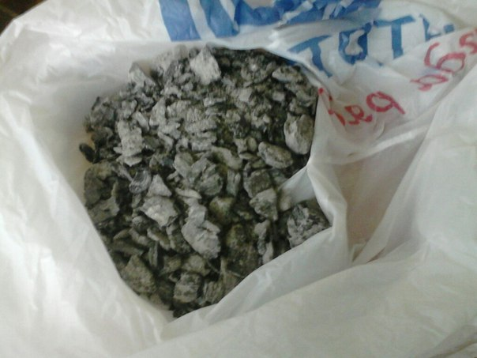
Composition of cinder
In composition of cinder we have this matter:
1) K₂CO₃, K₃PO₄, Na₃PO₄ – basifies the solution.
2) CaCO₃, Ca₃(PO₄)₂, CaSO₄, CaSiO₃, MgCO₃, MgSiO₃, particles С –insoluble .
3) CaCl₂, NaCl – it has no effects on pH.

Slide 6
Make Solution.

Slide 7
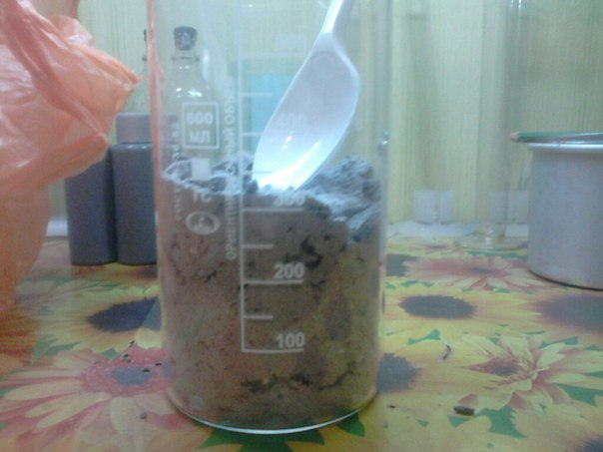
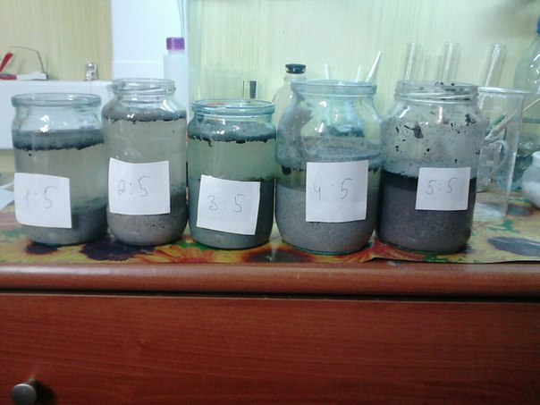
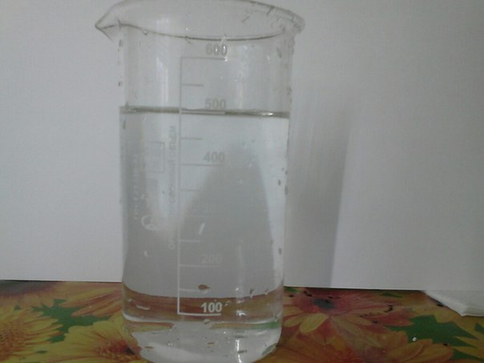
Put the cinder into five bottle and fill in bottle distilled water in the ratio : 1:5, 2:5, 3:5, 4:5, 5:5

Slide 8
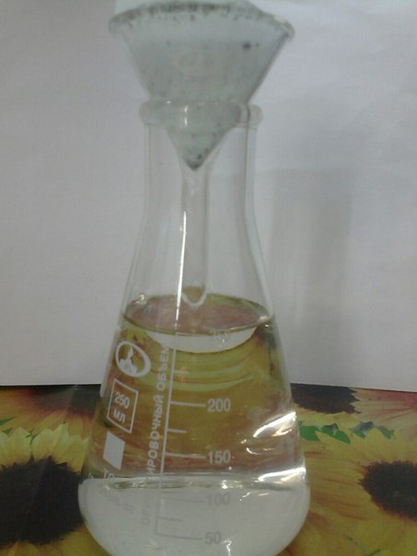
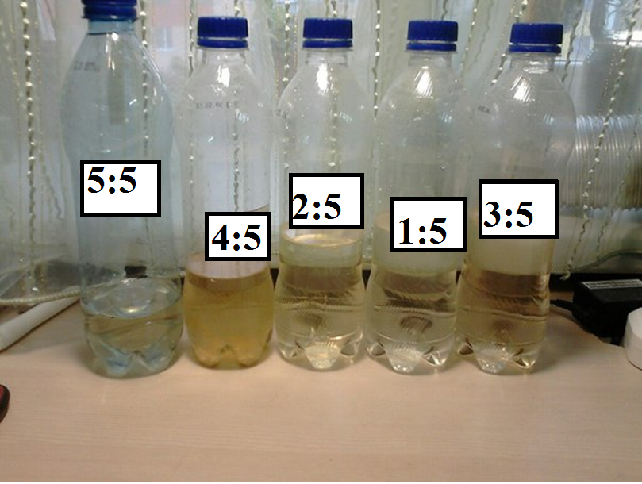
To filtrate the solution and fill in bottle

Slide 9
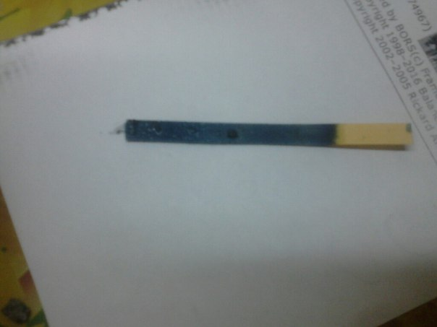
Measure C(OH–) и pH.

Slide 10
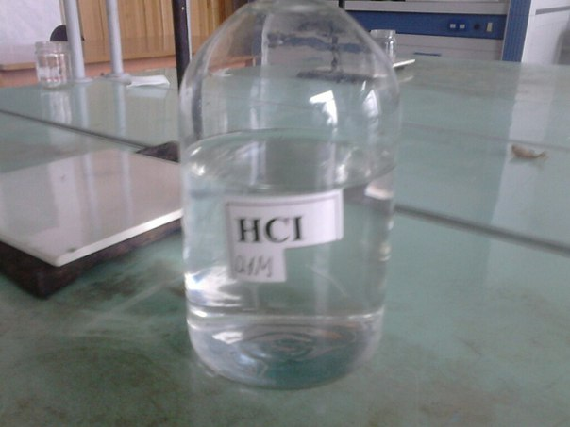
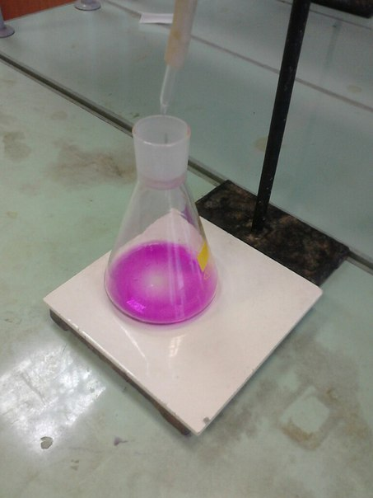
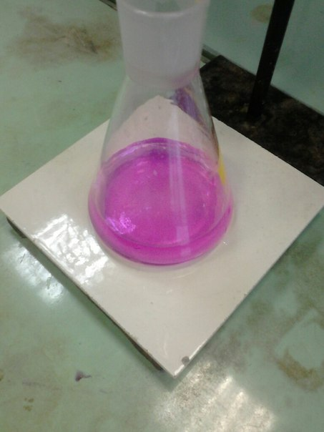
Titrate 5 ml of solution with phenolphthalein by molar solution HCl in threes

Slide 11
Analyze concentration of (OH–) and pH:
V_{tests}=5ml;
CO₃^{2–} +2H⁺=>H₂O+CO₂ (neutralization) OH–+H⁺=> H₂O (neutralization)
Equivalent low : С₁V₁=C₂V₂; С(HCl)*V(HCl)=С(solution)*V(solution)
pOH=-lg(С₂); pH+pOH=14; pH=14-pOH

Slide 12
Dependency graph C(OH–) of V(cinder)Part of cinder

Slide 13
Dependency graph pH of V(cinder)

Slide 14
Account of base of solution
Hydrolysis:
K₂CO₃+2HOH⬄2KOH+CO₂+H₂O 1) CO₃^{2–}+HOH⬄OH–+HCO₃– 2) HCO₃^{2–}+HOH⬄OH–+CO₂+H₂O
K₃PO₄+2HOH⬄KH₂PO₄+2KOH 1) PO₄^{3–}+HOH⬄OH–+HPO₄^{2–} 2) HPO₄^{2–}+HOH⬄OH–+H₂PO₄– 3) ———————————— Hydrolysis of phosphates have three stage, but in facts we have two stage.Вывод: В процессе гидролиза образуются ионы OH–, из-за которых раствор приобретает сильнощелочную реакцию.

Slide 15
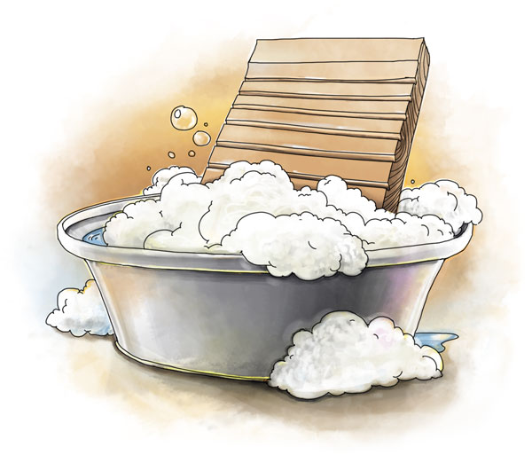
Wash with the solution of cinder and soap powder

Slide 16
Pollutant: stuffing

Slide 17
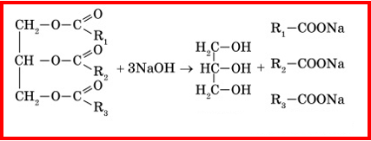
Why alkalis washing the stuffing ?

Slide 18
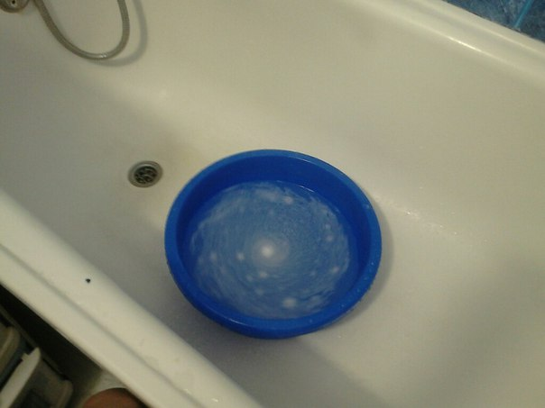
Results of washes
All solution make a good work, because it have pH=12 and high, but this solution can destroy internal bond, that’s why we must cut back our solution
Work of soap powder is analogy of our solution

Slide 19
Wash grass and dirt:

Slide 20
Conclusion:
Solution of cinder has high pH
Its easy to make
Our solution can wash stuffing, but we must cut back our solution
Our solution can not wash grass and dirt, because it is a mechanical wash

Slide 21
Thank you for your attention

