Slide 1
№14 Effervescent Tablet
Reporter: Andrey Kolyadin
Team: Russia-Voronezh

Slide 2
The problem
The rate of some chemical reactions may depend on surface area. Break effervescent tablets into smaller parts, or stir them into powder, to study how the dissolution rate depends on the surface area.

Slide 3
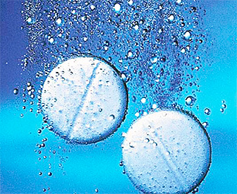
Why solubility of tablets is important?
Solubility is the most important property of drugs intended for ingestion or resorption in the oral cavity. Due to this property the active substance transfers from the tablet into the solution.

Slide 4
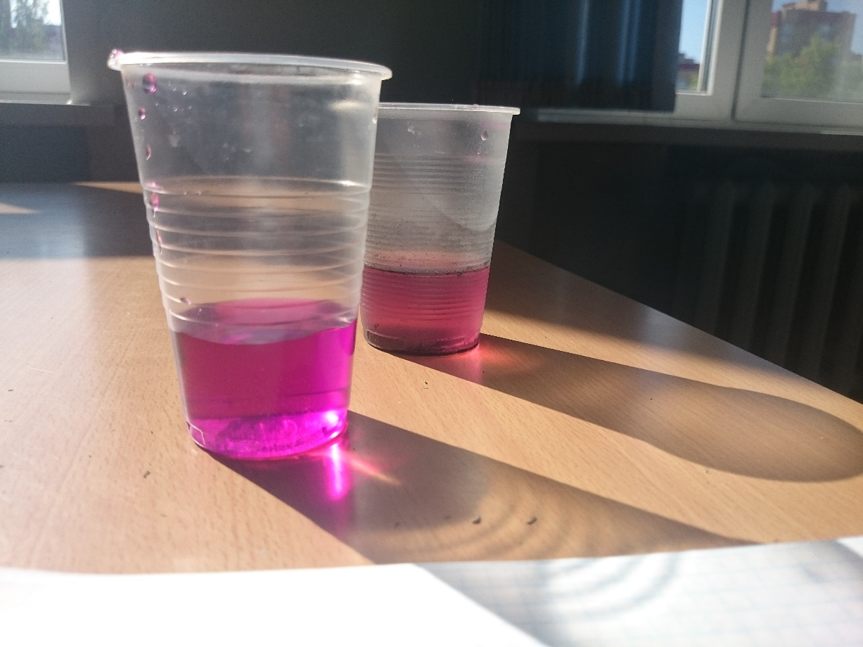
Theoretical basis
Solubility is the ability of the substance to interact with other substances to form a homogeneous system, i.e. a solution in which the substance is in the form of individual atoms, ions, molecules or complexes.

Slide 5
Factors affecting solubility
Factors
Temperature
Type of substance
Pressure
Area of contact
Intensiy of fluid motion

Slide 6
Tablets types, depending on their solubility and disintegration
Swelling followed by the decomposition
The decaying surface
Swellable, but not disintegrating
Soluble

Slide 7
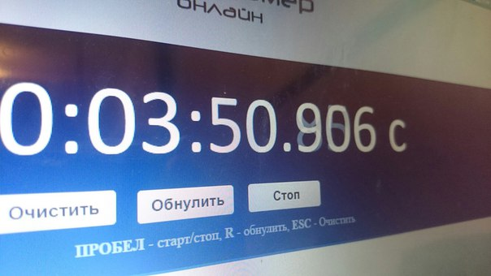
Experiment 1
Dissolve half of metamizole tablet in water

Slide 8
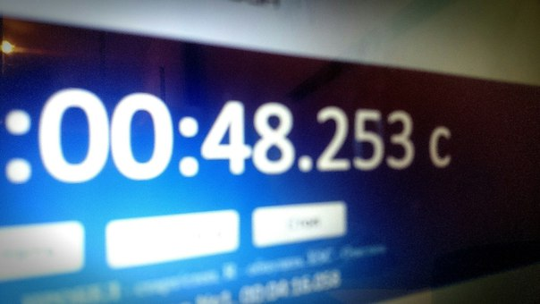
Make powder of metamizol tablet and dissolve it in water

Slide 9
Experiment 2 Dissolve tablet of ascorbic acid in water
9

Slide 10
Dissolution rate
Whole tablet | 4,6 minutes
Half tablet | 3,7 minutes
1/4 tablet | 3,1 minutes
1/6 tablet | 2,4 minutes
1/8 tablet | 1,1 minutes

Slide 12
Conclusions
Dividing a tablet into several parts or making a powder we are increasing the area of contact of reactants, which in turn affects the time of reaction, accelerating the process.

