Slide 1
IYNT 2017 NANJING Team BULGARIA
Rijke Tube
NAME : Georgi Ivanov
BULGARIA

Slide 2
Rijke Tube
If air inside a vertical cylindrical tube open at both ends is heated, the tube produces sound. Study this effect.
We will analyze the variables, which influence the process, and evaluate them.

Slide 3
Goals
We are going to find the parameters, that influence the process.
We are going to exclude the undetectable ones, or the unmeasurable.
Analyze the experimental results.
Search for other variations, that illustrate the process well.
Validate the outcome.
Make conclusions.

Slide 4
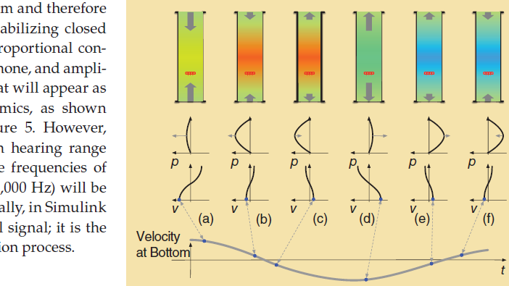
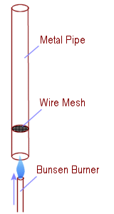
Explanation of the Process
In this segment we are going to explain briefly why does the process happen and how.
1. What is the Rijke Tube?
2. How does the process occur?

Slide 5
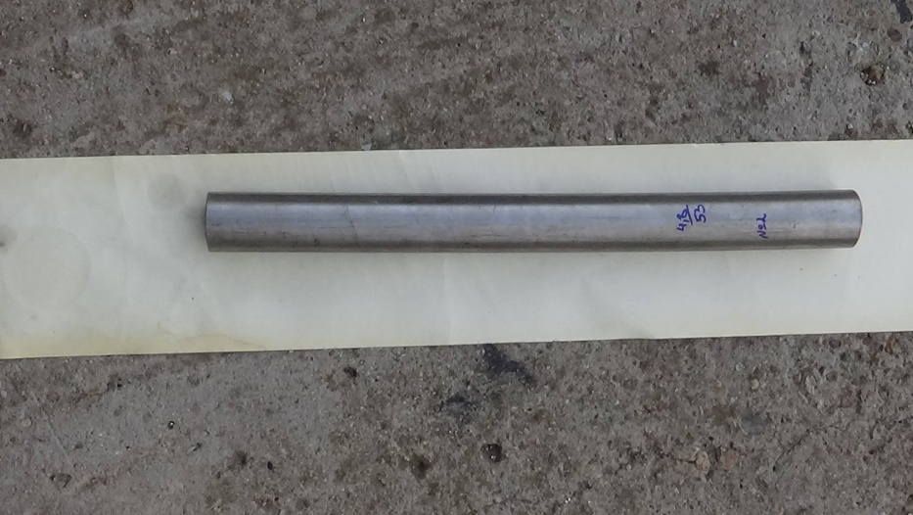
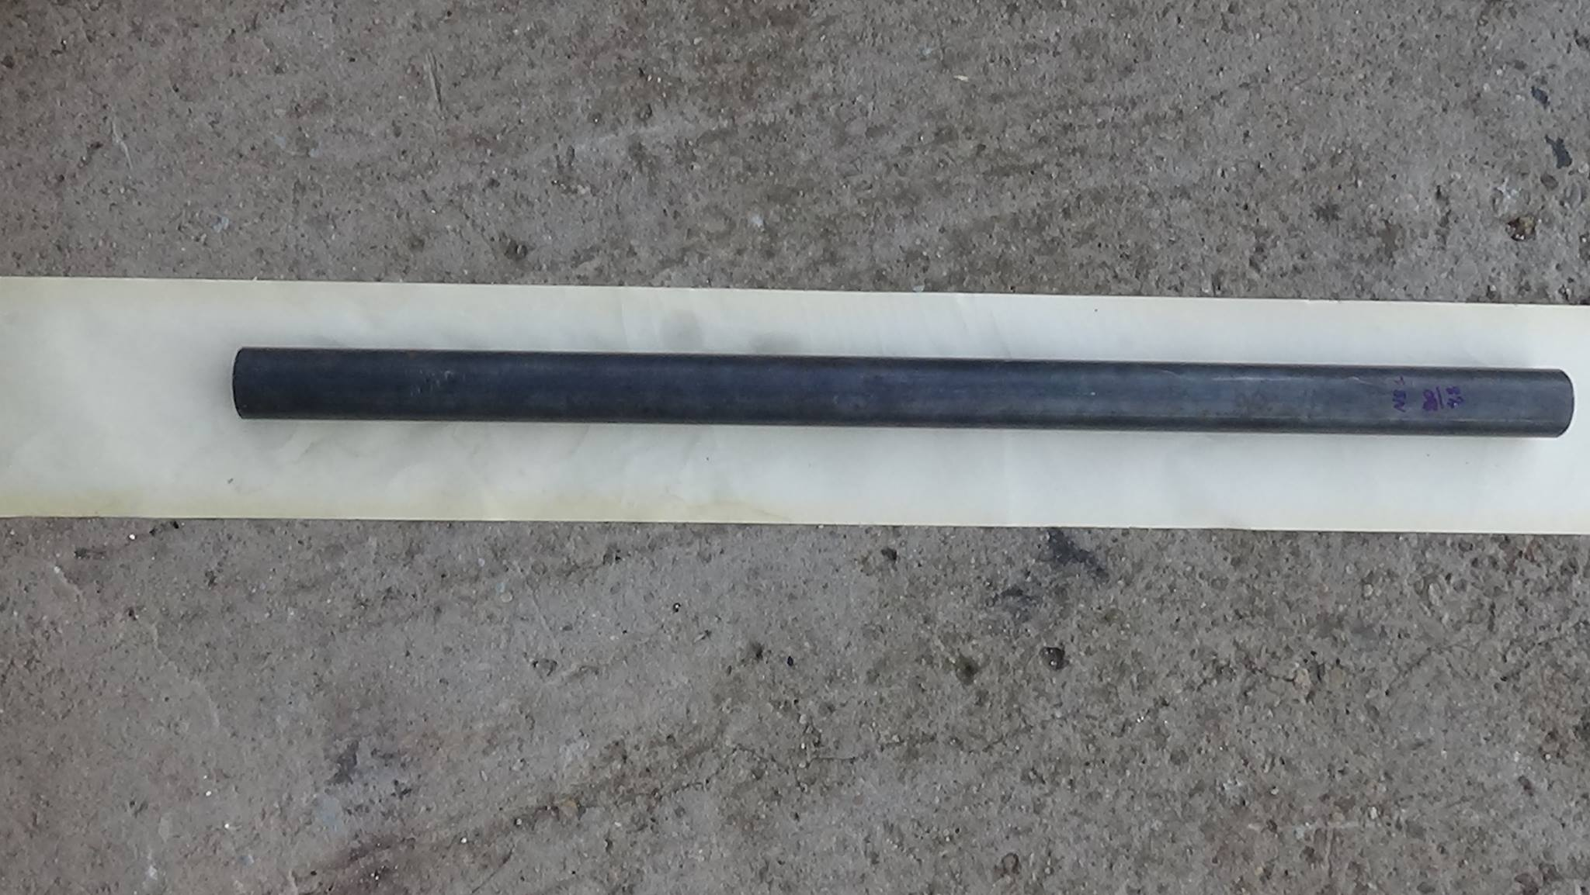
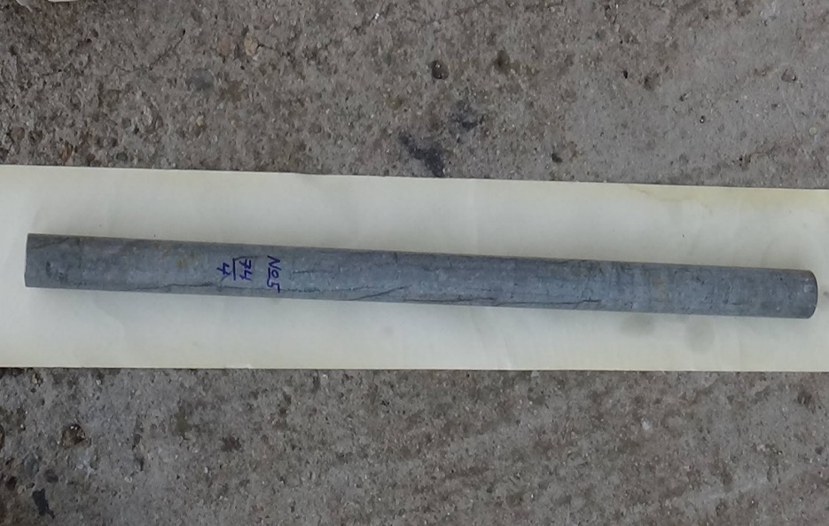
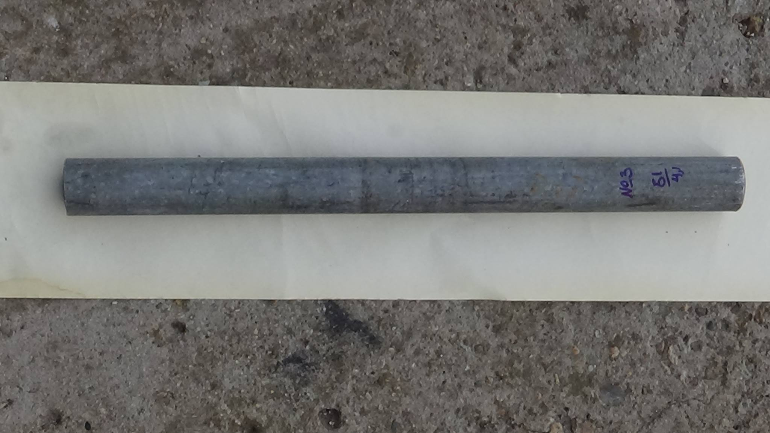
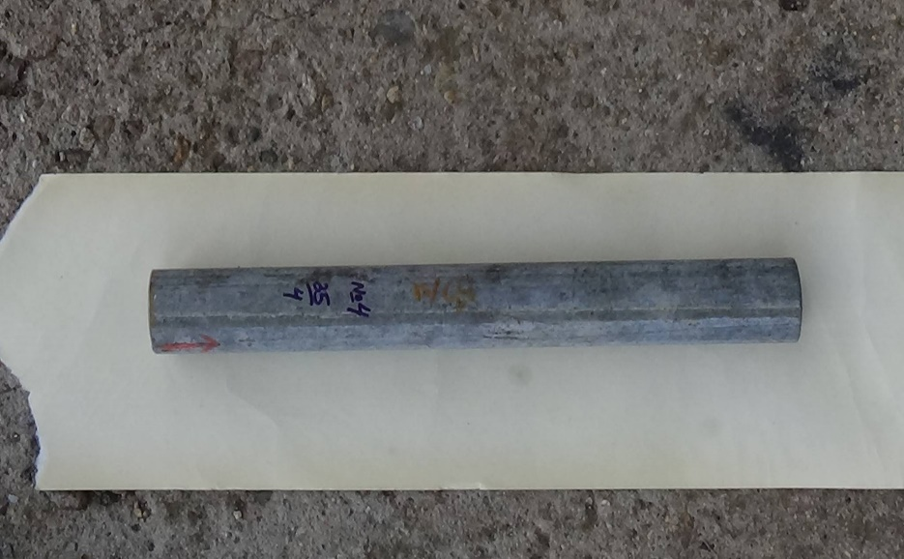
Experimental Setup and preparations
We have 5 tubes with different variable parameters, based on which we are going to sort and compare the results. Here is a table with all the characteristics.
 | Tube 1 | Tube 2 | Tube 3 | Tube 4 | Tube 5
Length | 90 | 53 | 51 | 35 | 74
Diameter | 4,8 | 4,8 | 4,1 | 4 | 4
C=l/d | 0,05 | 0,09 | 0,08 | 0,11 | 0,05
15 | 18 | 10,6 | 10,2 | 7 | 14,8
14 | 22,5 | 13,25 | 12,75 | 8,75 | 18,5
13 | 30 | 17,6 | 17 | 11,6 | 24
12 | 45 | 26,5 | 25,5 | 17,5 | 37

Slide 7
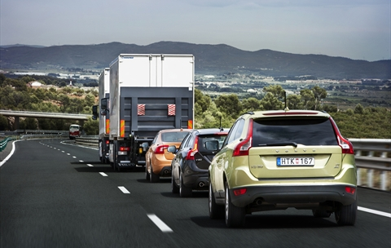
All variables in the process
Tube’s variables:
Length
Diameter (of the hole) – d
Aspect Ratio
Material of the Tube
Diameter of the tube’s ring – D-d (Where the “D” the diameter from end to end)
Tilt of the tube
Metal screen variables –
Density of material
coefficient of thermal transfer.
Specific thermal transfer coefficient
Area of the holes
And of course the ratio between length of the tube and the metal screen’ position.
Background’s variables
Background noise
Acoustics of space, in which is collected the data. (Noise reflections)
Background’s air variables:
Air Temperature
Air Humidity
Air Density.
Heat source’s variables
Q – Heat energy, generated from the source.
Position of the burner’s end in the tube
d
D
www.google.com/images

Slide 8
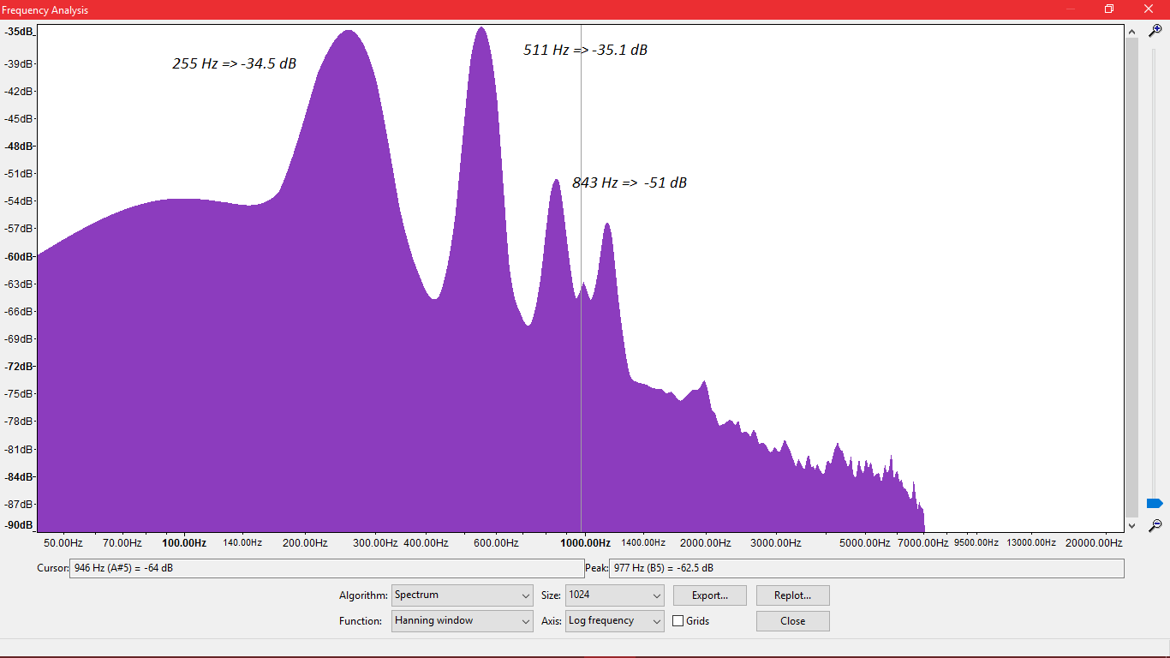
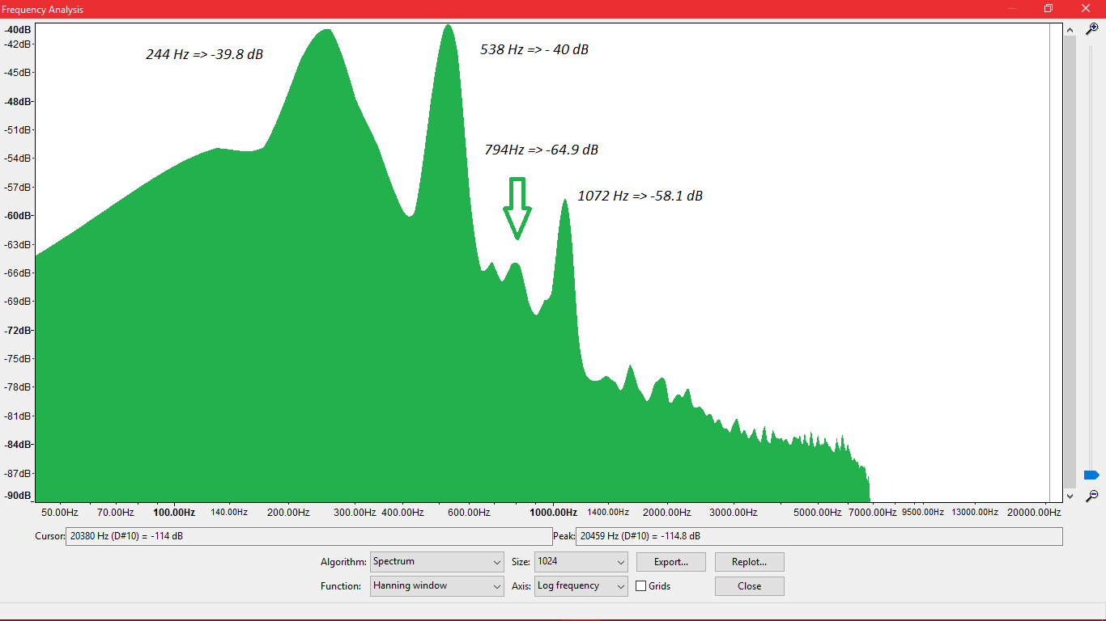
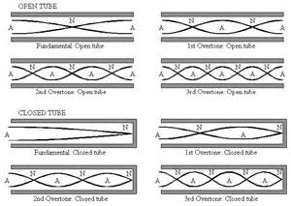
Length
How does the wavelength depend on the length of the tube?
Every Tube has an identical wavelength, which corresponds to the length of the tube itself – L/2=λ – This is why when the metal wire is half of the tube in, does not make sound.
When the heat source is put under the tube, the flow itself resonates of the frequency of the tube (THIS IS NOT THE PROCCES ITSELF)

Slide 9
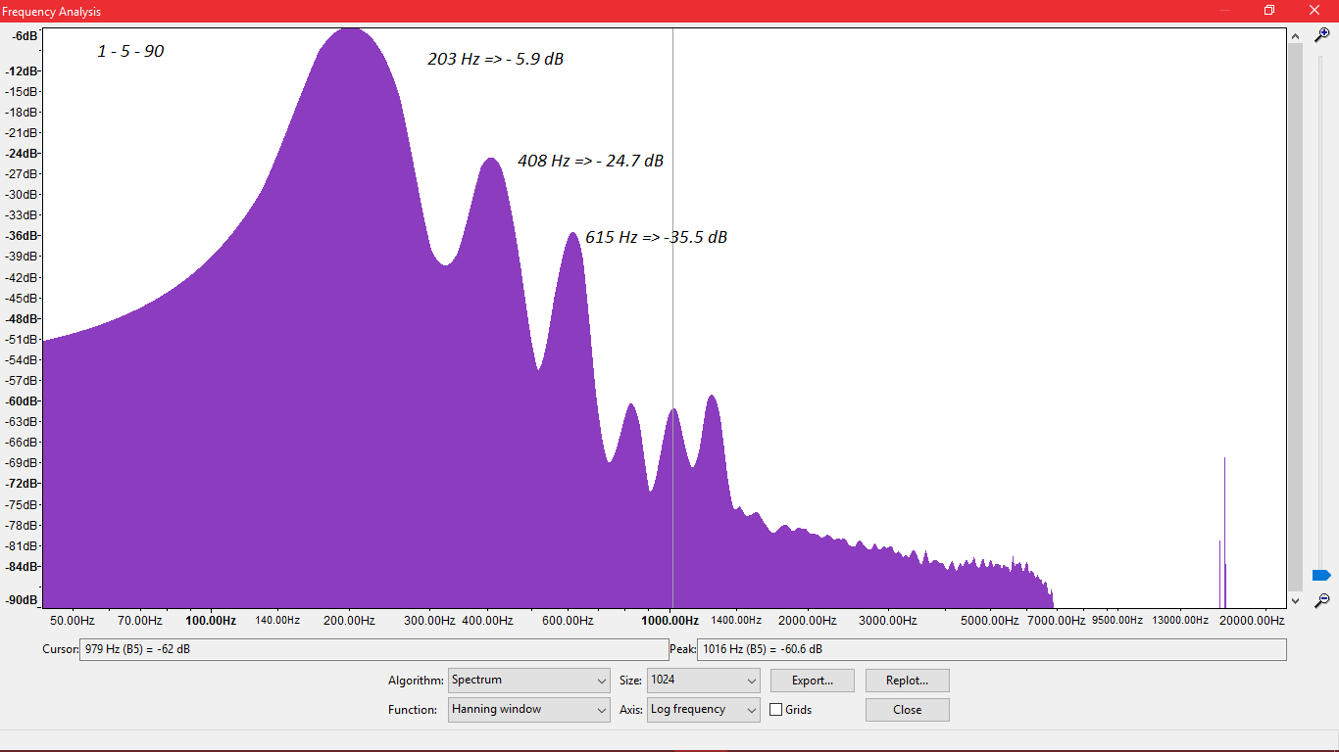
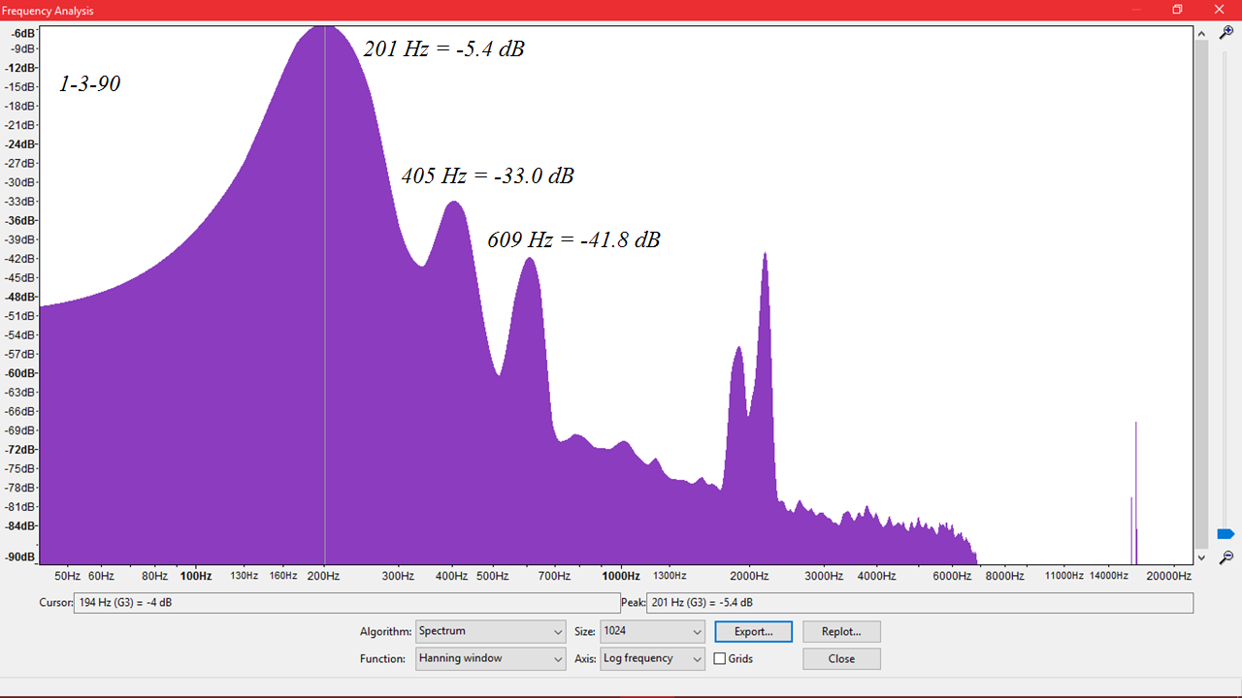
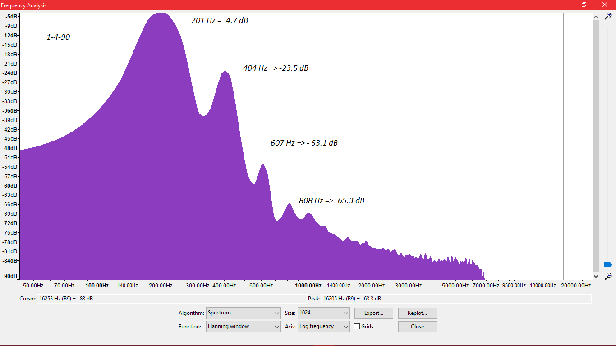
Position of the metal wire
When the wire is not placed exactly on the half of the tube, there is change of the wavelength.
1-3
When we vary the position of the metal wire, the recorded wavelength changes
The frequency of the peak will change with each tube (because of it’s length and position of metal wire)
1-4
1-5

Slide 10
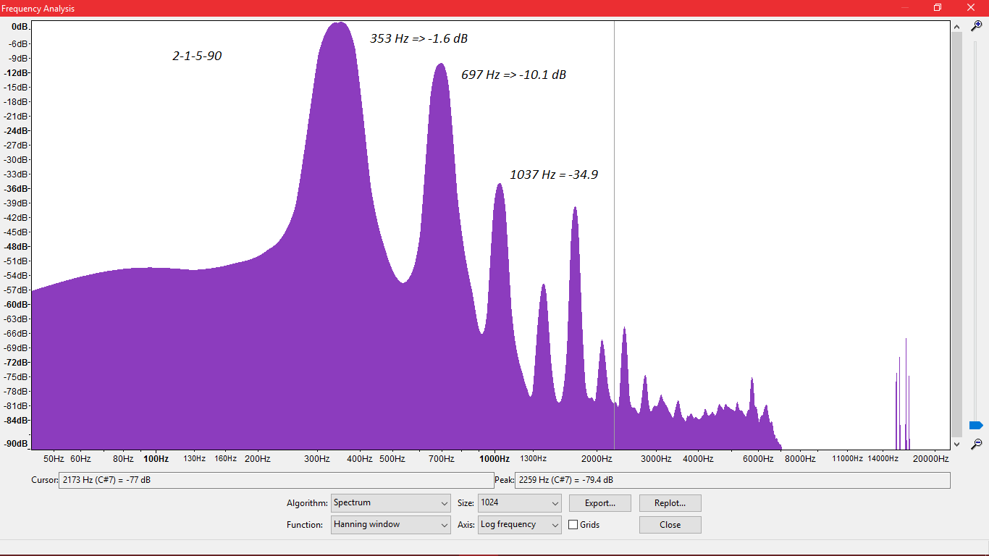
Difference in Wavelength for different length of tube
 | Tube 1 | Tube 2
Length | 90 | 53
Diameter | 4,8 | 4,8
Tube number 2
Tube number 1
The Difference between the two tubes are the length and diameter. So we need to take in account the position of the metal wire, as concluded from the previous comparison. The sound is going to vary with the harmonic maximum oscillations. (based on the frequency)

Slide 11
Tilt of tube
90
60
45
30
15
We can observe, that the sound intensity and process duration change, when tilting the tube.
We can defiantly observe a difference, when the tube is tilted. The results here are from the same tube and metal wire position.
Some of the visual data have a difference between their intensity of sound - this is from the experimental error – the heat transfer, but the length of the process is definitely longer

Slide 12
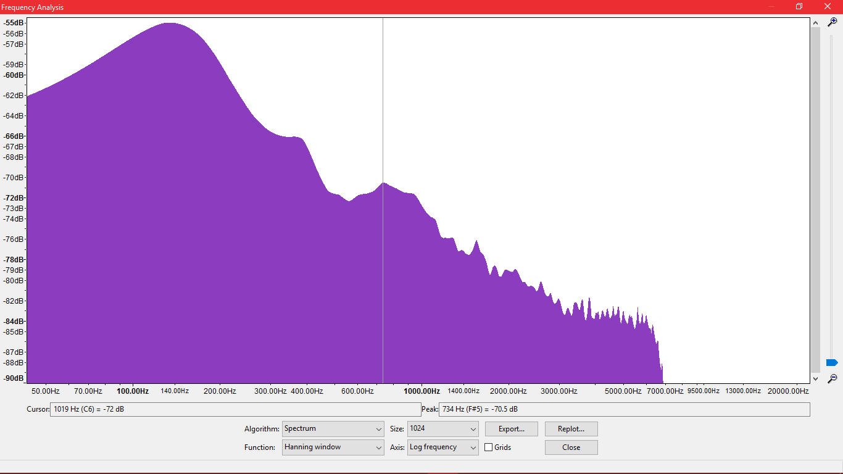
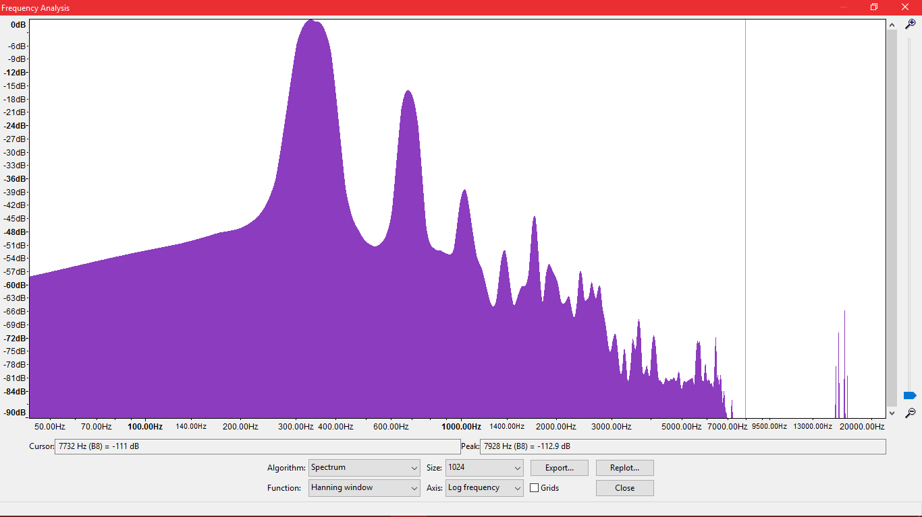
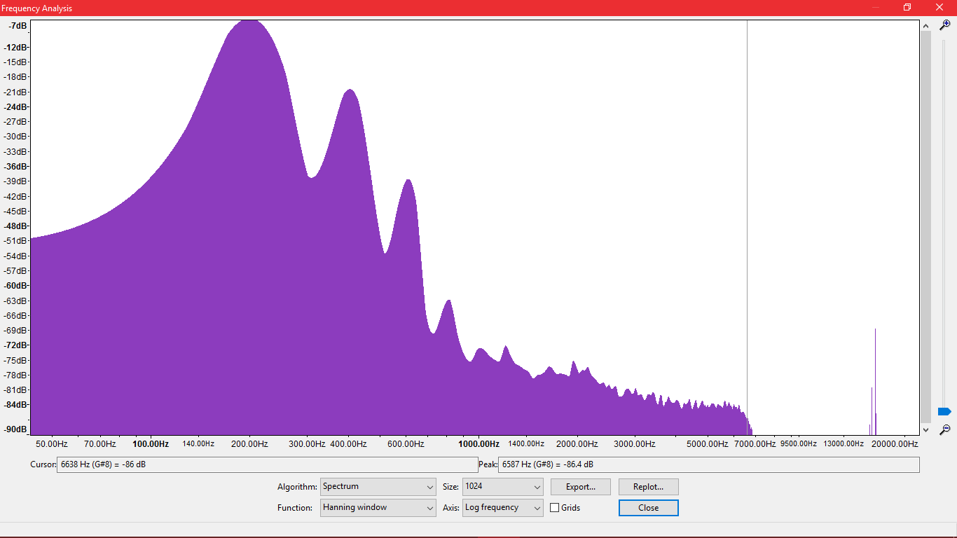
Background noise and acoustic
The Background is one of the most important variables, which influence the recording of the process. It fluctuates. In our situation the background won’t make the process unmeasurable, because several of the maximum peaks can not be an outcome from the background, but will make impossible the observations of 7th, 9th harmonic and so on.
The results measurement can change drastically with just changing the place of experiment.

Slide 13
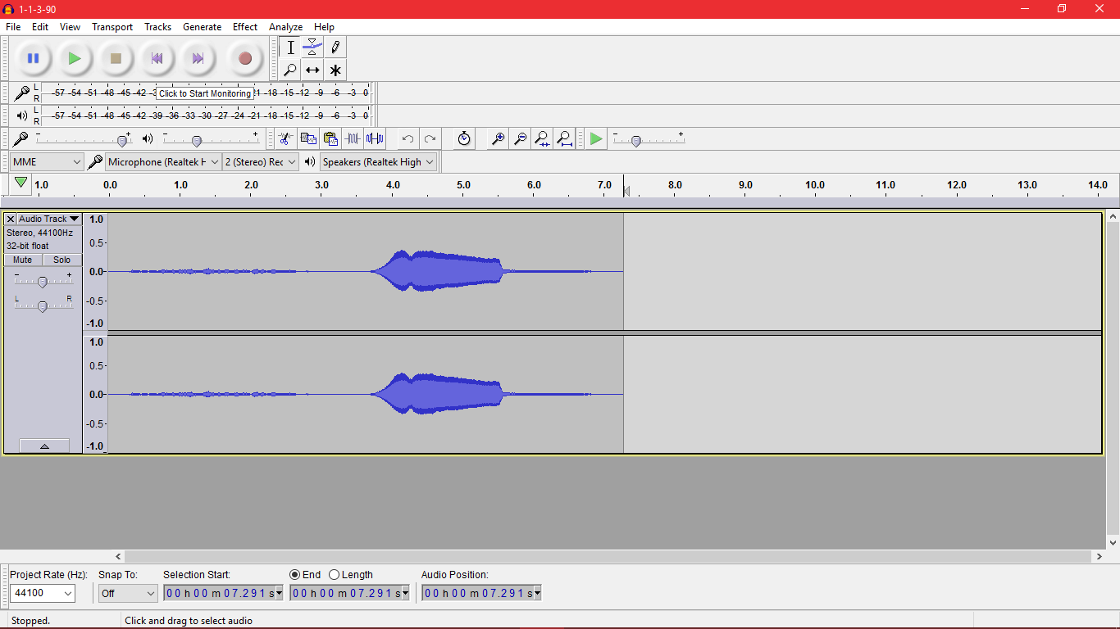
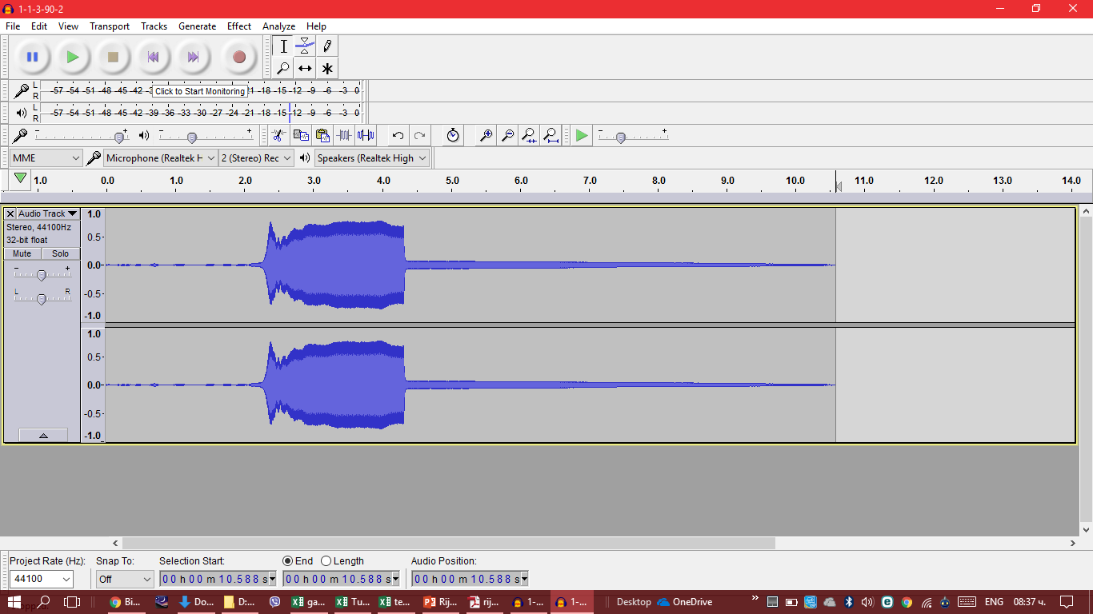
All variables influencing the intensity of sound and length of process
1. Thermal energy (IN THE SYSTEM)
Coefficient of thermal transfer of the tube.
Air humidity
Thermal energy from source
Distance of the heat source from the metal wire
All metal wire characteristics – Coefficient of thermal transfer and Specific coefficient of thermal transfer.
2. Air flow:
The velocity of the air inside the tube.
The tilt of the tube
Mins and Maximums of pressure.
Area of the holes of the metal wire (we change it by adding several wires on top of each other
The diameter of the tube
3. Other experimental setup variables
Distance of the tube from the microphone.
Type of microphone
Based on this factor is depended how much energy releases the metal wire, after heating
Based on the air flow is depended how much air comes into the system and respectively how much energy is transferred for the time of the process

Slide 14
Conclusion
Based on the length depends the ratio of wavelengths between different tubes.
Based on the position differ the wavelength for the tube itself.
The background is a factor, that influences the results and sometimes leads to errors in the measurements.
The intensity of the sound and the duration of the process depends on several factors as the area of the holes in the metal wires, heat transfer und etc.

Slide 15
Undetectable and unmeasurable variables
Data, that can not be measured:
1. Velocity of air and sound in the tube.
2. Background’s air variables:
Air Temperature
Air Humidity
Air Density.
Variables, that have a small to none influence:
The diameter of the ring (D-d)
The thermal transfer coefficient of the tube’s material.
Variables, with an influence, that can be reduced:
Background noise
Acoustic error from sound reflections.

Slide 16
=10*LOG(10^(0,1*(E3-B3))-1)+B3
E3 – Background intensity
B3 – Signal + Background intensity
We exported the audio-files as text document and then imported them in excel. The reason behind this function Is to show us were the “signal + background” has a higher level than the “background”.
This goes up to 2000 frequencies (depending on the bins), so this is just an illustration how we made the experiment
This is not always the case because of the fluctuations, so there can be more then the peaks from the harmonic.

Slide 17
Material of the tube
The material of the tube influences on several factors:
1. How much of the heat energy is lost, du to the absorption of the tube’s walls.
2. How will the sound oscillate in the tube.
To illustrate the influence we have tubes with the same characteristics except their material. – Zinc and Steel. We are going to compare their intensities to see if there is any difference

