Slide 1
IYNT 2017 NANJING Team BULGARIA
Problem 11
Grow light
Viktor Gilin
BULGARIA

Slide 2
The problem
11. Grow light
Investigate how different types of artificial lights affect plant growth. What is the role of light spectrum?

Slide 3
Theoretical part

Slide 4
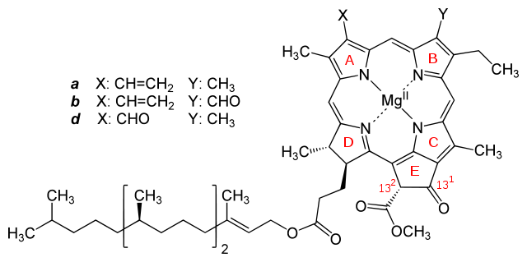
Pigments
Main carotenoids:
lutein
β-carotene
Chlorophyl

Slide 5
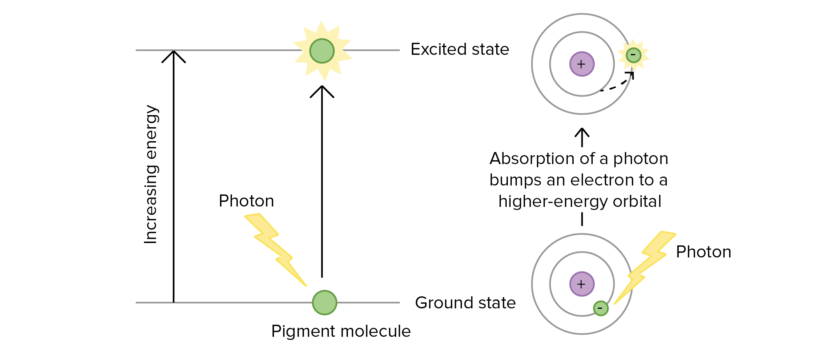
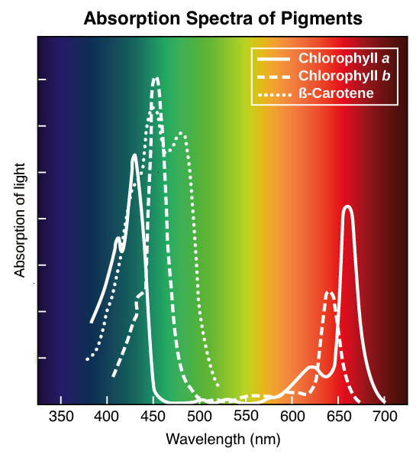
Absorption
https://www.khanacademy.org/science/biology/photosynthesis-in-plants/the-light-dependent-reactions-of-photosynthesis/a/light-and-photosynthetic-pigments

Slide 6
Our experiment

Slide 7
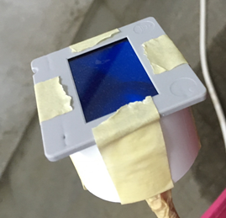
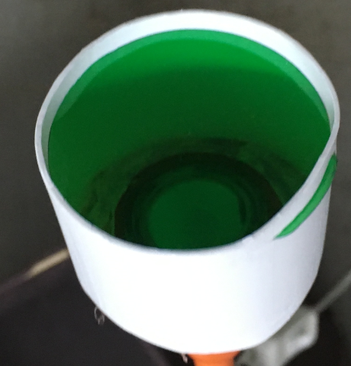
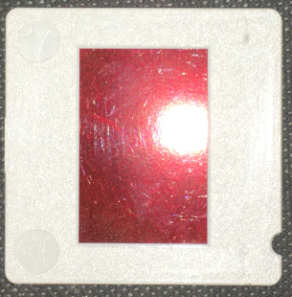
Experimental setup
8 flowerpots
4 LED lamps
4 boxes
Red, blue and green filter
A lot of seeds (garden cress)
Laboratory apparatus.

Slide 8
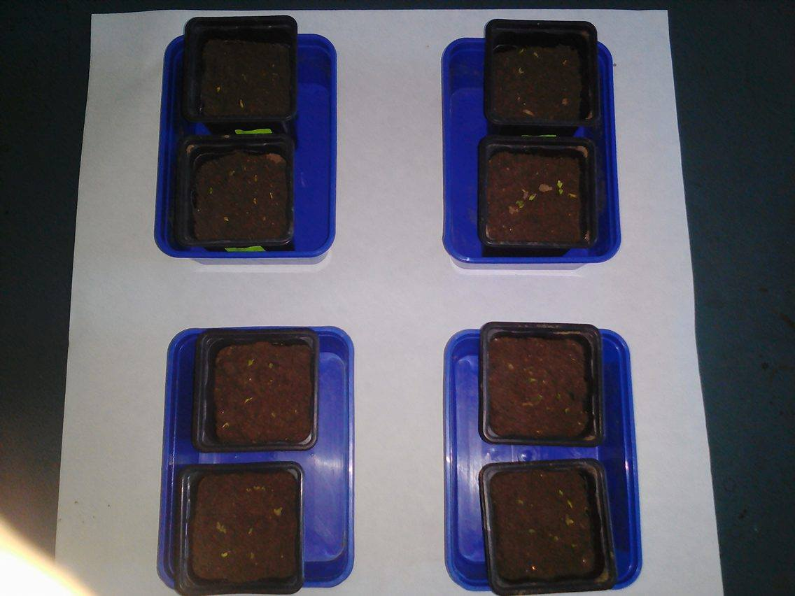
Day 3
The seeds have germinated

Slide 9
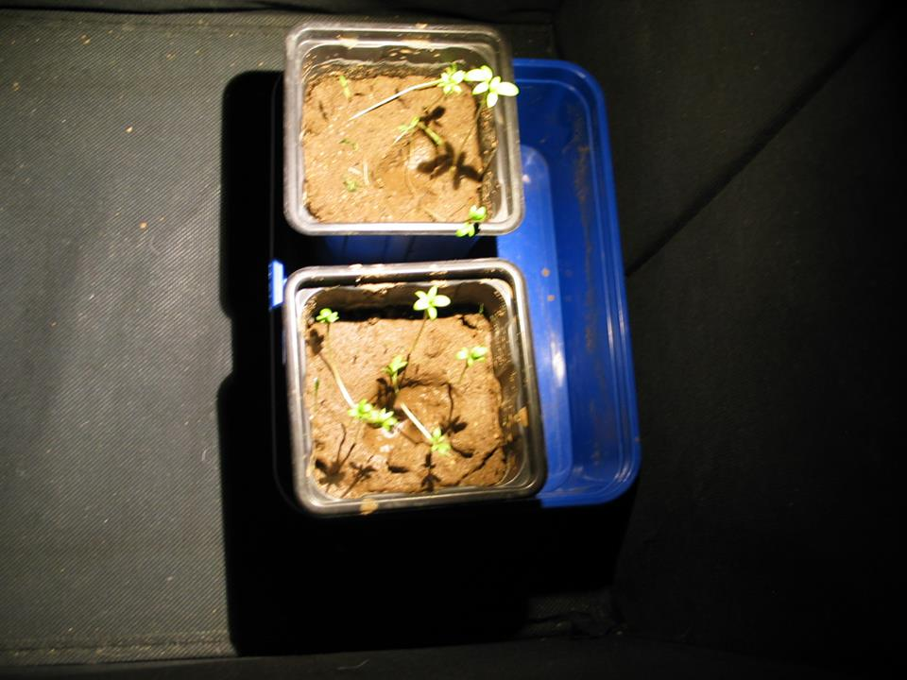
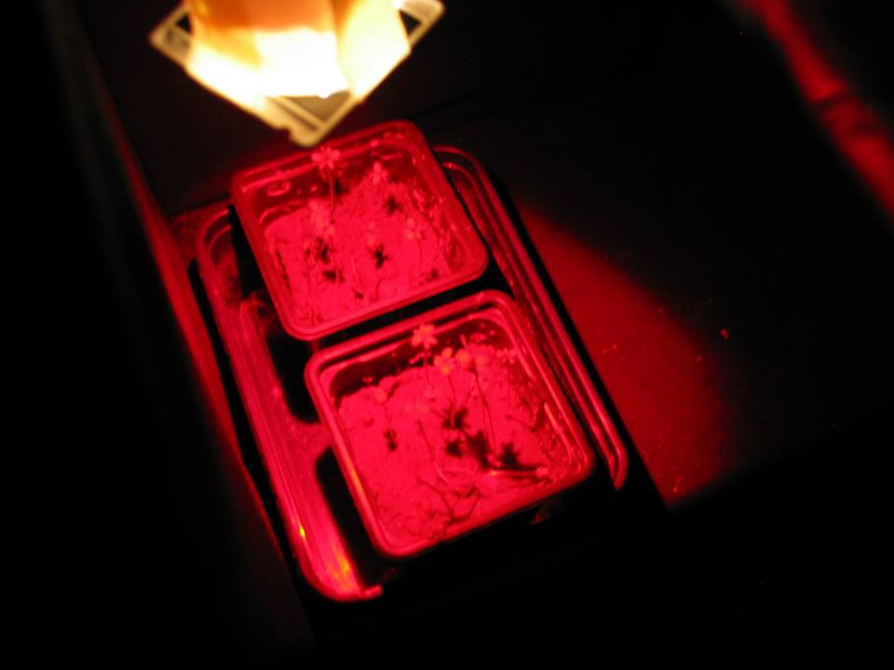
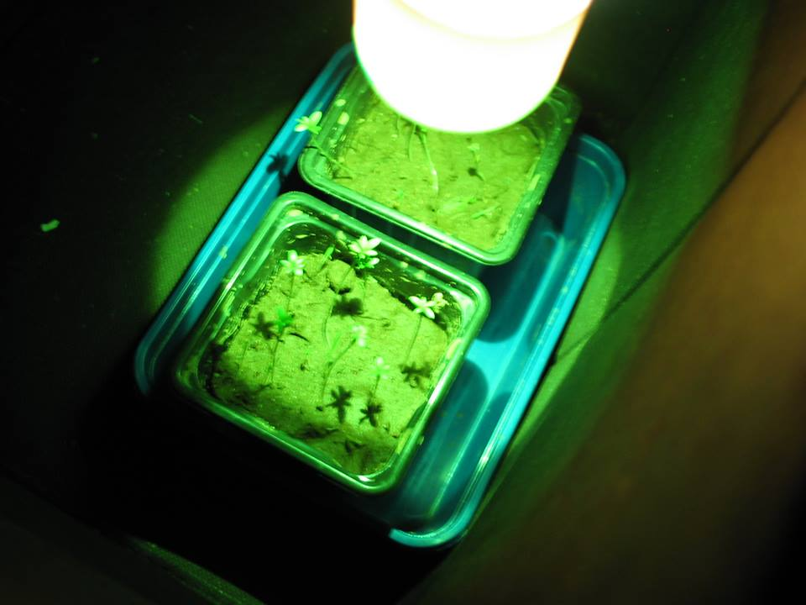
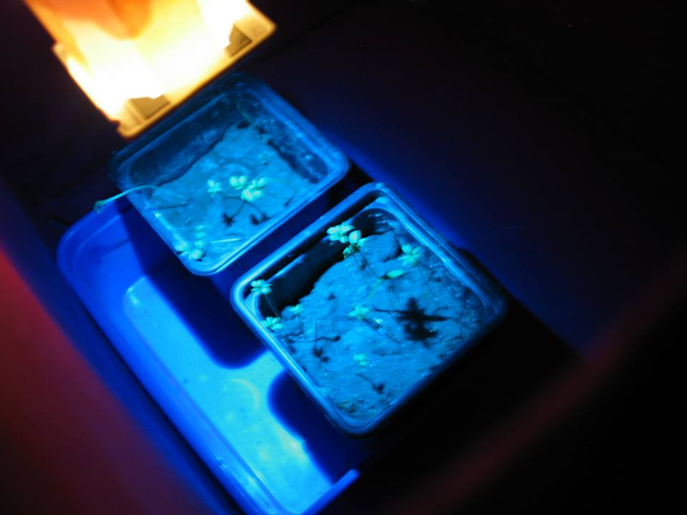
The illuminated plants

Slide 10
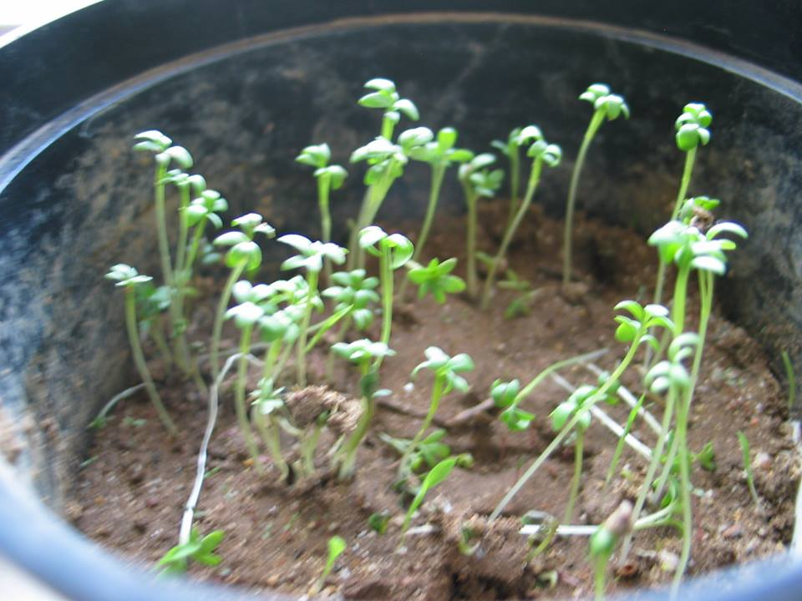
Control group - sunlight

Slide 11
The measurement
We have to measure the amount of photosynthetic pigments and the length of the over-ground of the plants.

Slide 12
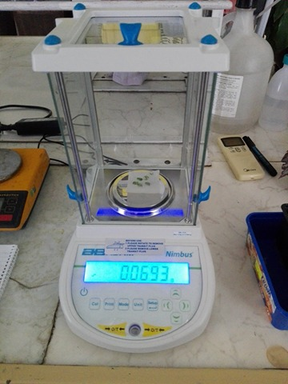
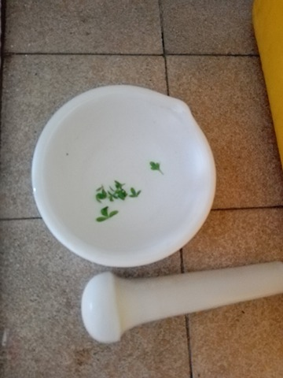
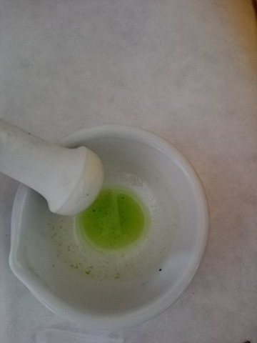
First we will measure the pigments
To do this we had to grind 1g fresh leaves in 20ml acetone (80%).

Slide 13
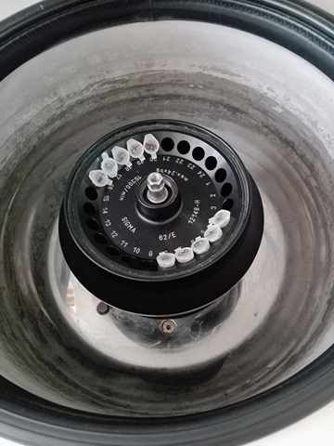
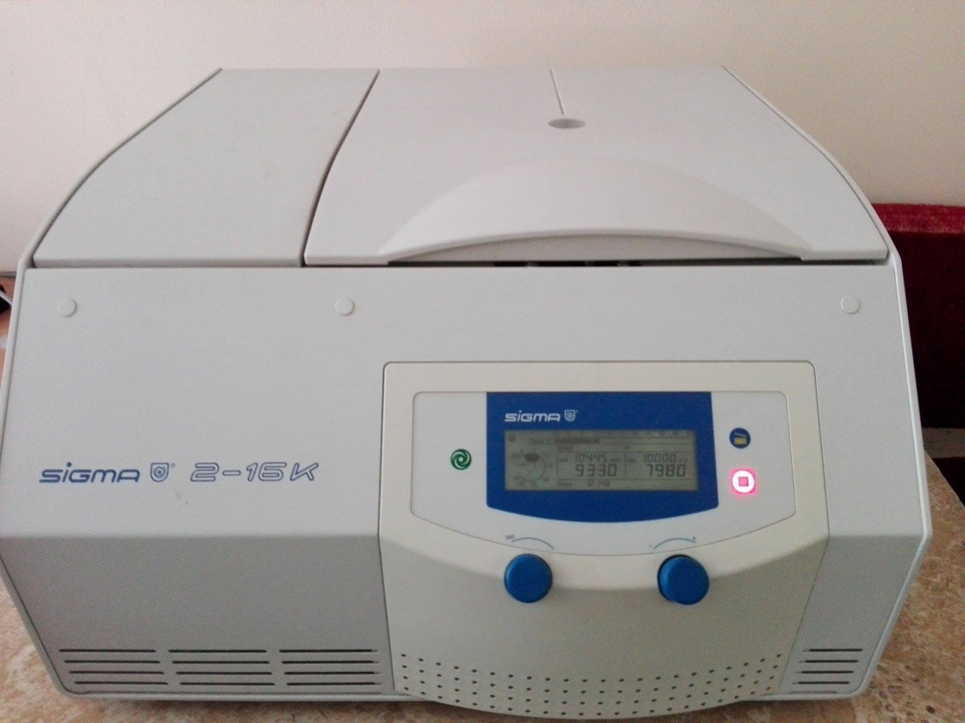
We put the samples in fridge or on ice water bath.
Than we centrifuge the samples for 10 min on 10000 g. In the centrifuge is forming sediment and supernatant (the thing under the sediment).

Slide 14
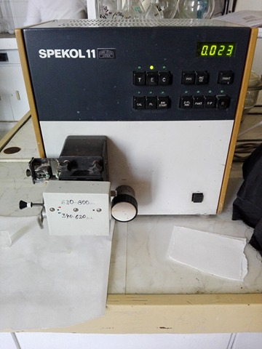
We take the supernatant and put it in another test-tubes. After that we fill up to 2 ml with acetone.
Than we put the samples in spectrophotometer(SPEKOL 11). In this apparatus we irradiate the samples with wavelenghts 663, 647 and 470 nm to measure the absorption.

Slide 15
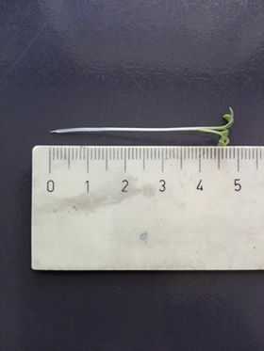
We also have to measure the length of the over-ground part of the plant. We measure them because they are the main part of the plant which grows a lot. We measure the plants with ruler.

Slide 16
Results

Slide 18
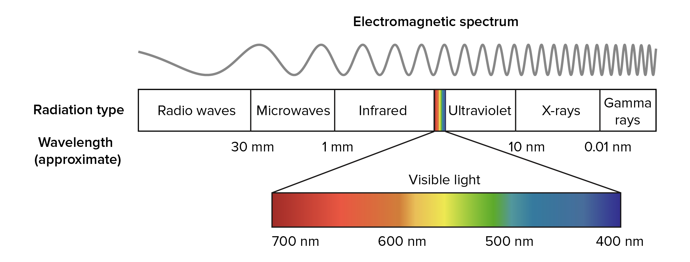
Light spectrum
The light is the electromagnetic waves with wavelength between 400 and 700 nm.
https://www.khanacademy.org/science/biology/photosynthesis-in-plants/the-light-dependent-reactions-of-photosynthesis/a/light-and-photosynthetic-pigments

Slide 19
To get results in µg/ml FW (fresh weight) we have to use special formulas (A=absorption)
Chl. a = 12.25*A 663 nm-2.55*A 647 nm
Chl. b = 20.31*A 647 nm-4.91*A 663 nm
Chl. a+b = 17.76*A 647 nm+7.34*A 663 nm
Car. = 4.69*A 470 nm-0.267*Chl. a+b

