Slide 1
26. Bouncing balls
Maria Krasnova
Team from Belarus

Slide 2
Aim
Make a small hole in a ping pong ball, fill it with some liquid and seal the hole. Drop the ball from the fixed height and investigate how high it bounces, depending on the amount of liquid inside

Slide 3
Theoretical part
Loss of mechanical energy can be calculated as:
∆E=mg(h-H₀)
h − height of bounch
H₀=const=0,1m − height of fall

Slide 4
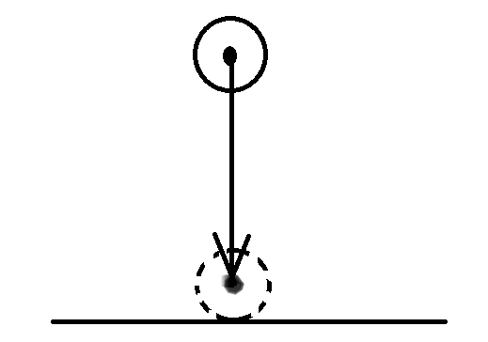
Theoretical part
KE=max, PE=0
KE=0, PE=max

Slide 5
Conclusion
As the fall height increases, the loss of mechanical energy decreases
As the volume of the water increases, the loss of mechanical energy also increases

Slide 6
Thank you for attention!
Maria Krasnova
Team from Belarus

