Slide 1
Paper wrinkles

Slide 2
The Problem
When a piece of paper dries after being wet, it can get wrinkled. Investigate and explain this phenomenon.

Slide 3
Objectives
To study this effect
To find out the conditions of the process
To find dependences characterizing the process

Slide 4
How does it work

Slide 5
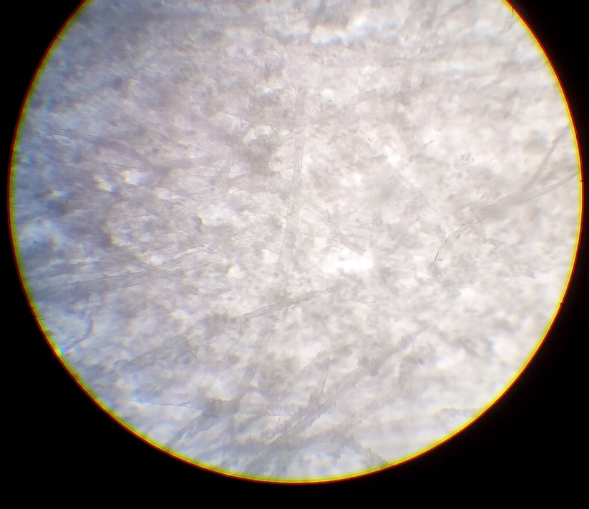
paper

Slide 6
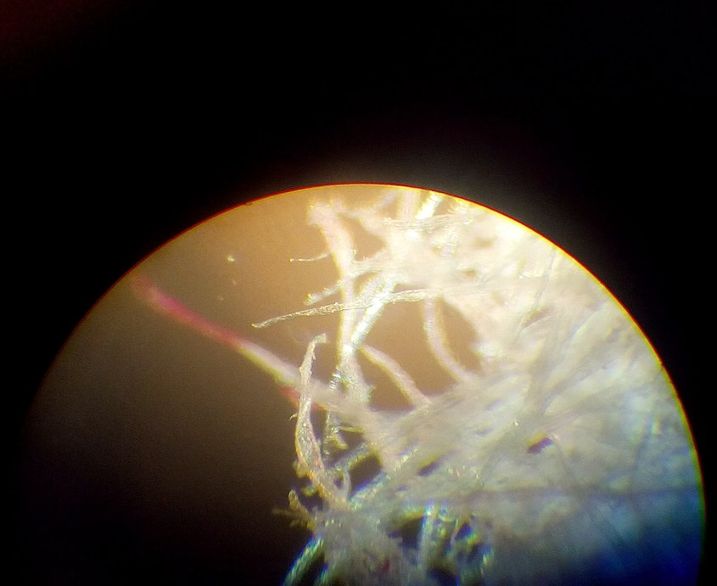
Fibers

Slide 7
Changes in structure
Molecular level
Fiber level
Macro level

Slide 9
Experiments
TO find out the dependence of the effect on the type of the paper I used two types:
A sheet from a notebook
A usual sheet a4

Slide 10
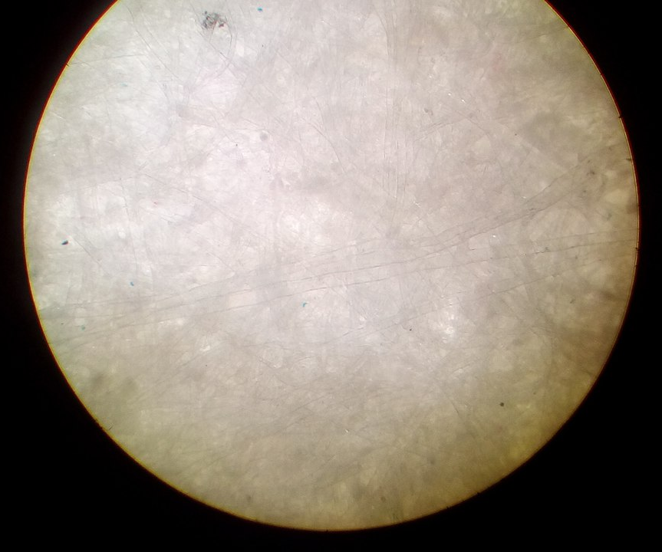
Notebook sheet
Dry

Slide 11
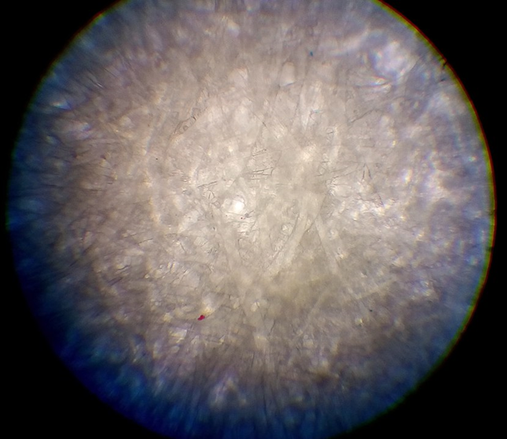
Notebook sheet
Wet

Slide 12
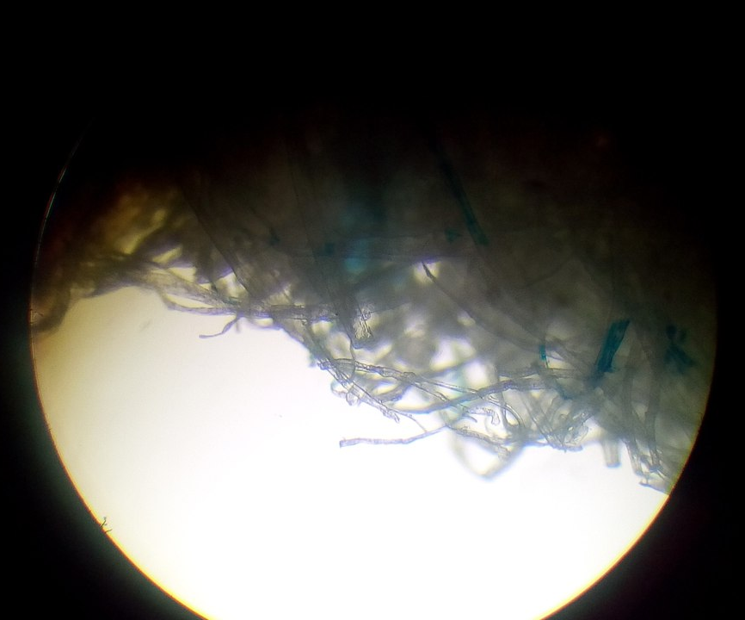
Notebook sheet
Dried up

Slide 13
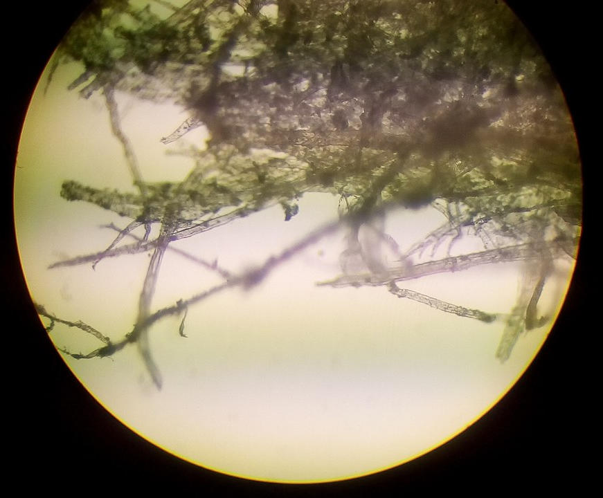
A4 sheet
Dry

Slide 14
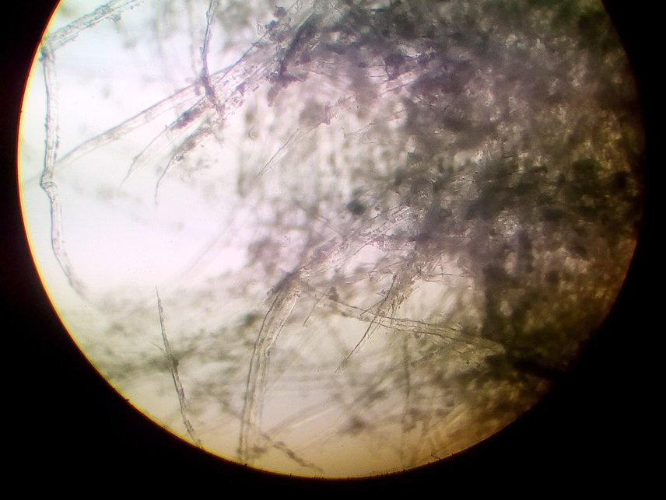
A4 sheet
Wet

Slide 15
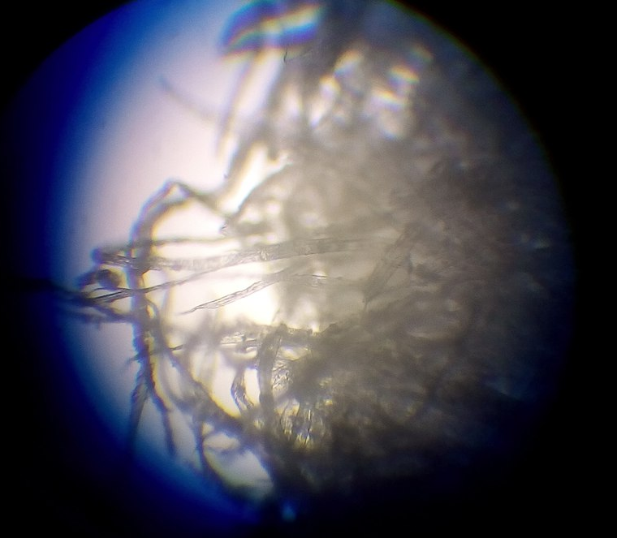
A4 sheet
Dried up

Slide 16
Conclusions of the experiment
Effect depends on the quantity of fibers
Effect depends on the quantity of interfiber space
The more the density of the paper the better effect we can notice

Slide 17
Explanation
The paper expands to some degree when hydrated. When drying, different parts of the paper dry at slightly different rates due to slight differences in the surrounding area and the slight randomness with which water evaporates. As it finishes drying, these variations become fixed.

Slide 18
WHAT CAN THE PROCESS DEPEND ON?
THE LIQUID
THE SPEED OF BECOMING DRY
THE TEMPERATURE

Slide 19
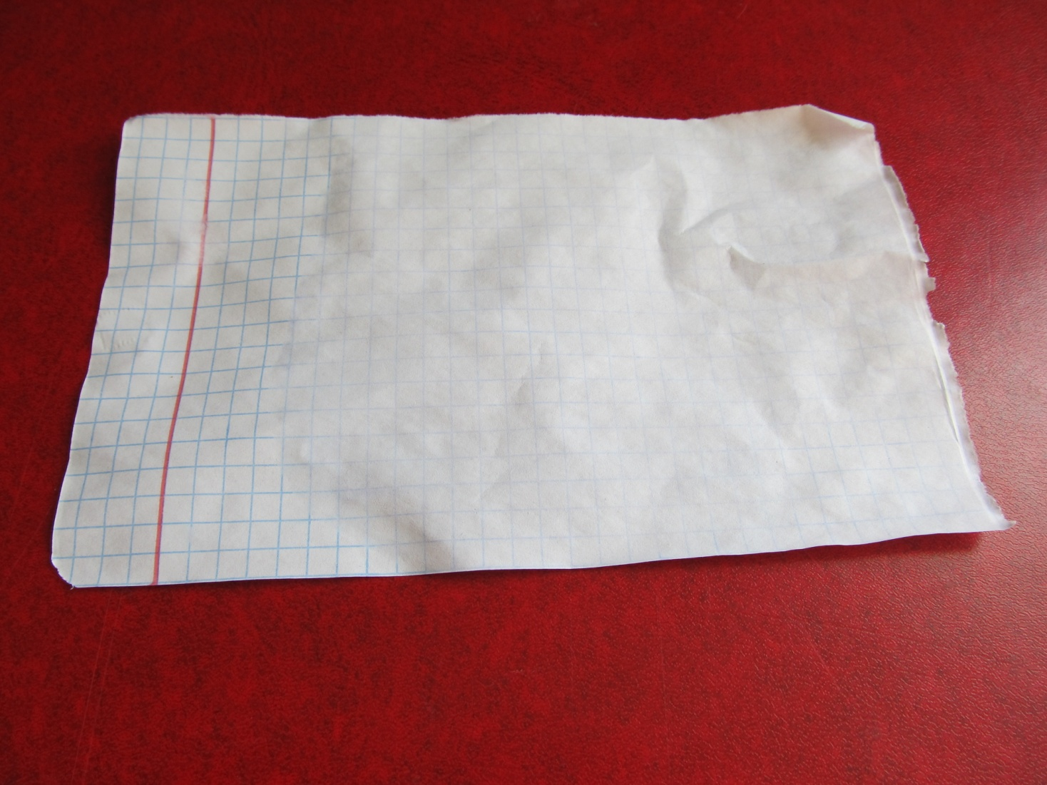
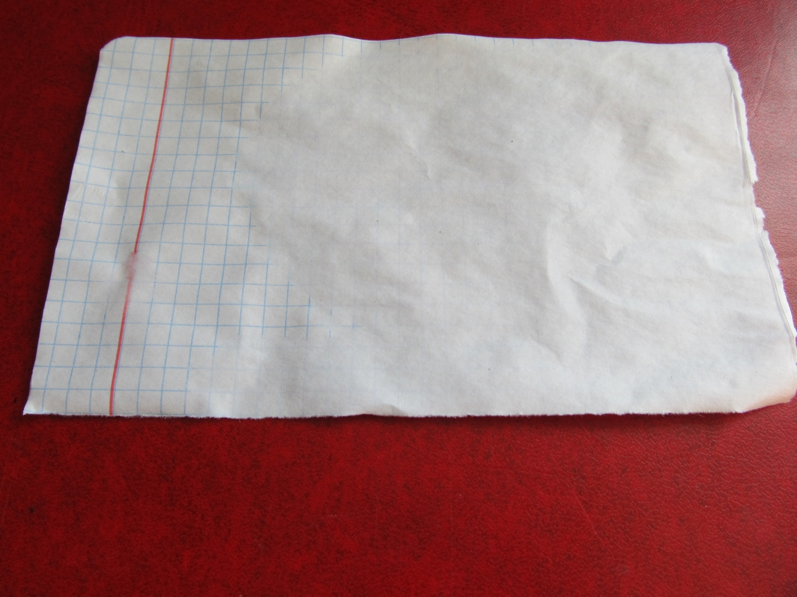
The liquid
Water
ALCOHOL

Slide 21
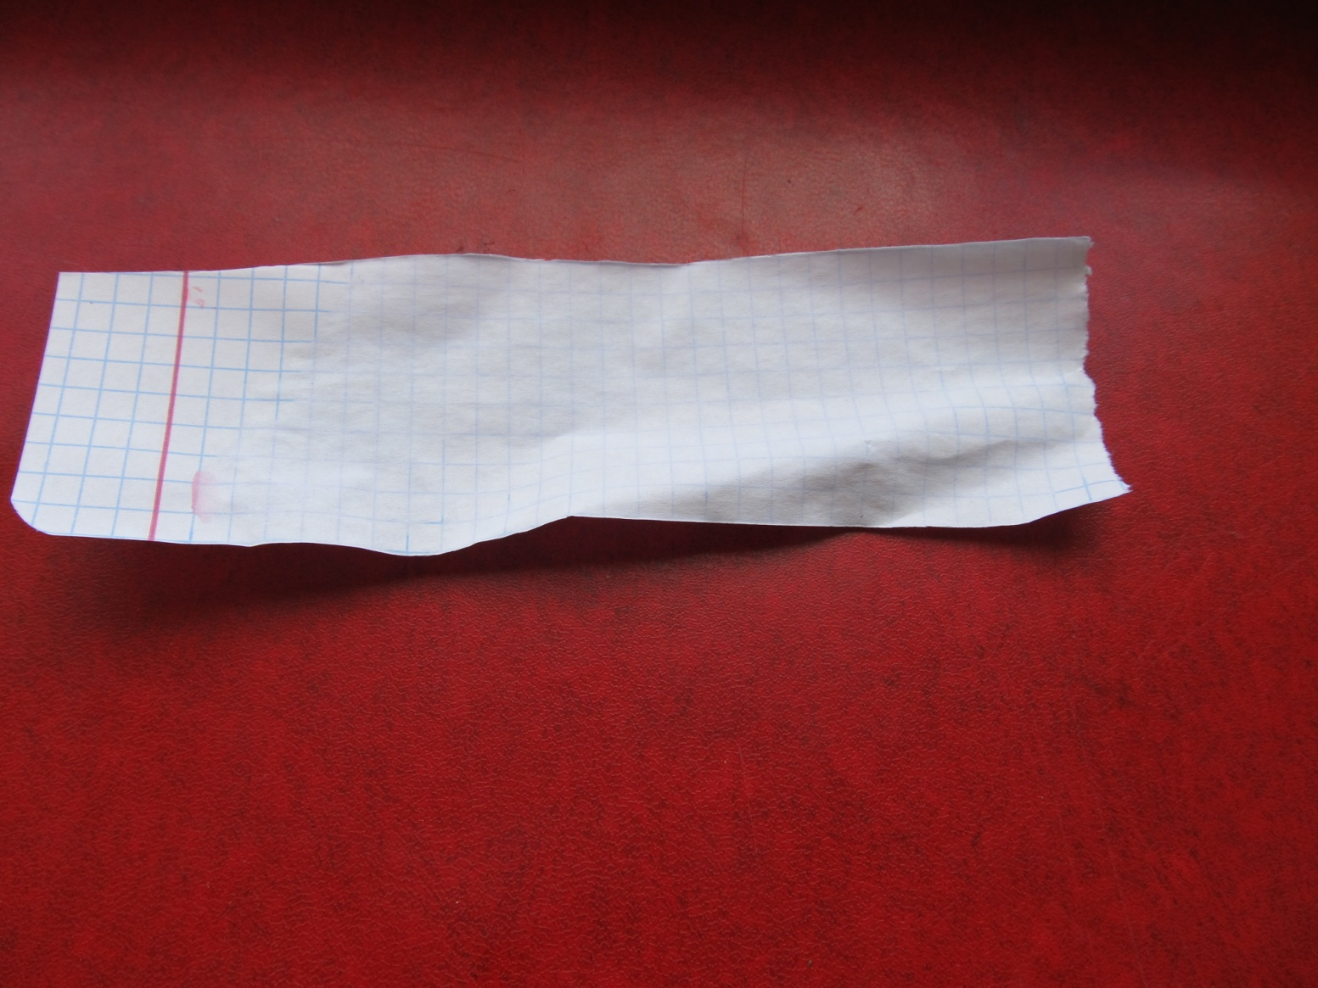
THE SPEED
IN THE WIND
WITHOUT WIND

Slide 22
THE TEMPERATURE
IN THE FRIDGE
IN THE ROOM

Slide 23
Results
Liquid influences the speed
Temperature influences the speed
Speed of evaporation is the main factor characterizing the process
The more the speed of evaporation the better effect we can notice

Slide 24
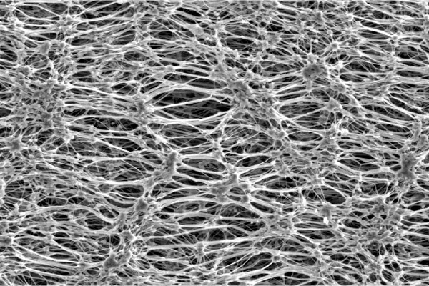
Why?

Slide 25
Necessary conditions
Big mass of molecules of the liquid
Big speed of evaporation

Slide 26
Conclusions
we have found the explanation of the effect
We have studied the effect and found main dependences

Slide 27
Thank you for attention
By andrew pevniy

