Slide 1
Water from the air

Slide 2
Problem
Design and construct a device allowing collecting of water by condensing moisture from air.
Determine if the water obtained with your device is suitable for drinking.
What amount of water is possible to collect during one Science Fight?

Slide 3
Objectives
To find out how water can be collected from the air
To make up a construction allowing collecting it
To study the qualities of the device

Slide 4
How does it work?

Slide 5
Humidity

Slide 6
Condensing

Slide 7
«Greenhouse»
The easiest way to collect water
Does not require any equipment
Rather big efficient

Slide 8
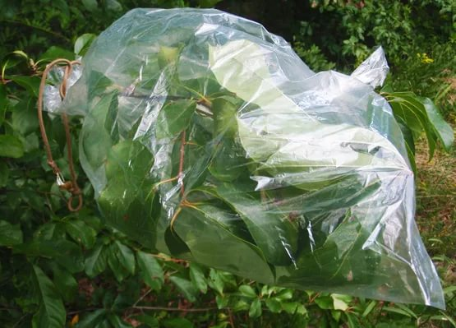
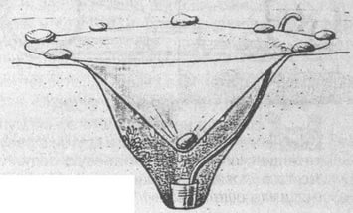
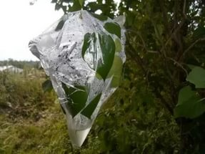
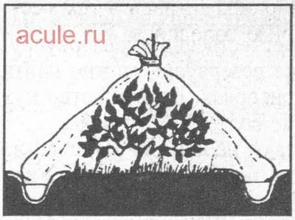

Slide 9
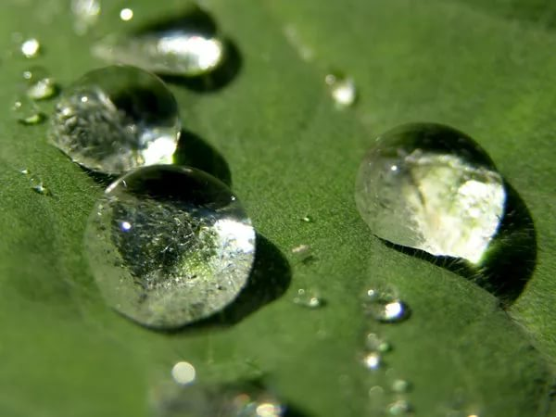
Dew

Slide 10
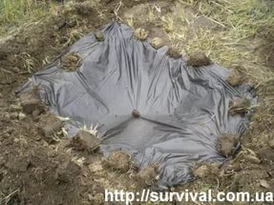
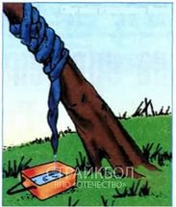
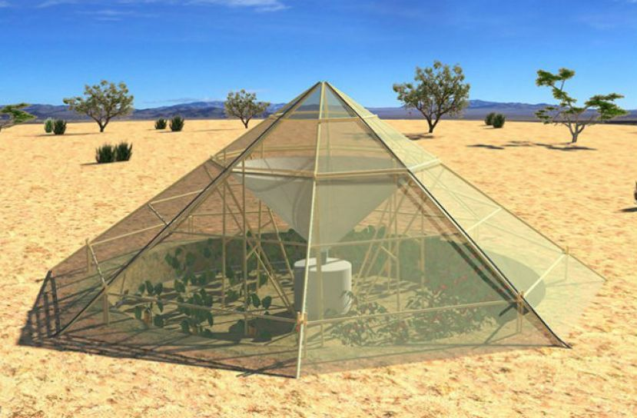

Slide 11
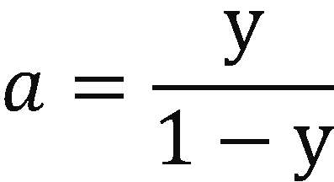
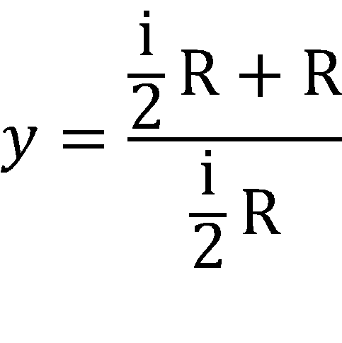
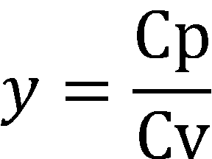
«Handmade»
PTª =const;

Slide 12
Adiabatic Law
i – number of degrees of freedom
For water: i=9; then
y = 11/9; a = -11/2=-5,5;
PT^{(-5,5)} =const or
P/T^{(5,5)}=const;

Slide 13
Relative humidity

Slide 15
Volumes
TV^{y-1} = const;
T₁=295K V₁/V₂=1,29
T₂=279K

Slide 16
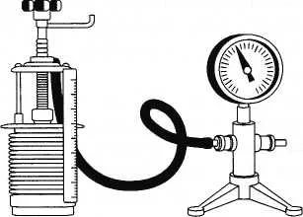
Easy examples
Rapid change
in volume

Slide 17
Thank you for attention

