Slide 1
13. ALLOMETRY
Laplace Witches
Reporter
NFLS, Jul.4th
Final

Slide 2
2017 IYNT-Final
13. Allometry
01. Problem Review
02. Theoretical Analysis
Laplace Witches
OUTLINE
03. Experimentation and Conclusion
04. Further Discussion and Improvements
05. References

Slide 3
01
PROBLEM REVIEW

Slide 4
Problem 13
Allometry
How do length and thickness of bones scale with overall size and weight of animal?

Slide 5
KEY WORDS ANALYSIS
KEY WORDS
1. Bone: (fish backbone)
2. Length: The length of the backbone
3. Thickness: The Circumference of the back
bone can represent thickness
4. Weight: The mass of the whole fish
Size: The volume of the whole fish
Scale with: the relationship between, the scale between.

Slide 6
02
THEORETICAL ANALYSIS

Slide 7
ISOMETRIC SCALING
ISOMETRIC SCALING
Isometric scaling is governed by the square-cube law. For example, an organism which doubles in length isometrically will find that the other quantities available to it, such as the surface-area will increase fourfold, while its volume and mass will increase by a factor of eight.

Slide 8
ALLOMETRIC SCALING
Allometric Scaling
Allometric scaling is any change that deviates from isometry

Slide 9
ALLOMETRIC SCALING
Perfect Isometric Scaling
A perfectly isometrically scaling organism would see all volume-based properties change proportionally to the body mass, all surface area-based properties change with mass to the power 2/3, and all length-based properties change with mass to the 1/3 power.

Slide 10
ALLOMETRIC SCALING
If, after statistical analyses, for example, a volume-based property was found to scale to mass to the 0.9 power, then this would be called "negative allometry", as the values are smaller than predicted by isometry. Conversely, if a surface area based property scales to mass to the 0.8 power, the values are higher than predicted by isometry and the organism is said to show "positive allometry".

Slide 11
FORMULA OF ALLOMETRY
Formulation
1. y = k*x^a
2. log y = a*log x + log k (logarithmic form)
x, y: Measured parameters (length, weight……)
k: A constant depending on species
a: Scaling exponent

Slide 12
03
EXPERIMENTATION
AND CONCLUSION

Slide 13
PRELIMINARY EXPERIMENT

Slide 14
GRAPHIC
Mass/g
Length/cm

Slide 15
FORMAL EXPERIMENT

Slide 16
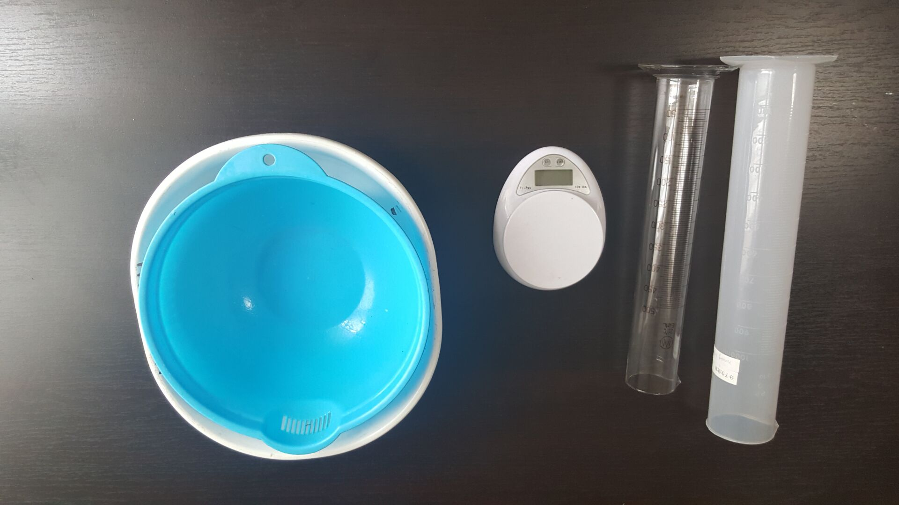
DEVICES

Slide 17
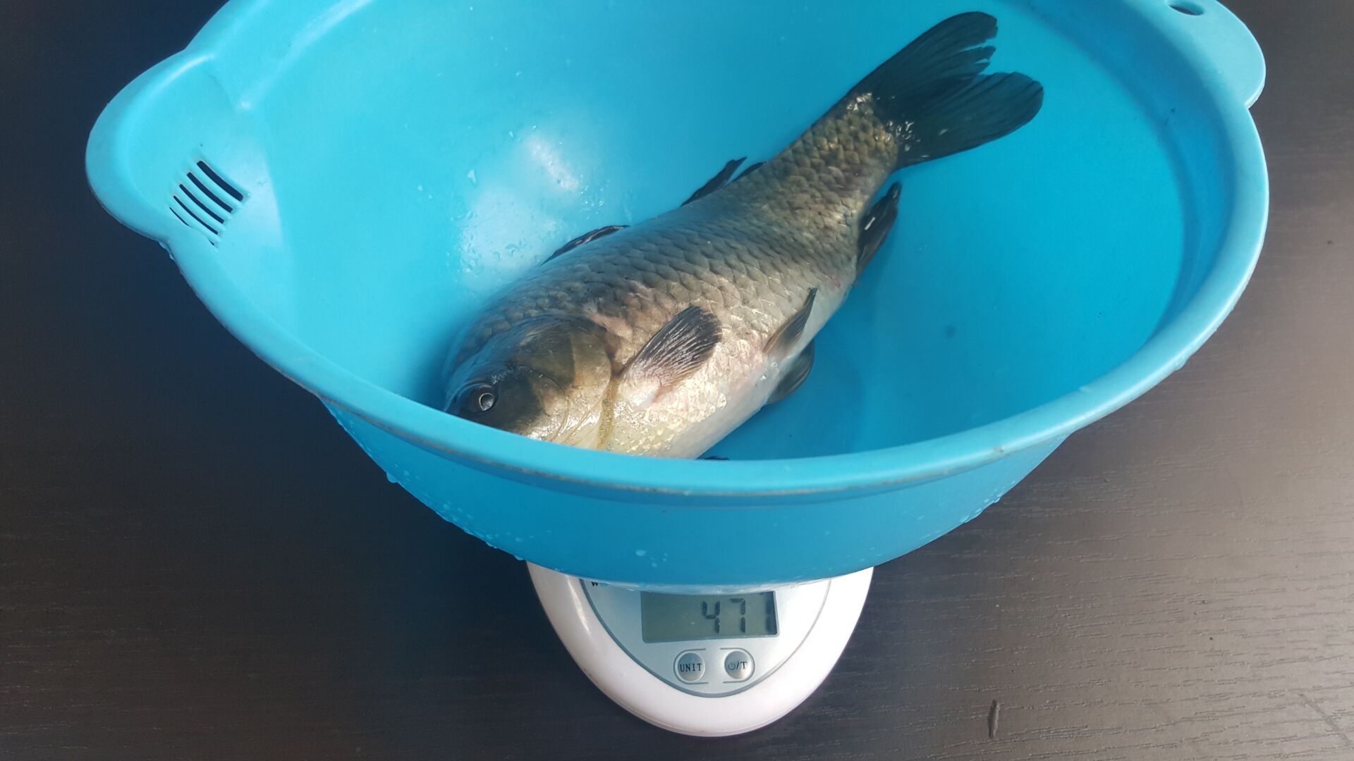
WEIGHT

Slide 18
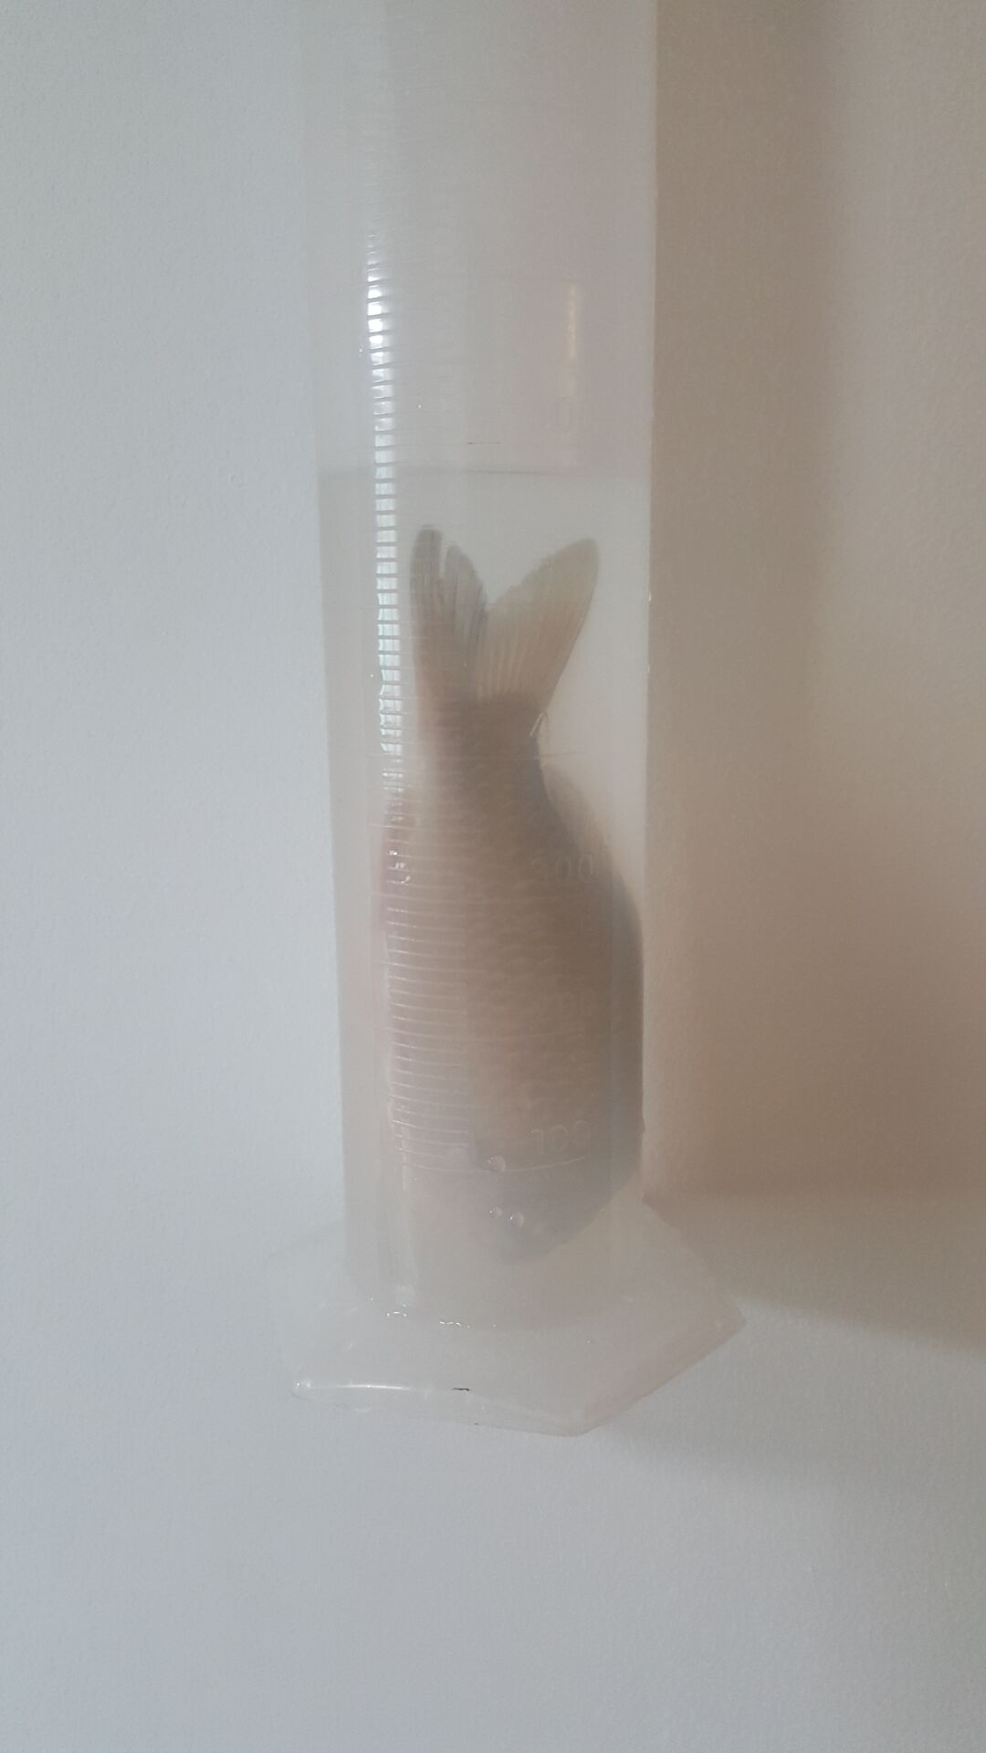
SIZE (SMALL FISH)

Slide 19
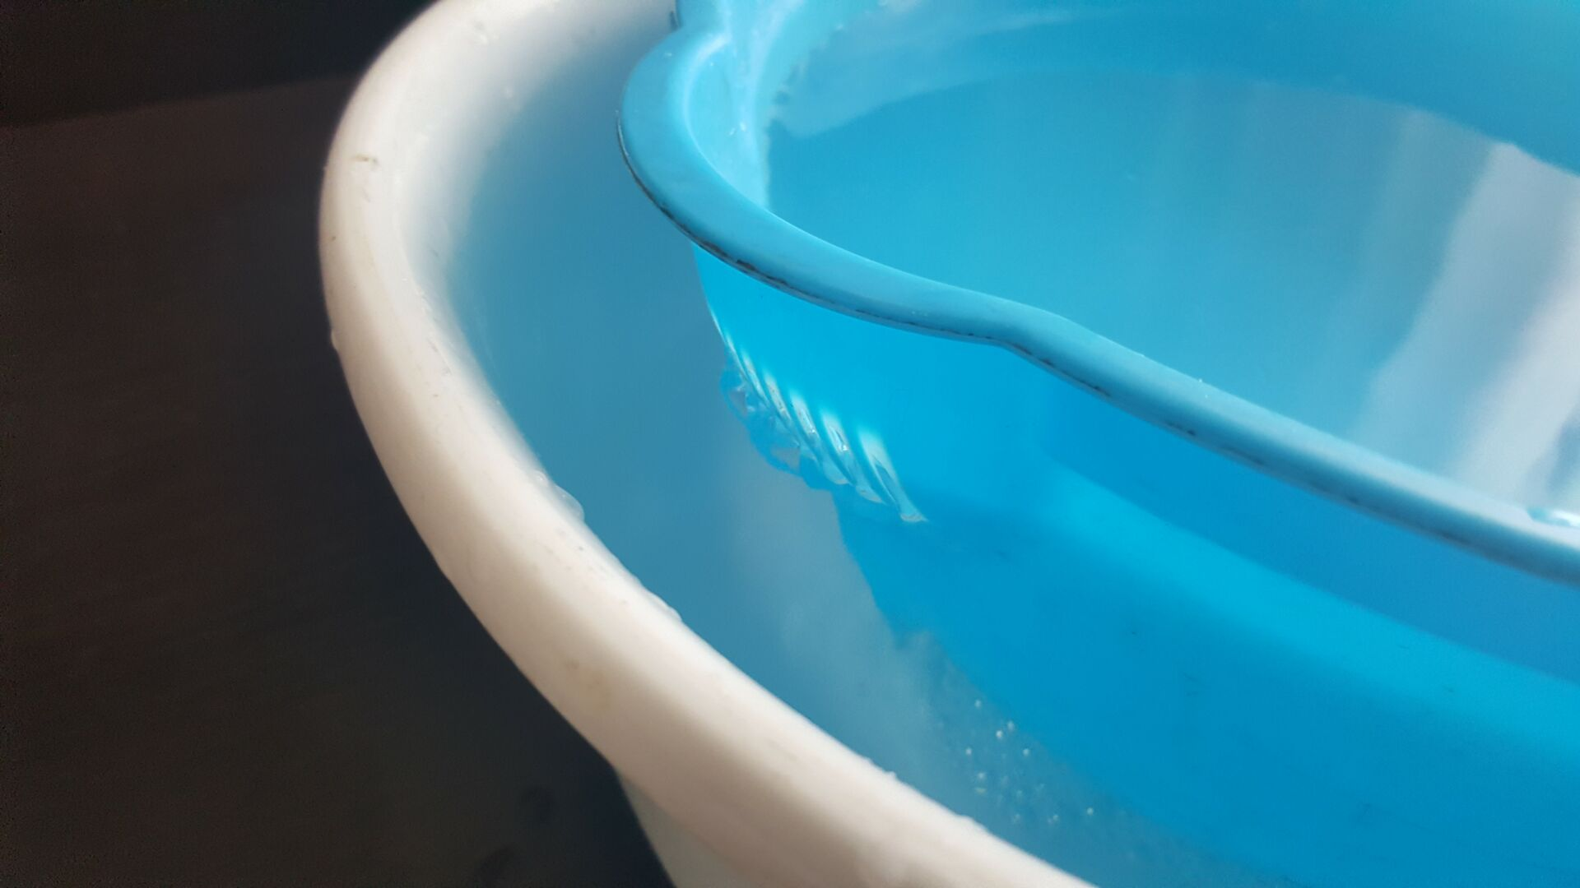
SIZE (BIG FISH)

Slide 20
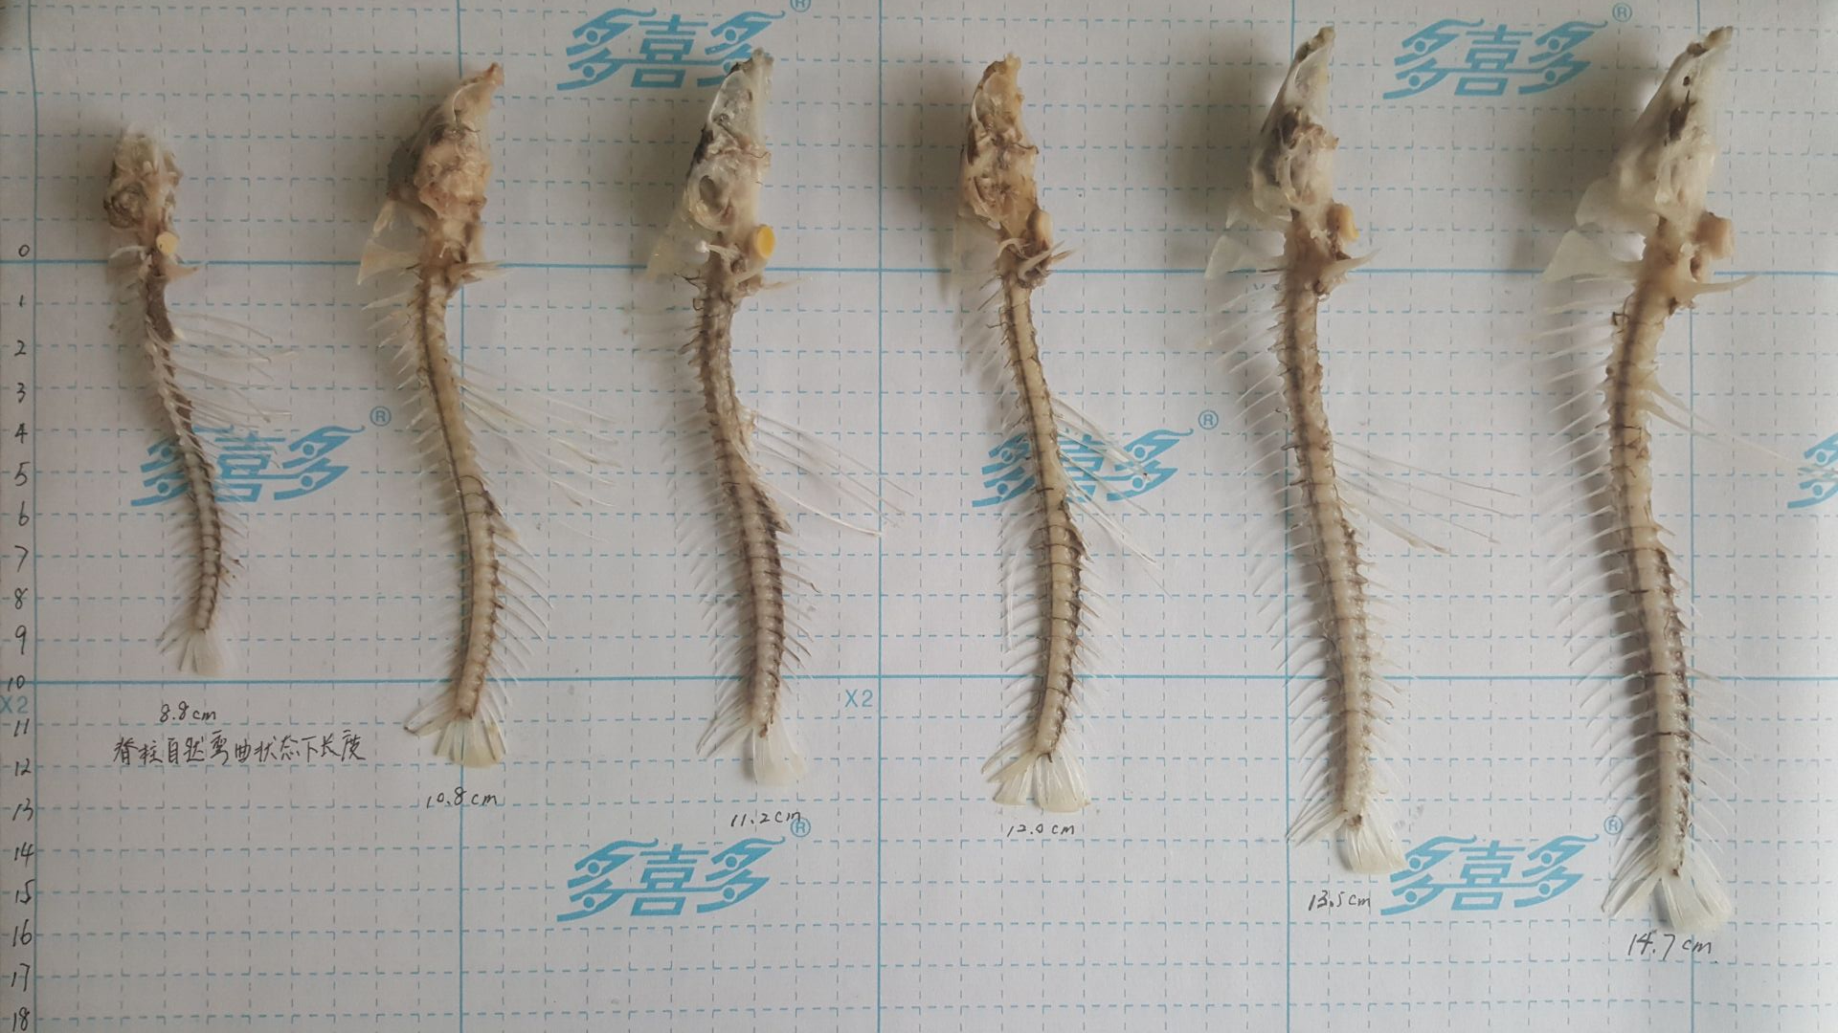
LENGTH

Slide 21
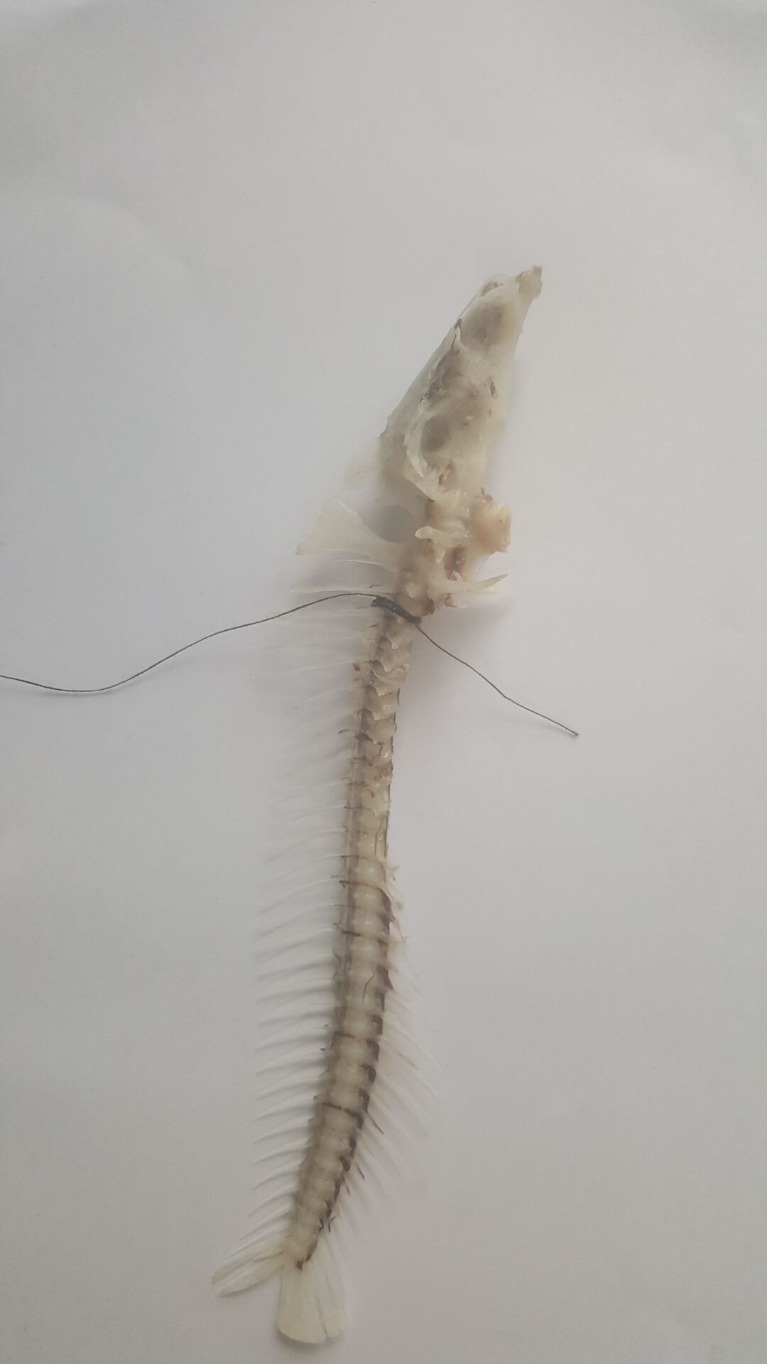
THICKNESS

Slide 22
GRAPHICS
Log V(Volume)
Log M(Mass)

Slide 23
STATISTICAL ANALYSIS
回归统计
Multiple R | 0.99488932
R Square | 0.989804758
Adjusted R Square | 0.987255948
标准误差 | 0.030172033
观测值 | 6
方差分析
 | df | SS | MS | F | Significance F
回归分析 | 1 | 0.353525815 | 0.353525815 | 388.3398814 | 3.91118E-05
残差 | 4 | 0.003641406 | 0.000910352
总计 | 5 | 0.357167221
 | Coefficients | 标准误差 | t Stat | P-value | Lower 95% | Upper 95% | 下限 95.0% | 上限 95.0%
Intercept | 0.021059559 | 0.120690792 | 0.174491848 | 0.869954662 | -0.3140318 | 0.356150919 | -0.3140318 | 0.356150919
X Variable 1 | 1.00044406 | 0.050767621 | 19.70634115 | 3.91118E-05 | 0.859490547 | 1.141397573 | 0.859490547 | 1.141397573
Standard Deviation
‘1’ and more means completely wrong
Our deviation is 3%, which is very close to 0.
The constant a
(ascent of the log linear)

Slide 24
LOGARITHMIC FORM
Log M(mass)
Log L(length)

Slide 25
STATISTICLE ANALYSIS
SUMMARY OUTPUT
回归统计
Multiple R | 0.99184607
R Square | 0.983758626
Adjusted R Square | 0.979698283
标准误差 | 0.037870334
观测值 | 6
方差分析
 | df | SS | MS | F | Significance F
回归分析 | 1 | 0.347475401 | 0.347475401 | 242.2845882 | 9.94588E-05
残差 | 4 | 0.005736649 | 0.001434162
总计 | 5 | 0.35321205
 | Coefficients | 标准 | t Stat | P-value | Lower 95% | Upper 95% | 下限 95.0% | 上限 95.0%
Intercept | -1.227258267 | 0.231294608 | -5.306039235 | 0.006062389 | -1.869435051 | -0.585081484 | -1.869435051 | -0.585081484
X Variable 1 | 3.365571851 | 0.216220054 | 15.56549351 | 9.94588E-05 | 2.76524874 | 3.965894963 | 2.76524874 | 3.965894963

Slide 26
Log V(Volume)
Log L

Slide 27
回归统计
Multiple R | 0.974240199
R Square | 0.949143965
Adjusted R Square | 0.936429956
标准误差 | 0.067387144
观测值 | 6
方差分析
 | df | SS | MS | F | Significance F
回归分析 | 1 | 0.339003112 | 0.339003112 | 74.65339882 | 0.000986804
残差 | 4 | 0.018164109 | 0.004541027
总计 | 5 | 0.357167221
 | Coefficients | 标准误差 | t Stat | P-value | Lower 95% | Upper 95% | 下限 95.0% | 上限 95.0%
Intercept | -1.161085499 | 0.411569726 | -2.821114932 | 0.047773984 | -2.30378625 | -0.018384748 | -2.30378625 | -0.018384748
X Variable 1 | 3.324288267 | 0.384745797 | 8.640219836 | 0.000986804 | 2.256062682 | 4.392513852 | 2.256062682 | 4.392513852

Slide 28
Log M(mass)
Log T(Thickness)

Slide 29
回归统计
Multiple R | 0.879840431
R Square | 0.774119183
Adjusted R Square | 0.717648979
标准误差 | 0.141230155
观测值 | 6
方差分析
 | df | SS | MS | F | Significance F
回归分析 | 1 | 0.273428224 | 0.273428224 | 13.70845376 | 0.020790032
残差 | 4 | 0.079783826 | 0.019945957
总计 | 5 | 0.35321205
 | Coefficients | 标准误差 | t Stat | P-value | Lower 95% | Upper 95% | 下限 95.0% | 上限 95.0%
Intercept | 2.279782832 | 0.062071598 | 36.72827653 | 3.281E-06 | 2.107444446 | 2.452121217 | 2.107444446 | 2.452121217
X Variable 1 | 2.670713522 | 0.721328463 | 3.702492912 | 0.020790032 | 0.667984641 | 4.673442403 | 0.667984641 | 4.673442403

Slide 30
Log V
Log T

Slide 31
回归统计
Multiple R | 0.847483137
R Square | 0.718227667
Adjusted R Square | 0.647784584
标准误差 | 0.158618915
观测值 | 6
方差分析
 | df | SS | MS | F | Significance F
回归分析 | 1 | 0.25652738 | 0.25652738 | 10.1958579 | 0.033118213
残差 | 4 | 0.100639841 | 0.02515996
总计 | 5 | 0.357167221
 | Coefficients | 标准误差 | t Stat | P-value | Lower 95% | Upper 95% | 下限 95.0% | 上限 95.0%
Intercept | 2.304565234 | 0.069714075 | 33.05738806 | 4.99381E-06 | 2.111007932 | 2.498122537 | 2.111007932 | 2.498122537
X Variable 1 | 2.58685745 | 0.810140997 | 3.193095347 | 0.033118213 | 0.337545443 | 4.836169457 | 0.337545443 | 4.836169457

Slide 32
CONCLUSION
Conclusion
The graph with a X-axis representing log L or log T, and a Y axis representing either log M or log V forms a linear with a ascent of a, which is 3.3-3.6 for fish.
2. The grow of fish belongs to allometric
growth instead of isometric growth.
But we need further discussion.

Slide 33
POSSIBLE DEVIATION ANALYSIS
Thickness deviation
Volume deviation (Surface Tension)
The third fish is mutated.
(No matter its length or thinkness, it’s
larger than usual.

Slide 34
04
FURTHER DISCUSSION
AND IMPROVEMENTS

Slide 35
IMPROVEMENTS
Use more fish of the same kind (need a LARGER!! sample number) and repeat the experiment to eliminate uncertainties
Use better devices to measure the thickness to make the result more accurate
Use different types of fish and repeat the experiment
4. Further investigate in the mutation of fish.

Slide 36
05
REFERENCES

Slide 37
REFERENCES
1. Longo, Giuseppe; Montévil, Maël (2014-01-01). Perspectives on Organisms. Lecture Notes in Morphogenesis. Springer Berlin Heidelberg. pp. 23–73. ISBN 9783642359378. doi:10.1007/978-3-642-35938-5_2.

Slide 38
Christian, A.; Garland T., Jr. (1996). "Scaling of limb proportions in monitor lizards (Squamata: Varanidae)" (PDF). Journal of Herpetology. 30 (2): 219–230. JSTOR 1565513. doi:10.2307/1565513.
Jump up^ R. O. Anderson and R. M. Neumann, Length, Weight, and Associated Structural Indices, in Fisheries Techniques, second edition, B.E. Murphy and D.W. Willis, eds., American Fisheries Society, 1996.
Jump up^ Pennycuick, Colin J. (1992). Newton Rules Biology. Oxford University Press. p. 111. ISBN 0-19-854021-3.
Jump up^ Schmidt-Nielsen 1984, p. 237
Jump up^ Gibbings, J.C. (2011). Dimensional Analysis. Springer. ISBN 978-1-84996-317-6.
^ Jump up to:ª ^{b} ^{c} ^{d}

Slide 39
THANK YOU
PPT模板下载：www.1ppt.com/moban/ 行业PPT模板：www.1ppt.com/hangye/
节日PPT模板：www.1ppt.com/jieri/ PPT素材下载：www.1ppt.com/sucai/
PPT背景图片：www.1ppt.com/beijing/ PPT图表下载：www.1ppt.com/tubiao/
优秀PPT下载：www.1ppt.com/xiazai/ PPT教程： www.1ppt.com/powerpoint/
Word教程： www.1ppt.com/word/ Excel教程：www.1ppt.com/excel/
资料下载：www.1ppt.com/ziliao/ PPT课件下载：www.1ppt.com/kejian/
范文下载：www.1ppt.com/fanwen/ 试卷下载：www.1ppt.com/shiti/
教案下载：www.1ppt.com/jiaoan/ PPT论坛：www.1ppt.cn

