Slide 1
11. Grow Light
LaplaceWitches
Nanjing Foreign Language School
2017.6.29-2017.7.4

Slide 2
2017 IYNT
011 Grow Light
01. TOPIC REVIEW
01-1. ABOUT THE PROBLEM
01-2. PRE-EXPERIMENTS
01-3. BASIC THEORY
LaplaceWitches
02. THE EXPERIMENT
02-1. MATERIALS
02-2. PROCEDURES
03. RESULTS
04. CONCLUSION
05. FURTHER DISCUSSIONS
06. REFERENCES

Slide 3
01
TOPIC REVIEW
01-1. ABOUT THE PROBLEM
01-2. HYPOTHESIS

Slide 4
TOPIC REVIEW
GROW LIGHT
Investigate how different types of artificial lights affect plant growth. What is the role of light spectrum?

Slide 5
TOPIC REVIEW
HYPOTHESIS
The color of light can significantly affect the plant growth, and more importantly, it's not only the visible light, but the UV and infrared areas in the spectrum - light that is not visible to the human eye.

Slide 6
02
THE EXPERIMENT
02-1. MATERIALS
02-2. PROCEDURES

Slide 7
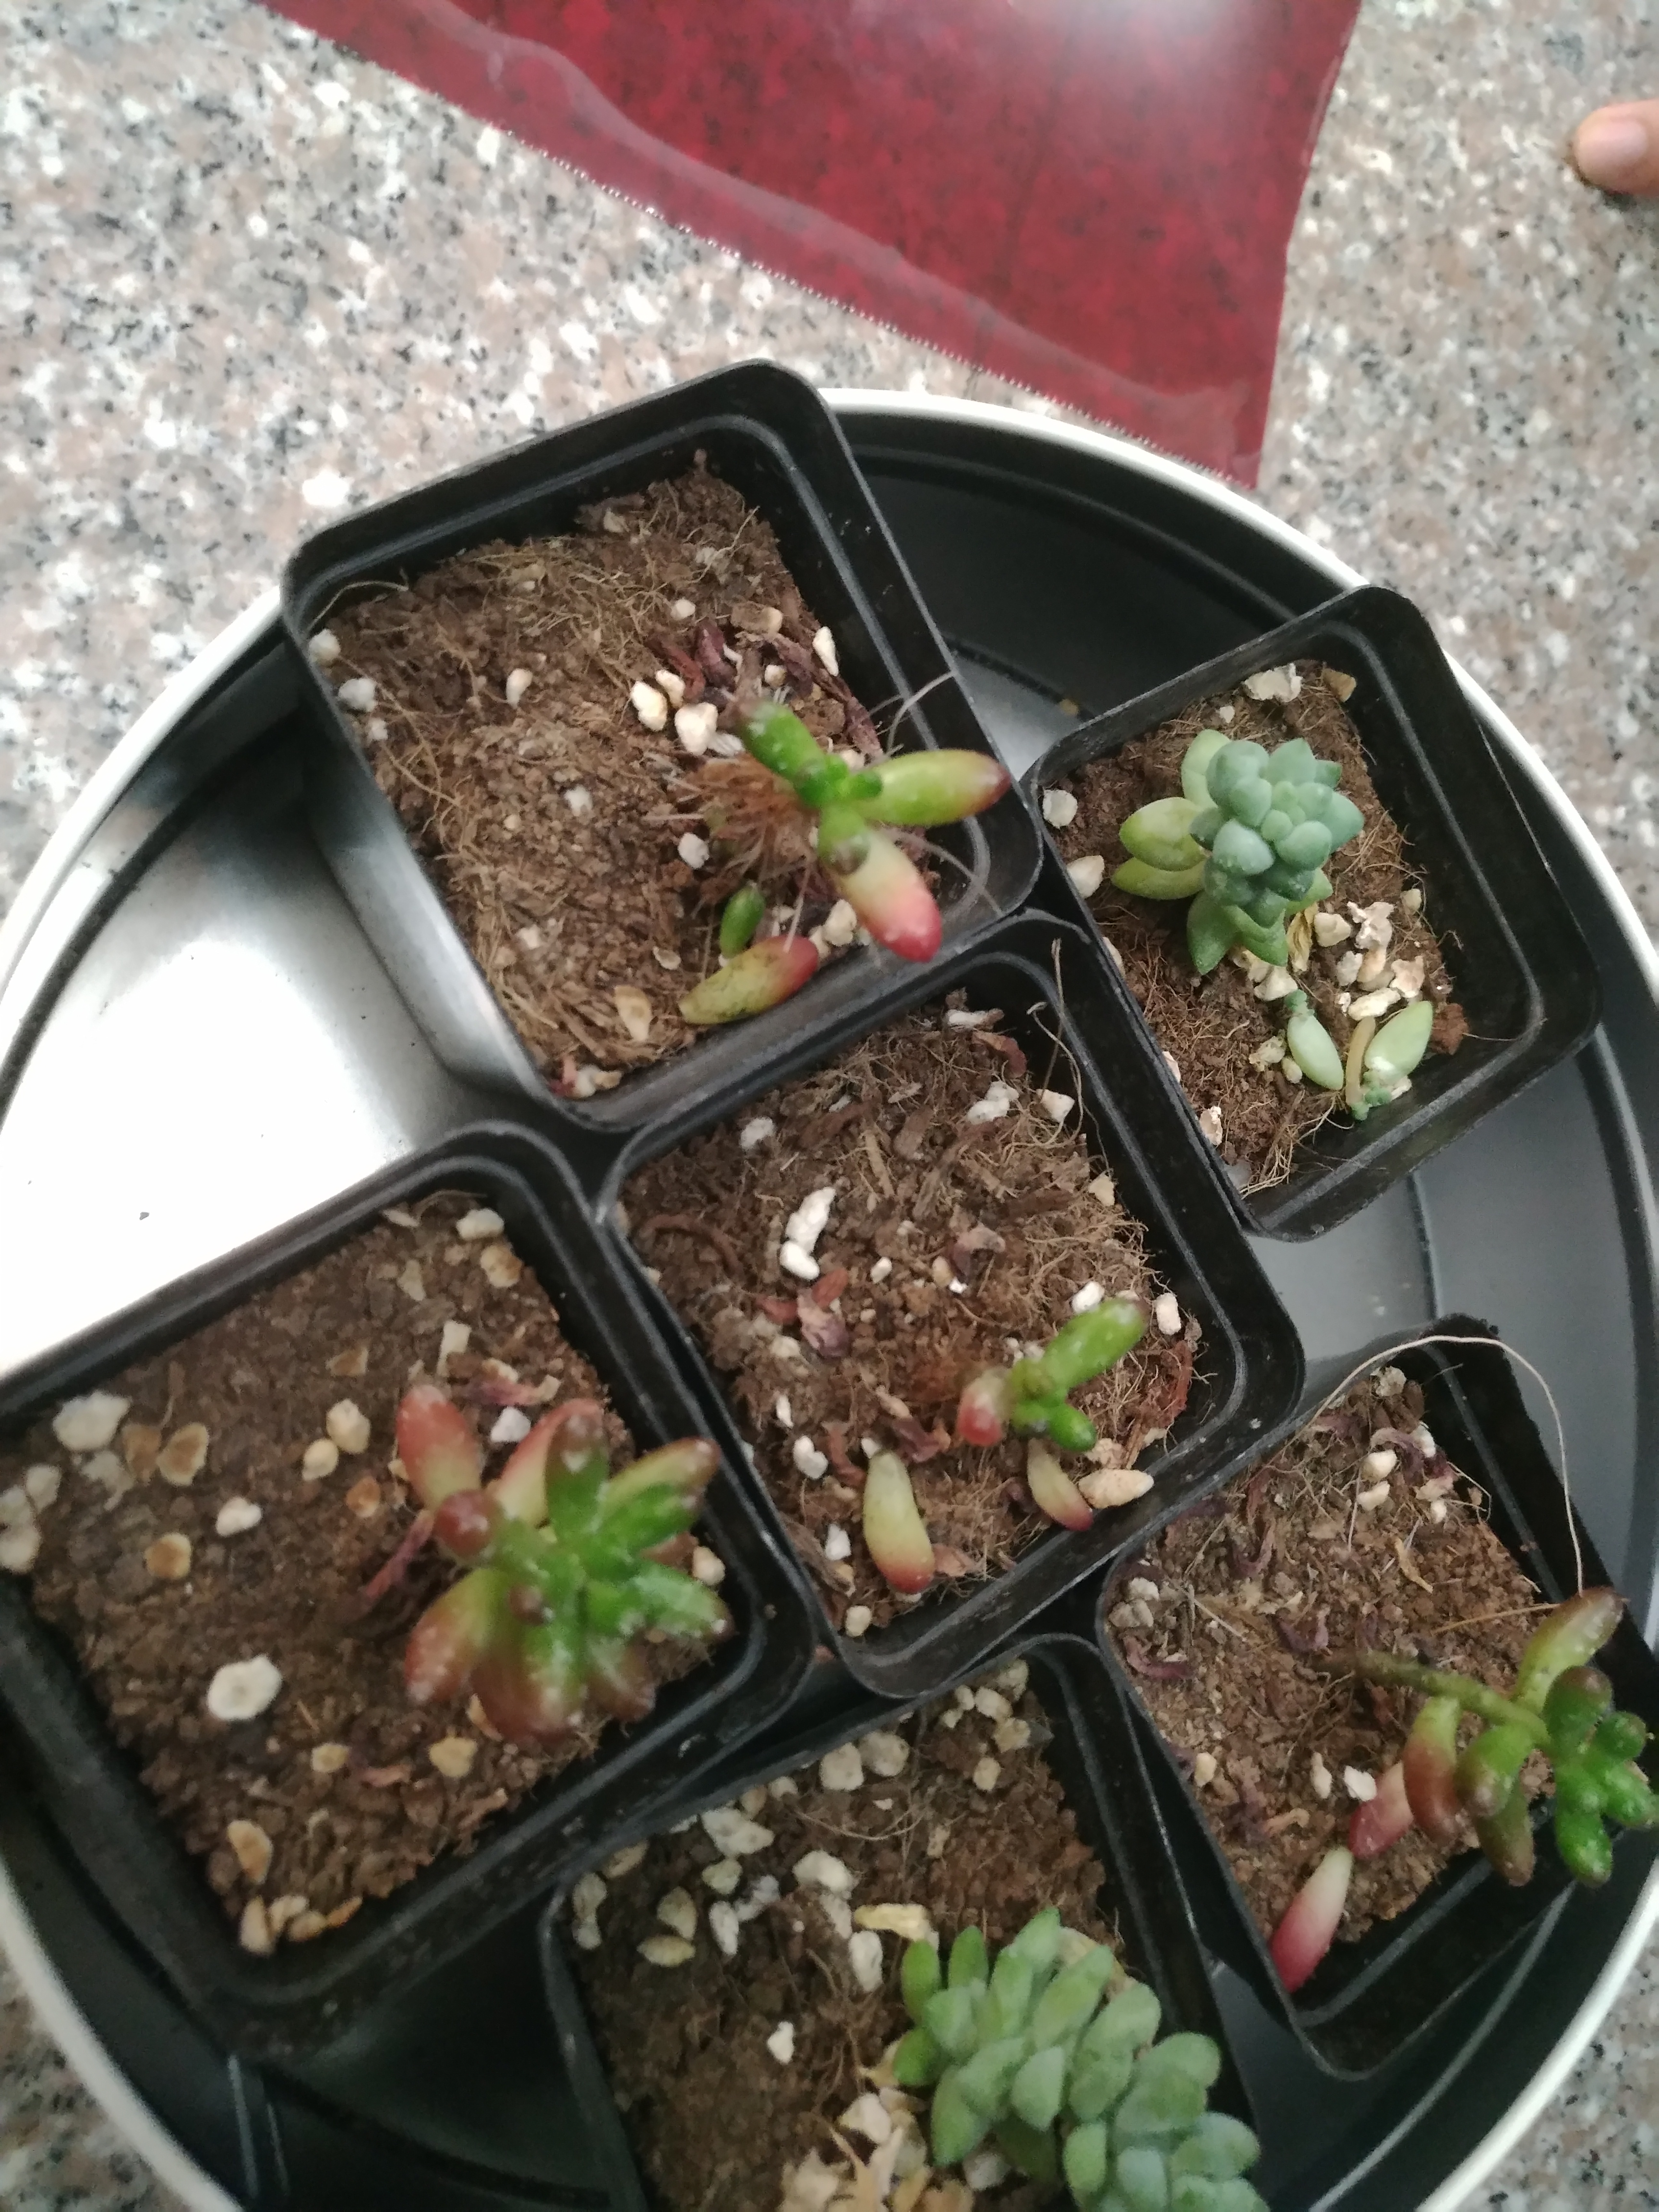
MATERIALS
Red light bulb
Blue light bulb
Yellow light bulb
Green light bulb
Several bottles
Some soil
Some seeds
Cellophanes

Slide 8
PROCEDURES
1 Place each plant in a box.
2 Put different colors of cellophane onto each box’s edges(We sticked it on the boxes). Meanwhile, we poked some small holes on the cellophanes in order to let the plants in each box breathe easily and change the air.
3 Place the lamp over the box so that the light does not escape from the box. Make sure that it is not touching any paper!
4 Turn the lights on every morning and turn them off every evening.
5 Place the fifth bottle with seed in a sunny window. Make sure that the soil stays damp, but not too wet.
6 After a week, we saw a sprout coming out of the soil. Wait for another week or more, then turn on the light in the room and take a photo of each plant.

Slide 9
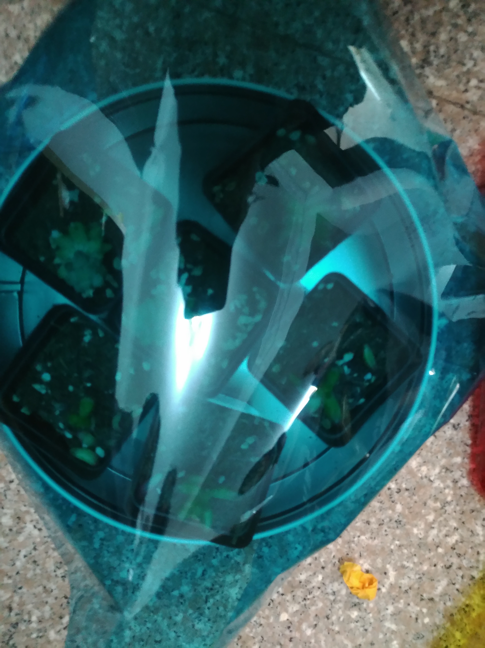
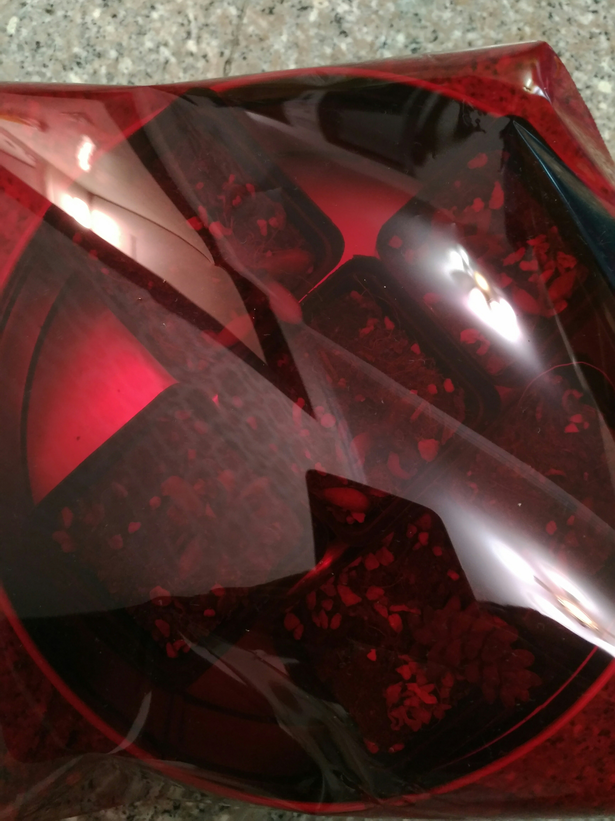
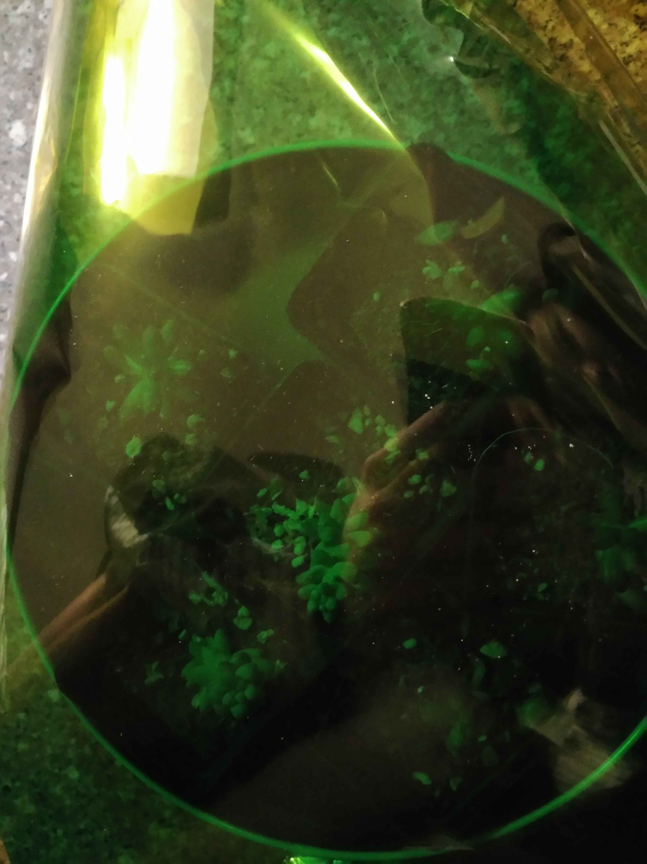
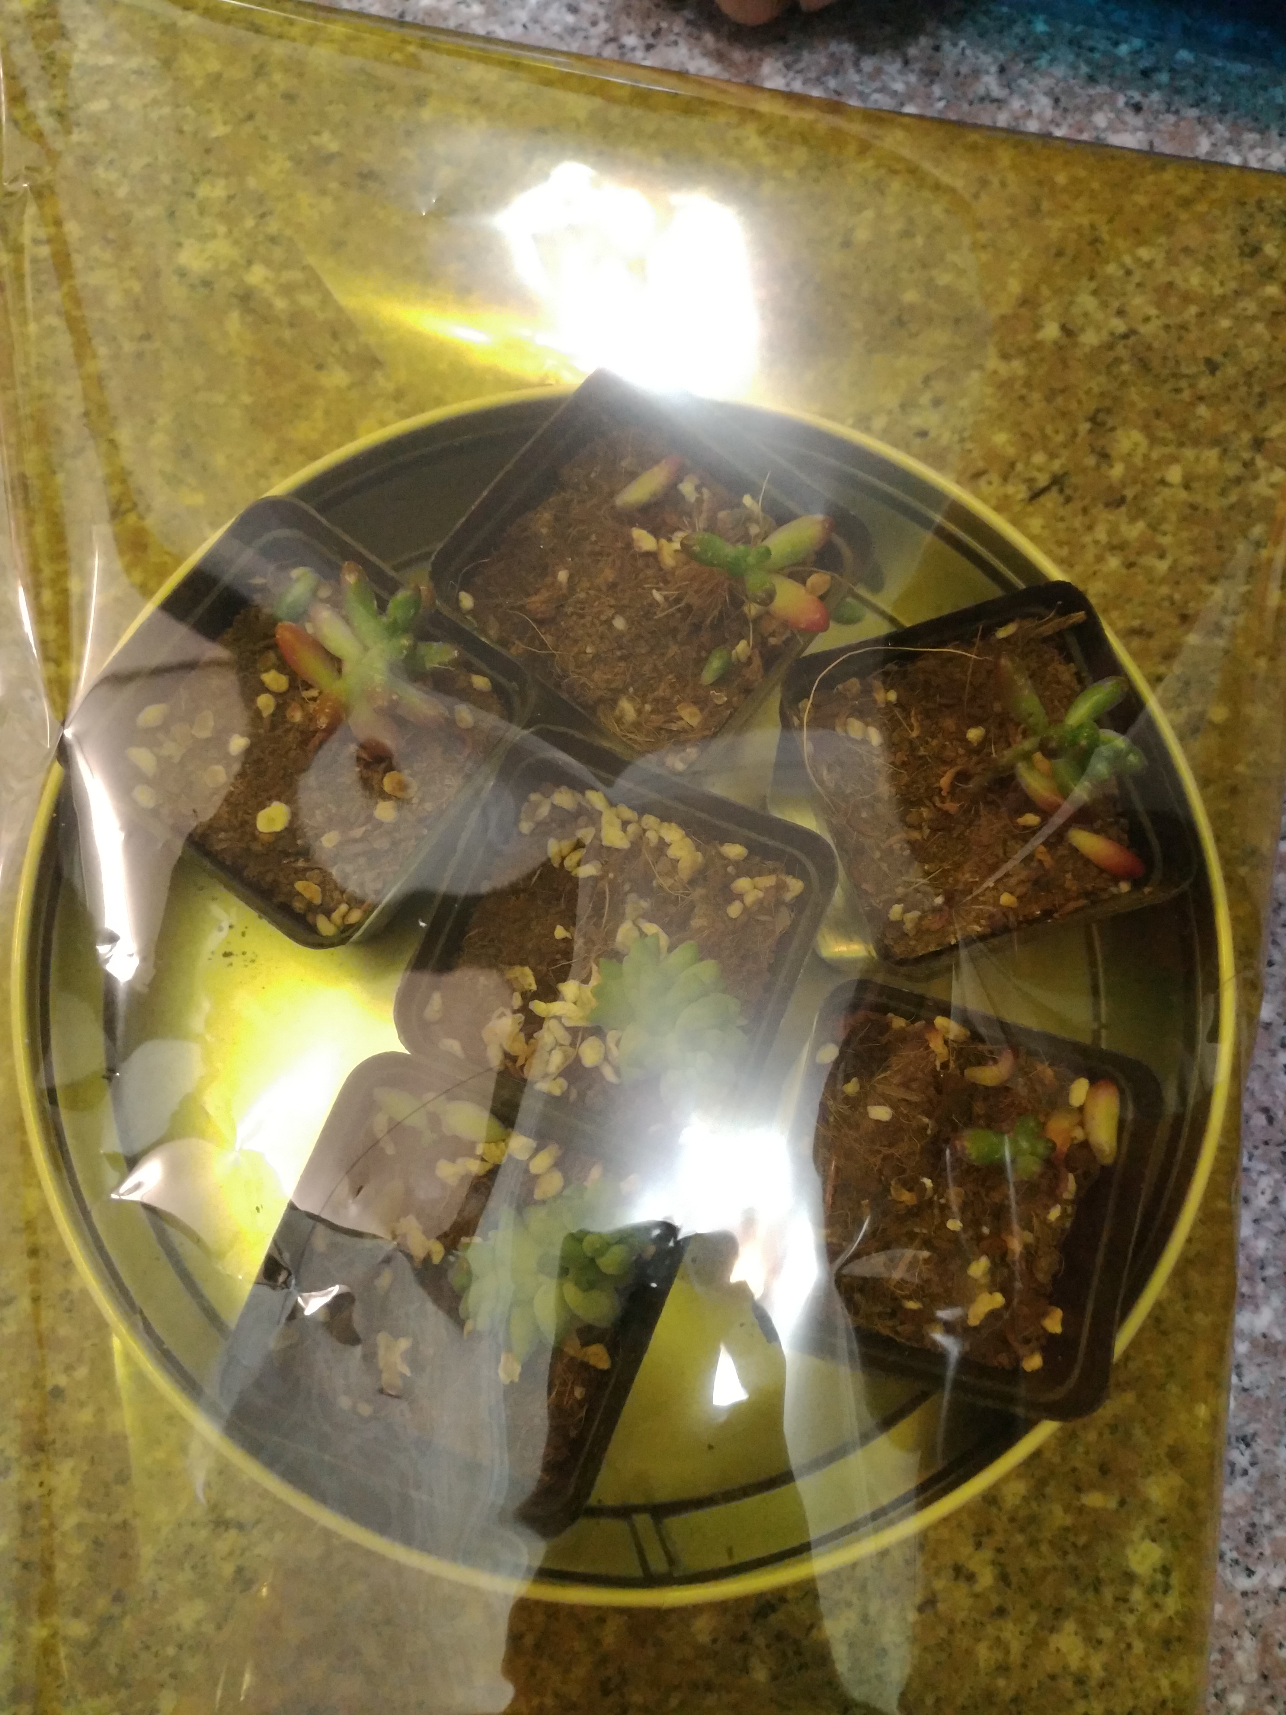
EXPERIMENTAL FACILITIES

Slide 10
03
RESULTS

Slide 11
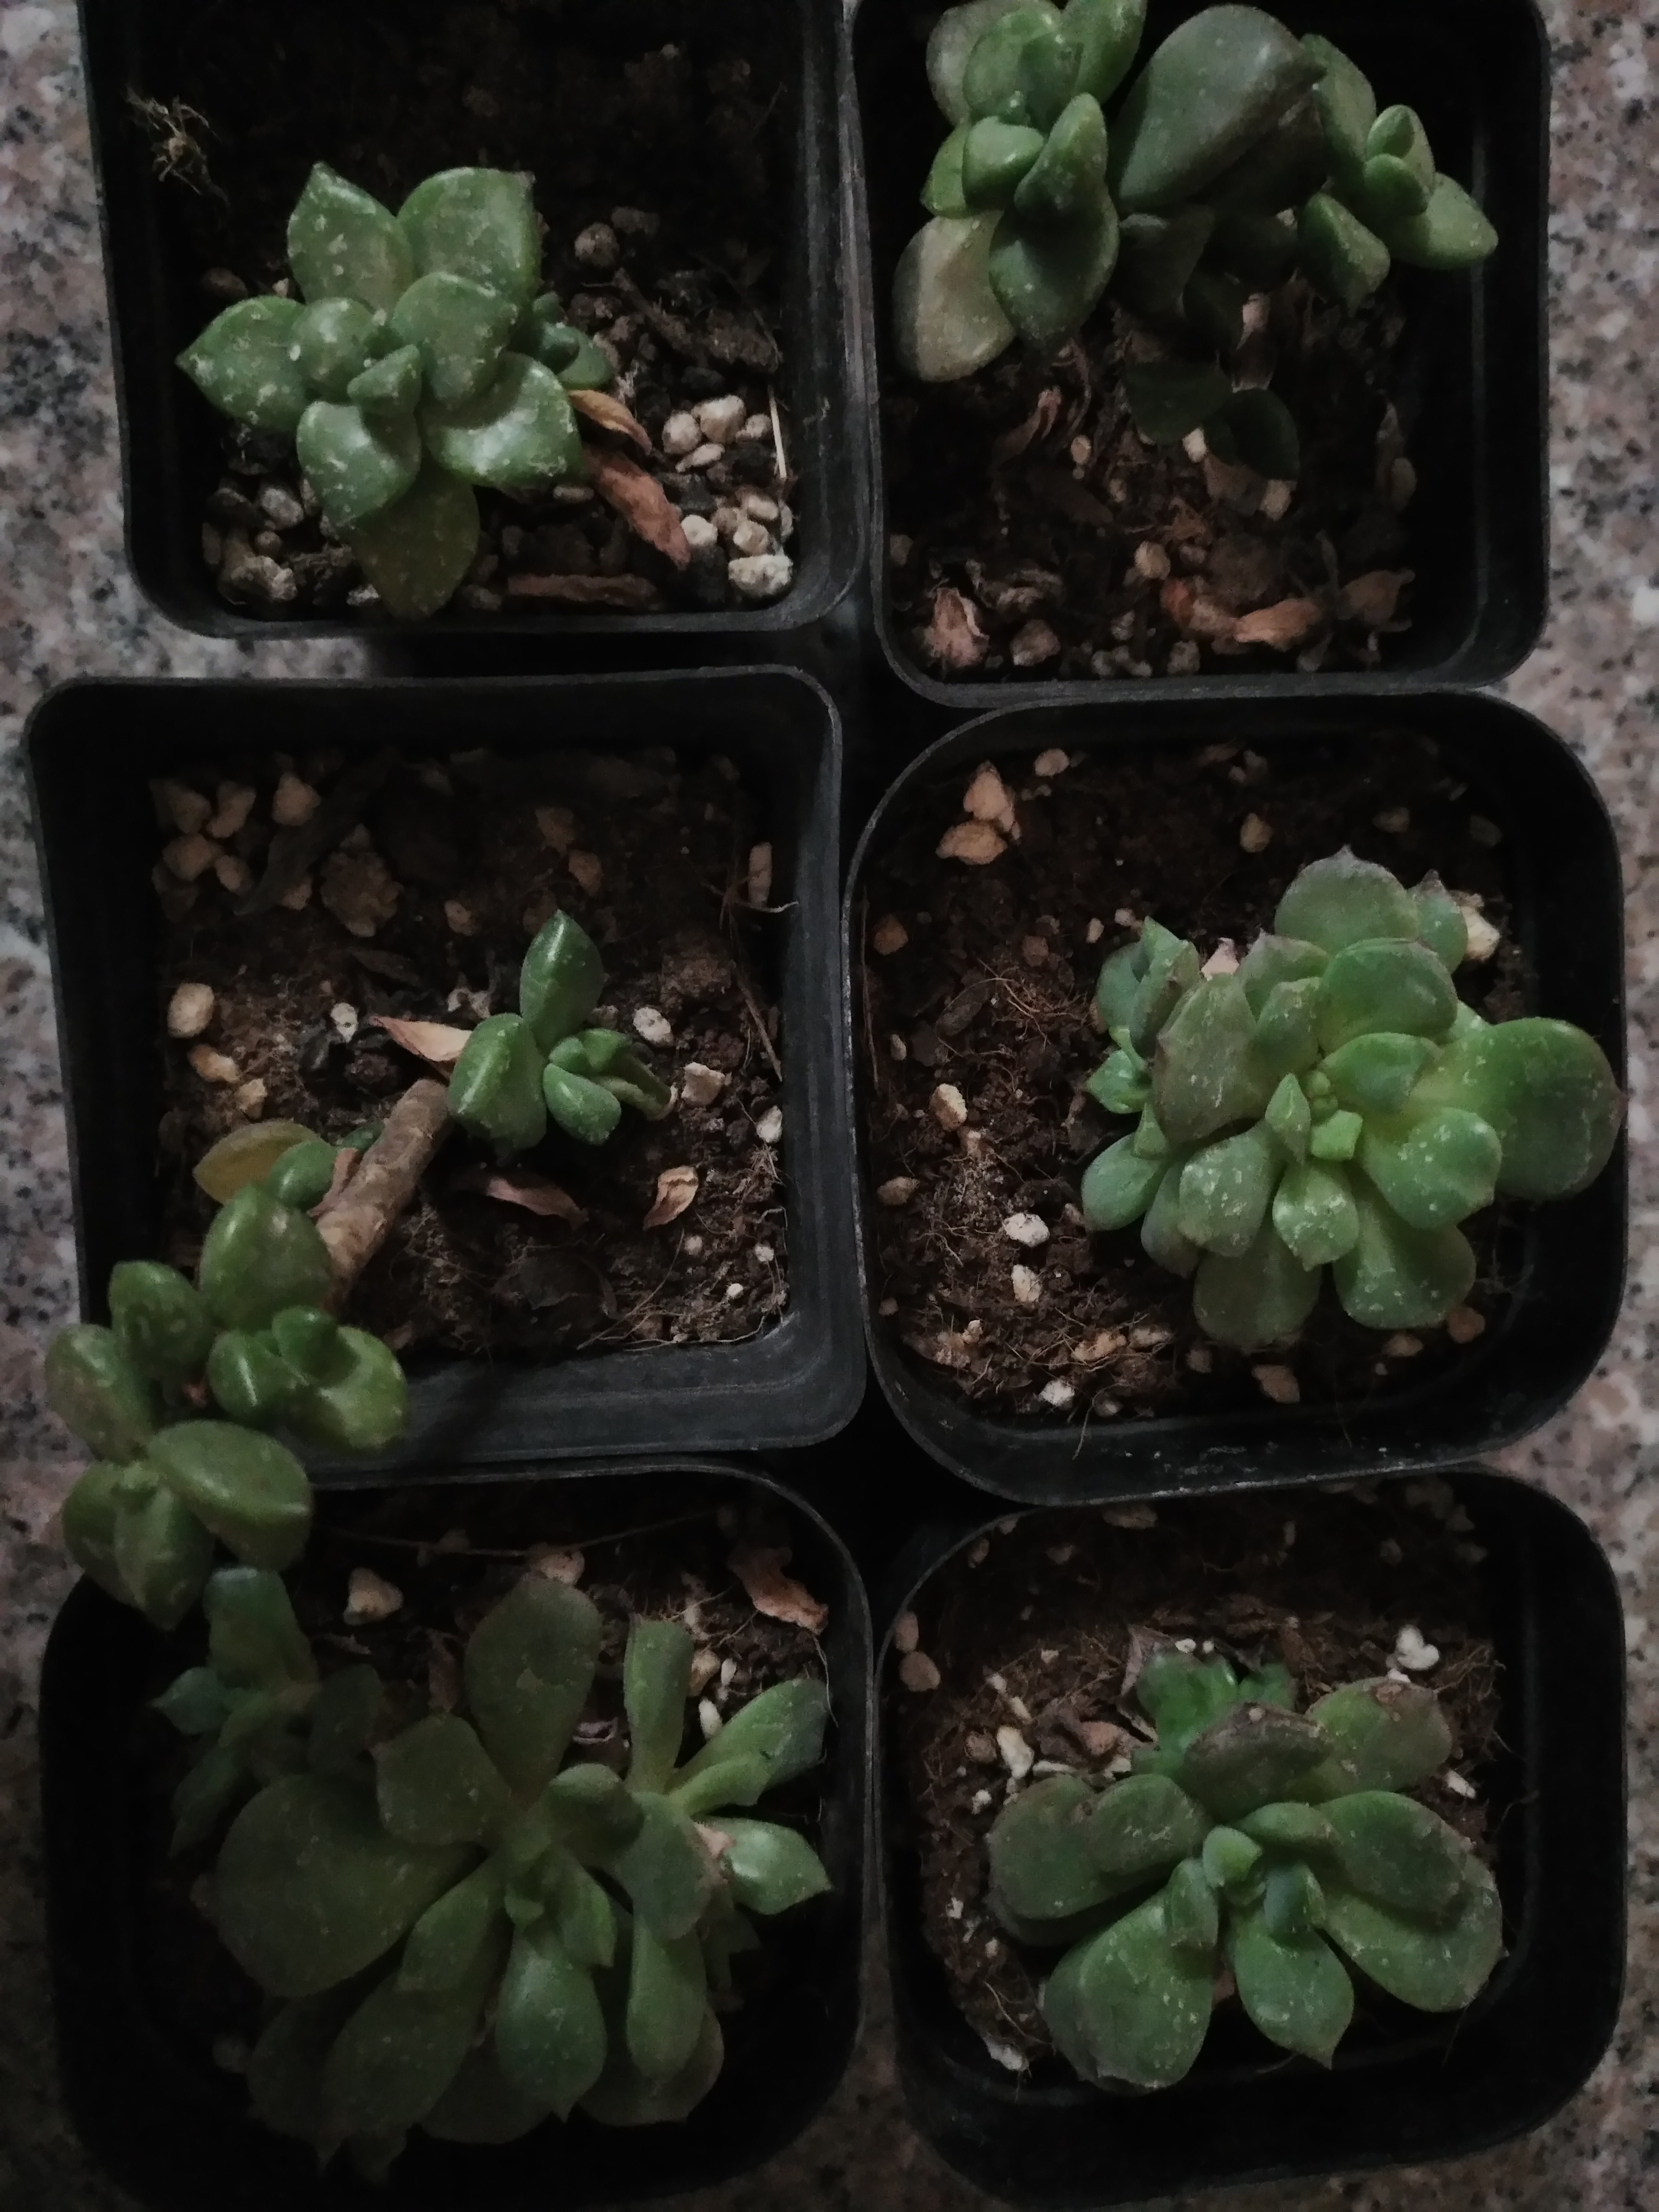
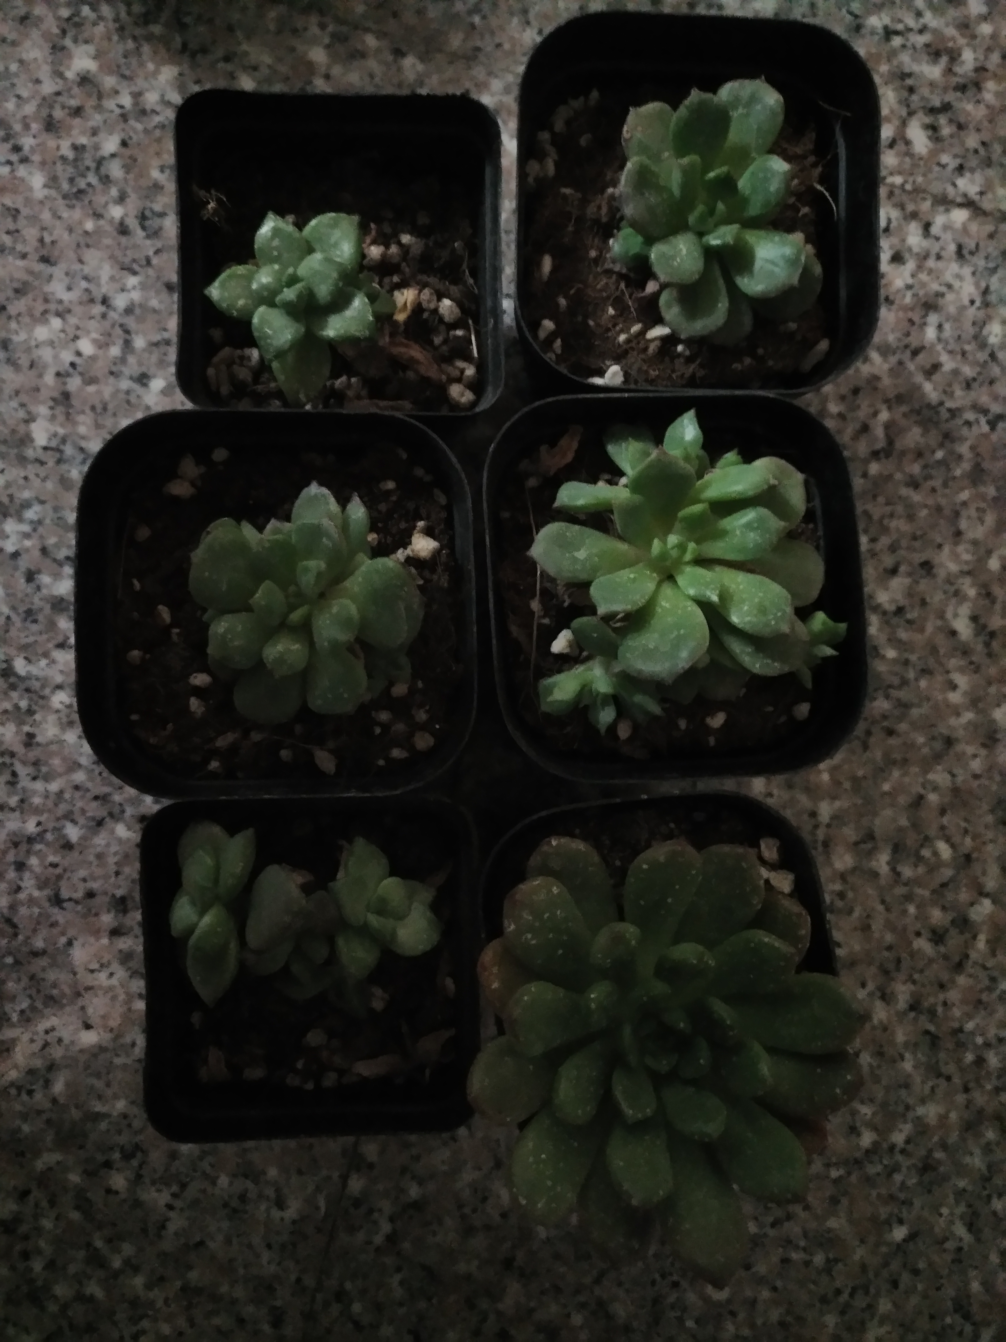
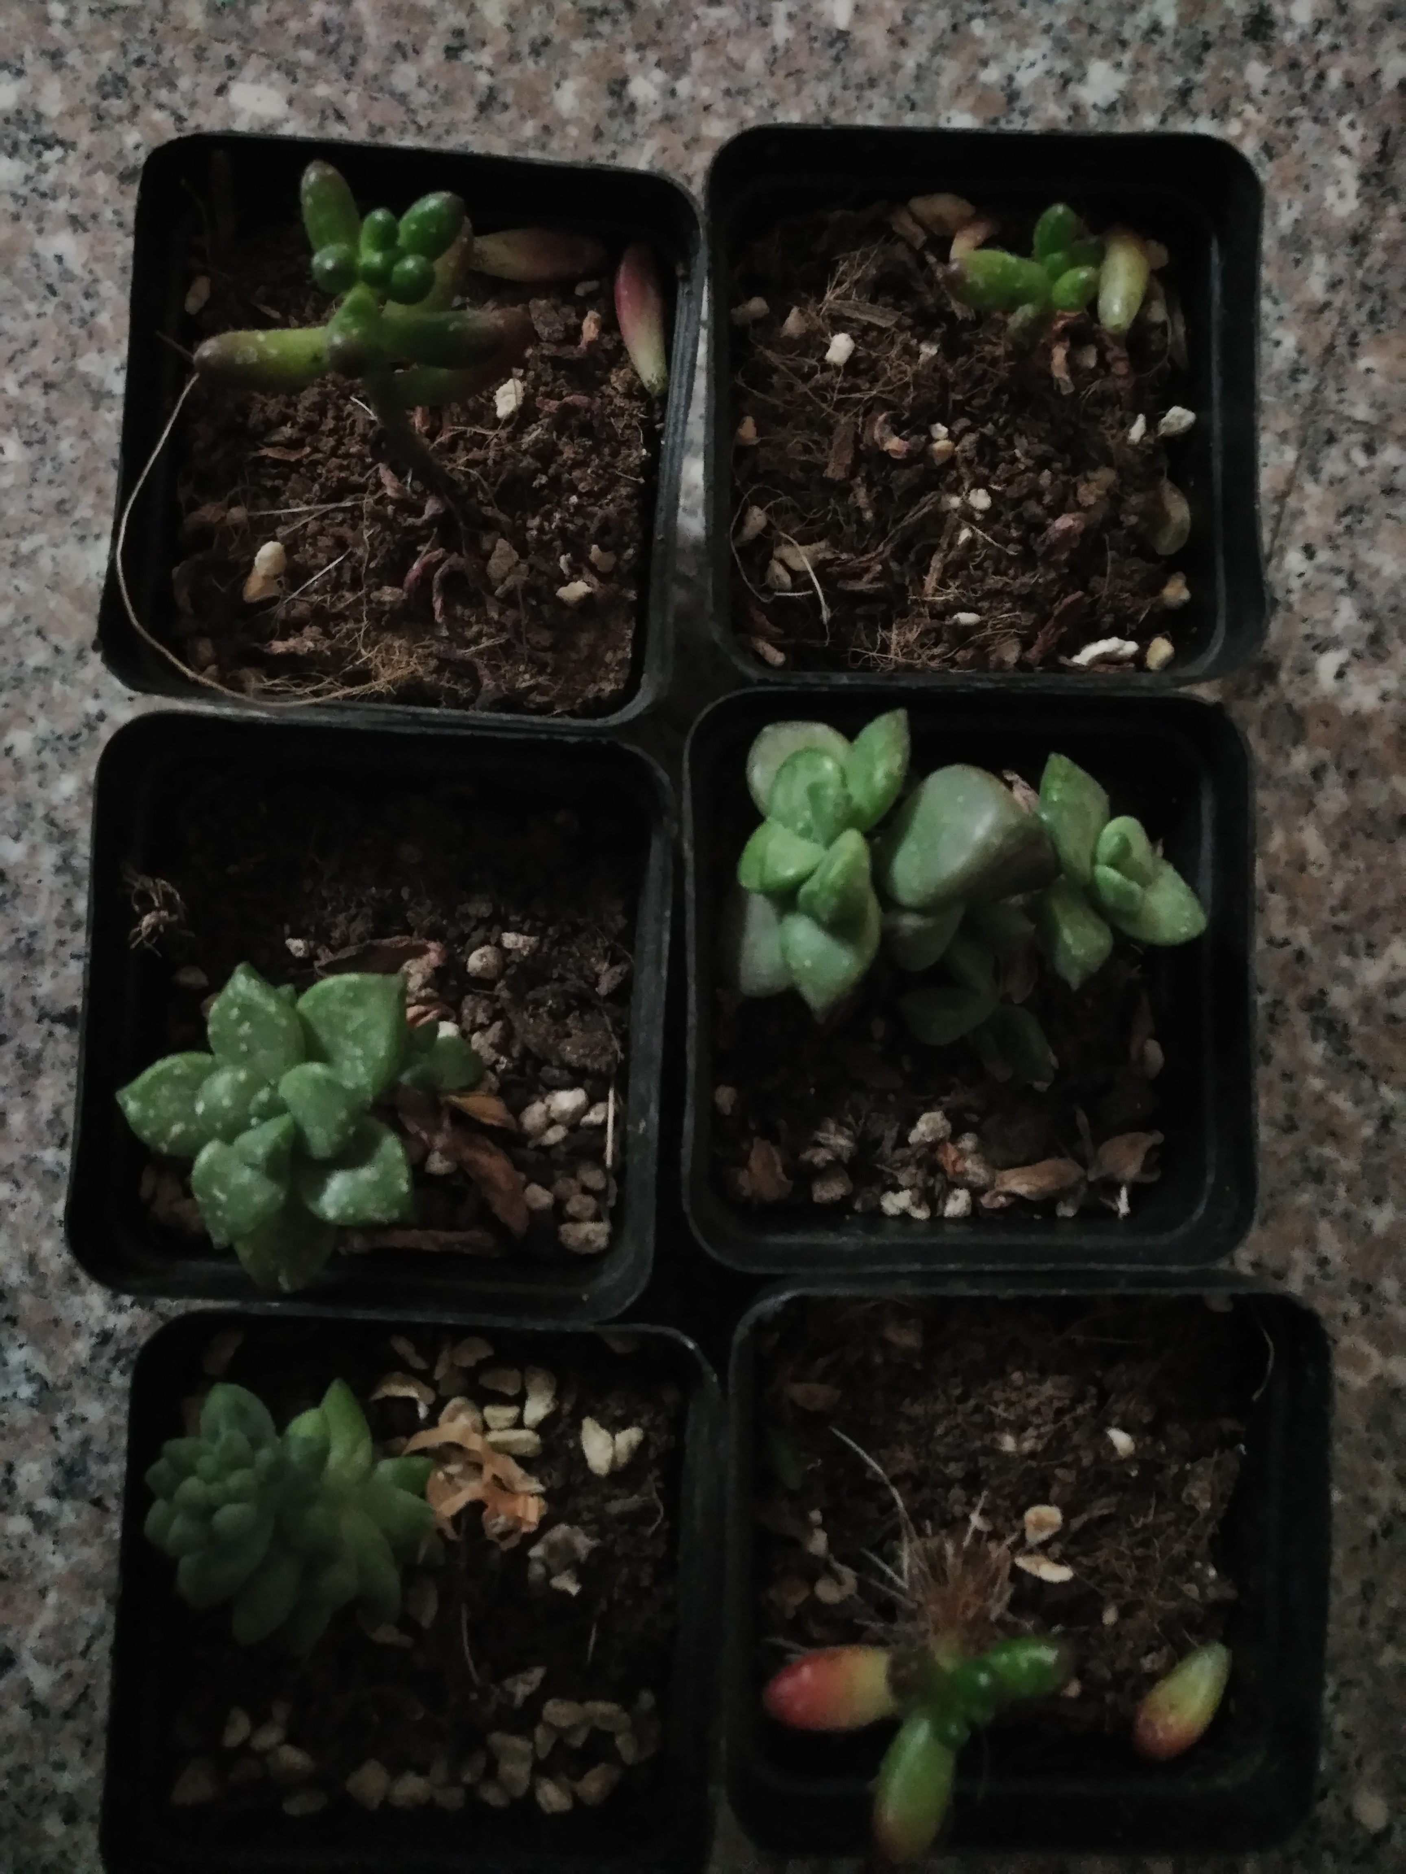
RESULTS
Red
Yellow&Blue
Green

Slide 12
AFTER 1 MONTH
Red Cellophane
1 Grow Bigger
2 Grow Bigger
3 Grow Bigger
4 Nothing Happened
5 Grow Bigger
6 Grow Bigger
Blue Cellophane
1 Died
2 Grow Bigger
3 Grow Bigger
4 Nothing Happened
5 Grow Bigger
6 Grow Bigger

Slide 13
AFTER 1 MONTH
Yellow Cellophane
1 Grow Bigger
2 Died
3 Nothing Happened
4 Nothing Happened
5 Grow Bigger
6 Grow Bigger
Green Cellophane
1 Died
2 Died
3 Grow Bigger
4 Nothing Happened
5 Died
6 Nothing Happened
Sunlight
1 Grow Bigger
2 Grow Bigger
3 Grow Bigger
4 Grow Bigger
5 Grow Bigger
6 Grow Bigger

Slide 14
LIGHT SPECTRUM

Slide 15
04
CONCLUSION

Slide 16
CONCLUSIONS
CONCUSION
Plants prefer full spectrum artificial lights or sunlight. Red light has the positive effect on the plants. And blue lights are the second. This is probably because plants only absorb red and blue lights to produce chlorophyll. The plant grows the worst under the green lights.

Slide 17
05
FURTHER DISCUSSION

Slide 18
UNCERTAINTY
1. The artificial light might possibly go into the box through the small holes and affect the plant growth.
2. The invisible lights like UV and infrared light might influence the result.(Because of the inconvenience of the facilities, we ignored this point.)
3. The existence of impure materials

Slide 19
06
REFERENCES

Slide 20
REFERENCES
1. www.colormatters.com Plant Growth & Light Color
2. www.education.com Effect of Artificial Light on Plant Growth
3. www.baidu.com
4. www.wikipedia.com

Slide 21
THANK YOU
PPT模板下载：www.1ppt.com/moban/ 行业PPT模板：www.1ppt.com/hangye/
节日PPT模板：www.1ppt.com/jieri/ PPT素材下载：www.1ppt.com/sucai/
PPT背景图片：www.1ppt.com/beijing/ PPT图表下载：www.1ppt.com/tubiao/
优秀PPT下载：www.1ppt.com/xiazai/ PPT教程： www.1ppt.com/powerpoint/
Word教程： www.1ppt.com/word/ Excel教程：www.1ppt.com/excel/
资料下载：www.1ppt.com/ziliao/ PPT课件下载：www.1ppt.com/kejian/
范文下载：www.1ppt.com/fanwen/ 试卷下载：www.1ppt.com/shiti/
教案下载：www.1ppt.com/jiaoan/ PPT论坛：www.1ppt.cn

