Slide 1
16. Paper Wrinckles
LaplaceWitches
Nanjing Foreign Language School
2017.6.29-2017.7.4

Slide 2
2017 IYNT
016 Paper wrinkles
01. Problem Analysis
Laplace Witches
02. Theoretical Analysis
03. Experimentation
04. Conclusion and Further Discussion

Slide 3
01
PROBLEM ANALYSIS

Slide 4
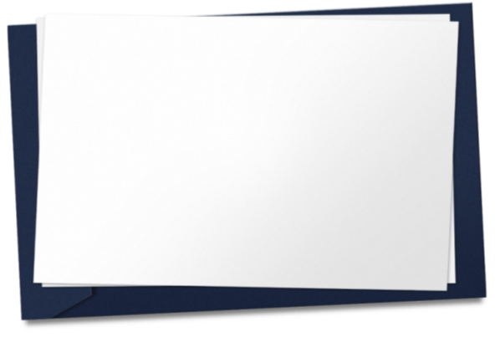
Problem
When a piece of paper dries after being wet, it can get
wrinkled. Investigate and explain this phenomenon.

Slide 5
KEY WORDS ANALYSIS
KEY WORDS
Paper
Wet
Dry
Wrinkles

Slide 6
02
THEORETICAL ANALYSIS

Slide 7
Theoretical Analysis
BASIC THEORY
The paper is essentially an amorphous polymer. Wetting it heavily opens the polymer structure by allowing water to penetrate the matrix of hydrogen-bonded vegetable fibers and separate them.

Slide 8
Theoretical Analysis
This leads to a bunch of related phenomenon, such as decreased wet strength, volume expansion (from the expansion of the matrix) and a conformational change that comes from the impingement of water.

Slide 9
Theoretical Analysis
When paper is dried, this conformational change becomes locked in and usually results in wrinkles because that's a lower energy state than a completely flat sheet of paper.

Slide 10
03
EXPERIMENTATION

Slide 11
EXPERIMENT 1

Slide 12
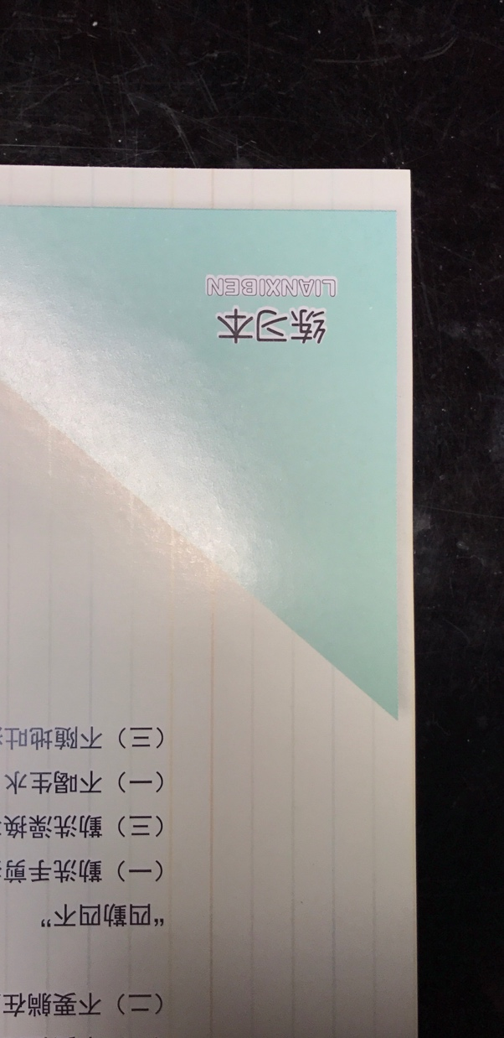
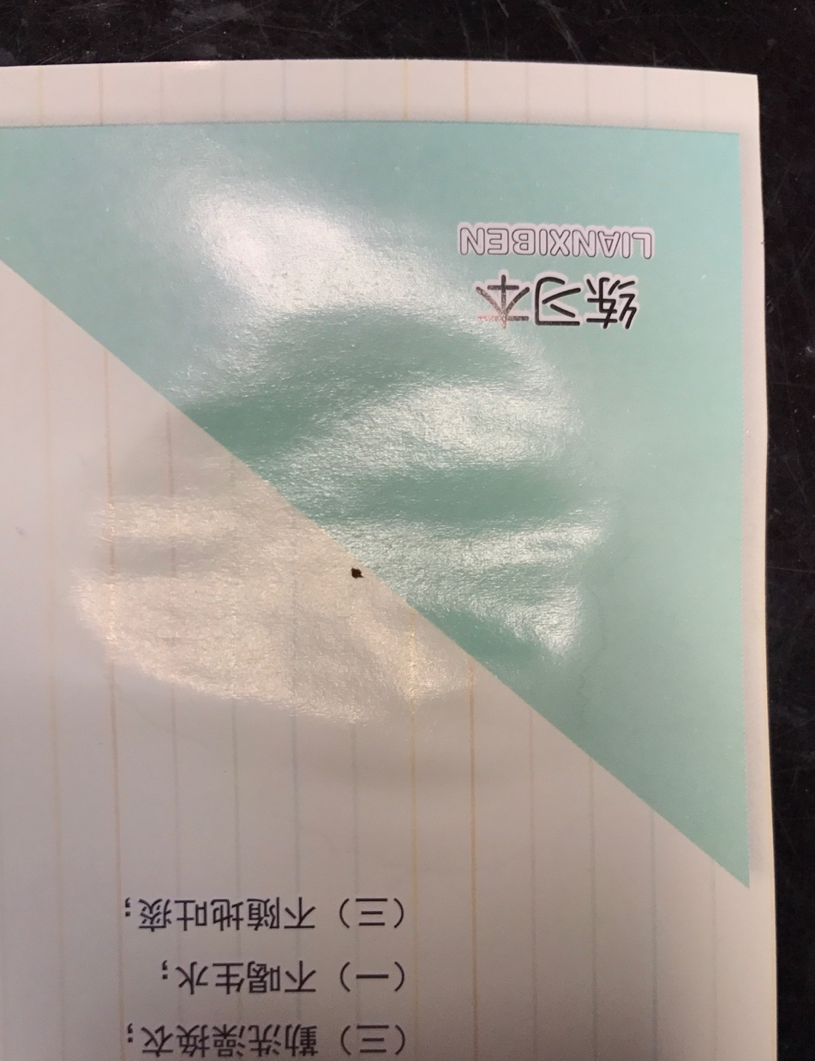
EXPERIMENT 2

Slide 13
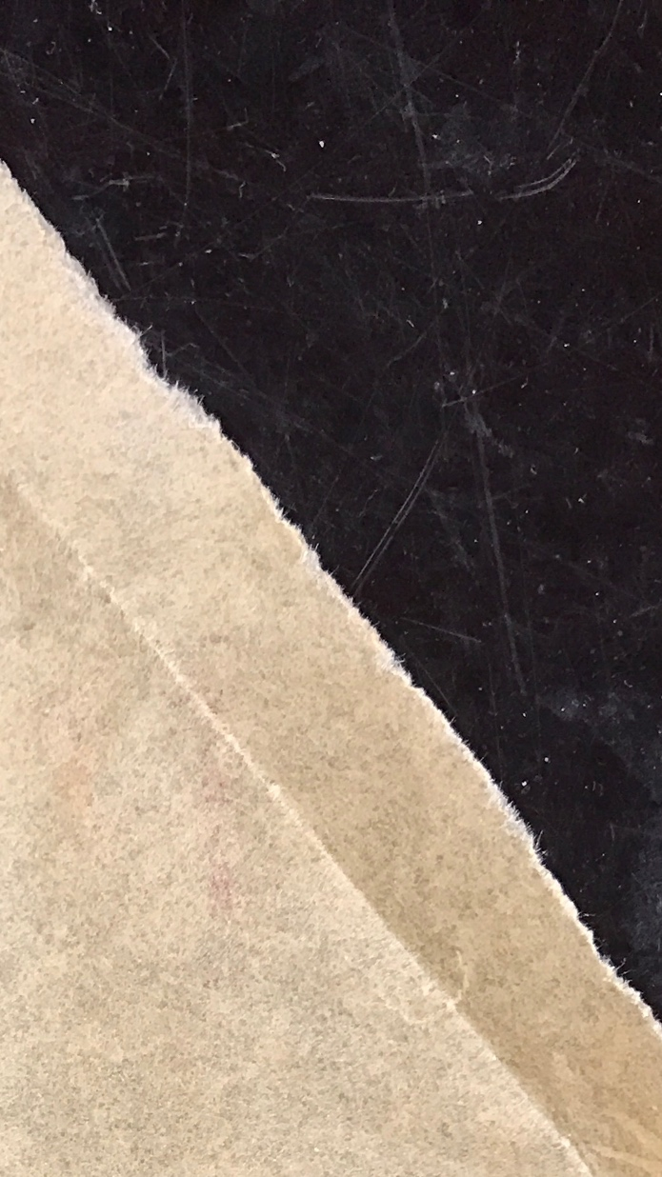
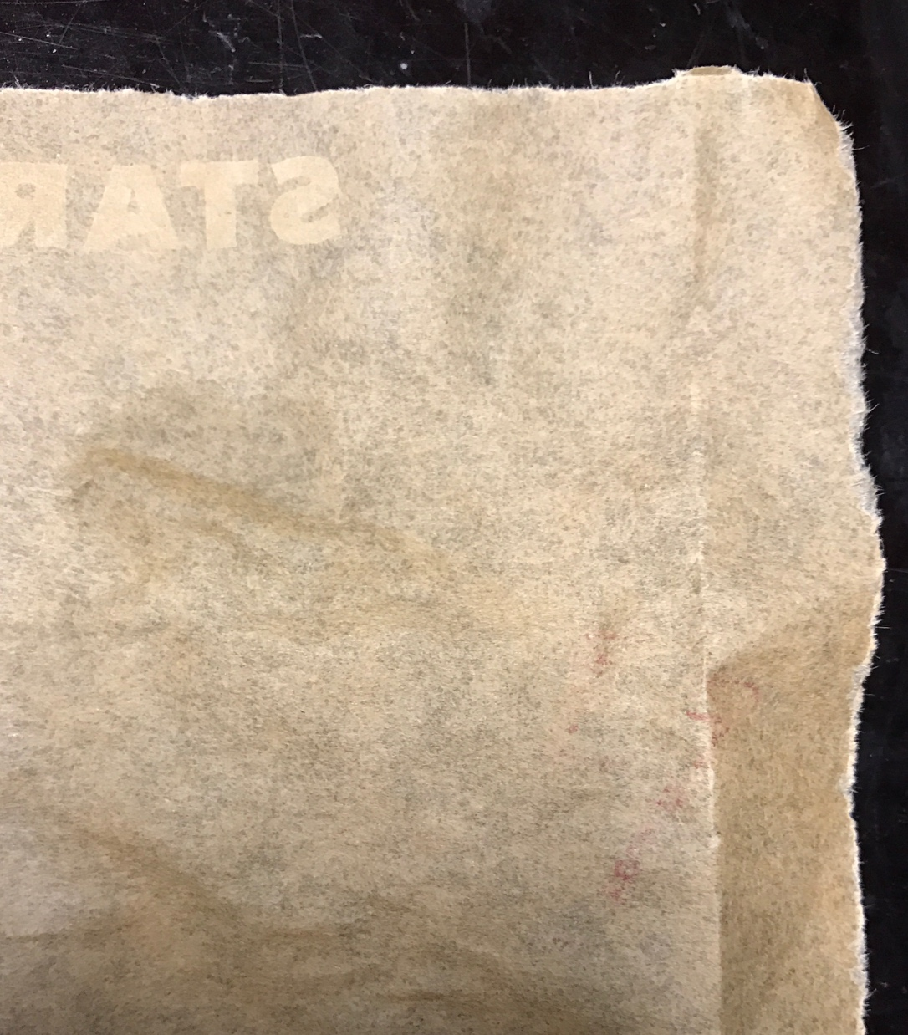
EXPERIMENT 3

Slide 14
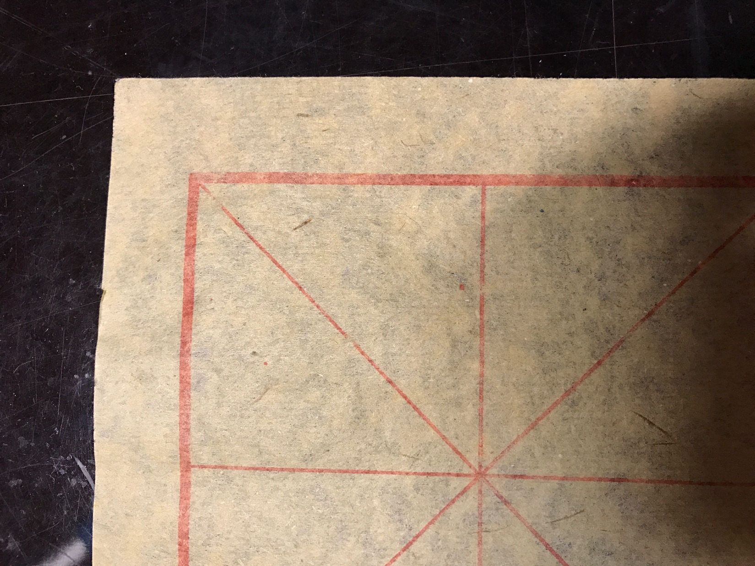
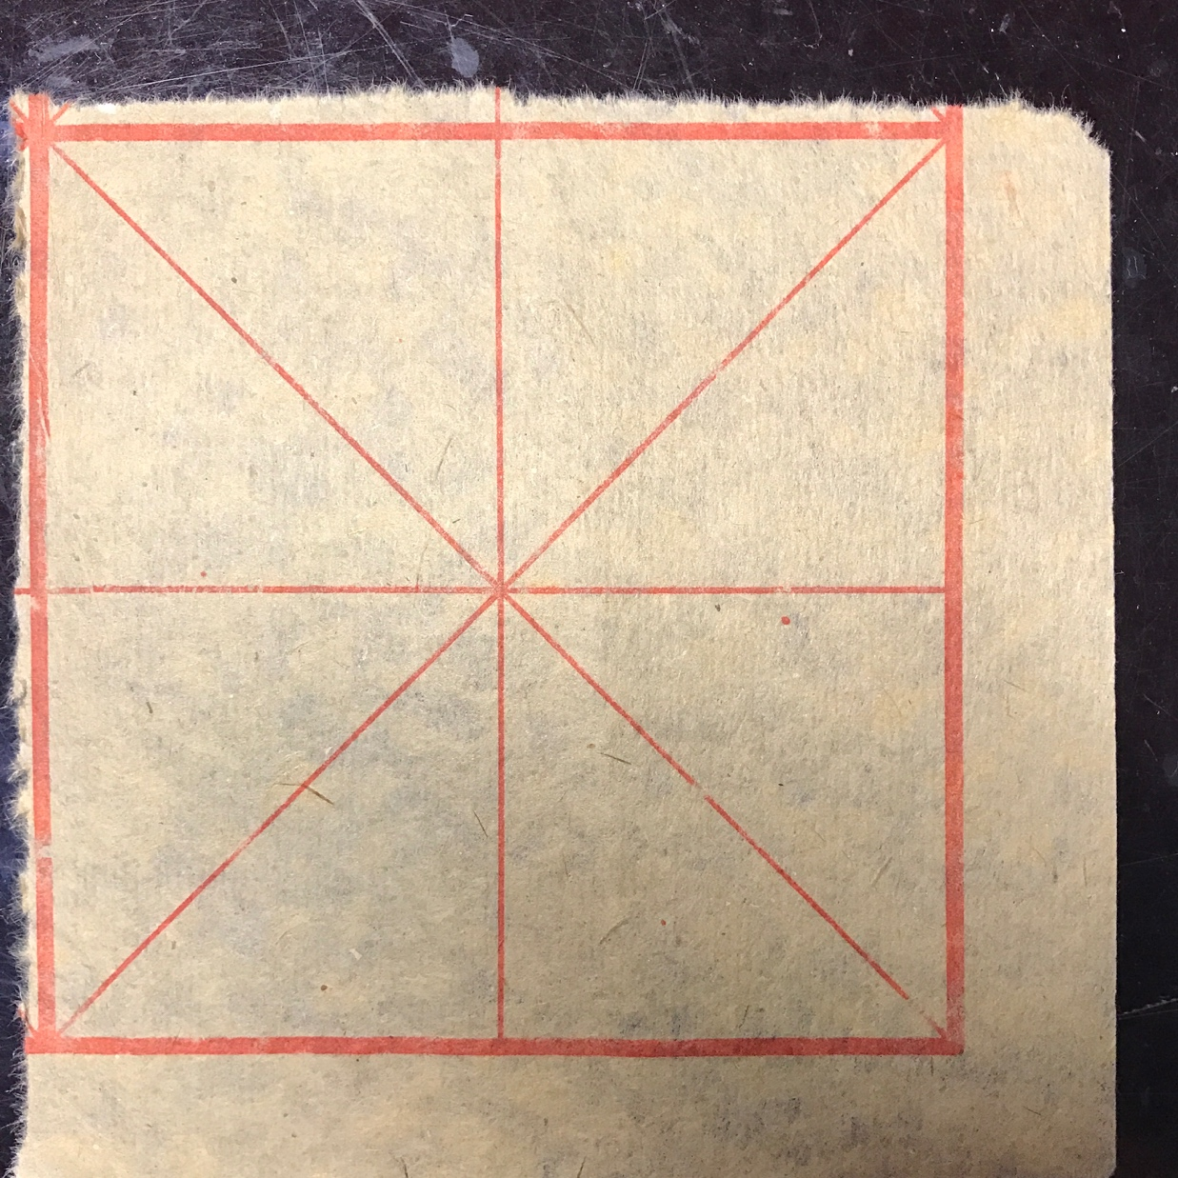
EXPERIMENT 4

Slide 15
PHENOMENON
Different kinds of paper have different levels of wrinkles.
The wrinkles of the cover of textbooks are very obvious while the wrinkles of Xuanzhi, a traditional Chinese paper used for calligraphy is completely unnoticeable.

Slide 16
CONCLUSION
Analysis
The Chinese traditional paper has an inattentive and disordered structure of vegetable fiber. Not being tense enough, the fiber in the paper switch themselves to the original situation after being dried, which seems that nothing has actually happened before.

Slide 17
ANALYSIS
Analysis
In contrast, the glossy paper has a relatively more intense kind of vegetable fiber, in which the hydrogen bonds are more close-knit, thus dramatically increasing the difficulty in breaking them. The intensity of the glossy paper fiber caused the appearance of a lot of wrinkles which are very burdensome to remove.

Slide 18
04
CONCLUSION
AND FURTHER DISCUSSION

Slide 19
CONCLUSION
The material and chemical structure is extremely significant for the paper’s behavior in the experiment.
The types of papers which have tight structures of chemical-bonds are more easily to get wrinkles and their wrinkles are very hard to remove.
The papers with fibers soft and not so intense tend not to produce ant wrinkles and remain the same after the experiment.

Slide 20
FURTHER DISCUSSION AND IMPROVEMENTS
Explore more kinds of different papers and enlarge the number of the samples.
Do more research from the chemical or biological viewpoint
3 Study the influence of the amount of water.
4 Do some quantative experiment.

Slide 21
THANK YOU
PPT模板下载：www.1ppt.com/moban/ 行业PPT模板：www.1ppt.com/hangye/
节日PPT模板：www.1ppt.com/jieri/ PPT素材下载：www.1ppt.com/sucai/
PPT背景图片：www.1ppt.com/beijing/ PPT图表下载：www.1ppt.com/tubiao/
优秀PPT下载：www.1ppt.com/xiazai/ PPT教程： www.1ppt.com/powerpoint/
Word教程： www.1ppt.com/word/ Excel教程：www.1ppt.com/excel/
资料下载：www.1ppt.com/ziliao/ PPT课件下载：www.1ppt.com/kejian/
范文下载：www.1ppt.com/fanwen/ 试卷下载：www.1ppt.com/shiti/
教案下载：www.1ppt.com/jiaoan/ PPT论坛：www.1ppt.cn

