Slide 1
10. Rijke’s Tube
LaplaceWitches
Nanjing Foreign Language School
2017.6.29-2017.7.4

Slide 2
2017 IYNT
010 Rijke’s Tube
01. INITIAL THOUGHTS
1. Project Review
LaplaceWitches
2. Key Words
02. THE EXPERIMENT
3. Analysis of the Research
4. Pre-experiment
5. Physical Theory
6. Experiment ABCDE.
7. Comparing, discusion, improving, references.

Slide 3
Project Review
TORNADO MACHINE
if air inside a vertical cylindrical tube open at both ends is heated, the tube produces sounds. Study this effect.
Build

Slide 4
Key Words
TORNADO MACHINE
vertical
cylindrical
open at both ends
Build

Slide 5
Analysis of the Research
TORNADO MACHINE
Attention
1
1 The heating temperature of the gauze.
2.The layers of the gauze.
3.The heating point of the tube
4.The temperature of air in the tube.
5.The material of the tube.
1

Slide 6
Pre-experiment
TORNADO MACHINE
Equipments
1 Vertical tubeTubes made of borosilicate, plastic and copper which are 80CM in length, 12.4cm in outer diameter, 12.00cm of inner diameter，
2 Gauze：One role of copper wire of 1meter in length, which weighed 130 grams. 5 roles of copper wire of 1 meter in length, which weighed 50 grams.
3 An electric heater. A long ruler.
4 Computer soft-wear to analyze the sound wave.

Slide 7
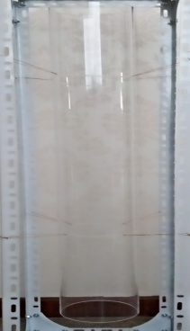
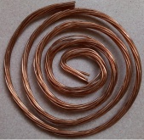
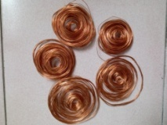
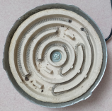
Pre-experiment
Equipments

Slide 8
Experiment Video

Slide 9
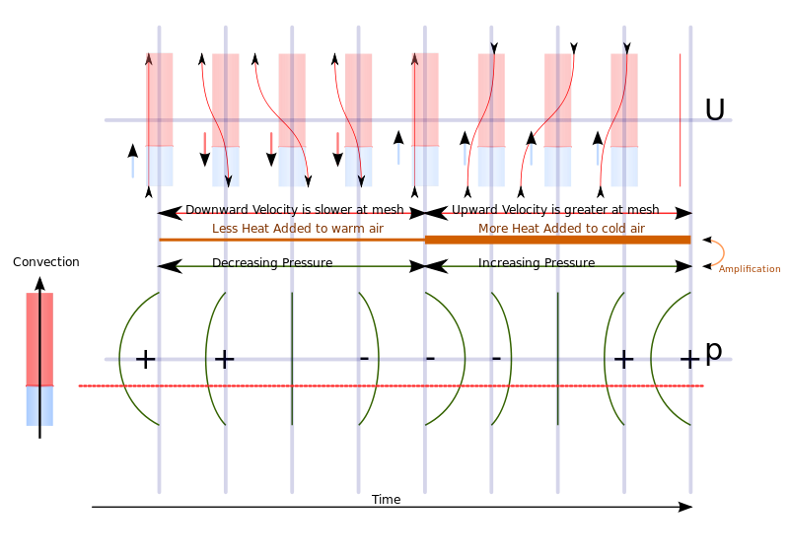
Physical Theory

Slide 10
Physical Theory
Theoretical reason

Slide 11
Experiment A
Control the temperature of the gauze. (temperature, loudness and lasting time of the sound)

Slide 12
Chart of the result of experiment A
Temperature of the gauze | 550 | 590 | 640 | 670 | 700
Producing sounds of(dB) | 40 | 45 | 49 | 55 | 51
Lasting for (s) | 6 | 8 | 9 | 10 | 7

Slide 13
Experiment B
Controlling the layers of gauzes.
(measure the temperature, the loudness and lasting time of the sound)
I heated layers(1,2,3,4) of gauzes into 670 degrees and put them in the same position of the gauze(1/4 from the bottom). Then I record the sound. Take notes of the lasting time and maximum sound.

Slide 14
The result of Experiment B
Layers of gauzes | 1 | 2 | 3 | 4
Lasting time (s) | 10 | 14 | 16 | 9
Loudest sound(dB) | 55 | 60 | 63 | 41

Slide 15
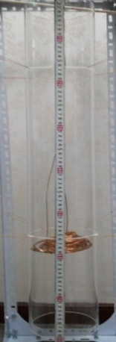
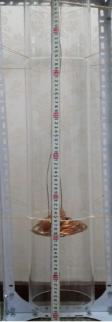
Different Layers of Gauzes

Slide 16
Experiment C
I put one layer of gauze in different positions to control the heating point of the tube.
(Record the heating point, the lasting time and loudness of the sound.)

Slide 17
Gauzes in different positions

Slide 18
Looking for the best position
I noticed that the position of the gauze in the tube is not critical as long as it is in the lower half
When I placed the gauze midway between these two positions (one quarter of the way in from the bottom end) I came close to the optimal placement.

Slide 19
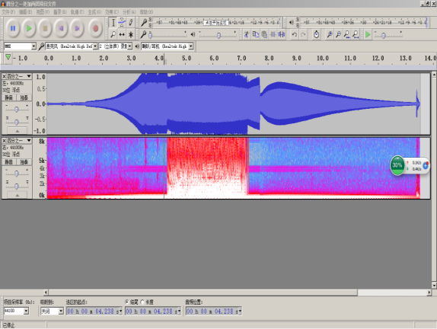
Analysis of the sound when the gauze is 1/4

Slide 20
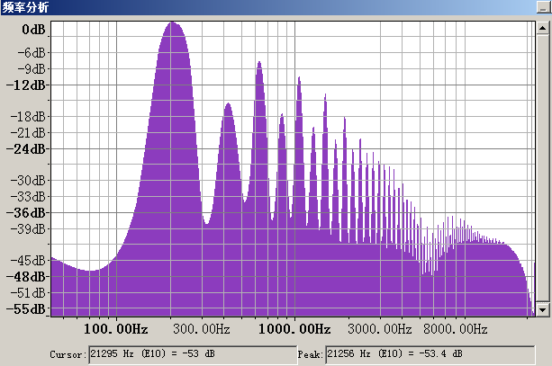
The Image of ¼ sound producing

Slide 21
Sound producing process

Slide 22
Upper half
Gauze position(from the bottom) | 0 | 1/4 | 1/2 | 3/4 | 1
Lasting time(s) | 7 | 10 | 8 | 0 | 0
Loudness(dB) | 47 | 55 | 49 | 0 | 0

Slide 23
Experiment D
I controlled the temperature of air in the tube and put one layer of gauze heated to 670 degrees in the 1/4 position of the tube.
Measured the lasting time and the maximum loudness of the tube.

Slide 24
Result of Experiment D
Temperature inside(degrees) | 20 | 60 | 100 | 200 | 300 | 400 | 500 | 600
Lasting time(s) | 10 | 9 | 8.1 | 7.3 | 6 | 5.5 | 3 | 0
Loudness(dB) | 55 | 40 | 38 | 36 | 29 | 26 | 22 | 0

Slide 25
Experiment E
I used tubes made of copper, plastic and borosilicate glass. I repeated the experiment on each tube three times and got the same data.

Slide 26
Comparing and Discussions
Comparing with the theory: Well matched.
Things that might have influenced:
The temperature may not last long.
The temperature of the environment may have slight effect.
The air stream may have been effected by the gauze.

Slide 27
Further improving and exploring
1 Use a highly developed electrical gauze.
2 Controlling the temperature of the experiment room.
3 Improving the size and shape of the gauze, make sure that it fits well with the edge of the tube.
4 Explore whether the leaning influences.
5 Explore the material of the tube.
6 Explore the size of the tube.

Slide 28
References
Pieter L. Rijke (1859) “On the vibration of the air in a tube open at both endsAnnalen der Physik und Chemie,
John Wm. Strutt (Lord Rayleigh) (1879) “Acoustical observations,” Philosophical Magazine, 5th series, vol. 7, pages 149-162.
P. Riess (1860) Annalen der Physik und Chemie, series 2, vol. 109, pages 145-147
Lord Rayleigh mentions the discoveries of Bosscha and of Riess in: John Wm. Strutt (Baron Rayleigh), The Theory of Sound, 2nd ed. [London: Macmillan, 1896], vol. 2, pages 233-234.
John Wm. Strutt (Lord Rayleigh) (18 July 1878) “The explanation of certain acoustical phenomena,” Nature, vol. 18, pages 319-321. See also: John Wm. Strutt (Baron Rayleigh), The Theory of Sound, 2nd ed. (London: Macmillan, 1896), vol. 2, pages 231-234.

Slide 29
THANK YOU
PPT模板下载：www.1ppt.com/moban/ 行业PPT模板：www.1ppt.com/hangye/
节日PPT模板：www.1ppt.com/jieri/ PPT素材下载：www.1ppt.com/sucai/
PPT背景图片：www.1ppt.com/beijing/ PPT图表下载：www.1ppt.com/tubiao/
优秀PPT下载：www.1ppt.com/xiazai/ PPT教程： www.1ppt.com/powerpoint/
Word教程： www.1ppt.com/word/ Excel教程：www.1ppt.com/excel/
资料下载：www.1ppt.com/ziliao/ PPT课件下载：www.1ppt.com/kejian/
范文下载：www.1ppt.com/fanwen/ 试卷下载：www.1ppt.com/shiti/
教案下载：www.1ppt.com/jiaoan/ PPT论坛：www.1ppt.cn

