Slide 1
23. ROTATING LIGHT
Laplace Witches
Nanjing Foreign Language School
2017.6.29-2017.7.4

Slide 2
2017 IYNT
23 RORATING LIGHT
01. Problem Review
02. Theoretical Analysis
Laplace Witches
OUTLINE
03. Experimentation and Conclusion
04. Further Discussion and Improvements
05. References

Slide 3
01
PROBLEM REVIEW

Slide 4
Problem 23
Problem
Some molecules have a property called optical activity: they rotate polarized light. This property can be observed using a polarizer and a laptop/phone screen as a source of plane polarized light.

Slide 5
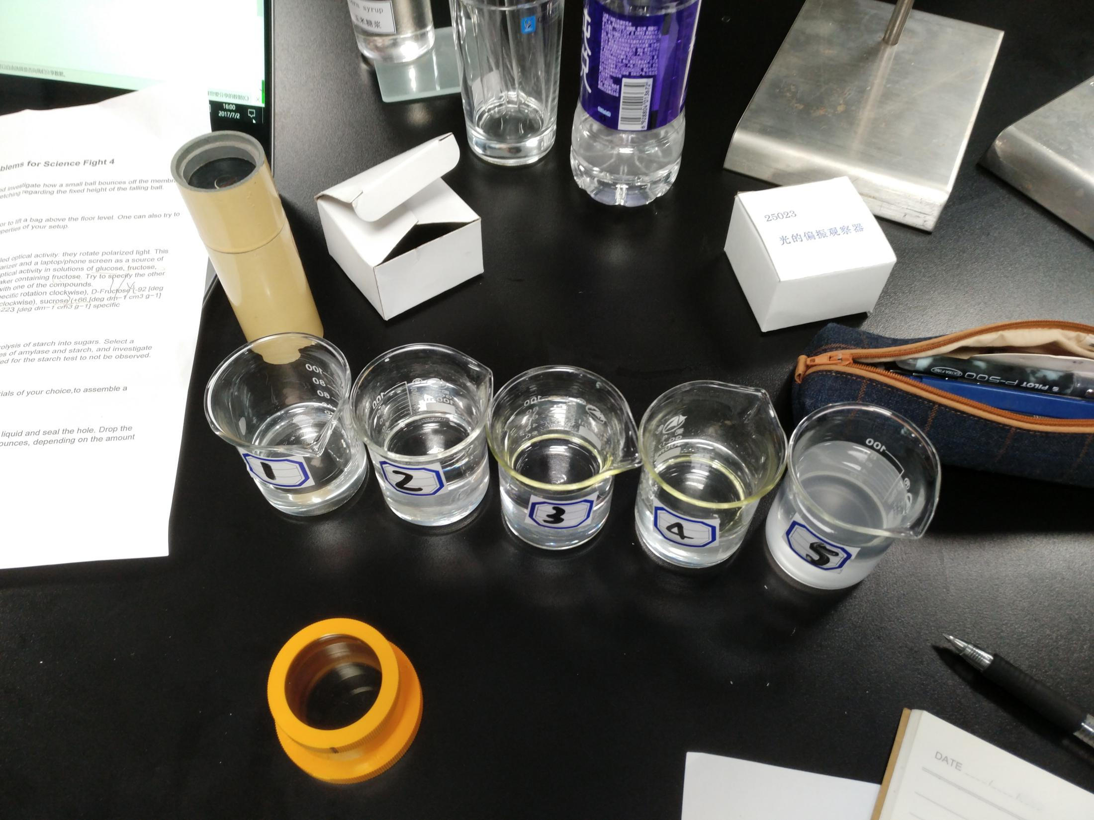
Investigate the optical activity in solutions of glucose, fructose, sucrose, and penicillin V to find the beaker containing fructose. Try to specify the other beaker the other beakers. Note, there are two beakers with one of the compounds.

Slide 6
KEY WORDS ANALYSIS
KEY WORDS
Optical Activity
Optical Activity is the ability of a substance to rotate the plane of polarization of plane-polarized light.

Slide 7
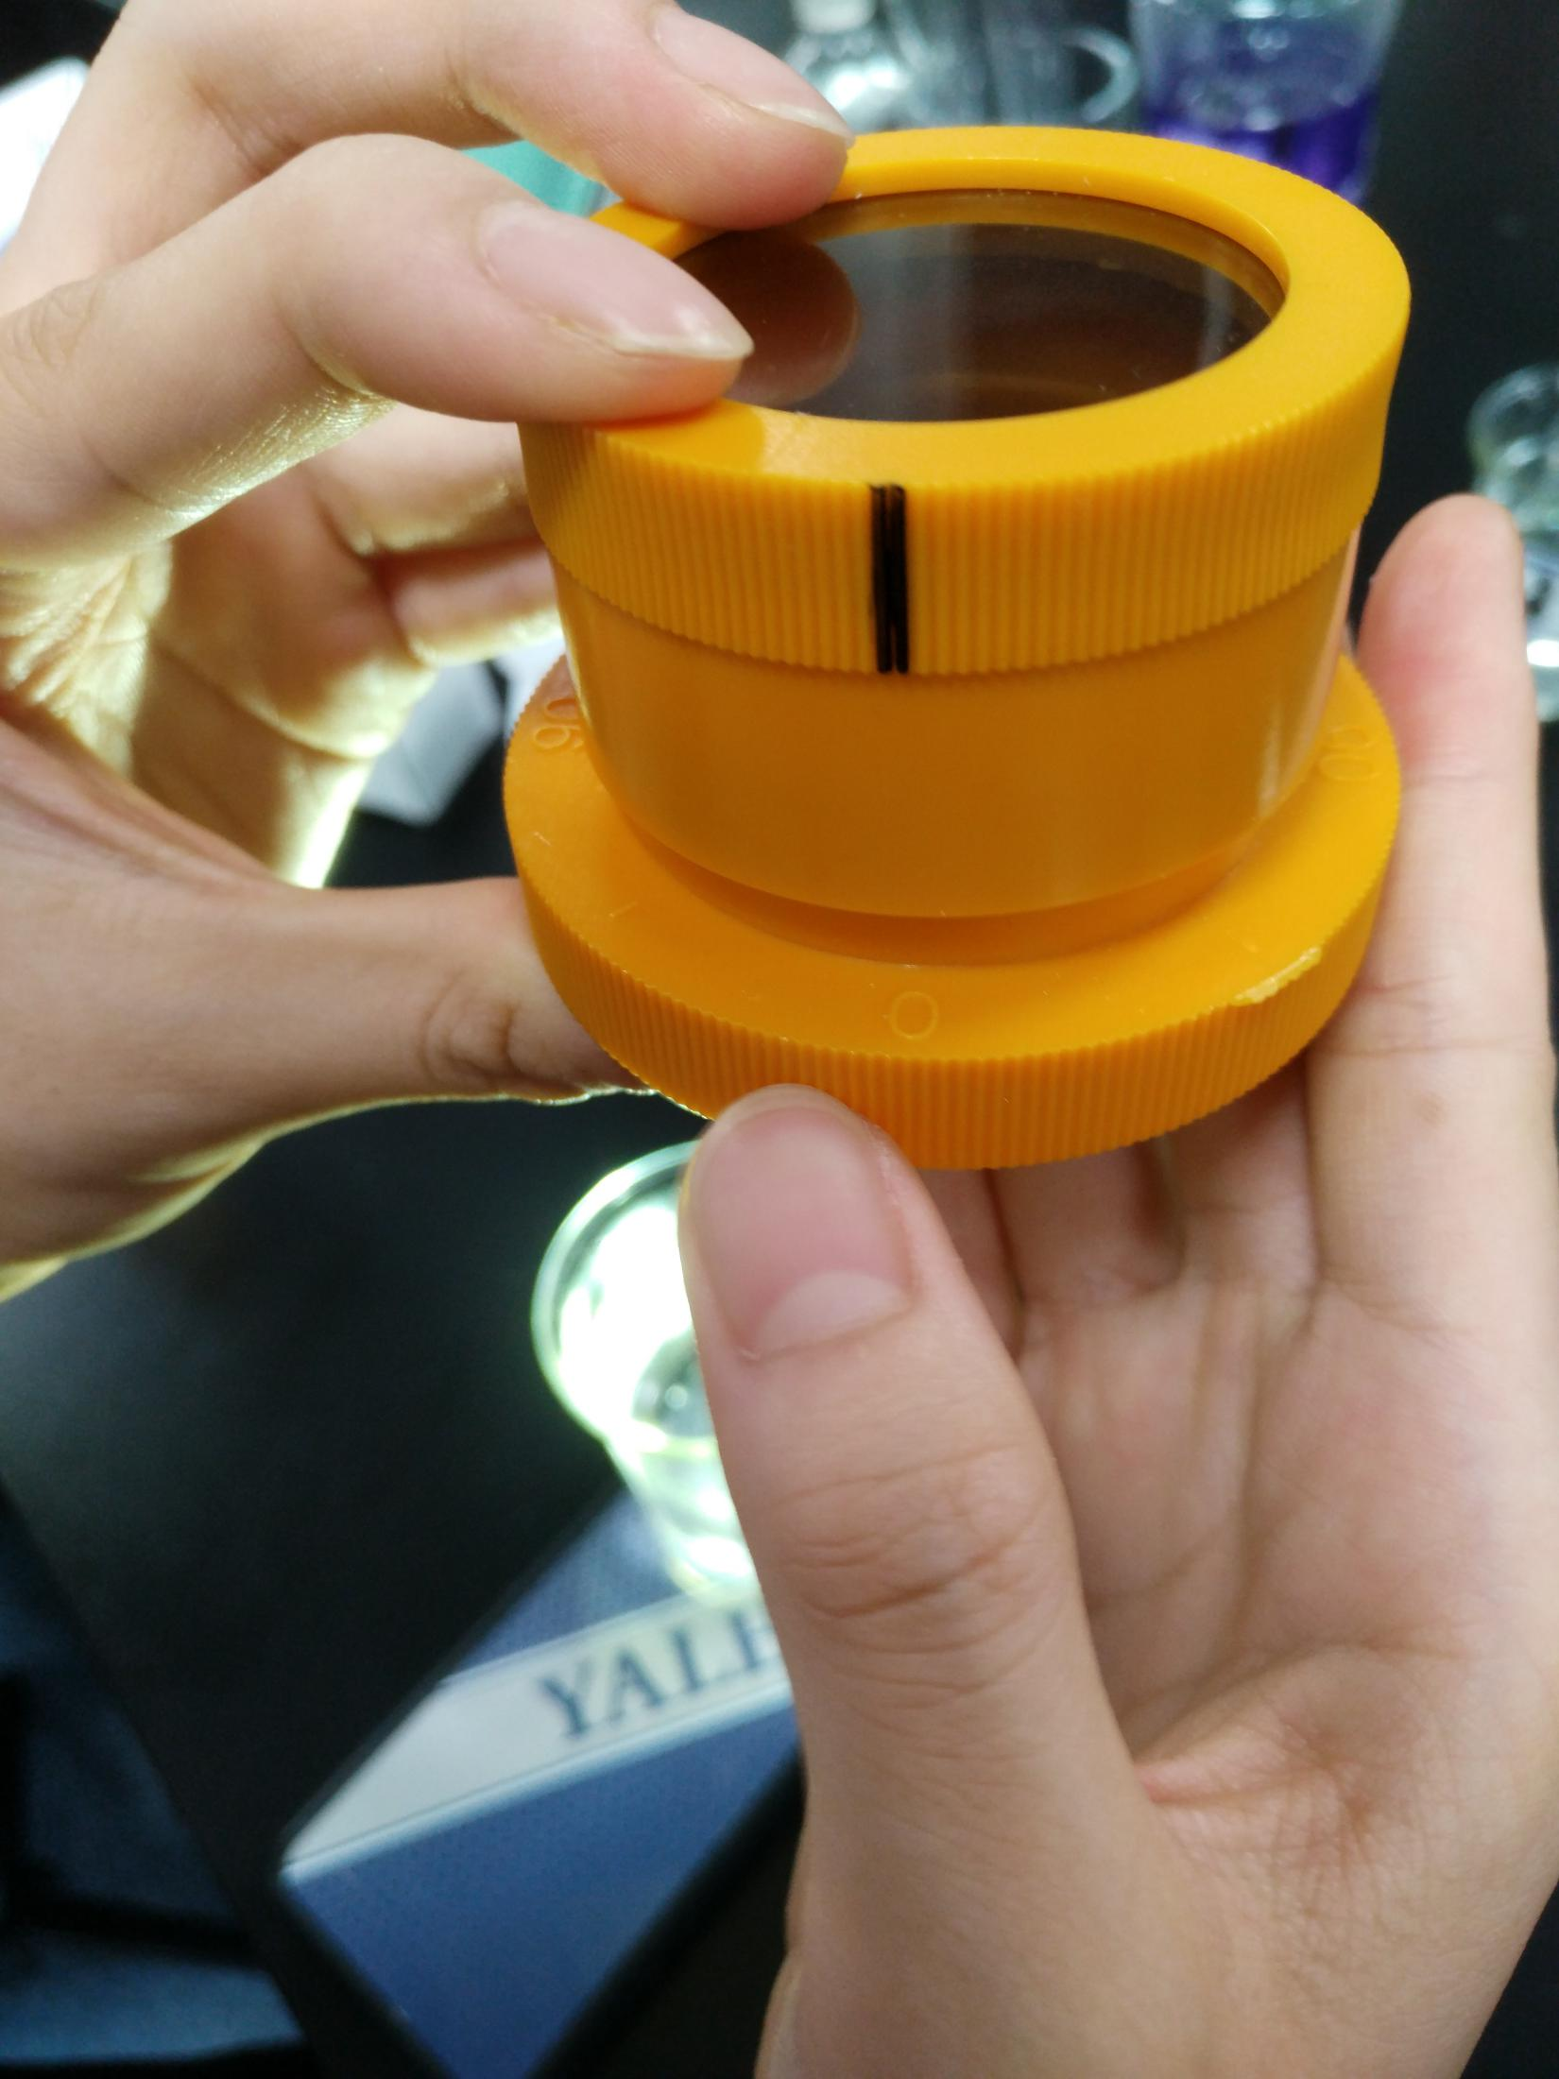
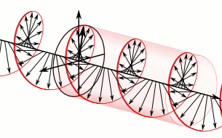
KEY WORDS ANALYSIS
KEY WORDS
2.polarized light

Slide 8
02
Theoretical Analysis

Slide 9
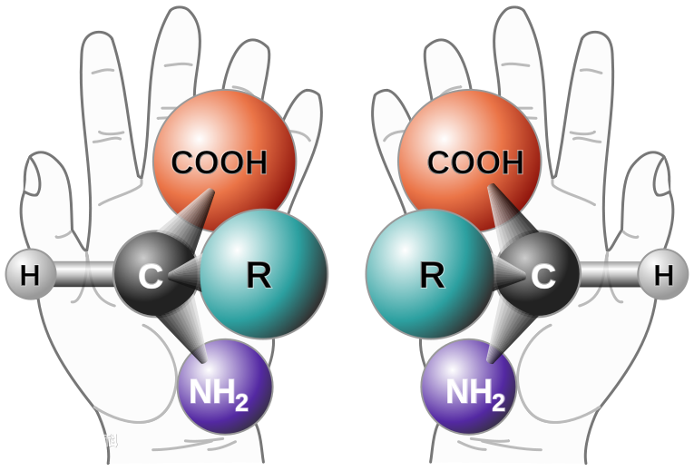
Theoretical Analysis
chiral molecules= optical activity
(Chirality=An object or a system is chiral means that it is distinguishable from its mirror image; that is, it cannot be superposed onto it. )

Slide 10
optical rotation
alpha(°):the inclination of the light
L(dm)：the length of the test tube
(filled with solution=the length of
solution)
C(g/ml): the concentration of the
solution
t:temperature
D：the wavelength of the light

Slide 11
03
EXPERIMENTATION
AND CONCLUSION

Slide 12
PRELIMINARY EXPERIMENT

Slide 13
data
D-Glucos (+53 [deg dm-1cm3g-1], clockwise)
D-Fructose (-92 [deg dm-1cm3g-1], counter clockwise)
Surcrose( +66 [deg dm-1cm3g-1], clockwise)
Penicillin V (+233 [deg dm-1cm3g-1], clockwise)

Slide 14
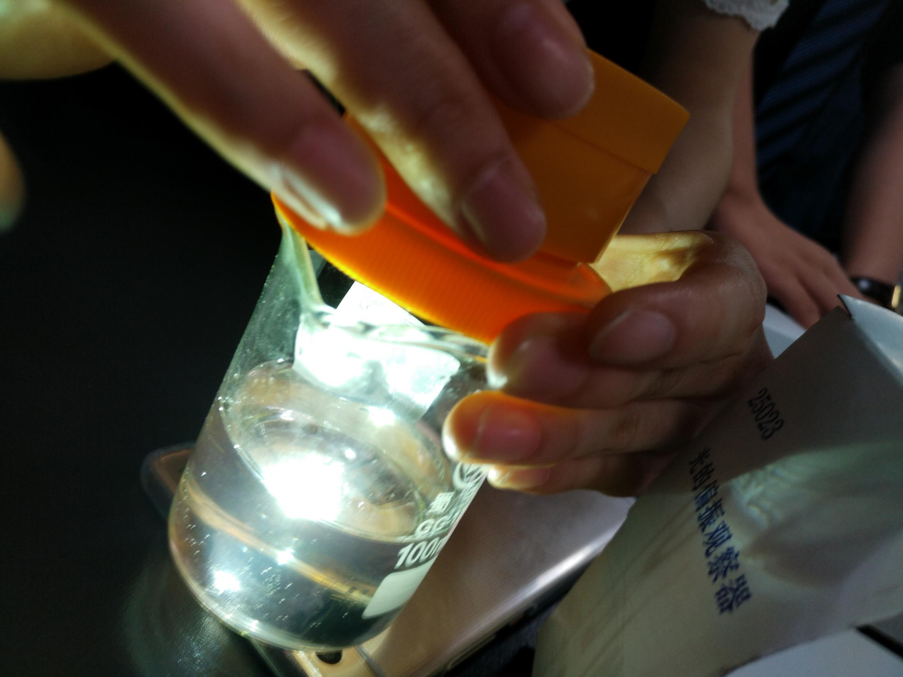
EXPERIMENT
 | 1 | 2 | 3 | 4 | 5
experiment | 45-60 | 60-70 | 90 | 45-60 | (180)+45
standard | 53 | 66 | 92 | 53 | 223
conclusion | Glucose | Surcrose | Fructose | Glucose | Penicillin V
We used the polarized mirror
to measure the angle of light
whcih is through the solution.

Slide 15
04
FURTHER DISCUSSION
AND IMPROVEMENTS

Slide 16
IMPROVEMENTS
Use lights of other colors, such as red light
repeat the experiment
use equipment with higher accuracy( use a light sensor to measure the light intensity to determine whether the light intensity has reached its maximum point.)
consider the influence of the glass beaker

Slide 17
THANK YOU
PPT模板下载：www.1ppt.com/moban/ 行业PPT模板：www.1ppt.com/hangye/
节日PPT模板：www.1ppt.com/jieri/ PPT素材下载：www.1ppt.com/sucai/
PPT背景图片：www.1ppt.com/beijing/ PPT图表下载：www.1ppt.com/tubiao/
优秀PPT下载：www.1ppt.com/xiazai/ PPT教程： www.1ppt.com/powerpoint/
Word教程： www.1ppt.com/word/ Excel教程：www.1ppt.com/excel/
资料下载：www.1ppt.com/ziliao/ PPT课件下载：www.1ppt.com/kejian/
范文下载：www.1ppt.com/fanwen/ 试卷下载：www.1ppt.com/shiti/
教案下载：www.1ppt.com/jiaoan/ PPT论坛：www.1ppt.cn

