Slide 1
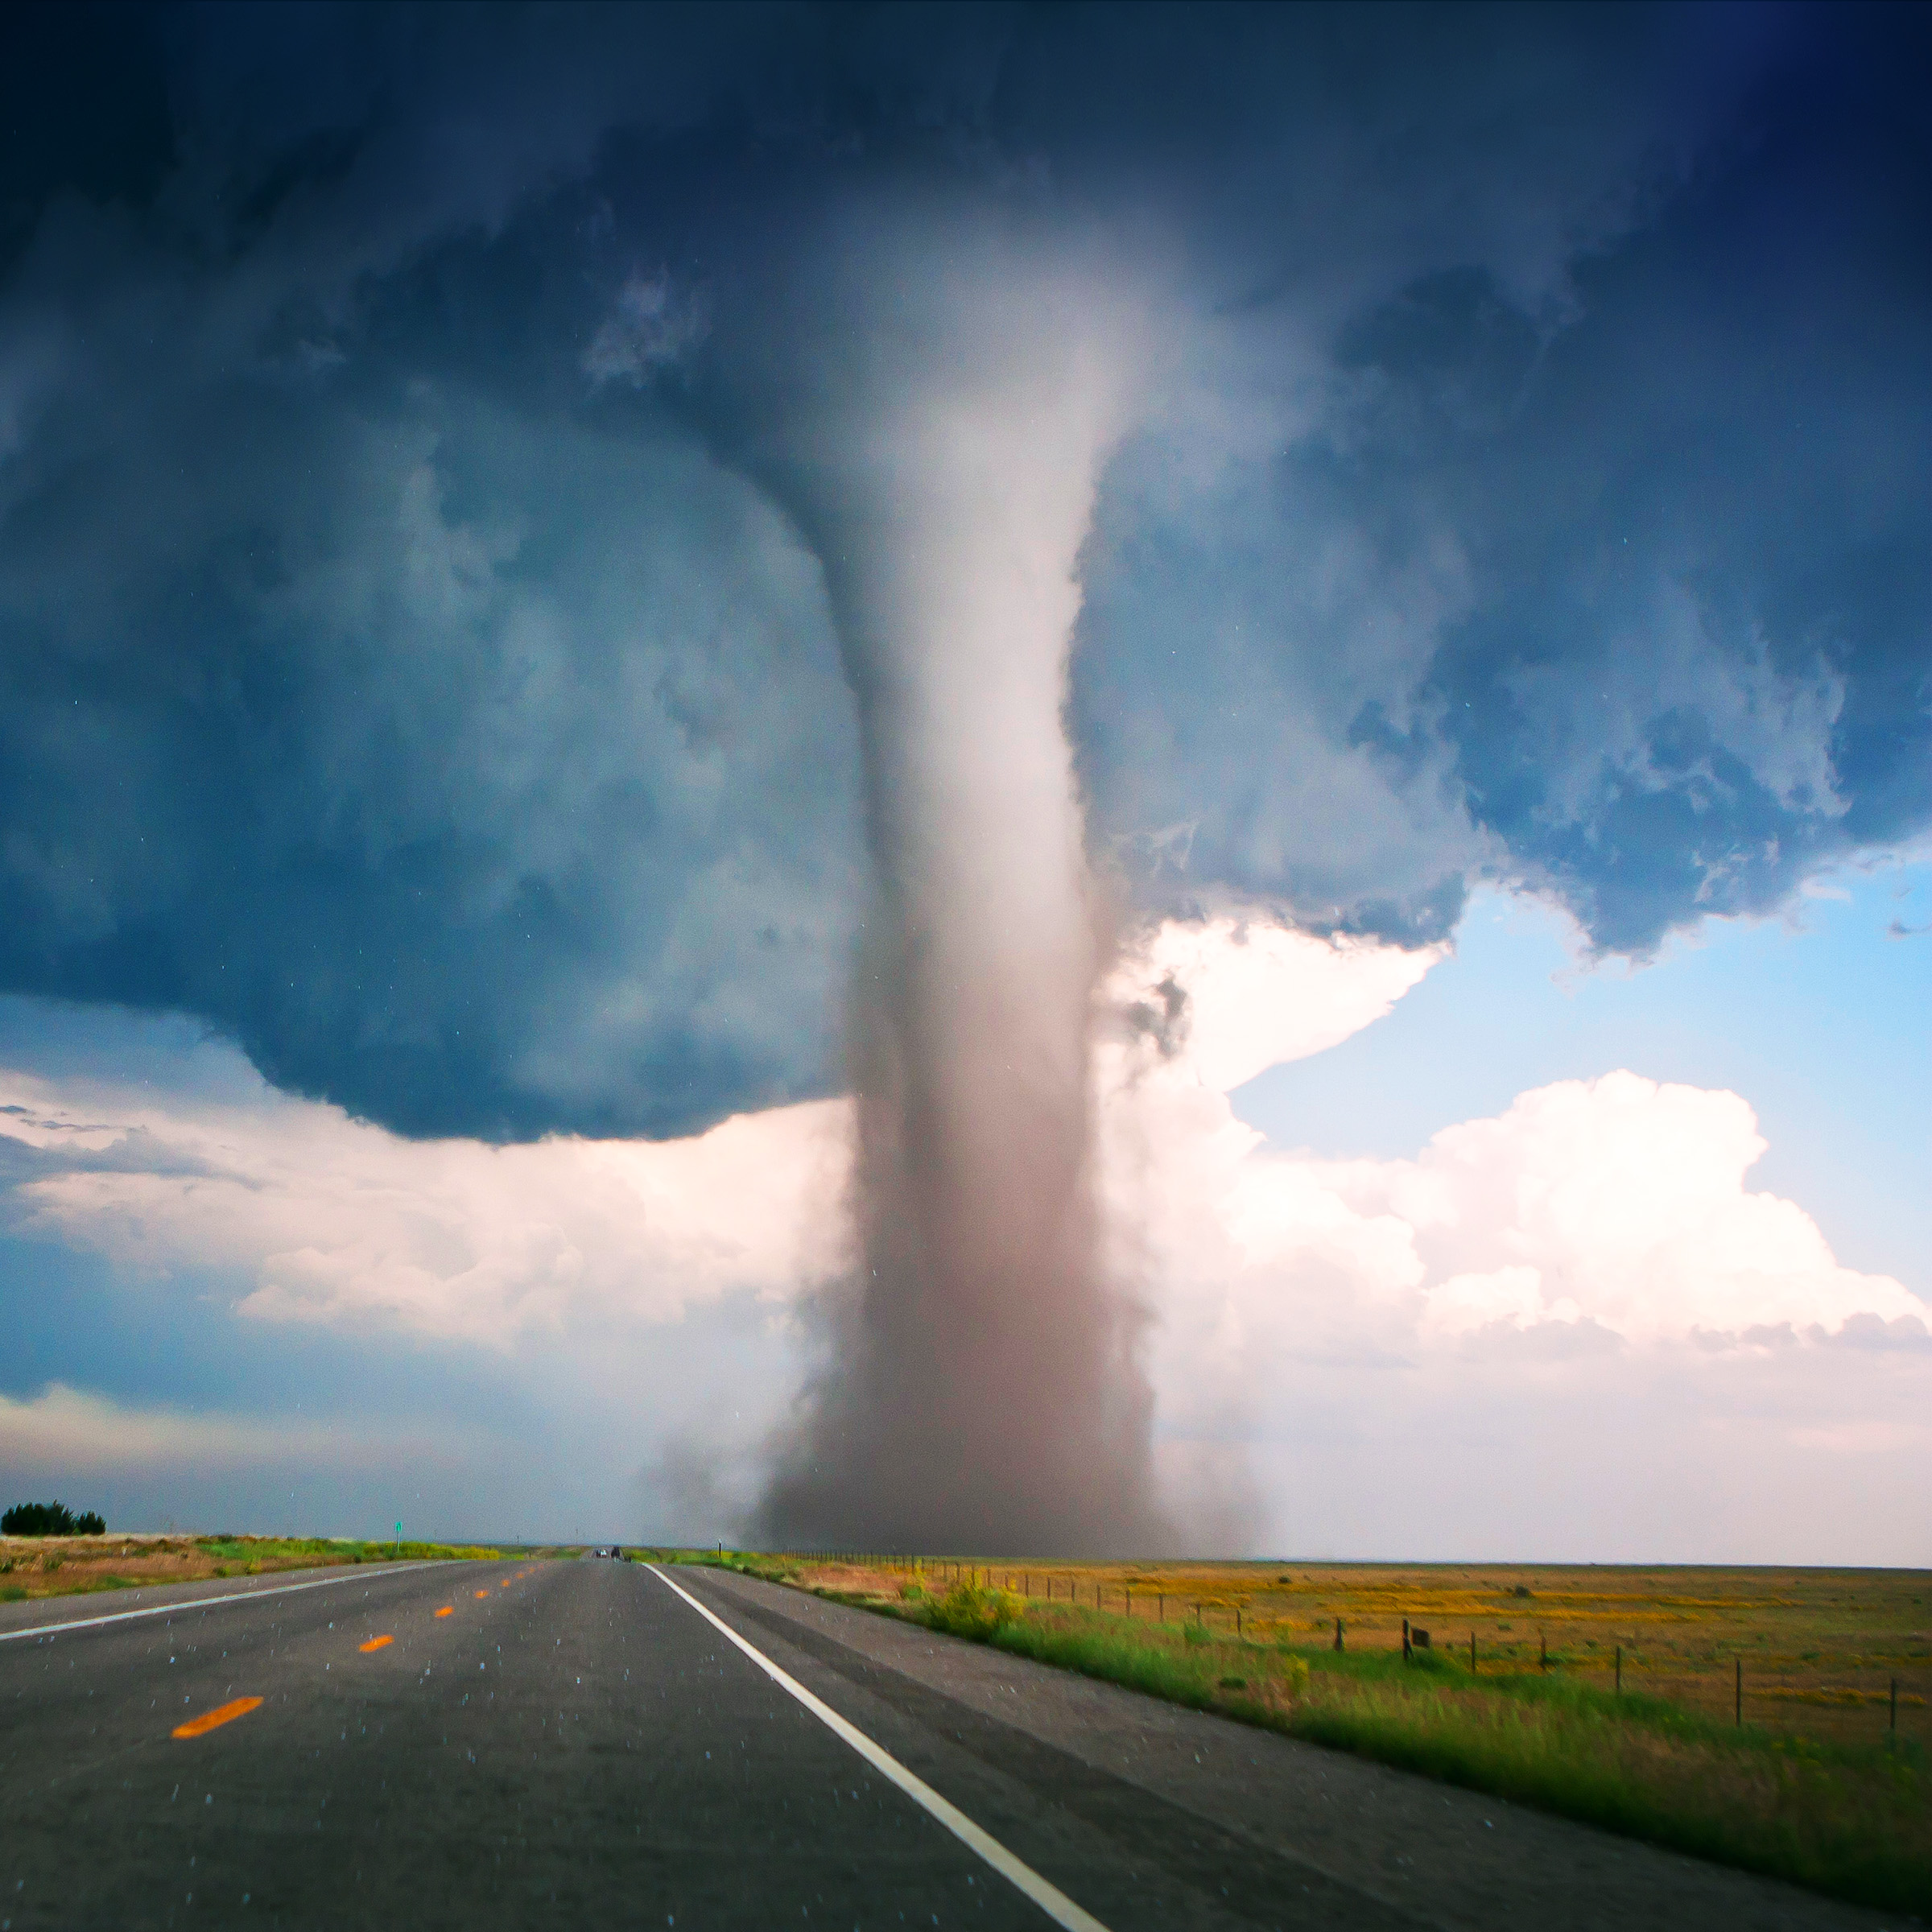
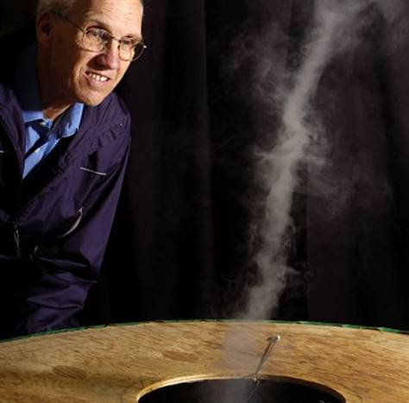
17. Tornado machine
----LaplaceWitches

Slide 2
INITIAL THOUGHTS

Slide 3
About the problem
Build a machine to produce an indoor air tornado. Investigate the properties and stability of the tornado. Is the machine portative enough to be demonstrated at a Science Fight room of the 5th IYNT?

Slide 4
Key Words
Machine
Indoor
Air Tornado
Properties
Stability
Portative

Slide 5
Pre-experiments (I)
Water Tornado
(shearing force)

Slide 6
视频

Slide 7
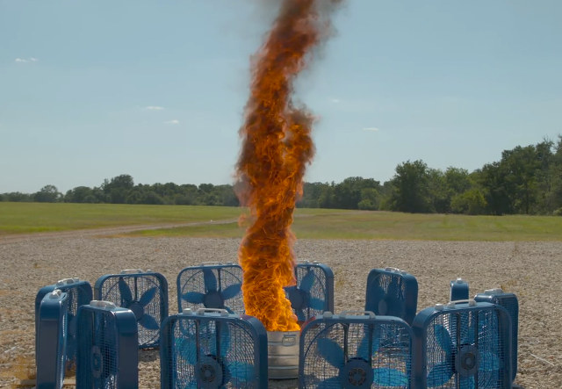
Pre-experiments (II)
Fire Tornado
(Shearing force + Elevating force)

Slide 8
视频

Slide 9
Basic Theory
Shearing force (切力)
Elevating force (上升力)

Slide 10
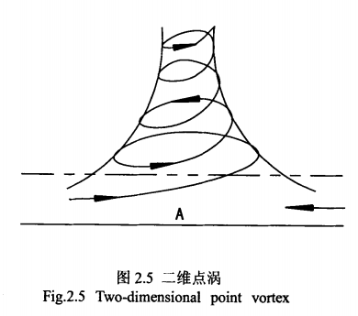
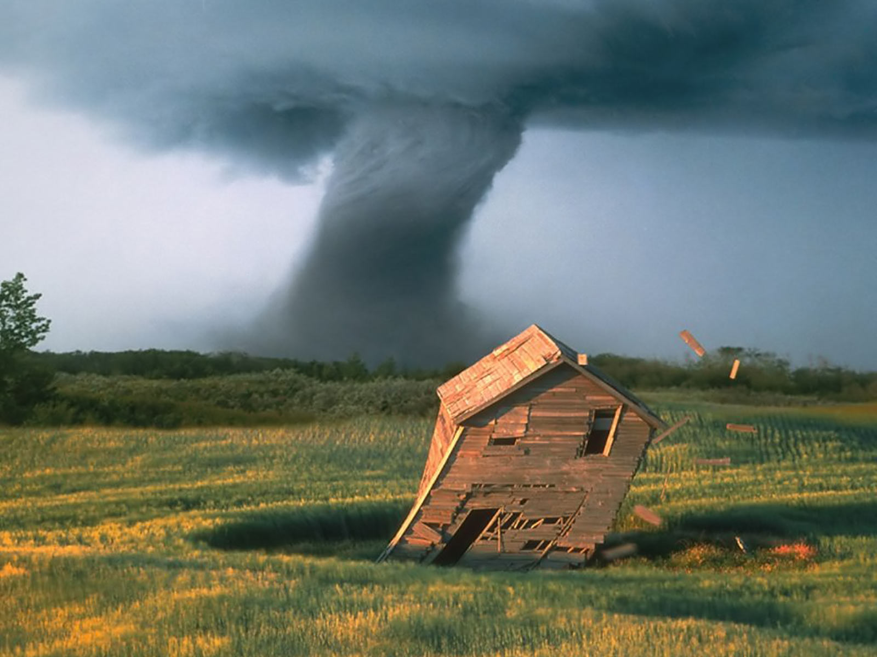

Slide 11
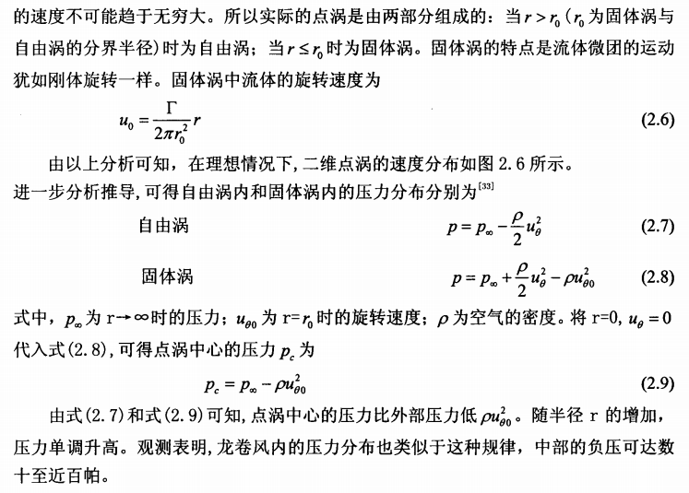

Slide 12
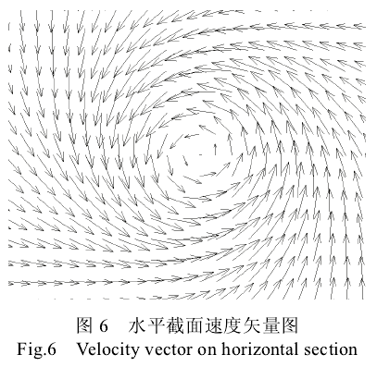

Slide 13
THE EXPERIMENT

Slide 14
Equipment and facilities
(PICTURE + WORDS)
(加上俯视图啊巴拉巴拉)
(还可以先放草稿图啊巴拉巴拉)

Slide 15
Draft (I)
Exhaust fan*1
Plexiglass board*4
Air blower*4
Nebulizer*1

Slide 16
Draft (II)
Vertical view

Slide 17
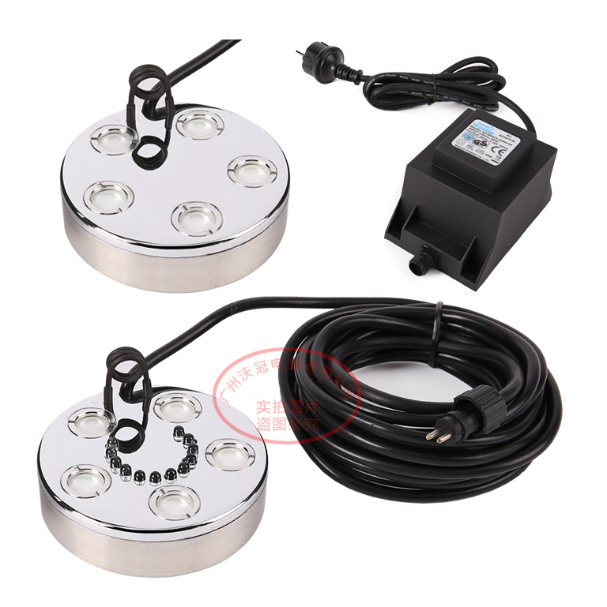
Purchasing ☺ (I)
Ultrasonic nebulizer
(1 head /
5 heads)

Slide 18
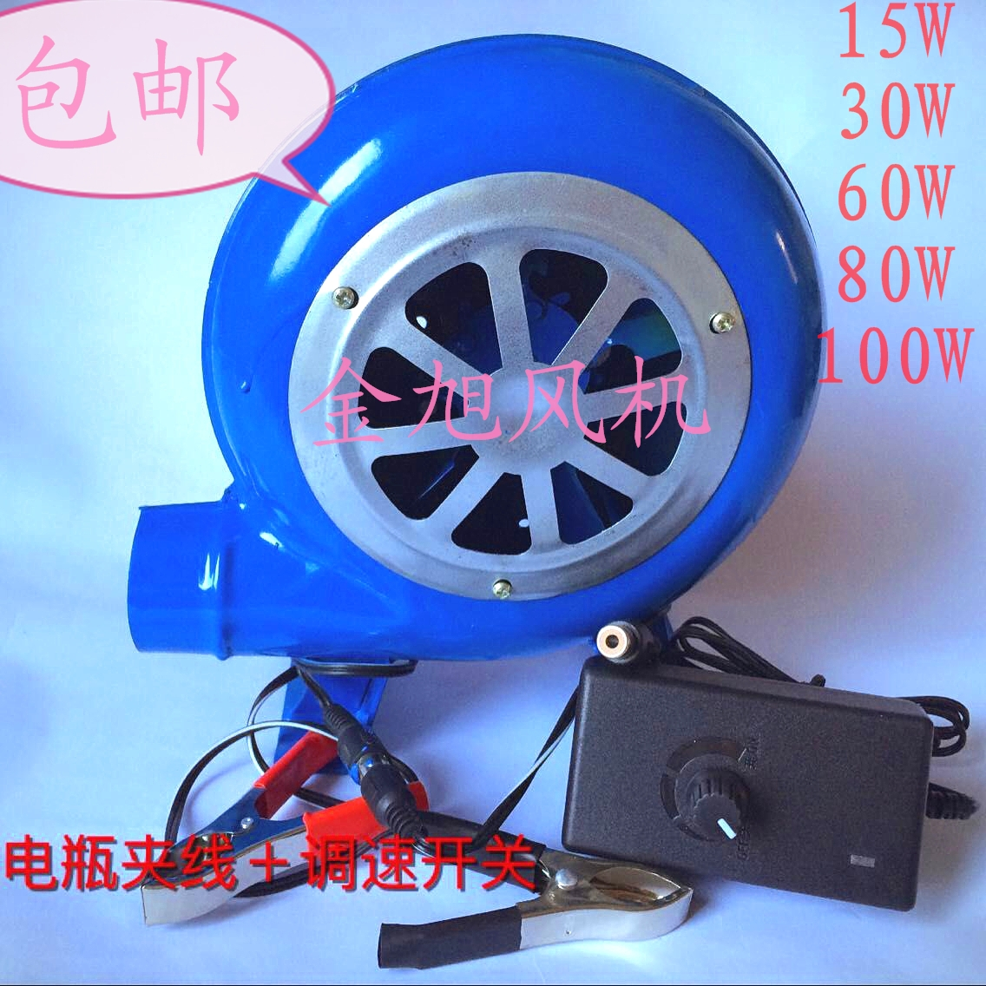
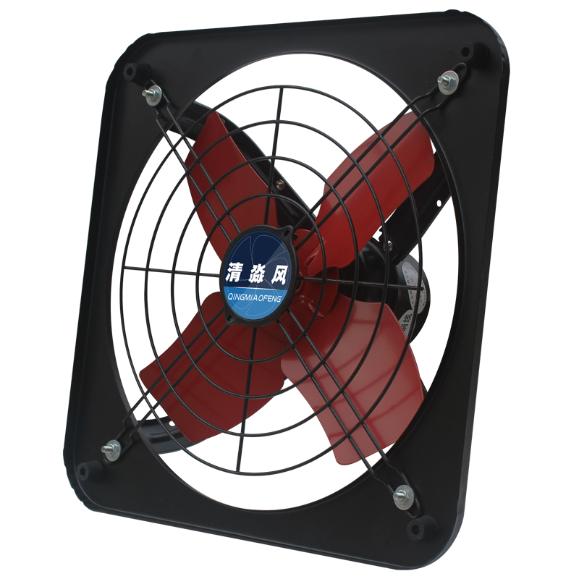
Purchasing ☺ (II)
Air blower*4
Exhaust fan*1

Slide 19
Purchasing ☺ (III)
Plexiglass board
*4

Slide 20
参数parameter
balabala

Slide 21
Steps (video provided)
Assemble
1) only 雾化器 on
2) 鼓风机 on
3) 抽风机 on
Put the stuff back in order

Slide 22
视频

Slide 23
Properties and Stability
开始慢动作
从开始形成到较为稳定的时间
从水雾分部不均匀到均匀的时间（或者分部规律）
引出2basictheories

Slide 24
Variables
雾化器雾化量（挡板半径）
鼓风机鼓风量（有／无，其作用及思考）（四边塞起来／侧面进气量－进气速度变化）
抽烟机抽风量（遮挡抽风口，面积）

Slide 25
变量图表实验。。。

Slide 26
结论（影响因素）

Slide 27
误差分析
风速计算误差
遮挡排风扇误差
遮挡抽风口误差
鼓风机加不加误差

Slide 28
参考文献

