Slide 1
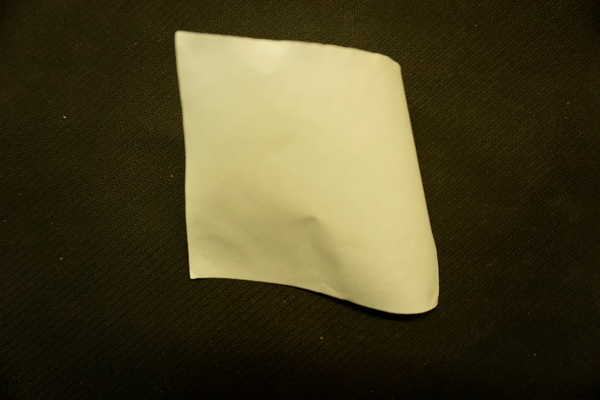
Problem No.16 Paper wrinkles
When a piece of paper dries after being wet, it can get wrinkled. Investigate and explain this phenomenon.

Slide 2
Catalog
Experimental Setup
Experiment result
Theoretical Investigation
Influence factors
Conclusion
Improvement
Notes:
First, I’m going to introduce my experimental setup and the key observation in the preliminary experiment.
Then, I’ll speak my theoretical investigation by 2 parts.
At last, I’ll come up with my conclusion and analyze the uncertainties to propose further insight.

Slide 3
Catalog
Experimental Setup
Experiment result
Theoretical Investigation
Influence factors
Conclusion
Improvement

Slide 4
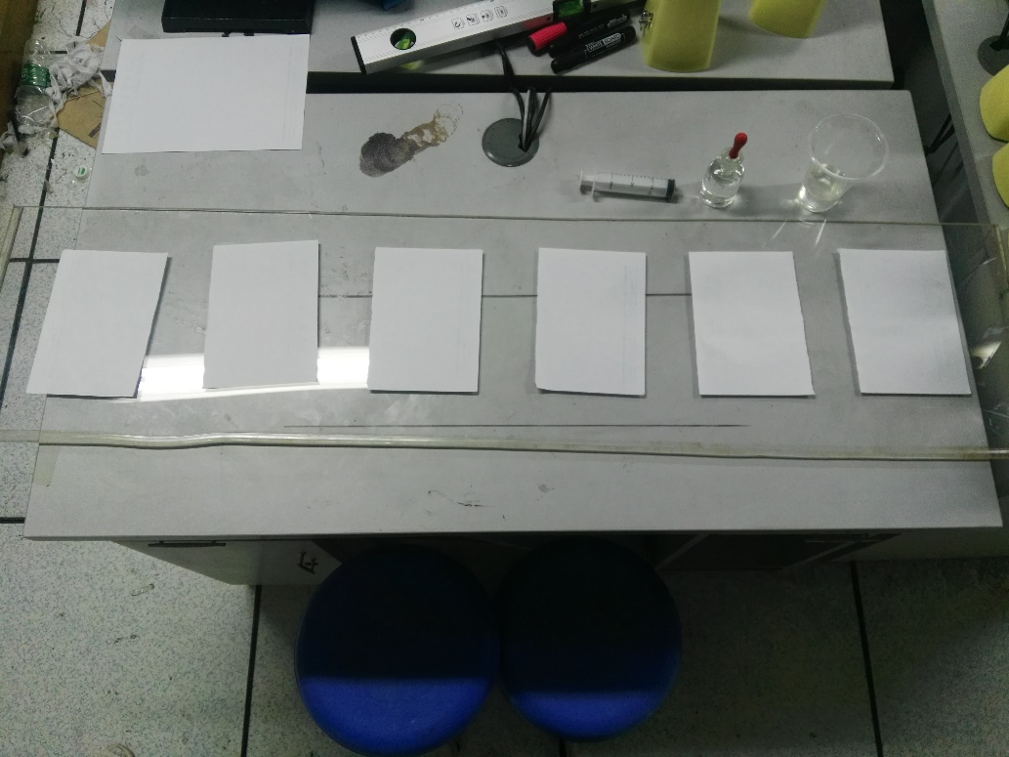
Experimental Setup (1)

Slide 5
Experimental Setup
Glycerinum
Water
Ethyl alcohol
Put different liquid to soak the paper completely
Dry out naturally

Slide 6
After two days
Paper soaked by water is more irregular than alcohol
(Glycerinum do not dry out even after four weeks :)
Water
Ethyl alcohol

Slide 7
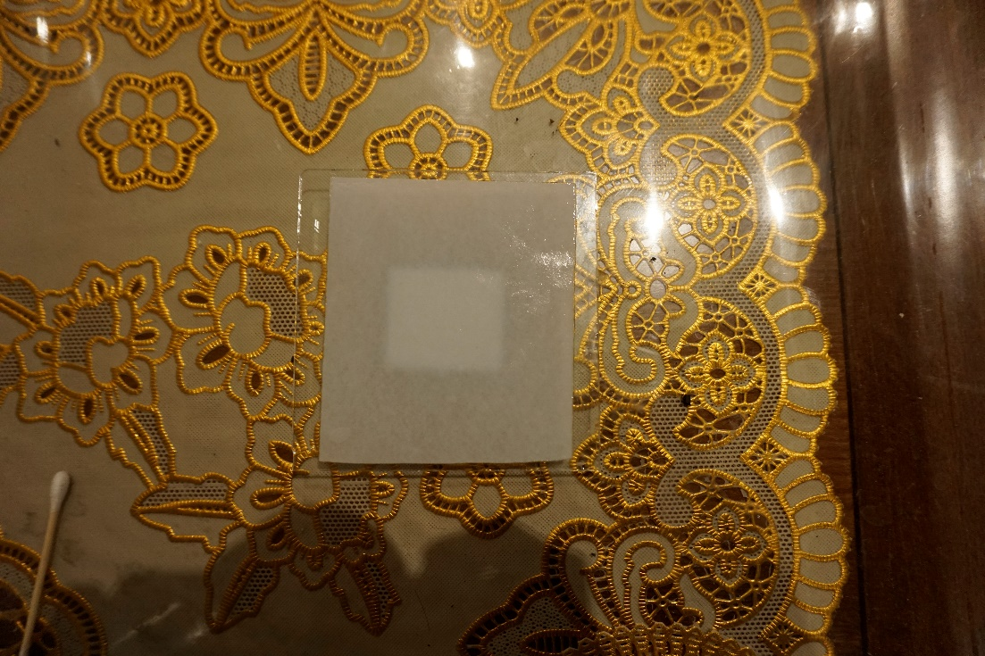
Four different methods to dry the paper (2)
Dry out naturally

Slide 8
Four different methods to dry the paper (2)
Put into the fridge one day and dry out naturally

Slide 9
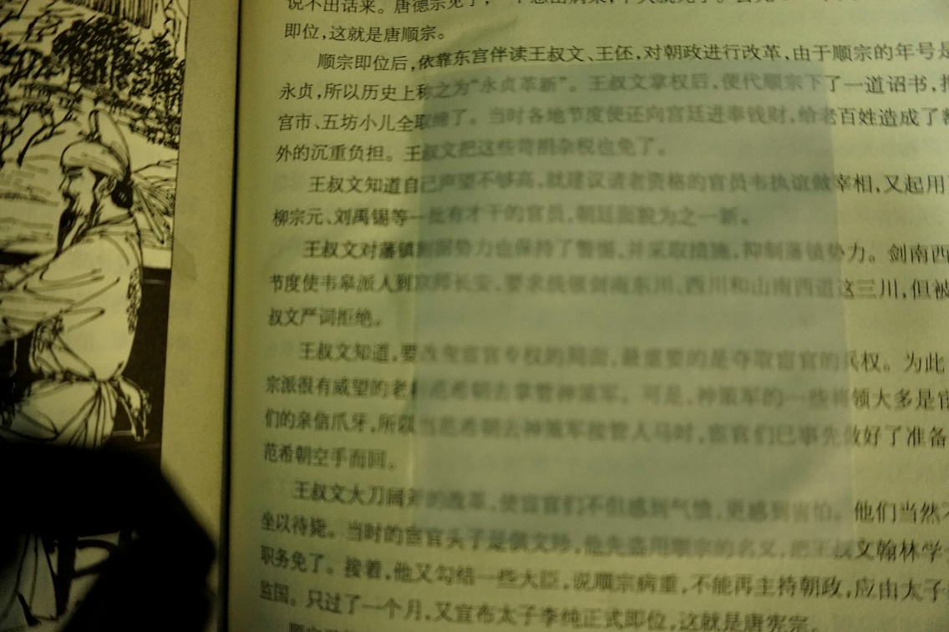
Four different methods to dry the paper (2)
Put it between pages of a book

Slide 10
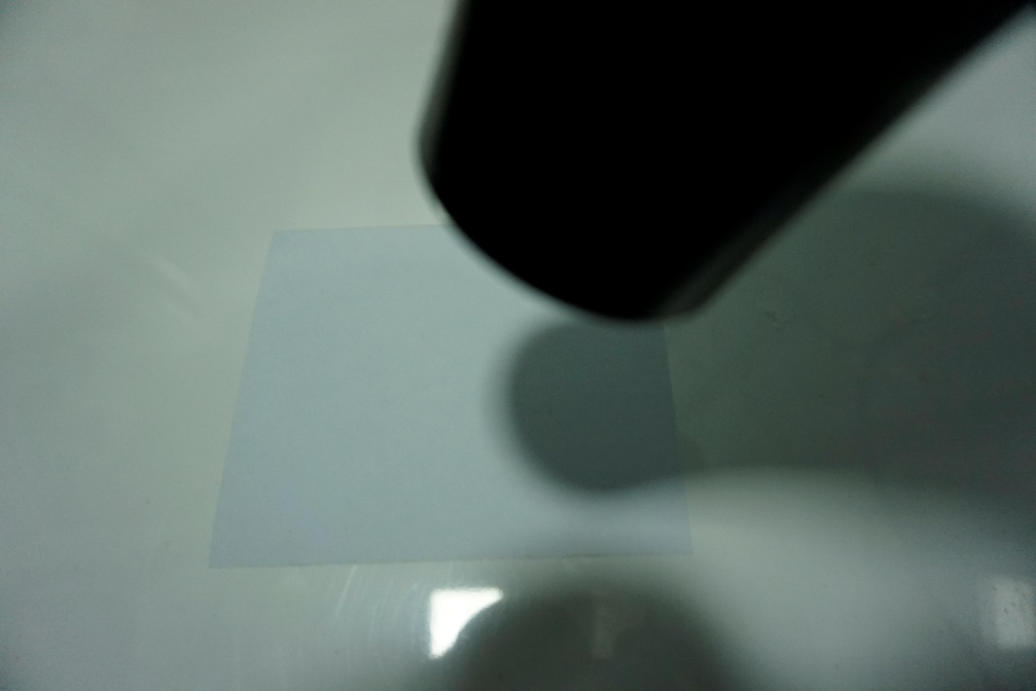
Four different methods to dry the paper (2)
Use blower

Slide 11
Result
Fridge
Between pages
Blower
Natural

Slide 12
Catalog
Experimental Setup
Experiment result
Theoretical Investigation
Influence factors
Conclusion
Improvement

Slide 13
Theoretical Investigation
Macroscopic:
Paper bending
Irregular
Waterlogging
Microcosmic
(Surface roughening):
Fiber apophysis
Fiber rising
Blower
(bending)
Naturally
(waterlogging)

Slide 14
Why paper can absorb water, and why it will dry out?
Paper’s fiber has many gap
Expand and hold water
Water evaporates and fiber shrinks

Slide 15
(1) Macroscopic
Bending and irregular:
(1) Not perfectly smooth
(2) Very complex structure with fiber
Absorb water unevenly
Destroy primary structure

Slide 16
(1) Macroscopic
Waterlogging :
(1) Impurities(such as metal salt) in water remain while water evaporates
(2) Fiber oxidates and
become fragile and yellow
（BUT it takes a long time）

Slide 17
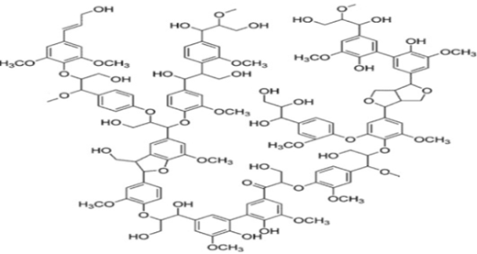
(2) Microcosmic
Surface roughening(lignin)：
Hydrogen bonds break and connect again(but not original)
Cause structure changed

Slide 18
Fiber rising
Y-H—X

Slide 19
(2) Microcosmic
Fiber expanding
Recovering
Release force
Bonds break

Slide 20
Catalog
Experimental Setup
Experiment result
Theoretical Investigation
Influence factors
Conclusion
Improvement

Slide 21
1.Temperature
Low temperature
Dry out more slowly
More balance drying

Slide 22
2.Wind
Fast wind
Some places dry out faster than others
Not smooth

Slide 23
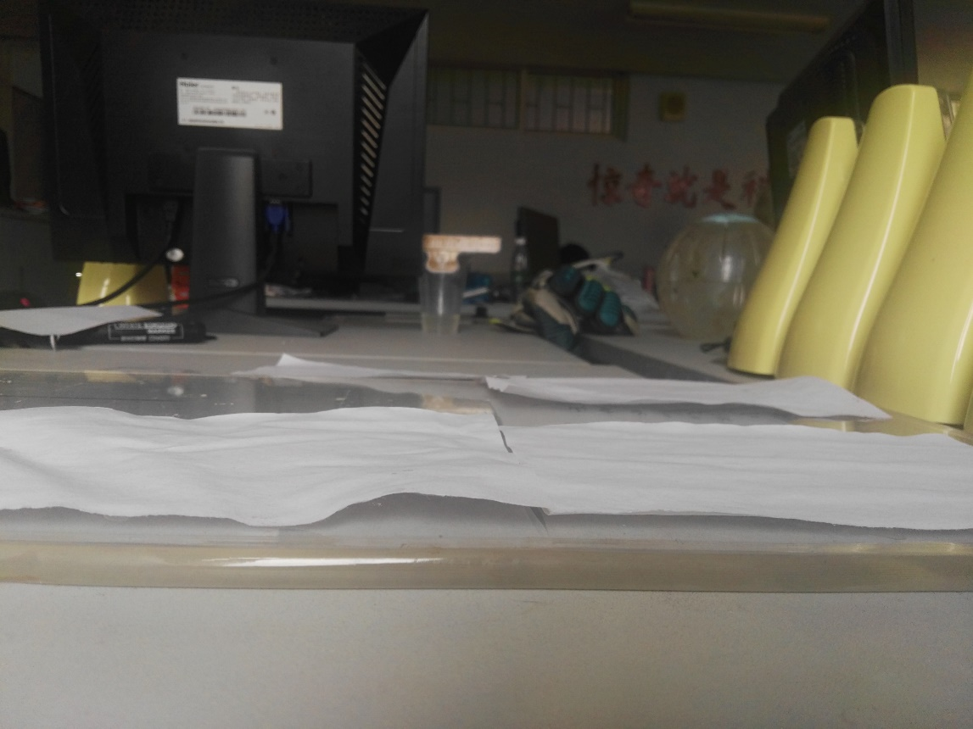
3.Variety of liquid
Alcohol has less surface tension
Less permeate force
Destroy less
Water
Ethyl alcohol

Slide 24
4.Pressure
Pressure on paper
Prevent bending and irregularity

Slide 25
Catalog
Experimental Setup
Experiment result
Theoretical Investigation
Data Analysis
Conclusion
Improvement

Slide 26
Improvement
1.More kinds of paper(hard and soft, large and small )
2.More experiments(reduce error)
3.More directly measure
4.More details about paper wrinkles(shape, flatness)

Slide 27
Catalog
Experimental Setup
Experiment result
Theoretical Investigation
Data Analysis
Conclusion
Improvement

Slide 28
Conclusion
1.Paper’s wrinkles have two parts
2.Fiber expands, Hydrogen bonds, fiber’s expansion are important
3.Tempurature, wind, varieties of liquid, pressure have influence on wrinkles
Macroscopic
Microcosmic

Slide 29
Reference
[1] http://info.printing.hc360.com/2008/03/17090674423-2.shtml
[2] Xu Li, Liu Jingang. Reason and evaluation method of paper roughening in water [R] China pulp and Paper Research Institute, 2009

Slide 30
Thanks for listening!

