Slide 1
Problem No.8 Tonic water in UV light
Tonic water glows brightly when exposed to an ultraviolet black light bulb. It is however easy to quench the glow of tonic water by adding salt. Investigate this effect. What other common substances glow under UV light and how can one influence their glow?

Slide 2
Catalog
Experimental Setup
Preliminary Experiment
Theoretical Investigation
Influence factors
Conclusion
Uncertainty Analysis
Notes:
First, I’m going to introduce my experimental setup and the key observation in the preliminary experiment.
Then, I’ll speak my theoretical investigation by 2 parts.
At last, I’ll come up with my conclusion and analyze the uncertainties to propose further insight.

Slide 3
Catalog
Experimental Setup
Preliminary Experiment
Theoretical Investigation
Influence factors
Conclusion
Uncertainty Analysis

Slide 4
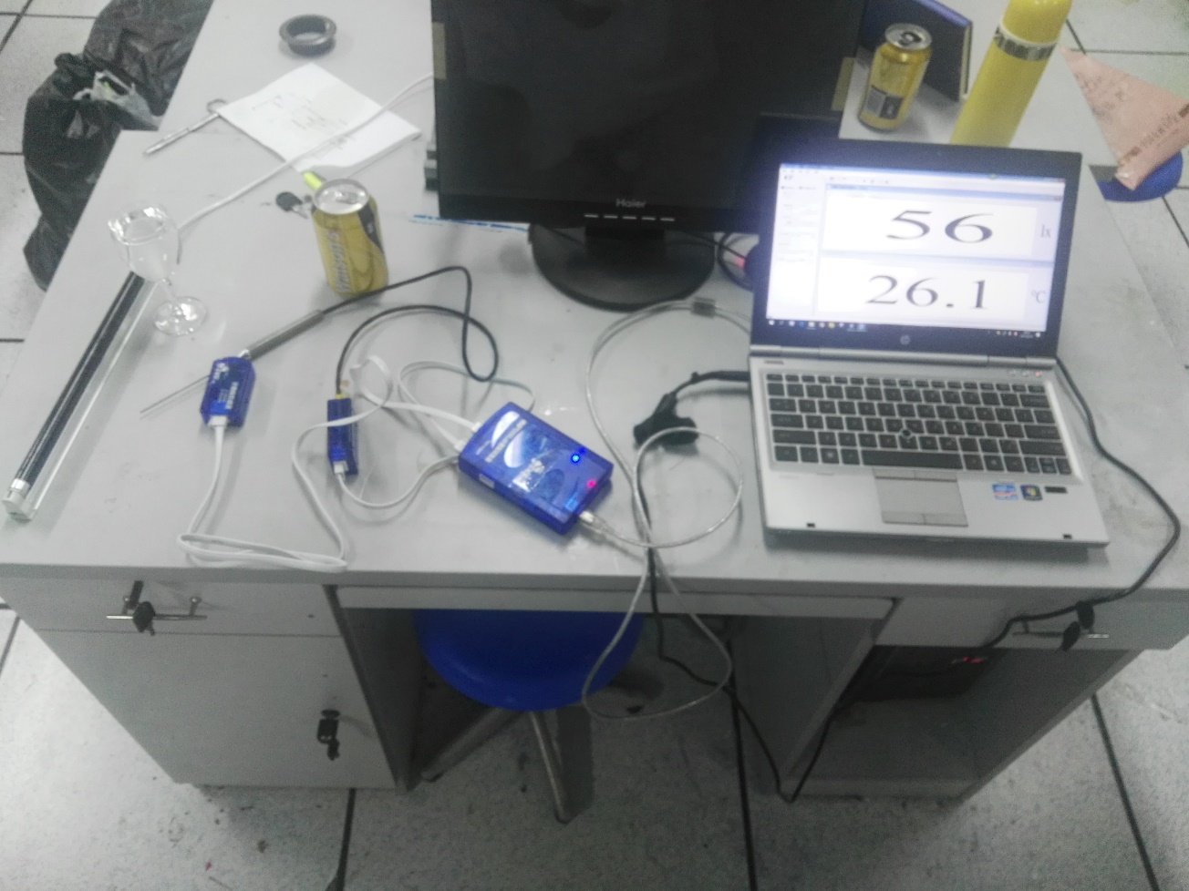
Experimental Setup (Software’s name: Dis Lab.)
Tonic water (45 ppm)
UV black light bulb

Slide 5
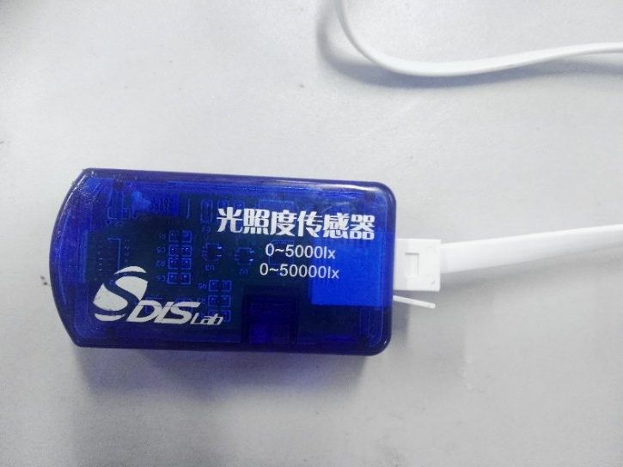
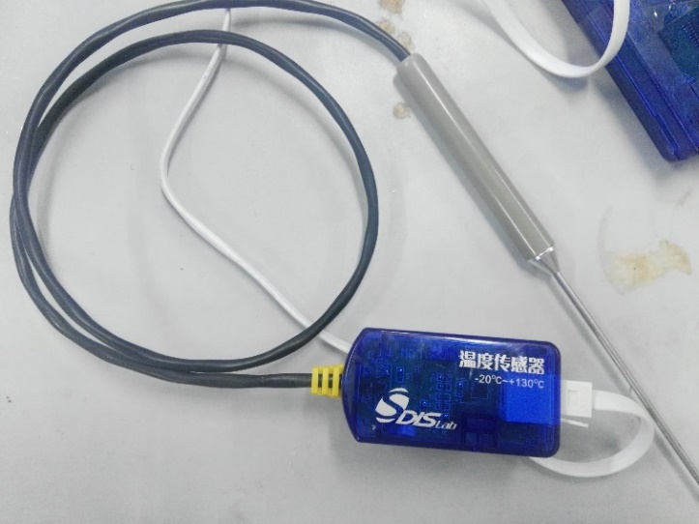
Measuring instrument (Dis Lab.)
pH sensor
solar sensor
Temperature sensor

Slide 6
Measuring instrument
Spectroscope

Slide 7
Equipment

Slide 8
About spectrum

Slide 9
Catalog
Experimental Setup
Preliminary Experiment
Theoretical Investigation
Influence factors
Conclusion
Uncertainty Analysis

Slide 10
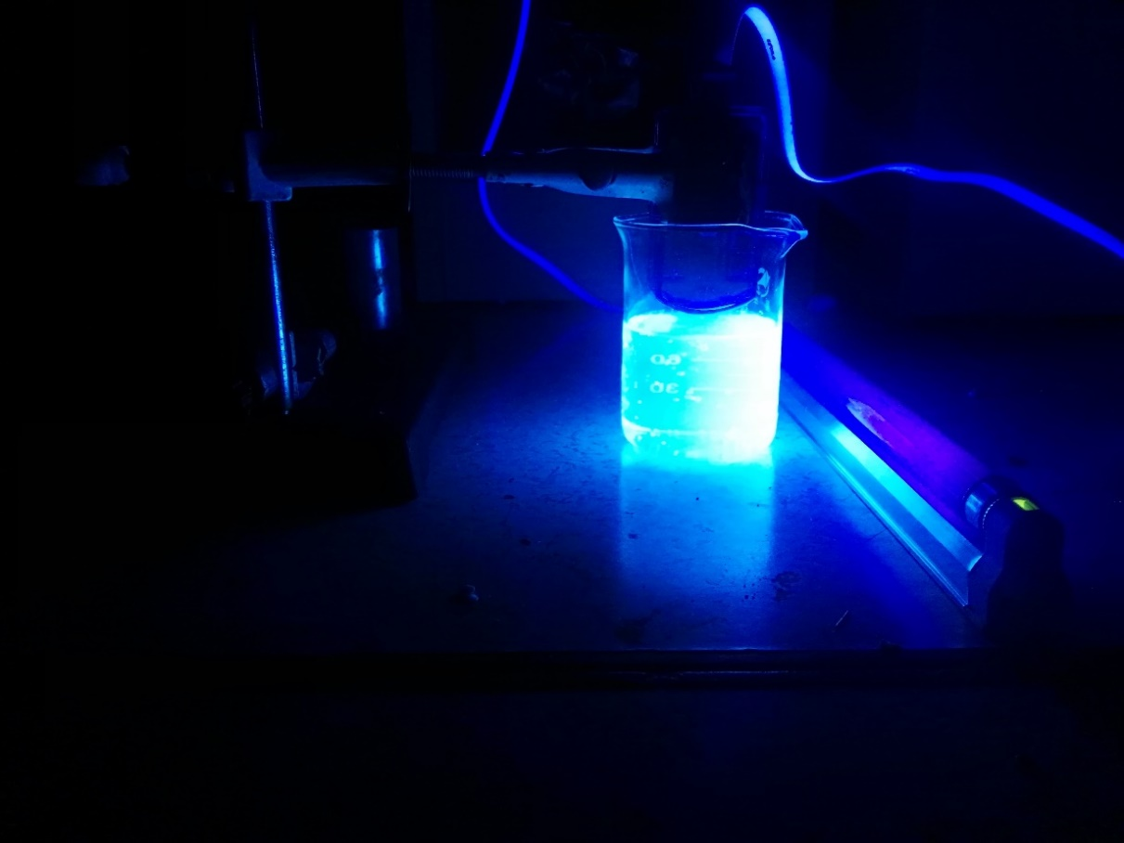
Primary experiment (25℃)
5cm between
light and solution
1cm between
sensor and solution

Slide 11
Adding salt
The light intensity has declined obviously
(ONLY 0.05g)
Appear lots of small bubble

Slide 12
About spectrum
Measure spectrum by spectroscope
Before and after adding salt

Slide 13
Catalog
Experimental Setup
Preliminary Experiment
Theoretical Investigation
Influence factors
Conclusion
Uncertainty Analysis

Slide 14
Theoretical Investigation
Hypothesis 1：
The Nitrogen and p-electron form conjugate structure
Attractive to H＋ ,like H-structure
Excite to excited state by UV light
Quantum transition
Quinine

Slide 15
Theoretical Investigation
Hypothesis 2：
The p-electrons of Quinoline form huge p-bonds
Excite to excited state by UV light
Quantum transition
Combining hypothesis 1 and 2
Quinine

Slide 16
Hypothesis
The UV light is a single frequency light
The light’s influence is infinitesimal disturbance
Regard the solution as isoconcentration

Slide 17
Theoretical Investigation
The probability of transition$δ$：
(Spontaneous emission)
$$δ=\frac{ω_{0}^{3}{\left|s\right|}^{2}}{3πε_{0}ℏc^{3}}$$
Electron：
$$n_{g}→n_{c}$$
Electron：
$n_{c}→n_{g}$+photon
The UV light（365mm）
The energy of every photon：
$E_{e}=E_{c}−E_{g}=e\left(\frac{1}{n_{c}^{2}}−\frac{1}{n_{g}^{2}}\right)$
The total energy of the light beam：
$ΣE=n_{e}\sum_{c=g+1}^{∞}{δe}\left(\frac{1}{n_{c}^{2}}−\frac{1}{n_{g}^{2}}\right)$
$$n_{e}=\frac{ρVN_{A}}{M}Δn_{e}=1.668×{10}^{19}$$

Slide 18
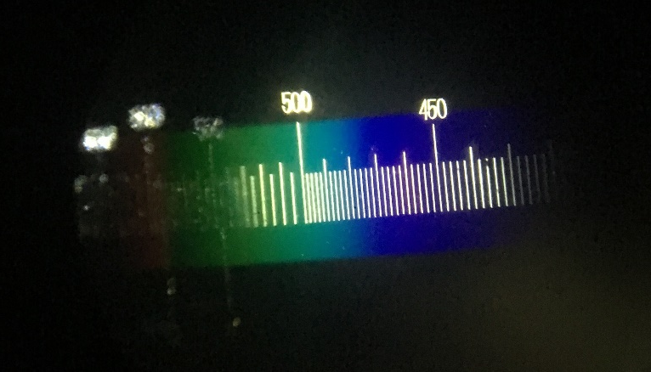
Theoretical Investigation
The fluorescence
（Stokes shift）
（$λ$=425-500nm）
P-bonds have complex structure
Transition is like superposition and emits continuous spectrum
The light intensity (visible light)$ΔE$
The wavelength of the light：
$\frac{1}{λ}=R\left(\frac{1}{n_{g}^{2}}−\frac{1}{n_{c}^{2}}\right)$
(R：the Rydberg constant)
360 550 nm

Slide 19
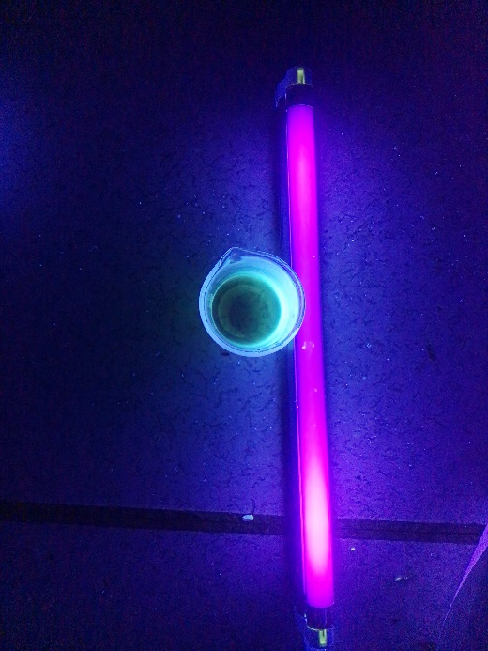
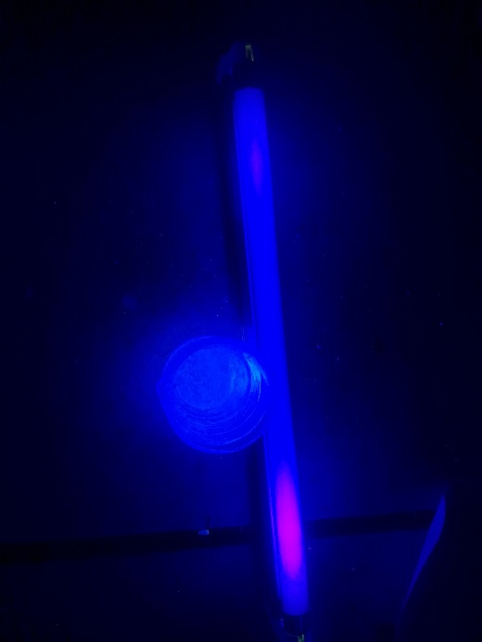
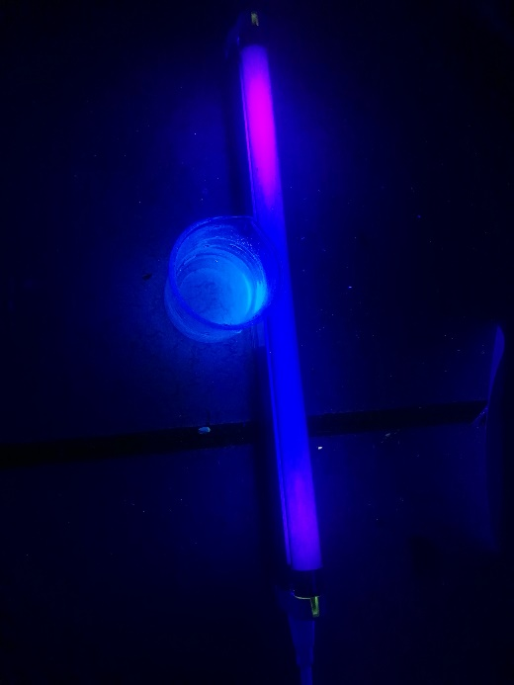
Adding salt :
Adding ${FeCl}_{3}$： Adding ${Na}_{2}{SO}_{3}$： Adding $NaCl$：

Slide 20
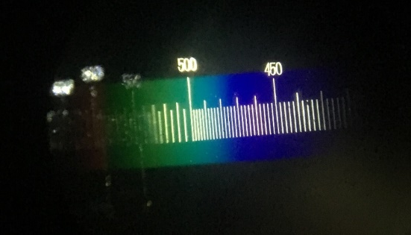
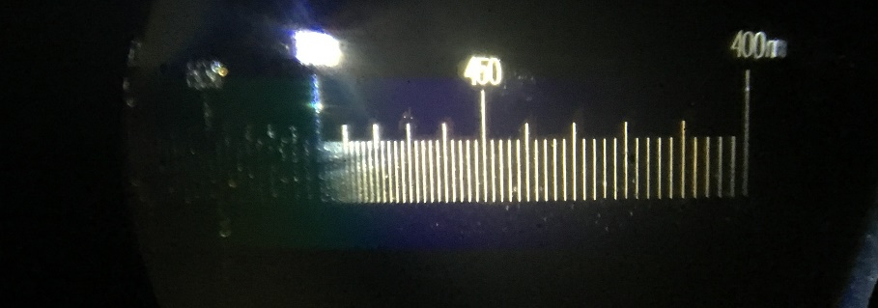
Adding salt（NaCl）
$$ΣE=n_{e }\sum_{c=g+1}^{∞}{δe}\left(\frac{1}{n_{c}^{2}}−\frac{1}{n_{g}^{2}}\right)$$
$$n_{e }$$
Fluorescence quenching

Slide 21
Adding salt（NaCl）
Fluorescence quenching：
(1) Collision √ (dynamic)
(2) Combination (No spectrum changes)
Halide（Cl-）play an important role

Slide 22
Adding salt（NaCl）
Fluorescence quenching：
According to Stern-Volmer equation :
$$\frac{F_{0}}{F}=1+K_{q}tQ$$
Experiment: $F_{0}=72$lx $F=13$lx $Q=0.5g/L$
Result : NaCl in Quinine,
$K_{q}$=4.7×${10}^{10}ml/s·g$=$9×{10}^{9}L/s·mol$

Slide 23
1.The influence of NaCl
Without NaCl (distance: 2cm; volume: 100ml) : 72 lx
Adding 0.05g NaCl : 13 lx
Adding 0.1g NaCl : $4$ lx
Taking in Stern-Volmer equation
Adding 0.1g NaCl: $F=4$.01lx
√

Slide 24
Catalog
Experimental Setup
Preliminary Experiment
Theoretical Investigation
Influence factors
Conclusion
Uncertainty Analysis

Slide 25
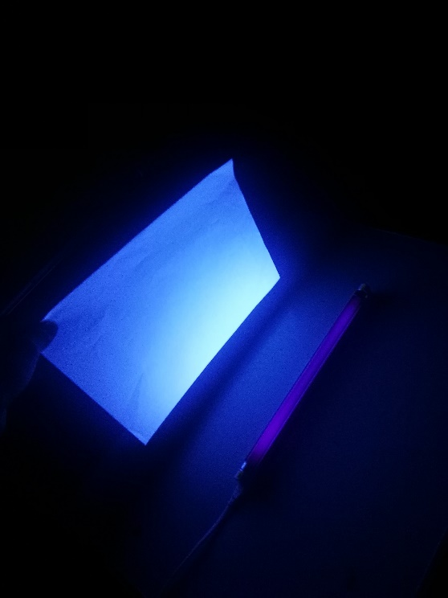
Other substances
(1)Bleached paper:
Principle like quinine (VBL)
Factors：
(1) The UV light’s luminance
(2) Distance
$δ$

Slide 26
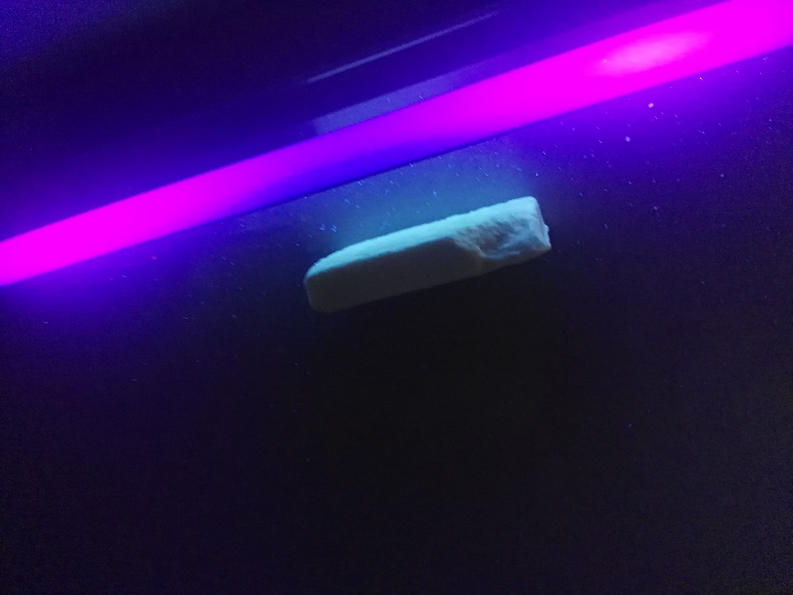
Other substances
(2)Soap
Principle like quinine (CBS)
Factors：
(3)Concentration
$n_{e }$

Slide 27
Other substances
(3)Clothes
Principle like (1)(2)
Factors：
(4)Square
$n_{e }$

Slide 28
Other substances
(4)Slipper
Photoluminescence
(1) Absorb the sunlight and store it
(2) Release the energy slowly
Factors：
(5) Time of sunlight

Slide 29
Influence
$$ΣE=n_{e }\sum_{c=g+1}^{∞}{δe}\left(\frac{1}{n_{c}^{2}}−\frac{1}{n_{g}^{2}}\right)$$
$n_{e }$ Concentration ; Square ; pH
$δ$ The UV light’s luminance ; Distance

Slide 30
Catalog
Experimental Setup
Preliminary Experiment
Theoretical Investigation
Data Analysis
Conclusion
Uncertainty Analysis

Slide 31
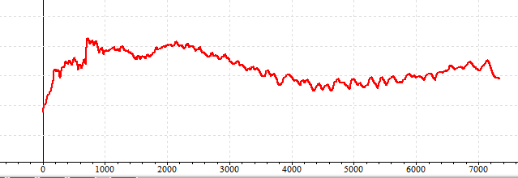
1.The time-dependent pH
The pH is not stable (4.6-5.4)
Influence the fluorescence

Slide 32
2.Visible light disturb
The black UV light emits visible light, too.
Not bright(≈0lx over 1cm)

Slide 33
Catalog
Experimental Setup
Preliminary Experiment
Theoretical Investigation
Data Analysis
Conclusion
Uncertainty Analysis

Slide 34
Conclusion
Fluorescence is caused by quantum transition
Fluorescence quenching（Collision）happens after adding salt
Other fluorescent substances :
paper, soap, clothes, slipper……（things has fluorescent agent）
Influence factors : $E\left(n_{e},δ\right)$
$n_{e}$: Concentration ; Square ; pH
$δ$ : The UV light’s luminance ; Distance

Slide 35
Reference
[1] Jonathan H. Gutow. Halide (Cl–) Quenching of Quinine Sulfate Fluorescence: W A Time-Resolved Fluorescence Experiment for Physical Chemistry [J] Journal of Chemical Education, Vol. 82 No. 2 February 2005 302-305
[2] Basic knowledge of fluorescence probe [OL]
[3] David J. Griffiths. Introduction to quantum mechanics [M] China Machine Press，2009
[4] Dynamic fluorescence quenching [OL]
[5] Li Bing, Wei Yongju. Study on Fluorescent Properties and Analytical Methods of Quinine Alkaloids [D]. Hebei province, China: Hebei Normal University 2012
[6] Tan Zhongyin, Yu Yingtao. Determination of quinine in Tonic water by molecular Fluorimetry [J] Natural Science Journal of Liaoning Natural University 1991,No.14 151-153

Slide 36
Thanks for listening!

Slide 37
Why is spontaneous emission
Transition has two parts : spontaneous ($δ_{sp}$) and stimulated emission ($δ_{st}$)
Easy to know:
$$\frac{δ_{sp}}{δ_{st}}=e^{\frac{ℏw}{k_{B}T}}−1$$
If T＝298K（25℃ ），v＞43×${10}^{12}$（＜6976nm）， $δ_{sp}$＞ $δ_{st}$
In this problem : v=425-500nm, much less than 6976nm

Slide 38
Bubbles
NaCl has declined the CO2’s solubility (“Squeeze out” CO2)

