Slide 1
IYNT 2017 PROBLEM 17
Qingdao No.2 High School

Slide 2
IYNT2017 PROBLEM 17 Tornado machine
17. Tornado machine
Build a machine to produce an indoor air tornado. Investigate the properties and stability of the tornado. Is the machine portative enough to be demonstrated at a Science Fight room of the 5th IYNT?
Reporter: Qinwanxian Liu
Qingdao No.2 High School

Slide 3
Experimental Setup
Preliminary Experiment
Theoretical Investigation
Data Analysis
Conclusion
Uncertainty Analysis

Slide 4
Experimental Setup
Preliminary Experiment
Theoretical Investigation
Data Analysis
Conclusion
Uncertainty Analysis

Slide 5
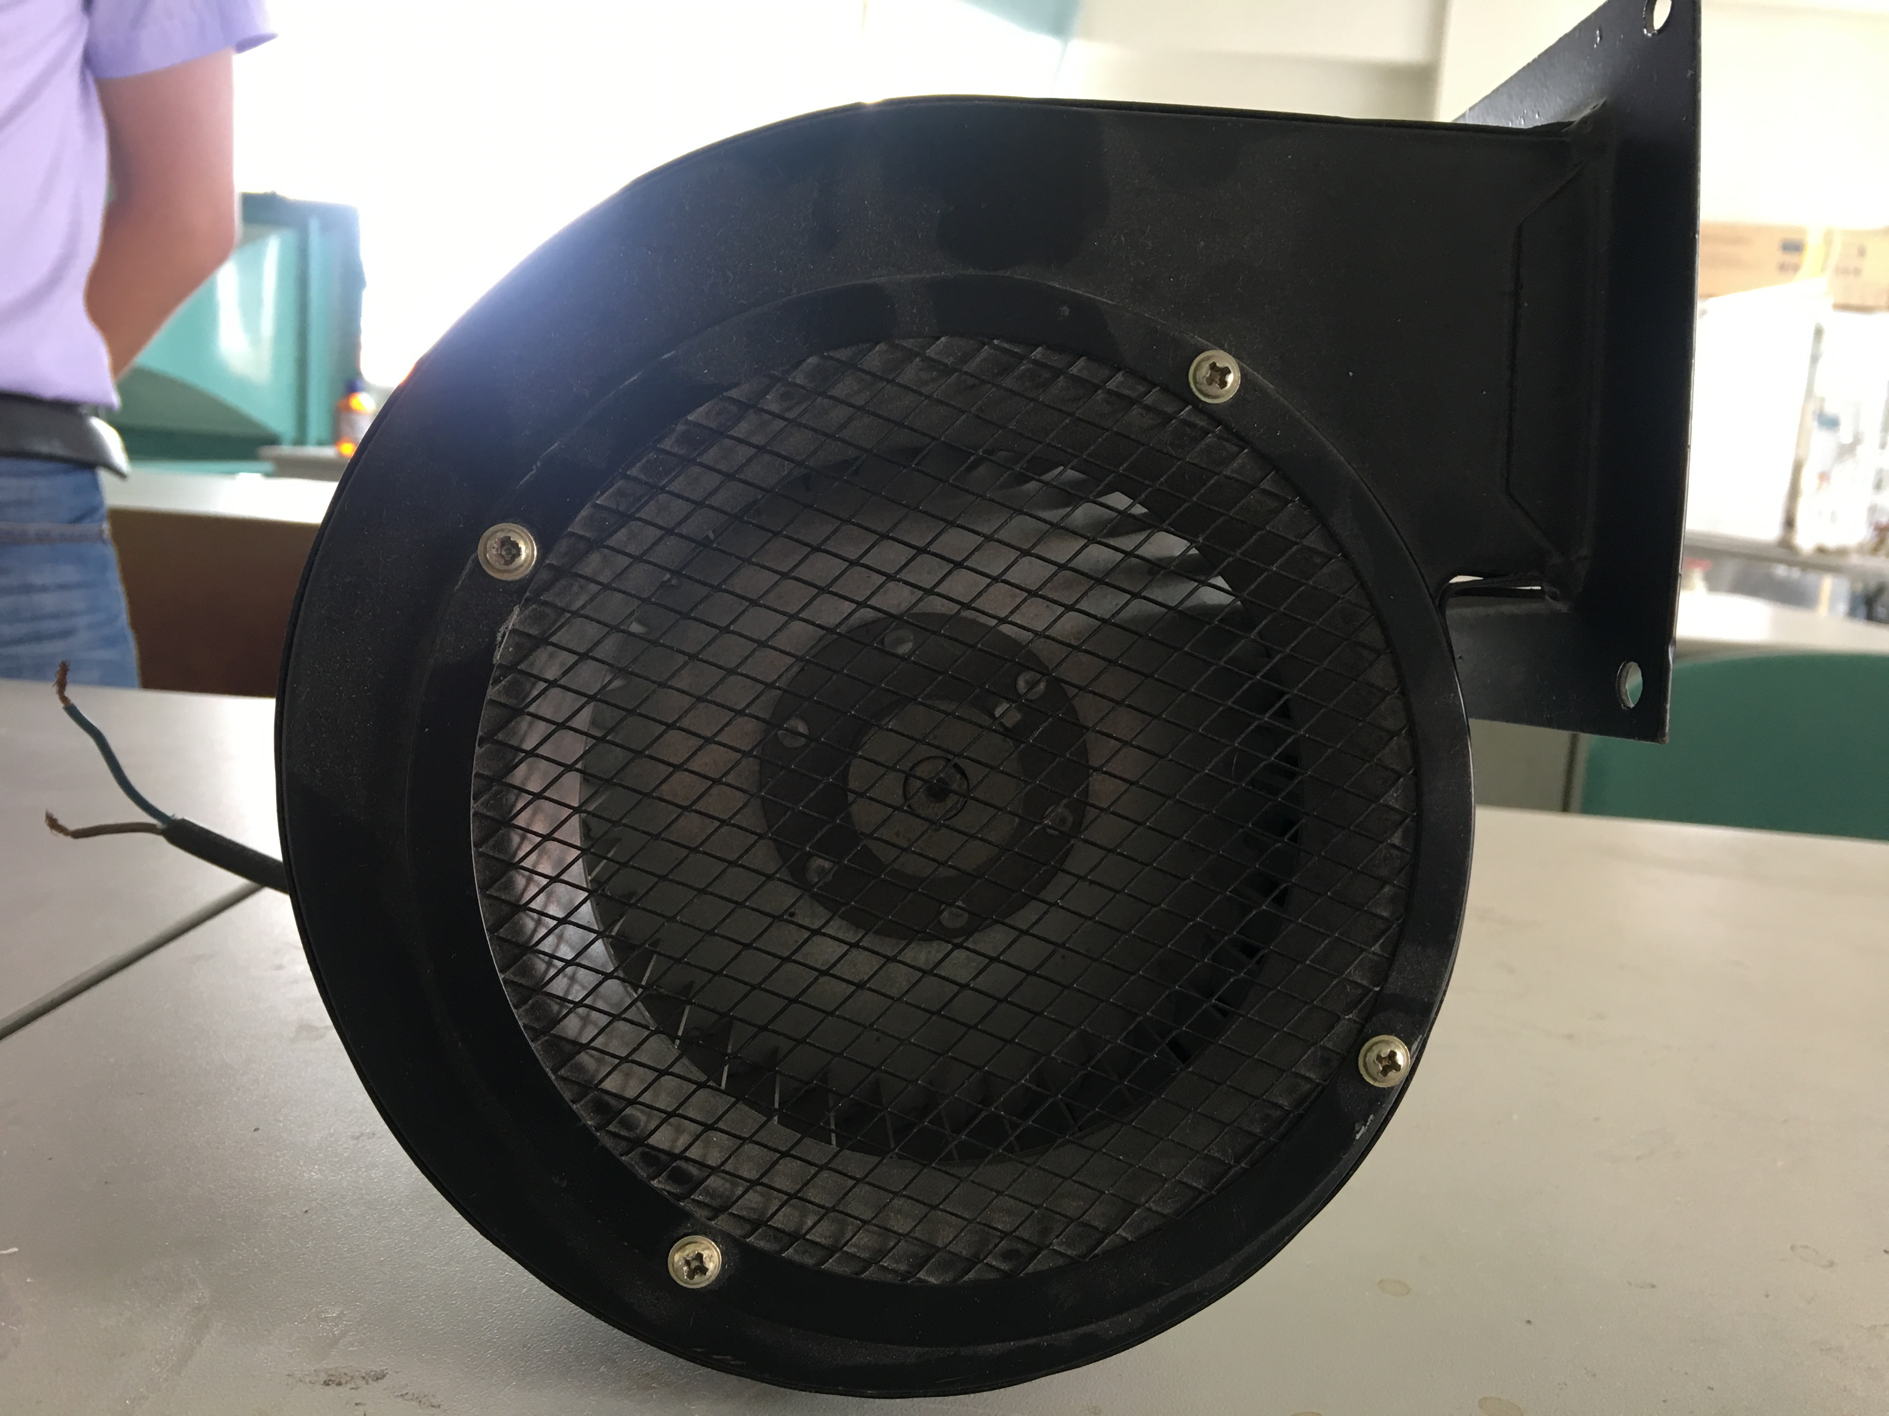
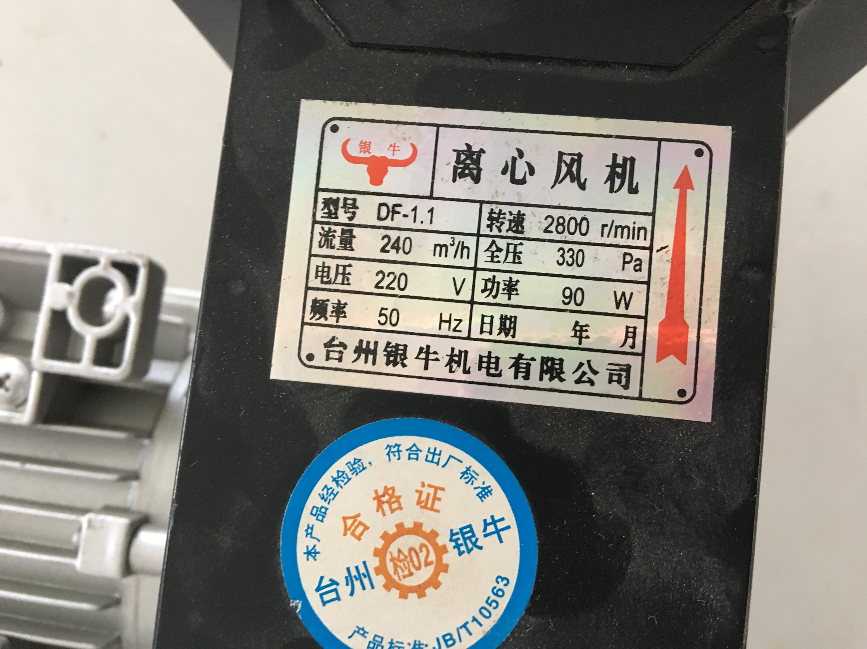
Experiment set-up 1
Centrifugal fan

Slide 6
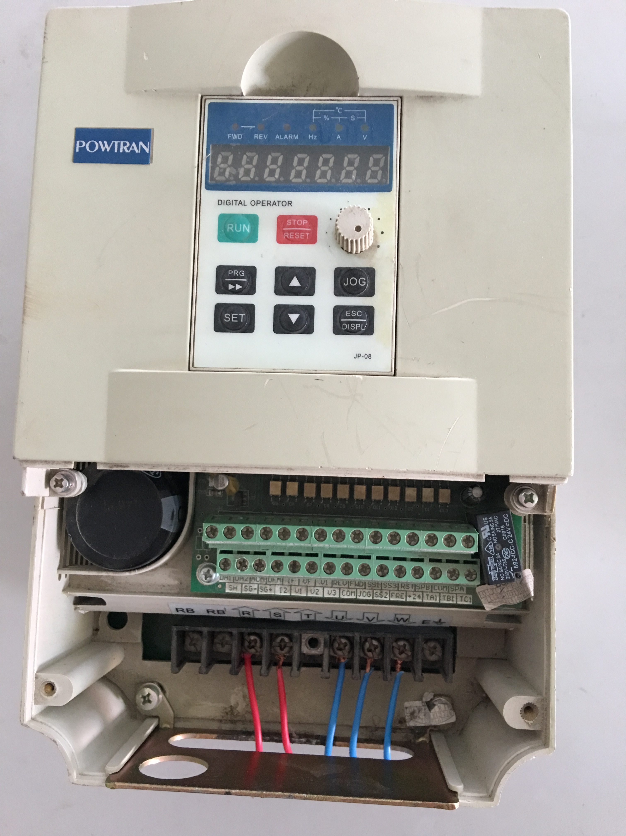
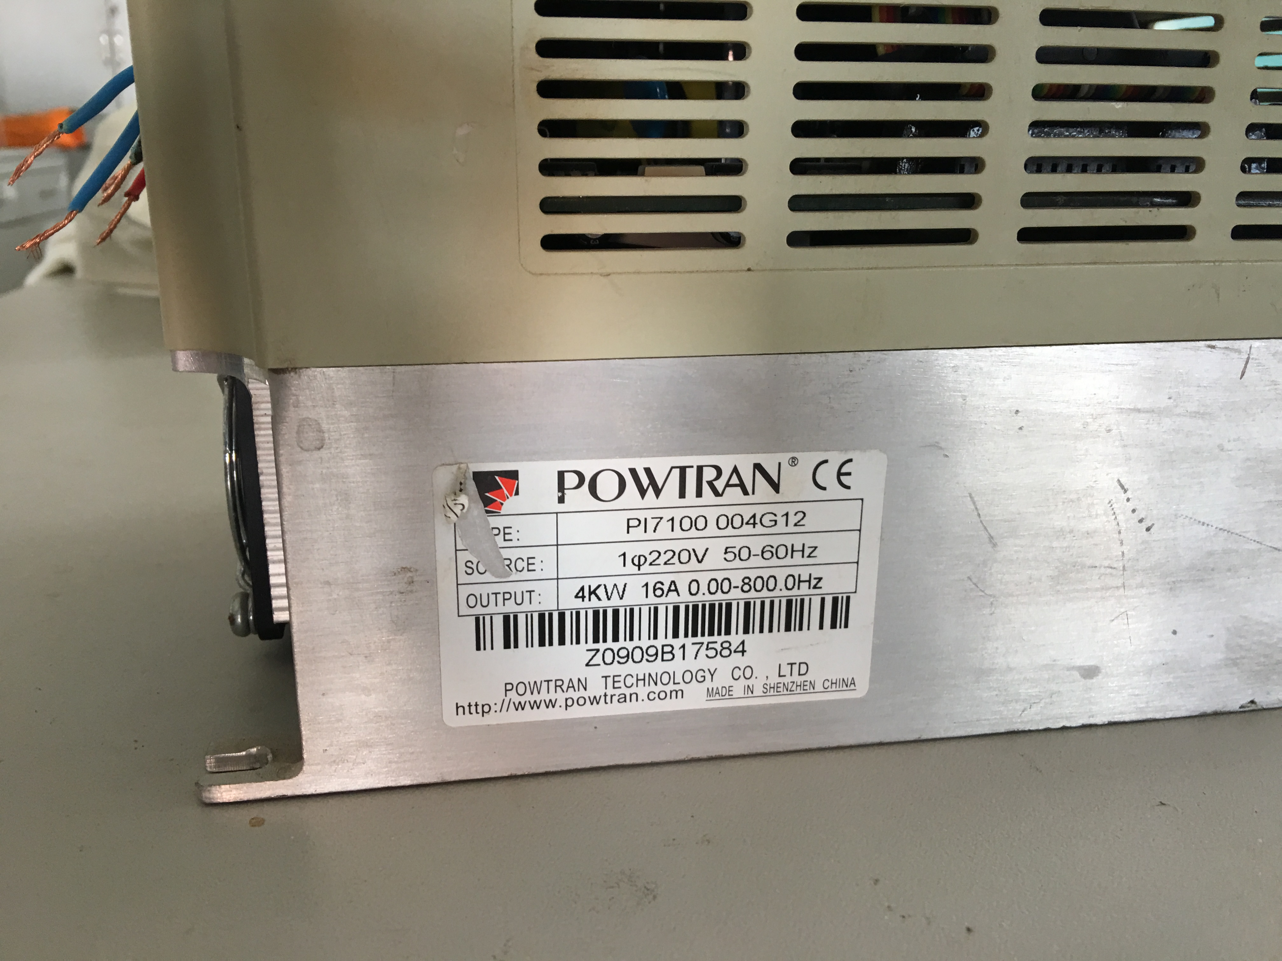
Experiment set-up 1
Variable-frequency Drive

Slide 7
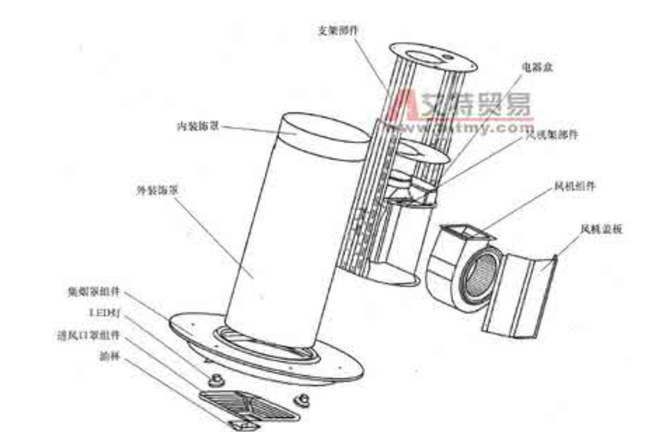
Similiar to te extractor hood.

Slide 8
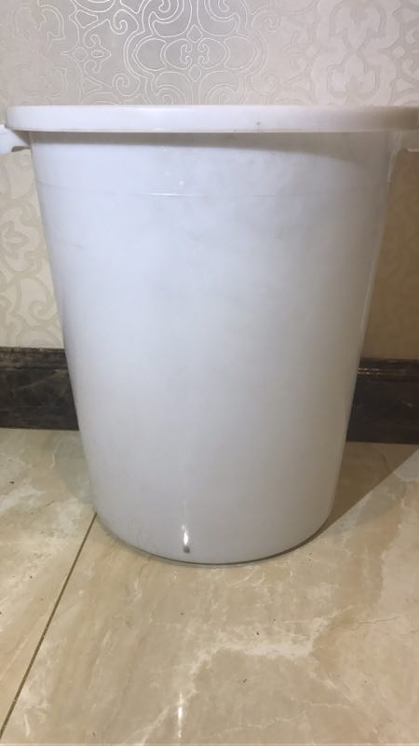
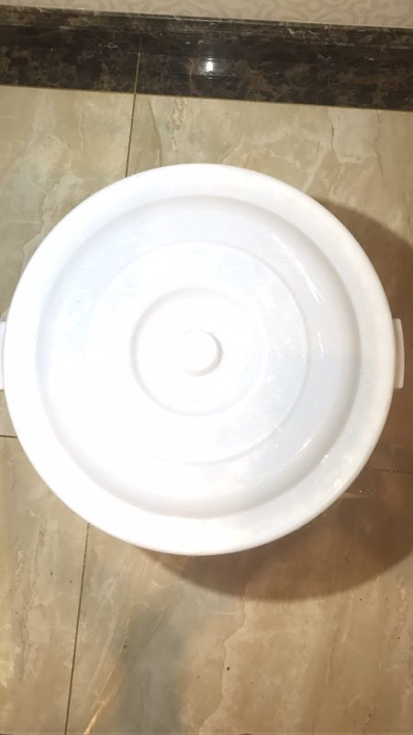
Cover
Bucket: 50 CM
Entrance of the wind

Slide 9
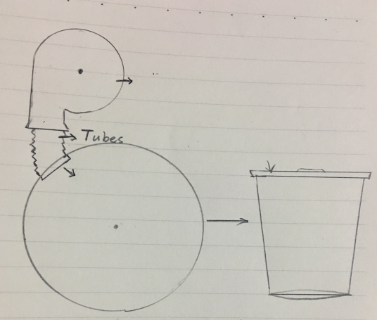
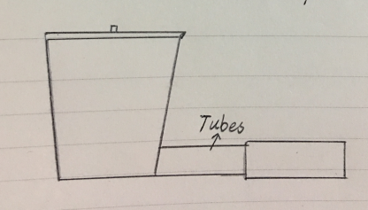
Centrifugal fan
bucket
cone bucket
Cone bucket

Slide 10
Experimental Setup
Preliminary Experiment
Theoretical Investigation
Data Analysis
Conclusion
Uncertainty Analysis

Slide 11
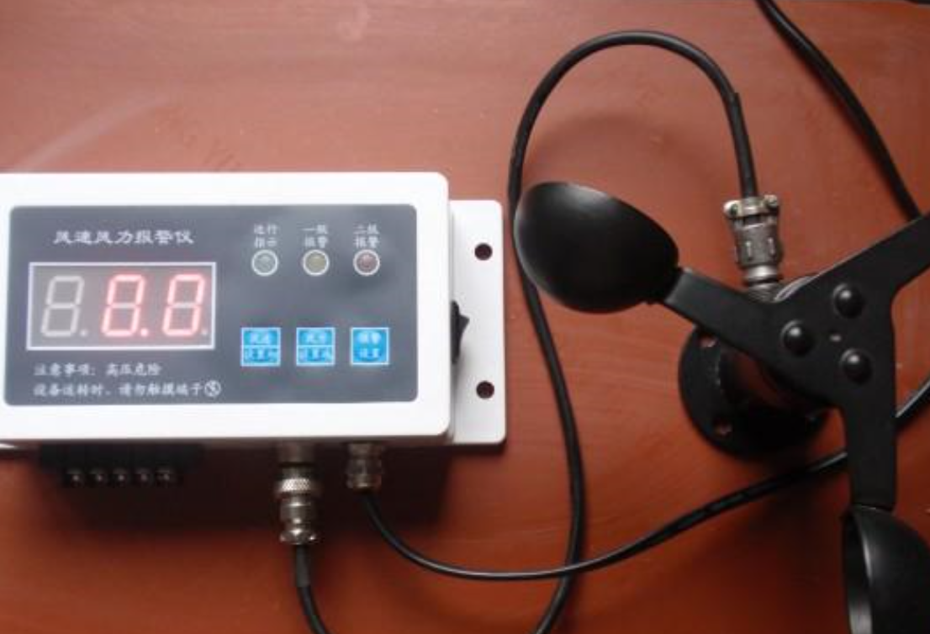
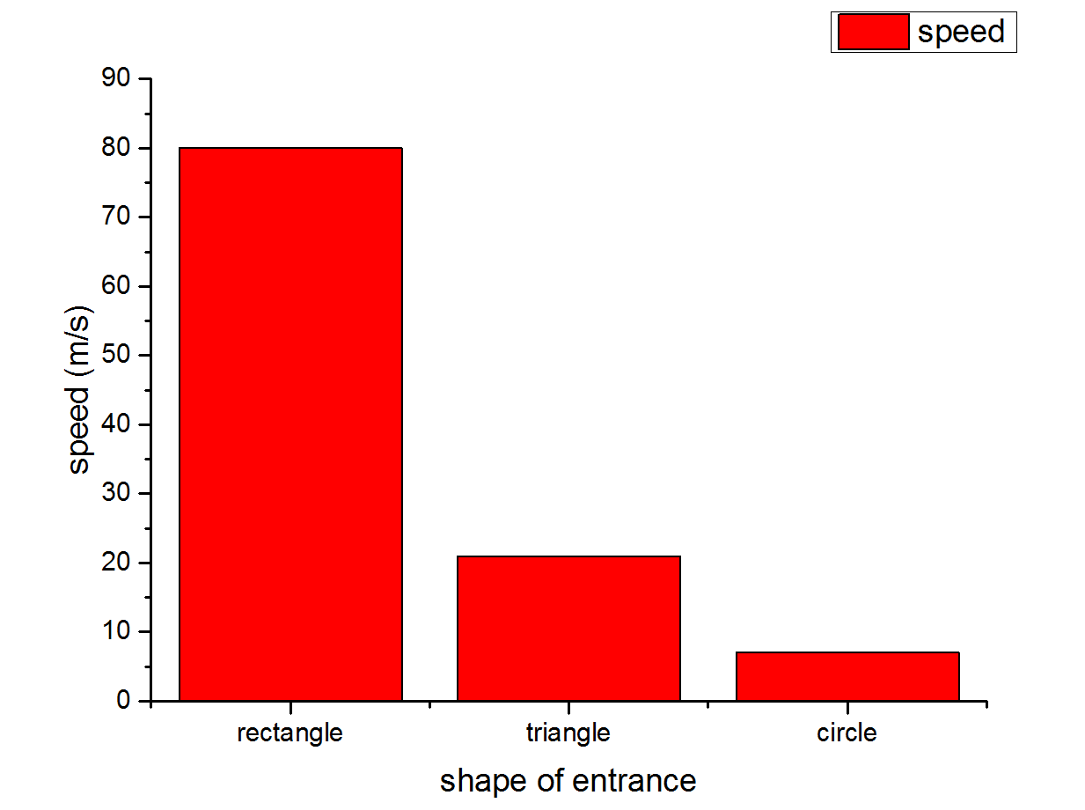
Disadvantage
1.Stablity could not be guaranteed cause the shape of the entrance influence the shape of the tornado,which cause the instablity.

Slide 12
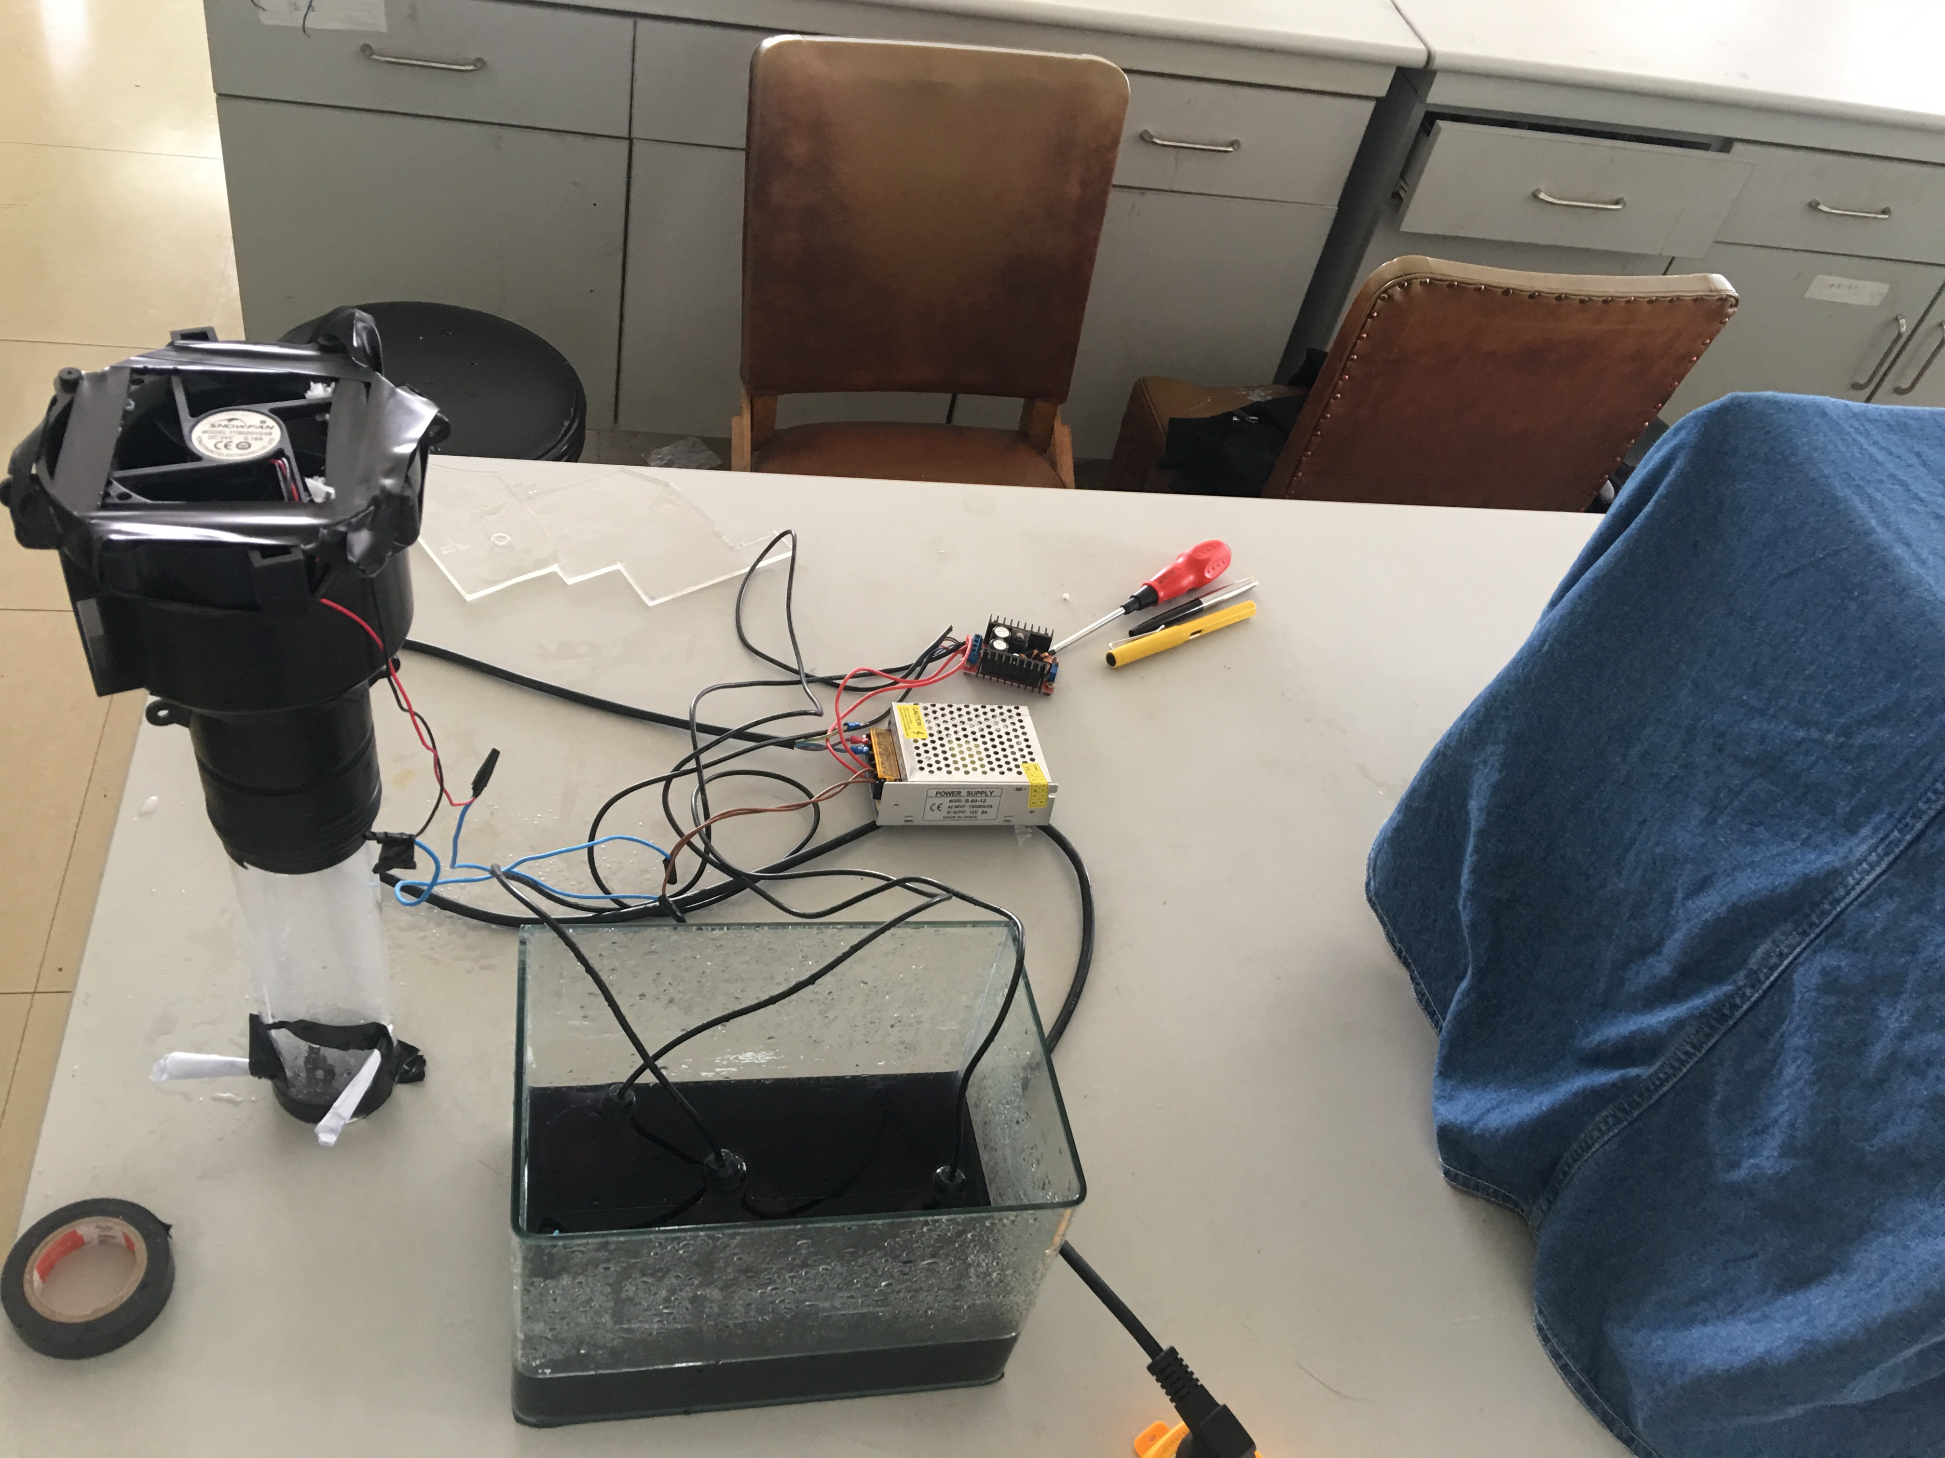
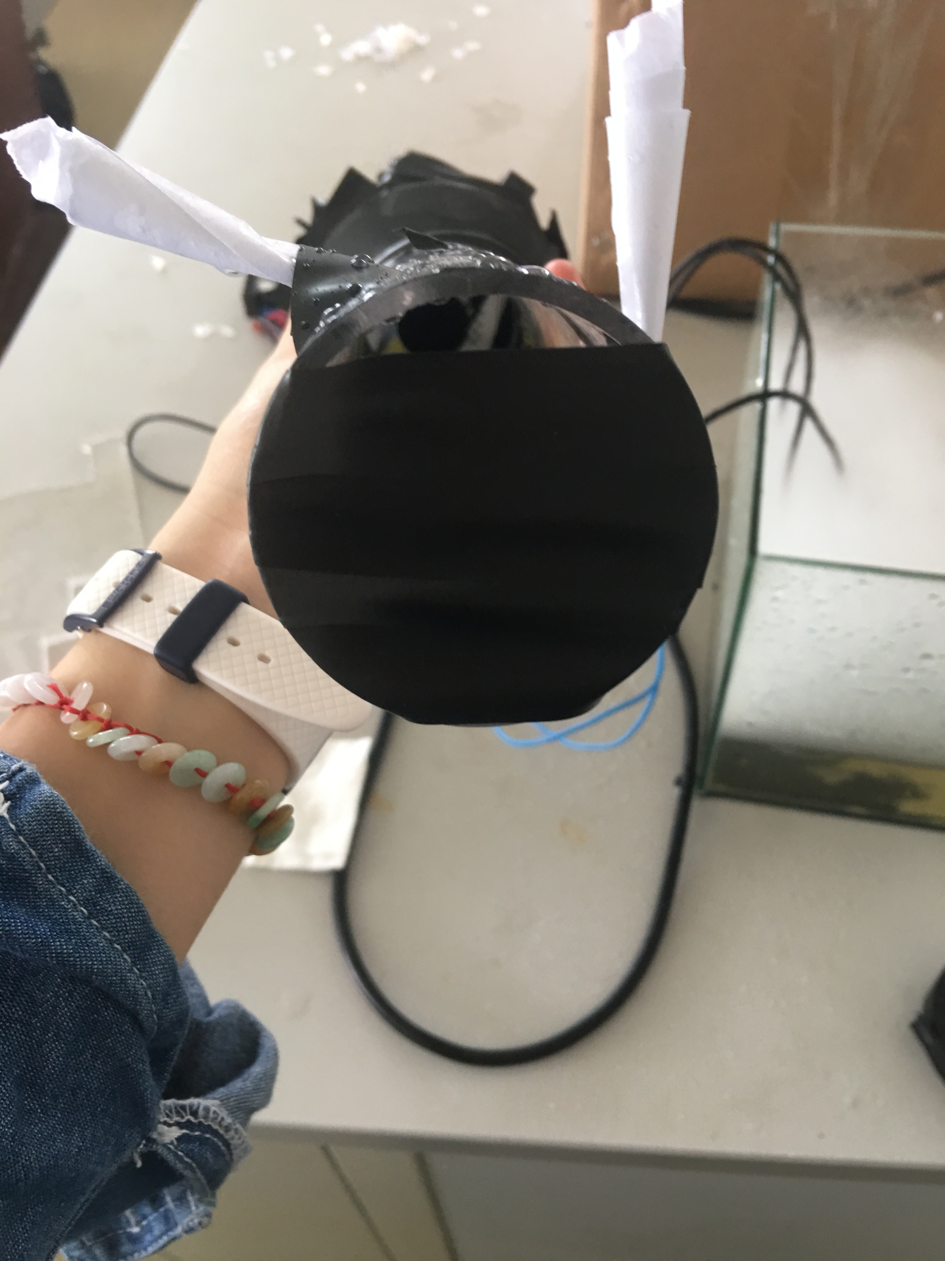
Experimental setup 2
TUBES
Tornado machine
Variable-frequency Drive
Background plate
Atomizer

Slide 13
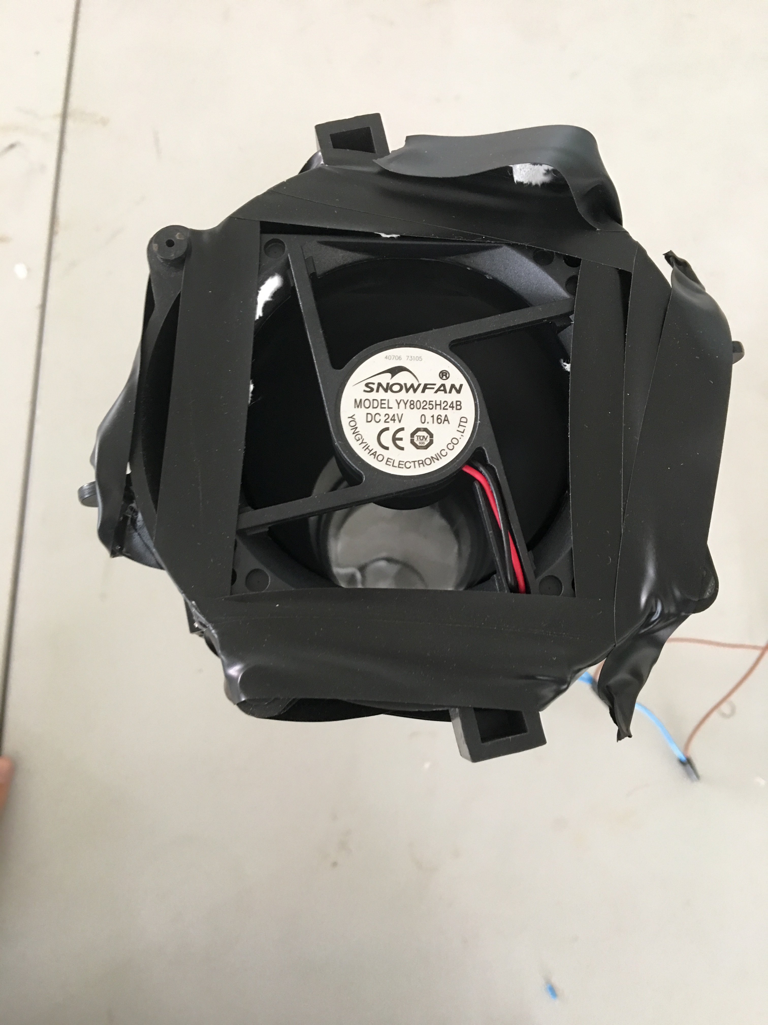
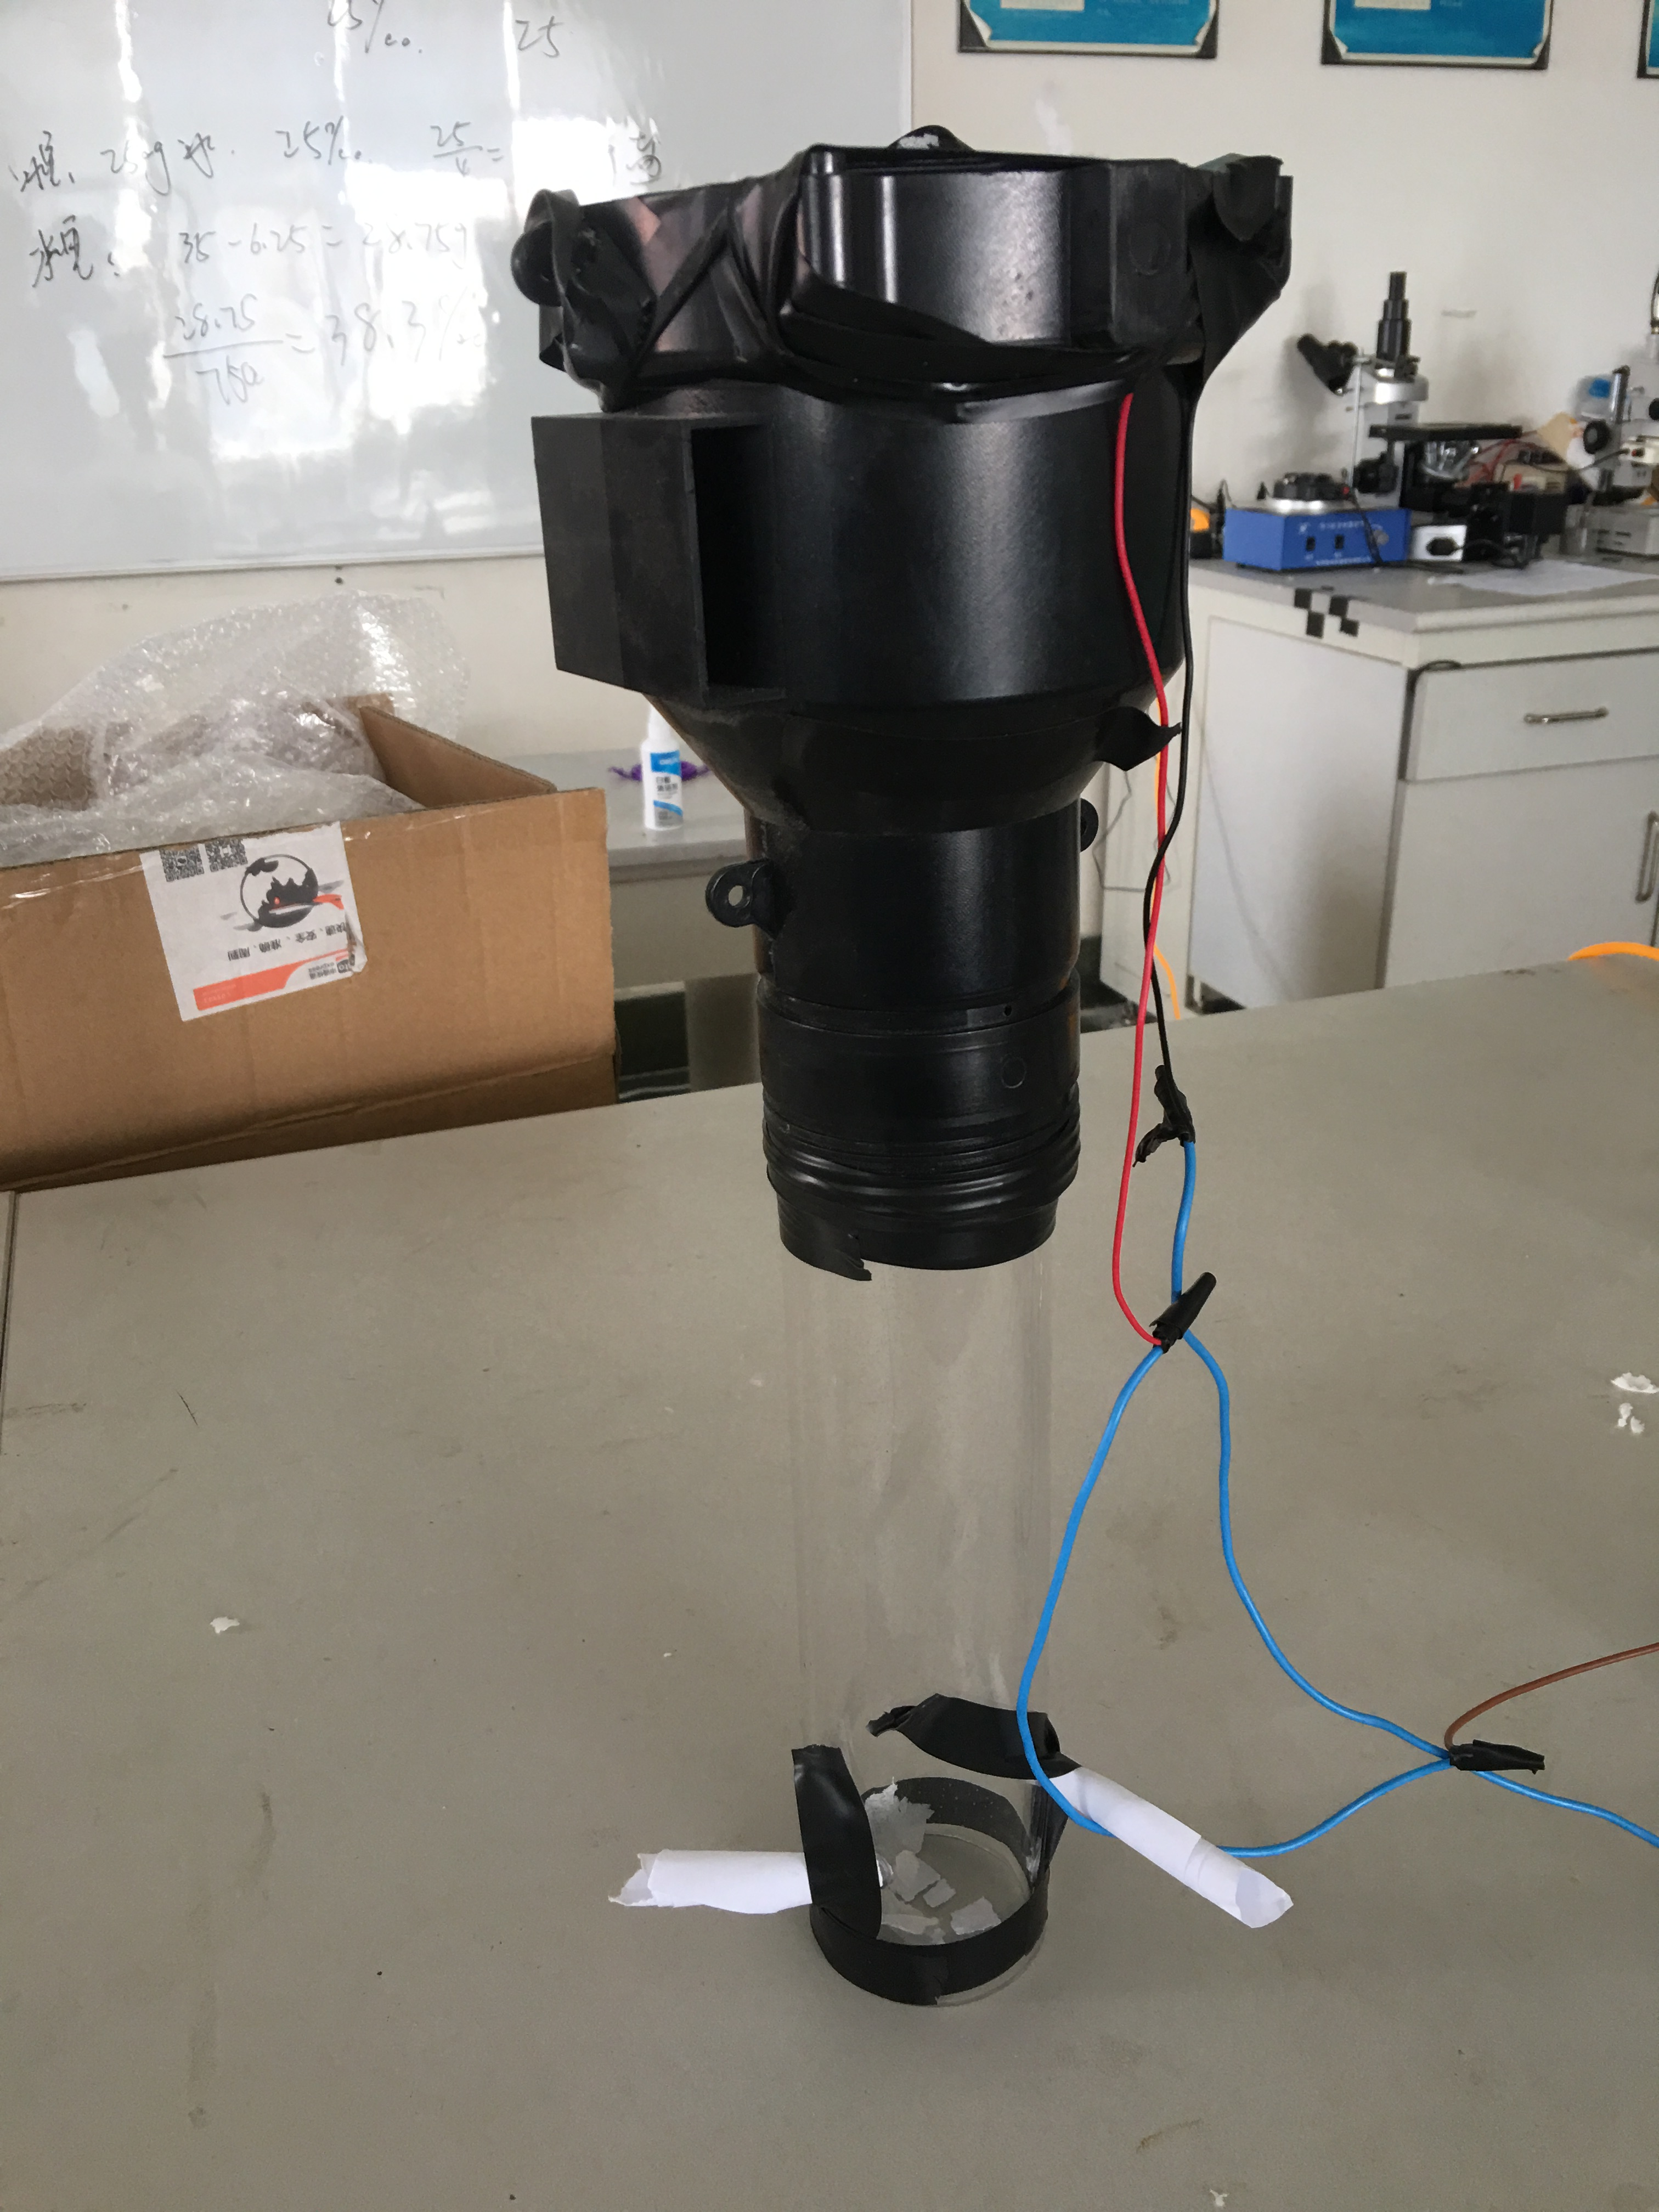
Experiment setup 2
Get the indraft.
Tubes that used to change the direction of the wind instead of using a centrifugal fan.
axial flow fan

Slide 14
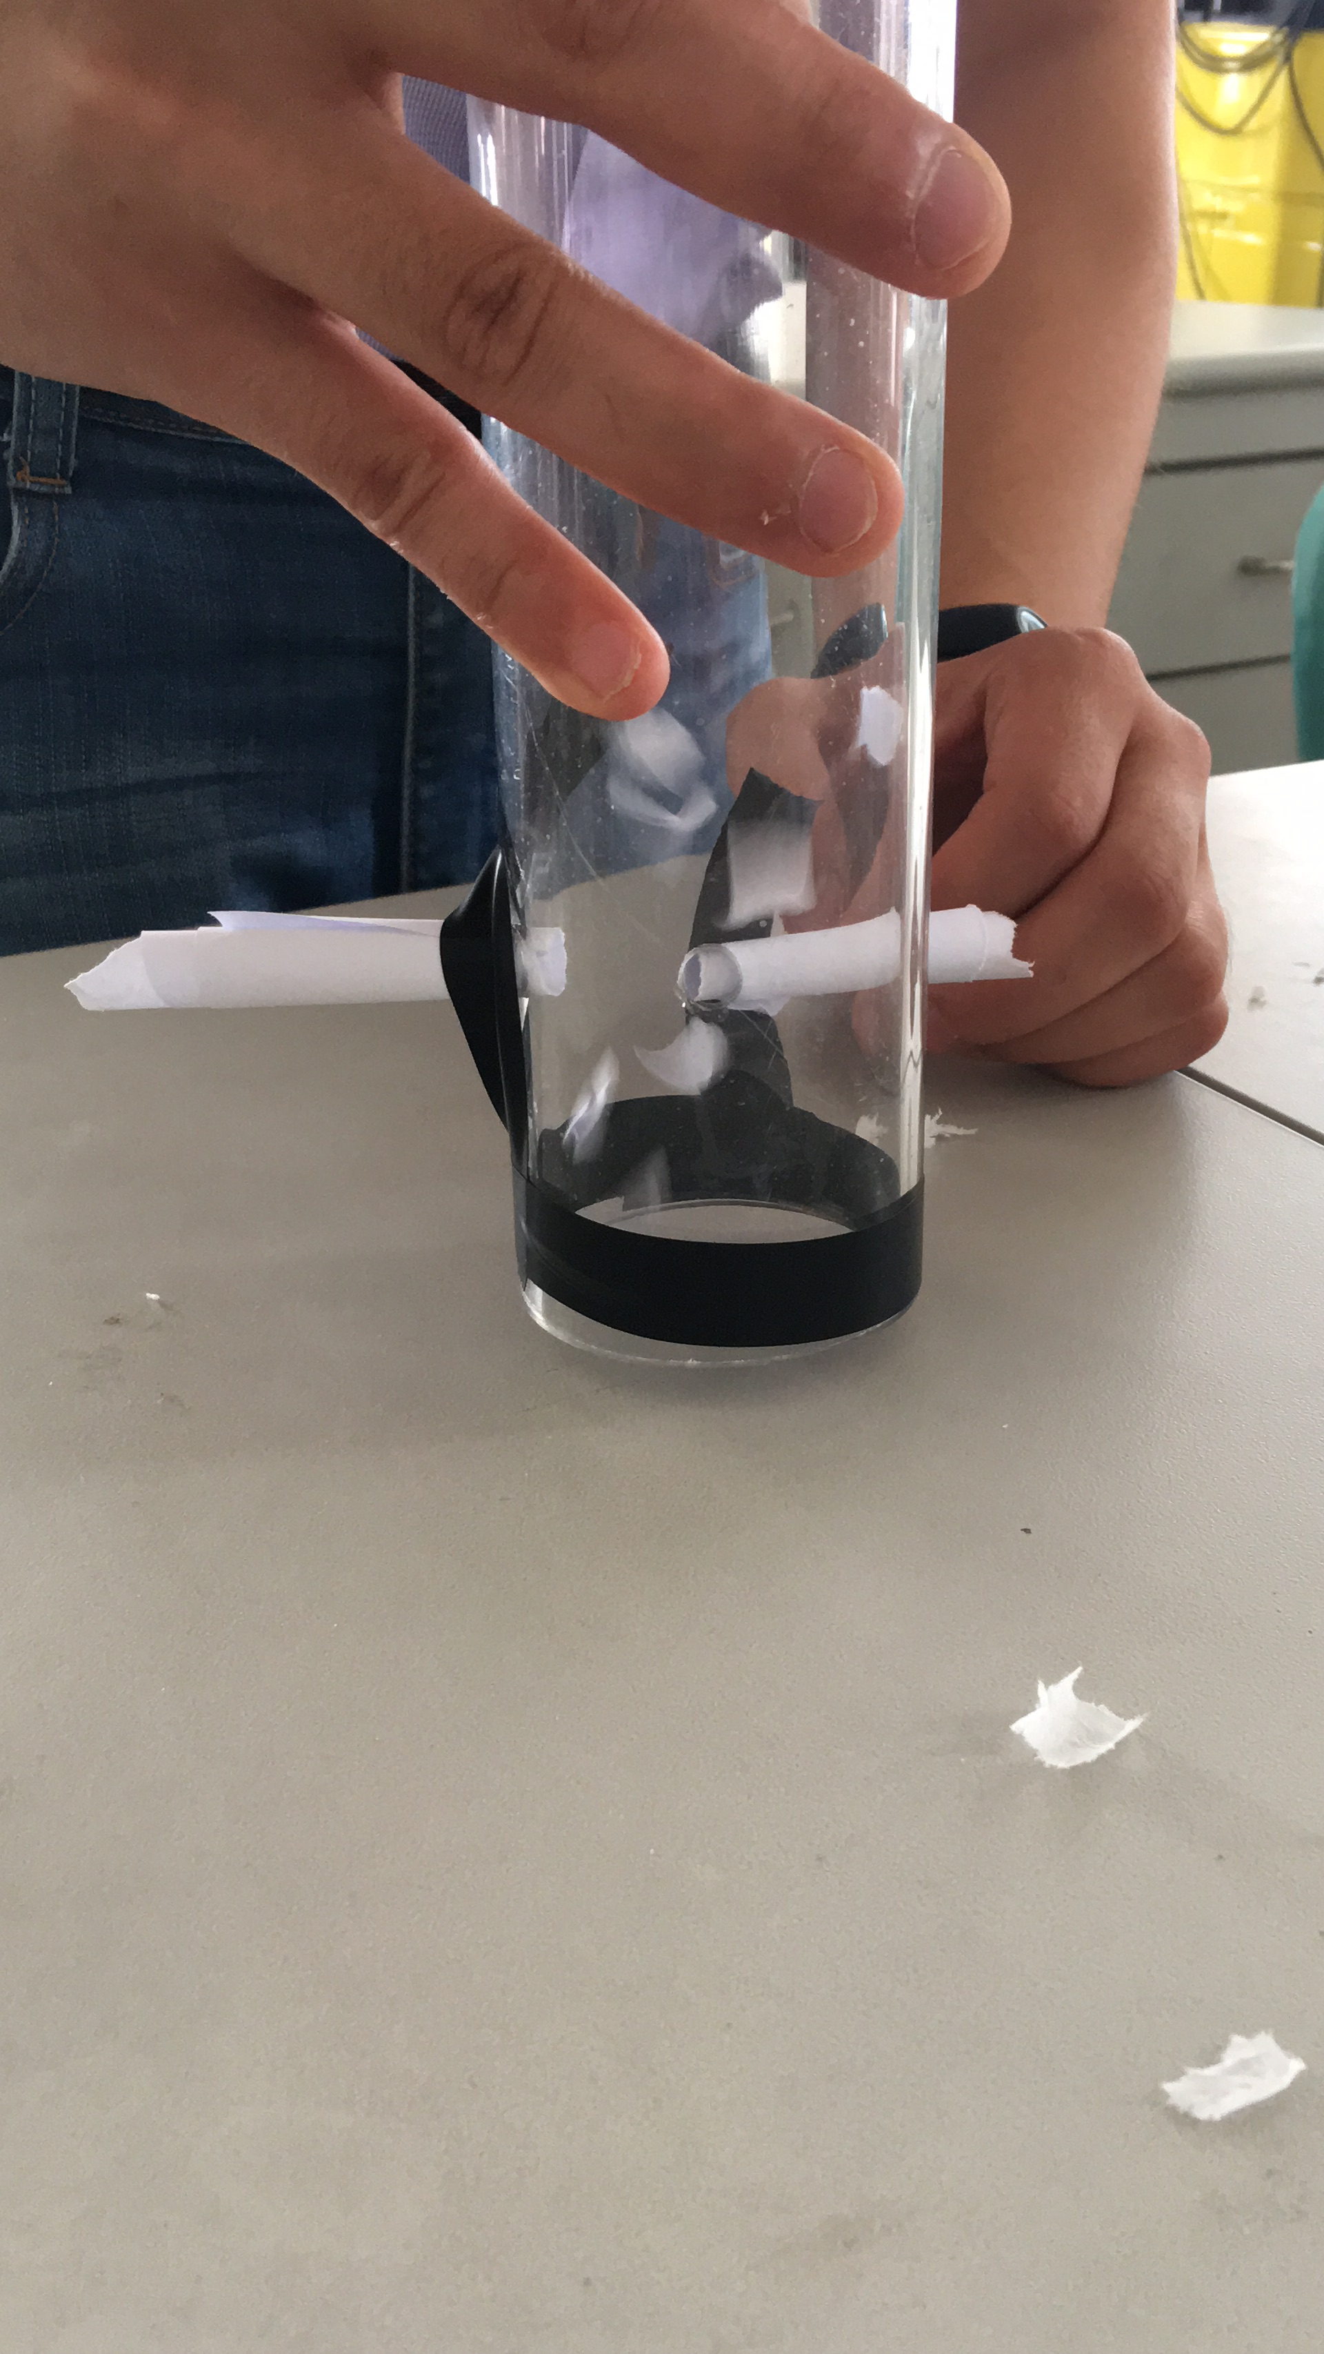
plan A-terrestrial tornado
Sliced paper.(to simulate the dust )

Slide 15
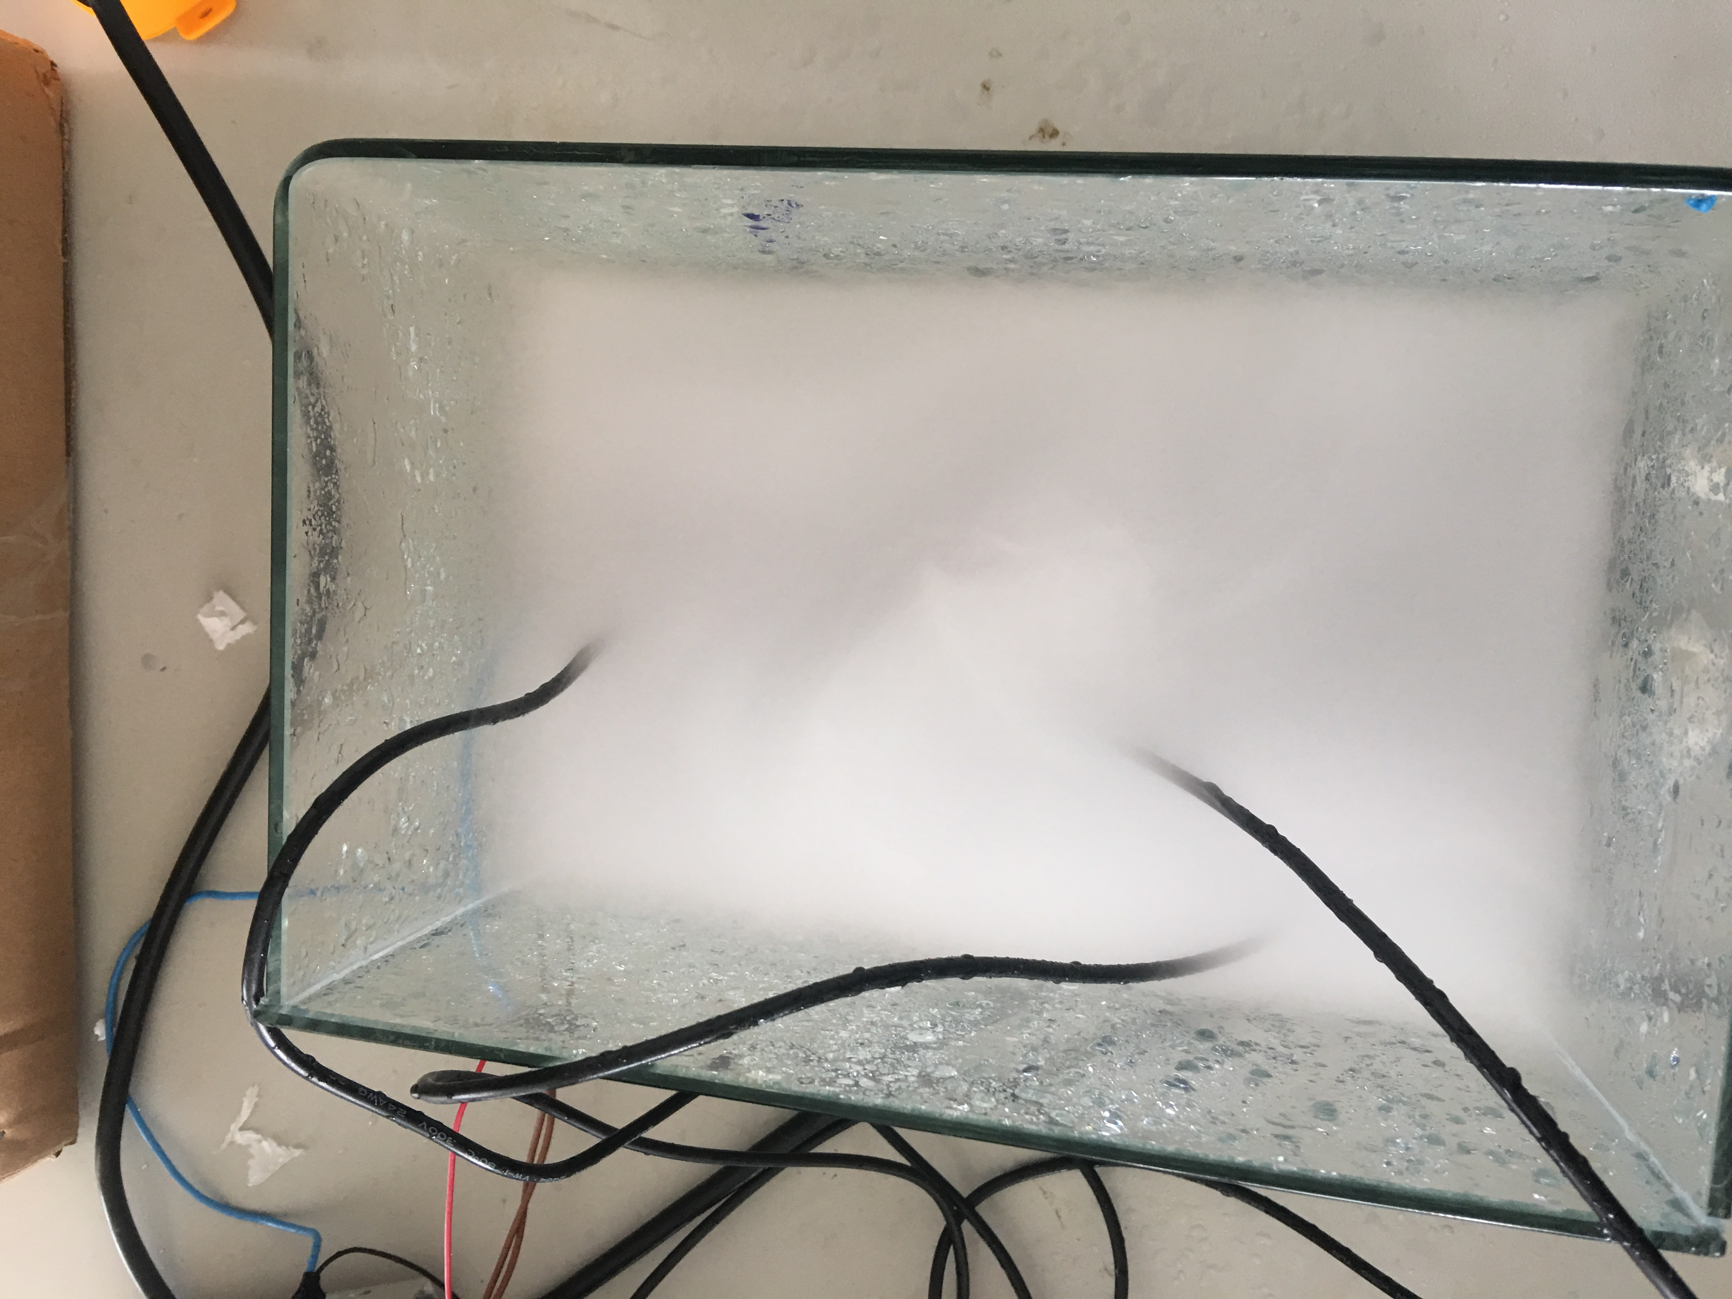
plan B maritime tornado
Spray
simulate the
real atmosphere when a
tornado comes from the ocean.

Slide 16
Experimental Setup
Preliminary Experiment
Theoretical Investigation
Data Analysis
Conclusion
Uncertainty Analysis

Slide 17
（1）The instability of the atmosphere produces a strong updraft, which is further enhanced due to the influence of the maximum cross flow in the jet stream. （2）Due to the interaction of wind with shear and shear in the vertical direction, the ascending air begins to rotate in the middle of the troposphere to form a mesoscale cyclone.

Slide 18
（3）With the development of mesoscale cyclones in the ground and stretch upward, and it becomes thinner and stronger. At the same time, a small area of increased support, that the nascent tornado formed in the cyclone, cyclone in the same process, the formation of a tornado core. （4）The rotation in the tornado core and that in the cyclone are different, and its strength is sufficient to tornado has been extended to the ground. When the development of the vortex to reach ground level, a sharp decline in surface pressure, surface wind speed increased rapidly, the formation of a tornado.

Slide 19
Theoritical analysis
Existing in the atmosphere.
Has great air speed and vertical speed.
A microscale system.
A superpositon of vortex and jet.
Could be easily formed in an extremely unstable circumstances.

Slide 20
①The jet is caused by strong convection by the horizontal convergence.
②The vortex is caused by inertial centrifugal force.

Slide 21
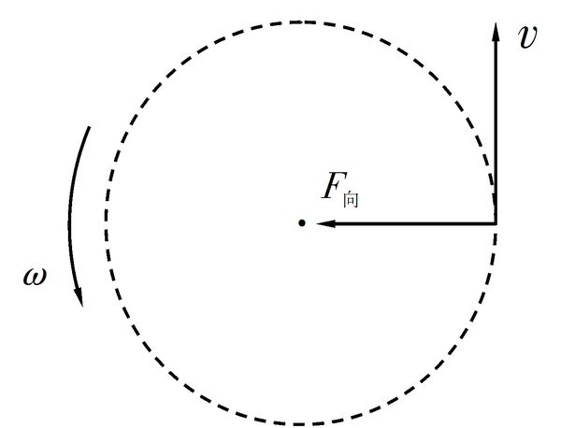
Force analysis-Inertial centrifugal force
Inertial centrifugal force
which causes the movitation of the vortex

Slide 22
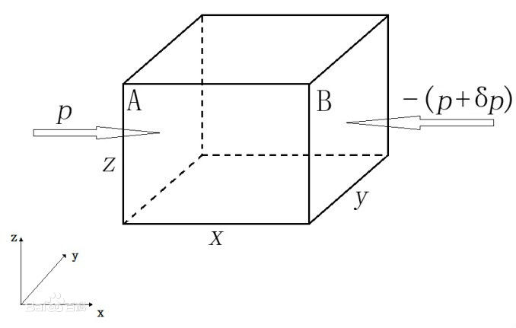
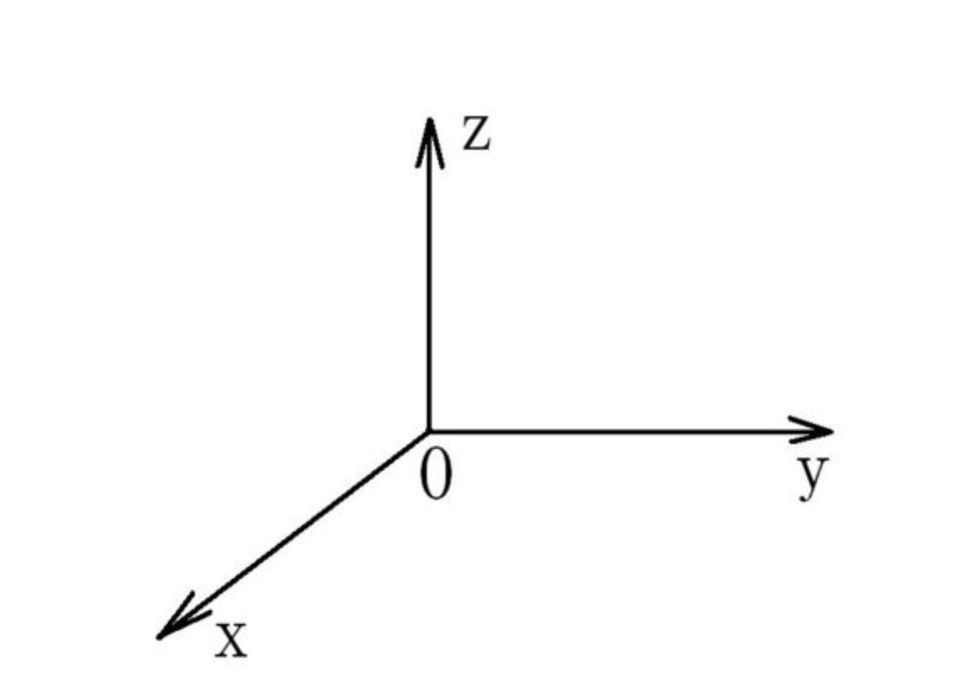
Force analysis-Pressure gradientforce

Slide 23
Hypothesis 1 Law of conservation of angular momentum
Angular momentum is the rotational analog of linear momentum. It is an important quantity in physics because it is a conserved quantity – the angular momentum of a system remains constant unless acted on by an external torque.
The definition of angular momentum for a point particle is a pseudovector r×p, the cross product of the particle's position vector r (relative to some origin) and its momentum vector

Slide 24
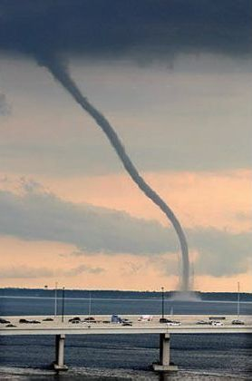
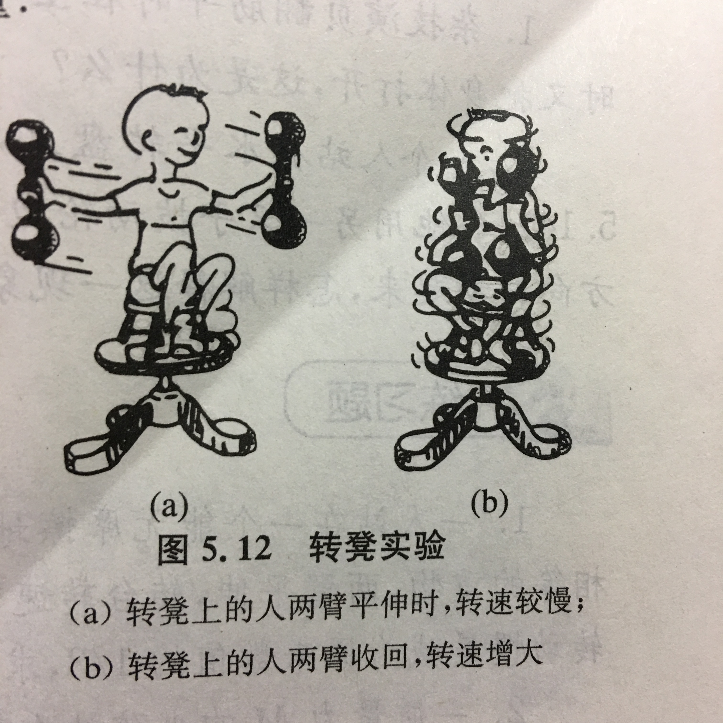

Slide 25
Basic Simultaneous equations
→ radial direction
→ tangential direction
→ vertical direction
Basic density,temperature,pressure

Slide 26
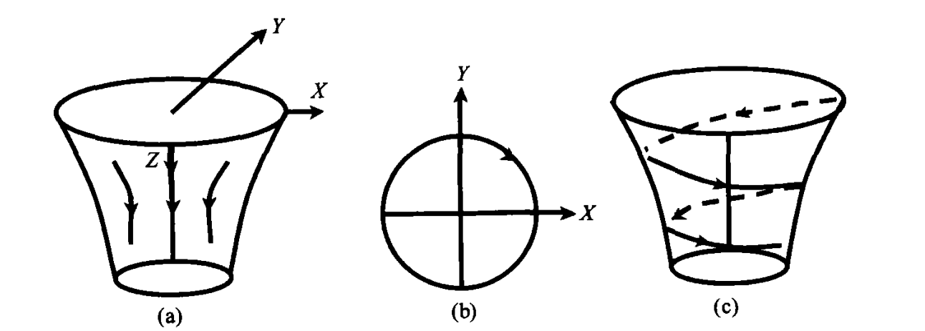
Theoritical analysis -Funnel type(stability)
The top shape of the
tube.

Slide 27
data analysis
Experimental Setup
Preliminary Experiment
Theoretical Investigation
Data Analysis
Conclusion
Uncertainty Analysis

Slide 28
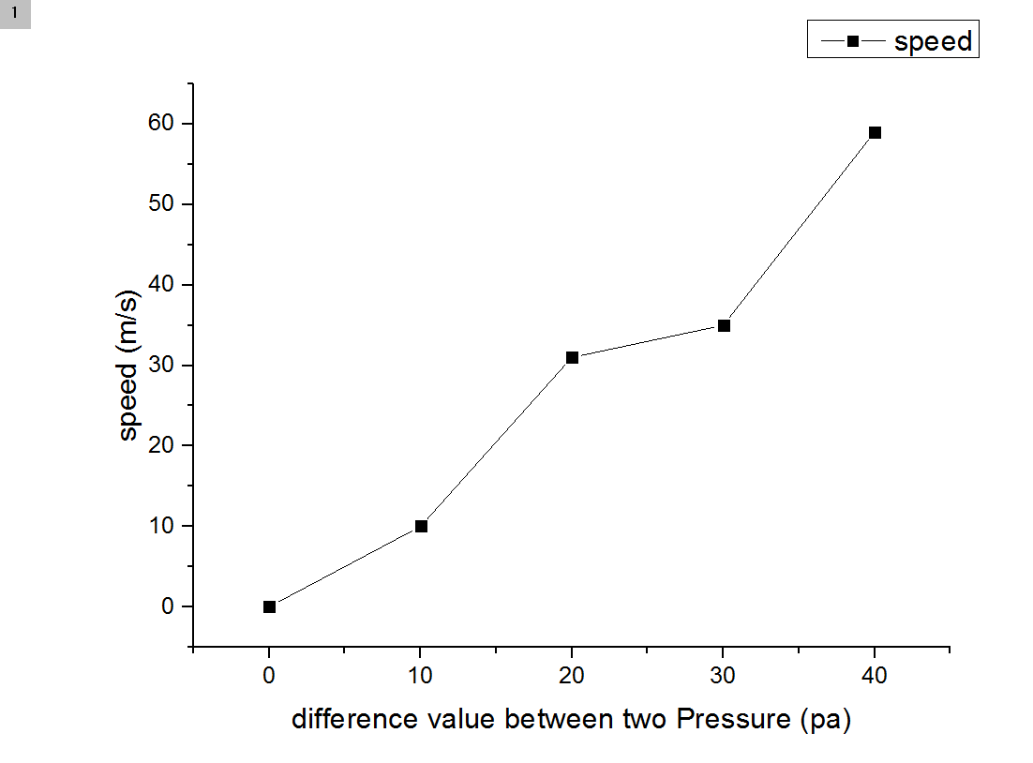
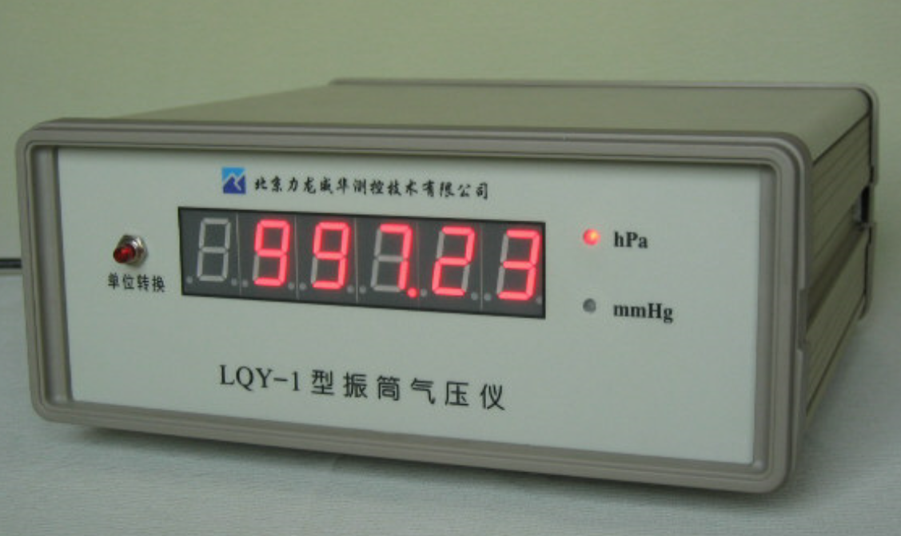
Draught head

Slide 29
Experimental Setup
Preliminary Experiment
Theoretical Investigation
Data Analysis
Conclusion
Uncertainty Analysis

Slide 30
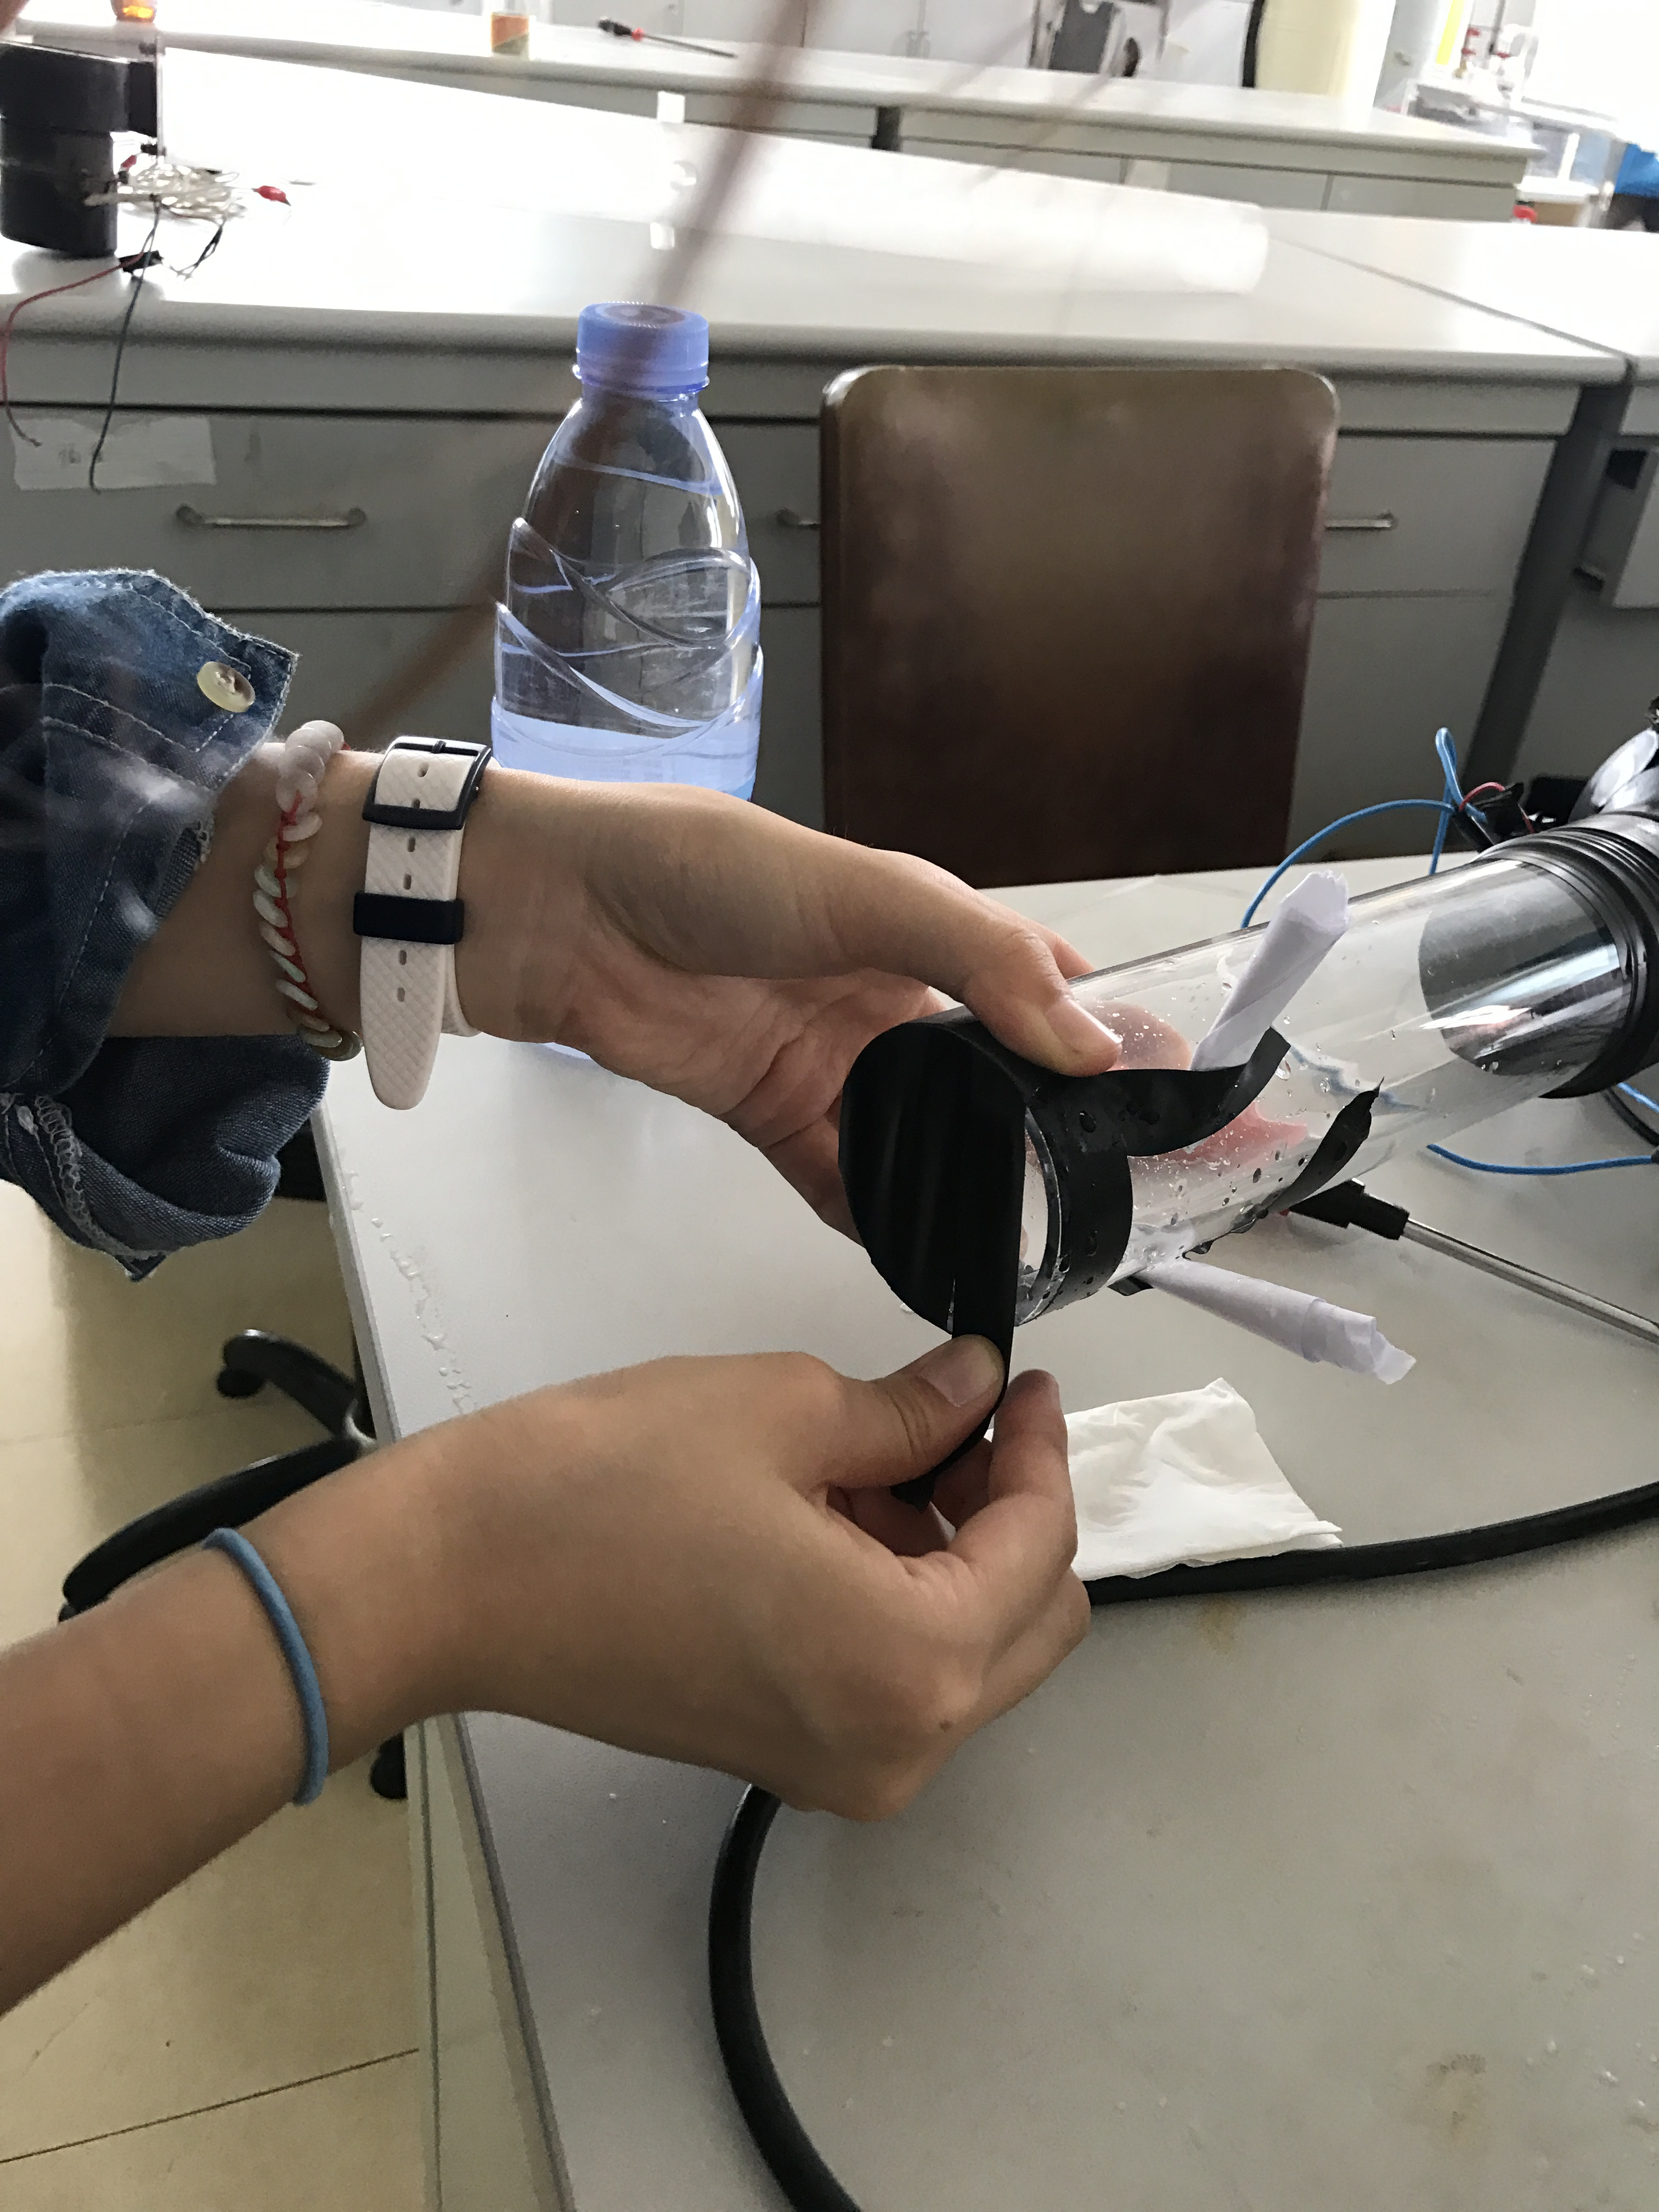
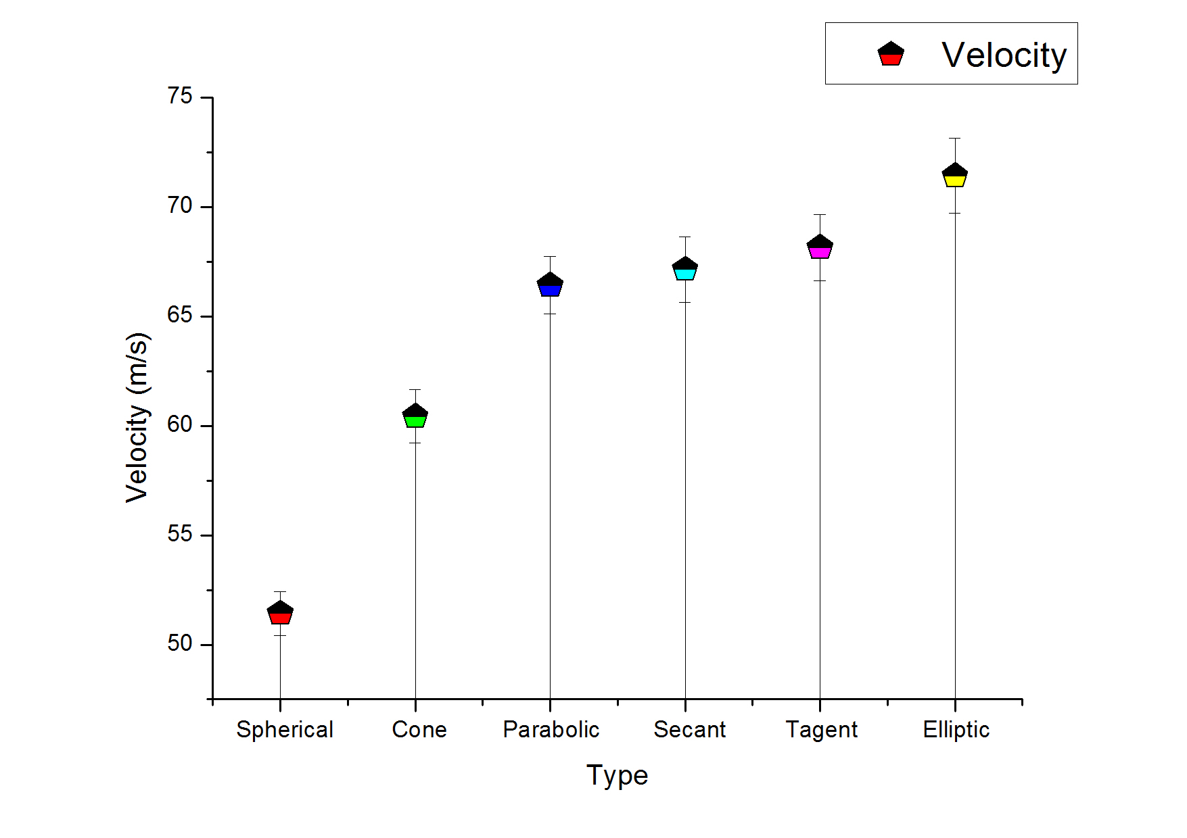
Uncertain analysis-shape of the entrance
trangle rhombus rectangle1 rectangle 2rectangle 3

Slide 31
Experimental Setup
Preliminary Experiment
Theoretical Investigation
Data Analysis
Conclusion
Uncertainty Analysis

Slide 32
Conclusion 1
The stablity of the tornado depends on the Gradientforce.

Slide 33
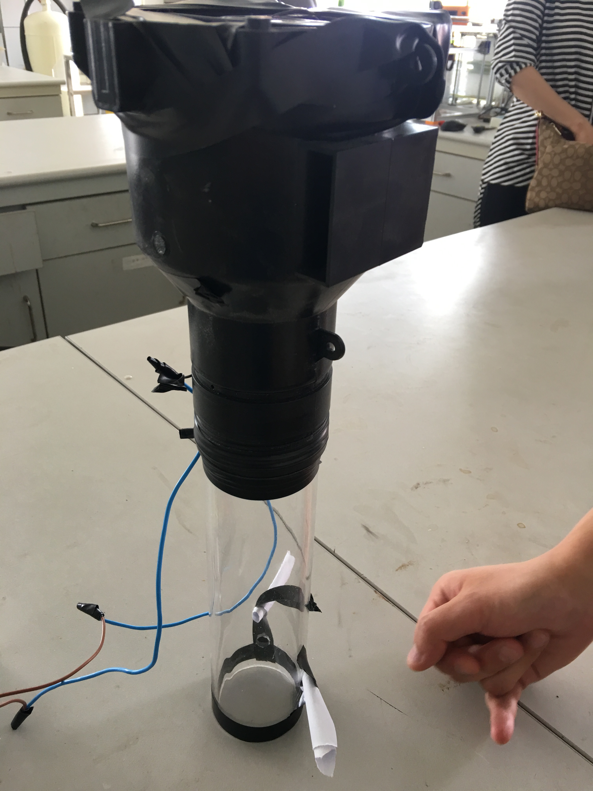
Exactly portative
Exactly portative!
41.5 cm high
diameter:15 cm

Slide 34
Thank you for listening!

Slide 35
Reference
1 Carl E. Mungan. “Internal ballistics of a pneumatic potato cannon.” Eur. J. Phys. 30, 453-457 (2009).
2 Mark Denny. “Internal Ballistics of Air ”, The Phys. Teacher. 49, 81-83 (2011).
3 Brett Taylor. “Recoil experiments using a compressed air cannon.” The Phys. Teacher 44, 582-584 (2006).
4 Koji Tsukamoto and Masanori Uchino. “The Blowgun Demonstration Experiment.” The Phys.Teacher 46, 334-336 (2008).
5 https://en.wikipedia.org/wiki/Venturi_effect

