Slide 1
THe Browning apple
By Harvey zhang ,class 13, grade 7

Slide 2
Project 6: Apples
Why do apple slices turn brown after being cut? Investigate the speed of this process and test methods to prevent browning of apple slices.

Slide 3
“Salt can keep the apple slices away from the air.”

Slide 4
Is it true?
Experiment: Can water stop apple from browning?

Slide 5
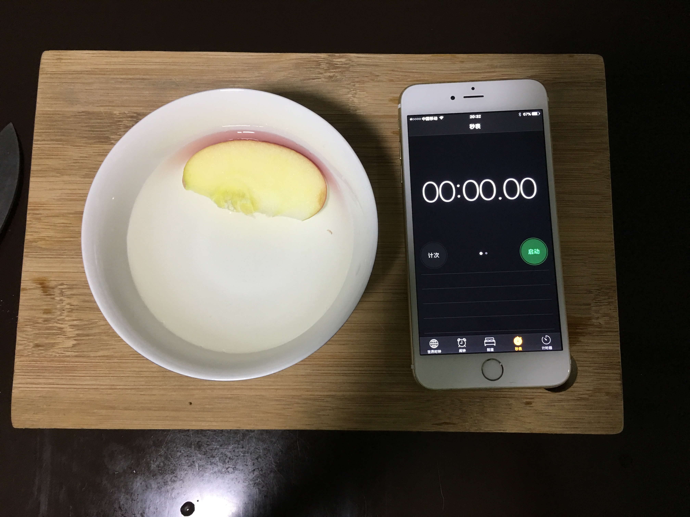

Slide 6
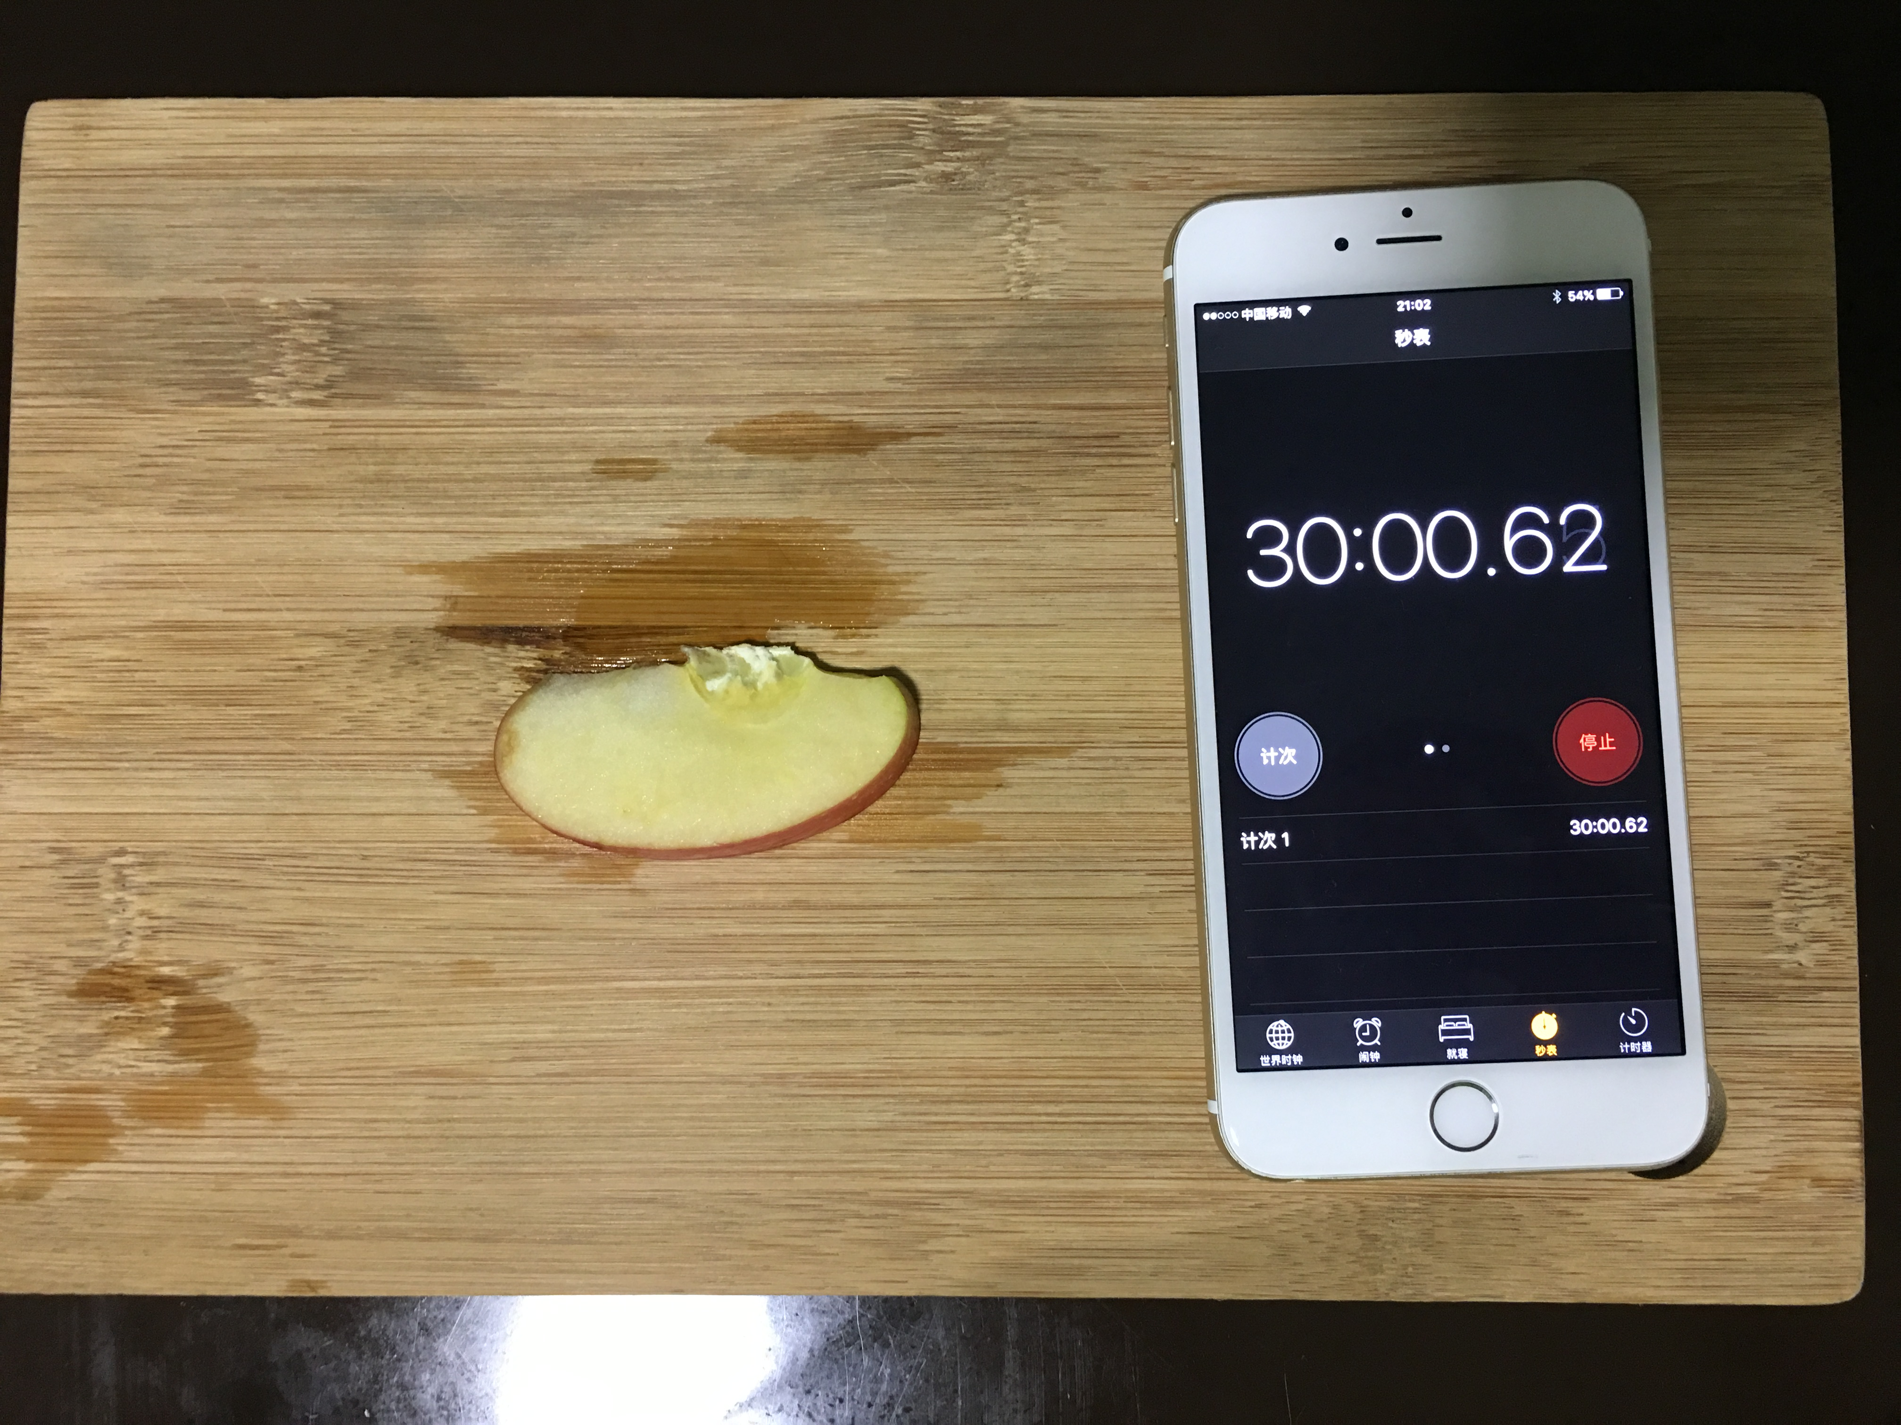

Slide 7
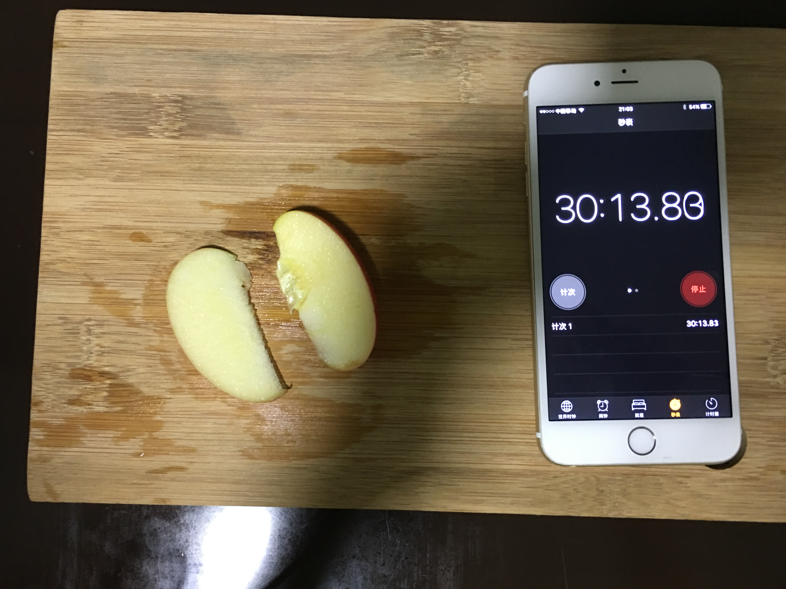

Slide 8
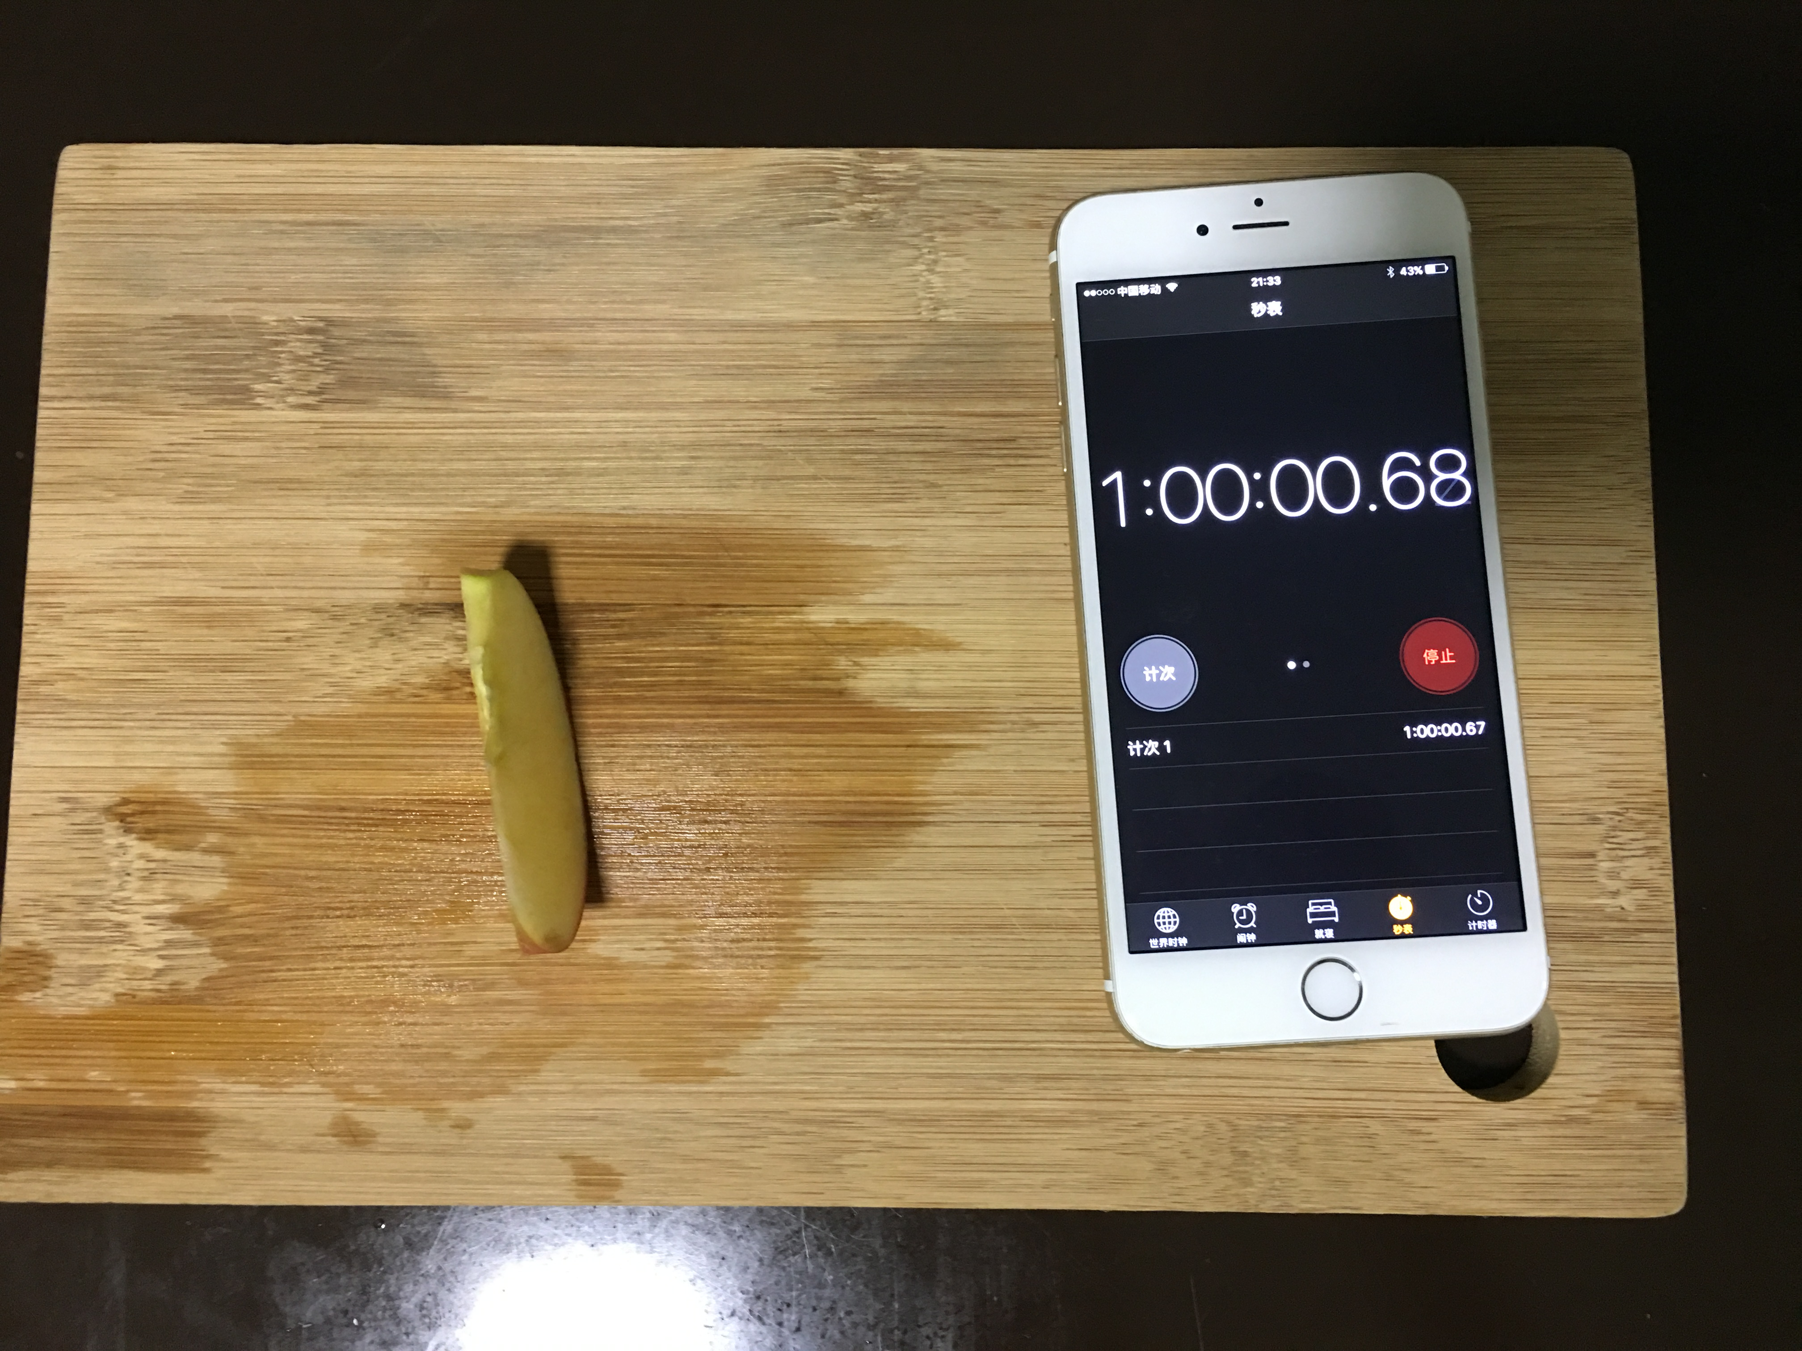
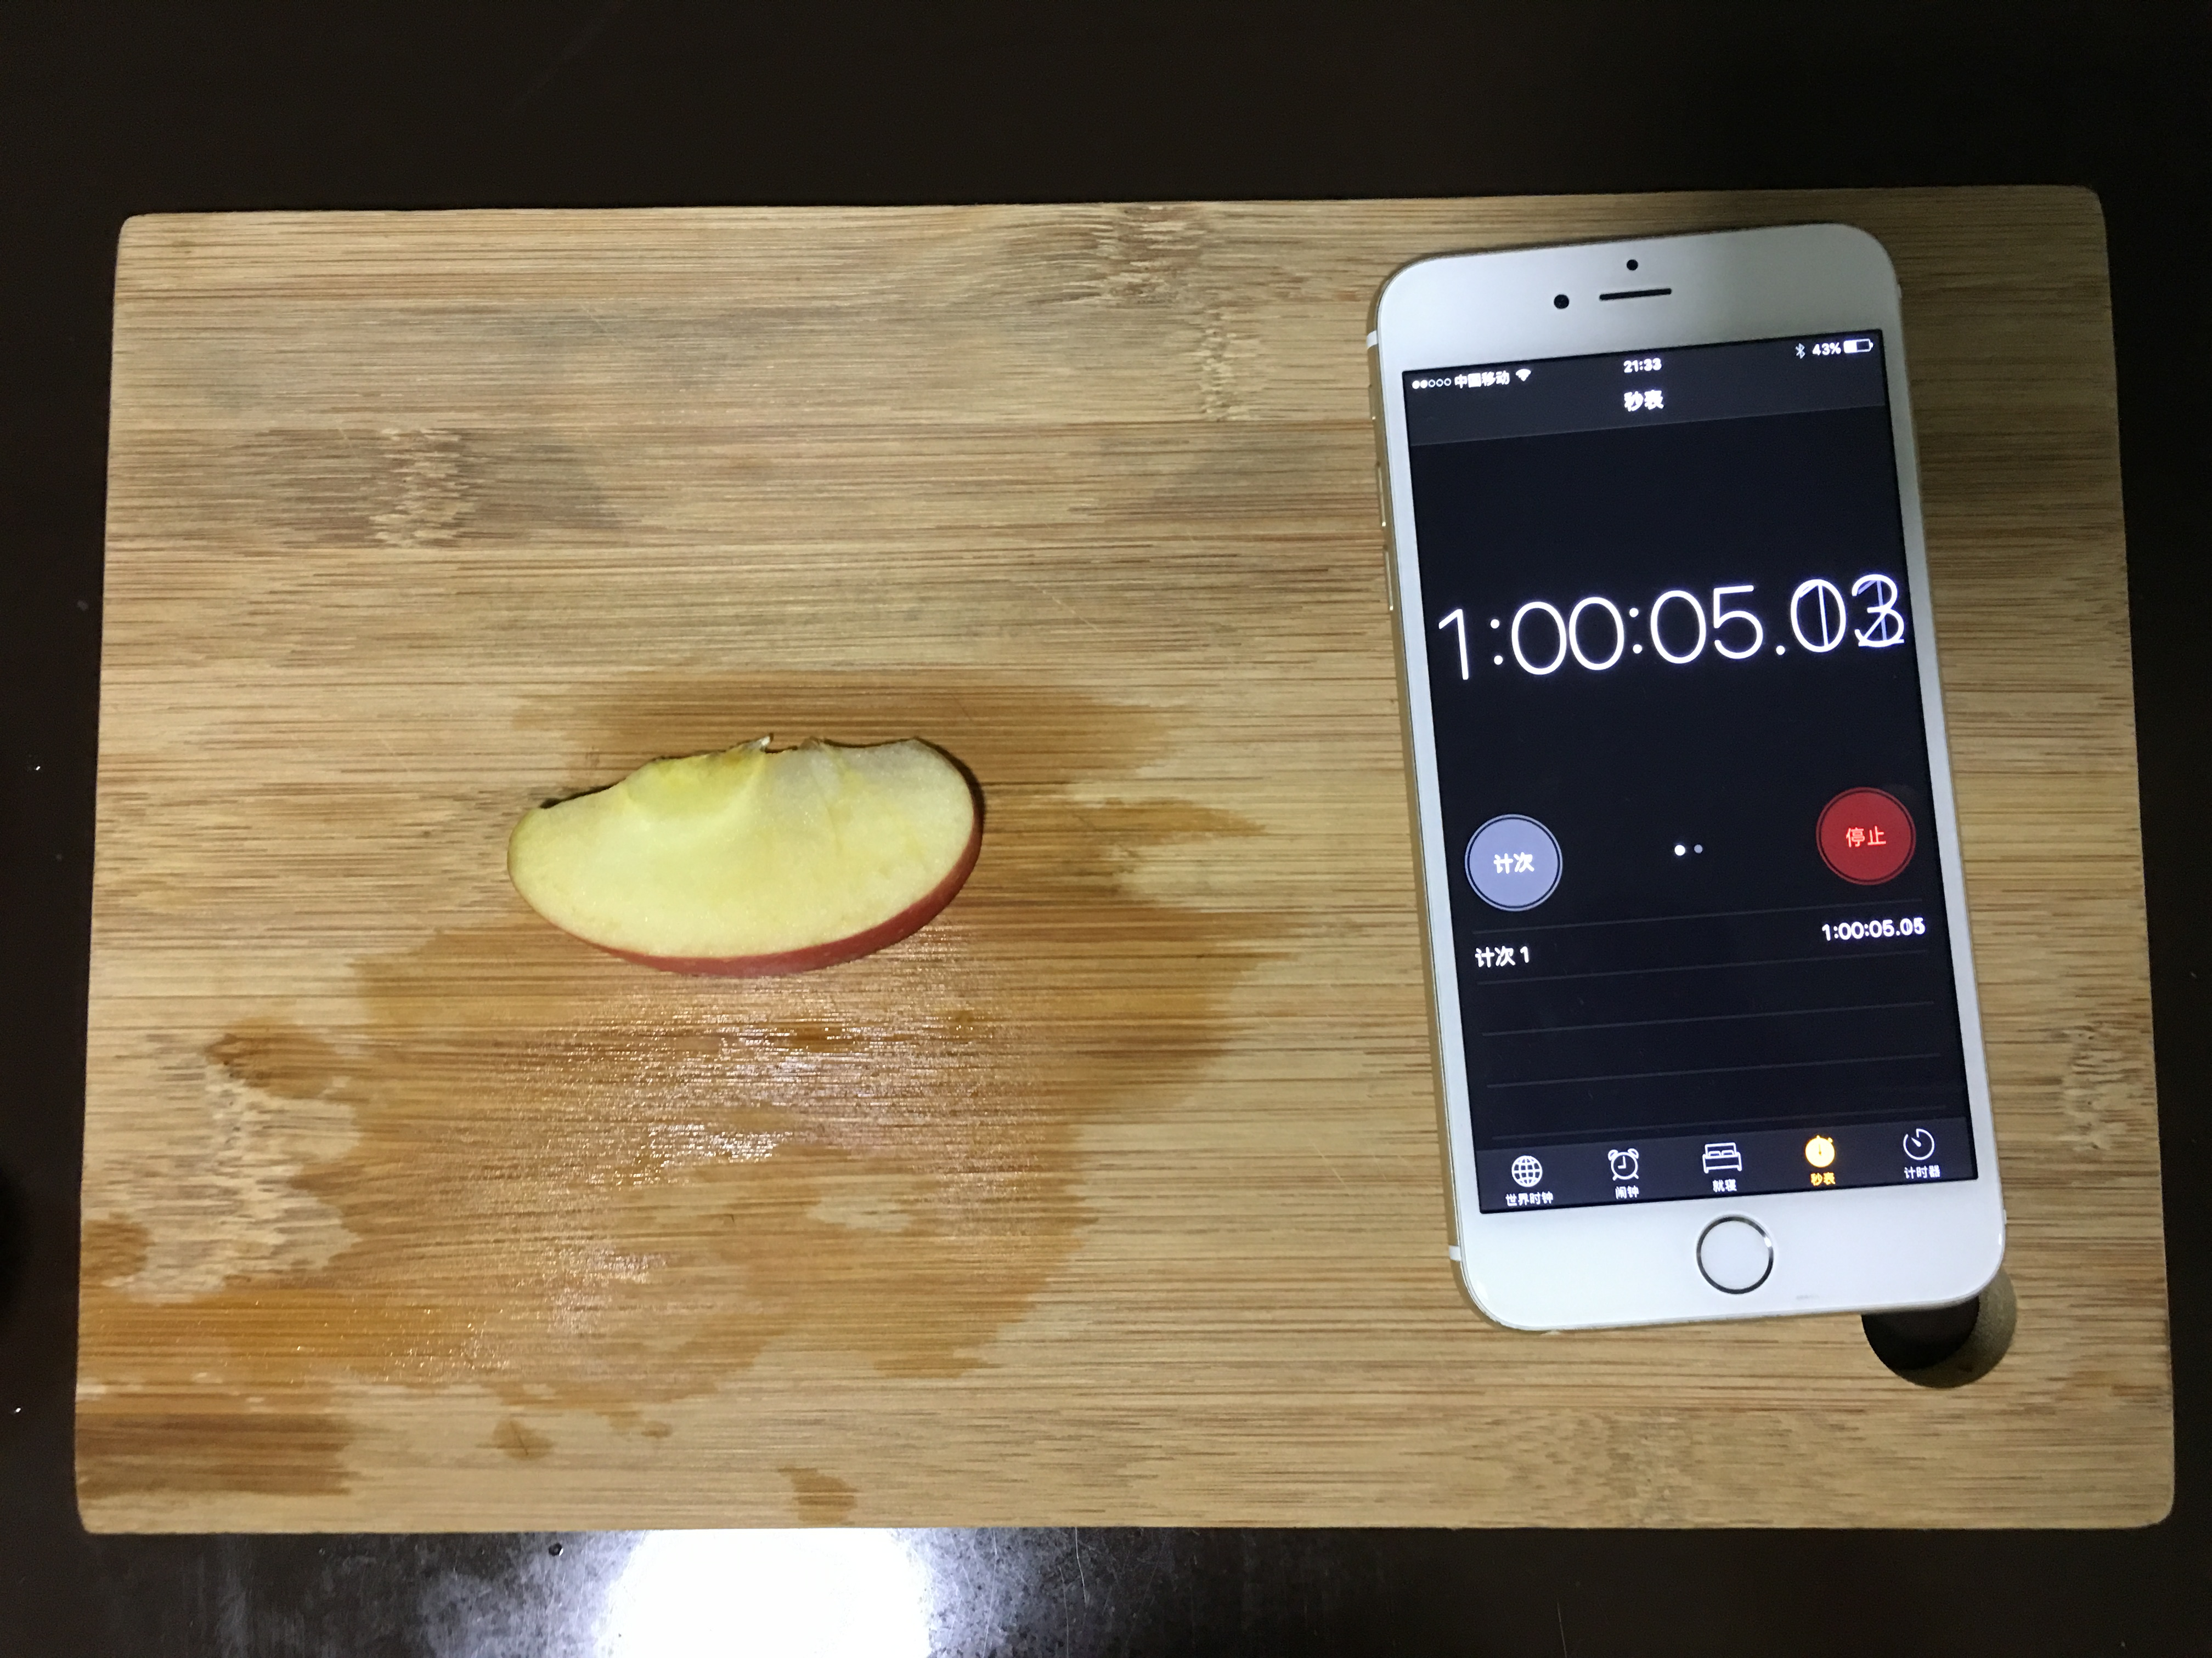

Slide 9
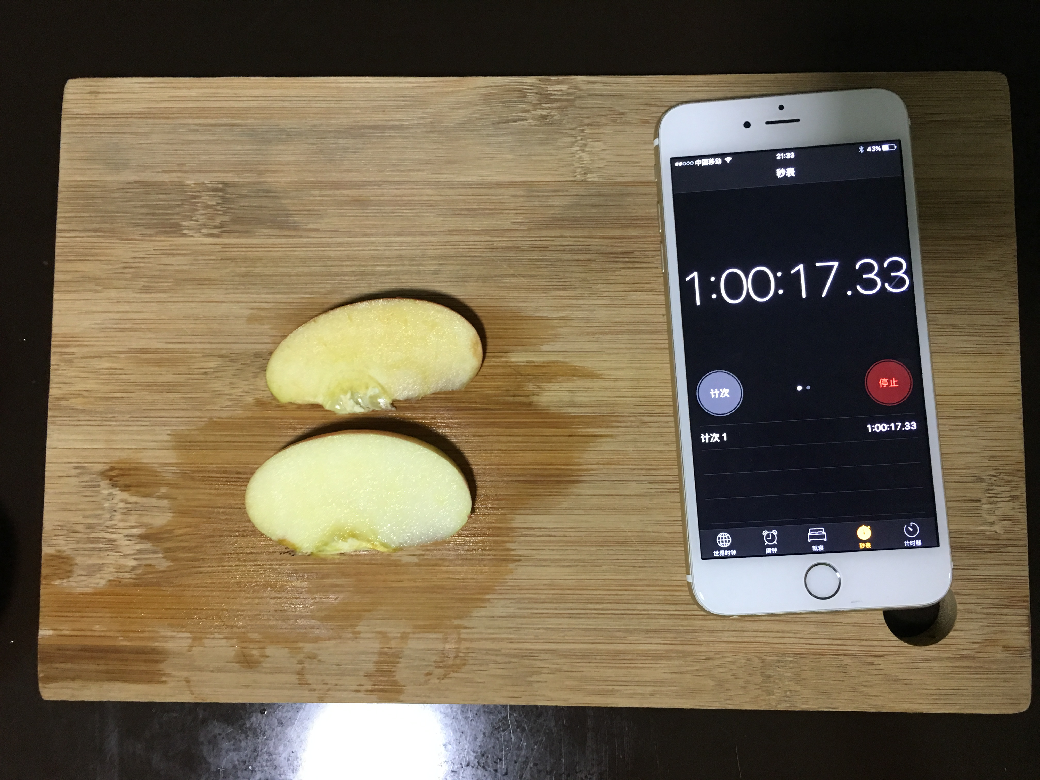

Slide 10
video time

Slide 11
Why browning?
How does liquid works?
Phenolic Compound(酚类化合物)———Oxidation(氧化)
Lose activity(活性)———Won’t become brown

Slide 12
THanks

