Slide 1
Grow Light

Slide 2
Grow Light
Investigate how different types of artificial lights affect plant growth. What is the role of light spectrum?

Slide 3
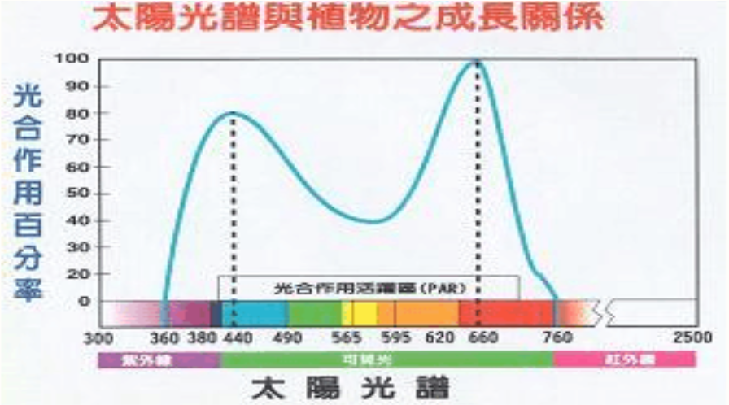

Slide 4
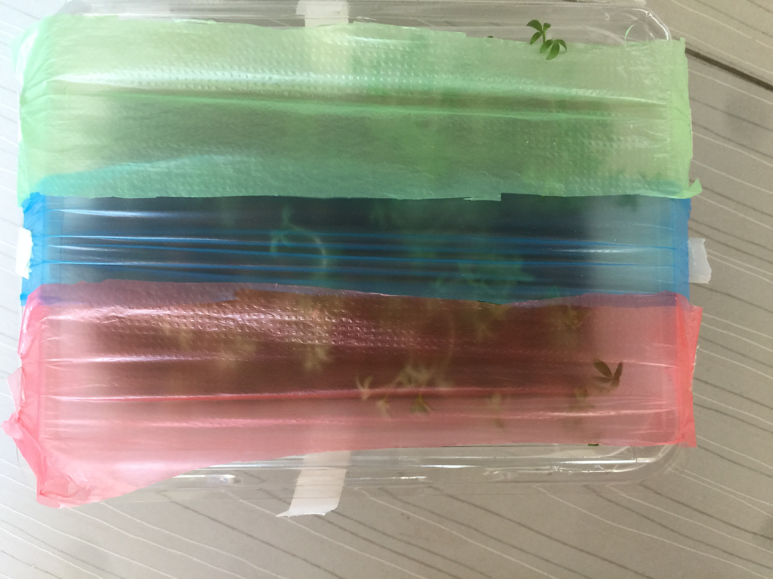
experiment

Slide 5
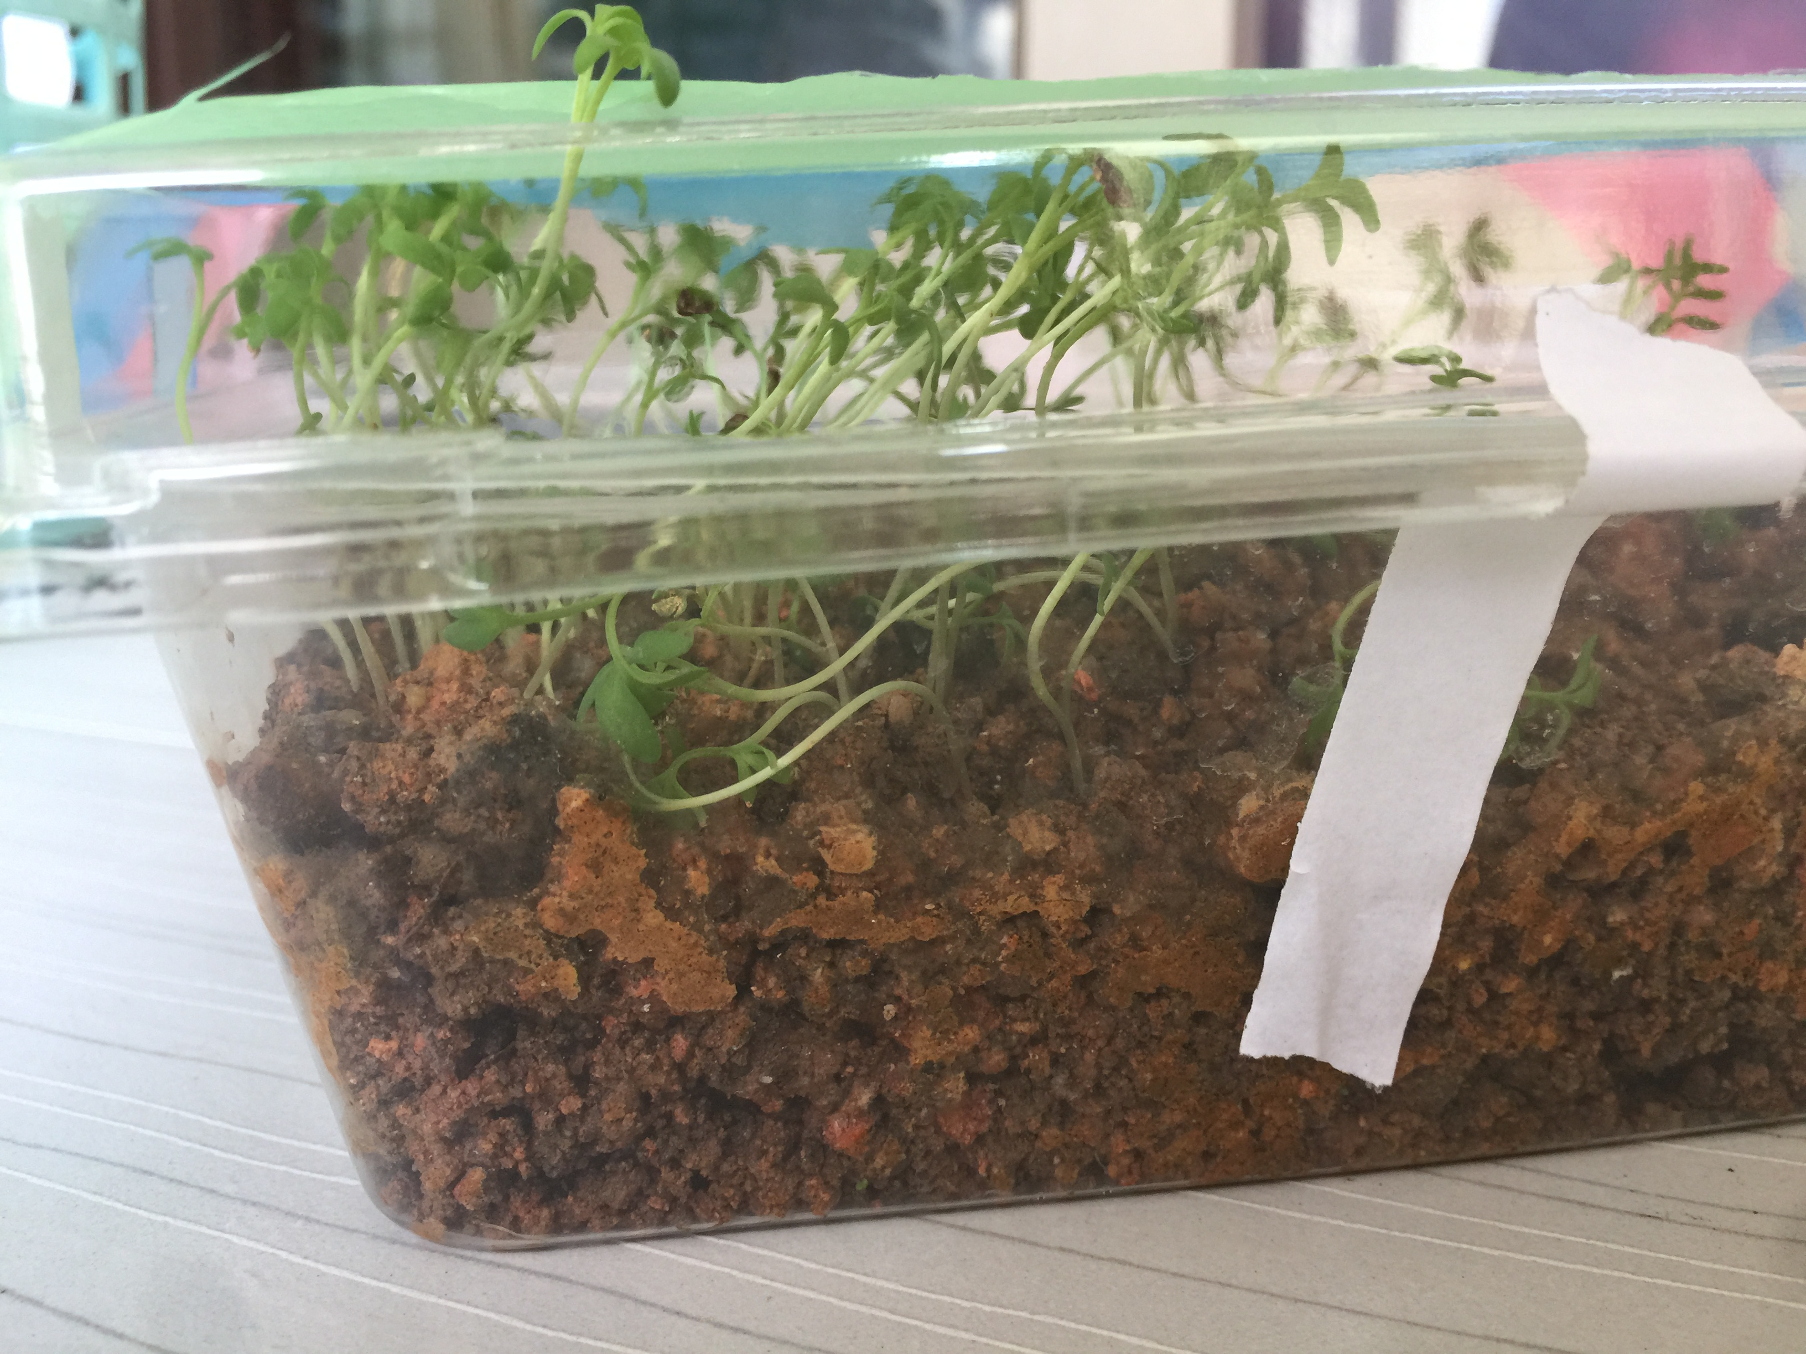
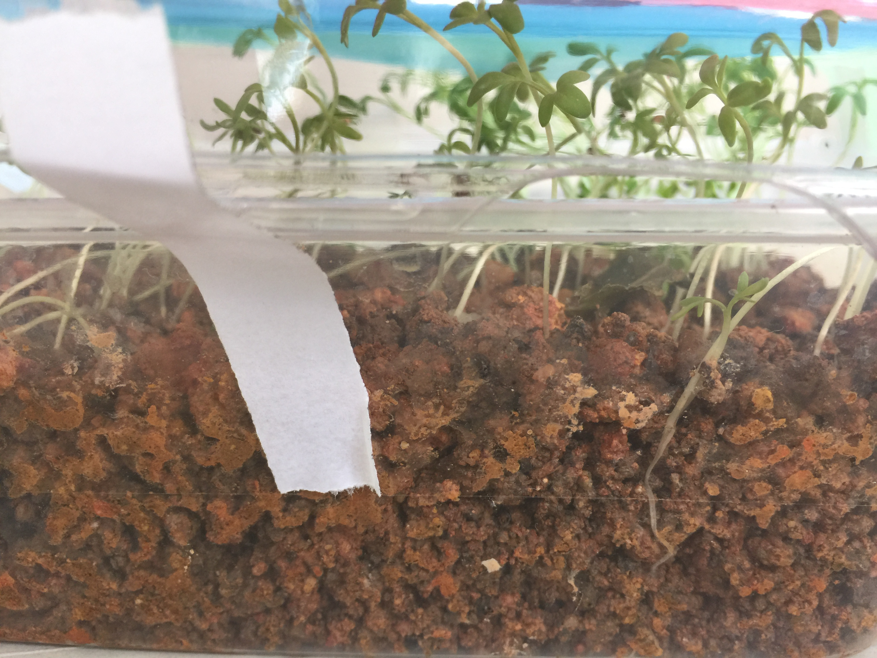
experiment
day 1

Slide 6
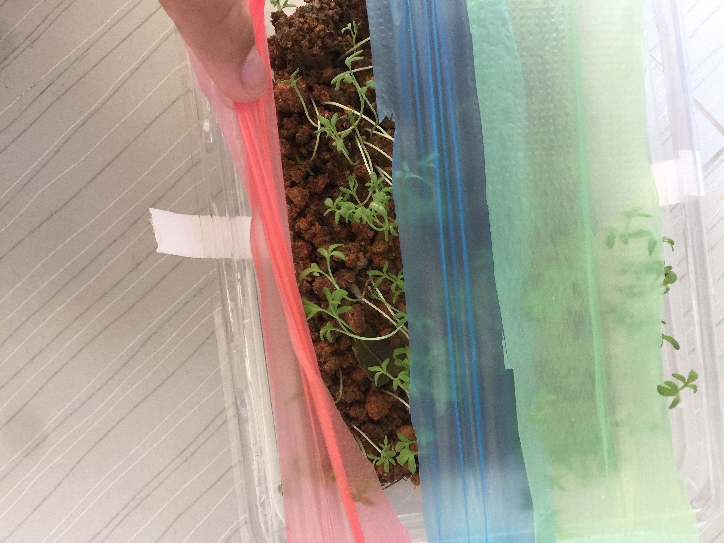
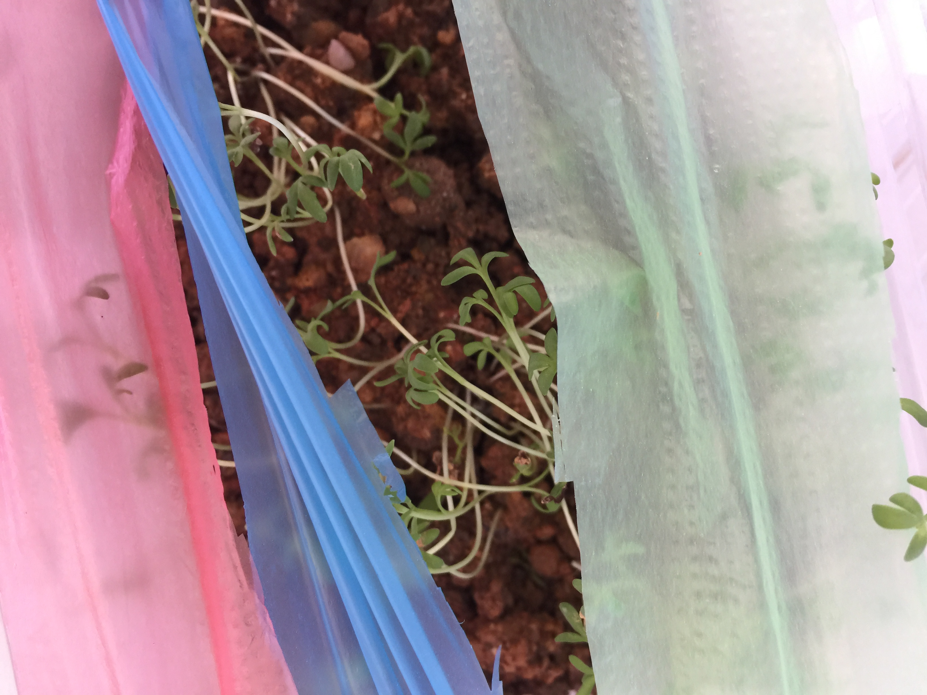
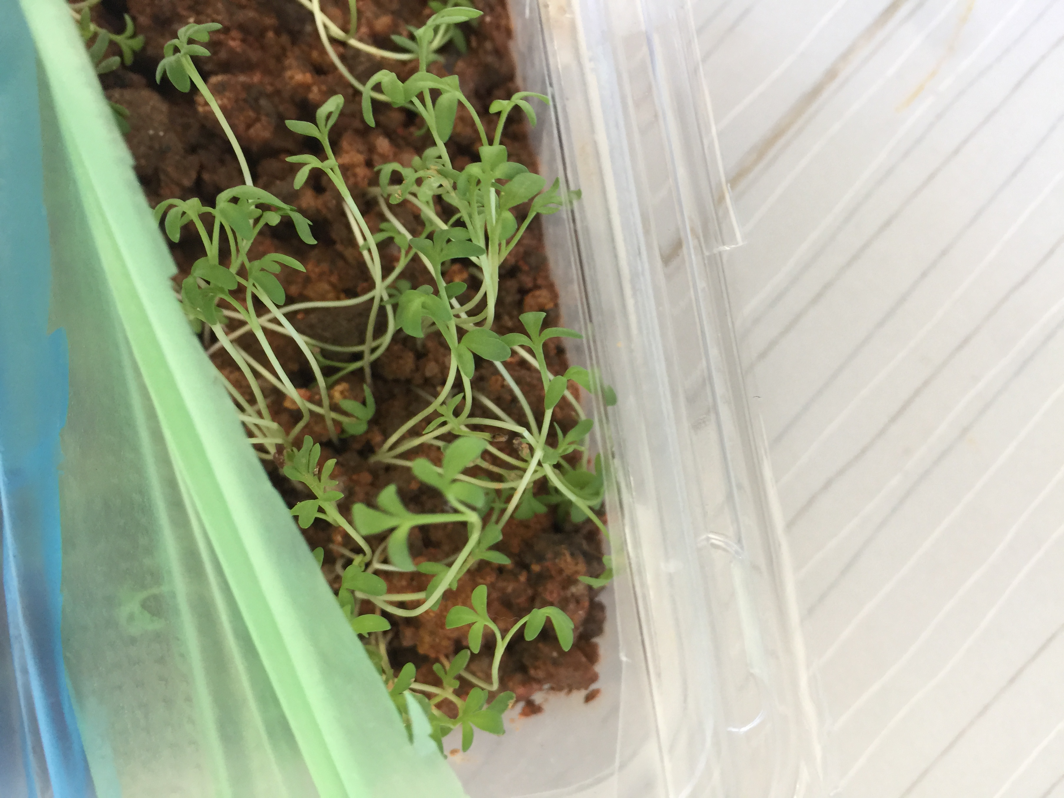
experiment
day 1

Slide 7
experiment
day 2
This experiment has a big coincidence
So we did another experiment…

Slide 8
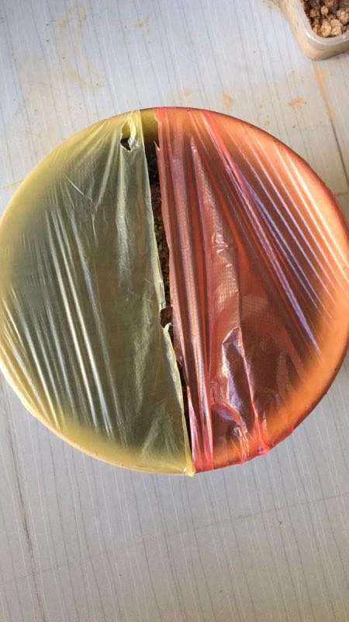
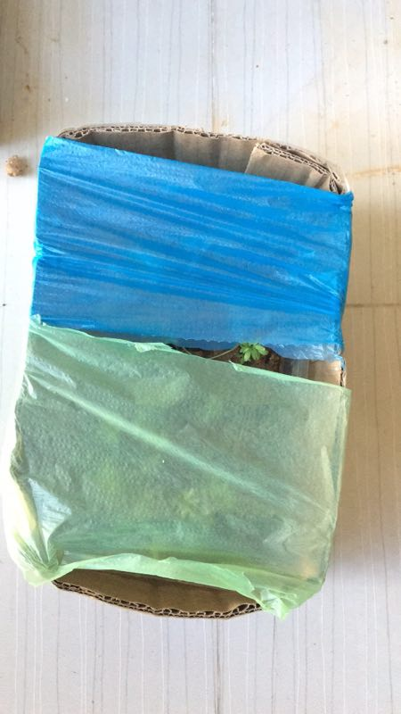
Experiment 2.0

Slide 9
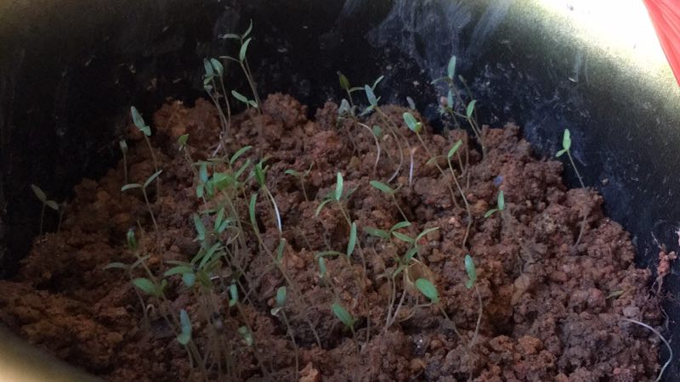
Experiment 2.0
day1
yellow
red

Slide 10
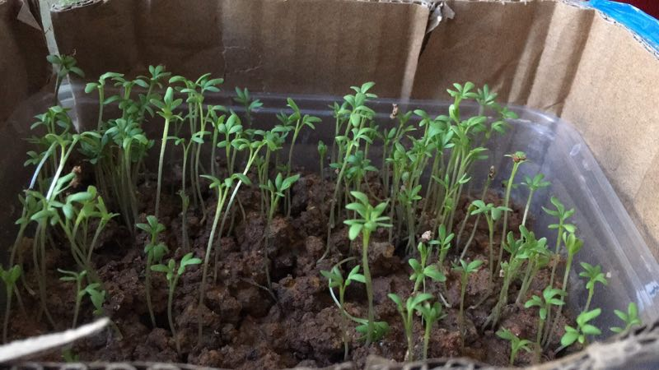
Experiment 2.0
day 1
green
blue

