Slide 1
Growing through asphalt

Slide 2
problem
Can a little plant grow straight up through concrete or asphalt?

Slide 3
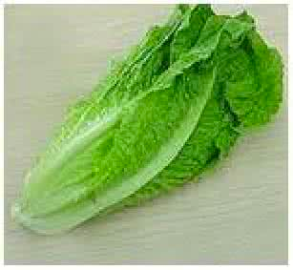
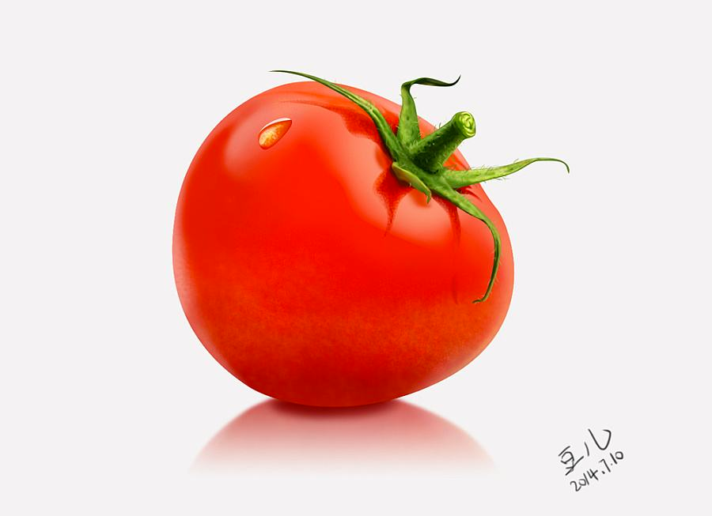
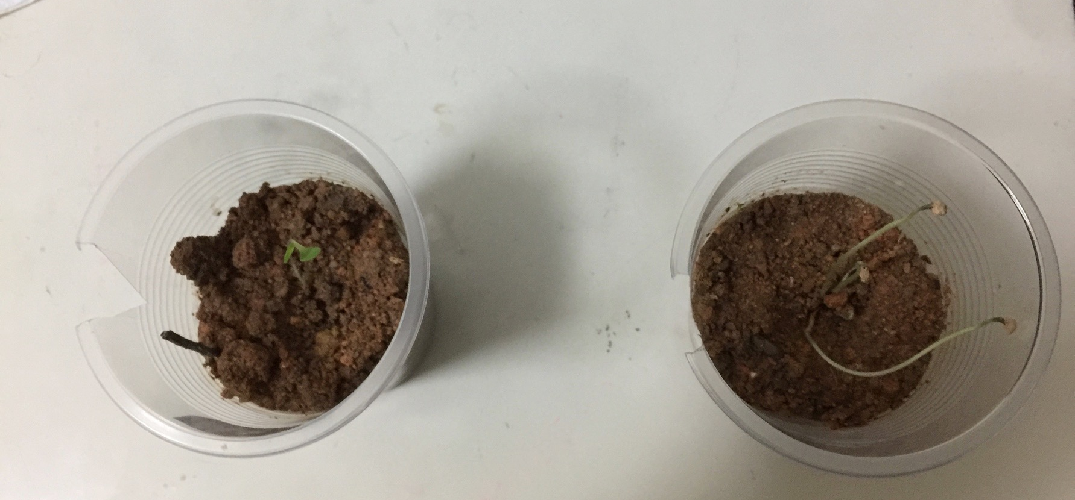
Our first experiment

Slide 4
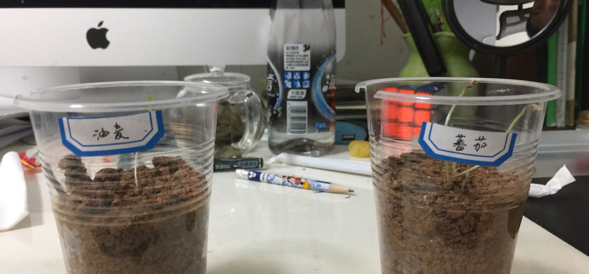
Our first experiment

Slide 5
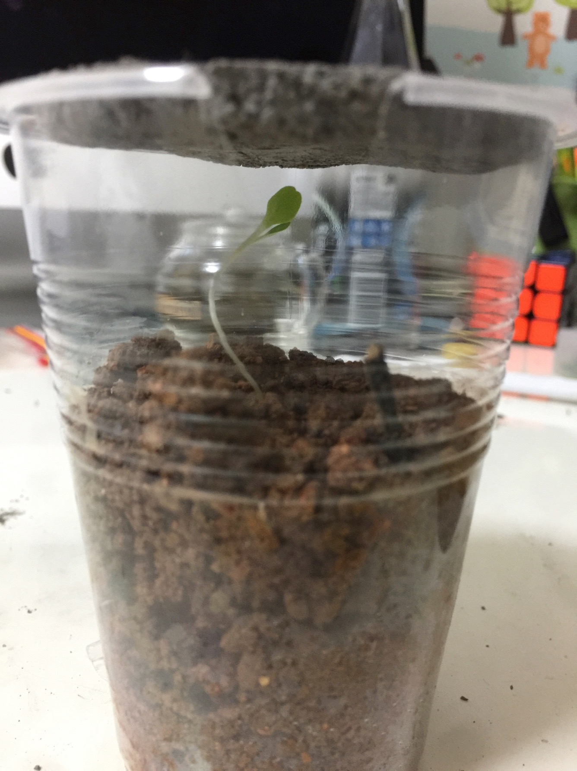
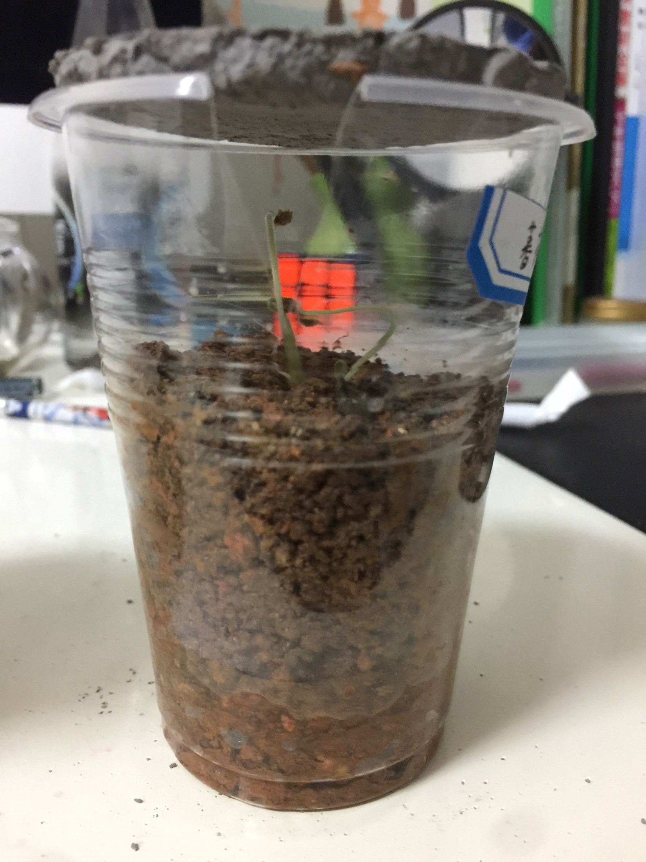
Our first experiment
concrete
concrete

Slide 6
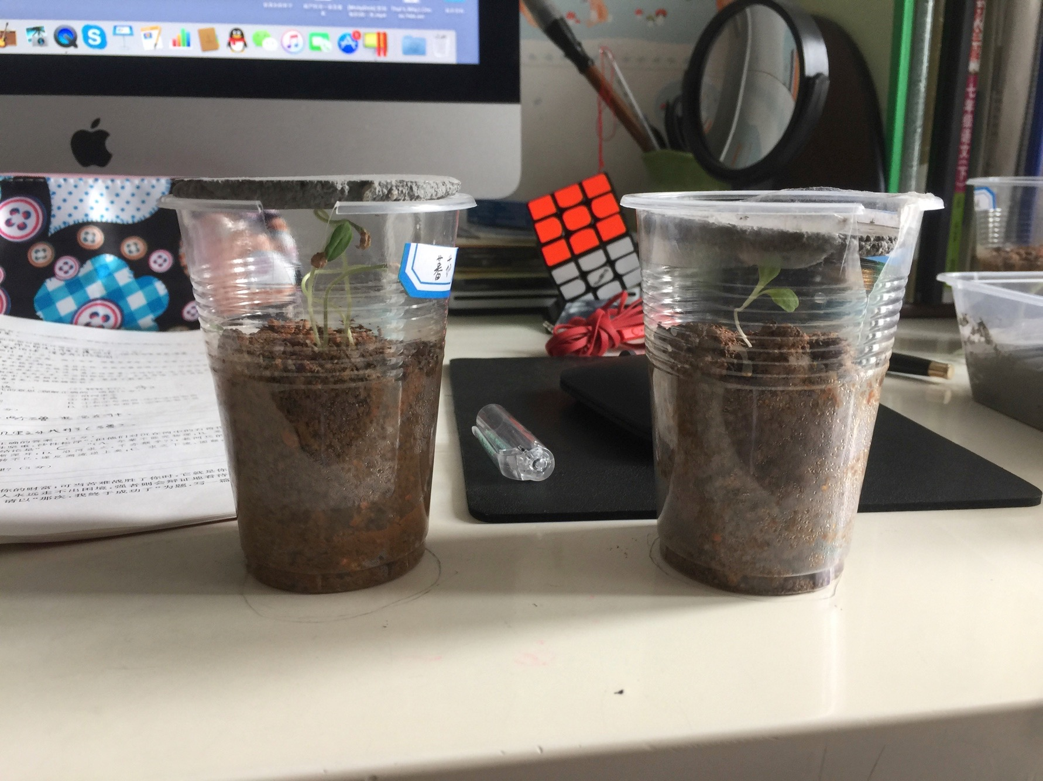
Our first experiment day 1

Slide 7
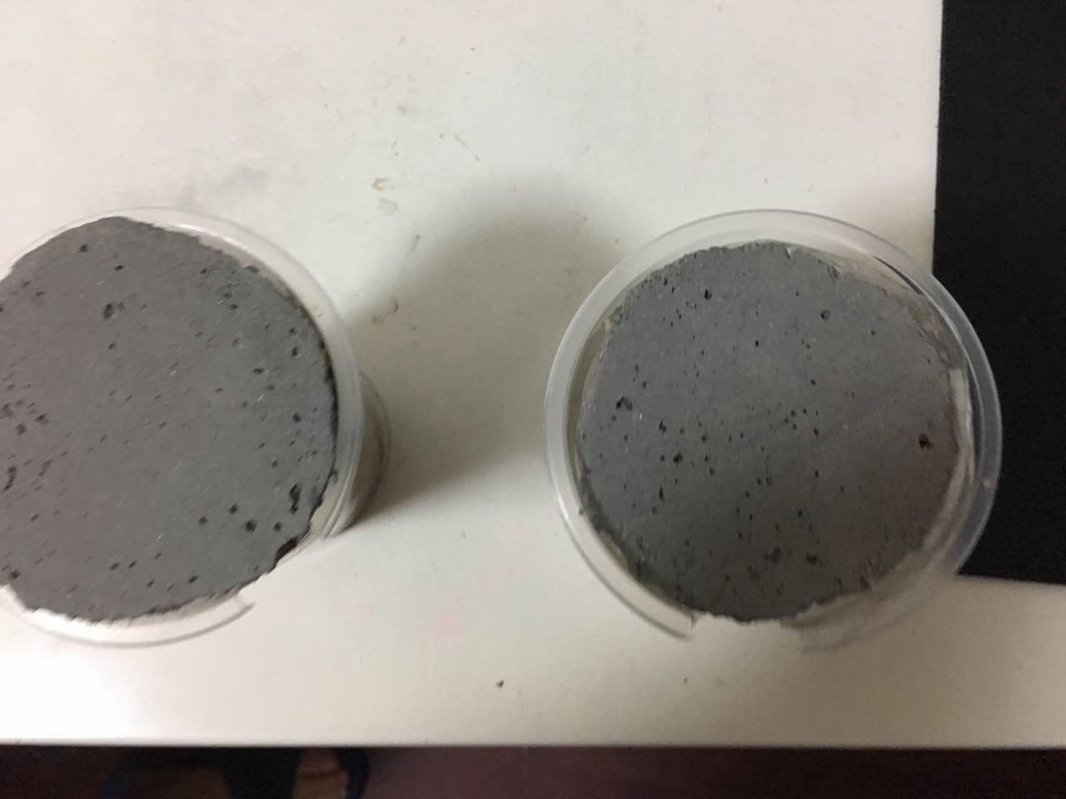
Our first experiment day 1

Slide 8
Our first experiment day 2

Slide 9
Our first experiment day 2

Slide 10
Our first experiment day 3
The plant was dead…

Slide 11
Then we began a new experiment…

Slide 12
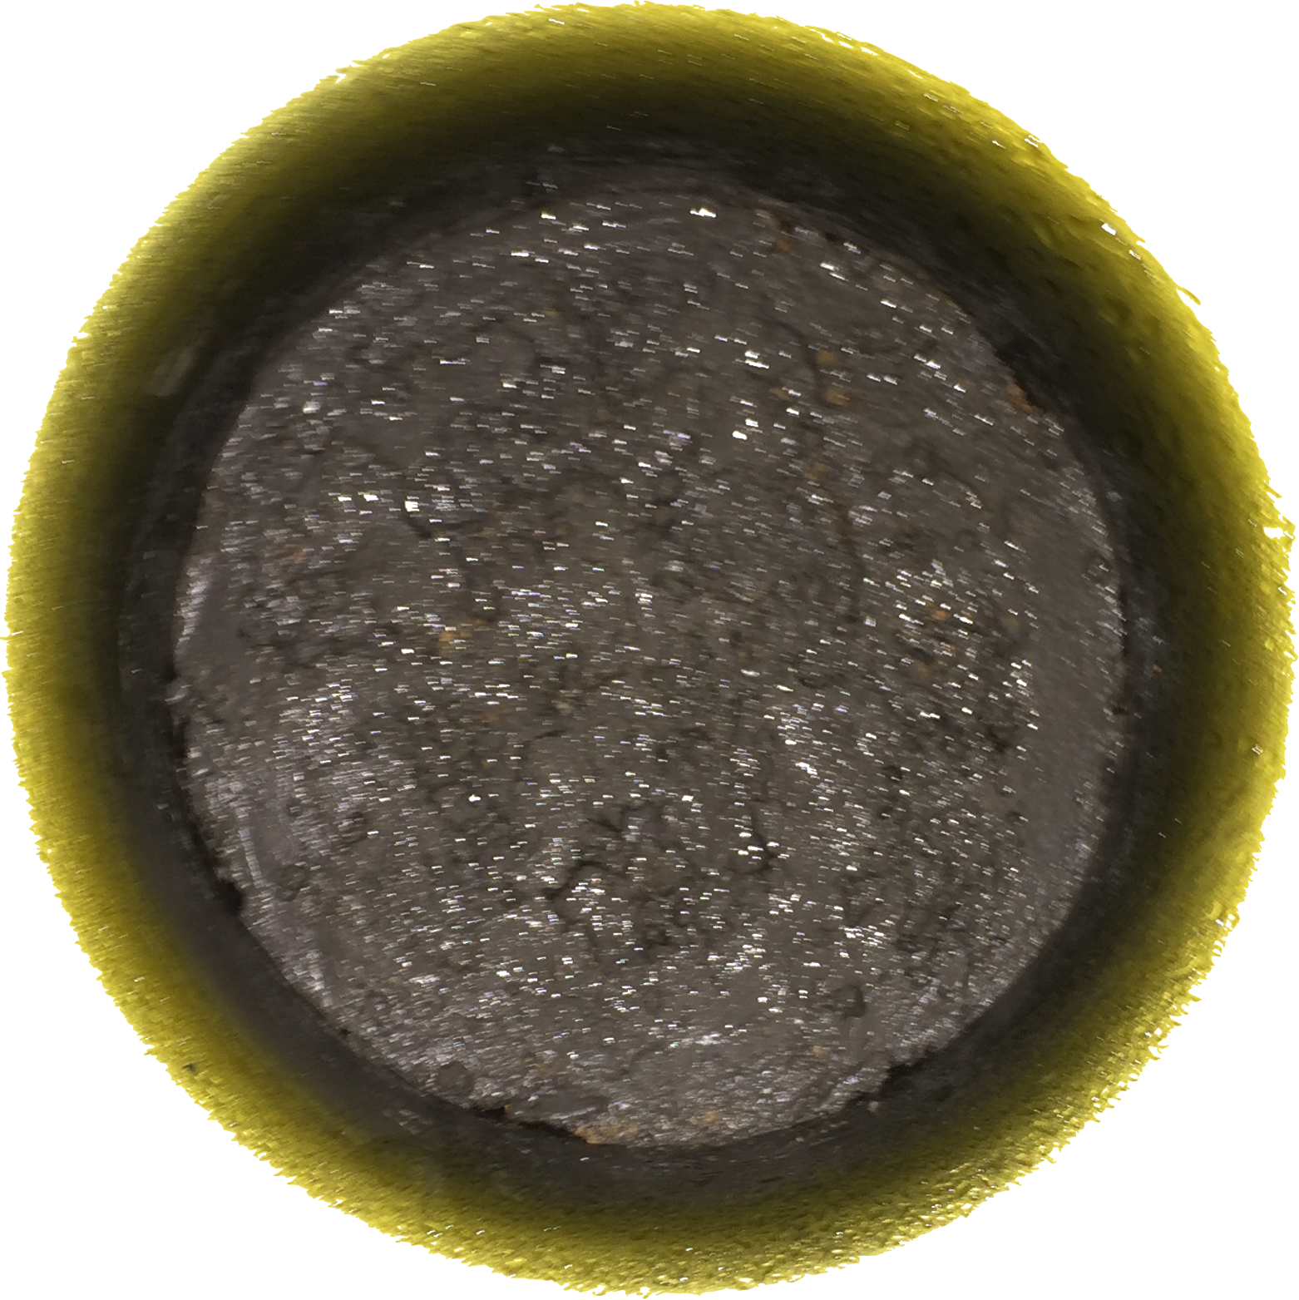
After several days…

Slide 13
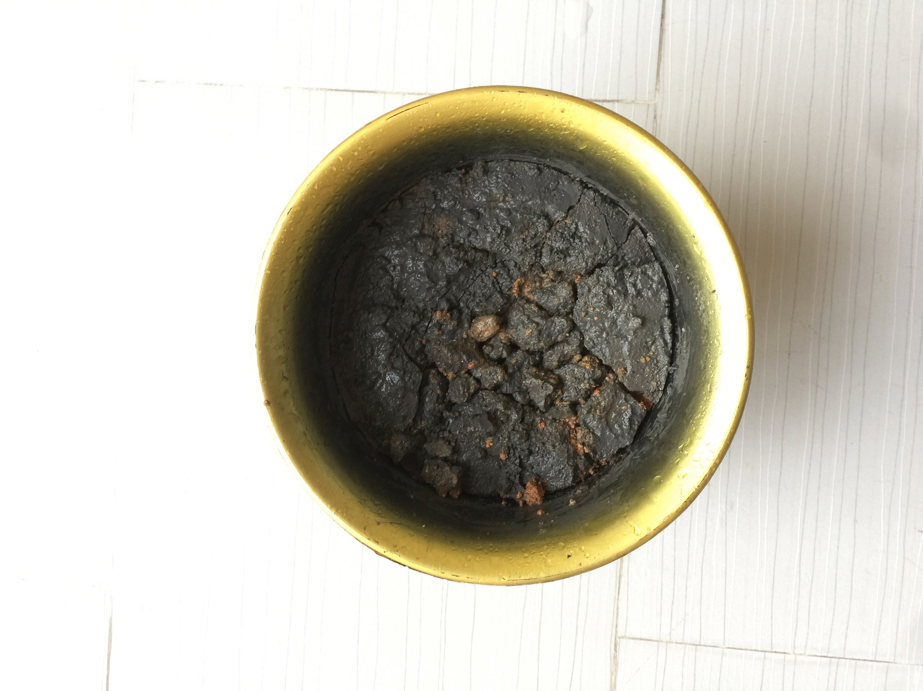
Then…

Slide 14
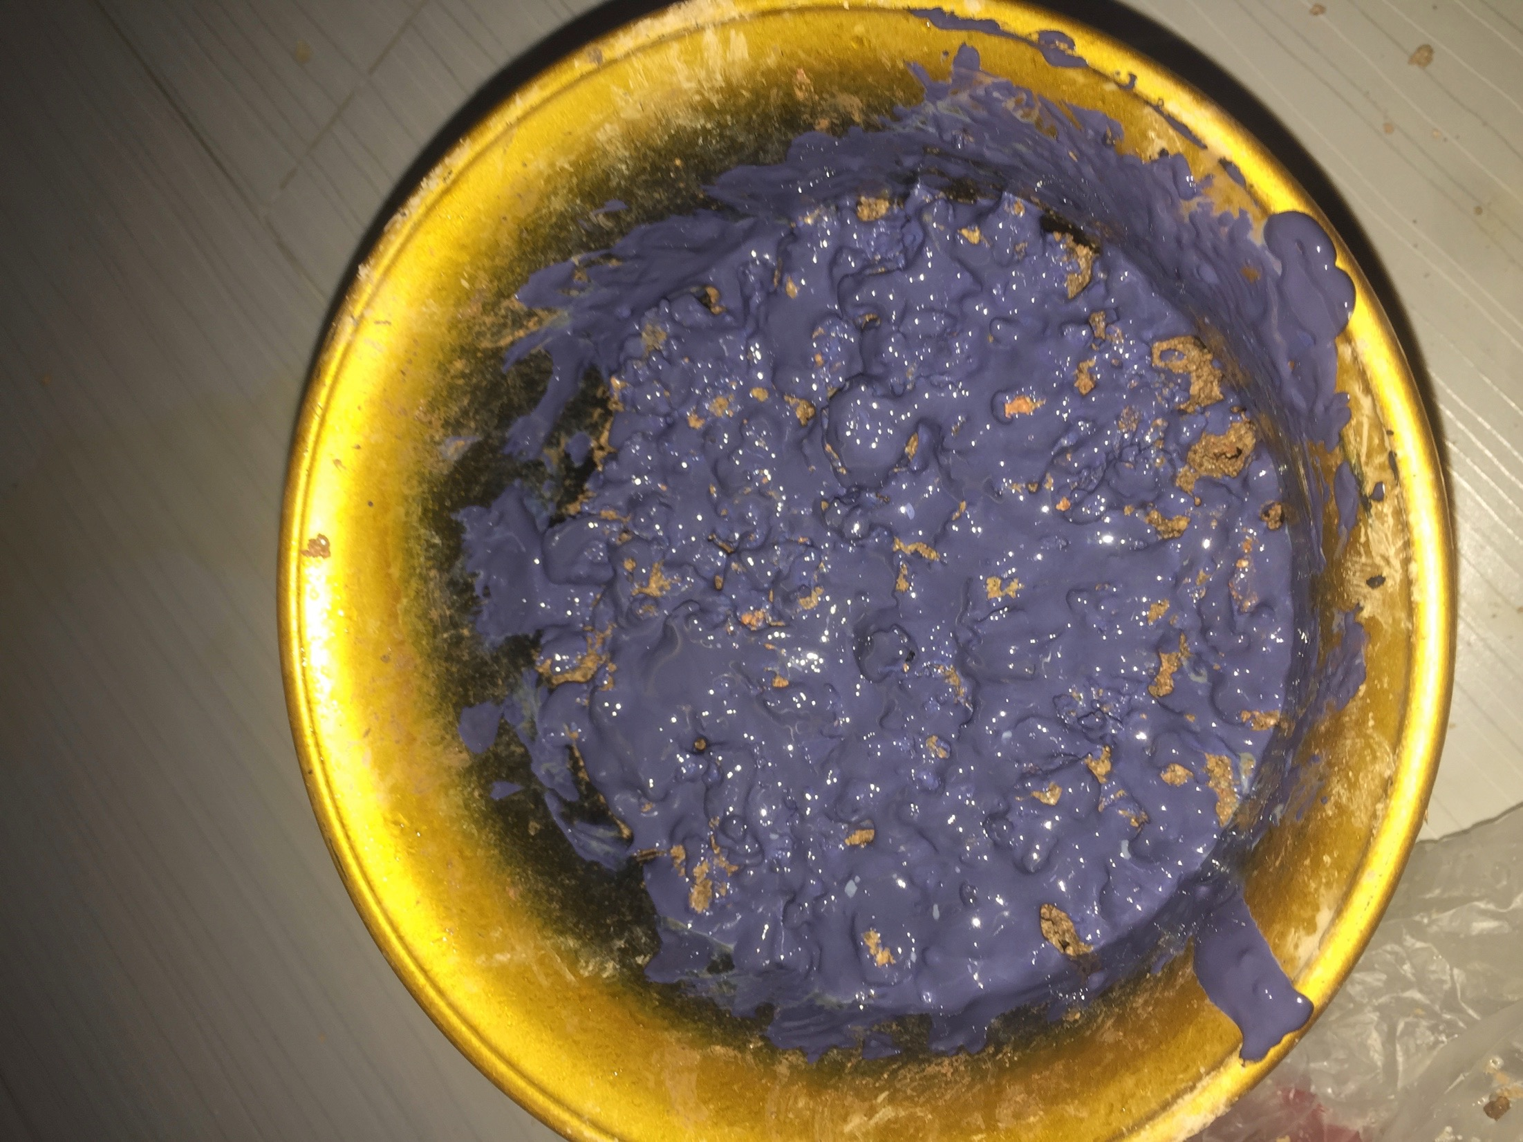
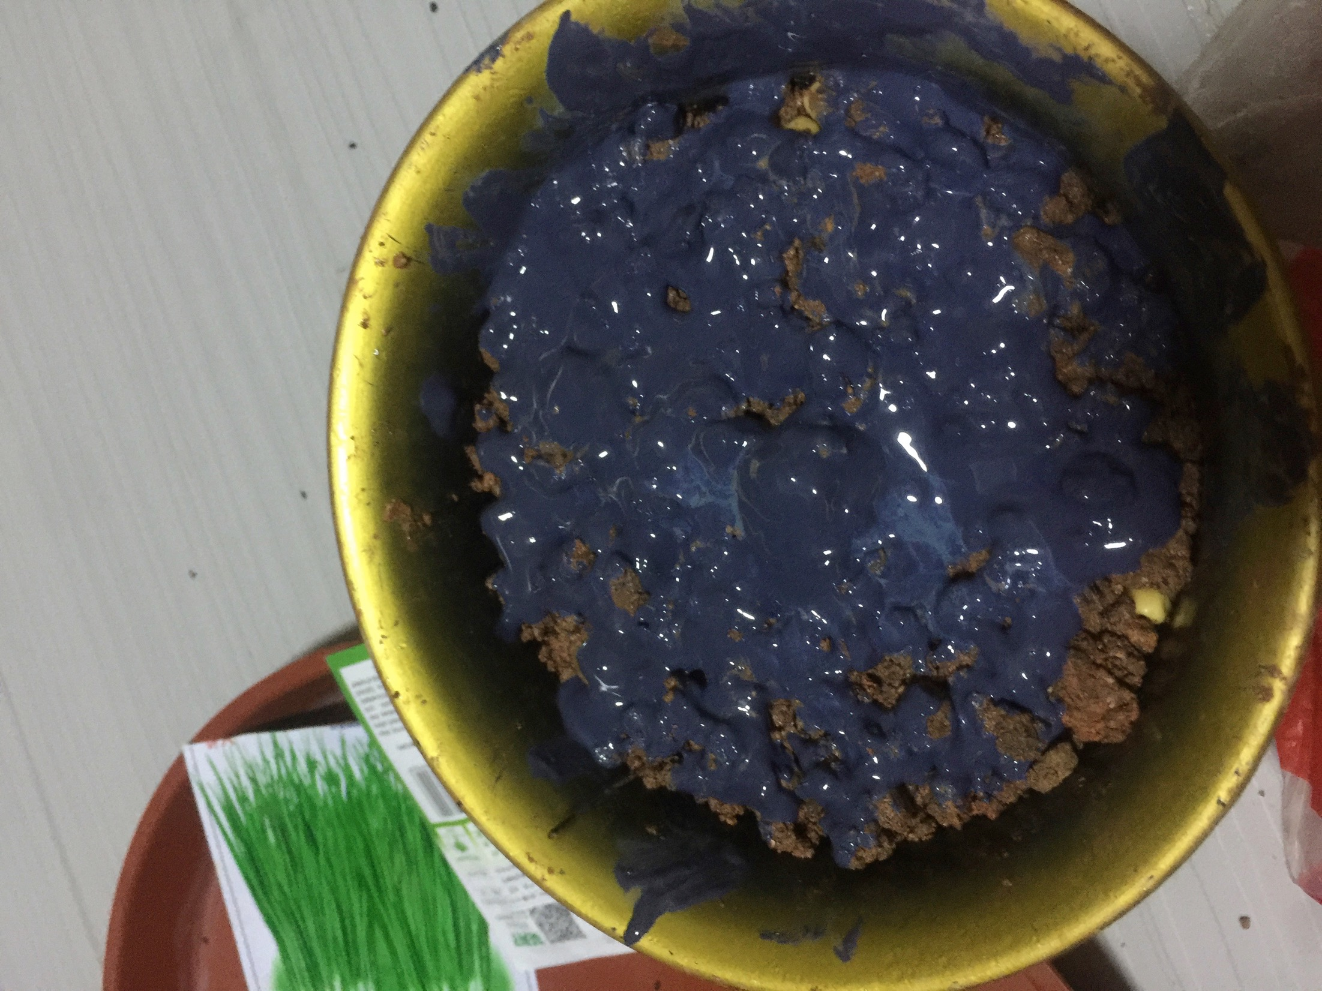
spring onion soybean

Slide 15
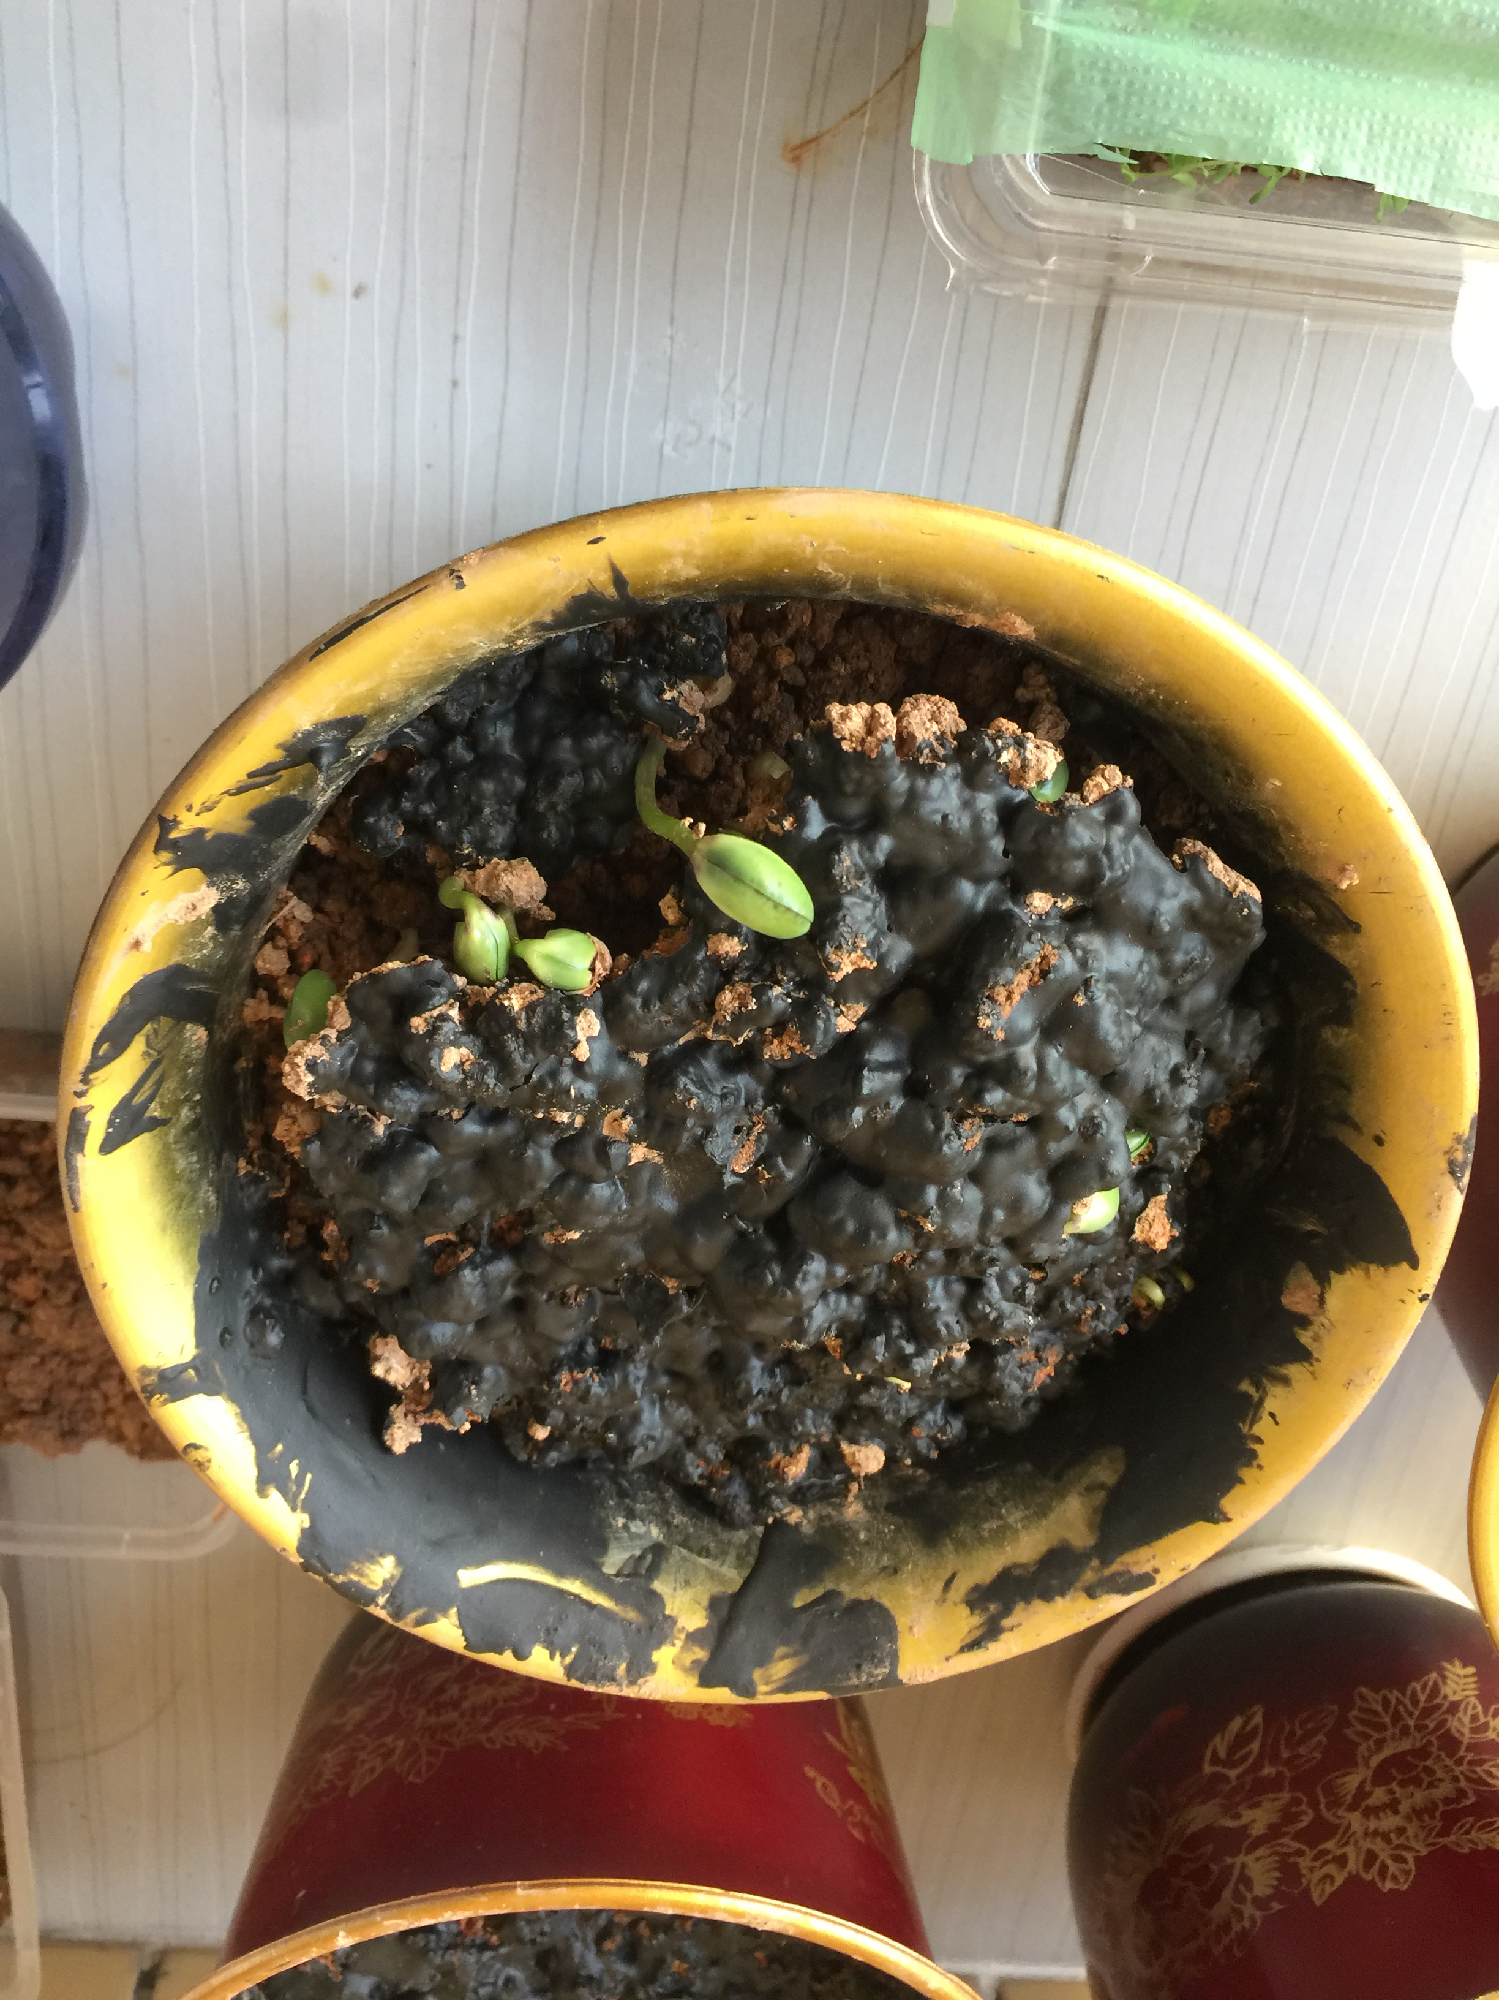
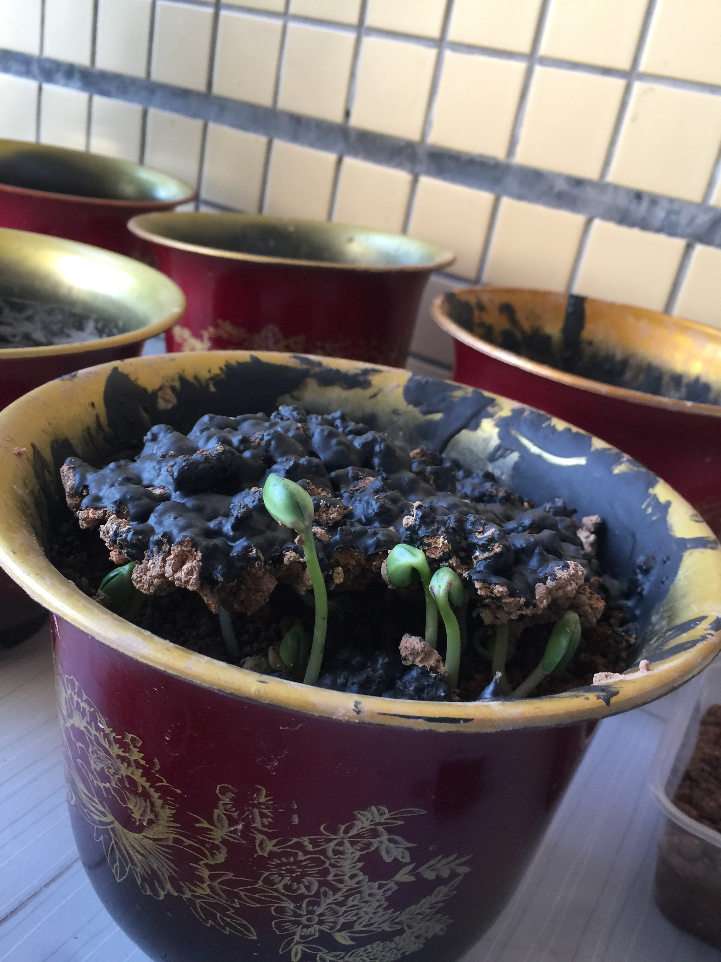
After 3 days

Slide 16
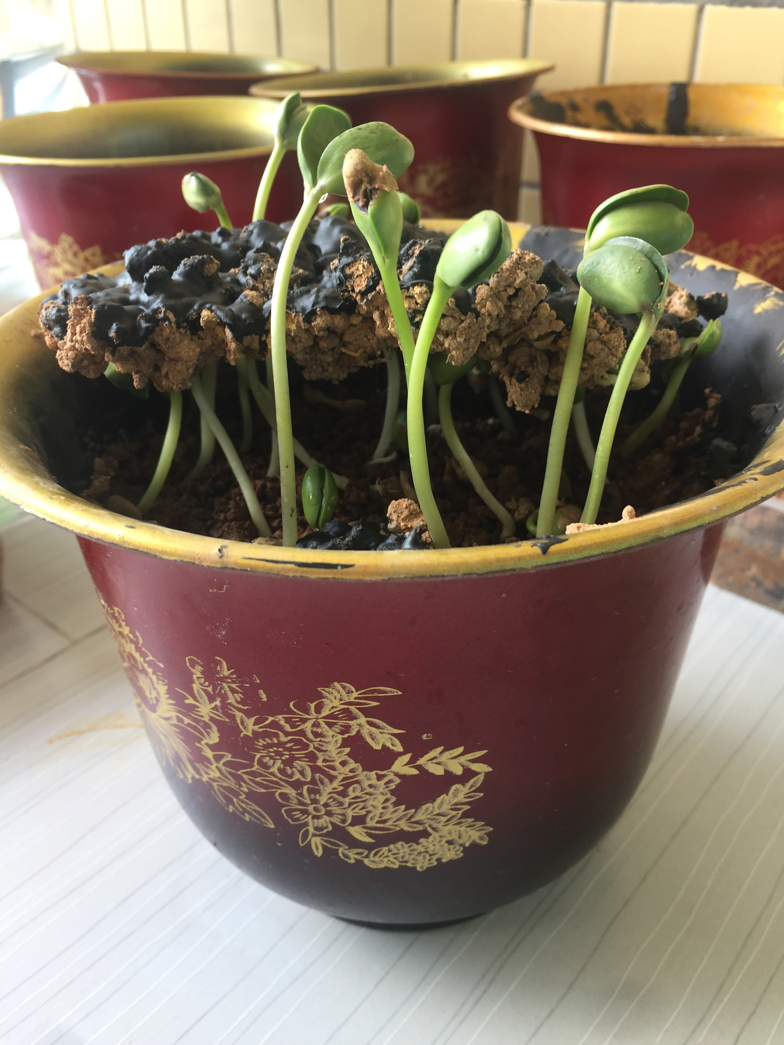
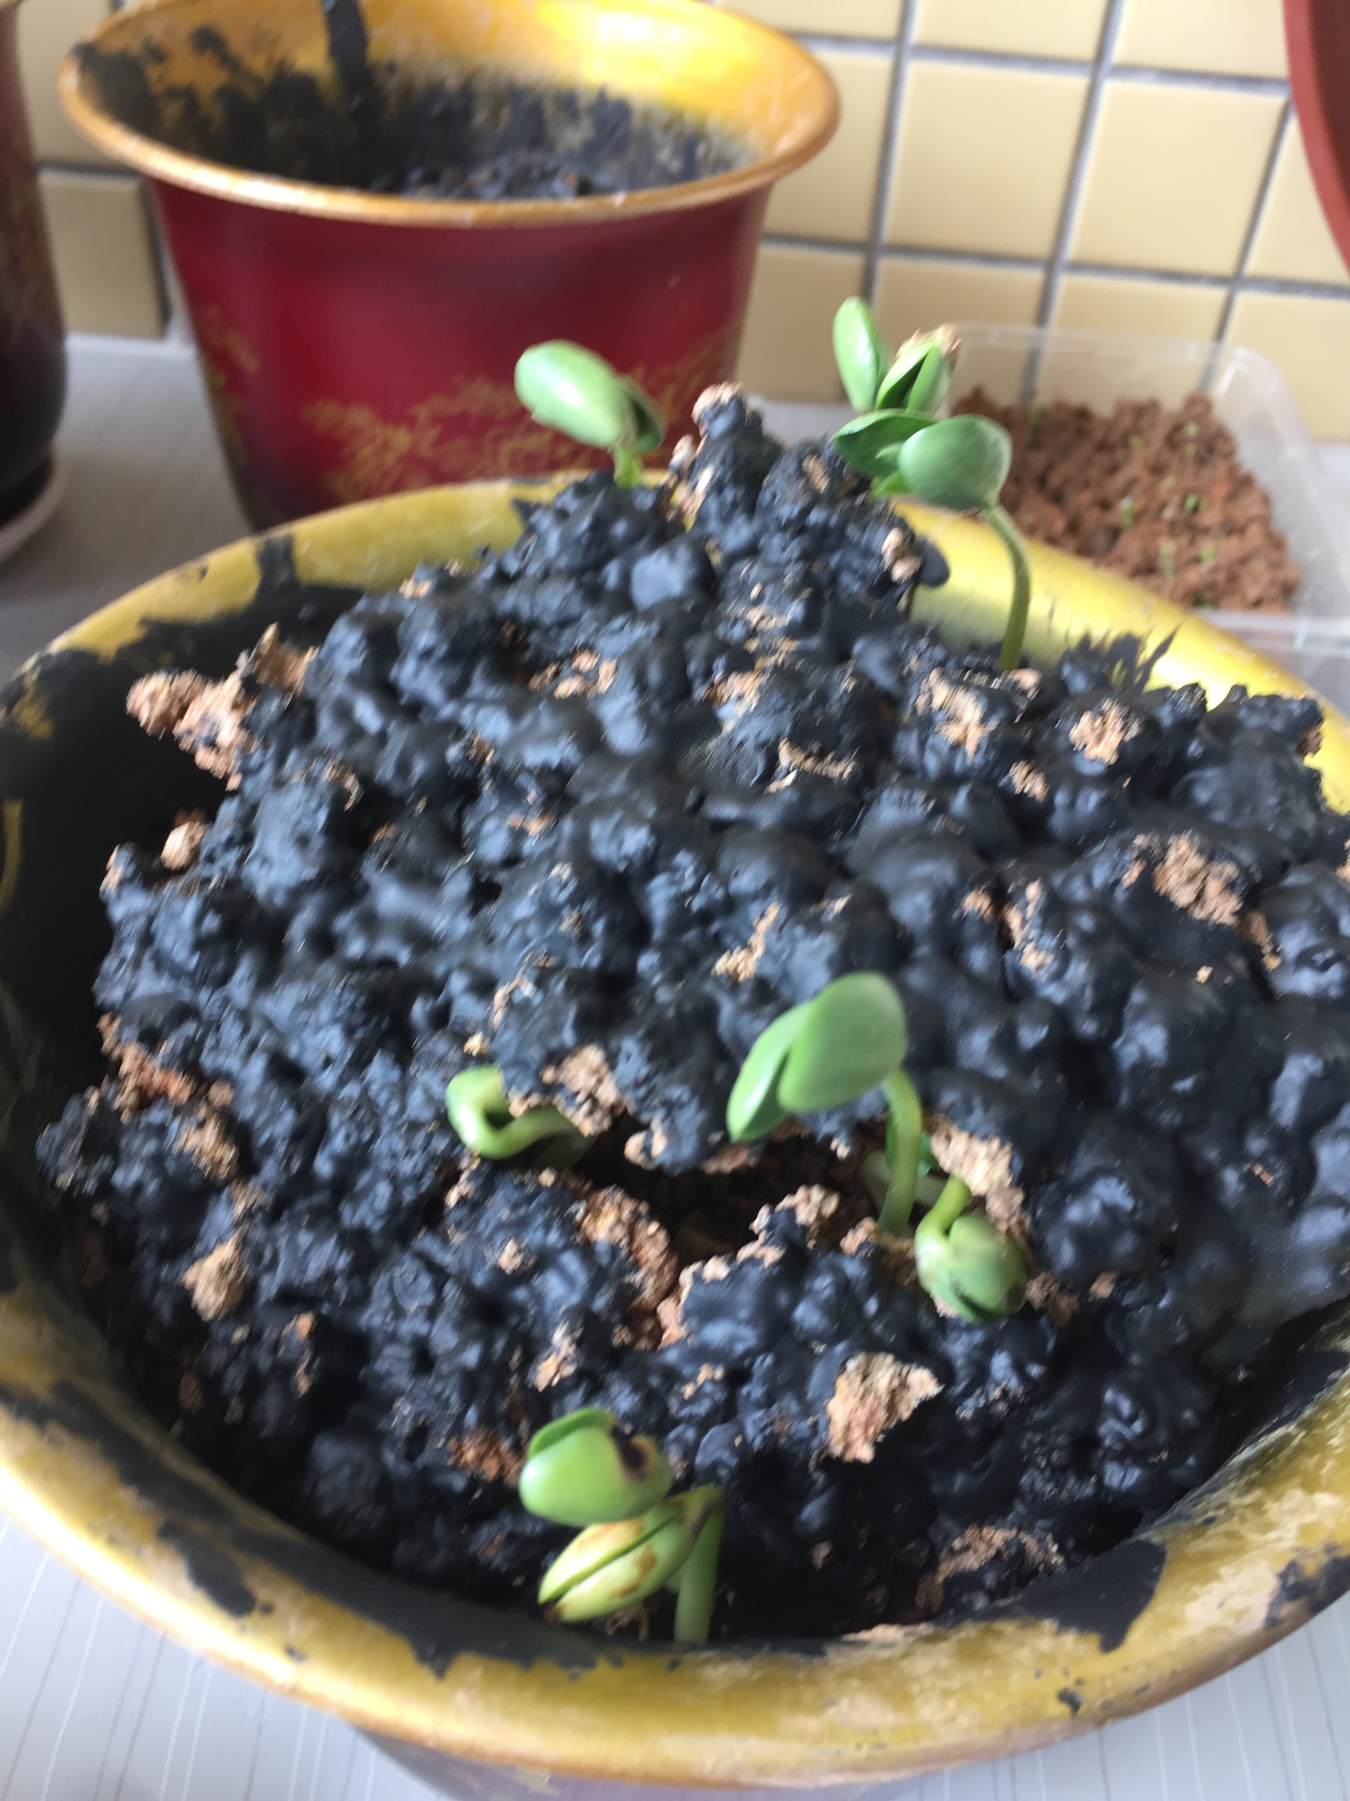
After 4 days

Slide 17
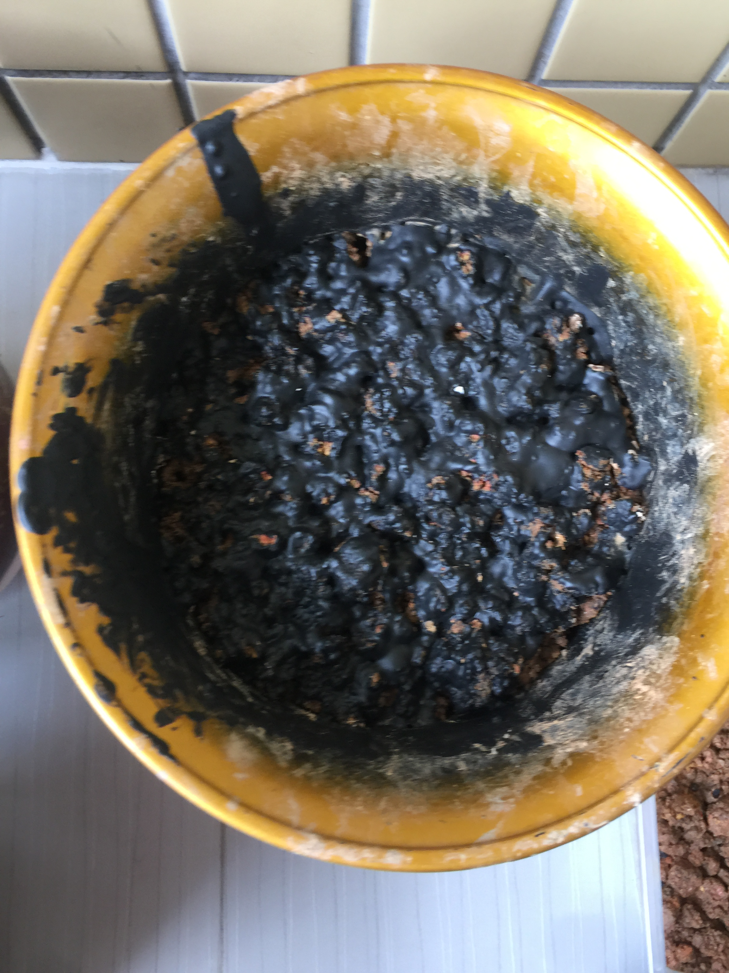

Slide 18
Extra experiment
Power of soybean

Slide 19
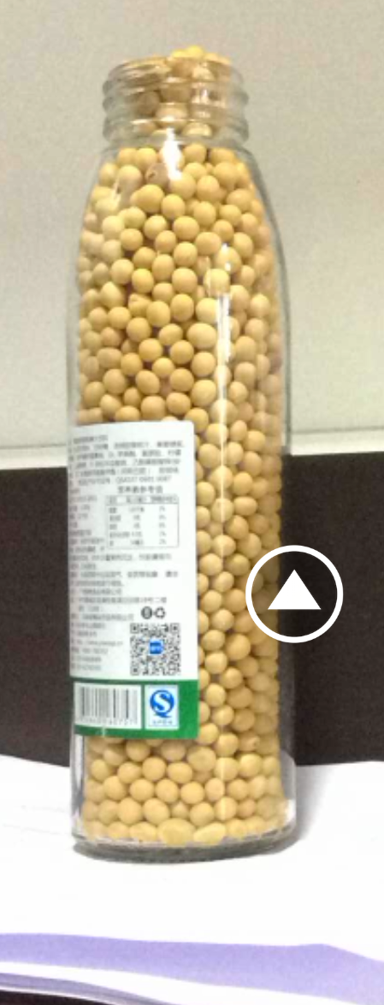

Slide 21
Thanks

