Slide 1
Rotating light
Shenzhen Middle School 2

Slide 2
Statement of question
(Purpose)
Some molecules have a property called optical activity – (rotation polarized light).
Different molecule have different optical activity. Which means they rotate the light through them in different angles.
We use this property to determine different solution.

Slide 3
Known information
The optical activity of different molecules:
D-Glucose +53 (dm⁻¹cm³g⁻¹)
D-Fructose -92 (dm⁻¹cm³g⁻¹)
Sucrose +66 (dm⁻¹cm³g⁻¹)
Penicillin V +233 (dm⁻¹cm³g⁻¹)
The unit means in a certain temperature, when the light goes through 1mL solution which contains 1g of chiral, how obvious is the rotation.
+ : the rotation is clockwise
- : the rotation is anti-clockwise

Slide 4
Variables &
Controlled conditions
Variables:
Type of solution → different optical activity
Controlled conditions:
1. Darkness in the lab
2. Distance from the light to the polarizer

Slide 5
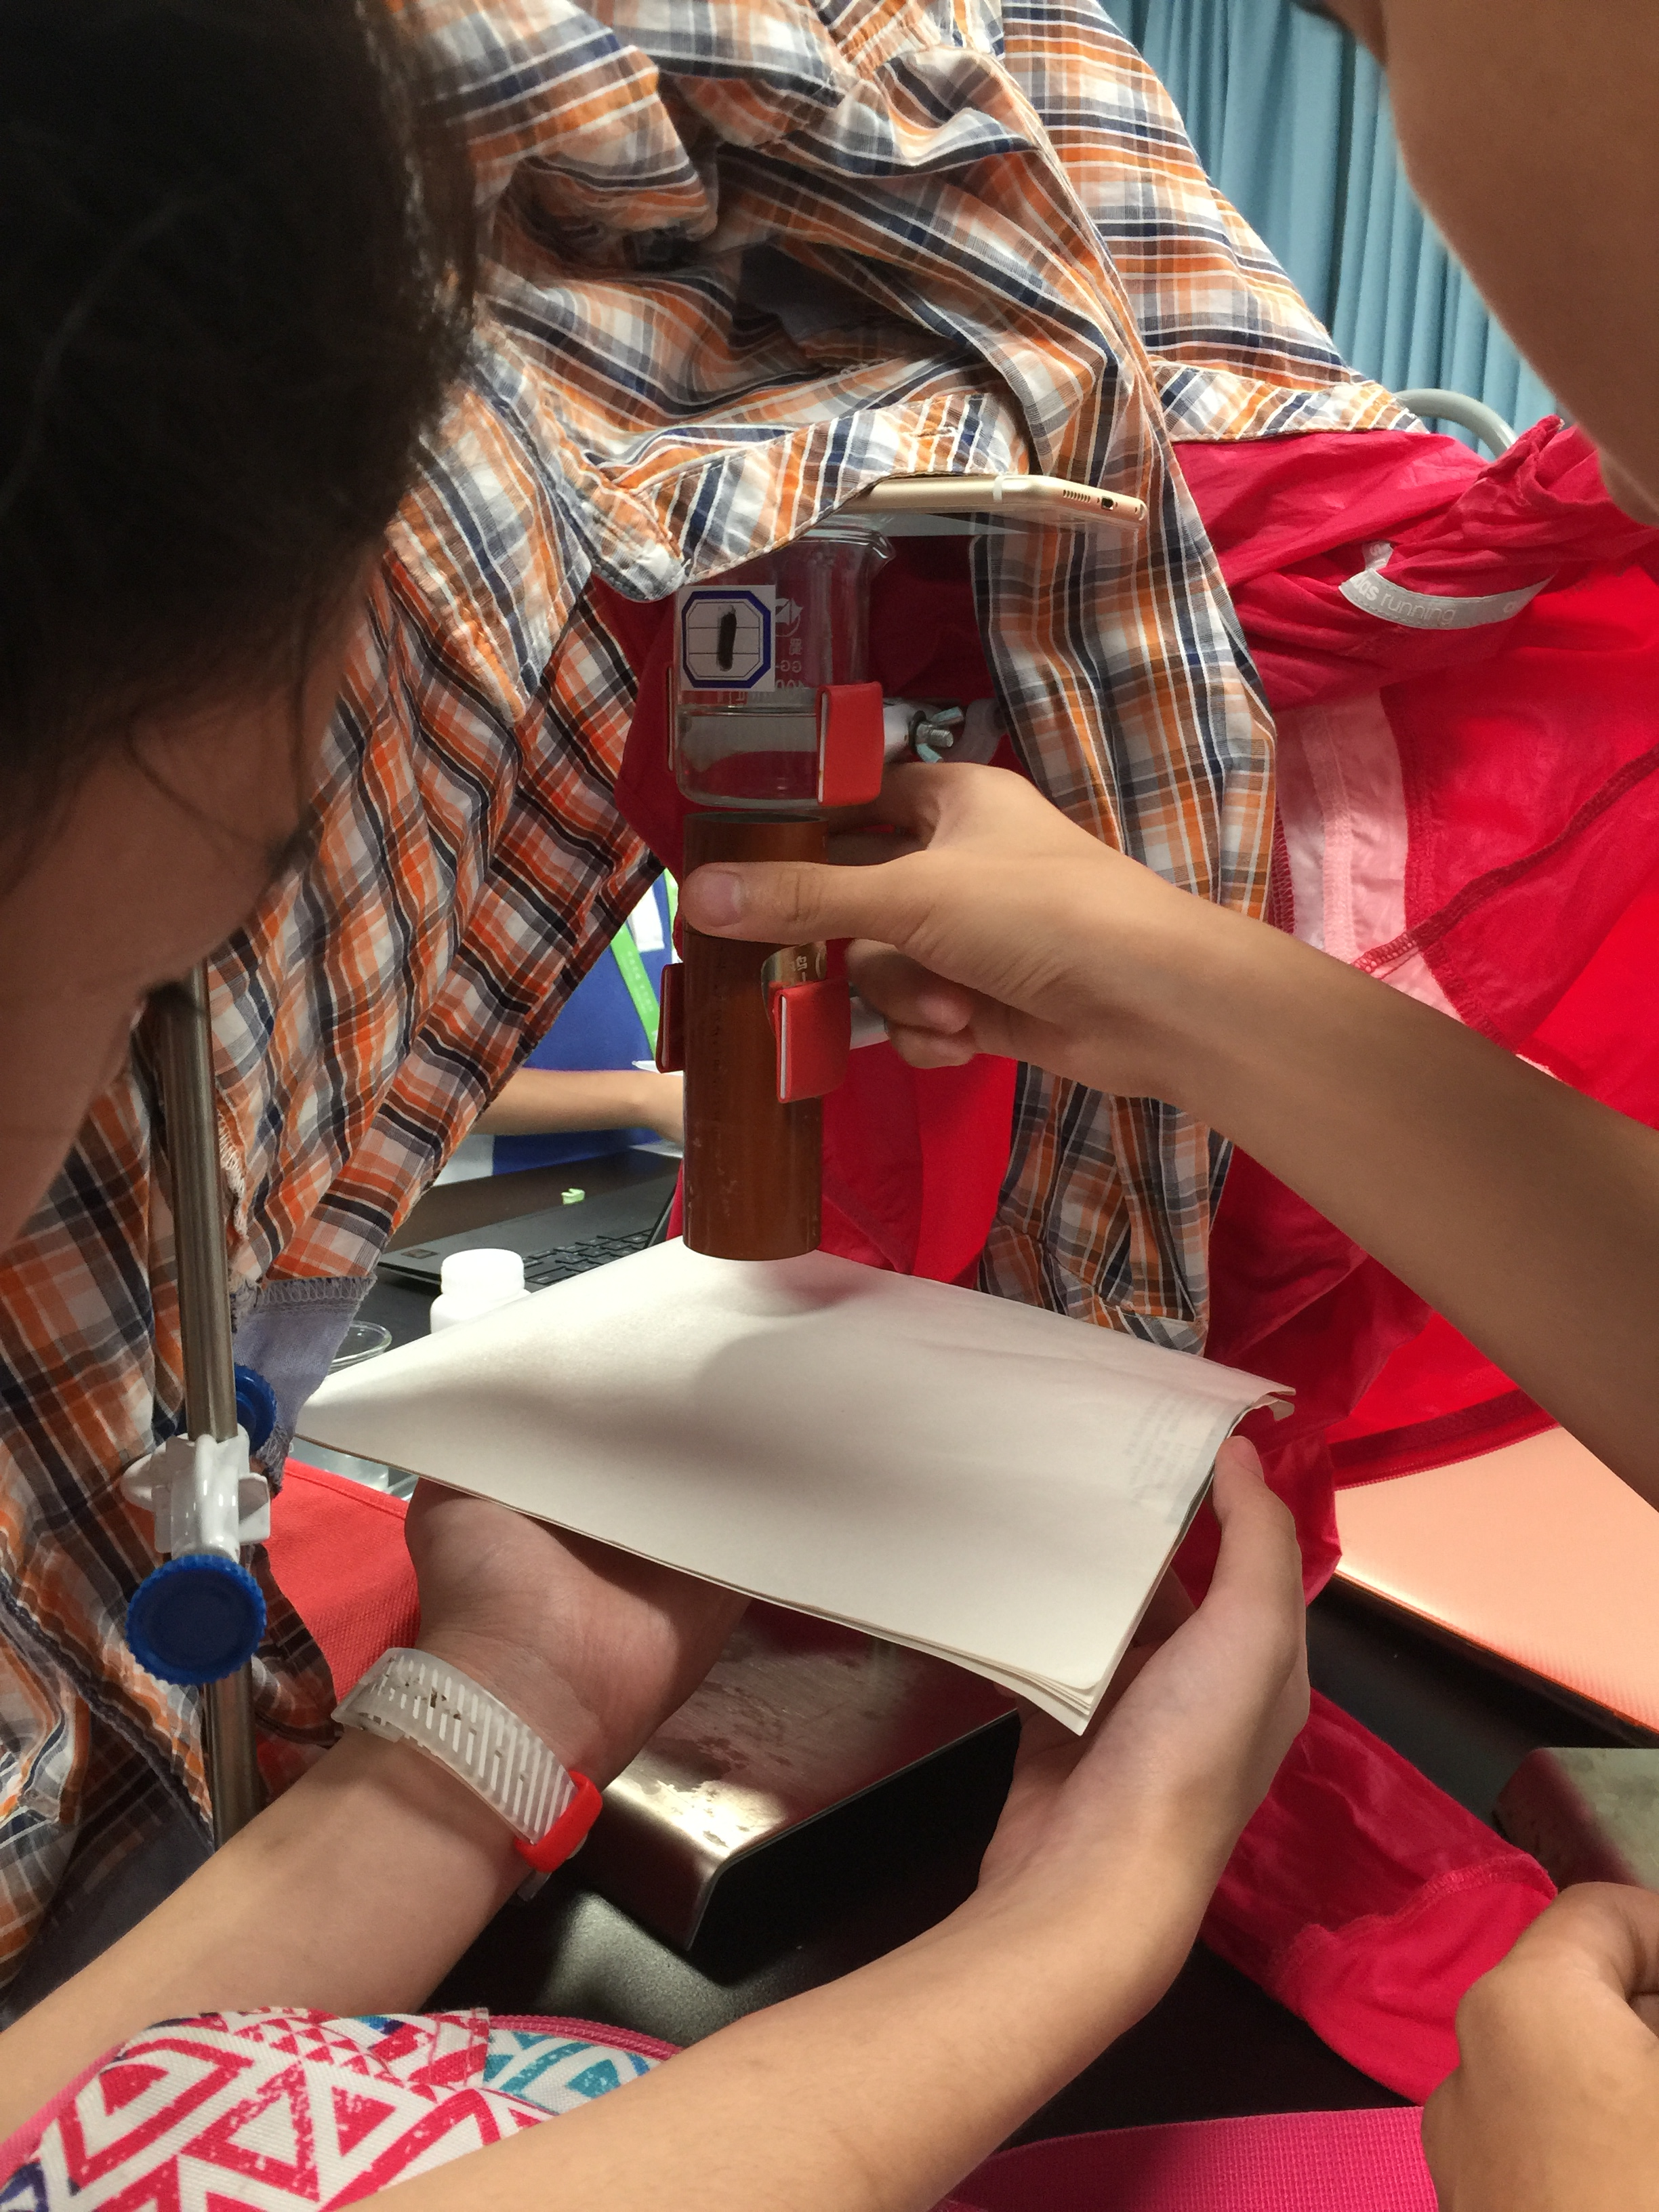
Process of experiment
We use light from the phone screen as polarized light source.
The light goes through the polarizer to a white sheet of paper.
We rotate the polarizer.
We record the change of the light on the paper.
(If it is darkened when we rotate clockwise or brightened when we rotate clockwise)

Slide 6
Experiment results
Beaker No. | Direction of rotation when the light gets darker
1 | Clockwise
2 | Anti-clockwise
3 | Anti-clockwise
4 | Clockwise
5 | Clockwise

Slide 7
Analysis of the results
Because we do not have a polarimeter (a machine that can get quantitative optical activity), we can only determine our solutions by qualitative results.
Luckily, we only have to determine the solution of fructose. And the optical activity of fructose is -92. Which means its rotation direction is different from any other solutions we have got.

Slide 8
Conclusion
Solutions in beakers No. 2 and No.3 are different from other solutions.
We assume that these beakers contain solution of fructose.

Slide 9
Things to improve
1. Main problem:
No quantitative index
2. Judges of the change of the darkness were made subjectively.

