Slide 1
ANALYTICAL INVESTIGATION OF IYNT 2017
AI XINYUE
CLASS 13 GRADE 7
SHENZHEN MIDDLE SCHOOL

Slide 2
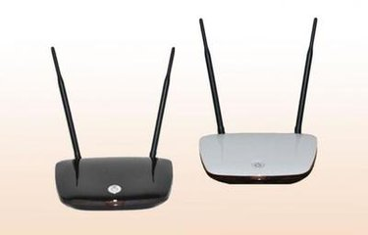
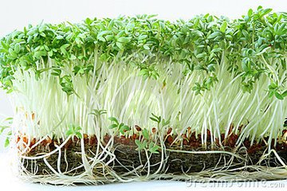
Description of question
How do Wi-Fi Routers affect the germinating and growing process of the garden cress?
In 2013, five young students claimed a sensational discovery that garden cress(Lepidium sativum) will not germinate when placed near two Wi-Fi routers.
We tried to do a partial reproduction of the experiment to see to what end we could reproduce the results.(under controlled conditions)
VS

Slide 3
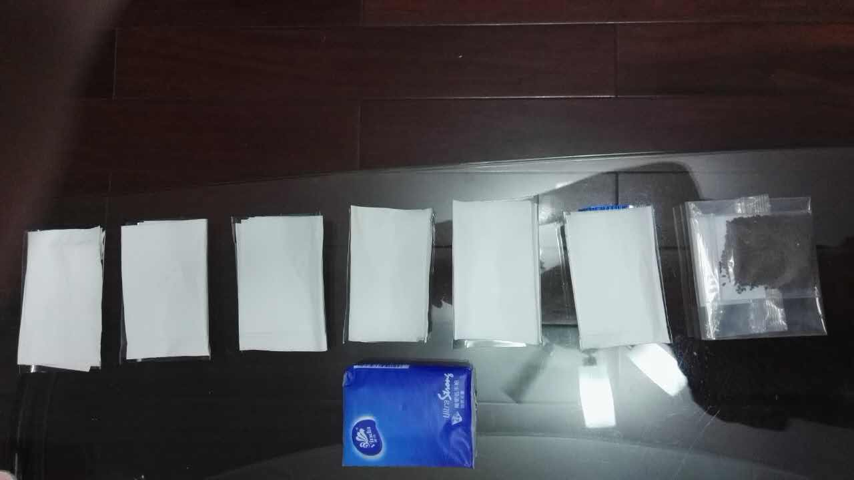
Conditions
Controlled conditions
All seeds were equally placed in comfortable environment --a plastic plate with moist tissues. There were100 seeds in each plate.
The variable to be investigated
We placed three of them near the Wi-Fi routers (5~10cm) and the others away from the routers (more than 5m).

Slide 4
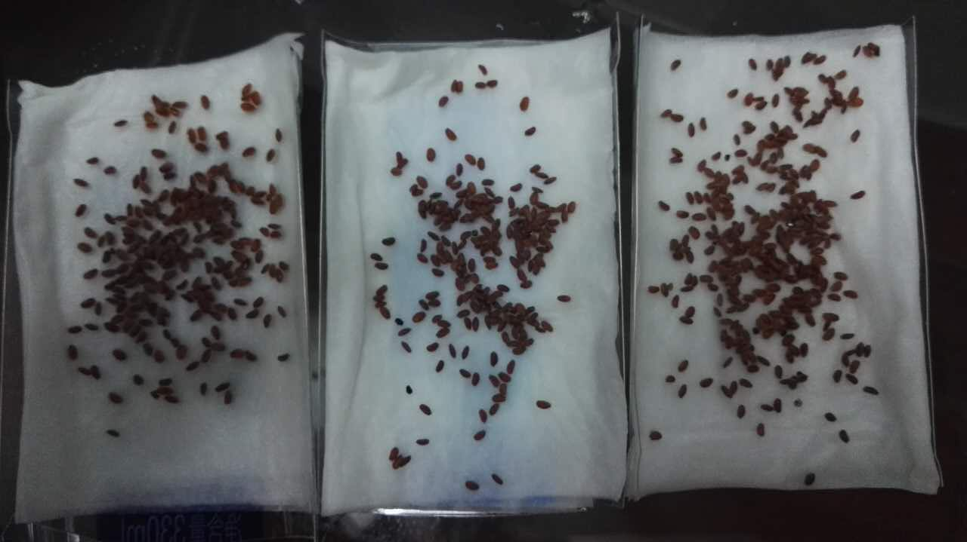
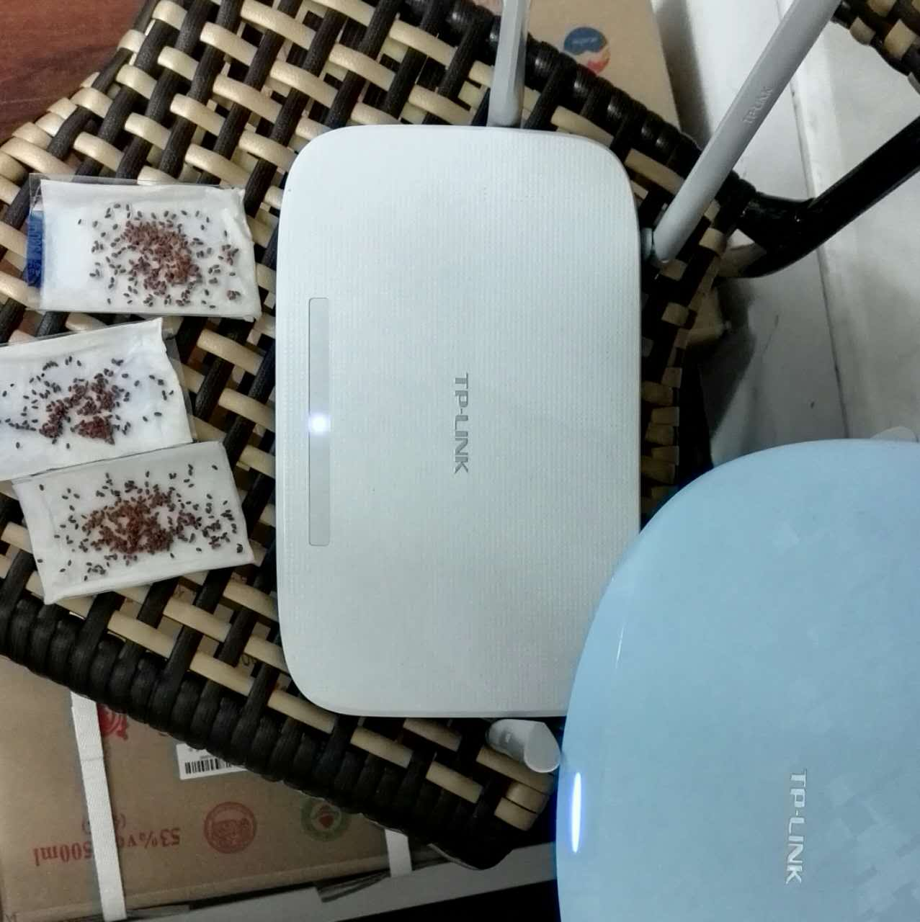
DAY 1
The garden cress of both sides didn’t germinate neither, maybe they wanted to absorb as much moisture as they could.
Away from the routers
Near the routers

Slide 5
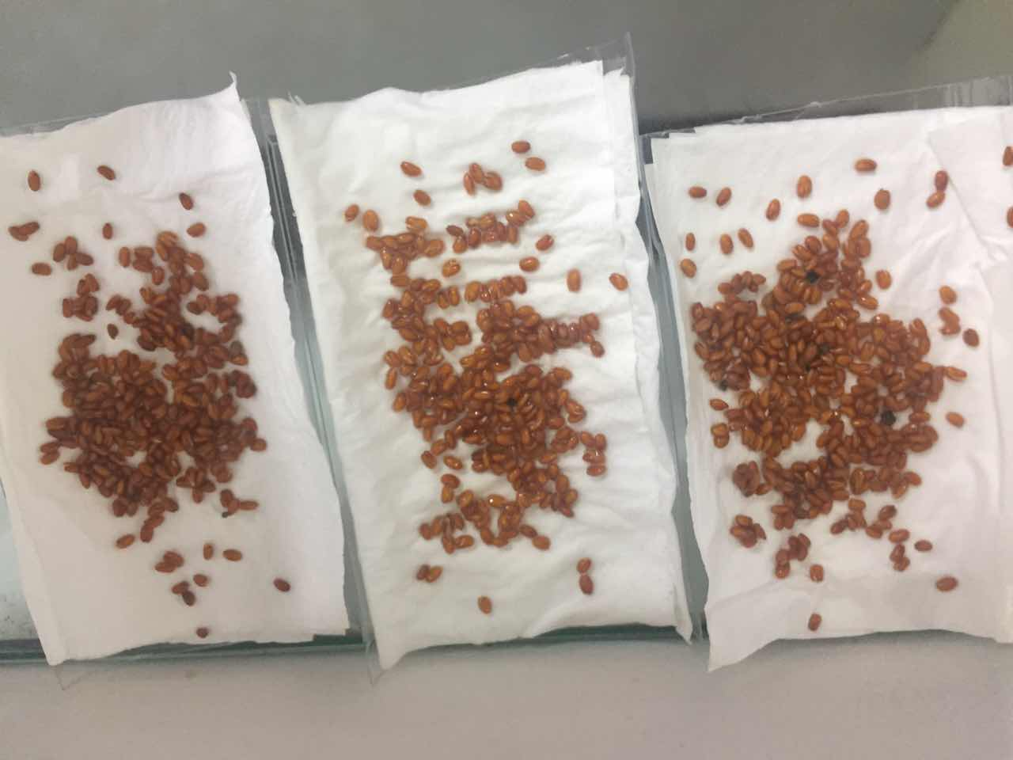
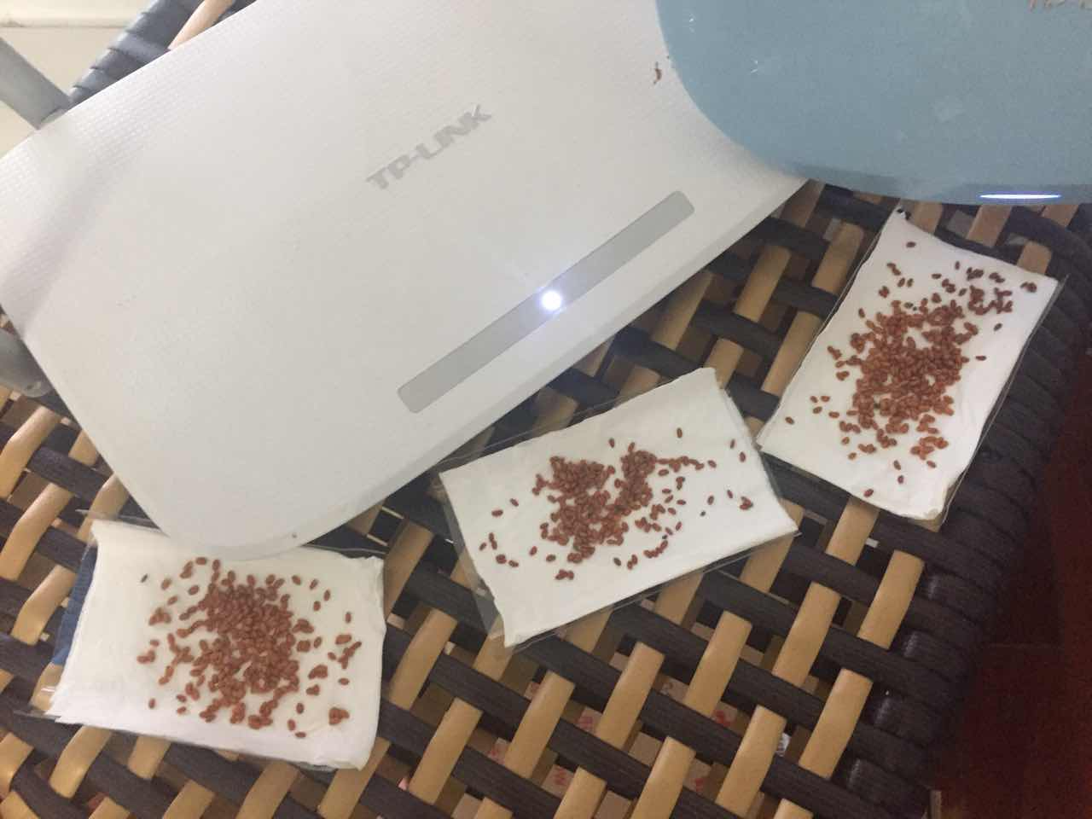
DAY 2
The garden cress of both sides swelled a little more and changed the dark color into a little lighter one.
Away from the routers
Near the routers

Slide 6
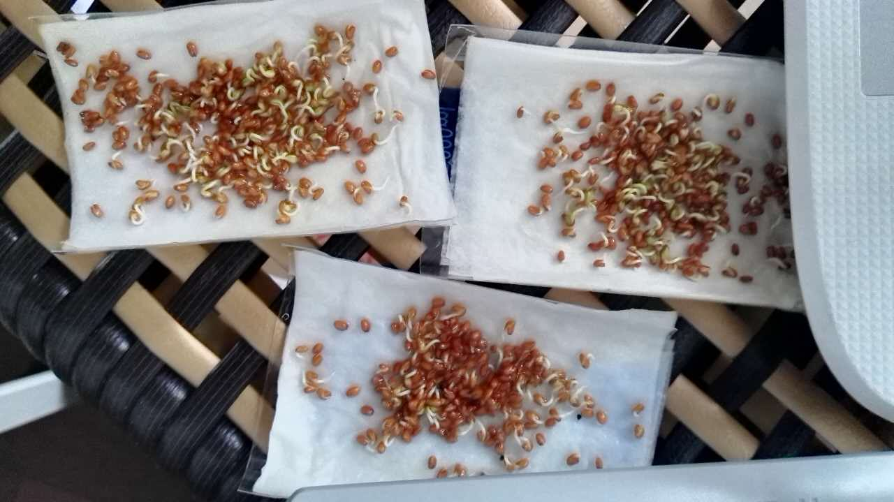
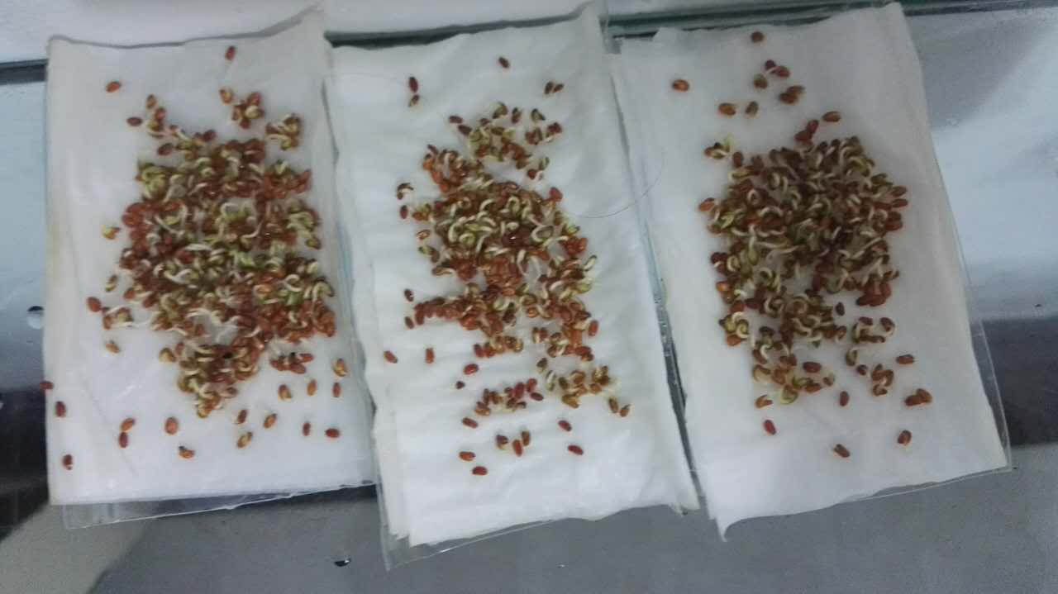
DAY 3
The garden cress sprouted a little and the seeds
the in three plates away from the routers seemed to grew more naturally than the ones near the routers.
Away from the routers
Near the routers

Slide 7
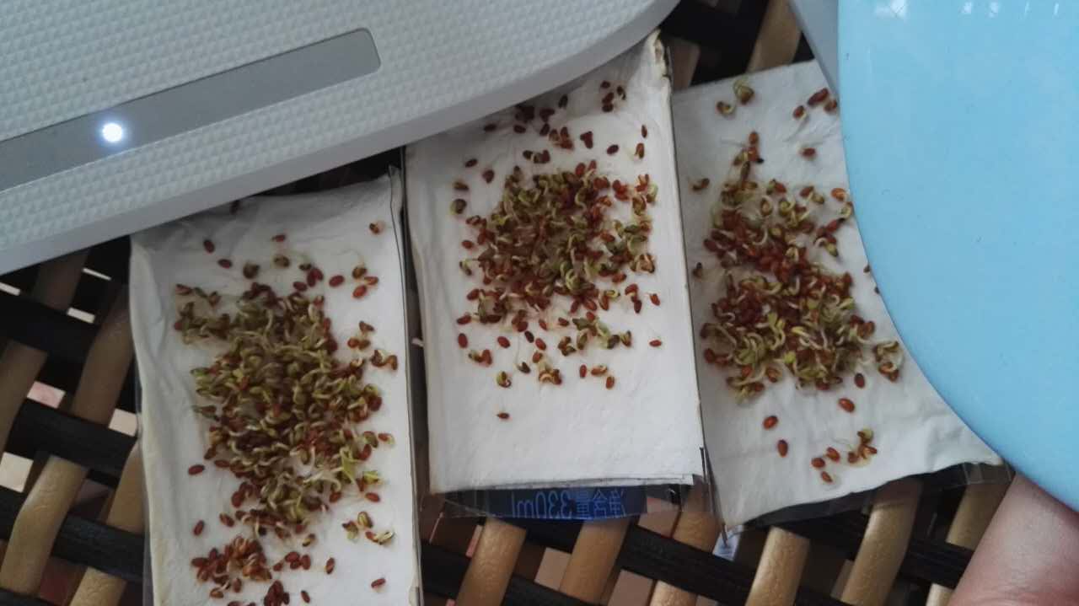
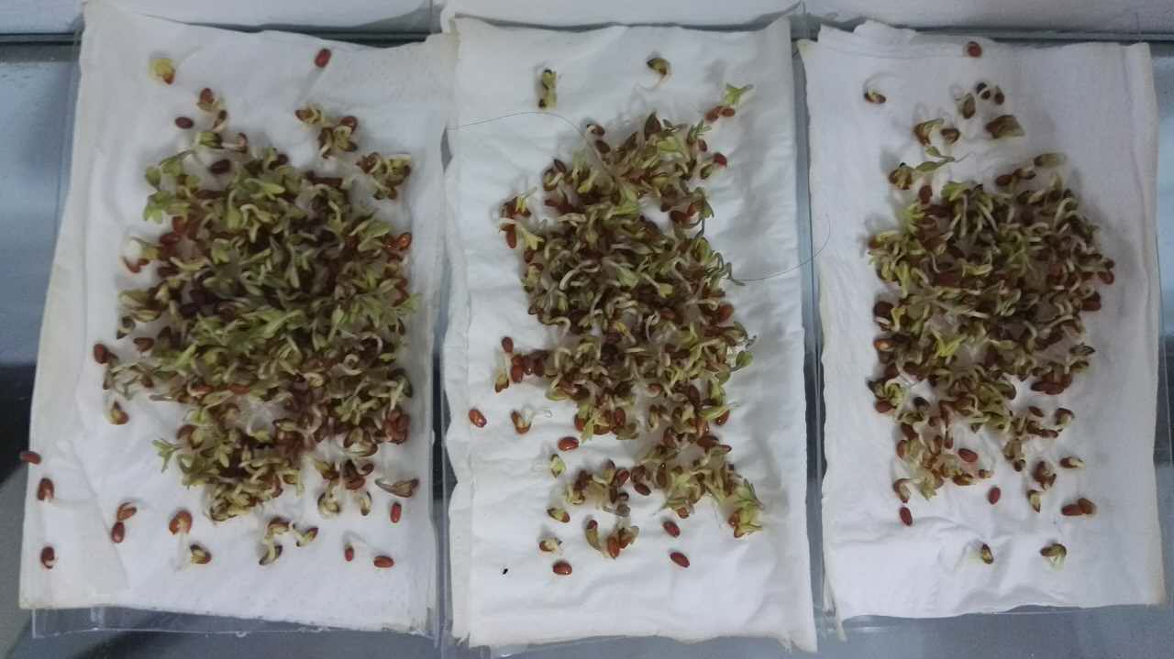
DAY 4
The cress in three plates away from the routers grew much higher and became much stronger than the ones near the routers.
Away from the routers
Near the routers

Slide 8
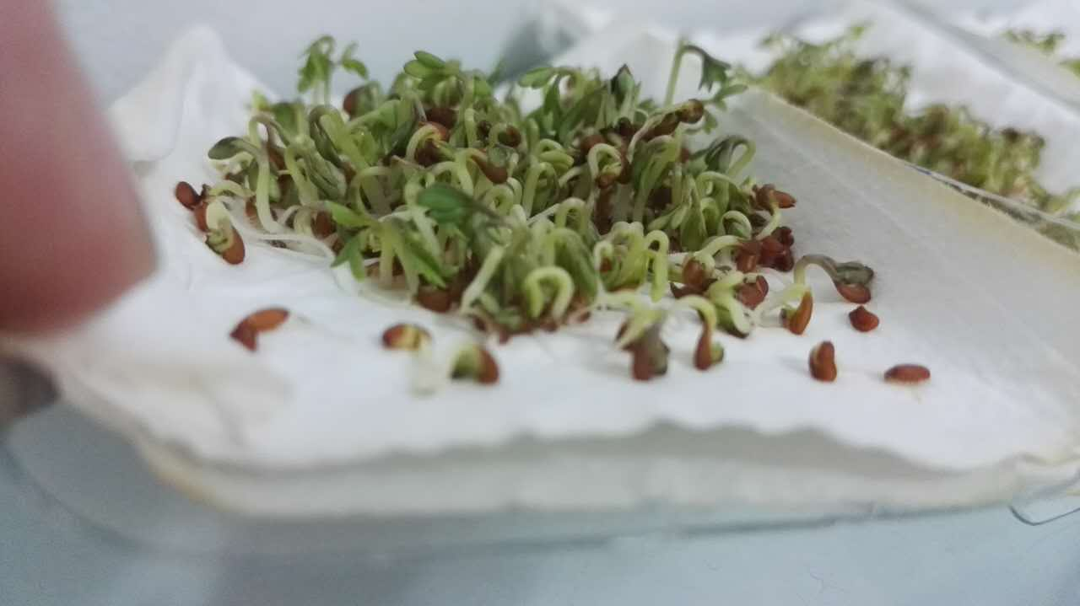
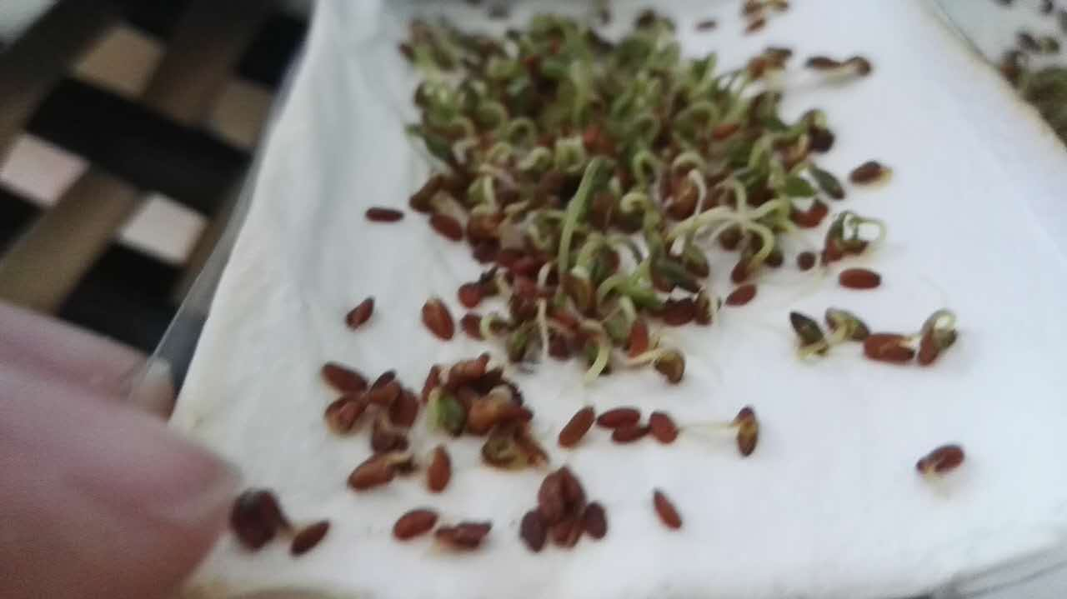
DAY 5
The more nutrition they absorbed, the higher they were. However, although they shared the same amount of sunlight, moisture and temperature– there were still some differences between the two categories.
Away from the routers
Near the routers

Slide 9
Away from the routers
Near the routers

Slide 10
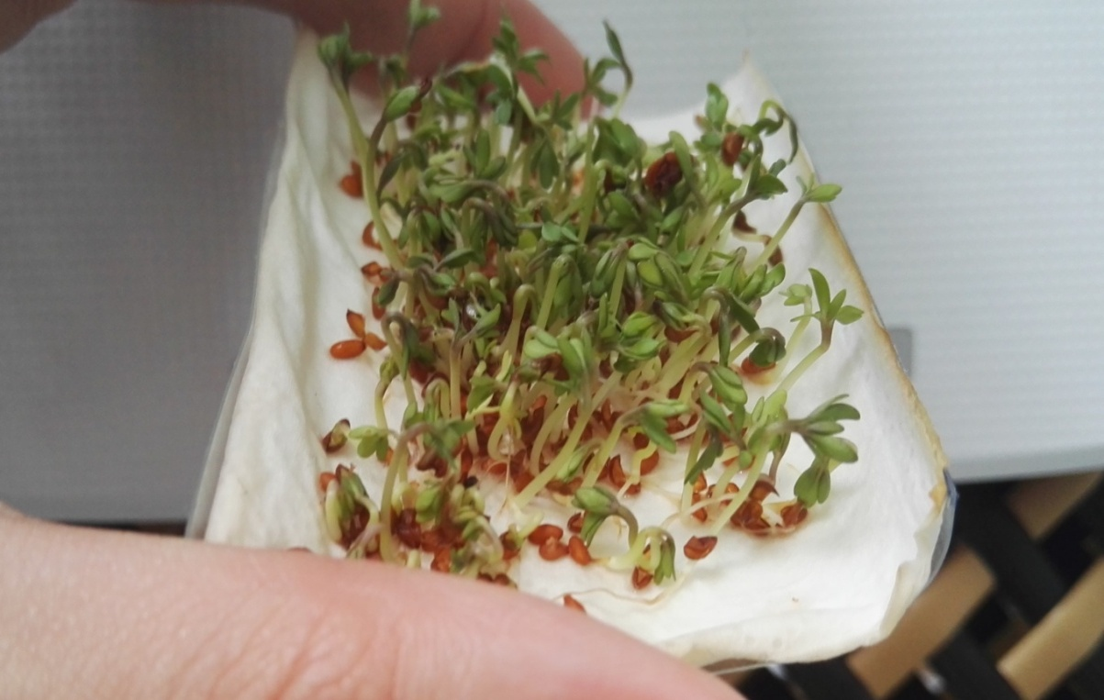
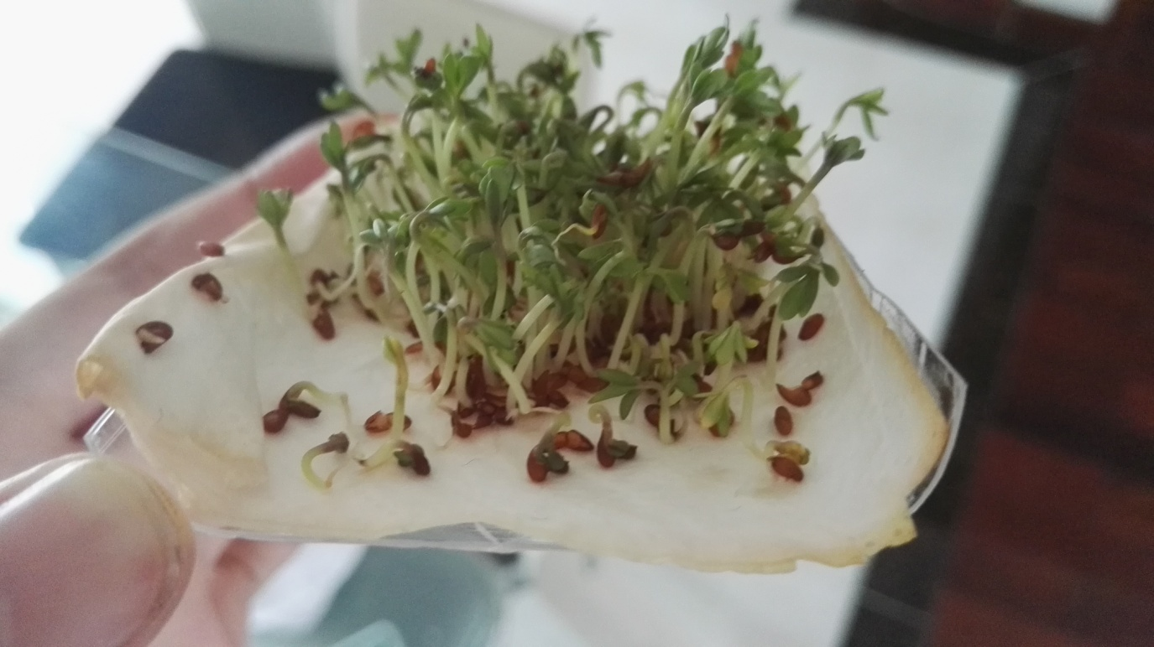
DAY 6
They all grew a lot and the plants in the ‘Away from the routers’ ’s plates are notably higher than those in the plates of ‘ Near the routers’. The following photos may provide more info.
Near the routers
Away from the routers

Slide 11
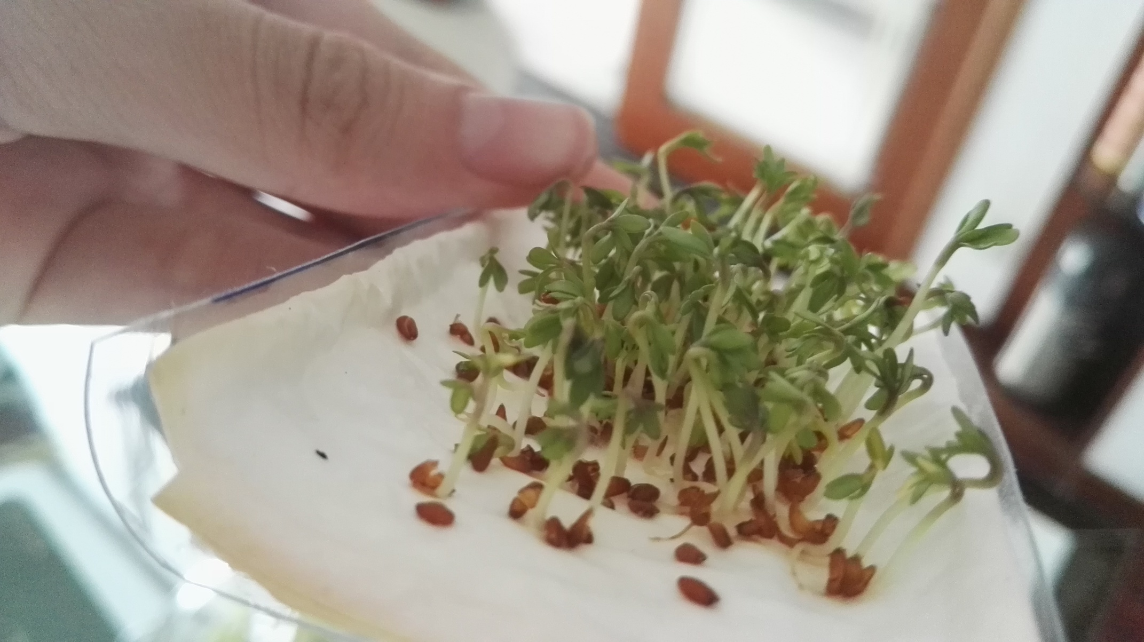

Slide 12
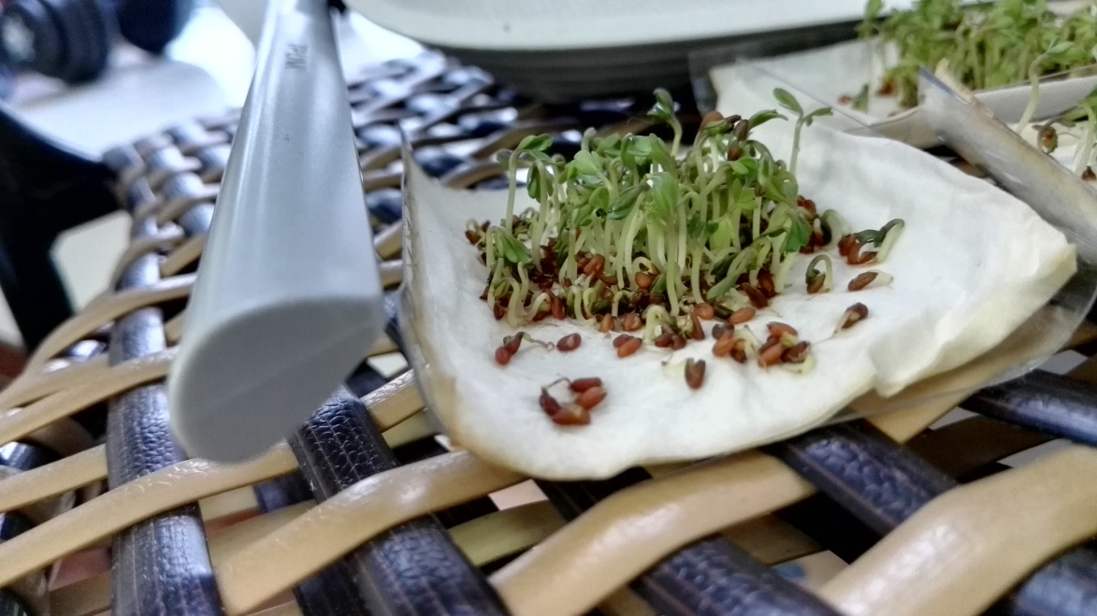
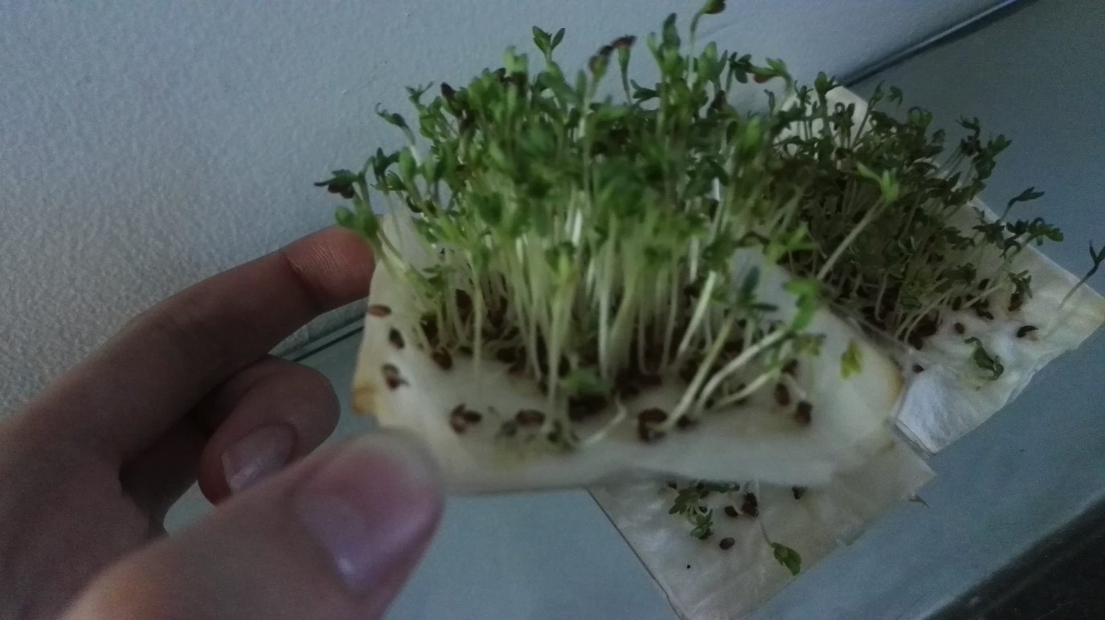
DAY 8
After 2 days, let’s see how the plants grew.
Despite the height of these plants, dramatically, the plants in the ‘Away from the routers’ ’s plates are greener and also ‘healthier’ than the others.
Away from the routers
Near the routers

Slide 13
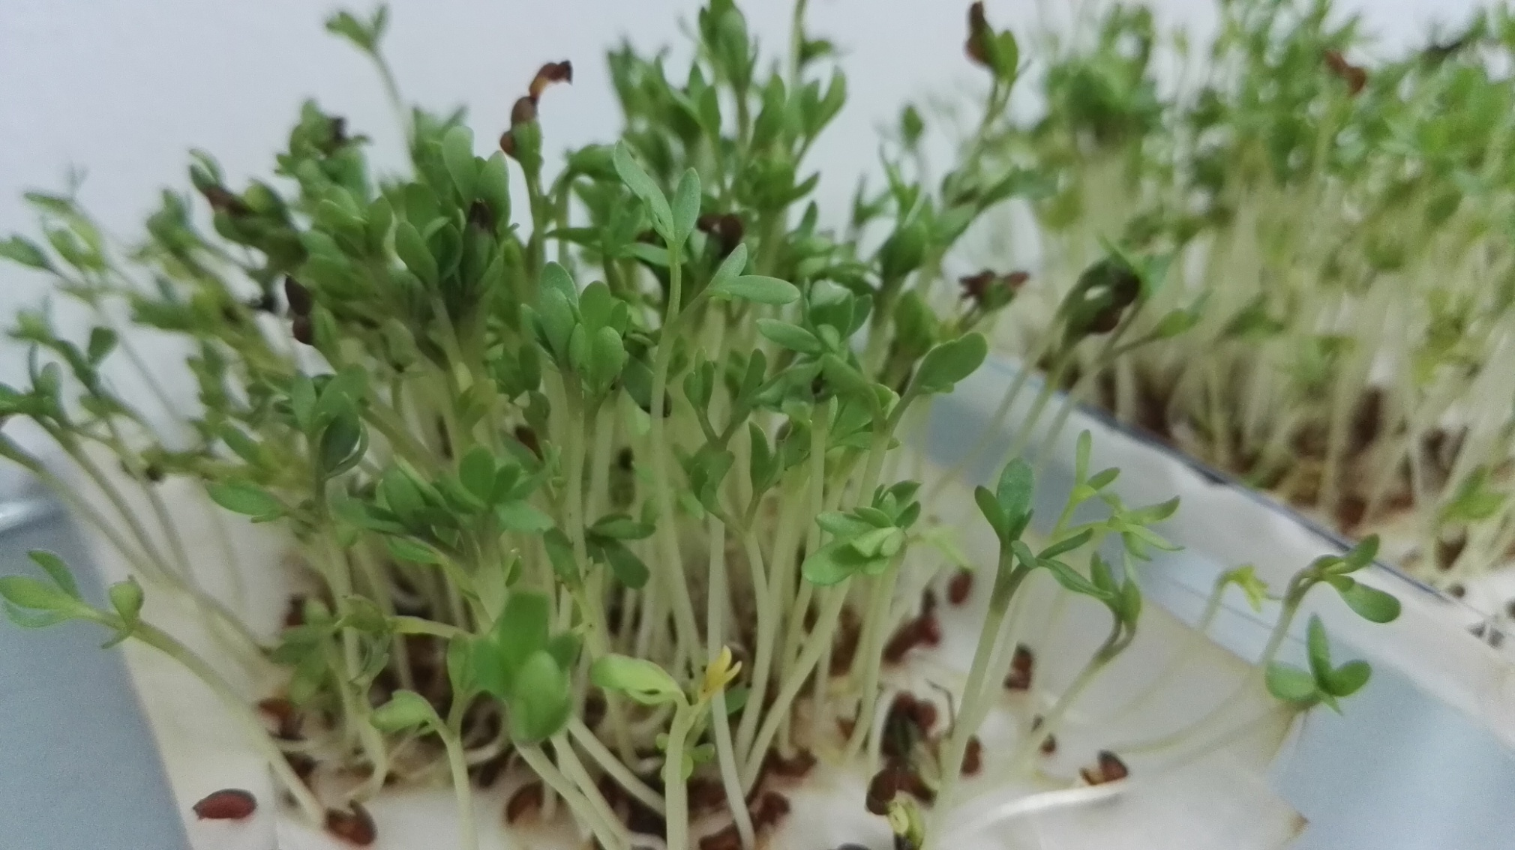
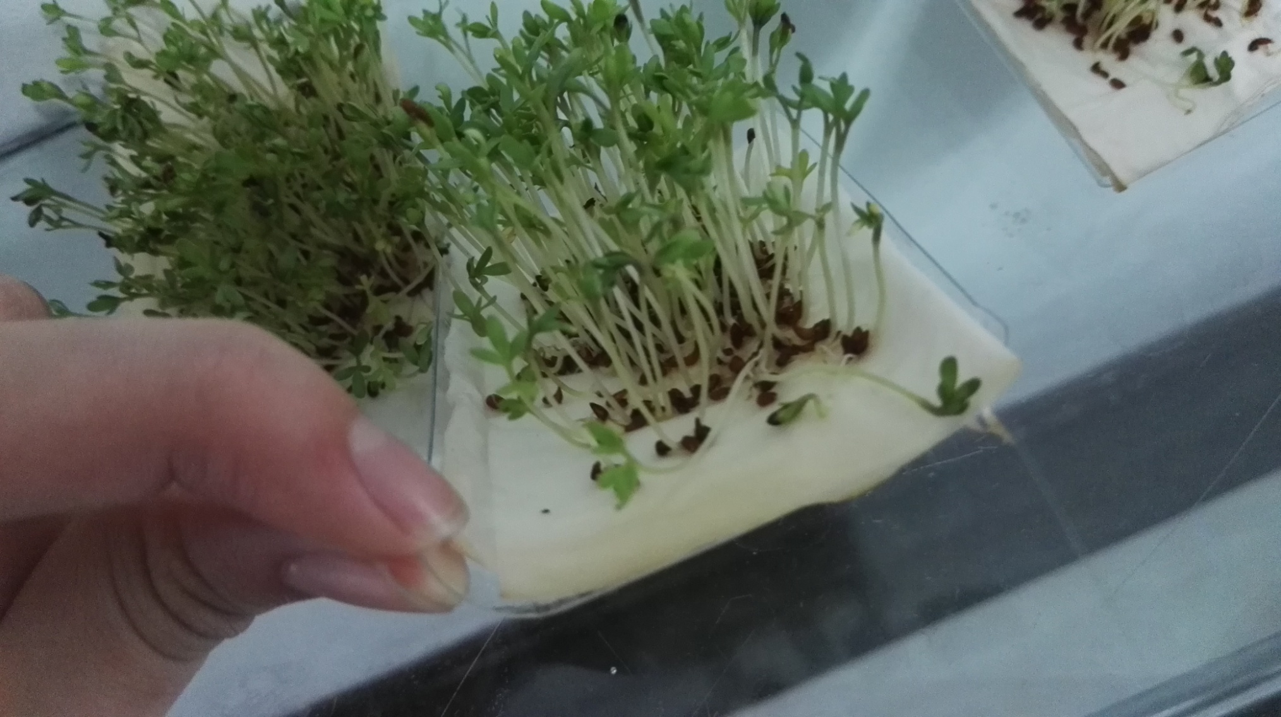
DAY 9 : away from the routers

Slide 14
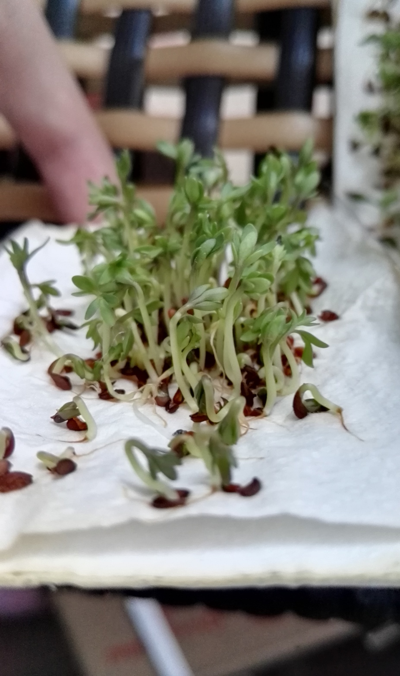
DAY 9 : NEAR THE ROUTERS

Slide 15
DAY 10
Unfortunately, our plants died because of they’ve grown so tall and the gravity increased, they just couldn’t manage the mass of its stem
However, the day before their death, I found out the seeds near the routers just became brown and weak. But the seeds away from the routers can grow well.

Slide 16
germination rates
Away from the routers:
100 seeds per plate $×$ 3 plates
Total: 300 seeds
Germinated : 268 seeds RATE: 89.33％
Near the routers:
100 seeds per plate $×$ 3 plates
Total :300 seeds
Germinated: 205 seeds RATE 68.33％

Slide 17
External factors
Although we tried our best to control the conditions in diverse ways, there were also some factors were not excluded in this experiment.
①：Wi-Fi routers may produce heat, which may influence the seeds in an enormous effect.
②：Many conditions affect the moisture’s evaporation. Such as the uncontrolled temperature, wind speed, etc.
③：Light may also be one external factor.

Slide 18
conclusion
In conclusion, according to the above experiments and its results along with our investigation, we confirm that Wi-Fi routers affect the growth of garden cress in decreasing its growing speed and inhibiting its germination. However, our experiment dismisses the result of "absolute inhibition in germination" which is claimed by the students in 2013.

Slide 19
THANK YOU…

