Slide 1
Tonic water in UV light
By : Tang Chao
From Shenzhen Middle School

Slide 2
Problem
Tonic water glows brightly when exposed to an ultraviolet black light bulb. It is however easy to quench the glow of tonic water by adding salt.
What other common substances glow under UV light and how can one influence their glow?

Slide 3
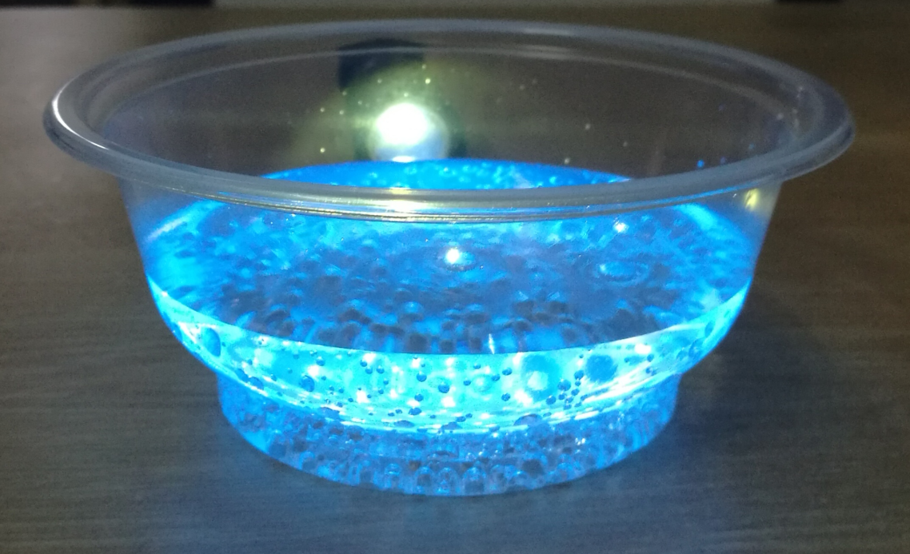
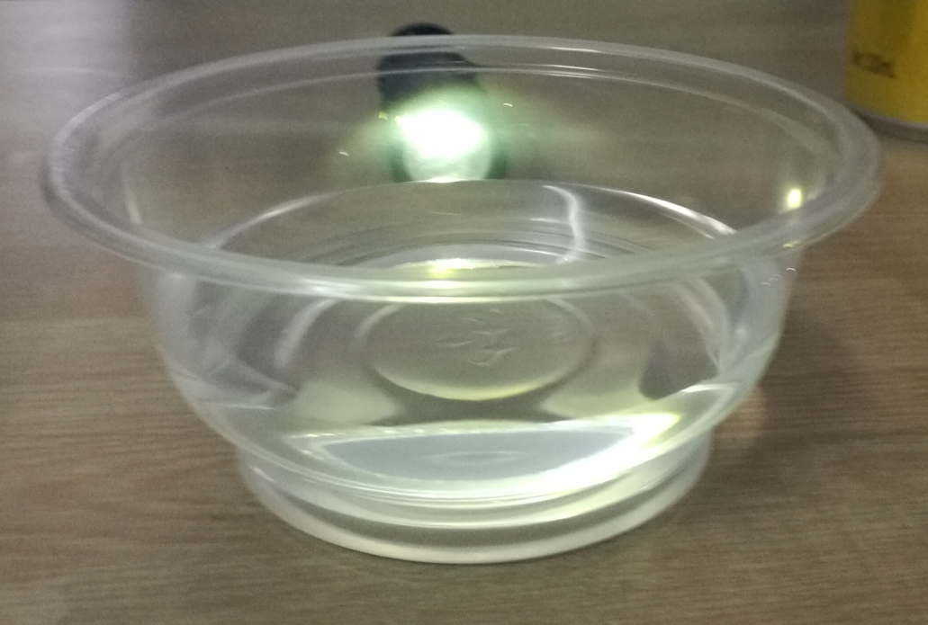
Experiment 1 --Water and Tonic water
Water
Tonic water

Slide 4
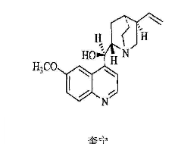
Why do these things happen?
Quinine ‘s molecular results contain large planar conjugated systems （大的平面共轭体系） and have fluorescence luminescence properties（具有荧光发光的性能）.

Slide 5
How can we
quench
the glow of tonic water ?

Slide 6
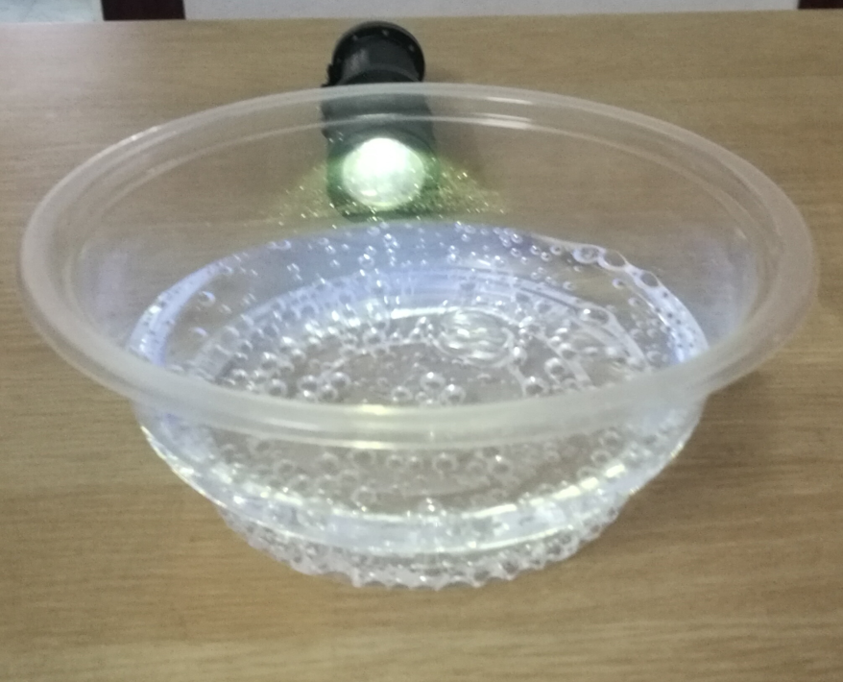
Experiment 2 --Tonic water and Tonic water with salt
Tonic water
Tonic water with salt

Slide 7
We found that it is easy to quench the glow of tonic water by adding salt.
Is there any other way?

Slide 8
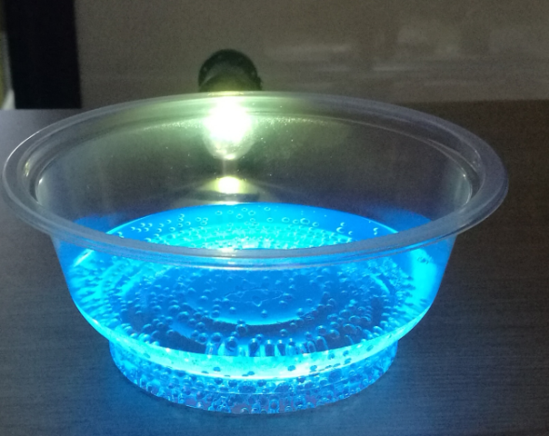
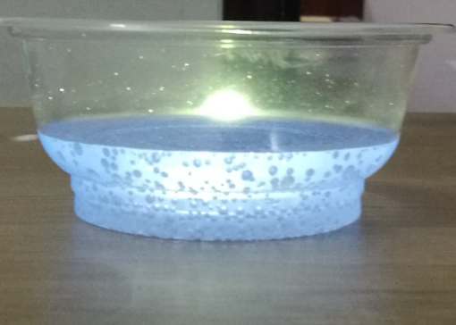
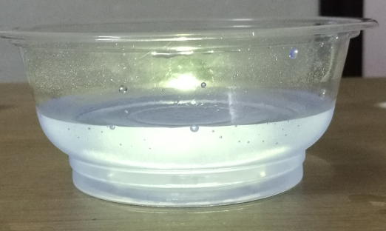
Experiment 3 -- Tonic water and Tonic water with edible alkali
pH=4
pH=6
pH=9

Slide 9
So we can quench the glow of tonic water by make the pH value increase , too.

Slide 10
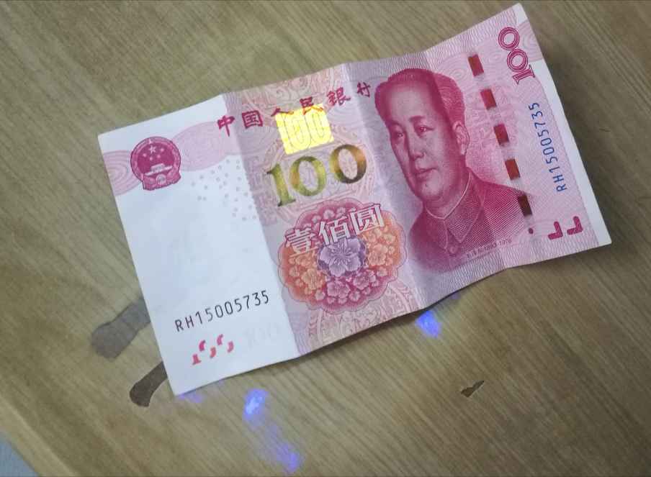
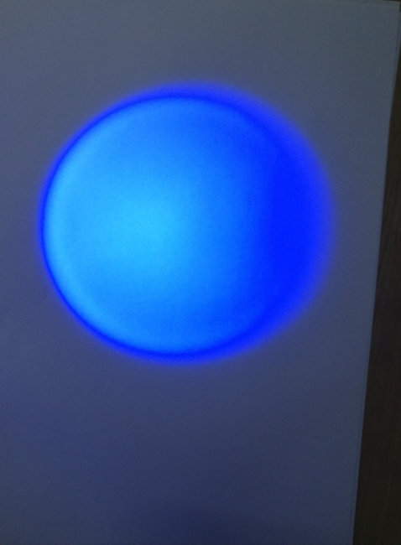
Other things that glows in the UV light
money
paper

Slide 11
Conclusion
Finally, we found that tonic water can glow brightly in the UV light .
And we can easily quench the glow of tonic water by adding salt or make the pH value increase .
Also, we found that money and paper can also glow in the UV light .

Slide 12
Thank you !

