Slide 1
Water from the air
By : Tang Chao
From Shenzhen Middle School

Slide 2
Problem
Design and construct a device allowing collection of water by condensing moisture from air .
Determine if the water obtained with your device is suitable for drinking .
What amount of water is possible to collect during one Science Fight .

Slide 3
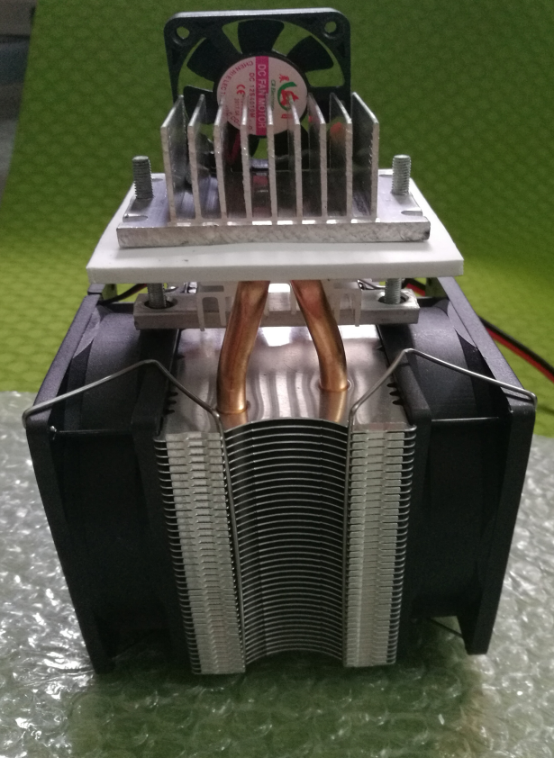
Plan
Condensing moisture from the air
Device
Fan
Cooling fin
Semiconductor refrigeration chip (半导体制冷片）
Cooling fan（散热风扇）
Heat dissipation body（散热主体）

Slide 4
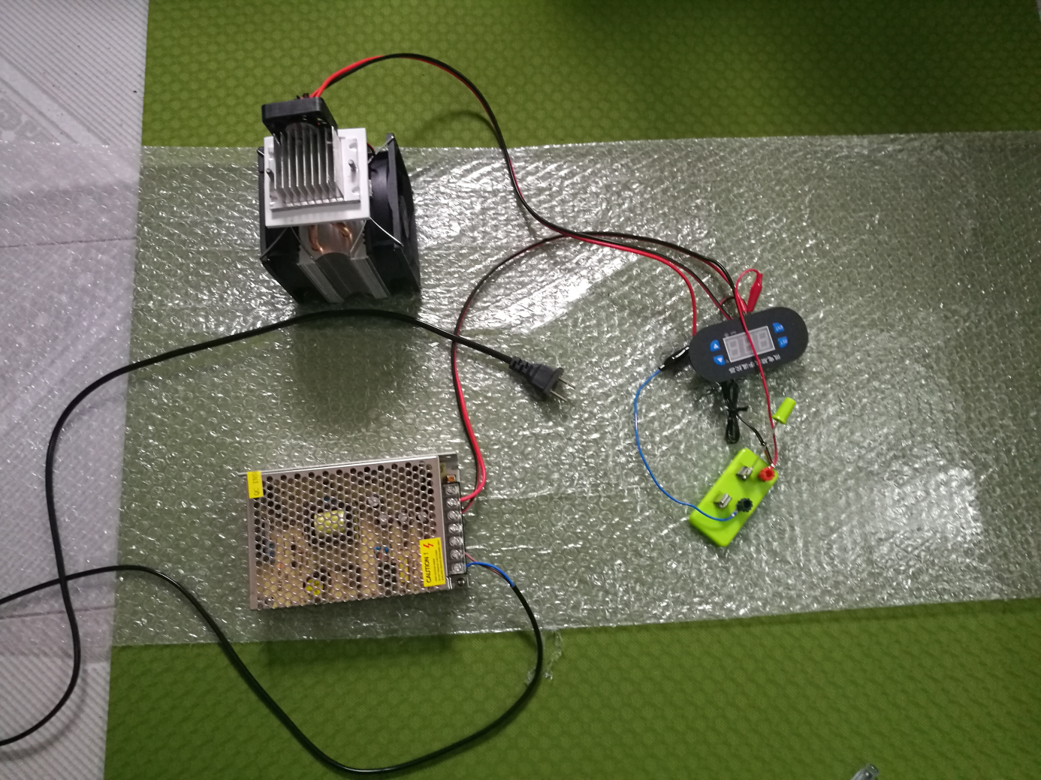
Thermostat（温控器）
Switch（开关）
power supply（ transformer ）（电源/变压器）

Slide 5
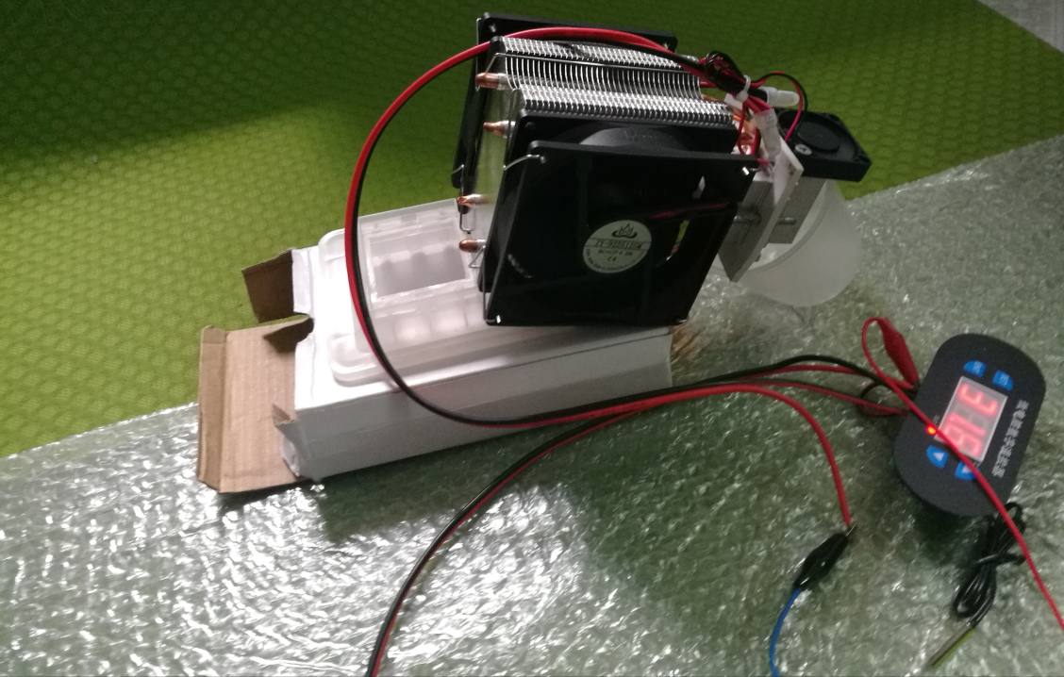
Principle
1.First , use the Semiconductor refrigeration chip to make the air cool and the water vapor from the air will become water and stay on the cooling fin.
2.Second , put a cup under the cooling fin and let the water drop into the cup

Slide 6
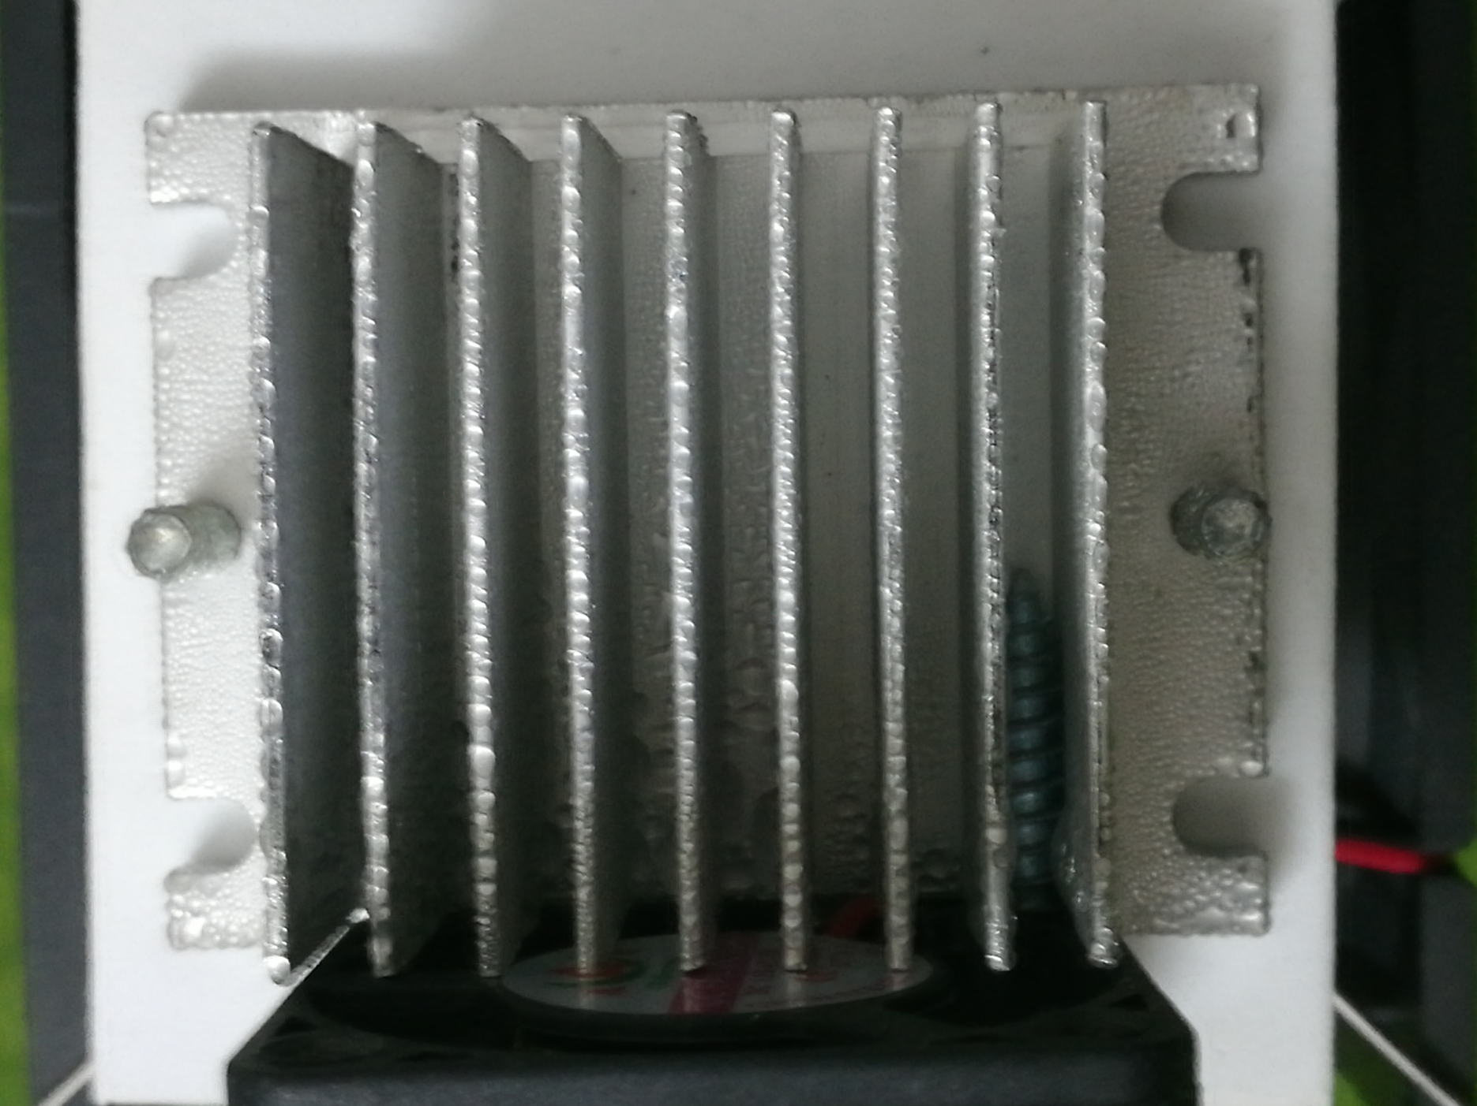

Slide 7
Measuring
1.Turn on the device and wait for 60 minutes
2.Use the test tube to measure the volume of the water we collect
Here is my data:
In 60 minutes , we collect about 20 mL of water and use 0.06 kw·h of electricity.
That is , we need 2 days and 2 hours to collect 1 L of water and use about 2.88 kw·h of electricity.

Slide 8
The quality of the water
I test the quality of the water and the pH of the water is 7.
This is in line with national drinking water hygiene standards.
national drinking water hygiene standards :
the pH of the water: 6.5 ~ 8.5

Slide 10
Conclusion
Finally, we designed a device that can collects water from the air .
We measured that the device can collect about 20 mL of water per hour .
And we tested that the pH of the water we collect is in line with the national drinking water hygiene standards .

Slide 11
Thank you!

