Slide 1
Problem 24: Mysterious amylase
Team Switzerland

Slide 2
Problem
24 Mysterious amylase
An enzyme called amylase catalyzes the hydrolysis of starch into sugars. Select a chemical test for starch, find convenient sources of amylase and starch, and investigate how much time of exposure to amylase is needed for the starch test to not be observed.

Slide 3
Interpretation
Use saliva (source of amylase) to get rid of the starch in bread. Measure this with an iodine test (indicator).

Slide 4
Hydrolysis
The chemical breakdown of a compound due to reaction with water.

Slide 5
Starch
Complex carbohydrate
Polymer
Many simple sugar chemically bonded

Slide 6
Amylase
Enzyme (biological catalyst)
Catalyses hydrolysis
Break down starch into sugars (complex)

Slide 7
Sources of starch & Amylase
Starch
Amylase
Bread
Saliva

Slide 8
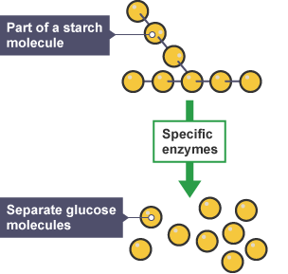
Basic Theory
Starch
Polymer
Carbohydrate
White, commercial bread is 46.7% starch
Amylase
Starch → Sugars (trisaccharides & disaccharides)
α Amylase
Saliva
95.5% Water
Small amounts of salivary amylase (α Amylase)
Formed by the salivary glands
Amylase
Complex sugars

Slide 9
Iodine test for starch
Triiodine anion I₃⁻ complexes with the starch, creating a dark blue color
When starch levels decrease, it turns a red-orange

Slide 10
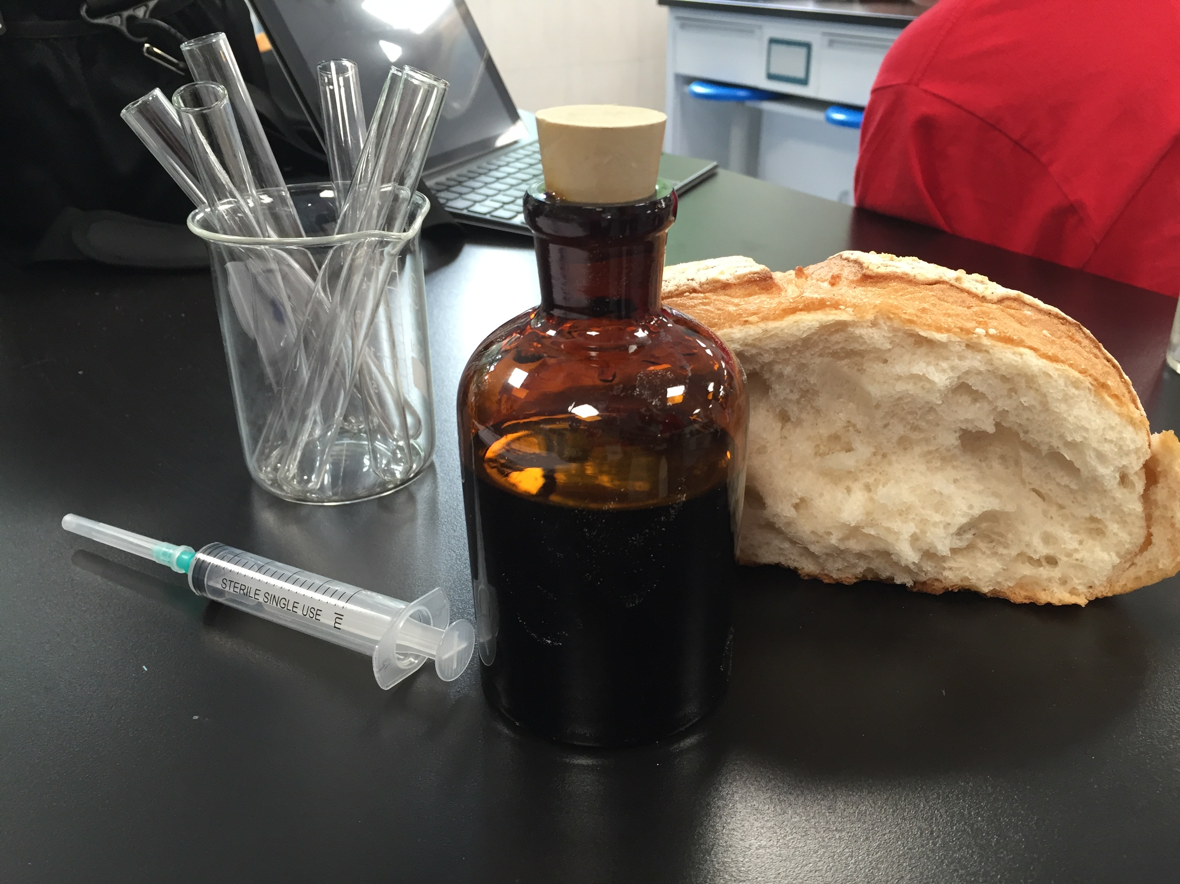
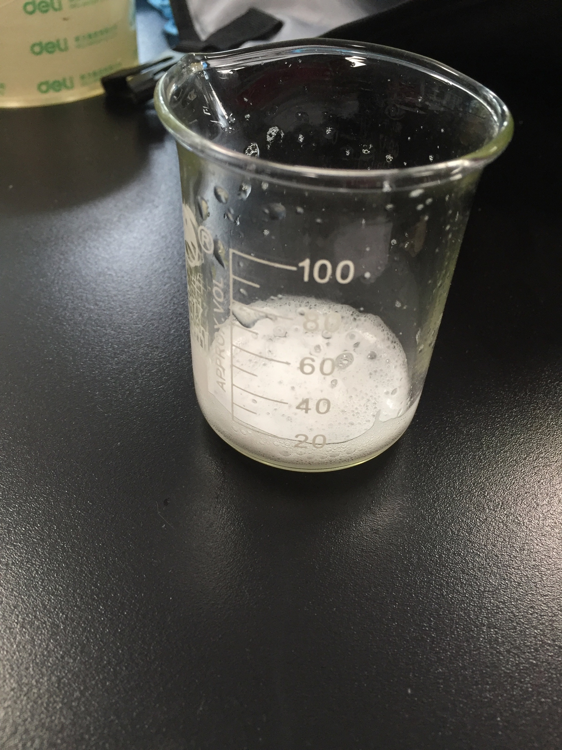
Material and Setup
Bread (46.7% starch)
Saliva
Test tubes
Scale
Iodine
Syringe
Timer

Slide 11
Experiments
First put 0.5g of bread in the test tube
Then put 0.25ml of iodine in the tube
The iodine turned black
Put in the saliva + start timer
Wait until the iodine brightened

Slide 12
Results
12% Brightness
20 Min
29% Brightness
20 Min

Slide 13
Colors
20 Min

Slide 14
Analysis
Idea:
The salivary amylase will turn starch into sugar
The iodine’s color lightened, supporting the previous statement
The amylase worked very slowly
Blue black → Red black

Slide 15
Conclusion
Amylase
Salivary amylase
Starch
Bread
Sugars
Amylase’s effect on starch
Starch → Sugars
Iodine test
Iodine Colors
Salivary amylase worked slowly, starch still observed
Blue black → Red black
Matches iodine colors

Slide 16
Sources
http://www.kickas.org/ubbthreads/ubbthreads.php?ubb=showflat&Number=143543
http://antoine.frostburg.edu/chem/senese/101/redox/faq/starch-as-redox-indicator.shtml

Slide 17
Thank You for listening

