Slide 1
Problem 10: Rijke’s Tube
Team Switzerland
Reporter: Michael Klein

Slide 2
The Problem
Rijke’s tube
If air inside a vertical cylindrical tube open at both ends is heated, the tube produces sound. Study this effect.
Build a Rijke’s tube Find out why it makes a sound
and what relevant parameters affect it.

Slide 3
What is a Rijke’s Tube?
Bunsen burner heats up mesh
Bunsen burner is removed
Sound is produced

Slide 4
Theory: Standing Waves on Strings
antinode
Different Modes
y
node
x
x = location y = displacement n = mode L = length of the string

Slide 5
Theory: Standing Waves in Tubes
The standing wave causes a continual tone:
Fundamental Harmonic Tone
First Harmonic
Second Harmonic
Notes:
Highest pressure difference at antinodes

Slide 6
Theory: Rijke’s Tube

Slide 7
Theory: Rijke’s Tube

Slide 8
Theory: Rijke’s Tube

Slide 9
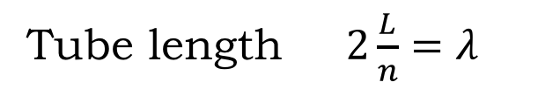
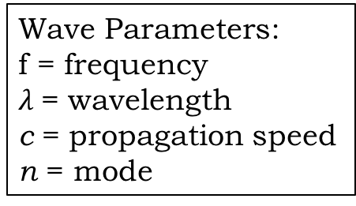
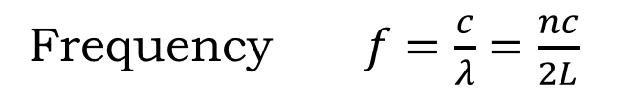
Theory: Frequency
Tube length $2\frac{L}{n}=λ$
Wave Parameters:
f = frequency
$λ$= wavelength
c = propagation speed
n = mode
Tube Parameters:
L = length of the tube
d = diameter of tube
Frequency $f=\frac{c}{λ}=\frac{nc}{2L}$
Correction due to wave reflection outside of the tube $f=\frac{nv}{2L + 0.8d}$
The theory suggests that the frequency (pitch of sound) is
inversely proportional to the length of the tube.

Slide 10
Experiments: Parameters
Tube
Orientation
Length
Diameter
Material
Gauze
Temperature
Position
Material investigated
Notes:
These are the relevant parameters that I thought of, I investigated the bold ones

Slide 11
Set Up
3 tubes made of steel
Clamps
Stand
Bunsen burner
Lighter
Aluminum gauze

Slide 12
Experiments

Slide 13
Tube Orientation
According to the theory, the tube only works when upright.

Slide 14

Experiments: Tube Length
Model for frequency:
$f=\frac{nv}{2L+0.8d}$
Investigated lengths:
0.83m
1.16m
1.46m
Decreasing frequency

Slide 15
Fundamental harmonic
212 Hz
1st harmonic
424 Hz

Slide 16
Fundamental harmonic
152 Hz
1st harmonic
304 Hz
2nd harmonic
456 Hz

Slide 17
Fundamental harmonic
124 Hz
1st harmonic
248 Hz
2nd harmonic
372 Hz
3rd harmonic
496 Hz

Slide 18
Experiments vs. Theory
Experiments
Theory
Notes:
Frequency as function of tube length

Slide 19
Temperature of gauze
Heating gauze vs. cooling gauze

Slide 20
Heating
Cooling

Slide 21
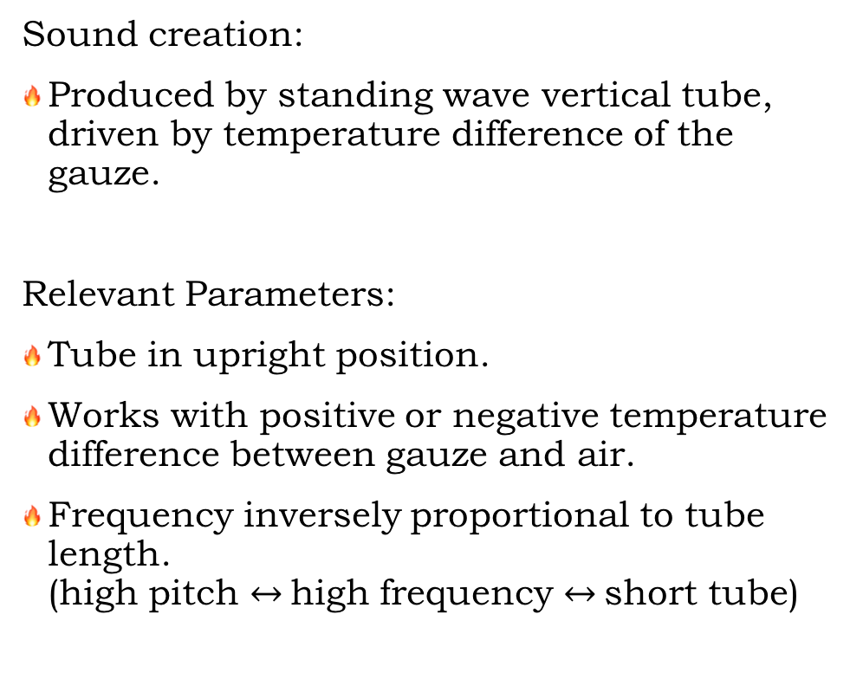
Conclusion
Sound creation:
Produced by standing wave vertical tube, driven by temperature difference of the gauze.
Relevant Parameters:
Tube in upright position.
Works with positive or negative temperature difference between gauze and air.
Frequency inversely proportional to tube length.
(high pitch $↔$high frequency $↔$short tube)
Hot or cold gauze

Slide 22
Thank you for listening

Slide 23
Sources
http://www.physicsclassroom.com/class/waves/Lesson-4/Formation-of-Standing-Waves
http://hyperphysics.phy-astr.gsu.edu/hbase/Waves/standw.html
https://www.youtube.com/watch?v=BhQUW9s-R8M
http://www.sciencedirect.com/science/article/pii/S1877705814028963
http://ilyam.org/proc2006/11_Singing_tube_Australia_Kathryn_Zealand_98-115_Proc_19th_IYPT_2006.pdf

Slide 24
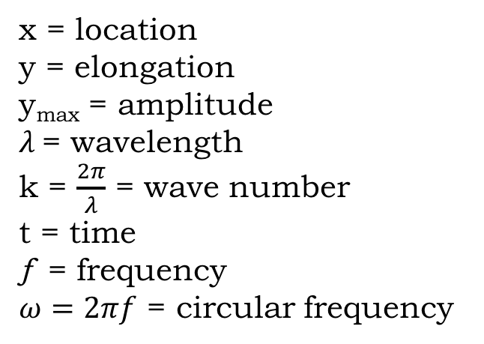
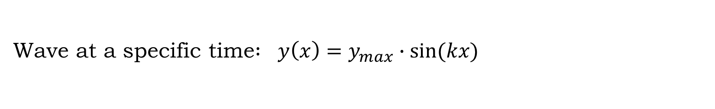
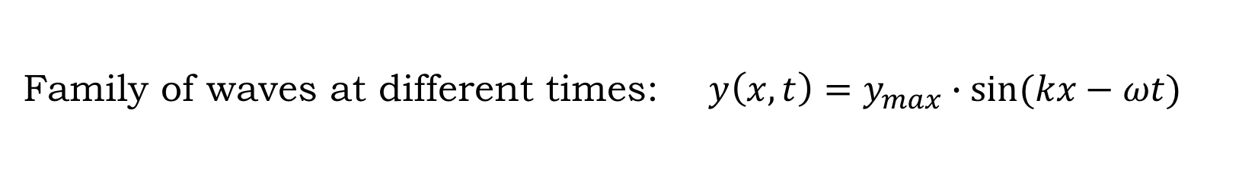
Sine Wave or Harmonic Wave
x = location
y = elongation
y_{max} = amplitude
$λ$= wavelength
k = $\frac{2π}{λ}$ = wave number
t = time
ƒ = frequency
$ω=2πf$ = circular frequency
Wave at a specific time$:$ $y\left(x\right)=y_{max}∙sin⁡(kx)$
Family of waves at different times: $y\left(x,t\right)=y_{max}∙sin⁡(kx−ωt)$
Notes:
Horizontal shift in omega t

Slide 26
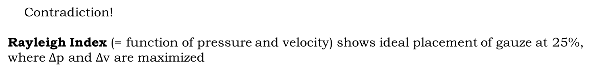
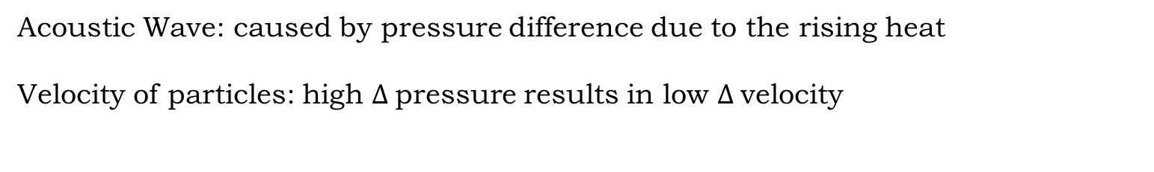


Gauze Position explained with Rayleigh index
Acoustic Wave: caused by pressure difference due to the rising heat
Velocity of particles: high $∆$pressure results in low $∆$velocity
$∆$v
Highest impact on pressure change
$$∆p$$
Most cool air heated
Contradiction!
Rayleigh Index (= function of pressure and velocity) shows ideal placement of gauze at 25%, where $∆$p and $∆$v are maximized
Notes:
Alternative position at 75% not good: the gauze would increase the pressure of the cold air after the pressure maximum in the centre of the tube

Slide 28
FFT

