Slide 1
IYNT 2017
Water from the Air
Samuel Züllig

Slide 2
The Task
Water from the Air:
“Design and construct a device allowing collection of water by condensing moisture from air. Determine if the water obtained with your device is suitable for drinking. What amount of water is possible to collect during one Science Fight?”
My Interpretation
  I need to build a device that dehumidifies air, find out if the water obtained is drinkable and find out, how much water I can collect in 30 minutes
2

Slide 3
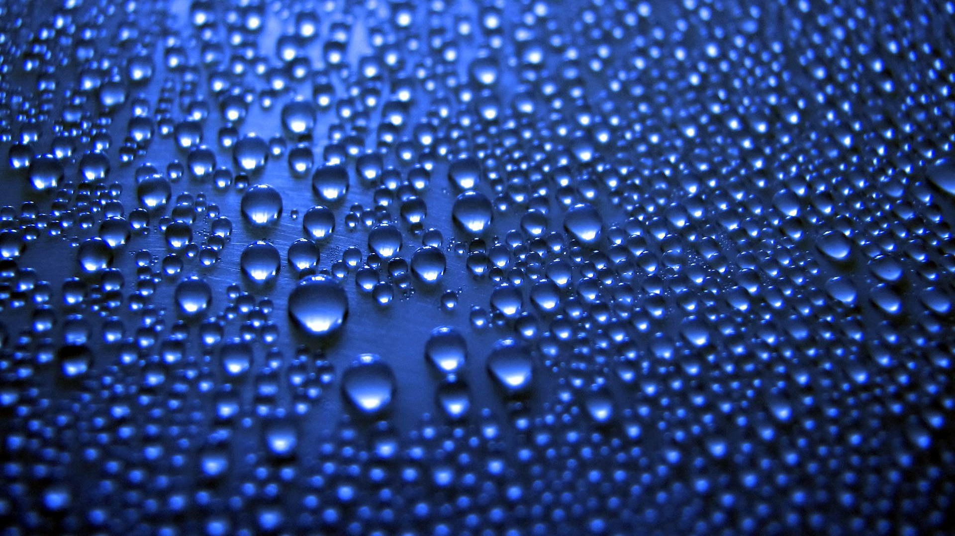
Phenomenon of Condensation
Condensation is the change of the physical state of matter from gas into liquid
Condensation occurs when the vapor is sufficiently cooled
27 June 2017
IYNT 2017 – Samuel Züllig
3
Notes:
State, that sublimation was used instead of condensation
(but the small difference doesnt really change anything)

Slide 4
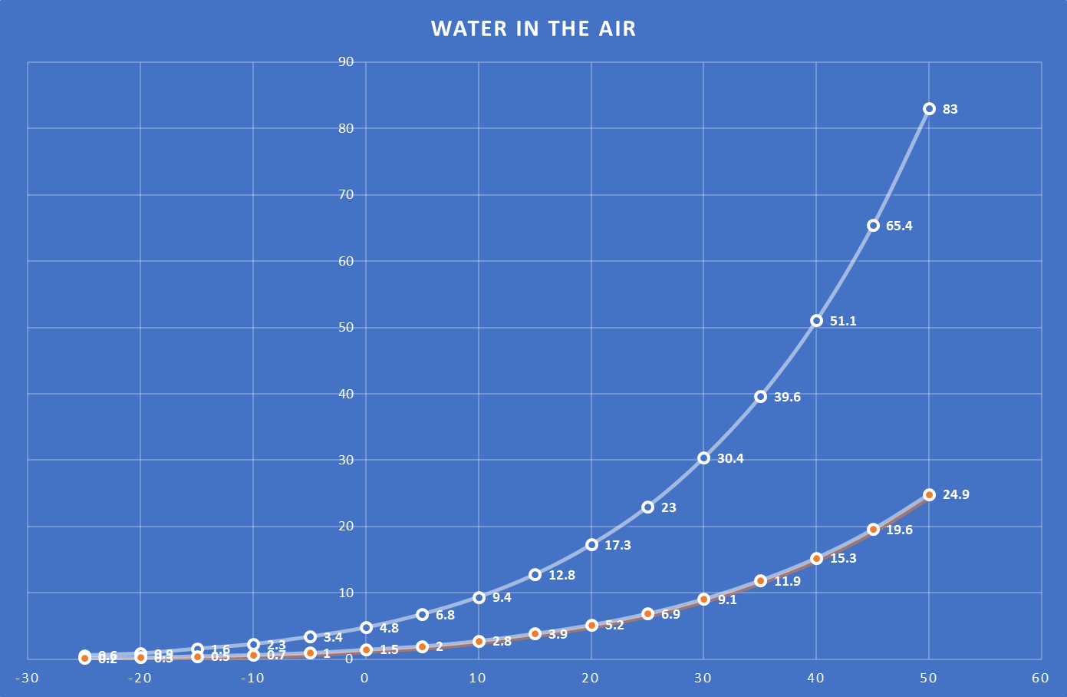
Theory behind the Device
Explanation
Air can hold more vapor at higher temperatures
The more the humidity, the more water you can gather of the air.
By reducing the air temperature, one can «force» the air to «give away» its vapor as condensed water
Grams of Water/m3 Air
100% Humidity
30% Humidity
Device Condition
Air temperature in °C
27 June 2017
IYNT 2017 – Samuel Züllig
4
Notes:
Ok so on the X-Axys we have Air Temperatur and on the Y-Axys we have the grams of water per cubic meter of air (Humidity). The white curve shows the absolute humidity at a certain temperature. The absolute humidity basically means that any water added in to this cubic meter of air will end up as rain. The orange curve shows the realtive humidity. So if we have 30% umidity like we have here, basically means that the air consists of 30% water. So as this graph shows, the lower the air teperature is, the less water it can hold. The situation that we had is 20° with 30% humidity. Basically what we did is, we cooled the air to -30°. So our 30% Hûmidity which is 5.2g is much more than 100% saturation at -30. So we could obtain that water, because 100% Saturation at -30°`=0.6 per cubic meter fo air. So we technically should obtain 4.6 g of water – more on that later.

Slide 5
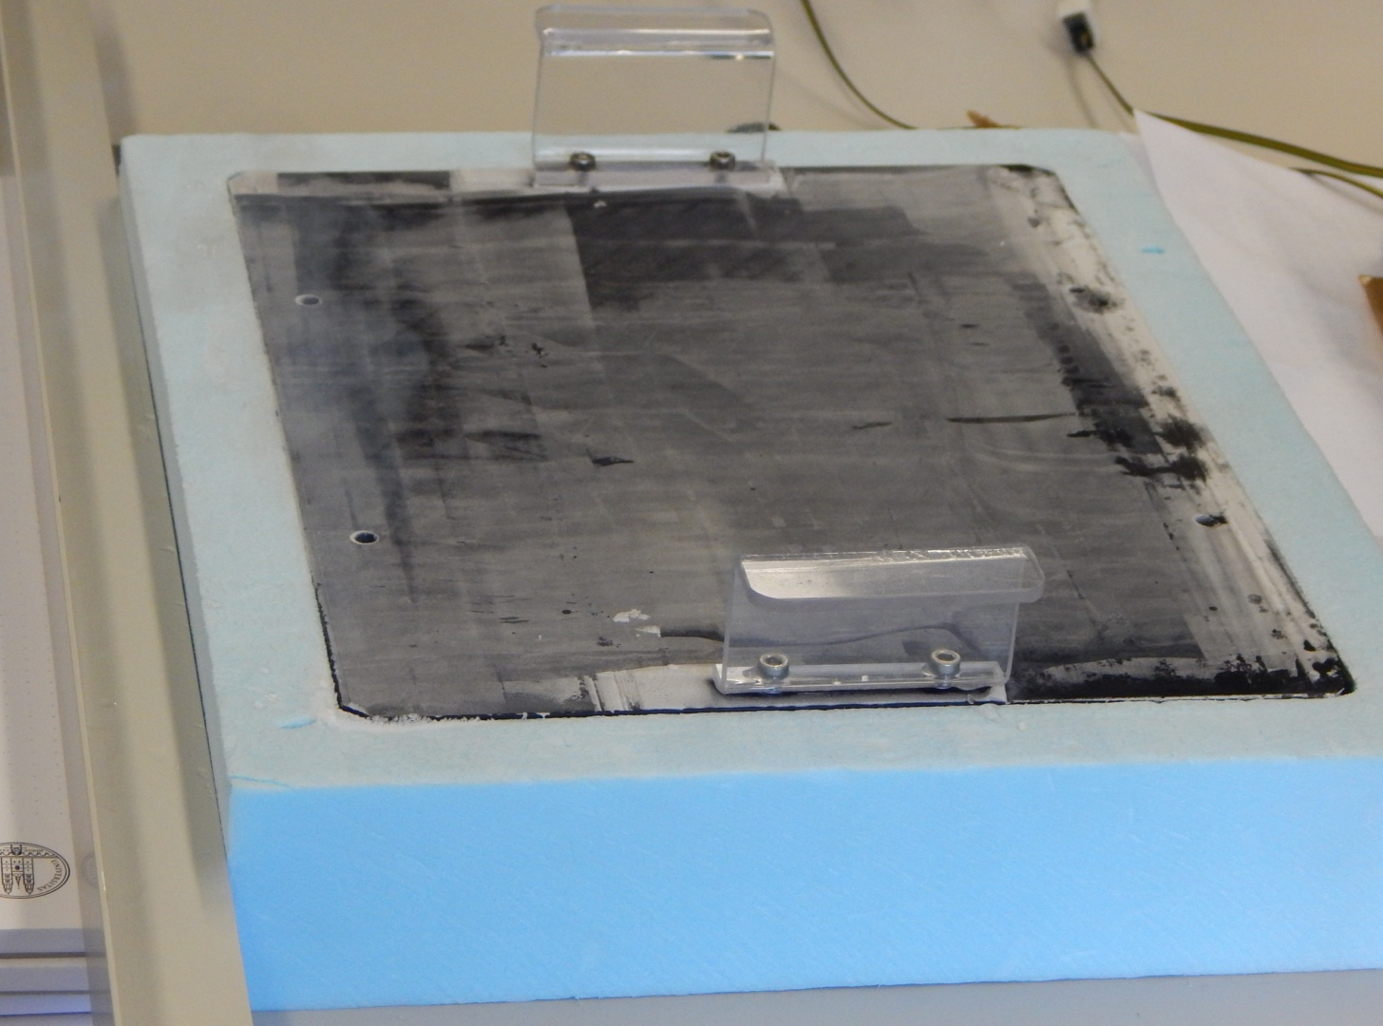
Basic Setup
90° Metal bar
Handles to take metal piece off
Styropore box containing Liquid N₂
Metal plate painted black to improve heat exchange

Slide 6
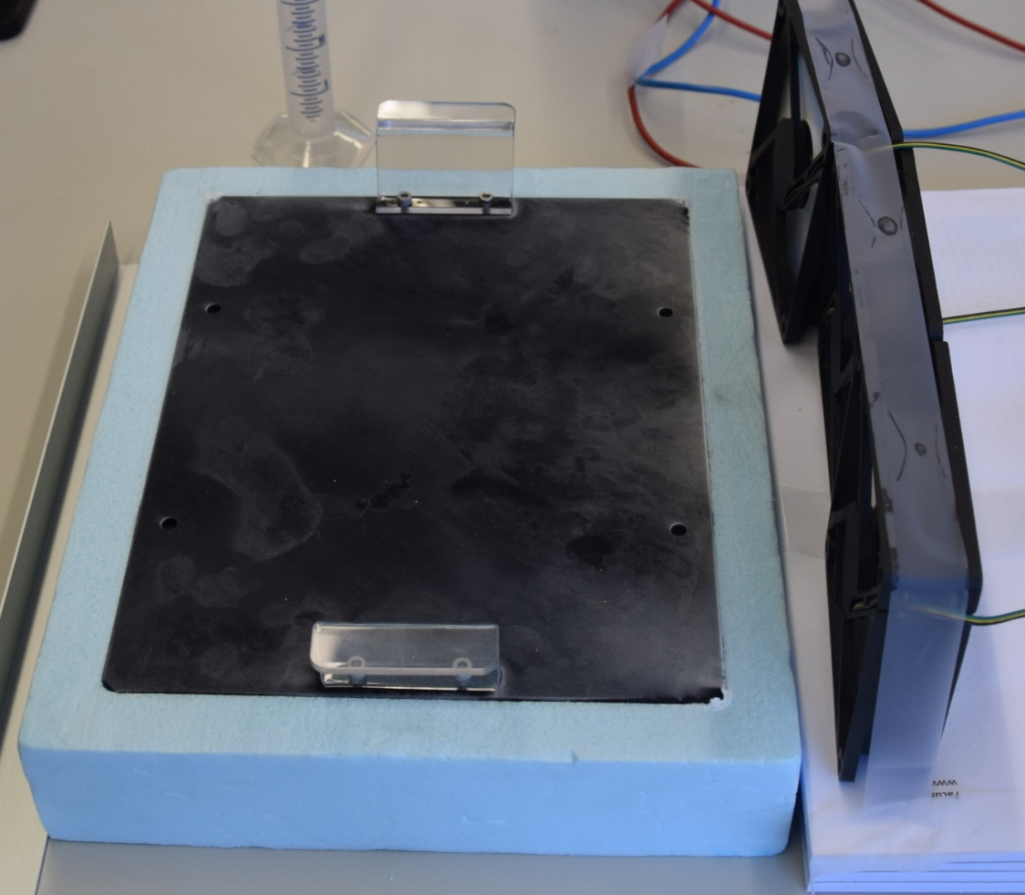
Improved Setup
90° Metal bar
Handles to take metal piece off
Styropore box containing Liquid N₂
Metal plate painted black to improve heat exchange
3 Fans running at 15 Volts
27 June 2017
IYNT 2017 – Samuel Züllig
6

Slide 7
Improved Setup
90° Metal bar
Handles to take metal piece off
Styropore box containing Liquid N₂
Metal plate painted black to improve heat exchange
3 Fans running at only 7.5 Volts (lower speed)
27 June 2017
IYNT 2017 – Samuel Züllig
7

Slide 8
How much Water can we obtain?
30 minutes
Ice collected every 2 minutes
Total amount:
3.5g
27 June 2017
IYNT 2017 – Samuel Züllig
8

Slide 9
Purity of Water
Condensed water is pure
When collected hygienically, the water is "consumable"
Water doesn’t contain minerals
Notes:
Ok, now I’m going to answer the queston wether or not the water is actually consumable. Its a yes but no situation. Why? Beacasue the water that we obtained is very pure meaning that it doest contain any minerals. Our drinking water unlike pure water does contain minerals. If the water does not contain any minerals, which is really bad for our cells and can potentially killif you consum to much pure water.

Slide 10
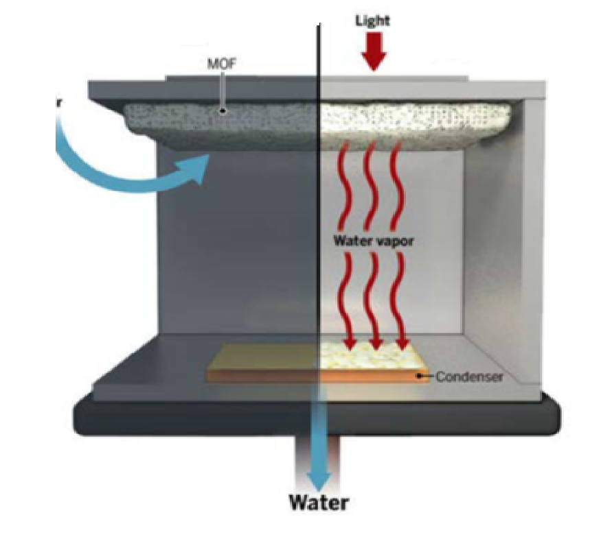
AWGs in Deserts
Light
MOF
Works with low humidity
Gathers ~ 3L of water per day
MOFs (Metal Organic Frameworks)
MOF crystals pressed into copper
Water vapor
Condenser
Water

Slide 11
Thank you for your Attention

Slide 12
Bibliography
Picture of Condensation:
http://kingofwallpapers.com/condensation.html
Concept of Condensation:
https://en.wikipedia.org/wiki/Condensation
Values for Temperature-Humidity Curve:
http://www.tis-gdv.de/tis_e/misc/klima.html
AWG Article:
http://www.sciencemag.org/news/2017/04/new-solar-powered-device-can-pull-water-straight-desert-air[04/Jun/2017 13:36:03]

