Slide 1
iynt 2017
Team GEORGIA
Problem # 13
Allometry
Reporter : Anastasia Kartvelishvili

Slide 2
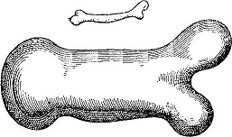
PROBLEM
How do length and thickness of bones scale with overall size and weight of animal?

Slide 3
Plan of presentation
What is allometry
Does size matter?
What bone is made from?
Theoretical model
How bone length is depends on body mass
Experiments
Comparison of theoretical model and experiments
Conclusion

Slide 4
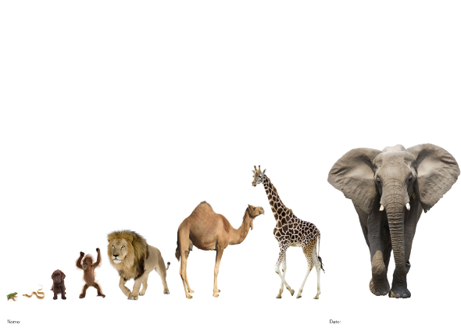
Body Size
Growth rate
Metabolic rate

Slide 5
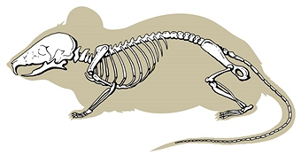
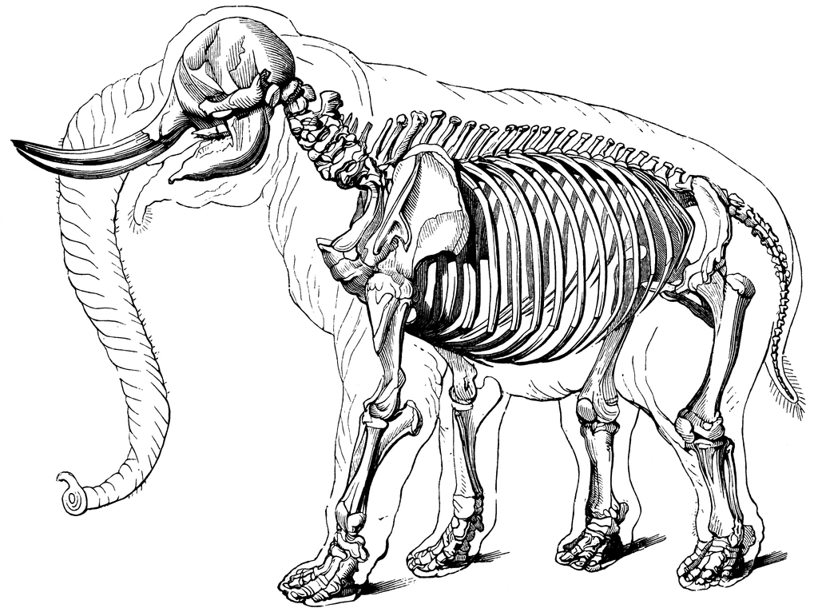
What is Allometry?

Slide 6
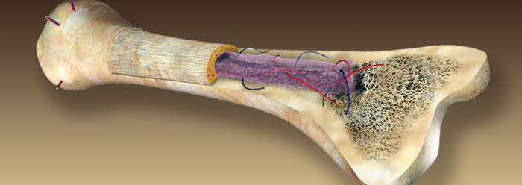
What bone is made from
Salts
White blood cell
Ossein
Ca and P

Slide 7

${ S}_{2}$= 6$K^{2 }L^{2 }$= $S_{1 }×K^{2}$
$V_{2}$ =$K^{3}$ $L^{\begin{aligned}3 \\ \end{aligned}}$ = $K^{3 }×$ $V_{1}$
L kL
NOTE : L ~ $V^{1/3}$ ~ $S^{1/2}$ AND A ~ $V^{2/3}$

Slide 8
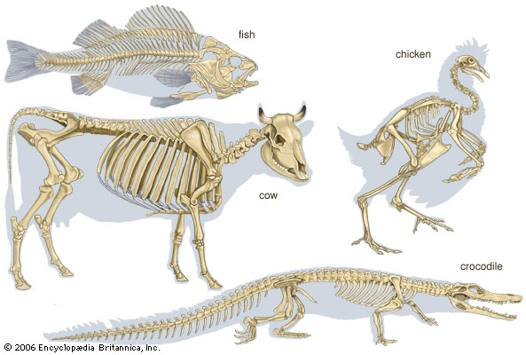

How skeletal mass depends on overall mass of animals
( $m^{1.0}$ ) $×$ $($ $m^{0.33 }$) = $m^{1.33}$

Slide 9
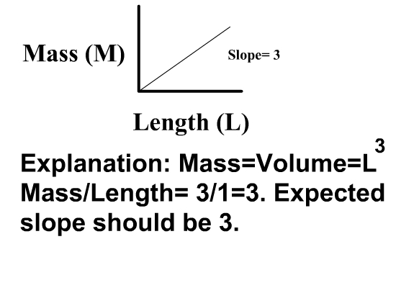
Allometric relations show as a straight lines when plotted on a double- logarithmic axes.

Slide 10
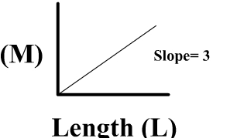

The expected double-logarithmic plot of $L^{3}$/ $L^{1 }$in this case is 3
($\log_{10 }$($L^{3}$) / $\log_{10}$($L^{1}$) ) =3

Slide 11
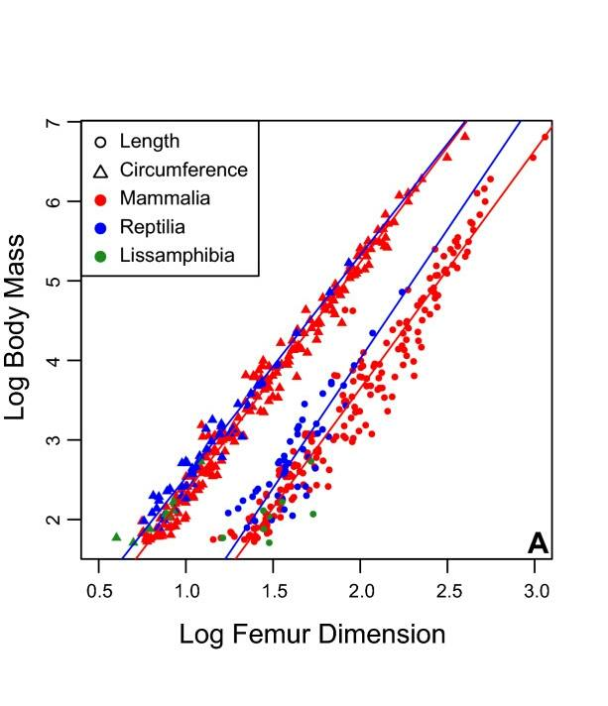
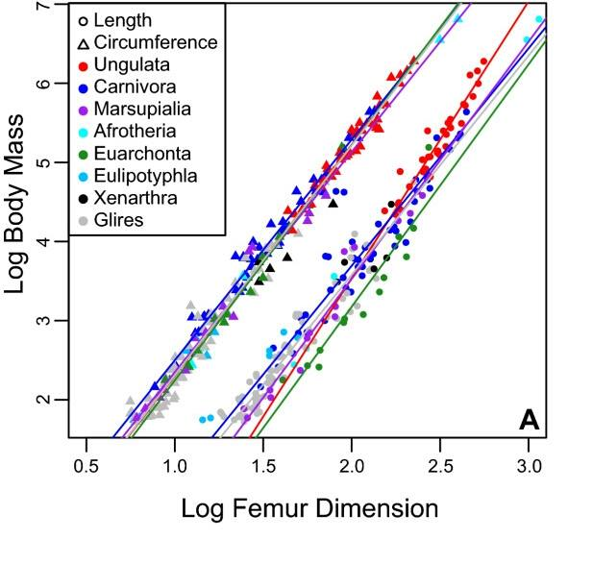
Here is a graph where you see how log (body mass) is depend on log (Femur length)

Slide 12
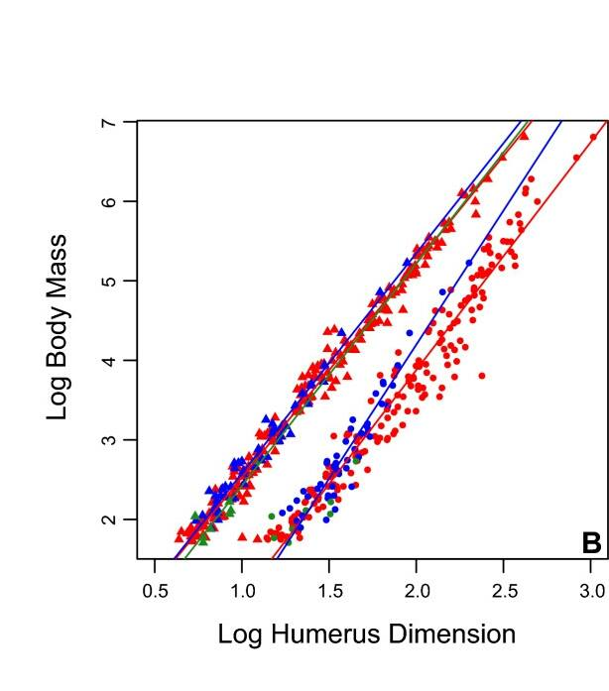
On another graph you see how log (body mass) is depend on log( Humerus length).

Slide 13
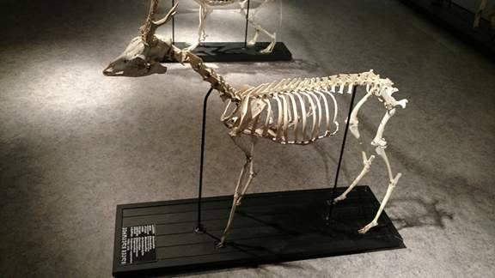
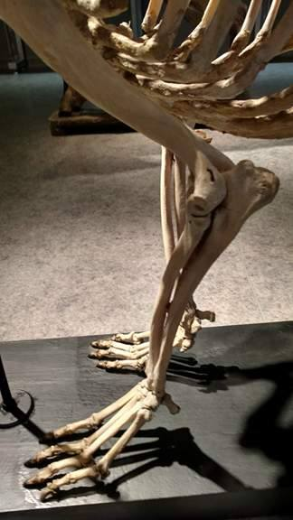
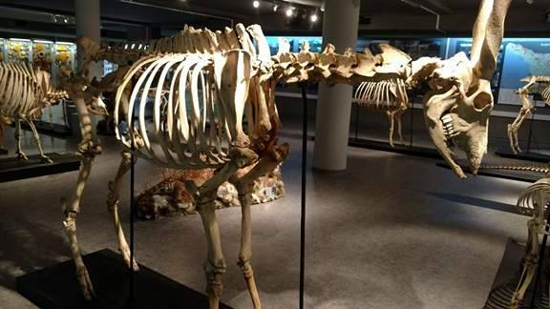
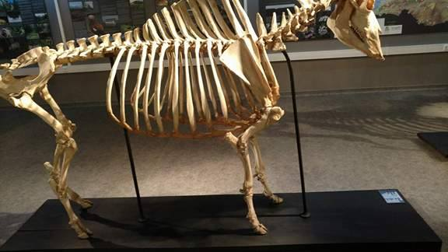
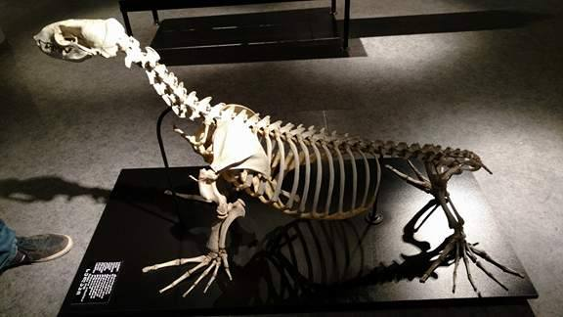
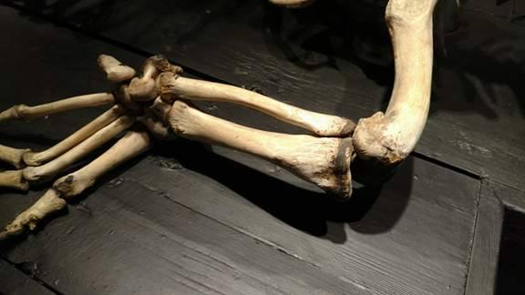
experiments

Slide 14
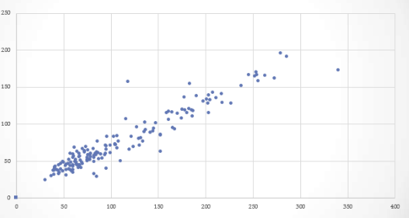
How cubic root of a body mass depends on a length of a body
length of a body (m)
Mass of body (kg)

Slide 15
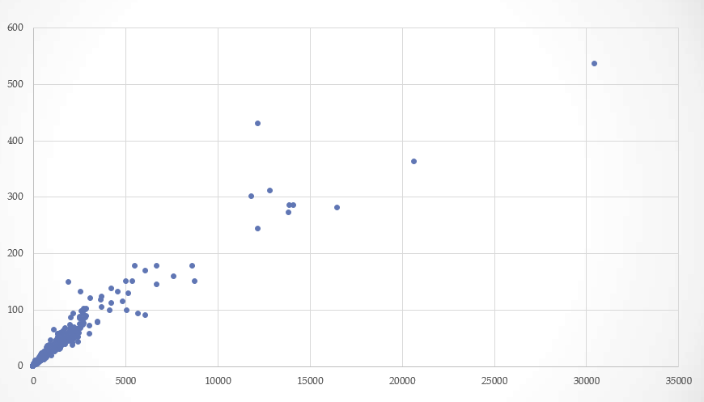
How cubic root of an animal mass depends on a length of animal
length of an animal (m)
Body mass (kg)

Slide 16
CONCLUSION
Animals growth rate, metabolic rate and skeletal mass is strongly depended on its overall mass.
All on this double-logarithmic axes alometric relations are shown as straight line, as it was said in a theory.
Bone length is proportional to m^{1/3} .

Slide 17
Thank you for your attention!

