Slide 1
IYNT 2017 Team of Georgia

Slide 2
apples 6th Problem for the 5th IYNT 2017
Why do apple slices turn brown after being cut? Investigate the speed of this process and test methods to prevent browning of apple slices.

Slide 3
plan
Cause of the process
What depends the speed of the process on
Ways to prevent from browning
On air
Without oxygen
In lemon juice
Heated
Stored in refrigerator
Experiments
Comparison of preventing ways
Conclusion

Slide 4
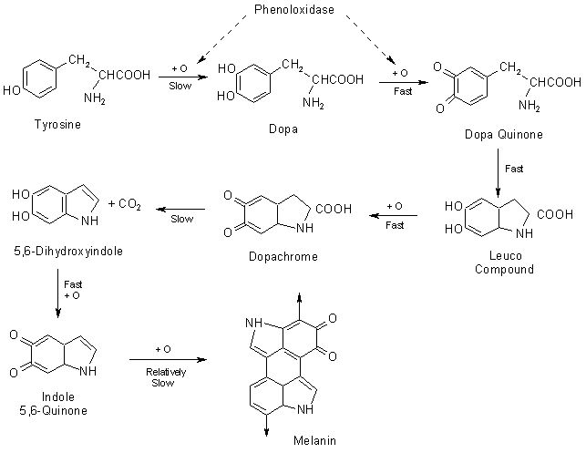
Why do apple slices turn brown after being cut?

Slide 5
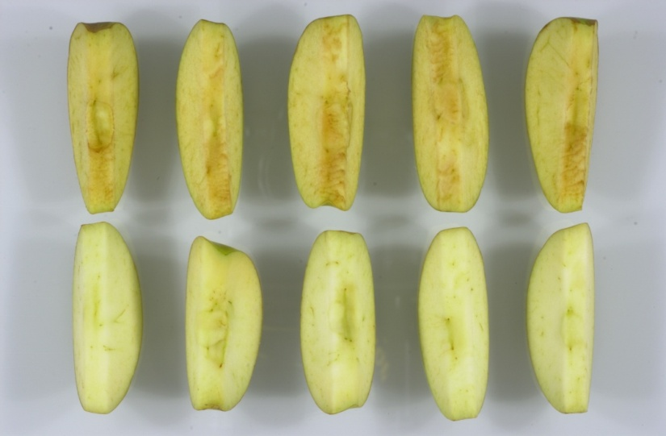
Speed of this process
Depends on:
Spicies
Maturity
Temperature
pH on the surface

Slide 6
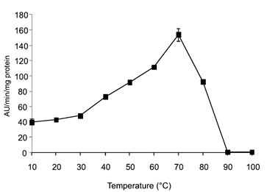

Slide 7
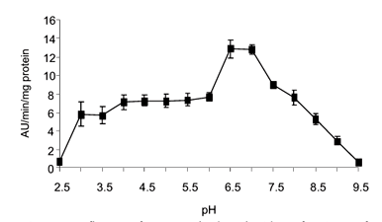

Slide 8
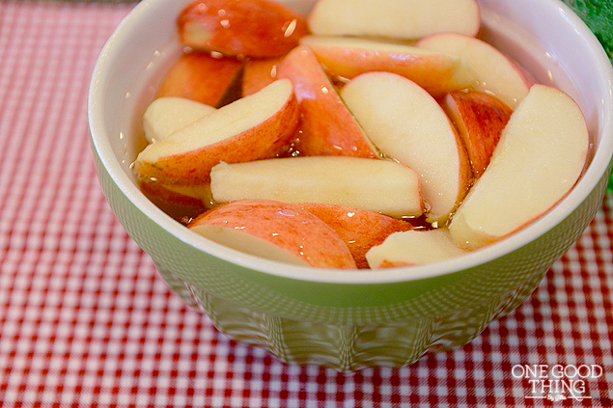
How to prevent browning of apple slices
Methods:
heat (cooking)
reducing the pH on the surface of the fruit
Make Fe and Cu ions react with EDTA
reducing the amount of available oxygen
storing the fruit in the refrigerator

Slide 9
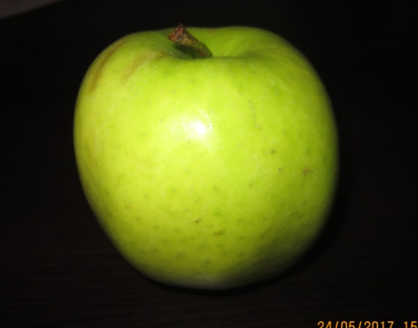
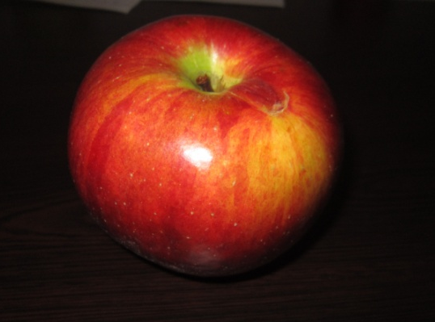
Golden Delicious
Kekhura
Green

Slide 10
Experiments
On air
In the water(without oxygen)
In the lemon juice
With EDTA
Heated(different temperatures)
Stored in refrigerator

Slide 11
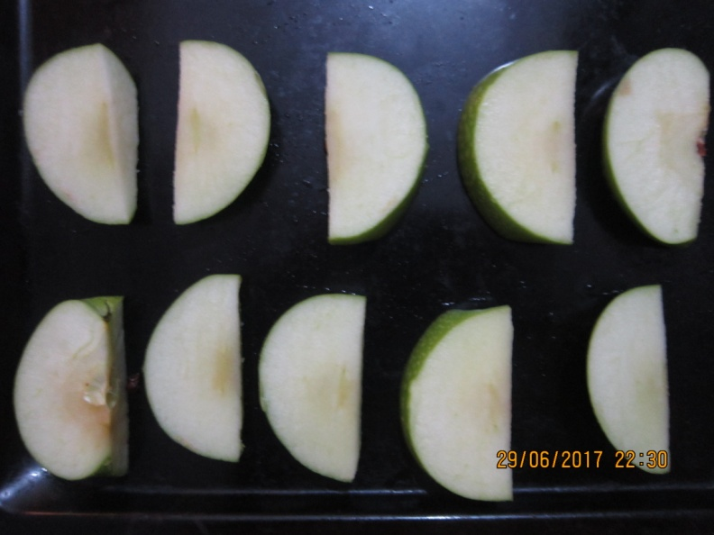
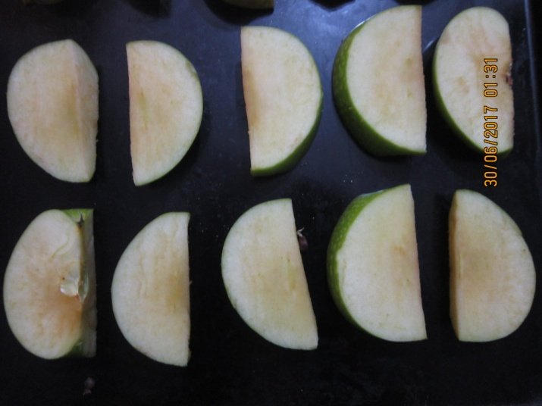
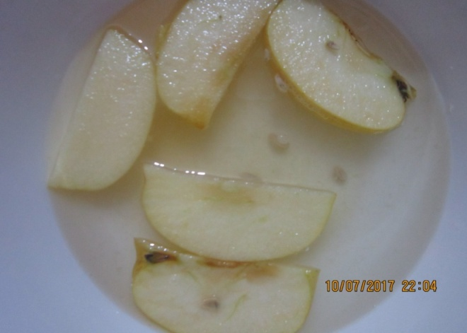
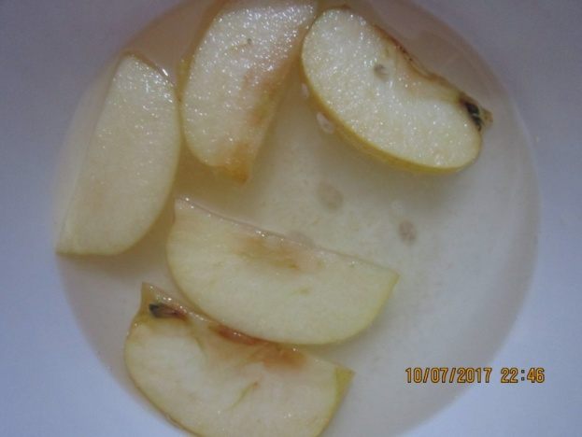

Slide 12
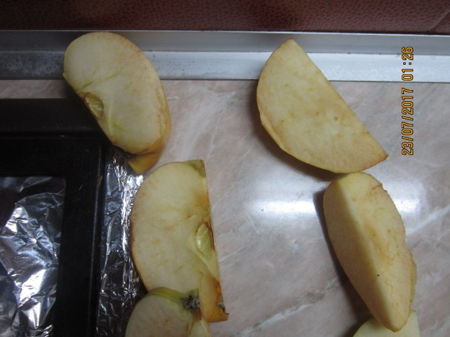
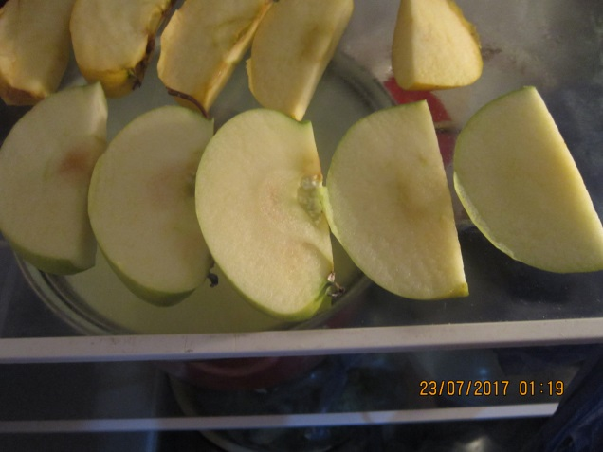
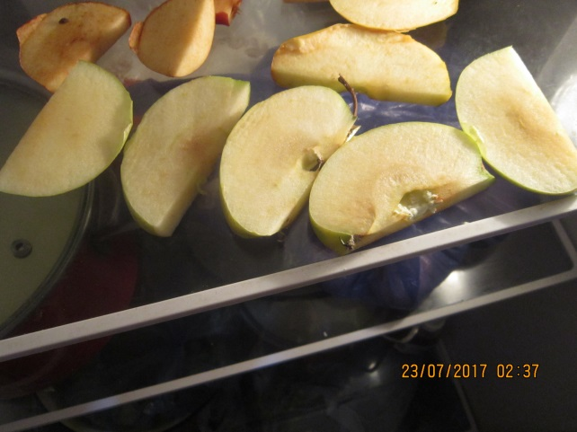
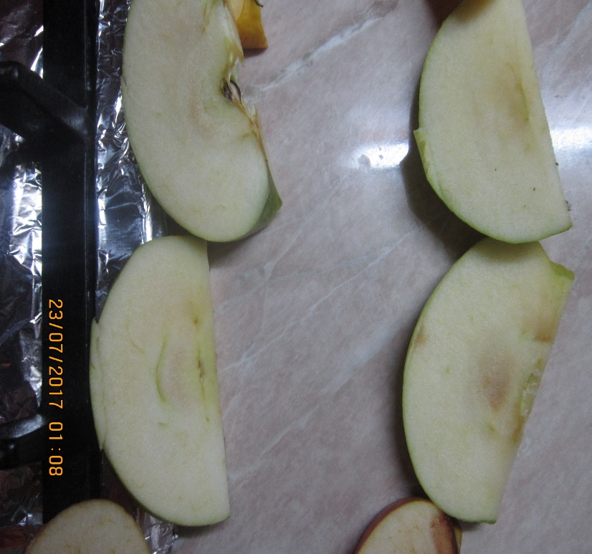

Slide 13
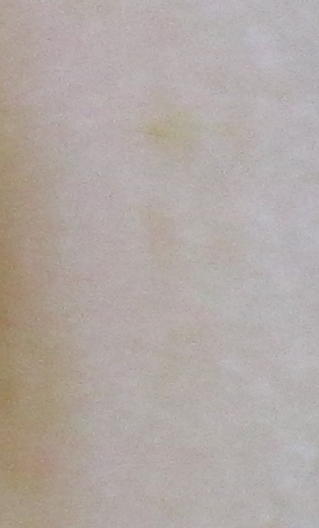
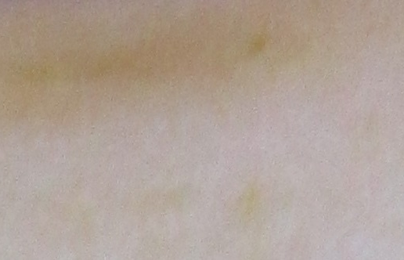
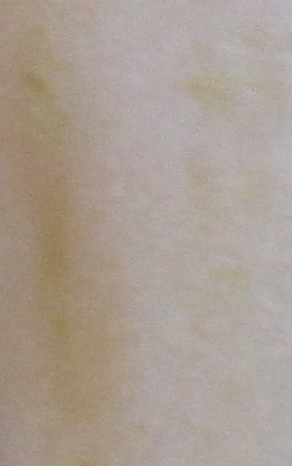
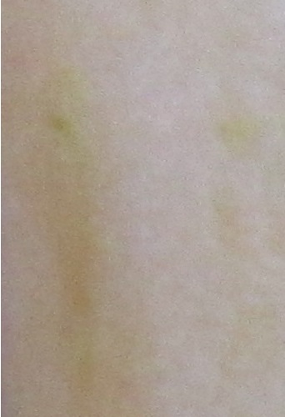
No treatment _ golden delicious

Slide 14
In lemon juice- golden delicious

Slide 15
In lemon juice – golden delicious
Browning level
time

Slide 16
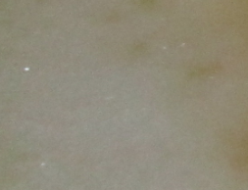
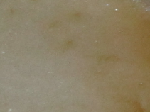
In water – golden delicious

Slide 17
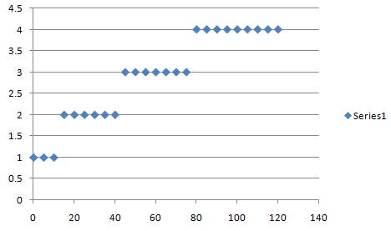
In water – golden delicious
level of brownness
Time, min

Slide 18
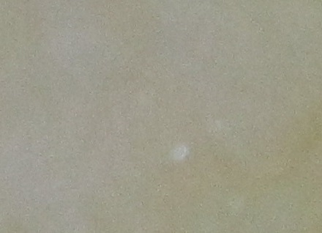
With EDTA – golden delicious

Slide 19
With EDTA – golden delicious

Slide 20
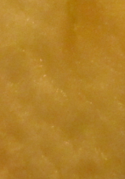
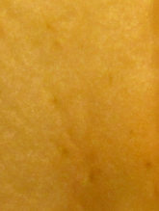
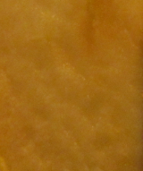
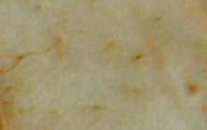
On different temperature – golden delicious
10⁰C
35⁰C
80⁰C

Slide 21
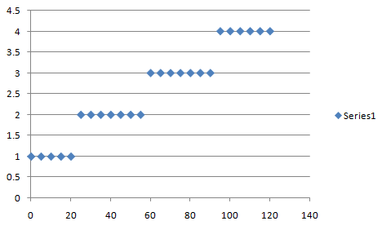
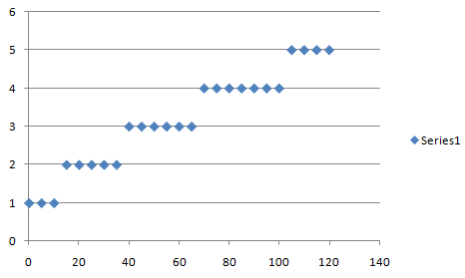
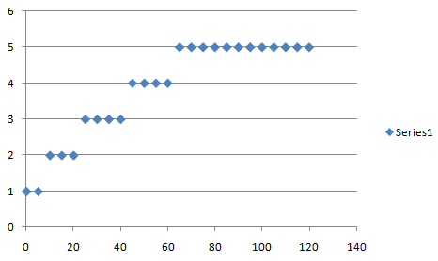
Temperature comparison
10⁰C
35⁰C
80⁰C

Slide 22
No treatment - green

Slide 23
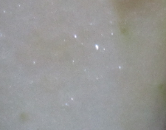
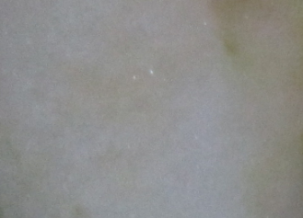
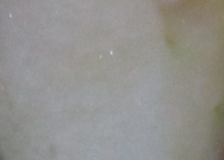
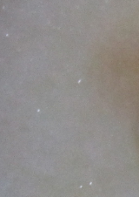
In lemon juice – green

Slide 24
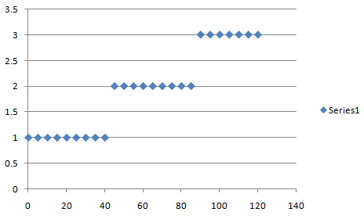
In lemon juice - green
level of brownness
Time, min

Slide 25
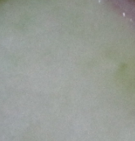
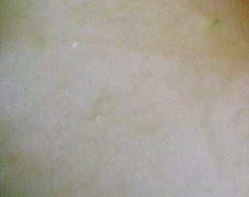
In water - green

Slide 26
In water - green
level of brownness
Time, min

Slide 27
With EDTA - green

Slide 28
With EDTA - green

Slide 29
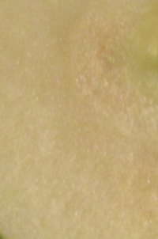
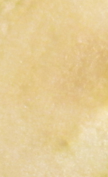
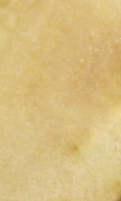
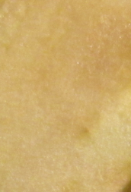
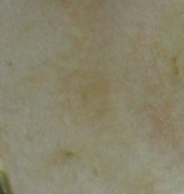
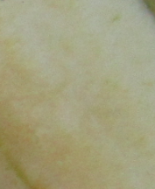
On different temperature - green

Slide 30
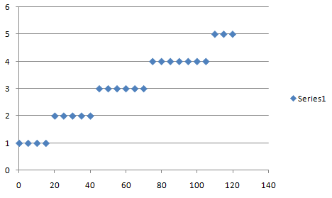
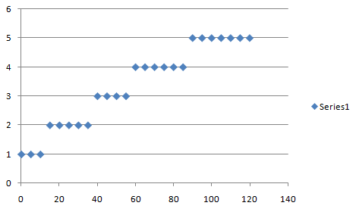
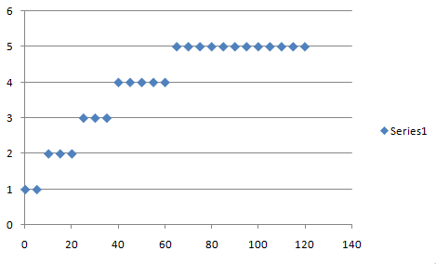
Temperature comparison
10⁰C
35⁰C
80⁰C
80⁰C

Slide 31
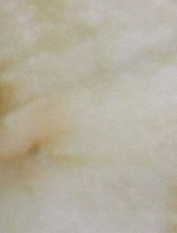
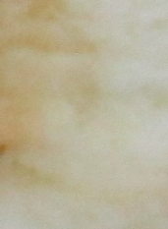
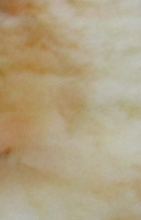
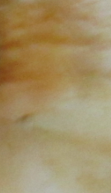
On air - kekhura

Slide 32
In lemon juice - kekhura

Slide 33
In lemon juice - kekhura
level of brownness
Time, min

Slide 34
In water - kekhura

Slide 35
In water - kekhura
level of brownness
Time, min

Slide 36
With EDTA - kekhura

Slide 37
With EDTA - kekhura

Slide 38
On different temperature - kekhura
10⁰C
35⁰C
80⁰C

Slide 39
Temperature comparison
10⁰C
35⁰C
80⁰C

Slide 40
Comparison of preventing ways
Lowering pH
In water
On low temperature
With EDTA

Slide 41
Conclusion
If we damage apple cells the apple will turn brown
This reaction is caused by phenolases and phenols in the apple cell
The speed of this process depends on temperature, pH, access to the oxygen
Methods to prevent an apple from browning: lowering pH on the surface, not allowing oxygen to the apple surface, heating, storing in the refrigerator, reducing amount of free ions using ETDA
The best way for it is putting an apple in lemon juice

Slide 42
Thanks for your attention

Slide 43
No treatment _ golden delicious

Slide 44
Idared(without anything)
After 30min after 1hour after 1.5hour
After 2hours after2.5hours after 3hours

Slide 45
Without oxygen- golden delicious

Slide 46
In lemon juice- golden delicious

Slide 47
Without oxygen- kekhura

